Slide 1
Spindle Summit Update
Jake Stephens
03/11/24

Slide 2
How do group II’s and IB’s fit into the picture?
Conventionally length/velocity and force sensors
If IA’s signal force and yank during stretch, how does the CNS “know” what is force and what is yank?
Group II’s originate from the spindle and lack the same responses to stretch dynamics as IA’s
What about during shortening?
Group IB’s respond to muscle contraction very well
Working hypothesis: external vs self-generated forces

Slide 3
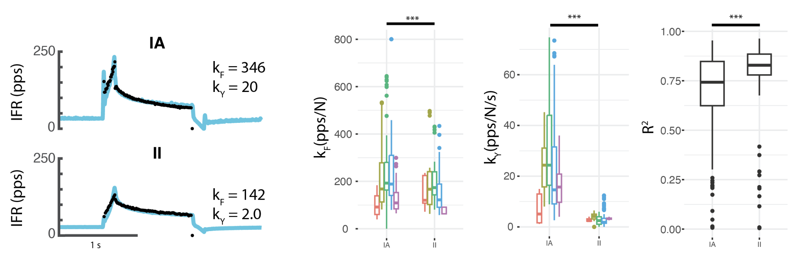
Group II’s can be explained by force and yank
Group II’s originate from the muscle spindle as well, yet respond differently to stretch
If IA’s signal force and yank on the spindle, could group II’s be the force signal?

Slide 4
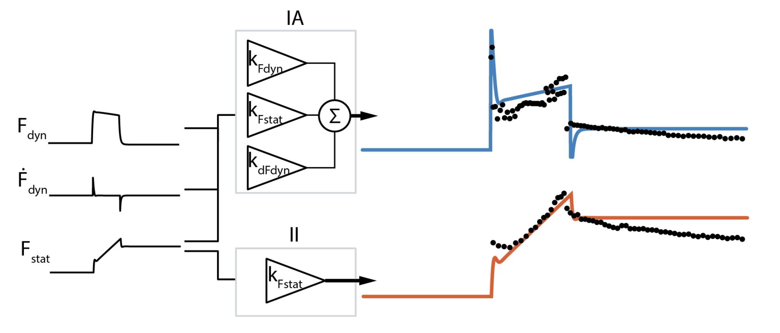
Can we model it?
IA’s innervate “static” type bag₂ and chain fibers, and “dynamic” bag₁ fibers
II’s only innervate bag₂ and chain fibers

Slide 5
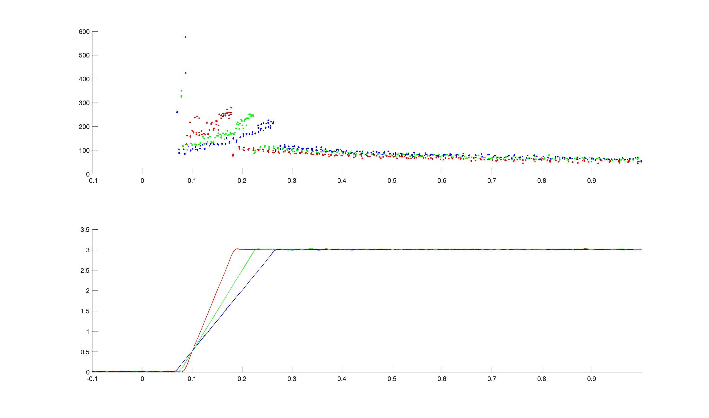
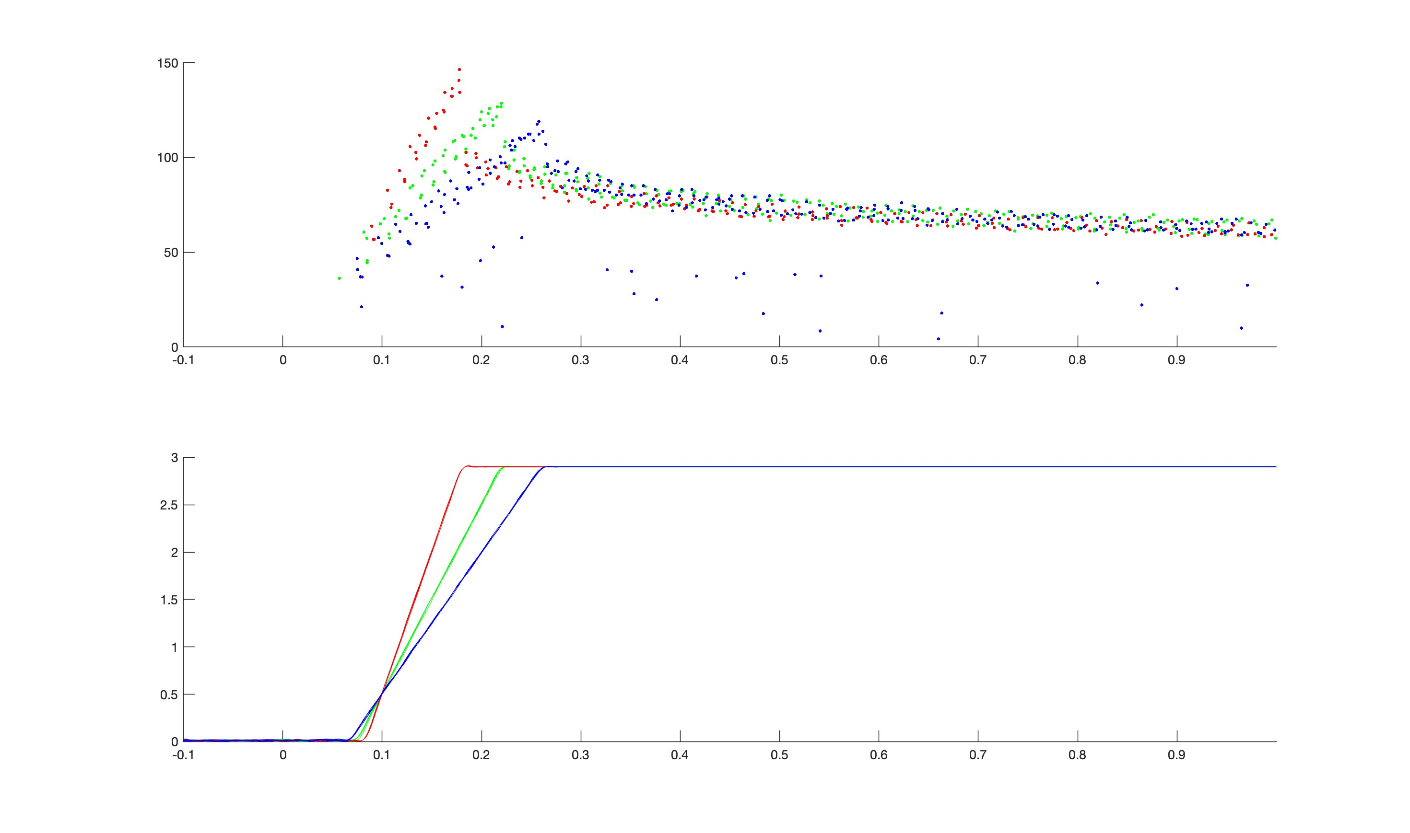
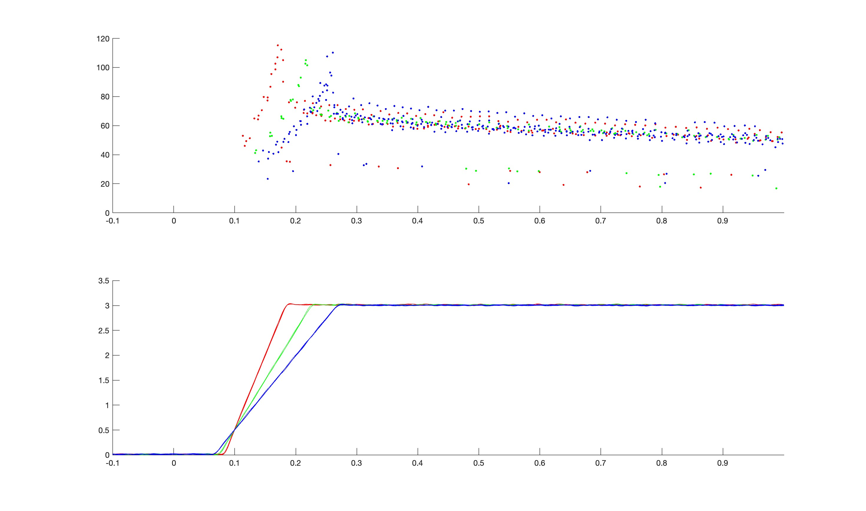
Next steps:
Collect data for group II’s and IB’s at different ramp velocities (30, 20, 15)
Different triangle velocities (5, 4, 3.33)
Different sine frequencies (2.2, 2, 1.5)
Collect data in active stretch
Continuation of work loop analysis with a focus on different cell types

