Slide 1
Restriction enzymes
November 4, 2022

Slide 2
How Do We Characterize Phages?
Notes:
This semester, we have described our phages based on plaque morphology (size, shape, turbidity), and, over the holiday break, we will sequence the genomes of 2-3 phages. A restriction enzyme digest is an intermediate step that allows us to get a partial understanding of our phage genomes and select phages for sequencing that appear to be genetically distinct from one another.

Slide 3
The Basics
A restriction enzyme is a protein that recognizes and cuts specific sequences of DNA (called restriction sites).
Example: EcoRI cleaves DNA at sites with the 5’ GAATTC 3’ sequence:
Restriction site
5’
3’
G A A T T C
C T T A A G
3’
5’
5’
3’
G
A A T T C
C T T A A
G
3’
5’
Notes:
Restriction enzymes are used as a bacterial defense system: These enzymes recognize and cut phage DNA. But, we can also use them in the lab.

Slide 4
The Basics
Most restriction enzymes recognize palindromic sequences, meaning that both strands of DNA have the same sequence when read 5’ to 3’.
5’
3’
G A A T T C
C T T A A G
3’
5’

Slide 5
The Basics
If the enzyme makes staggered cuts, the cut ends of DNA will have a short single-stranded overhang (sticky ends). If the cuts are not staggered and there is no overhang, we call these blunt ends.
Sticky ends
Blunt ends
3’
3’
A A T T C
T T C
G
A A G
5’
5’
5’
5’
G
G A A
C T T A A
C T T
3’
3’

Slide 6
Restriction Enzyme Nomenclature (Smith & Nathans, 1973)
The genus and species of the host organism is identified by using the first letter of the genus and the first two letters of the species to form a three-letter abbreviation in italics.
E. coli → Eco
The strain or type is identified in non-italics.
Strain RY13 → EcoR
If a host strain has several restriction enzymes, they are numbered in order of discovery using Roman numerals.
First restriction enzyme isolated from that strain → EcoRI

Slide 7
Restriction Enzyme Nomenclature: Practice
Host organism: Haemophilus influenzae
Strain Rd (abbreviation is d)
Third restriction enzyme discovered in this strain
HindIII
https://www.educaplay.com/learning-resources/9969603-enzyme_matching.html
Notes:
Walk through the example, then ask students to play the game at the bottom. They will compete to see who can correctly name each of the restriction enzymes in the shortest amount of time, and the winner will get candy!

Slide 8
Restriction Digest
Restriction digestion: Incubation of a piece of DNA with one or more restriction enzymes
Example: Each of you incubates your phage genome with the restriction enzyme BamHI, which recognizes the restriction site GGATCC. What is going to happen during the incubation period?
BamHI will cut your phage DNA every time the sequence GGATCC occurs.
Madison’s Phage:
GGATCC occurs once
Tyler’s Phage:
GGATCC occurs 3 times
Amelia’s Phage:
GGATCC occurs 8 times
Notes:
If you perform restriction digestions with multiple different enzymes, you are going to create a more specific genetic fingerprint of your phage, and we can compare that genetic fingerprint to other phages in the classroom to get an idea of how genetically similar your phages are to one another.

Slide 9
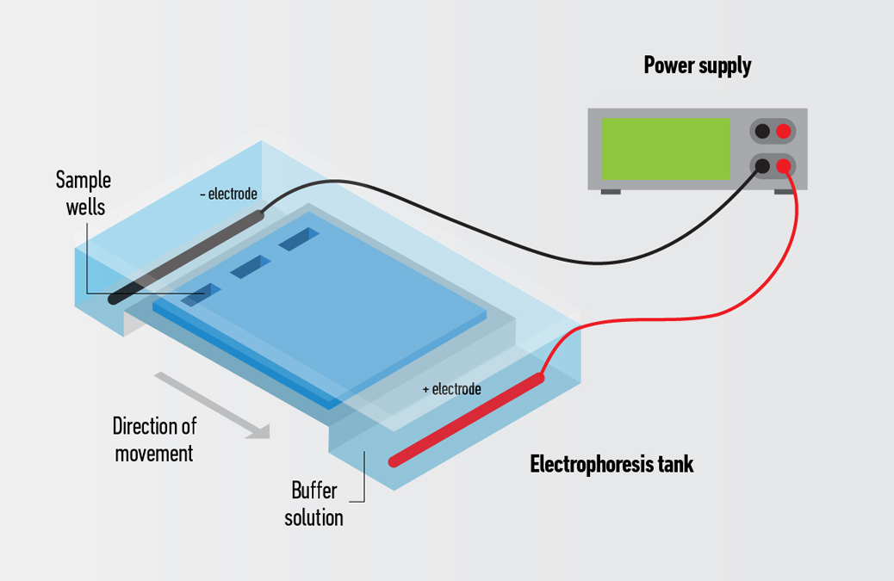
Gel Electrophoresis
Melt agarose. Add a fluorescent DNA-binding dye to the gel.
Pour the gel into a mold and allow it to solidify.
Place the gel in the electrophoresis apparatus and load your samples into the wells.
Connect the apparatus to a power supply. An electric current will flow through the gel and cause DNA fragments to migrate.
Notes:
We need a way to visualize these DNA fragments. Gel electrophoresis is a common way to separate and visualize macromolecules, like DNA.
--DNA moves toward the positive electrode because DNA is negatively charged.
--Smaller DNA fragments will move further down the gel than larger DNA fragments. Think about moving through a crowd – is it easier for an individual to move through a crowd, or for a group of 20 people to maneuver through a crowd? The individual! In the same way, it is easier for smaller DNA fragments to maneuver through the agarose gel than larger DNA fragments.

Slide 10
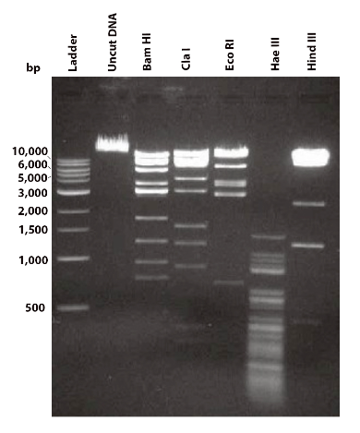
Restriction Enzyme Gel
Notes:
This is an example of a restriction enzyme gel. Questions for students to consider:
--Why do we need a ladder?
--Why would we run uncut DNA on a gel?
--Why would we incubate our DNA samples with multiple different restriction enzymes?

Slide 11
Today’s Class
We are going to do gel electrophoresis with uncut phage DNA.
While the gel is running:
Do the Paper Restriction Enzyme Activity (Exercises 1, 2, 3.1, and 3.2). Turn in your responses to the questions at the end of class.
[If we have time] Complete the virtual Lambda-HindIII digest.

