Slide 1
Film Linguistics Predicting Viewer Rating
Stephen Strawbridge Cohort #1019
Notes:
Hello all, welcome to my presentation on using film linguistics to predict viewer rating
Today I will assume you, my audience, are movie producers.
By the end of the presentation, I will show you all how using the linguistic features of a script can be used to predict an average movie ranking.

Slide 2
Background and Problem Statement
What features do people consider in a “good movie?”
Current producers are not considering linguistic content of script!
Model: Use linguistic ratios to predict moving rating
Notes:
Film producers know that there is a vast variety of variables that are considered when film reviewers give their review score, such as character development, plot, director style, quality of actor/actress performance, and many more.
But have the linguistic features of a movie script ever been considered? Could usage of certain words in the script hold predictive value on how well the film will be received by it's viewer? Film producers, more often than not, do not place heavy attention on word usage and linguistic features in a script.
I hypothesize that movie production companies are not as accurate as they could be in anticipating their reviews from viewers, because they have not considered script linguistics.
This presentation aims to create the most ideal prediction model, with an emphasis on script linguistics, so that production companies can anticipate their review success during the production phase and adjust budgets accordingly.

Slide 3
Process Overview
3. Support Vector Model
5. Conclusion and Recommendations
1. Background
2. EDA
4. Analysis
Notes:
The process outline/overview of this presentation is as follows:

Slide 4
Dataset Background
Nearly 10,000 movies
35 linguistic ratios
Multiple genres
Multiple countries
Time range: 1992 – 2014
IMdb average rating rank scale: 1 - 10
Notes:
Before diving into EDA, it would be helpful to see the quick synopsis of the dataset used
The dataframe is mostly comprised off linguistic ratios (“Swear word ratio”, “Positive ratio”, etc) across multiple genres, countries, and years
These word ratios have their own respective dictionary, for example: the “family ratio” includes words like mother, father, sister, brother, etc
Most importantly, each movie has an average rating rank given from Imdb, on a range of 1 to 10.

Slide 5
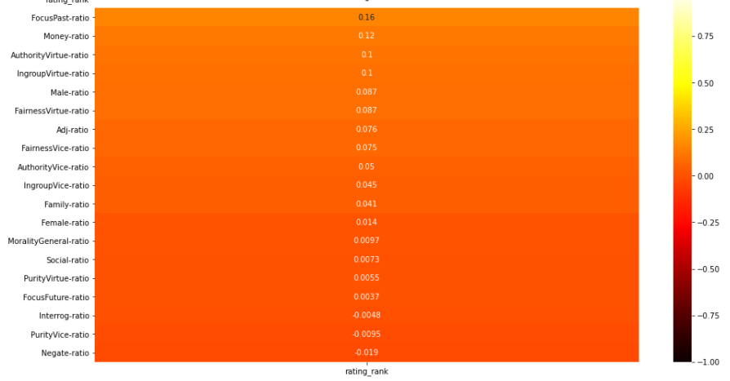
Correlation Heatmap
Example Linguistic Ratios!
Notes:
First, quick disclaimer on linguistic ratios –
This slide is busy on purpose: this correlation heatmap between the linguistic ratios and target variable (rating rank) is given to illustrate how distinguishing between distinct linguistic features holds little to no interpretability. Our data science models thrive off of the interactions between these ratios, rather than the single ratios themselves. With nearly a hundred ratios to work off of, the EDA section will not explore any specific ratios, but rather more on the target variable (rating rank).

Slide 6
EDA (Exploratory Data Analysis --> Tableau
Notes:
Dash-Rating by year/country/genre (observe average, and then std deviation) –
Our dataset expands over the past 30 years: We can see the average among the dataset stays very consistent, hovering around 6.4
When going through each year, we can see the average between the US and other countries varies, but does not vary too widely.
Rating Rank – distribution by genre
Consistent average rating ranks are also seen throughout the distribution by genres
The drama genre, which is also the most frequently observed genre in the dataset, has the highest average ranking and the lowest standard deviation
Rating Rank – distribution by country
Finally, we can see the consistency of movie ratings across multiple countries in the world. Pakistan holds the highest average rating at about 8.3

Slide 7
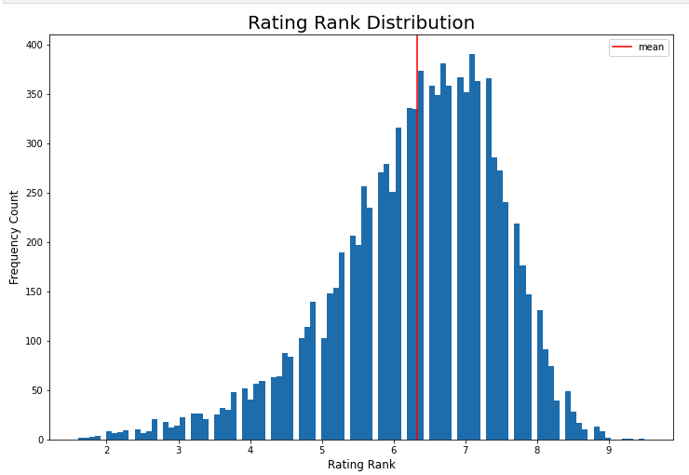
Our data is distributed fairly evenly….
Tough baseline model to beat!
Notes:
What is the main takeaway from the EDA section previously? With enough votes, the rating rank distribution becomes very centered around the mean even when considering a wide number of factors such as genre, year, or country.
This indicates that the baseline model for predicting average rating will be tough, but not impossible to beat: in other words, how much more accurate would we be if we didn't just predict the mean rating of 6.3 every time?
With that said, let’s take a look at our best model utilized to answer our original data science problem!

Slide 8
Key points: 1. Many small indistinguishable features 2. Penalty/regularization parameter Baseline RMSE: 1.132 Testing RMSE: 0.941 RMSE was reduced by 16.88% !
Support Vector Regression Model
Notes:
After trying out a few different types of data science models, the support vector regression model was chosen as the most successful model.
For the purposes of this presentation, the details of this model will not be described. You should just note that of the main reasons this model was chosen was because of it’s ability to add a penalty parameter to amplify magnitudes of these numerous features that may otherwise go unnoticed.
After many trials and errors of tuning the model, we can evaluate the scoring metrics:
we can look at the RMSE score (root mean squared error score), which finds the error amount by looking at the difference between our actual rating values and our predicted rating values. Baseline RMSE is about 1.13 while our testing RMSE was about 0.94. Our RMSE was reduced by 16.88%!
Let’s take a deeper dive into how our predicted ratings faired against our actual ratings visually in Tableau:

Slide 9
EDA on Model Results --> Tableau
Notes:
5. Preds vs Actuals
We can see that our model predicted in a range of about 3.5 to 8.5, despite the actual scale being 1.5 to 9.5. This actually makes sense, as very few movies had ratings outside of the range of 3.5 to 8.5.
The darker centered regions indicate many datapoints, and we can fortunately see that many of our predictions fall in this region.
6. Residuals
We can briefly take a look at the error amounts, in normal and absolute value amount, for our predictions.
Not surprisingly, our errors follow a linear pattern, in which the model underestimates both the lower and higher rated movies. The biggest errors are seen in the few movies that had very low actual ratings.
Dash Model Results
Finally, we can take a look at the following dashboard to observe even deeper specifics on predictions.
Lets first filter by country – we can see errors that seem fairly consistent between movies in the US and movies outside the US.
Lets next filter by 3 primary genres – we can see that predictions in the comedy genre appear to have a lower error amount on average for each movie rating predicted. Most specifically, the majority comedy movies outside the US actually have errors of less than 2. Action and drama have very similar error distributions.

Slide 10
Conclusion and Recommendations
Adjust film budget accordingly!
03
Extra assurance!
Implement model on a preliminary script during production phase
02
01
Get an average predicted rating, without even having other features of film
Notes:
As perhaps noticed on the previous slides, scoring metrics may at first appear a little less than ideal. One might initially think that the model is not very compelling or useful
However, it should be noted that the baseline model was very difficult to beat, as the vast majority of the movie ranks were distributed closely around the mean.
If the model can beat this difficult baseline, it should be fair to say that there exists a predictive relationship between the linguistic features of a script and how well the viewers rank the movie.
During the production phase of a movie in which perhaps only the preliminary script has been assembled, producers can obtain extra assurance on how well their movie might be received using this data science model.
Therefore, you movie producers can gain greater confidence into how well a movie will perform based on the script alone! As opposed to based on all other common features such as director, actors, etc. With this initial confidence, a budget can be adjusted for the film.

Slide 11
Context of the words
Finding combination of ratios is very challenging → still room for improvement!
Genre feature could skew results
Limitations and ideas for improvement
Notes:
Despite my confidence in the extra assurance that can be obtained with this data science model, there are some limitations about the model that should be disclosed:
First, the context of the words is not taken into account. Viewers may interpret and feel words differently depending on the delivery and context of the words.
Next, finding which, and how many, ratios to use as features is extremely challenging, as nearly every ratio had low correlation and low variability between each other. Even with hours of trial and error, the most ideal combinations of the 224 original ratios was not found. Perhaps with more time or a greater workforce on this project could more ideal combinations be found.
Lastly, the genre feature could skew results. Genre was included as a feature in the modeling process, but better models may have been achieved if models were ran separately for each genre. This intuitively makes sense, as viewers may want to hear certain words more often in a romance film as opposed to a horror film.

Slide 12
THANK YOU
Any questions?
stephenstrawbridge@gmail.com.com • +1 650 810 5681 • https://www.linkedin.com/in/stephen-strawbridge/
Notes:
Thank you and I will now take questions at this time.

Slide 13
Sources
Dataworld website: https://data.world/robertjoellewis/film-subtitles
Open subtitles API: https://www.opensubtitles.org/en/search/subs
LIWC dictionary: https://dashboard.receptiviti.com/docs/liwc
Moral foundations dictionary: https://moralfoundations.org/wp-content/uploads/files/downloads/moral%20foundations%20dictionary.dic

Slide 14
EDITABLE ICONS

