Slide 1
Monomi: Practical Analytical Query Processing over Encrypted Data
Stephen Tu, M. Frans Kaashoek, Samuel Madden, Nickolai Zeldovich
MIT CSAIL

Slide 2







Typical deployment
“Give me the # of views of all adults by country”
Query
Response
US | 1M
Italy | 3K
… | …
Vulnerable database
Trusted user
Problem: Want to run queries over data!

Slide 3
Approach 1: Fully Homomorphic Encryption (FHE)
Groundbreaking theoretical result [Gentry 09]
Run any computation over encrypted data
Prohibitive overheads in practice

Slide 4
Approach 2: Specialized Schemes
Cryptosystems supporting specific operations:
Equality (deterministic) [AES]
Addition [Paillier 99]
Inequality (order preserving) [Boldyreva 09]
Keyword Search [Song 00]
These operations common in SQL queries…

Slide 5

Practical state of the art: CryptDB
Trusted
Under attack
plain query
Proxy
DB Server
transformed query
Application
decrypted results
encrypted results
Encrypted DB
Stores encryption keys
Deterministic encryption: Equality
Paillier cryptosystem: Addition
Order preserving encryption: Inequality
Original Query:
Transformed Query:
SELECT country,
SUM(views) FROM users WHERE age > 18
GROUP BY country
SELECT country_DET,
PAILLIER_SUM(views_HOM) FROM users_ENCRYPTED WHERE age_OPE > 0xDEADBEEF
GROUP BY country_DET
No client computation: CryptDB requires that all computation in a query are supported by a specialized crypto-system
0xDEADBEEF = Encrypt_OPE(18)

Slide 6
Problem: OLTP ≠ OLAP
CryptDB is designed for OLTP queries
We are interested in OLAP queries
Queries typically involve more computation
CryptDB can only support 4/22 TPC-H queries

Slide 7
Problem: OLTP ≠ OLAP
Our insight
SELECT
category,
SUM(cost * quantity) AS value
FROM
product WHERE
made_in = ‘United States’
GROUP BY category HAVING SUM(cost * quantity) > 1000000 ORDER BY value
SELECT
category,
SUM(cost * quantity) AS value
FROM
product WHERE
made_in = ‘United States’
GROUP BY category HAVING SUM(cost * quantity) > 1000000 ORDER BY value
SELECT
category,
SUM(cost * quantity) AS value
FROM
product WHERE
made_in = ‘United States’
GROUP BY category HAVING SUM(cost * quantity) > 1000000 ORDER BY value
SELECT
category,
SUM(cost * quantity) AS value
FROM
product WHERE
made_in = ‘United States’
GROUP BY category HAVING SUM(cost * quantity) > 1000000 ORDER BY value
Our insight: Most of the query can be executed on the server, except a few parts
No efficient additive + order preserving homomorphic cryptosystem
No efficient additive + multiplicative homomorphic cryptosystem
What happens when we run this query with CryptDB?

Slide 8
Contributions
Monomi: A new system for practical analytical query processing
Split client/server query execution
Pre-computation + other runtime optimizations
Query planner/designer
Monomi: Can run TPC-H with 1.24x median overhead (vs. plaintext) using these three techniques.

Slide 9

Split client/server execution
SELECT
category,
SUM(cost * quantity) AS value
GROUP BY
category
HAVING SUM(cost * quantity) > 1000000 ORDER BY value
SELECT
category,
SUM(cost * quantity) AS value
SELECT
category,
SUM(cost * quantity) AS value
FROM
product
WHERE
made_in = ‘United States’
GROUP BY category HAVING SUM(cost * quantity) > 1000000 ORDER BY value
category_DET | cost_DET | quantity_DET | …
0xdd032543 | 0x34778428 | 0xaeb7e344 | …
0xdd032543 | 0x7658Ae7e | 0xeba13477 | …
SELECT
category_DET,
cost_DET,
quantity_DET,
product_ENC
GROUP BY
category
HAVING SUM(cost * quantity) > 1000000 ORDER BY value
FROM
product_ENC
WHERE
made_in_DET =
Encrypt_DET(‘United States’)
Trusted Client
Untrusted Server
Notes:
Explain what the table is
Make it clear that goal is to find a query to run on server over the specific crypto systems

Slide 10
Pre-computation
category_DET | cost_DET | quantity_DET | …
0xdd032543 | 0x34778428 | 0xaeb7e344 | …
0xdd032543 | 0x7658Ae7e | 0xeba13477 | …
category_DET | cost_DET | quantity_DET | cost_qty_HOM | …
0xdd032543 | 0x34778428 | 0xaeb7e344 | 0x24bbae88 | …
0xdd032543 | 0x7658Ae7e | 0xeba13477 | 0x8927deaf | …
SELECT
category_DET,
PAL_SUM(cost_qty_HOM),
product_ENC
SELECT
category_DET,
cost_DET,
quantity_DET,
GROUP BY
category
HAVING SUM(cost * quantity) > 1000000 ORDER BY value
FROM
product_ENC
WHERE
made_in_DET =
Encrypt_DET(‘United States’)
FROM
product_ENC
WHERE
made_in_DET =
Encrypt_DET(‘United States’)
GROUP BY
category_DET
HAVING SUM(cost * quantity) > 1000000 ORDER BY value
Trusted Client
Untrusted Server
Notes:
Show on DB server that we store (cost * quantity)

Slide 11
Split execution in action
Split A
ClientDecrypt
columns: [0]
Split B
ClientSort
key: [1]
ClientGroupFilter
expr: $1 > 1000000
ClientDecrypt
columns: [0]
ClientGroupBy
key: [0]
ClientSort
key: [1]
Split B pushes
to server
ClientProjection
exprs: [$0, $1*$2]
ClientGroupFilter
expr: $1 > 1000000
Trusted
ClientDecrypt
columns: [1,2]
ClientDecrypt
columns: [1]
SELECT category_DET,
cost_DET,
quantity_DET FROM product_ENC WHERE made_in_DET = 0xDEADBEEF
SELECT category_DET,
PAL_SUM(cost_qty_HOM) FROM product_ENC WHERE made_in_DET = 0xDEADBEEF GROUP BY category_DET
RemoteSQL
RemoteSQL
Untrusted

Slide 12
Challenge: Splitting queries
Strawman: Greedy split
Always running computation on server if possible
Problem: Can fail to produce the optimal plan

Slide 13
Why greedy split can fail
Crypto ops have very different runtimes
Paillier addition: .005ms
Deterministic (AES) decrypt: .01ms (2x add)
Paillier decrypt: .5ms (100x add, 50x AES decrypt)

Slide 14
Why greedy split can fail
SELECT SUM(salary) FROM employees GROUP BY dept
Two possible plans:
A: Server uses Paillier to SUM for each dept
B: Server does GROUP BY, returns deterministic ciphertexts for salaries, client decrypts + sums
Optimal plan depends on data
A better for large groups, B better for small groups
Large groups amortize cost of Paillier decryption

Slide 15

Challenge: Splitting queries
Solution: Cost-based optimizer (planner) for computing optimal split
Side benefit: Can propose what-if scenarios to evaluate gains from allowing a crypto-system
Performance vs. security trade-off
Split 1
Cost: 803.1
Planner
Split 2
Cost: 400.2
Split 3
Cost: 1791.8

Slide 16
Challenge: Physical design
Physical design means:
Which crypto-systems to materialize?
Which pre-computed expressions?
Strawman: Materialize everything
Space inefficient, hurts performance in row-stores
Infinite number of expressions to pre-compute
Solution: workload trace + cost-model + integer linear program (ILP)

Slide 17


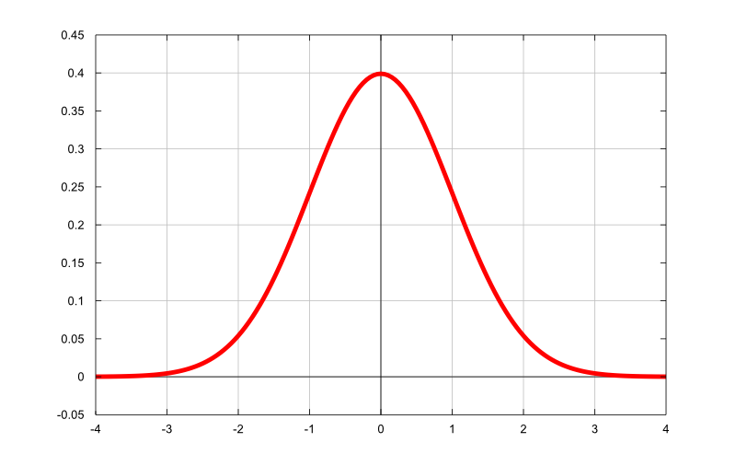


Putting it all together
Q1
Q2
Column | DET | OPE | PAL
name
age
salary
Q3
Monomi Planner
Query workload
Space budget
Monomi Designer
Monomi Runtime
Database
Database statistics
Encrypted Data
Setup
Querying

Slide 18
How well does this work?

Slide 19
Evaluation
How many TPC-H queries can Monomi run?
What is the overhead compared to plaintext?
What optimizations matter?
Setup:
TPC-H scale 10
Postgres 8.4 on Linux 2.6
8GB RAM, 16 cores, six 7200 RPM HDDs

Slide 20
Most TPC-H queries supported
Monomi’s approach handles all TPC-H queries
Our prototype handles 19/22 due to missing SQL features (e.g. views)
First system we know of that can do this!
CryptDB only supports 4/22

Slide 21
Overhead vs. plaintext
Takeaway:
min overhead 1.03x,
median overhead 1.24x,
max overhead 2.33x

Slide 22
Many techniques important
See paper for details on other optimizations
Notes:
Talk about greedy + precomp

Slide 23
Related work
Trusted hardware (Cipherbase, TrustedDB):
Requires changing hardware (e.g. FPGAs)
Different set of assumptions
Untrusted server (CryptDB, [Hacıgümüs et al]):
Monomi first to show OLAP with low overhead
General purpose query planner + designer

Slide 24
Summary
Monomi: analytics on encrypted data can be made practical!
Techniques:
Split client/server execution
Pre-computation + other optimizations
Planner/designer

Slide 25
Thanks, questions?

