Slide 1

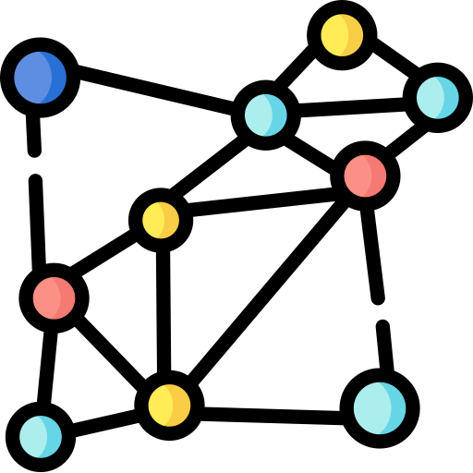
The Mixing Bowl
By
The Mixing Bowl
By
dataRecipes.info

