Slide 1
Announcements
Project Update
  Extension: due Friday, April 20
  Create web page with description, results
  Present your project in class (~10min/each) on Friday, April 27

Slide 2
Stereo Reconstruction Pipeline
Steps
  Calibrate cameras
  Rectify images
  Compute disparity
  Estimate depth

Slide 3
Image Rectification

Slide 4
Image Rectification
Image Reprojection
  reproject image planes onto common
  plane parallel to line between optical centers
  a homography (3x3 transform)
  applied to both input images
  C. Loop and Z. Zhang. Computing Rectifying Homographies for Stereo Vision. IEEE Conf. Computer Vision and Pattern Recognition, 1999.
Show VM video

Slide 5
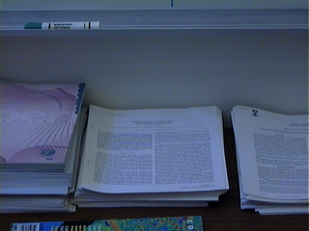

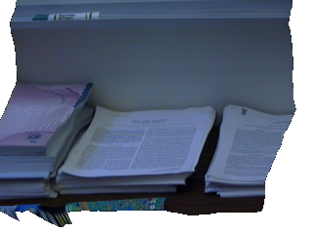
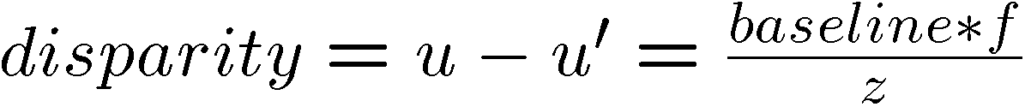
Depth from Disparity
input image (1 of 2)
depth map
3D rendering
[Szeliski & Kang ‘95]
X
z
u
u’
f
f
C
baseline
C’

Slide 6
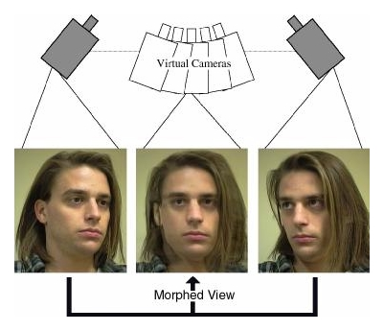
Disparity-Based Rendering
Render new views from raw disparity
  S. M. Seitz and C. R. Dyer, View Morphing, Proc. SIGGRAPH 96, 1996, pp. 21-30.
  L. McMillan and G. Bishop. Plenoptic Modeling: An Image-Based Rendering System, Proc. of SIGGRAPH 95, 1995, pp. 39-46.

Slide 7
Choosing the Baseline
Large Baseline
Small Baseline
What’s the optimal baseline?
  Too small: large depth error
  Too large: difficult search problem

Slide 8
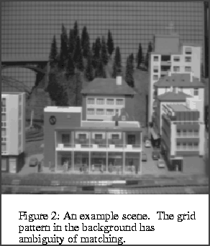
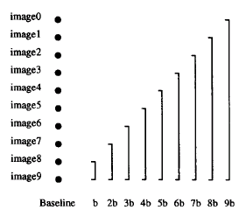
The Effect of Baseline on Depth Estimation

Slide 9
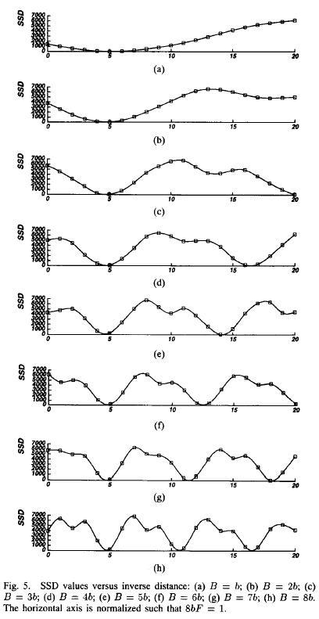
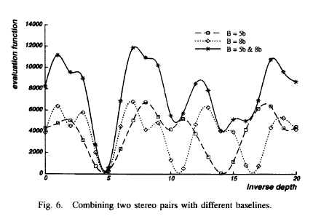
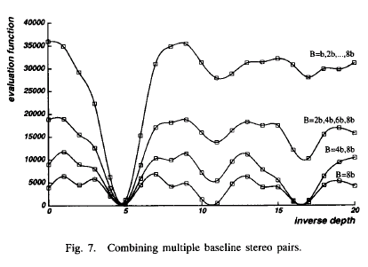

Slide 10
Multibaseline Stereo
Basic Approach
  Choose a reference view
  Use your favorite stereo algorithm BUT
    replace two-view SSD with SSD over all baselines
Limitations
  Must choose a reference view (bad)
  Visibility!
CMU’s 3D Room Video

Slide 11
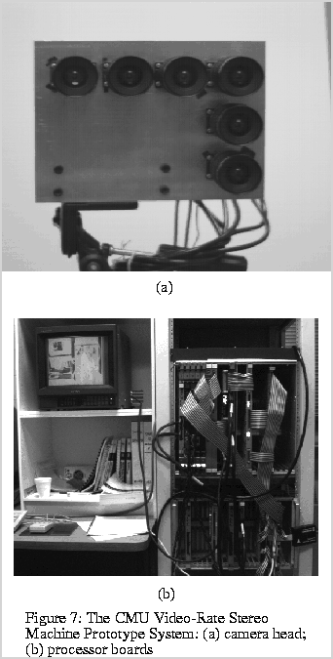
Video

Slide 12
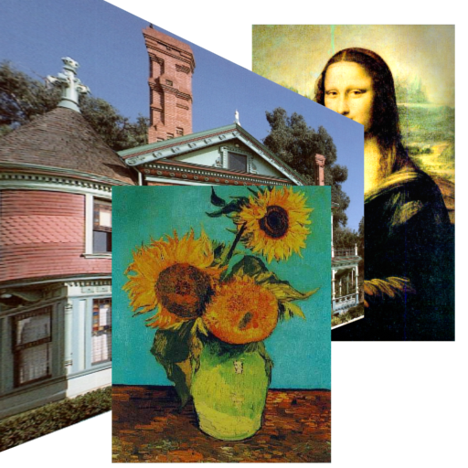
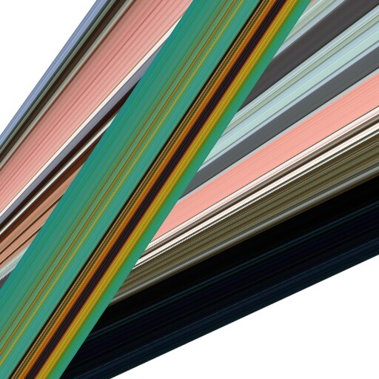
Epipolar-Plane Images [Bolles 87]
http://www.graphics.lcs.mit.edu/~aisaksen/projects/drlf/epi/
Lesson: Beware of occlusions

Slide 13
The Global Visibility Problem
Which points are visible in which images?
Known Scene
Unknown Scene
Forward Visibility
known scene
Inverse Visibility
known images

Slide 14
Volumetric Stereo
Scene Volume
V
Input Images
(Calibrated)
Goal: Determine transparency, radiance of points in V

Slide 15
Discrete Formulation: Voxel Coloring
Discretized
Scene Volume
Input Images
(Calibrated)
Goal: Assign RGBA values to voxels in V
      photo-consistent with images

Slide 16
Complexity and Computability
Discretized
Scene Volume
3
N voxels
C colors
True
Scene
All Scenes (C^{N3})
Photo-Consistent
Scenes

Slide 17
Issues
Theoretical Questions
  Identify class of all photo-consistent scenes
Practical Questions
  How do we compute photo-consistent models?

Slide 18
Voxel Coloring Solutions
1. C=2 (silhouettes)
  Volume intersection [Martin 81, Szeliski 93]
2. C unconstrained, viewpoint constraints
  Voxel coloring algorithm [Seitz & Dyer 97]
3. General Case
  Space carving [Kutulakos & Seitz 98]

Slide 19
Reconstruction from Silhouettes (C = 2)
Binary Images
Approach:
  Backproject each silhouette
  Intersect backprojected volumes

Slide 20
Volume Intersection
Reconstruction Contains the True Scene
  But is generally not the same
  In the limit (all views) get visual hull
    Complement of all lines that don’t intersect S

Slide 21
Voxel Algorithm for Volume Intersection
Color voxel black if on silhouette in every image
  O(MN³), for M images, N³ voxels
  Don’t have to search 2^{N3} possible scenes!

Slide 22
Properties of Volume Intersection
Pros
  Easy to implement, fast
  Accelerated via octrees [Szeliski 1993]
Cons
  No concavities
  Reconstruction is not photo-consistent
  Requires identification of silhouettes

Slide 23
Voxel Coloring Solutions
1. C=2 (silhouettes)
  Volume intersection [Martin 81, Szeliski 93]
2. C unconstrained, viewpoint constraints
  Voxel coloring algorithm [Seitz & Dyer 97]
3. General Case
  Space carving [Kutulakos & Seitz 98]

Slide 24
Voxel Coloring Approach
1. Choose voxel
Color if consistent
  (standard deviation of pixel
  colors below threshold)
2. Project and correlate
Visibility Problem: in which images is each voxel visible?

Slide 25
Depth Ordering: visit occluders first!
Layers
Scene
Traversal
Condition: depth order is the same for all input views

Slide 26
What is A View-Independent Depth Order?
A function f over a scene S and a camera volume C
p
q
C
v
S
f
Such that for all p and q in S, v in C
  p occludes q from v only if f(p) < f(q)
For example: f = distance from separating plane

Slide 27
Panoramic Depth Ordering
  Cameras oriented in many different directions
  Planar depth ordering does not apply

Slide 28
Panoramic Depth Ordering
Layers radiate outwards from cameras

Slide 29
Panoramic Layering
Layers radiate outwards from cameras

Slide 30
Panoramic Layering
Layers radiate outwards from cameras

Slide 31
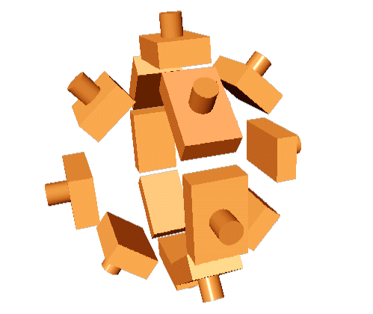
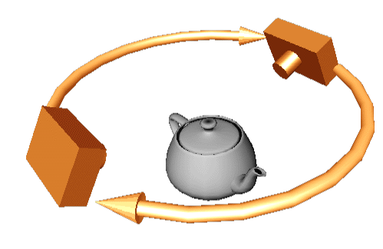
Compatible Camera Configurations
Depth-Order Constraint
  Scene outside convex hull of camera centers
Inward-Looking
cameras above scene
Outward-Looking
cameras inside scene

Slide 32
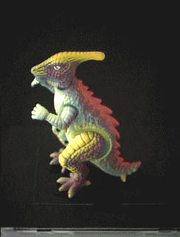
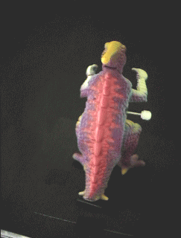
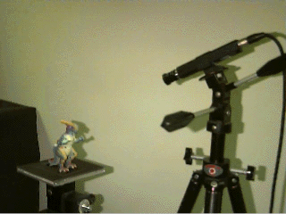

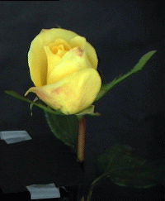
Calibrated Image Acquisition
Selected Dinosaur Images
Calibrated Turntable
360° rotation (21 images)
Selected Flower Images

Slide 33
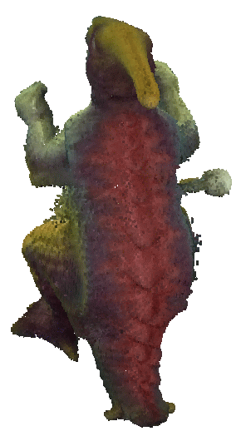

Voxel Coloring Results (Video)
Dinosaur Reconstruction
72 K voxels colored
7.6 M voxels tested
7 min. to compute
on a 250MHz SGI
Flower Reconstruction
70 K voxels colored
7.6 M voxels tested
7 min. to compute
on a 250MHz SGI

Slide 34
Limitations of Depth Ordering
A view-independent depth order may not exist
p
q
Need more powerful general-case algorithms
  Unconstrained camera positions
  Unconstrained scene geometry/topology

Slide 35
Voxel Coloring Solutions
1. C=2 (silhouettes)
  Volume intersection [Martin 81, Szeliski 93]
2. C unconstrained, viewpoint constraints
  Voxel coloring algorithm [Seitz & Dyer 97]
3. General Case
  Space carving [Kutulakos & Seitz 98]

Slide 36
Space Carving Algorithm
Image 1
Image N
…...
Space Carving Algorithm
  Initialize to a volume V containing the true scene
  Choose a voxel on the current surface
  Project to visible input images
  Carve if not photo-consistent
  Repeat until convergence

Slide 37
Convergence
Consistency Property
  The resulting shape is photo-consistent
    all inconsistent points are removed
Convergence Property
  Carving converges to a non-empty shape
    a point on the true scene is never removed
p

Slide 38
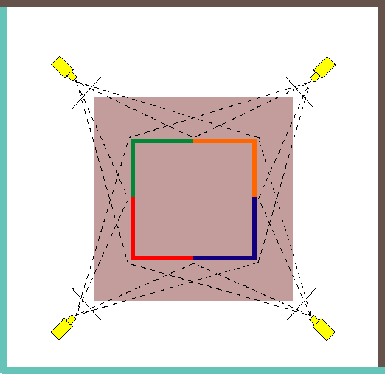
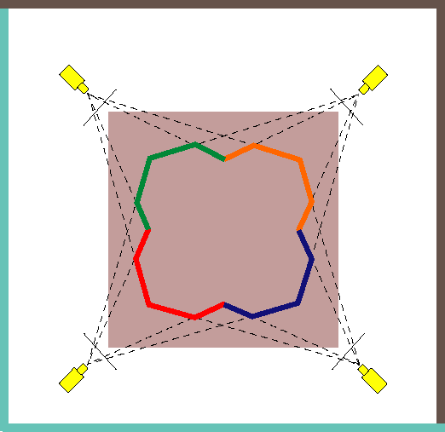
What is Computable?
V
V
True Scene
Photo Hull
The Photo Hull is the UNION of all photo-consistent scenes in V
  It is a photo-consistent scene reconstruction
  Tightest possible bound on the true scene

Slide 39
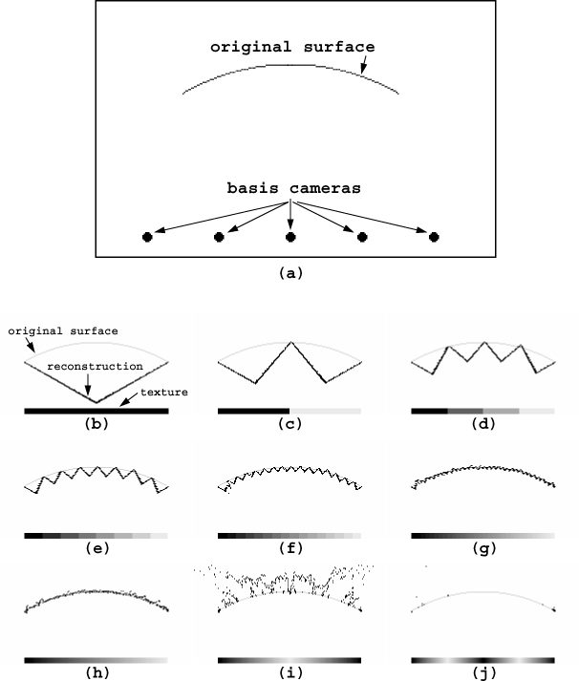

Slide 40
Space Carving Algorithm
The Basic Algorithm is Unwieldy
  Complex update procedure
Alternative: Multi-Pass Plane Sweep
  Efficient, can use texture-mapping hardware
  Converges quickly in practice
  Easy to implement
Results
Algorithm

Slide 41

Multi-Pass Plane Sweep
  Sweep plane in each of 6 principle directions
  Consider cameras on only one side of plane
  Repeat until convergence
True Scene
Reconstruction

Slide 42
Multi-Pass Plane Sweep
  Sweep plane in each of 6 principle directions
  Consider cameras on only one side of plane
  Repeat until convergence

Slide 43
Multi-Pass Plane Sweep
  Sweep plane in each of 6 principle directions
  Consider cameras on only one side of plane
  Repeat until convergence

Slide 44
Multi-Pass Plane Sweep
  Sweep plane in each of 6 principle directions
  Consider cameras on only one side of plane
  Repeat until convergence

Slide 45
Multi-Pass Plane Sweep
  Sweep plane in each of 6 principle directions
  Consider cameras on only one side of plane
  Repeat until convergence

Slide 46
Multi-Pass Plane Sweep
  Sweep plane in each of 6 principle directions
  Consider cameras on only one side of plane
  Repeat until convergence

Slide 47
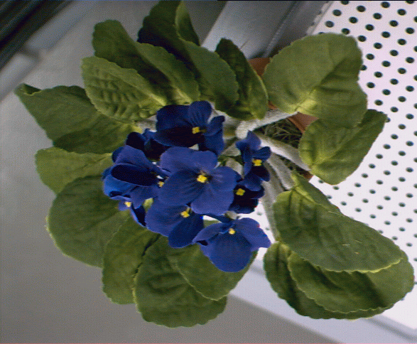
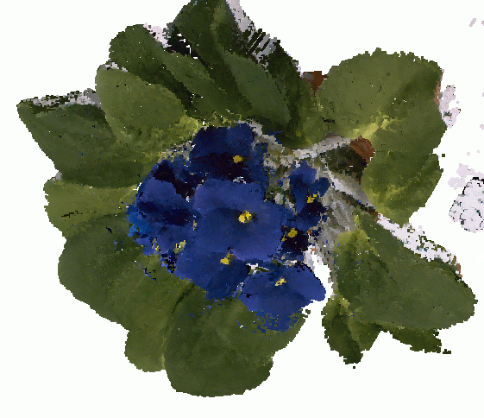
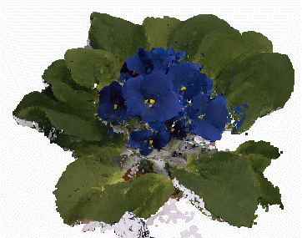
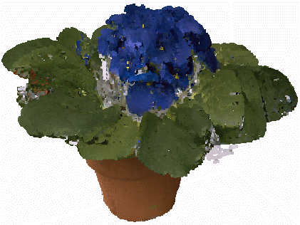
Space Carving Results: African Violet
Input Image (1 of 45)
Reconstruction
Reconstruction
Reconstruction

Slide 48
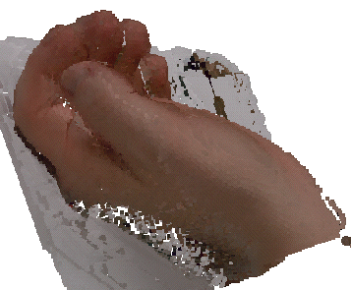
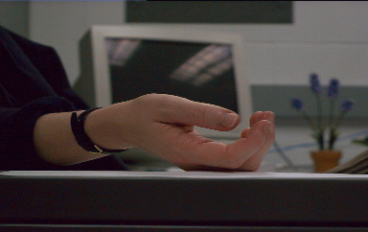
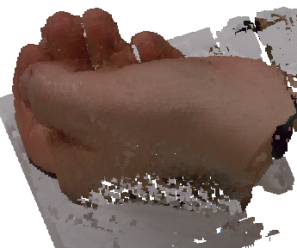
Space Carving Results: Hand
Input Image
(1 of 100)
Views of Reconstruction

Slide 49
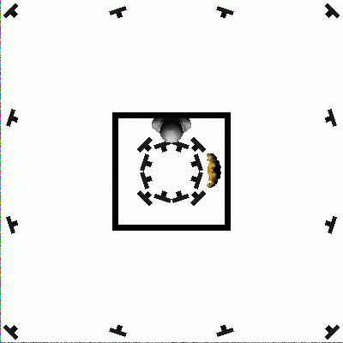
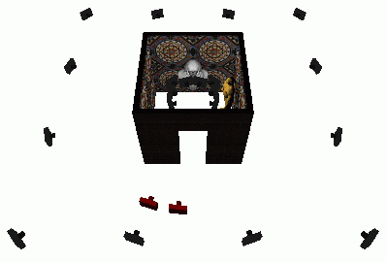
House Walkthrough
24 rendered input views from inside and outside

Slide 50
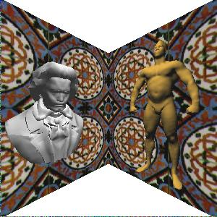
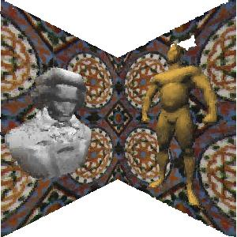
Space Carving Results: House
Input Image
(true scene)
Reconstruction
370,000 voxels

Slide 51
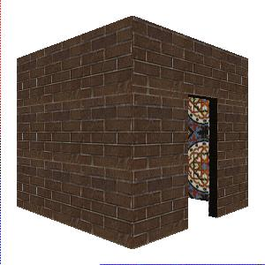
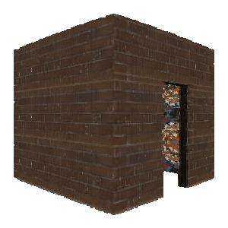
Space Carving Results: House
Input Image
(true scene)
Reconstruction
370,000 voxels

Slide 52
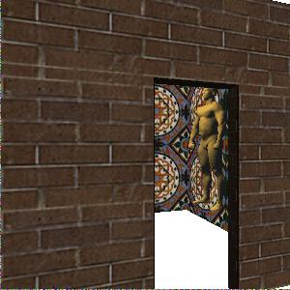
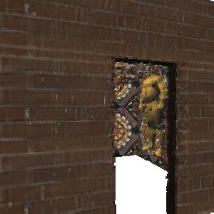
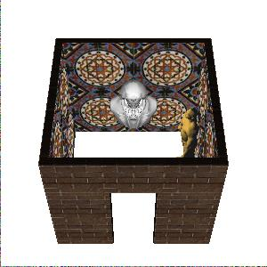
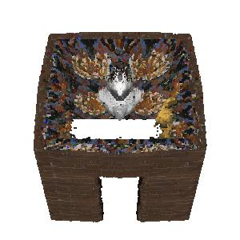
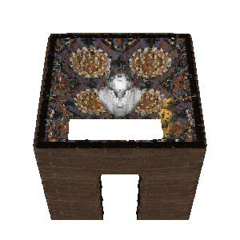
Space Carving Results: House
New View (true scene)
Reconstruction
New View
(true scene)
Reconstruction
Reconstruction
(with new input view)

Slide 53
Other Features
Coarse-to-fine Reconstruction
  Represent scene as octree
  Reconstruct low-res model first, then refine
Hardware-Acceleration
  Use texture-mapping to compute voxel projections
  Process voxels an entire plane at a time
Limitations
  Need to acquire calibrated images
  Restriction to simple radiance models
  Bias toward maximal (fat) reconstructions
  Transparency not supported

Slide 54
Other Approaches
Level-Set Methods [Faugeras & Keriven 1998]
  Evolve implicit function by solving PDE’s
Probabilistic Voxel Reconstruction [DeBonet & Viola 1999]
  Solve for voxel uncertainty (also transparency)
Transparency and Matting [Szeliski & Golland 1998]
  Compute voxels with alpha-channel
Max Flow/Min Cut [Roy & Cox 1998]
  Graph theoretic formulation
Mesh-Based Stereo [Fua & Leclerc 1995], [Zhang & Seitz 2001]
  Mesh-based but similar consistency formulation
Virtualized Reality [Narayan, Rander, Kanade 1998]
  Perform stereo 3 images at a time, merge results

Slide 55
Level Set Stereo [Faugeras & Keriven 1998]
Pose Stereo as Energy Minimization
  First idea: find best surface S(u,v) to match images
  This is a variational minimization problem
    solved by deforming surface infinitesimally
    deformation given by Euler-Lagrange equations
Problem—how to handle case where object is not a single surface?
  Can use level-set formulation
    represent the object as a function f(x,y,z) whose zero-set is the object’s surface
    evolve f instead of S

Slide 56
Bibliography
Volume Intersection
  Martin & Aggarwal, “Volumetric description of objects from multiple views”, Trans. Pattern Analysis and Machine Intelligence, 5(2), 1991, pp. 150-158.
  Szeliski, “Rapid Octree Construction from Image Sequences”, Computer Vision, Graphics, and Image Processing: Image Understanding, 58(1), 1993, pp. 23-32.
Voxel Coloring and Space Carving
  Seitz & Dyer, “Photorealistic Scene Reconstruction by Voxel Coloring”, Proc. Computer Vision and Pattern Recognition (CVPR), 1997, pp. 1067-1073.
  Seitz & Kutulakos, “Plenoptic Image Editing”, Proc. Int. Conf. on Computer Vision (ICCV), 1998, pp. 17-24.
  Kutulakos & Seitz, “A Theory of Shape by Space Carving”, Proc. ICCV, 1998, pp. 307-314.

Slide 57
Bibliography
Related References
  Bolles, Baker, and Marimont, “Epipolar-Plane Image Analysis: An Approach to Determining Structure from Motion”, International Journal of Computer Vision, vol 1, no 1, 1987, pp. 7-55.
    DeBonet & Viola, “Poxels: Probabilistic Voxelized Volume Reconstruction”, Proc. Int. Conf. on Computer Vision (ICCV) 1999.
  Faugeras & Keriven, “Variational principles, surface evolution, PDE's, level set methods and the stereo problem", IEEE Trans. on Image Processing, 7(3), 1998, pp. 336-344.
  Szeliski & Golland, “Stereo Matching with Transparency and Matting”, Proc. Int. Conf. on Computer Vision (ICCV), 1998, 517-524.
  Roy & Cox, “A Maximum-Flow Formulation of the N-camera Stereo Correspondence Problem”, Proc. ICCV, 1998, pp. 492-499.
  Fua & Leclerc, “Object-centered surface reconstruction: Combining multi-image stereo and shading", International Journal of Computer Vision, 16, 1995, pp. 35-56.
  Narayanan, Rander, & Kanade, “Constructing Virtual Worlds Using Dense Stereo”, Proc. ICCV, 1998, pp. 3-10.

