Slide 1
MCA MINI PROJECT · 2025–26
SimuNet
API Chaos Engineering & Load Testing Platform
Web-Based Concurrent Load Generation and Real-Time Telemetry Framework
PRESENTED BY
UNDER THE GUIDANCE OF
Stephin Siby
Ms. Athira R Kurup
Roll No: 51
Dept. of Computer Applications (MCA)
Assistant Professor, Department of Computer Applications

Slide 2
PROJECT OVERVIEW
Executive Abstract
SimuNet reimagines API load and resilience testing as a lightweight, browser-native experience — replacing heavyweight desktop tools with a real-time, shareable engineering console.
1
From Desktop to Browser
2
Concurrency + Chaos
› Replaces heavy tools like JMeter and Postman with a zero-install web dashboard
› Accessible from any device — no local setup, no licence files, no bulky JVM overhead
› Test sessions are shareable via a link, enabling instant team collaboration
› Simulates thousands of concurrent virtual users using Node.js worker threads
› Injects artificial latency and fault conditions to test system resilience under chaos
› Streams live metrics over WebSockets instead of static, post-test log files
SimuNet — MCA Mini Project
02 / 15

Slide 3
MOTIVATION
Problem Statement & Industry Need
Challenges with Current Tools
Why It Matters
› High learning curve — steep onboarding for JMeter's XML-based test plans and Postman's manual collection runs
› Heavy desktop memory footprint — JVM-based tools consume large amounts of local RAM/CPU during simulated load
› Static, post-test logs — results are only visible after a run completes, with no live feedback loop
› Lack of instant sharing — test configurations and results are trapped in local files, not links
Servers routinely fail under unpredictable traffic spikes — flash sales, viral campaigns, or sudden API demand — often because teams never simulated realistic concurrent load before deployment.
REAL-WORLD TRIGGER SCENARIOS
› E-commerce flash sales causing checkout API timeouts
› Unexpected viral traffic overwhelming public endpoints
› Undetected bottlenecks surfacing only in production
SimuNet — MCA Mini Project
03 / 15

Slide 4
GOALS
Project Objectives
01
Browser-Based Control Dashboard
02
Multi-Threaded Load Engine
Deliver a zero-install React interface for configuring and launching load tests entirely in the browser.
Generate high-volume concurrent virtual users using Node.js Worker Threads for true parallel execution.
03
Real-Time WebSocket Telemetry
04
Chaos Fault Injection
Stream live throughput, latency, and error metrics to the dashboard via Socket.io as the test runs.
Introduce controllable artificial latency and failure conditions to validate system resilience.
SimuNet — MCA Mini Project
04 / 15

Slide 5
BOUNDARIES
Project Scope
IN SCOPE
FUTURE SCOPE
› Browser-based configuration and control of load test sessions
› Slider-driven control of virtual user (VU) count and ramp-up pattern
› Chaos-mode artificial latency and delay injection per request
› Live, auto-updating Chart.js graphs for throughput and response time
› Post-run session summaries with key performance indicators
› Multi-region distributed load generation nodes for geo-realistic testing
› AI-assisted bottleneck prediction from historical telemetry patterns
› Automated CI/CD pipeline plugins (GitHub Actions integration)
SimuNet — MCA Mini Project
05 / 15

Slide 6
RELATED WORK
Literature Review
Title & Year | Authors & Publication | Methodology / Tech | Key Findings & Contribution
Chaos Engineering for Resilient Cloud Systems (2021) | R. Basiri et al., IEEE Cloud Computing | Controlled fault-injection experiments on microservices | Formalised chaos engineering principles for proactively surfacing hidden cloud failure modes
Distributed Load Testing for Scalable APIs (2022) | S. Menon & P. Rao, Int. Journal of Computer Applications | Multi-node distributed request generation | Showed horizontal scaling of load generators improves realism of high-concurrency simulations
Real-Time Telemetry Streaming Architectures (2023) | A. Fernandes et al., ACM SIGSOFT | Publish–subscribe pipelines with in-memory brokers | Demonstrated sub-second metric propagation using WebSocket + in-memory buffer pipelines
Headless & Browser-Based Stress Testing GUIs (2026) | K. Iyer & T. Nakamura, IEEE Software | Browser-native dashboards over legacy desktop clients | Found browser-first tooling reduces onboarding time and improves cross-team test sharing
SimuNet — MCA Mini Project
06 / 15

Slide 7
COMPARISON
Existing vs. Proposed System
Parameter | Existing Tools (JMeter / Postman) | SimuNet (Proposed)
Deployment Type | Desktop application, local installation required | Browser-based, zero installation
Resource Utilization | High local JVM / RAM & CPU overhead | Lightweight — server-side worker threads
Configuration Complexity | XML test plans / manual collection setup | Slider & form-driven visual configuration
Real-Time Feedback | Post-run static logs and reports | Live WebSocket telemetry during the test
Collaboration | Local files, manual sharing | Shareable links, instant team visibility
SimuNet — MCA Mini Project
07 / 15

Slide 8
TELOS FRAMEWORK
Feasibility Study
T
E
L
O
S
Technical
Economic
Legal & Ethical
Operational
Schedule
Built entirely on mature, well-documented open-source technology: Node.js, React, Redis and Socket.io.
Zero licensing cost — every component in the stack is free and open-source, minimising project budget.
Chaos and load testing is confined to owned/authorised environments to prevent misuse against third-party systems.
Simple browser access model requires no specialised training for QA or DevOps teams to adopt.
Six-sprint Agile roadmap fits comfortably within the MCA mini-project academic timeline.
SimuNet — MCA Mini Project
08 / 15

Slide 9
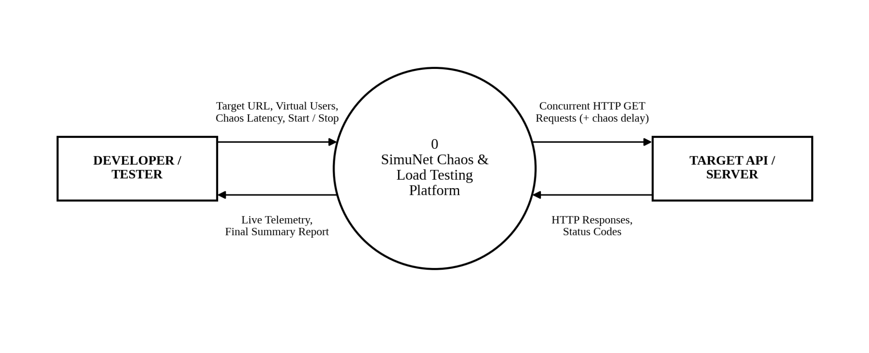
DFD LEVEL O

Slide 10
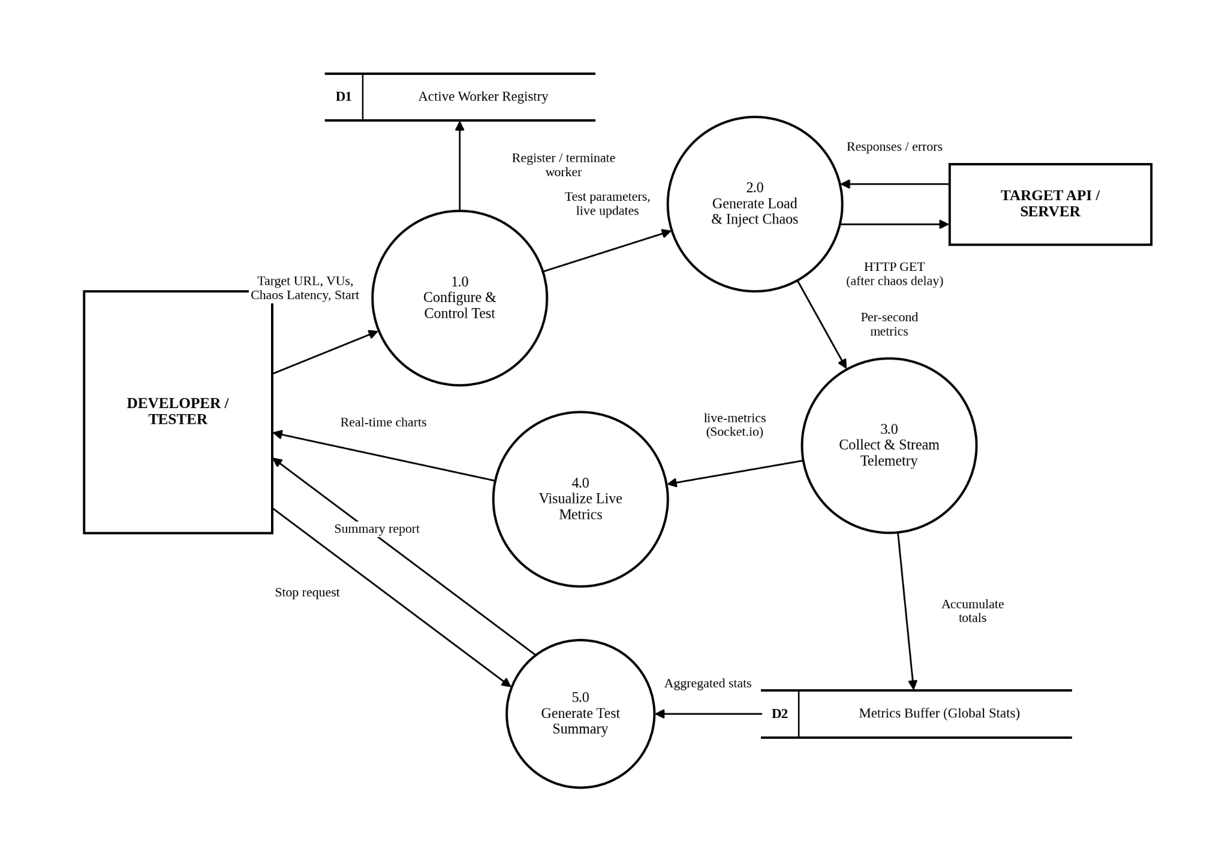
DFD LEVEL 1

Slide 11
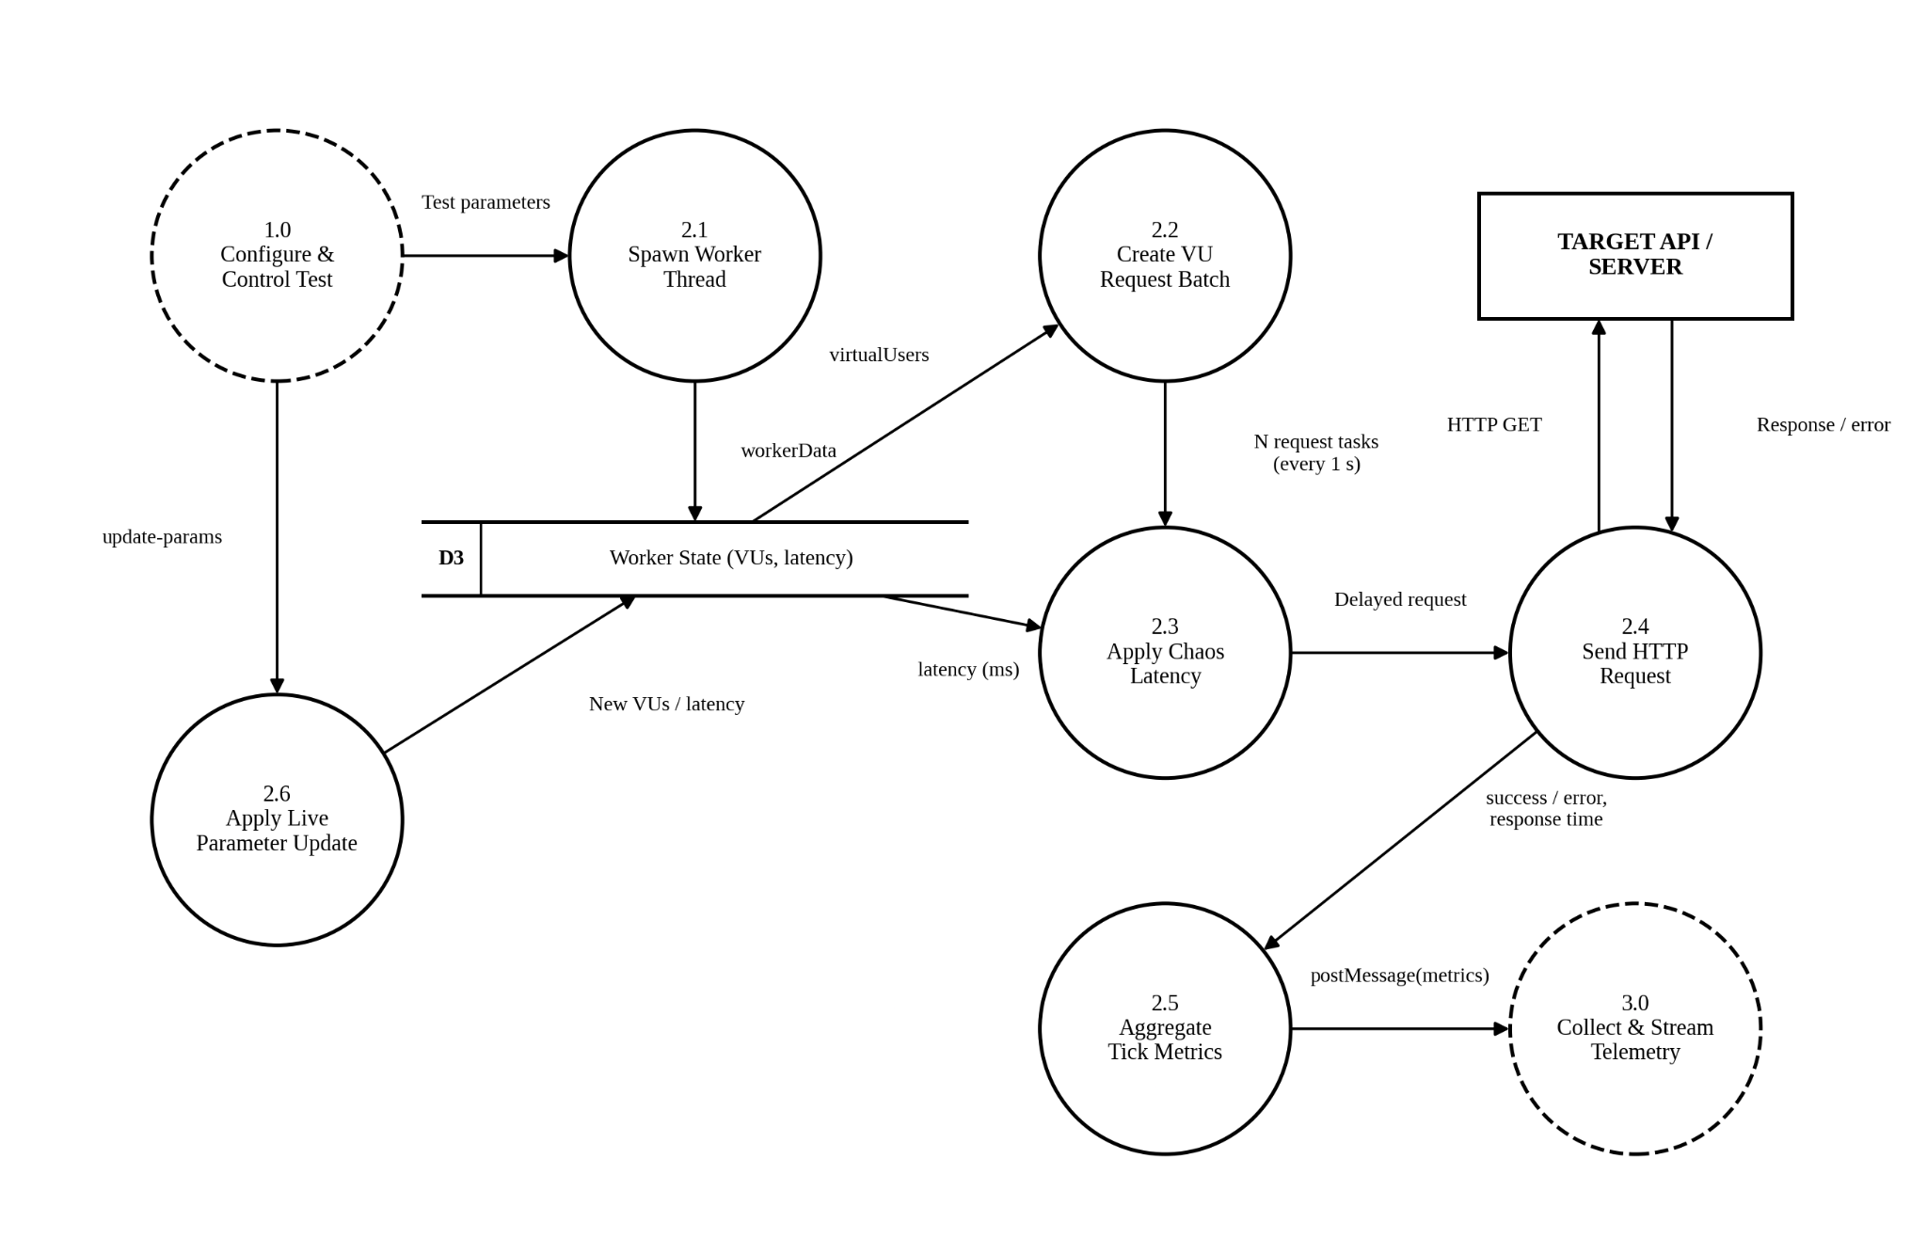
DFD LEVEL 2 LOAD ENGINE

Slide 12
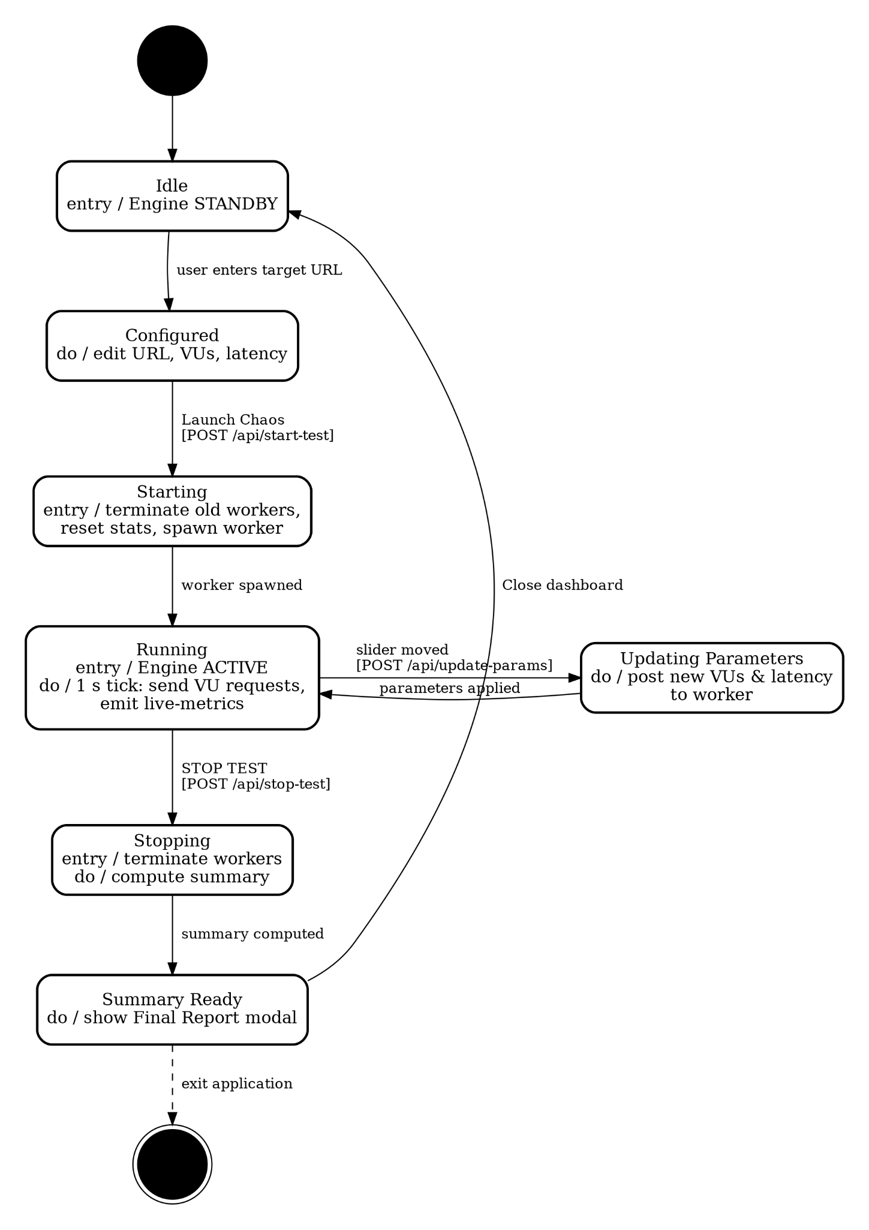
STATE DIAGRAM

Slide 13
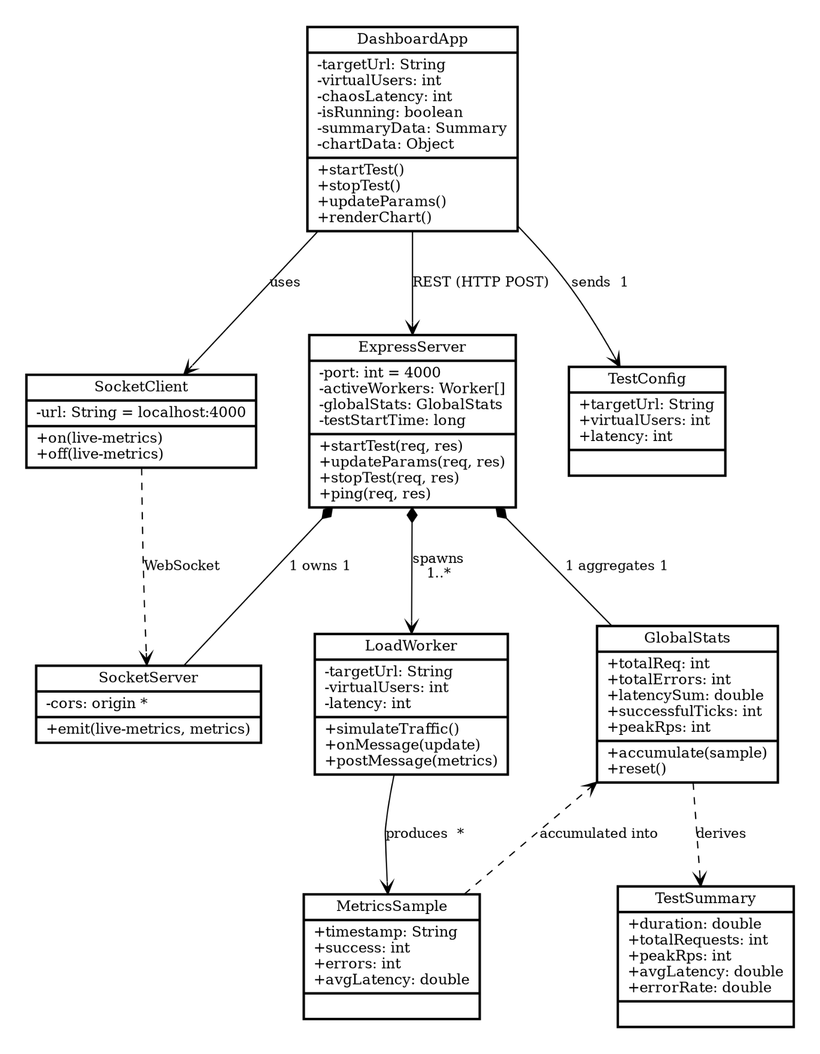
CLASS DIAGRAM

Slide 14
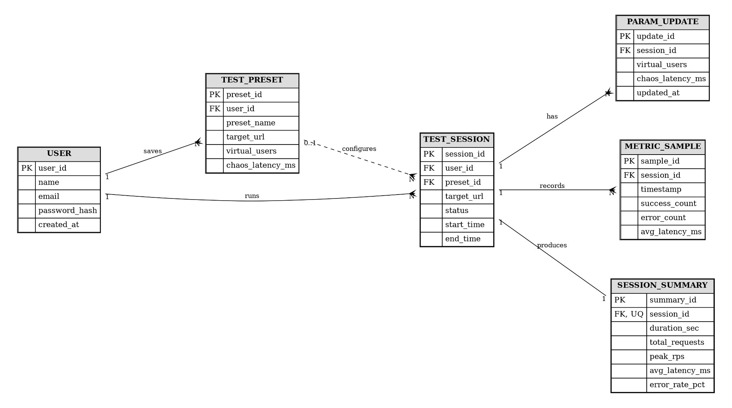
ER DIAGRAM

Slide 15
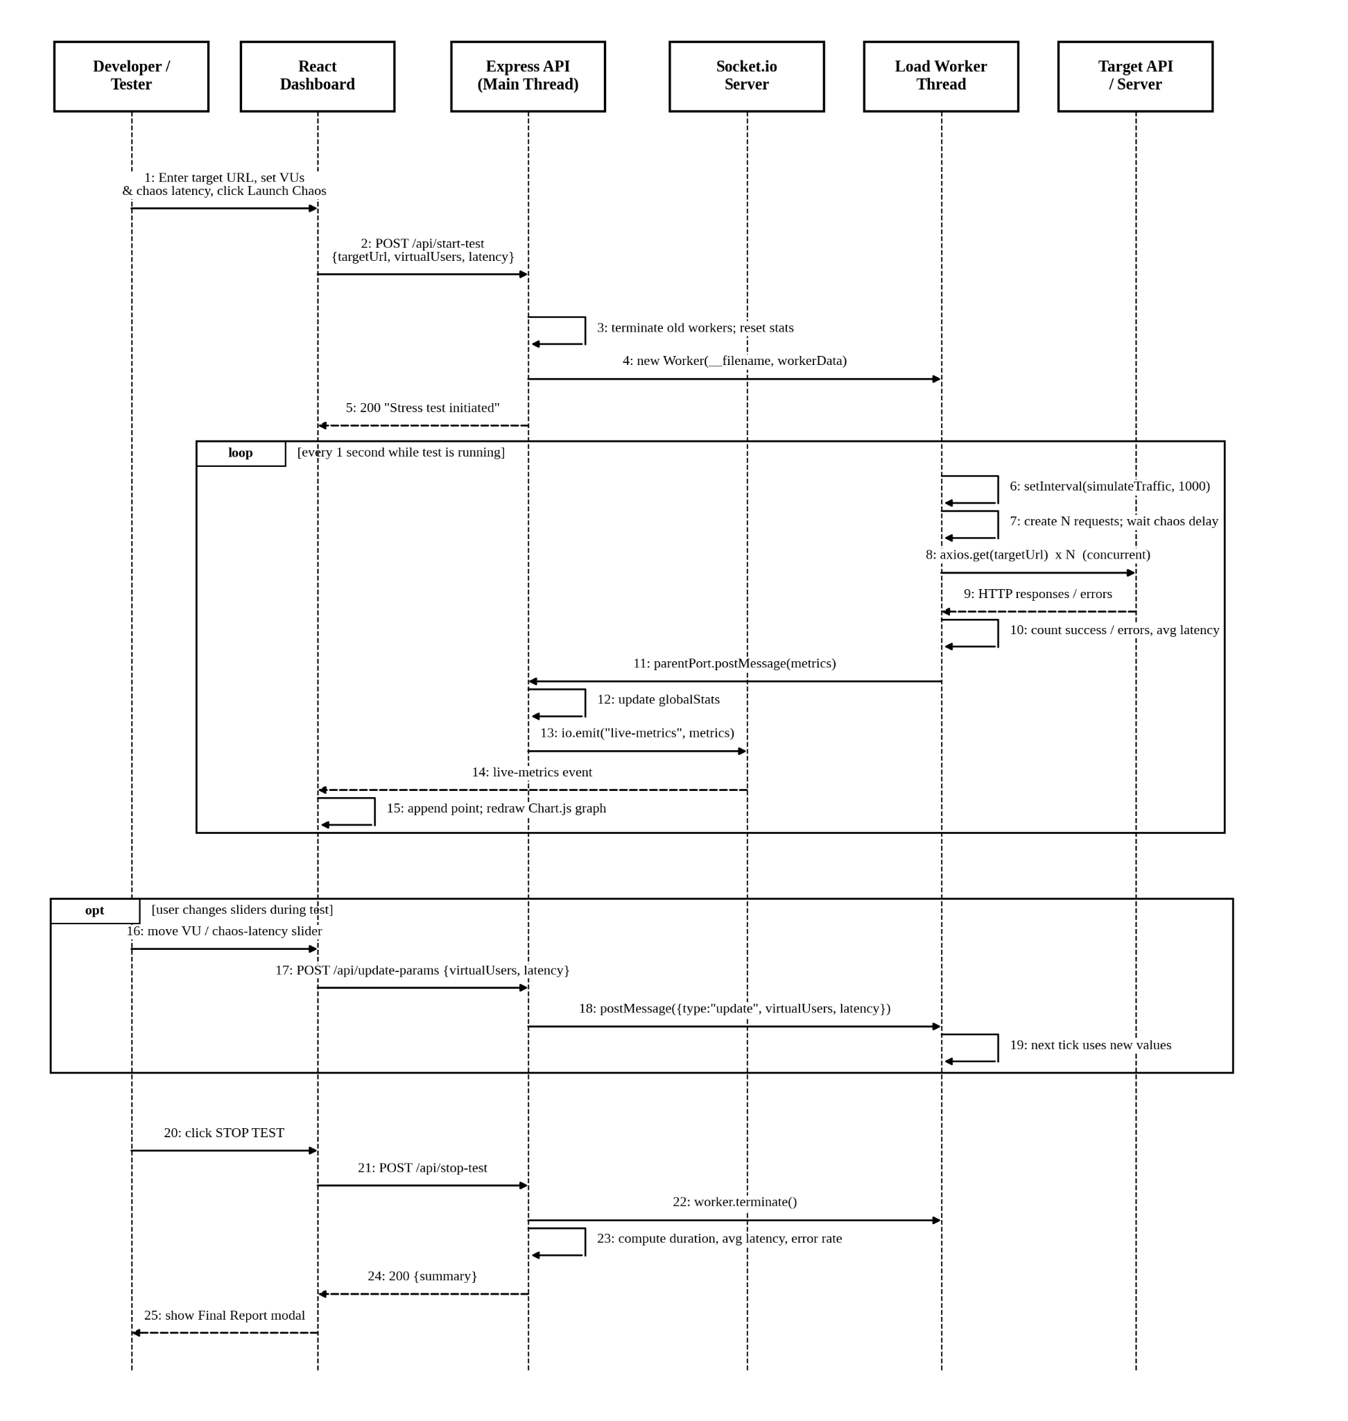
SEQUENCE DIAGRAM

Slide 16
AGILE ENGINEERING LIFECYCLE
Methodology
1
SPRINT 1
2
SPRINT 2
3
SPRINT 3
Requirements Analysis
Architecture & Engine Modeling
Load Generation Engine
Gathered functional & non-functional requirements from existing load-testing pain points.
Designed system architecture, module boundaries, and worker-thread execution model.
Implemented the concurrent request engine using Node.js Worker Threads.
4
SPRINT 4
5
SPRINT 5
6
SPRINT 6
Telemetry Pipeline
Chaos Injection Module
Benchmarking & Validation
Built the Redis-backed metrics pipeline streamed live via WebSockets.
Added configurable latency and fault-injection logic into the request pipeline.
Validated engine accuracy and dashboard responsiveness under sustained load.
SimuNet — MCA Mini Project
09 / 15

Slide 17
ARCHITECTURE
System Modules Breakdown
1
User & Config Management
Handles session creation, test configuration forms, and stored presets.
2
Load Generation Worker Engine
Node.js Worker Threads spin up concurrent virtual users to hit target endpoints.
3
Chaos Injection Engine
Applies controllable artificial latency and simulated fault conditions per request.
4
Real-Time Telemetry Engine
Redis buffers live metrics; Socket.io streams them to the dashboard in real time.
5
Analytics & PDF Report Generator
Aggregates run data into charts and exports a shareable summary report.
SimuNet — MCA Mini Project
10 / 15

Slide 18
TECH STACK
Technology Stack Architecture
Frontend
Backend Core
Real-Time / Messaging
React.js · Tailwind CSS
Node.js · Worker Threads
WebSockets · Socket.io
In-Memory Buffer
Data Visualization
Tooling / DevOps
Redis
Chart.js
Docker
SimuNet — MCA Mini Project
11 / 15

Slide 19
IMPACT
Real-World Applications & Use Cases
E-Commerce Flash Sale Preparation
Academic Query Performance Evaluation
DevOps Pre-Deployment Scaling Validation
Simulate sudden surges of concurrent checkout requests to validate that payment and inventory APIs hold up before a sale goes live.
Give students and researchers a hands-on platform to study API throughput, latency, and failure behaviour under load.
Let engineering teams chaos-test staging environments and confirm auto-scaling policies before a production release.
SimuNet — MCA Mini Project
12 / 15

Slide 20
CURRENT STATUS
Project Progress & Implementation Status
COMPLETED
PENDING
✓
Dashboard UI (React + Tailwind CSS)
!
PDF Report Exporter
✓
Load Generation Worker Thread Engine
!
Multi-Node Load Scaling
✓
Real-Time WebSocket Telemetry Layer
Both pending items are scoped for the final project phase and do not block core demonstration of the load-testing and chaos-injection workflow.
✓
Live Chart.js Visualization
SimuNet — MCA Mini Project
13 / 15

Slide 21
WRAP-UP
Conclusion & Key Takeaways
SimuNet demonstrates that a modern, browser-native architecture can match — and in usability terms exceed — traditional desktop load-testing tools.
Accessible Engineering
True Concurrency
A zero-install, browser-based workflow lowers the barrier to serious performance testing.
Node.js Worker Threads deliver genuine parallel load generation, not simulated concurrency.
Live Observability
Resilience by Design
WebSocket-driven telemetry turns testing into a real-time, interactive experience.
Built-in chaos injection encourages proactive, not reactive, system reliability.
SimuNet — MCA Mini Project
14 / 15

Slide 22
IEEE CITATIONS
References
› [1] R. Basiri, N. Behnam, R. de Rooij, L. Hochstein, L. Kosewski, J. Reynolds, and C. Rosenthal, "Chaos Engineering," IEEE Software, vol. 33, no. 3, pp. 35-41, 2021.
› [2] S. Menon and P. Rao, "A Framework for Distributed API Load Testing at Scale," International Journal of Computer Applications, vol. 184, no. 12, pp. 18-24, 2022.
› [3] A. Fernandes, M. Costa, and J. Silva, "Real-Time Telemetry Streaming Architectures for Web Services," in Proc. ACM SIGSOFT Symposium, 2023, pp. 112-120.
› [4] K. Iyer and T. Nakamura, "Headless and Browser-Based Stress Testing GUIs: A Comparative Study," IEEE Software, vol. 43, no. 1, pp. 60-68, 2026.
› [5] Node.js Foundation, "Worker Threads — Node.js Documentation," Node.js API Reference, 2026. [Online]. Available: https://nodejs.org/api/worker_threads.html
› [6] Socket.IO, "Socket.IO Documentation," 2026. [Online]. Available: https://socket.io/docs/
› [7] Redis Ltd., "Redis Documentation," 2026. [Online]. Available: https://redis.io/docs/
› [8] IEEE, "IEEE Recommended Practice for Software Reliability," IEEE Std 1633-2016 (Reaffirmed 2021), pp. 1-72, 2021.
SimuNet — MCA Mini Project
15 / 15

Slide 23


Slide 24
THANK YOU

