Slide 1
F# Introduction
Par StéF#ne Larocque

Slide 2
Monad
All told, a monad in X is just a monoid in the category of endofunctors of X, with product × replaced by composition of endofunctors and unit set by the identity endofunctor.

Slide 3
Monad
All told, a monad in X is just a monoid in the category of endofunctors of X, with product × replaced by composition of endofunctors and unit set by the identity endofunctor.
Ha ha ha! ☺

Slide 4
Why use F#
Conciseness F# is not cluttered up with coding “noise” such as curly brackets, semicolons and so on. You almost never have to specify the type of an object, thanks to a powerful type inference system. And it generally takes less lines of code to solve the same problem.

Slide 5
Why use F#
Convenience Many common programming tasks are much simpler in F#. This includes things like creating and using complex type definitions, doing list processing, comparison and equality, state machines, and much more. And because functions are first class objects, it is very easy to create powerful and reusable code by creating functions that have other functions as parameters, or that combine existing functions to create new functionality.

Slide 6
Why use F#
Correctness F# has a very powerful type system which prevents many common errors such as null reference exceptions. And in addition, you can often encode business logic using the type system itself, so that it is actually impossible to write incorrect code, because it is caught at compile time as a type error.

Slide 7
Why use F#
Concurrency F# has a number of built-in tools and libraries to help with programming systems when more than one thing at a time is happening. Asynchronous programming is directly supported, as is parallelism. F# also has a message queuing system, and excellent support for event handling and reactive programming. And because data structures are immutable by default, sharing state and avoiding locks is much easier.

Slide 8
Why use F#
Completeness Although F# is a functional language at heart, it does support other styles which are not 100% pure, which makes it much easier to interact with the non-pure world of web sites, databases, other applications, and so on. In particular, F# is designed as a hybrid functional/OO language, so it can do almost everything that C# can do as well. Of course, F# integrates seamlessly with the .NET ecosystem, which gives you access to all the third party .NET libraries and tools. Finally, it is part of Visual Studio, which means you get a good editor with IntelliSense support, a debugger, and many plug-ins for unit tests, source control, and other development tasks.

Slide 9
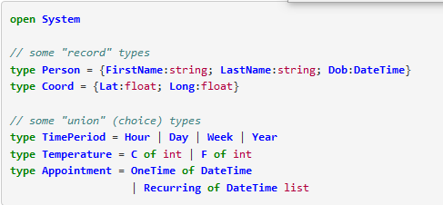
Simple Type System

Slide 10
Mathematical functions
The impetus behind functional programming

Slide 11
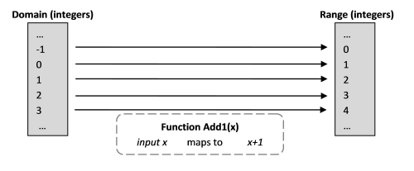
Add1(x) = x + 1

