Slide 1
BITCOIN ANALYTICS TOOL
Stephen Lewis

Slide 2
OBJECTIVE
01
02
03
PROBLEM
PROCESS
SOLUTION
Cryptocurrency investing is increasing but blockchain analytical tools are lacking
Develop my own comprehensive solution that combines on-chain data with price information
Deploy fully-functional web-app for users

Slide 3






WORKFLOW
Coinbase & Blockchain.com API’s
Python & Keras Clean and Model
STORAGE
DEPLOYMENT
DATA SOURCES
ANALYSIS
Streamlit.io
MongoDB Database

Slide 4
FEATURES
Daily Stats
Price Charts
Sentiment
Predictions
Price, Hash Rate, Block Size, Transaction Activity
Historical Price and Volume Charts
News Feed and NLP Sentiment Analysis
Weekly LSTM Model Price Predictions

Slide 5
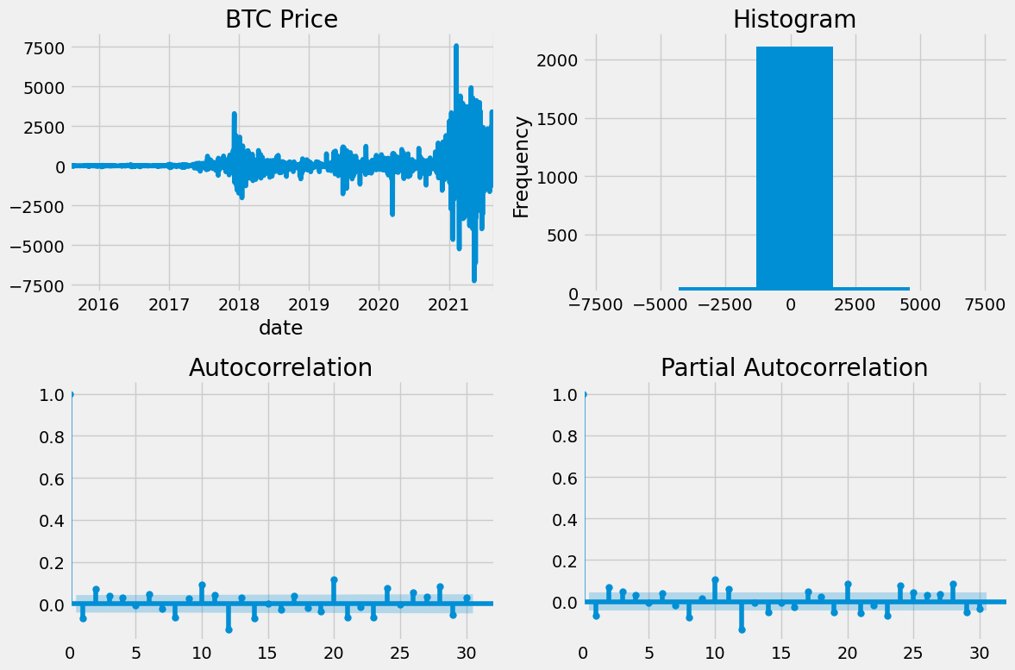
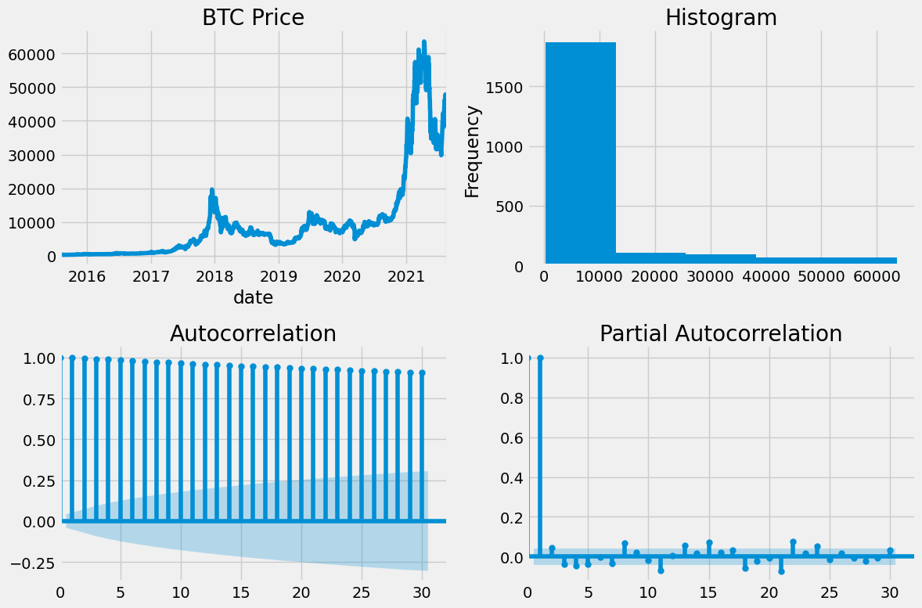
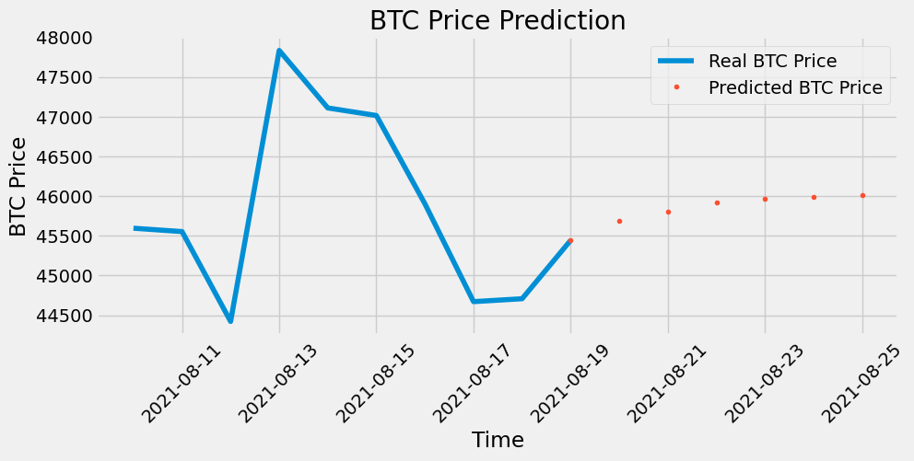
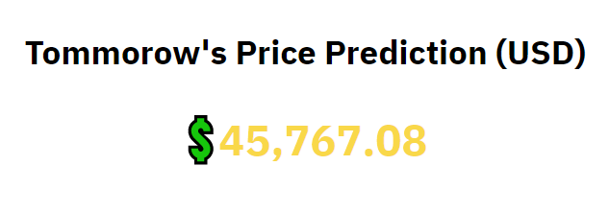
Prediction Model
Metric | Score
MSE | 0.209
RMSE | 0.457
MAE | 0.234
MSLE | 0.039

Slide 6
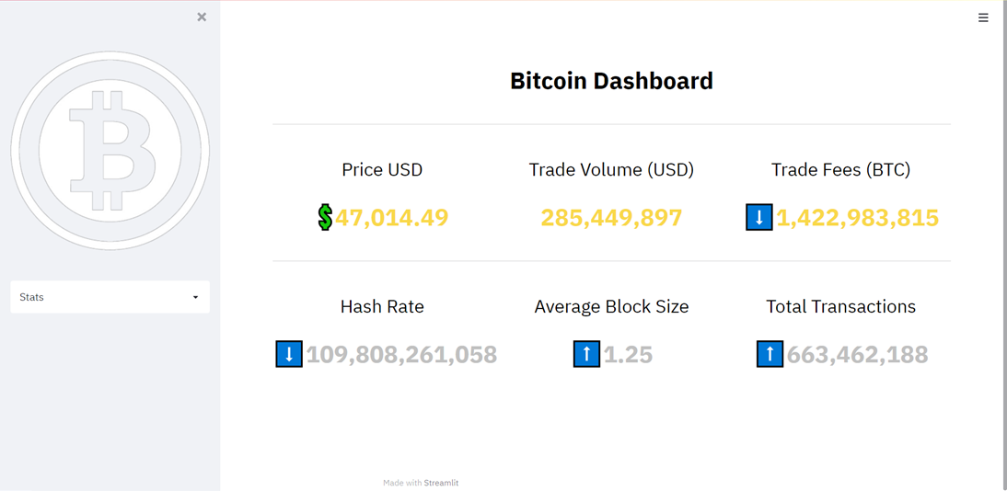
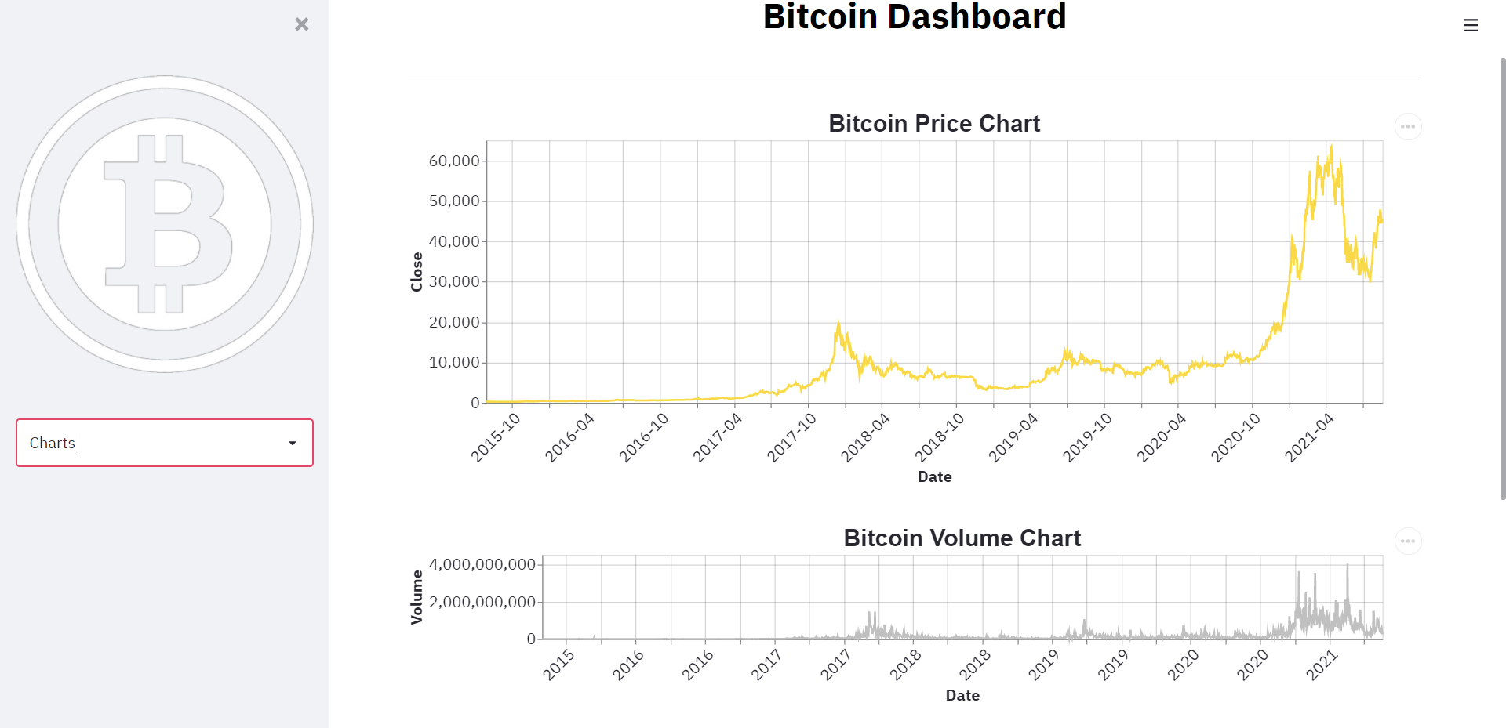
SNEAK PEEK

Slide 7
FUTURE WORK
NLP SENTIMENT ANALYSIS
FULL DEPLOYMENT
ADVANCED METRICS
Real-time news feed and sentiment analysis
Deploy a production version of the app
Continue to add blockchain specific metrics

Slide 8
THE END

