Slide 1
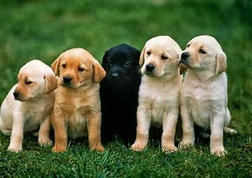
Petfinder Analysis in Chicago
Team Members: Luke, Shubhangi, Val, Stephanie, Alyssa
Notes:
Valeria

Slide 2

Project Goals
Test the hypothesis that black dogs take longer to adopt (Black Dog Syndrome).
Identify dog adoption trends depending on age, breed, size and their coat.
Notes:
Valeria

Slide 3
Why we chose this topic:
Our love of dogs made us curious about how certain characteristics affect their time on the site.
We wanted to identify these challenges and compare them to dogs that have already been adopted and see how some struggle more than others to find a family.
We would also love to convince Will and anyone else in this class to adopt a dog. Win-win.
Notes:
Valeria

Slide 4
Resources
-Petfinder API (https://api.petfinder.com/)
-Petpy Wrapper (https://petpy.readthedocs.io/en/latest/api.html)
-Geoapify API (https://api.geoapify.com)
Notes:
Luke

Slide 5
Description of the dataset
We were exploring the dataset of the dogs which were adopted and are adoptable in the Chicago area from January 2023 till now. We retrieved around 8000 records from the api into the dataset.
Key data columns:
Age
Gender
Size
Coat
Status
Color
Breed
Days on petfinder
Adoptable days online
Address
Notes:
Luke

Slide 6
Our Analysis Strategy
Bar Chart
Word Cloud
Scatter plot with linear regression
Independent (Two Sample) T-Test
HeatMap
Hvplot to show the map
Boxplot
Notes:
Luke

Slide 7
Data Overview & Cleaning
Started with two datasets with 4,000 rows each and 50 columns
Merged the two datasets
Reduced the columns
Created new columns
Dropped the duplicate IDs, if any
Notes:
Stephanie

Slide 8
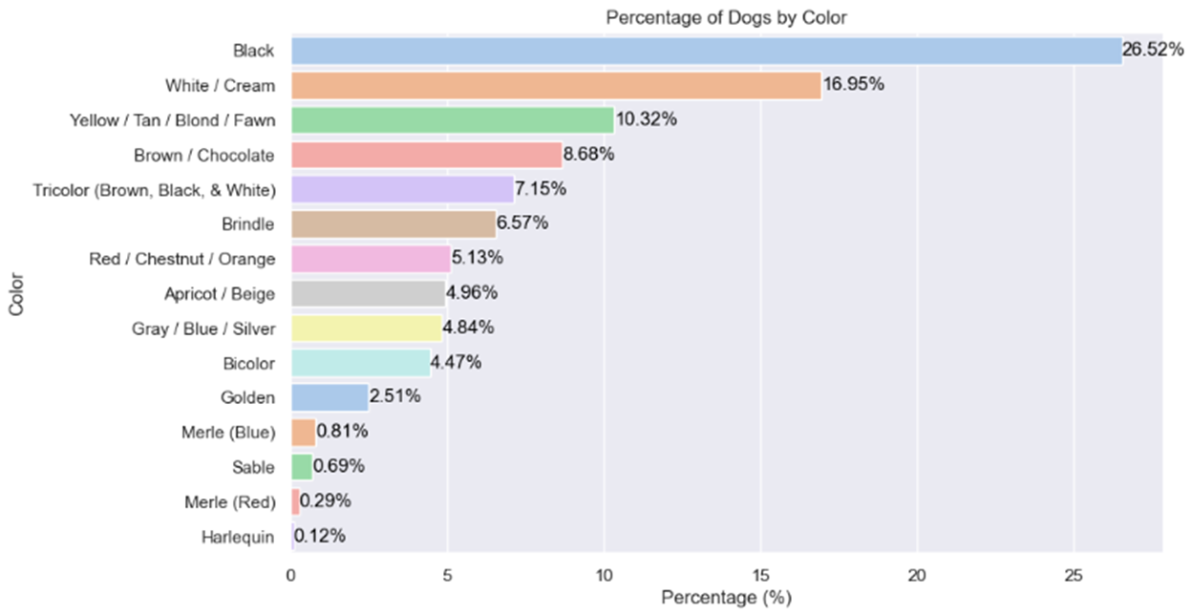
Analysis - Color
Key Insights:
Black dogs are the most frequent color dog available in our sample of Chicago area data making this a great dataset to analyze for black dogs
Notes:
Alyssa

Slide 9
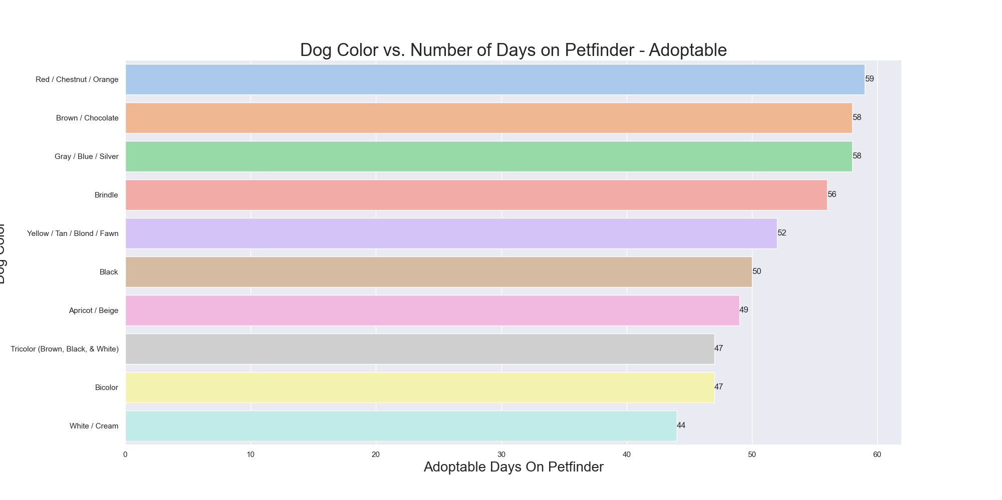
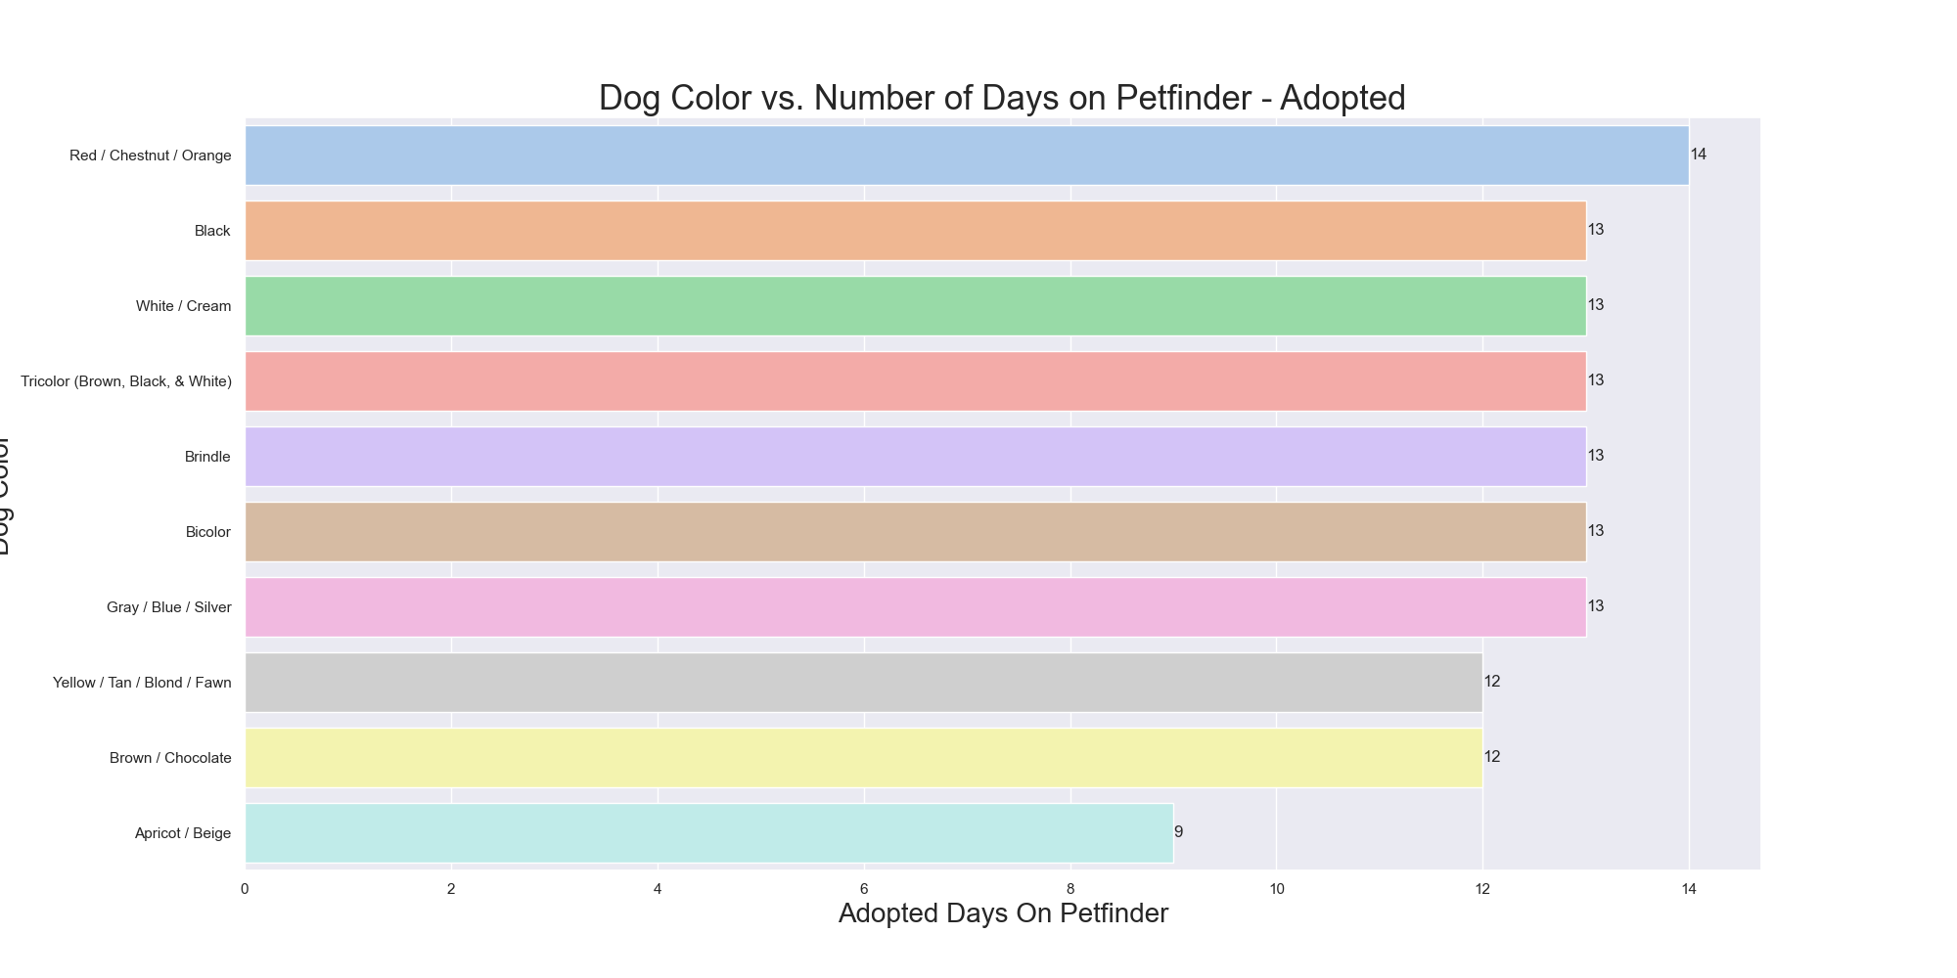
Analysis - Color
Key Insights:
In both adoptable and adopted dogs, Black dogs are not listed substantially longer than other colors
Notes:
Alyssa

Slide 10
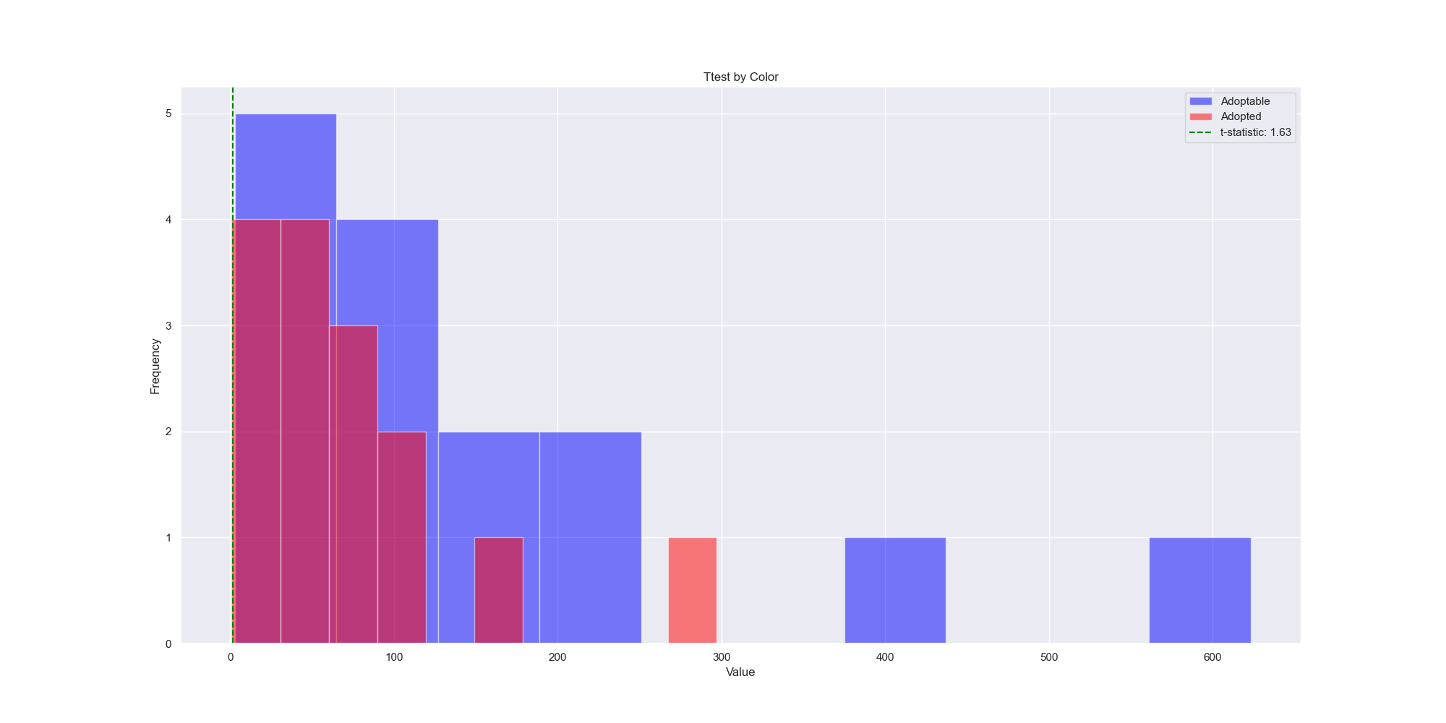
Analysis - Color
Key Insights:
In the findings of the ttest, the pvalue is .11 which is over .05 showing us that in the distribution of colors in adoptable vs. already adopted dogs, these populations are statistically different.
Notes:
Luke

Slide 11
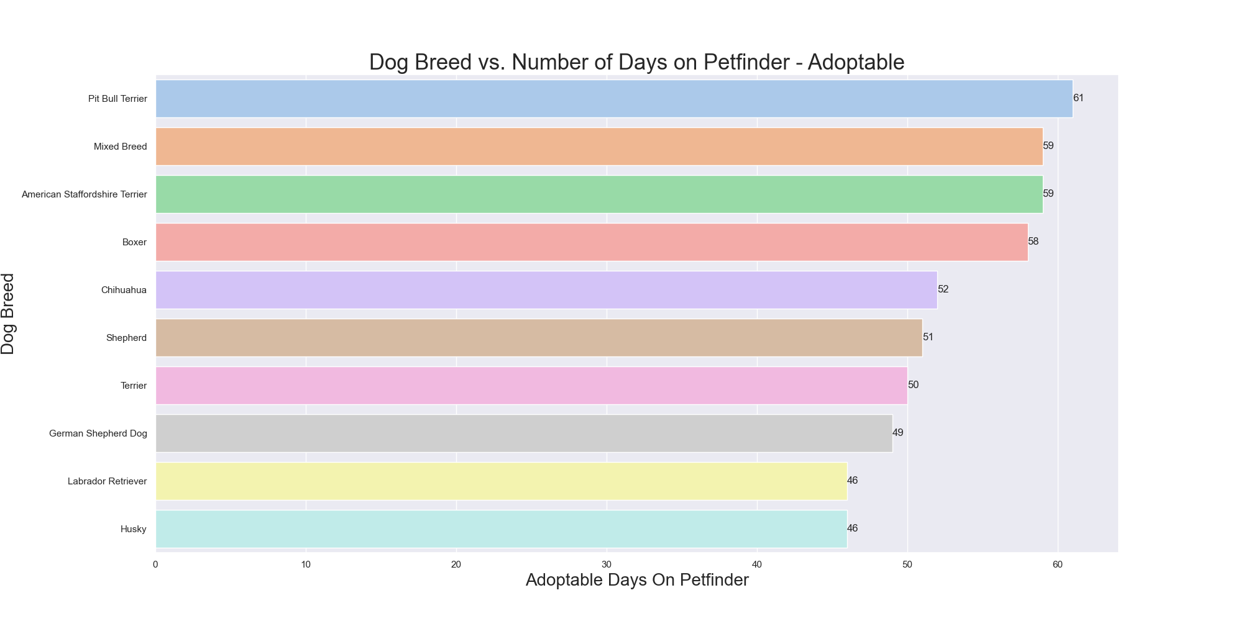
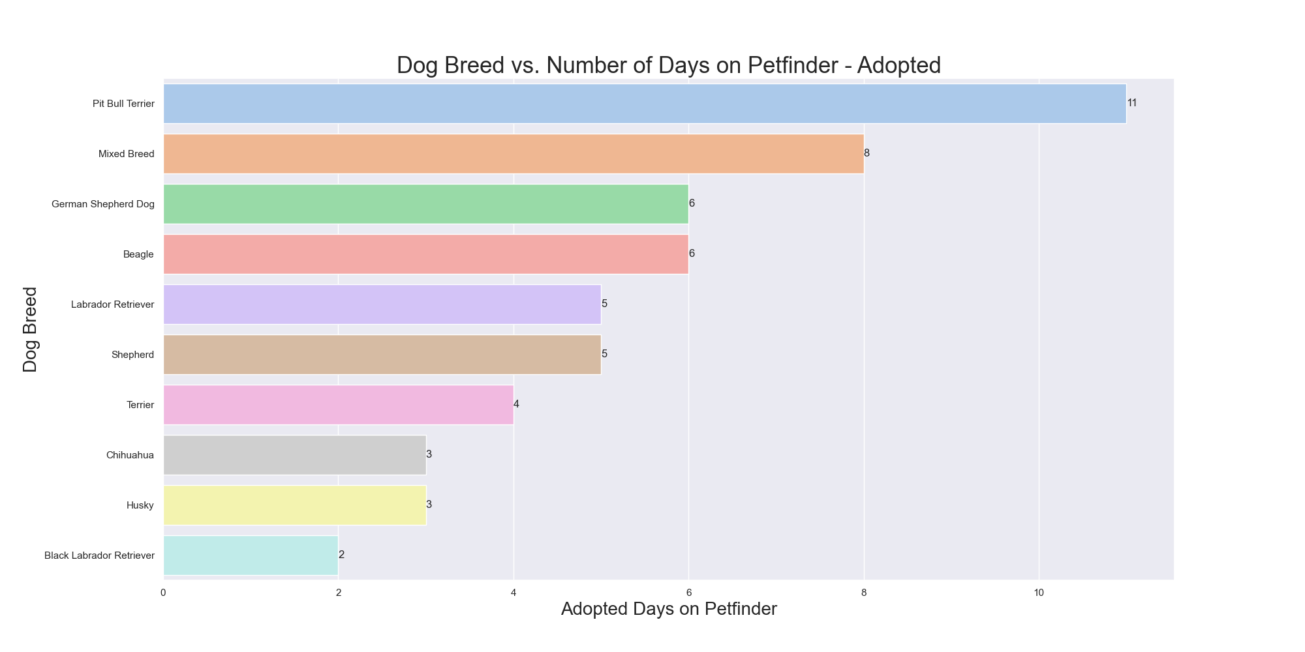
Analysis - Breed
Key Insights:
In both our adoptable and already adopted dog populations, Pitbulls take the longest to find a home
Notes:
Shubhangi

Slide 12
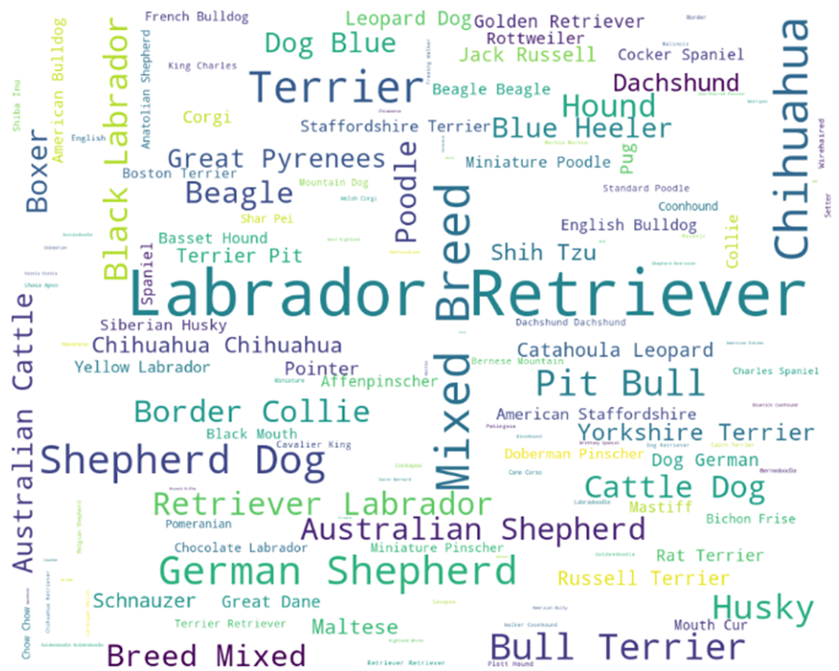
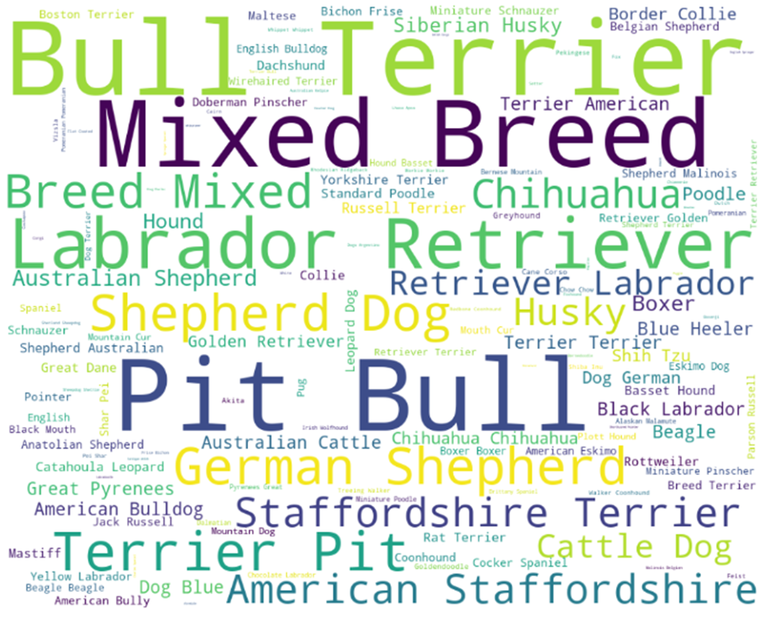
Analysis - Breed
Adopted
Adoptable
Key Insights:
While Pitbulls are the most frequently available dogs for adoption, the Labrador Retriever is the most frequently adopted dog, highlighting the difference in breed preferences
Notes:
Shubhangi

Slide 13
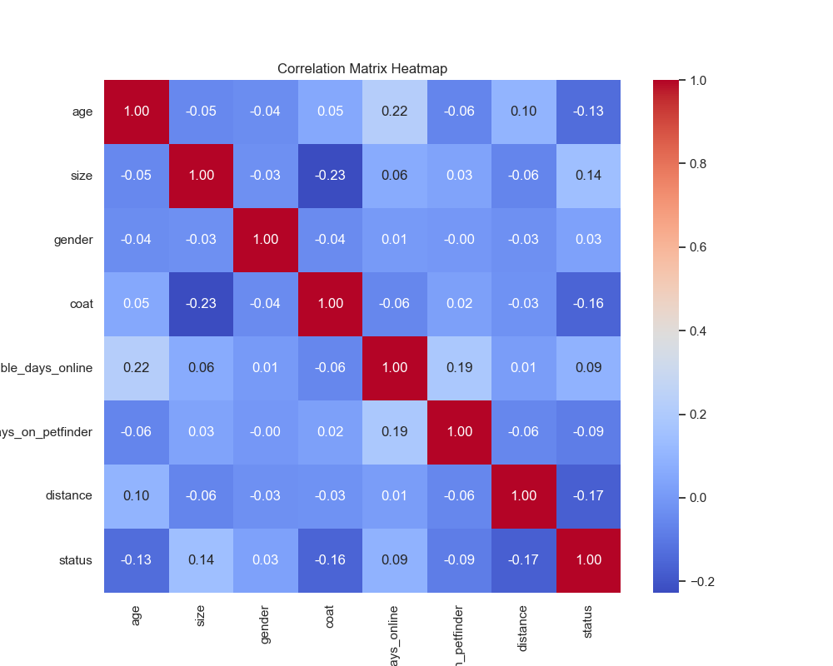
Correlation Matrix
Key Insights:
In a correlation heatmap, the color intensity represents the strength and direction of the correlation between two variables.
Correlation values typically range from -1 to 1.
A positive correlation (closer to 1) warmer colors, such as red.
A negative correlation (closer to -1) cooler colors, such as blue.
No correlation (closer to 0) neutral color.
Notes:
Shubhangi

Slide 14
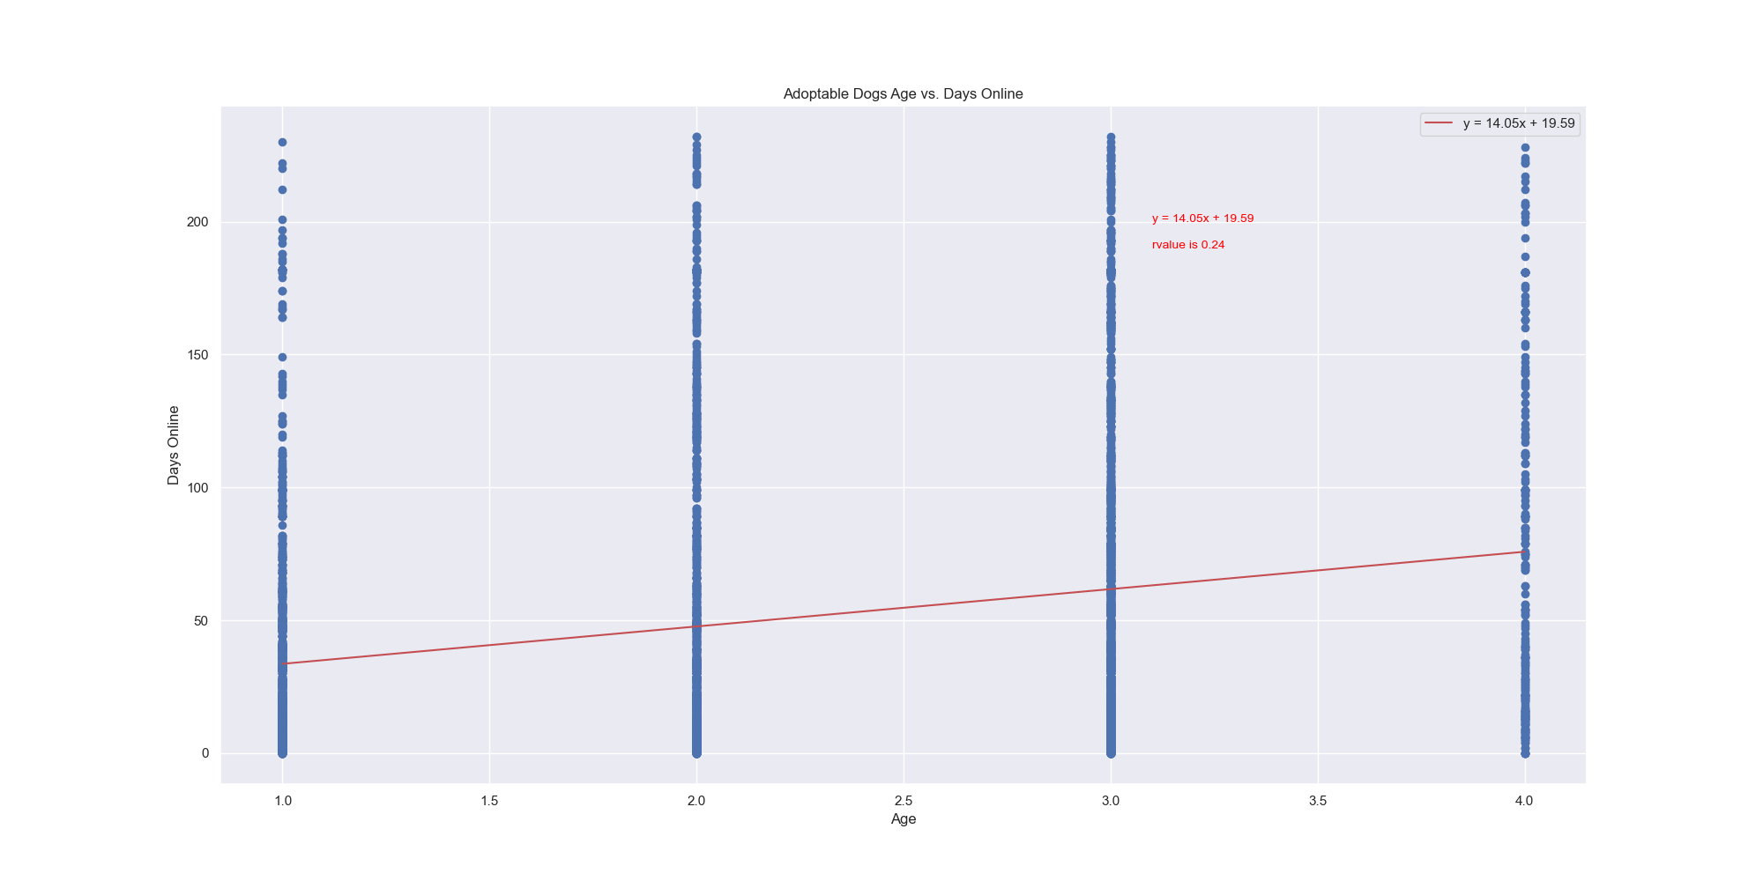
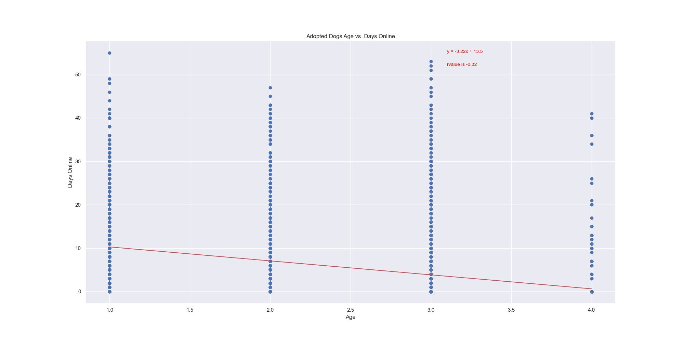
Analysis - Age
Key Insights:
We are getting mixed results for the correlation between age and days online prior to adoption with the adoptable dog population having a positive correlation of .24 and adopted dogs having a negative correlation of -.32. This looks to be due to more senior dogs getting adopted faster in the adopted population.
Notes:
Stephanie

Slide 15
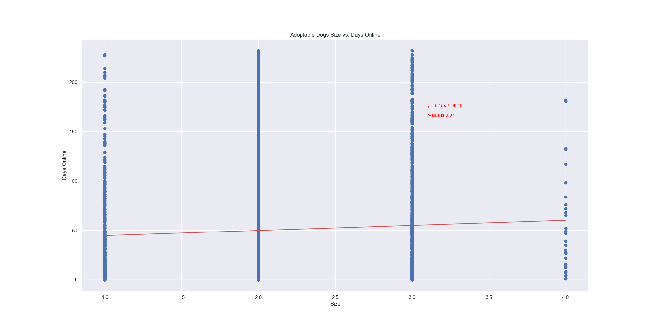
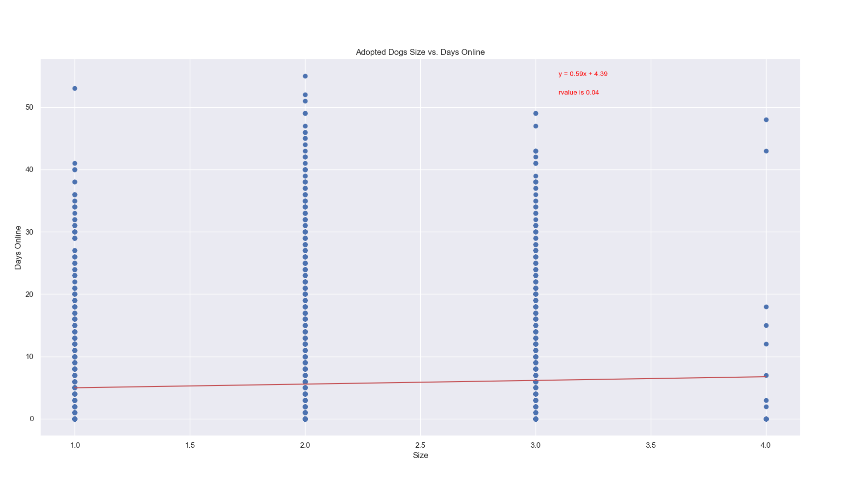
Analysis - Size
Key Insights:
For size of the dogs, we are seeing a slight positive correlation of larger size dogs being available longer prior to adoption. The correlation coefficients are .07 in the adoptable population and .04 in the population that has already been adopted.
Notes:
Stephanie

Slide 16
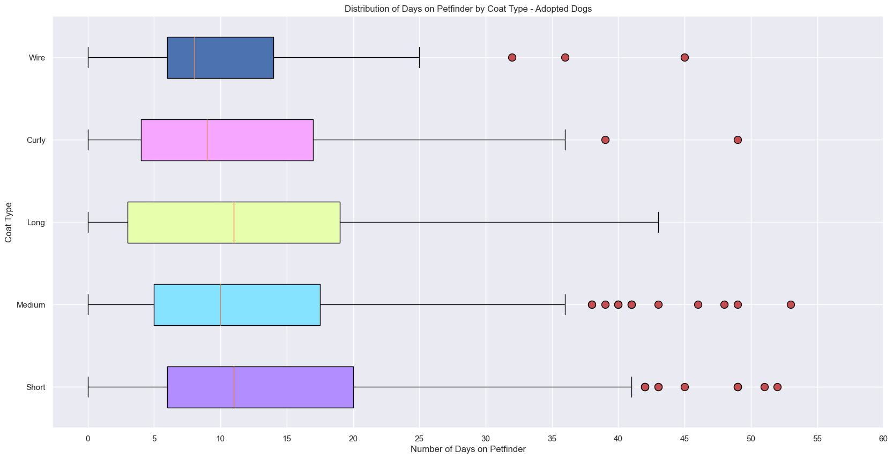
Analysis - Coat
Key Insights:
The majority of the data is more closely distributed with a relatively small number of outliers
Notes:
Alyssa

Slide 17
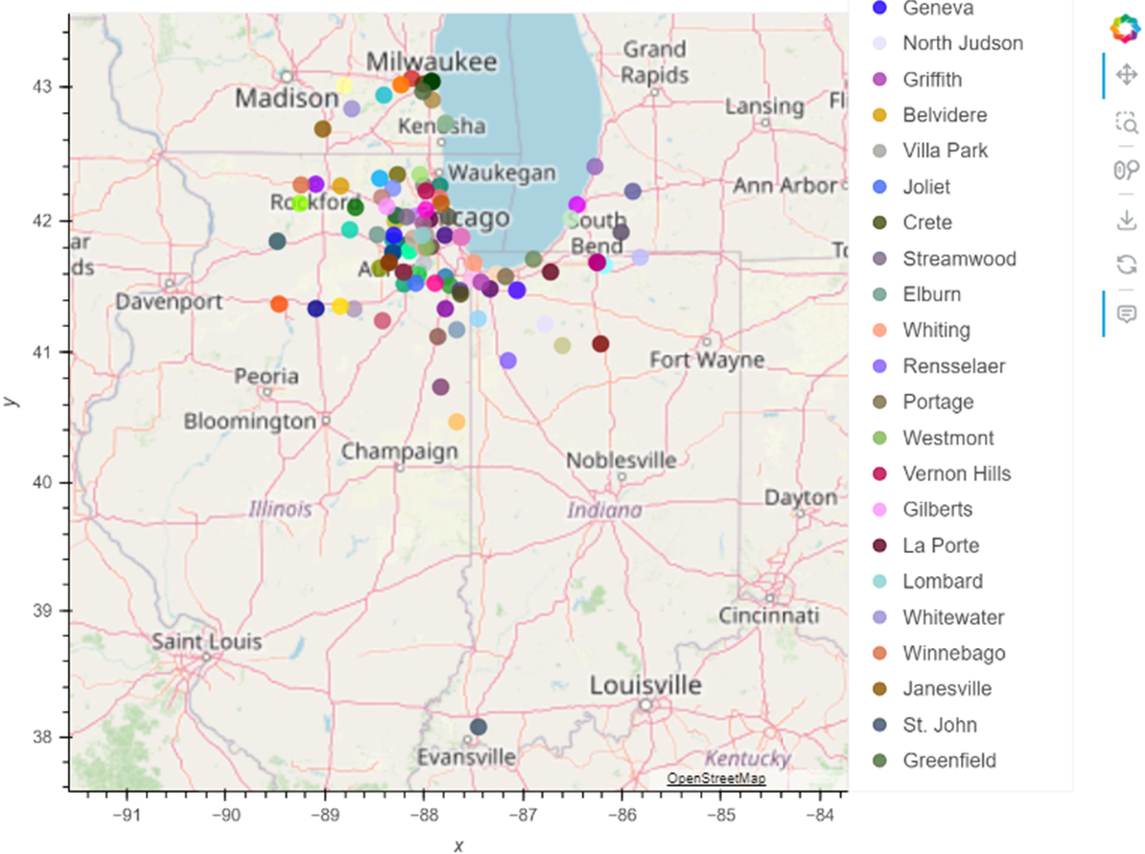
Analysis - Location
Key Insights:
This map shows the location of where the shelters in the dataset are located
Notes:
Valeria

Slide 18
Challenges
Calculating the number of days on petfinder/adoptable days online
There is no defined specification for age or breed size.
Inconsistency of breed identification by the shelter.
Analyzing categorical data vs. numerical
Notes:
Shubhangi

Slide 19
Ideas for Future Work
Analyze the data by:
Location
Adoption fee
Disability
Animal type/species
Notes:
Alyssa

Slide 20
