Slide 1


App Update Review(Instagram)
Stephon Mensah

Slide 2
Introduction
Motivation:
Understanding user needs and concerns can significantly impact an app's functionality and user satisfaction.
Analyzing social media platforms like Instagram, which undergo frequent updates, provides insights into how well these updates align with user expectations.
Problem aimed to solve:
To evaluate the alignment between user reviews and app updates, especially focusing on issues and feature requests mentioned by users.
To determine if updates are effectively addressing user concerns and improving overall user experience.

Slide 3
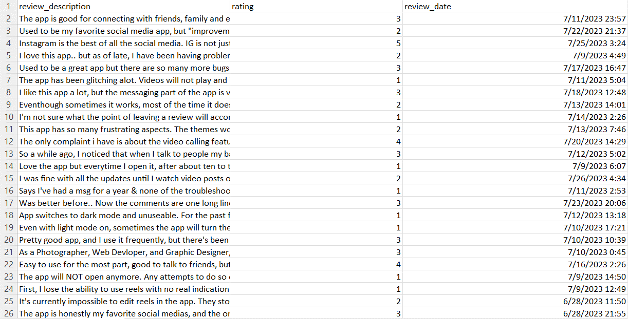
DataSET
User reviews of Instagram from Google Play Store and App Store (via Kaggle.com)

Slide 4

Techniques
Named Entity Recognition (NER):
Utilizing spaCy NLP library for entity extraction.
Sentiment Analysis:
Using NLTK's Sentiment Intensity Analyzer to classify the sentiment of reviews(Positive or Negative)
Text Vectorization (TF-IDF Vectorizer):
used to convert text data into numerical format so that machine learning algorithms can process it
Support Vector Machine (SVM) Analysis:
Employing SVM for classification of sentiment.
Notes:
spaCy NLP Library:
spaCy is an advanced Natural Language Processing (NLP) library designed for performing complex and sophisticated linguistic tasks. It's known for its speed and ability to handle large volumes of text efficiently.
NLTK (Natural Language Toolkit):
NLTK is a versatile and widely-used library in Python that provides tools for working with human language data (text). It's commonly used for research, education, and prototyping in NLP.
Support Vector Machine (SVM):
SVM is a powerful machine learning algorithm used for both classification and regression tasks. It's particularly useful for handling complex and high-dimensional data, working by finding the optimal boundary (or hyperplane) that separates different classes of data.

Slide 5
Implementation
Data Preprocessing:
Extracted and cleaned Instagram user reviews
Applied Text Normalization and filtering to enhance data quality
KeyWords = ['update', 'fix', 'bug', 'issue', 'crash', 'glitch', 'improve', 'patch', 'version']
Named Entity Recognition (ner):
Extracted key features and issues mentioned by users.
Sentiment Analysis:
Classified reviews as positive or negative based on sentiment scores.
Support Vector Machine (Svm) analysis:
Applied SVM for review classification
Notes:
# Define keywords related to updates and fixes

Slide 6
Evaluation Plan
Evaluation Metrics:
Alignment Score: Determine how many issues or features mentioned in reviews have corresponding mentions in subsequent change-logs.
User Satisfaction Post Update: Analyze the message of the reviews after the update to gauge if user sentiment improved, confirming that the updates addressed concerns.
SVM Model Performance Metrics:
Accuracy, Precision, Recall, F1-Score

Slide 7
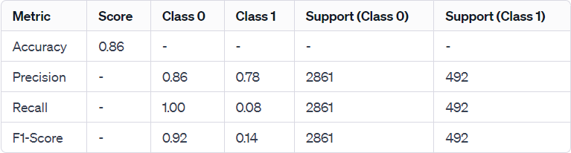
Evaluation
Class 0 (Negative Class): Reviews with 1, 2, or 3 star ratings
Class 1 (Positive class), Reviews with 4 or 5 star ratings
Notes:
"Accuracy" represents the overall accuracy of the SVM model.
"Precision" for each class indicates how many of the identified samples were actually relevant.
"Recall" shows how many relevant samples were identified correctly.
"F1-Score" is the harmonic mean of precision and recall.
"Support" indicates the number of actual occurrences of each class in the specified dataset.
The support numbers indicate that the dataset used for testing is imbalanced, with a larger number of negative reviews compared to positive ones.

Slide 8
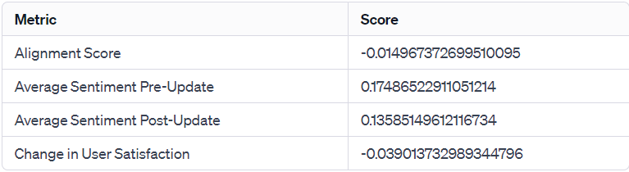
Evaluation
1. Alignment Score: less reported issues or different focus areas in post-update reviews
2. Average Sentiment Pre-Update: most reviews were negative
3. Average Sentiment Post-Update: increase in negative reviews
4. Change in User Satisfaction: user satisfaction worsened following the update
Notes:
Alignment Score (-0.014967372699510095): This score decreased slightly after the update. It means there were fewer mentions of updates and fixes in reviews, suggesting either less reported issues or different focus areas in post-update reviews.
Average Sentiment Pre-Update (0.17486522911051214): This number indicates that before the update, most reviews were negative.
Average Sentiment Post-Update (0.13585149612116734): After the update, the sentiment score is even lower than before, showing an increase in negative reviews.
Change in User Satisfaction (-0.039013732989344796): This drop implies that overall user satisfaction worsened following the update.
1 and 3 kind of contradict. while the update may have resolved certain issues (as indicated by the decrease in specific keyword mentions), it seems to have introduced new problems or failed to meet user expectations in other ways, resulting in a net decrease in satisfaction.

Slide 9
Improvements for future
Use multiple specific significant update dates and compare the pre and post sentiments and reviews for all of them
Sample a larger set of the Dataset

Slide 10

Questions?

