Slide 1
Introduction to bulk RNA-seq analysis
Monash Malaysia workshop
December 2026
Stephanie Studniberg
Postdoctoral Research Fellow (Hansen lab)
Monash Biomedicine Discovery Institute
stephanie.studniberg@monash.edu

Slide 2
Introductions!

Slide 3
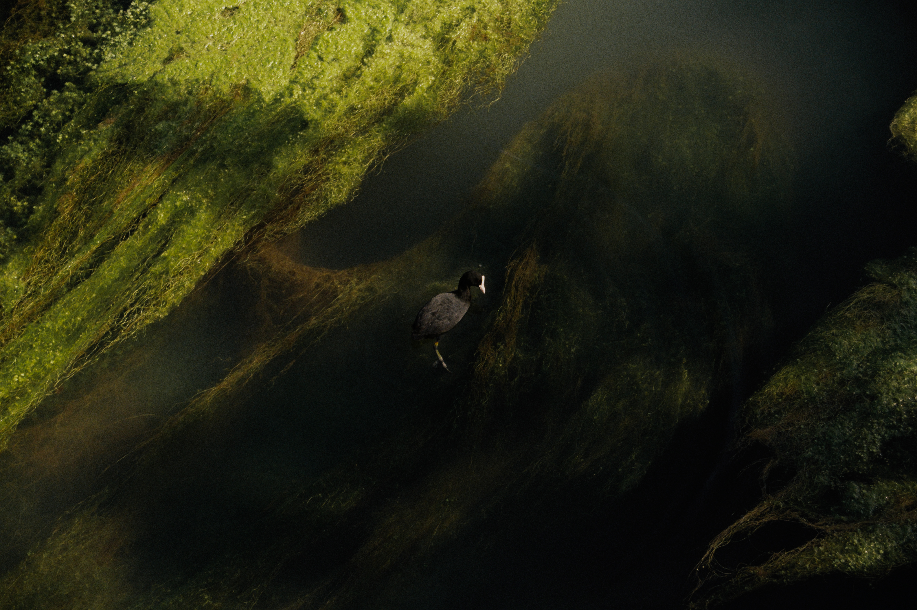
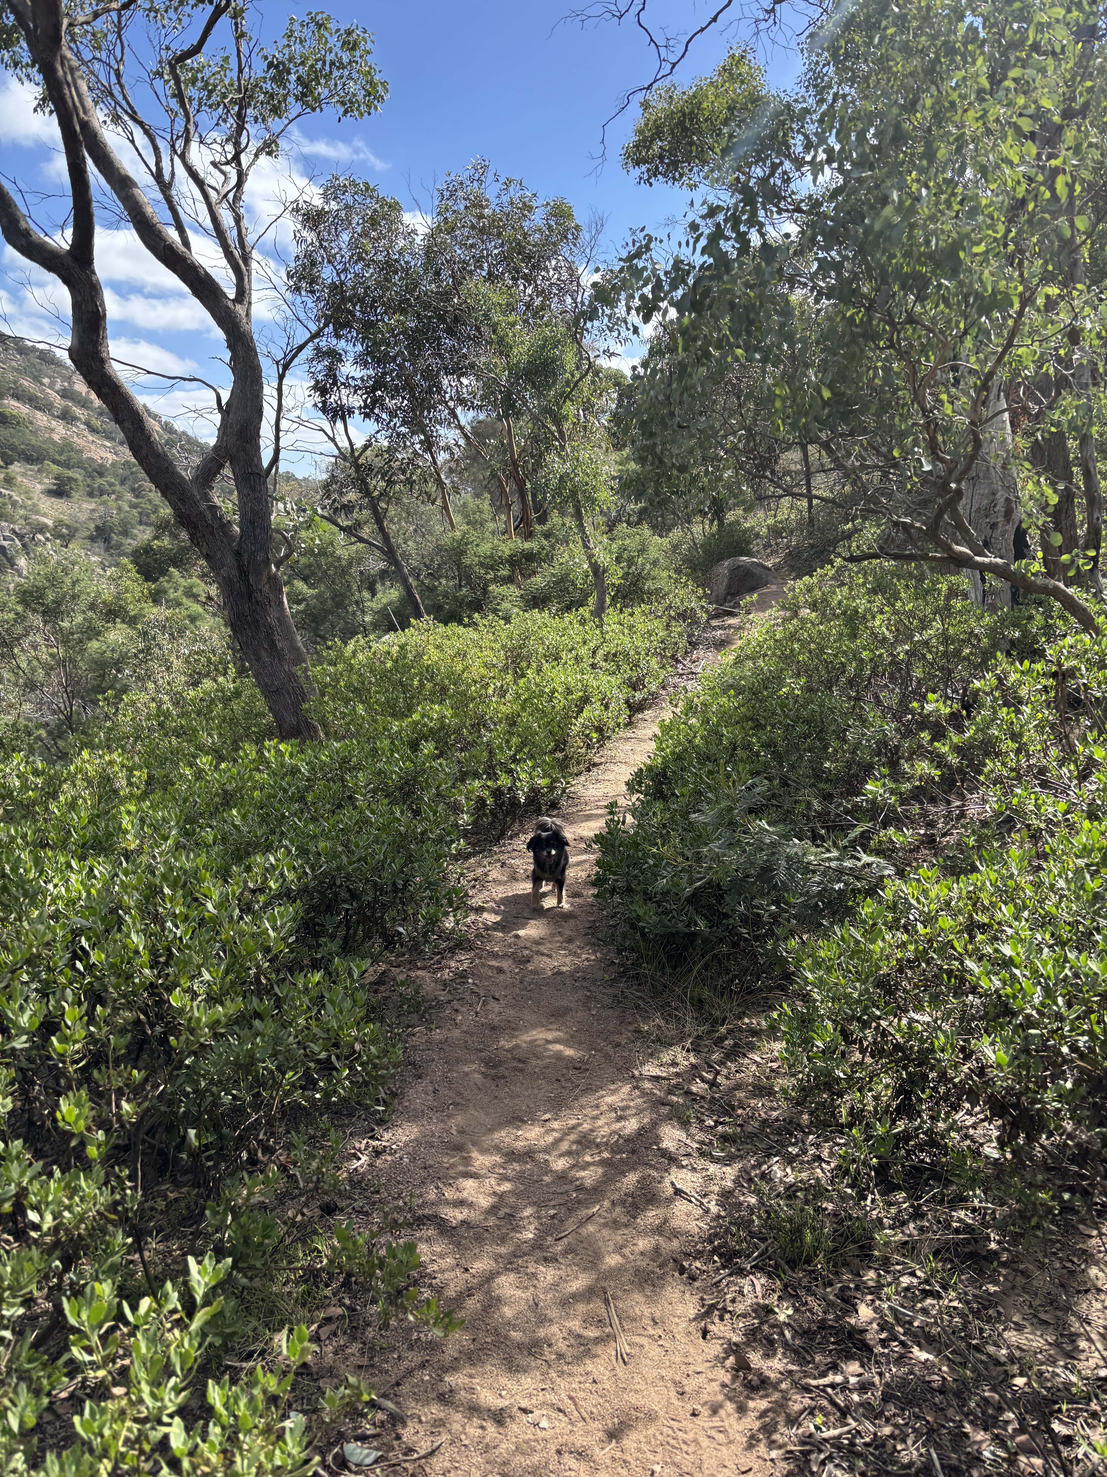
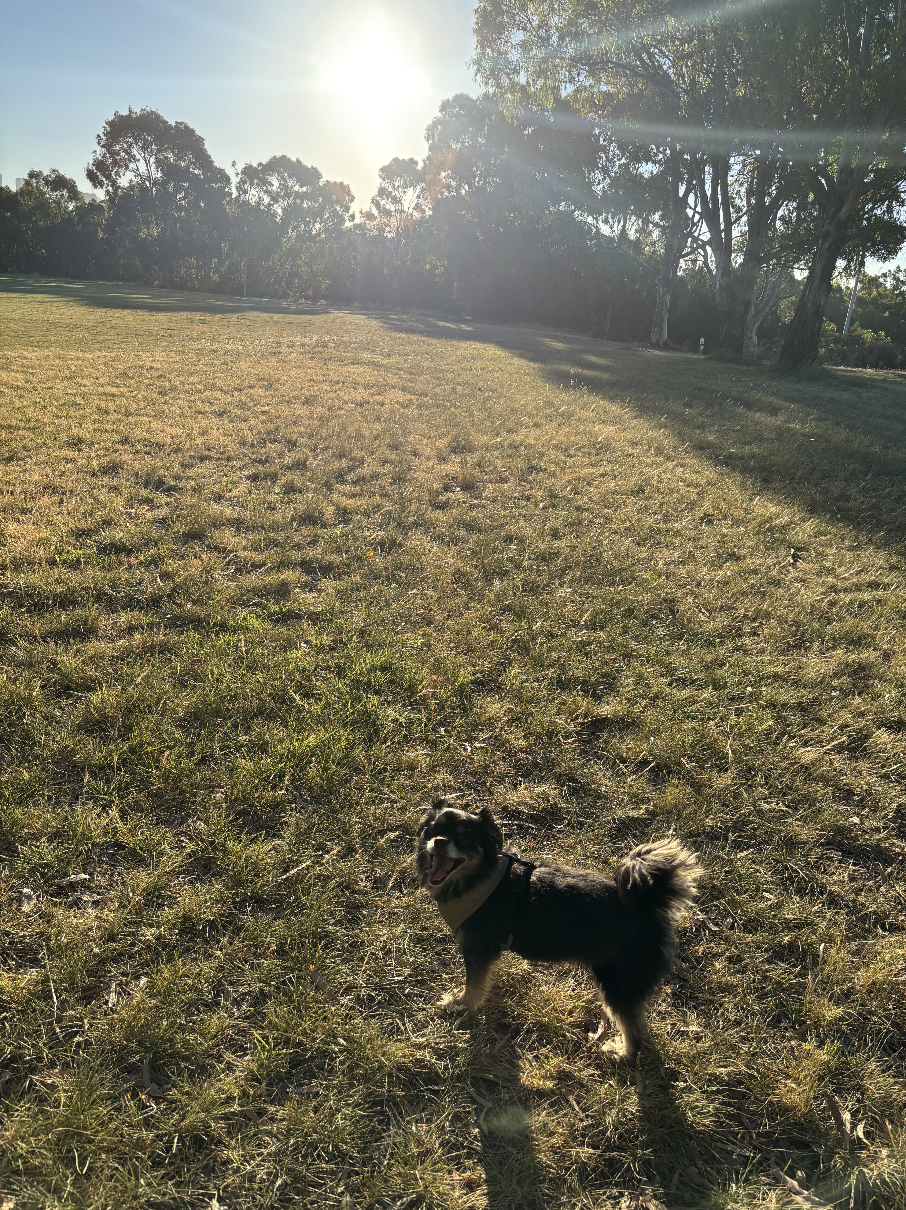
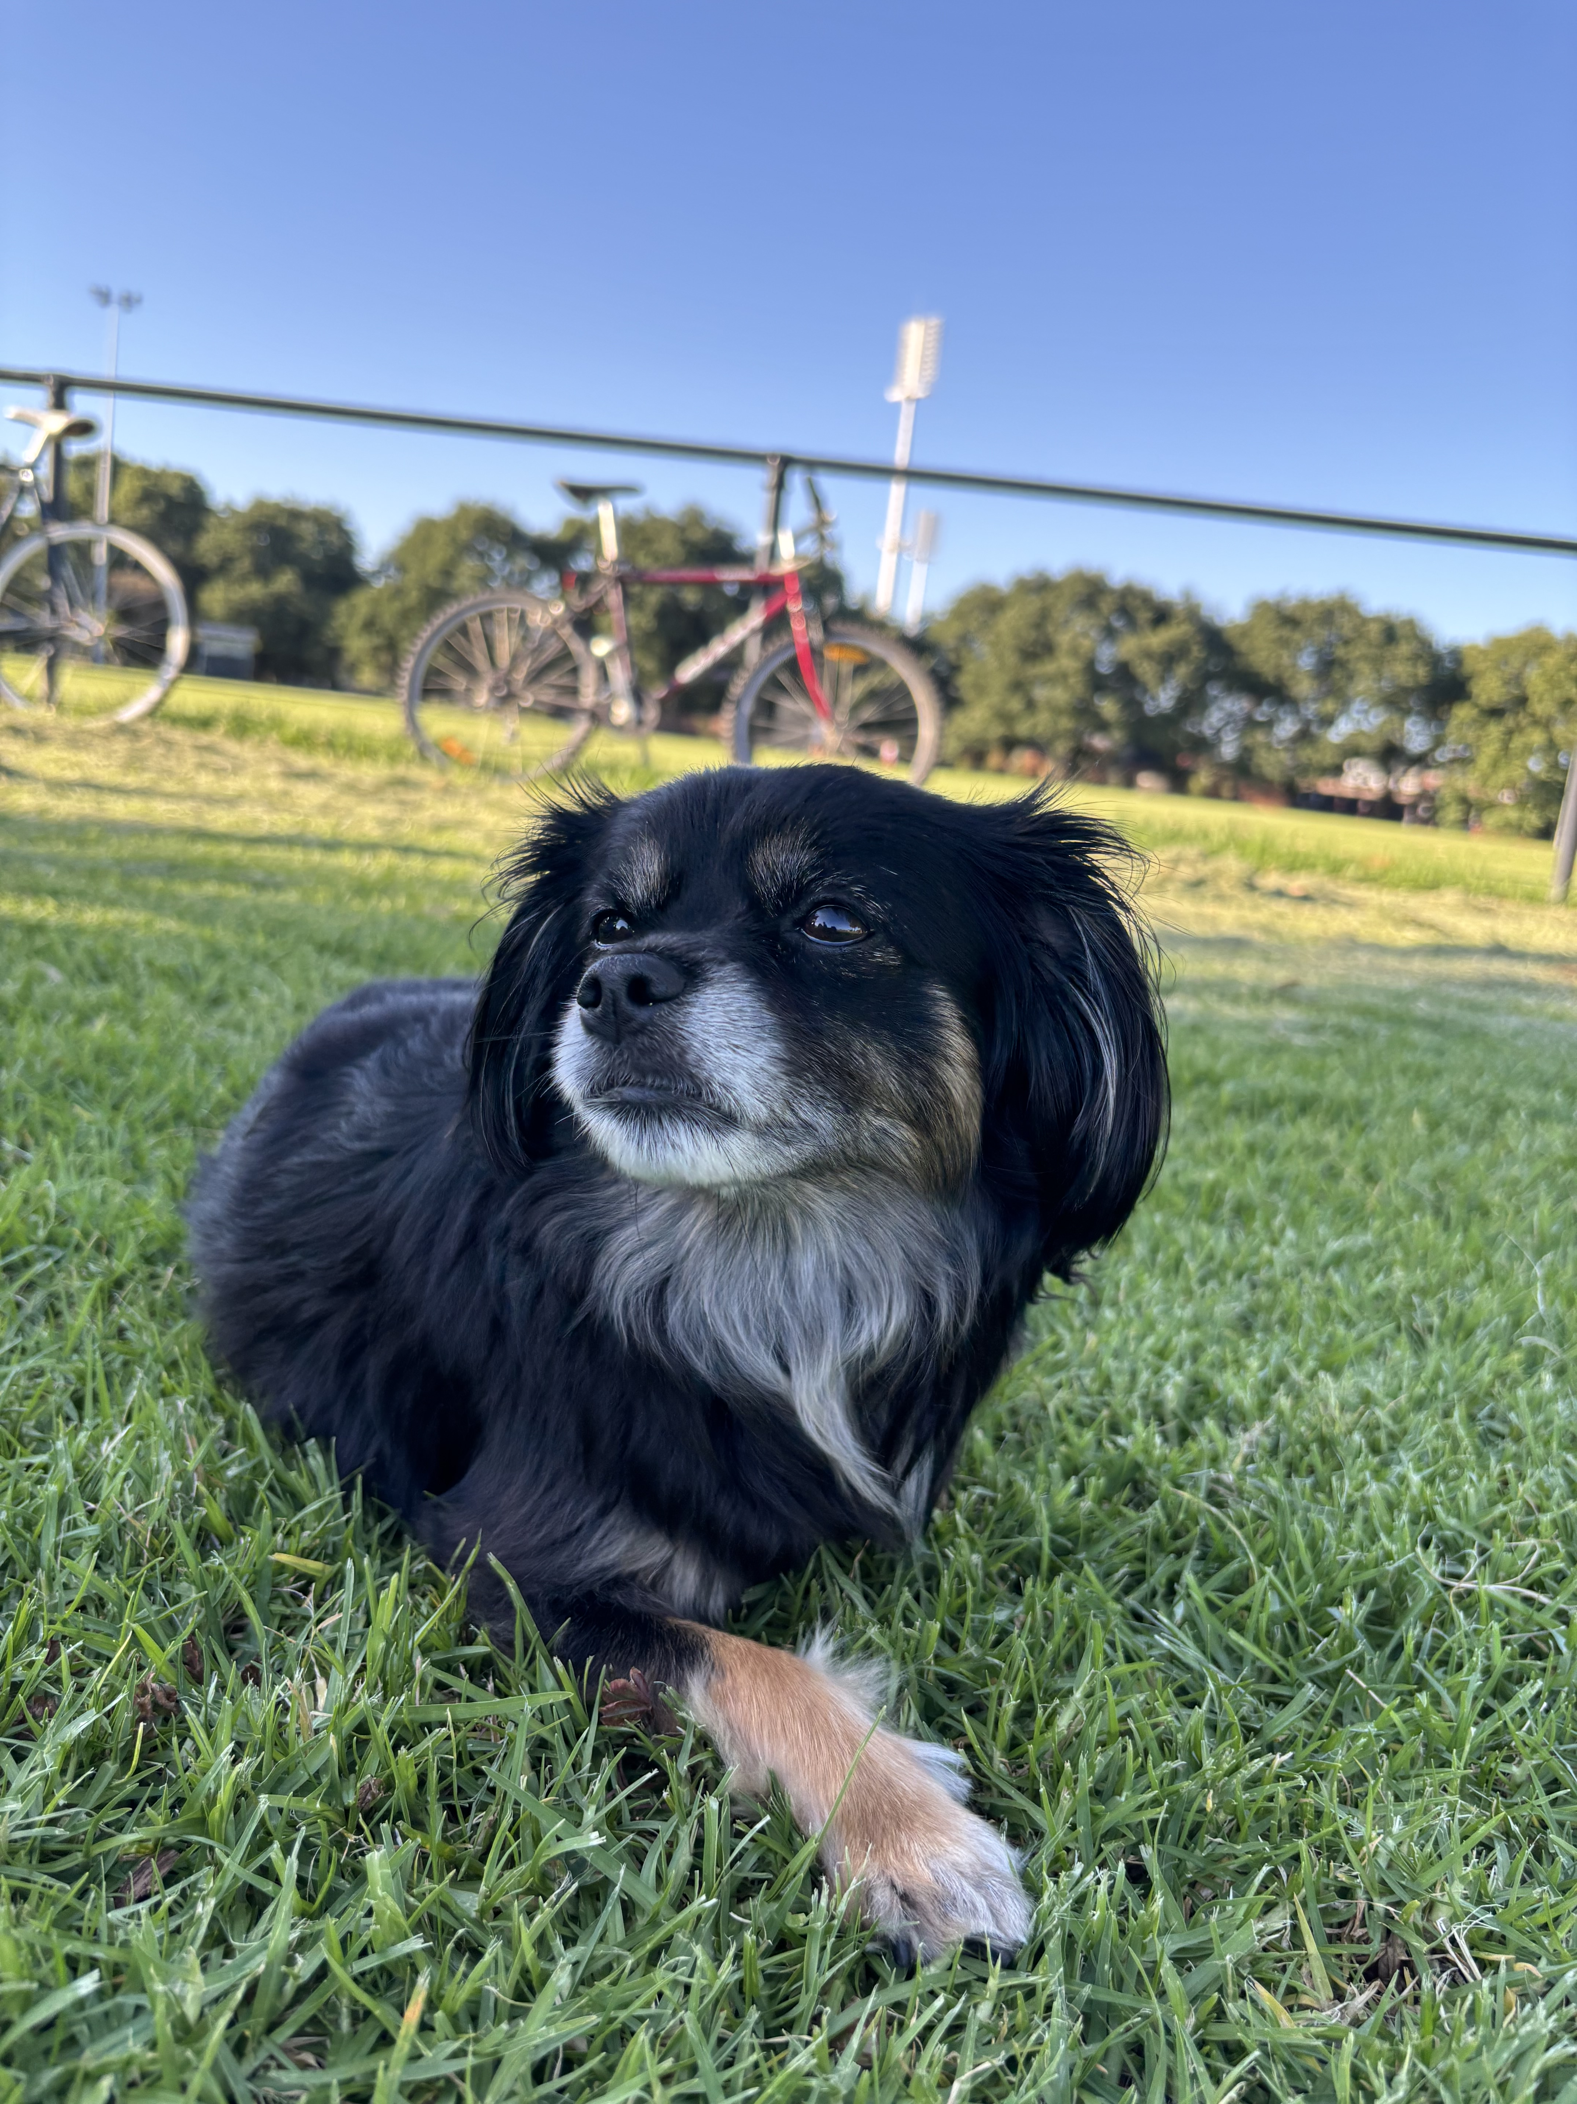

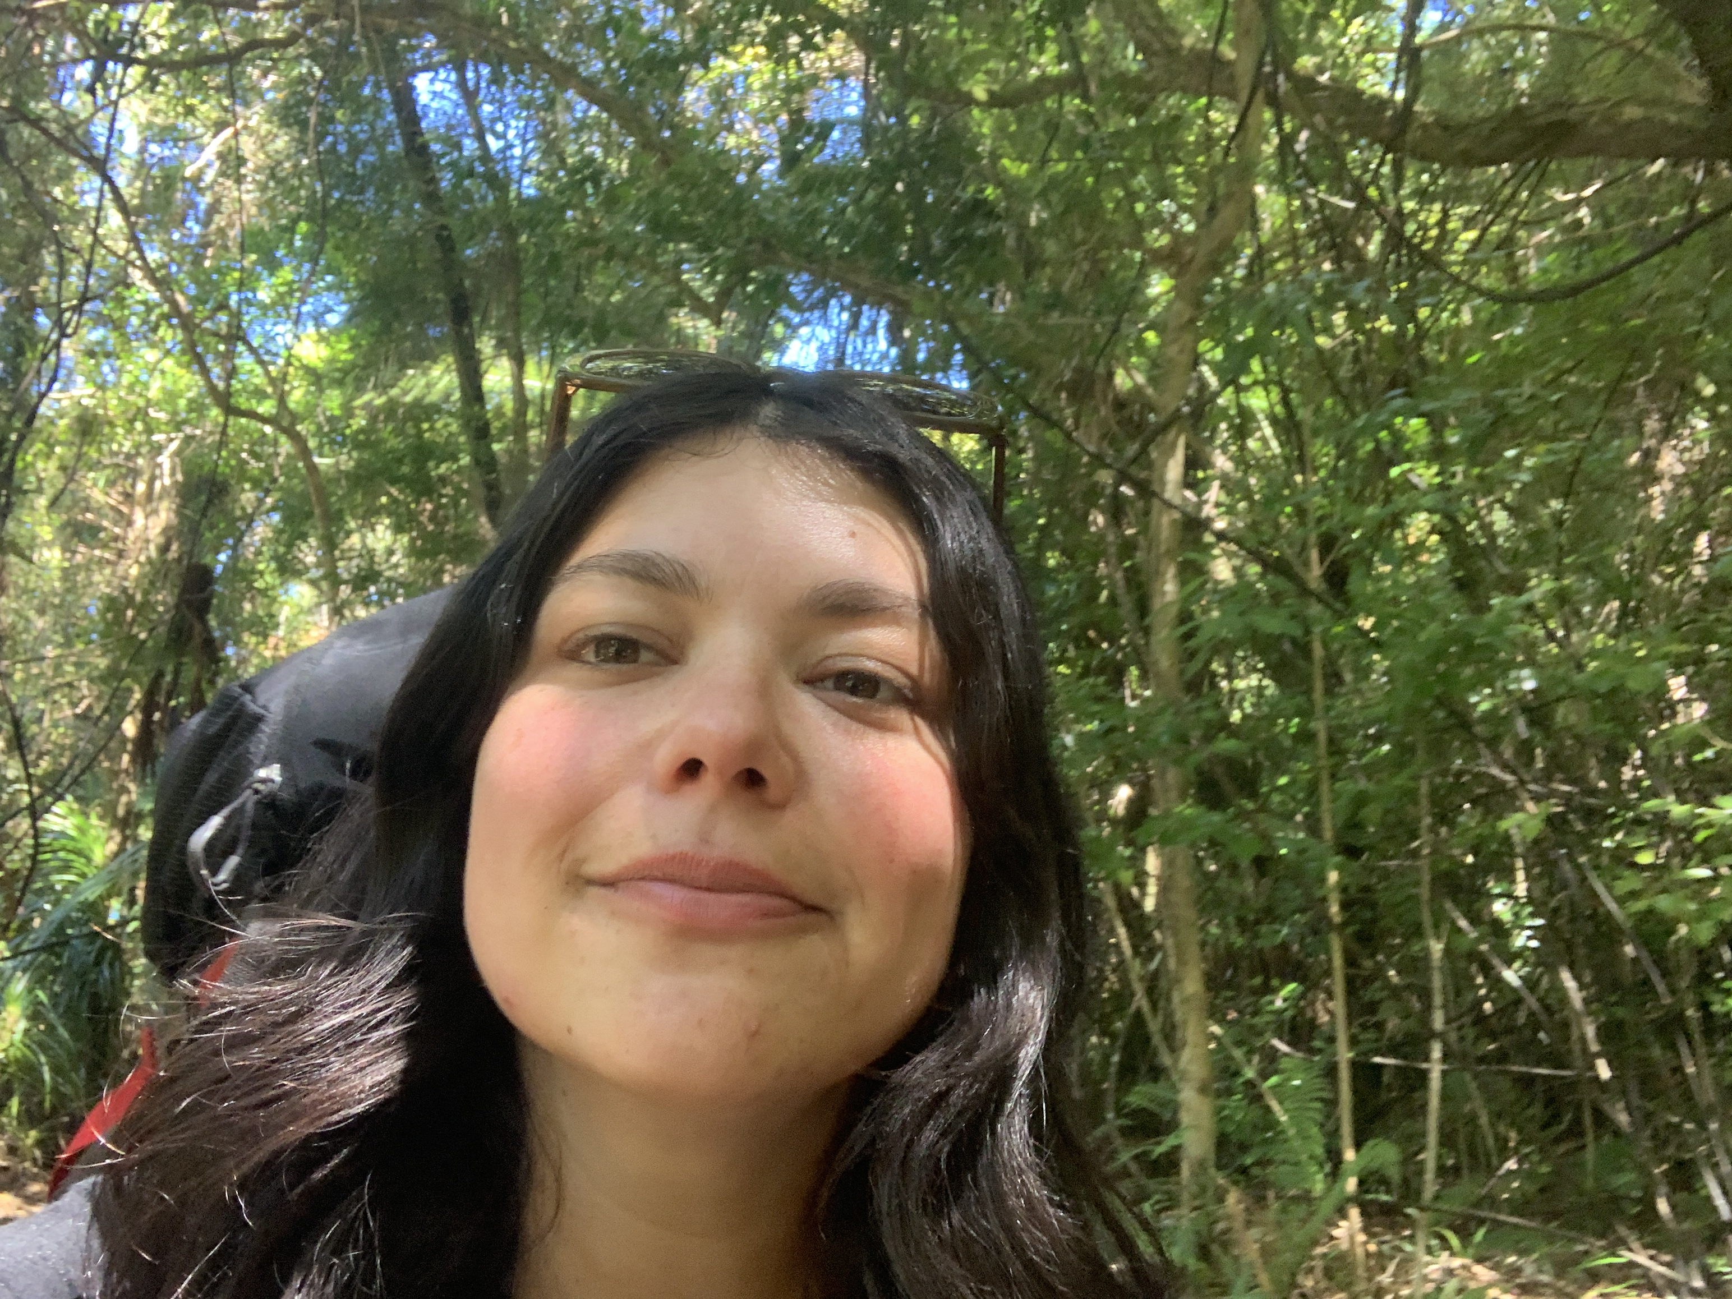
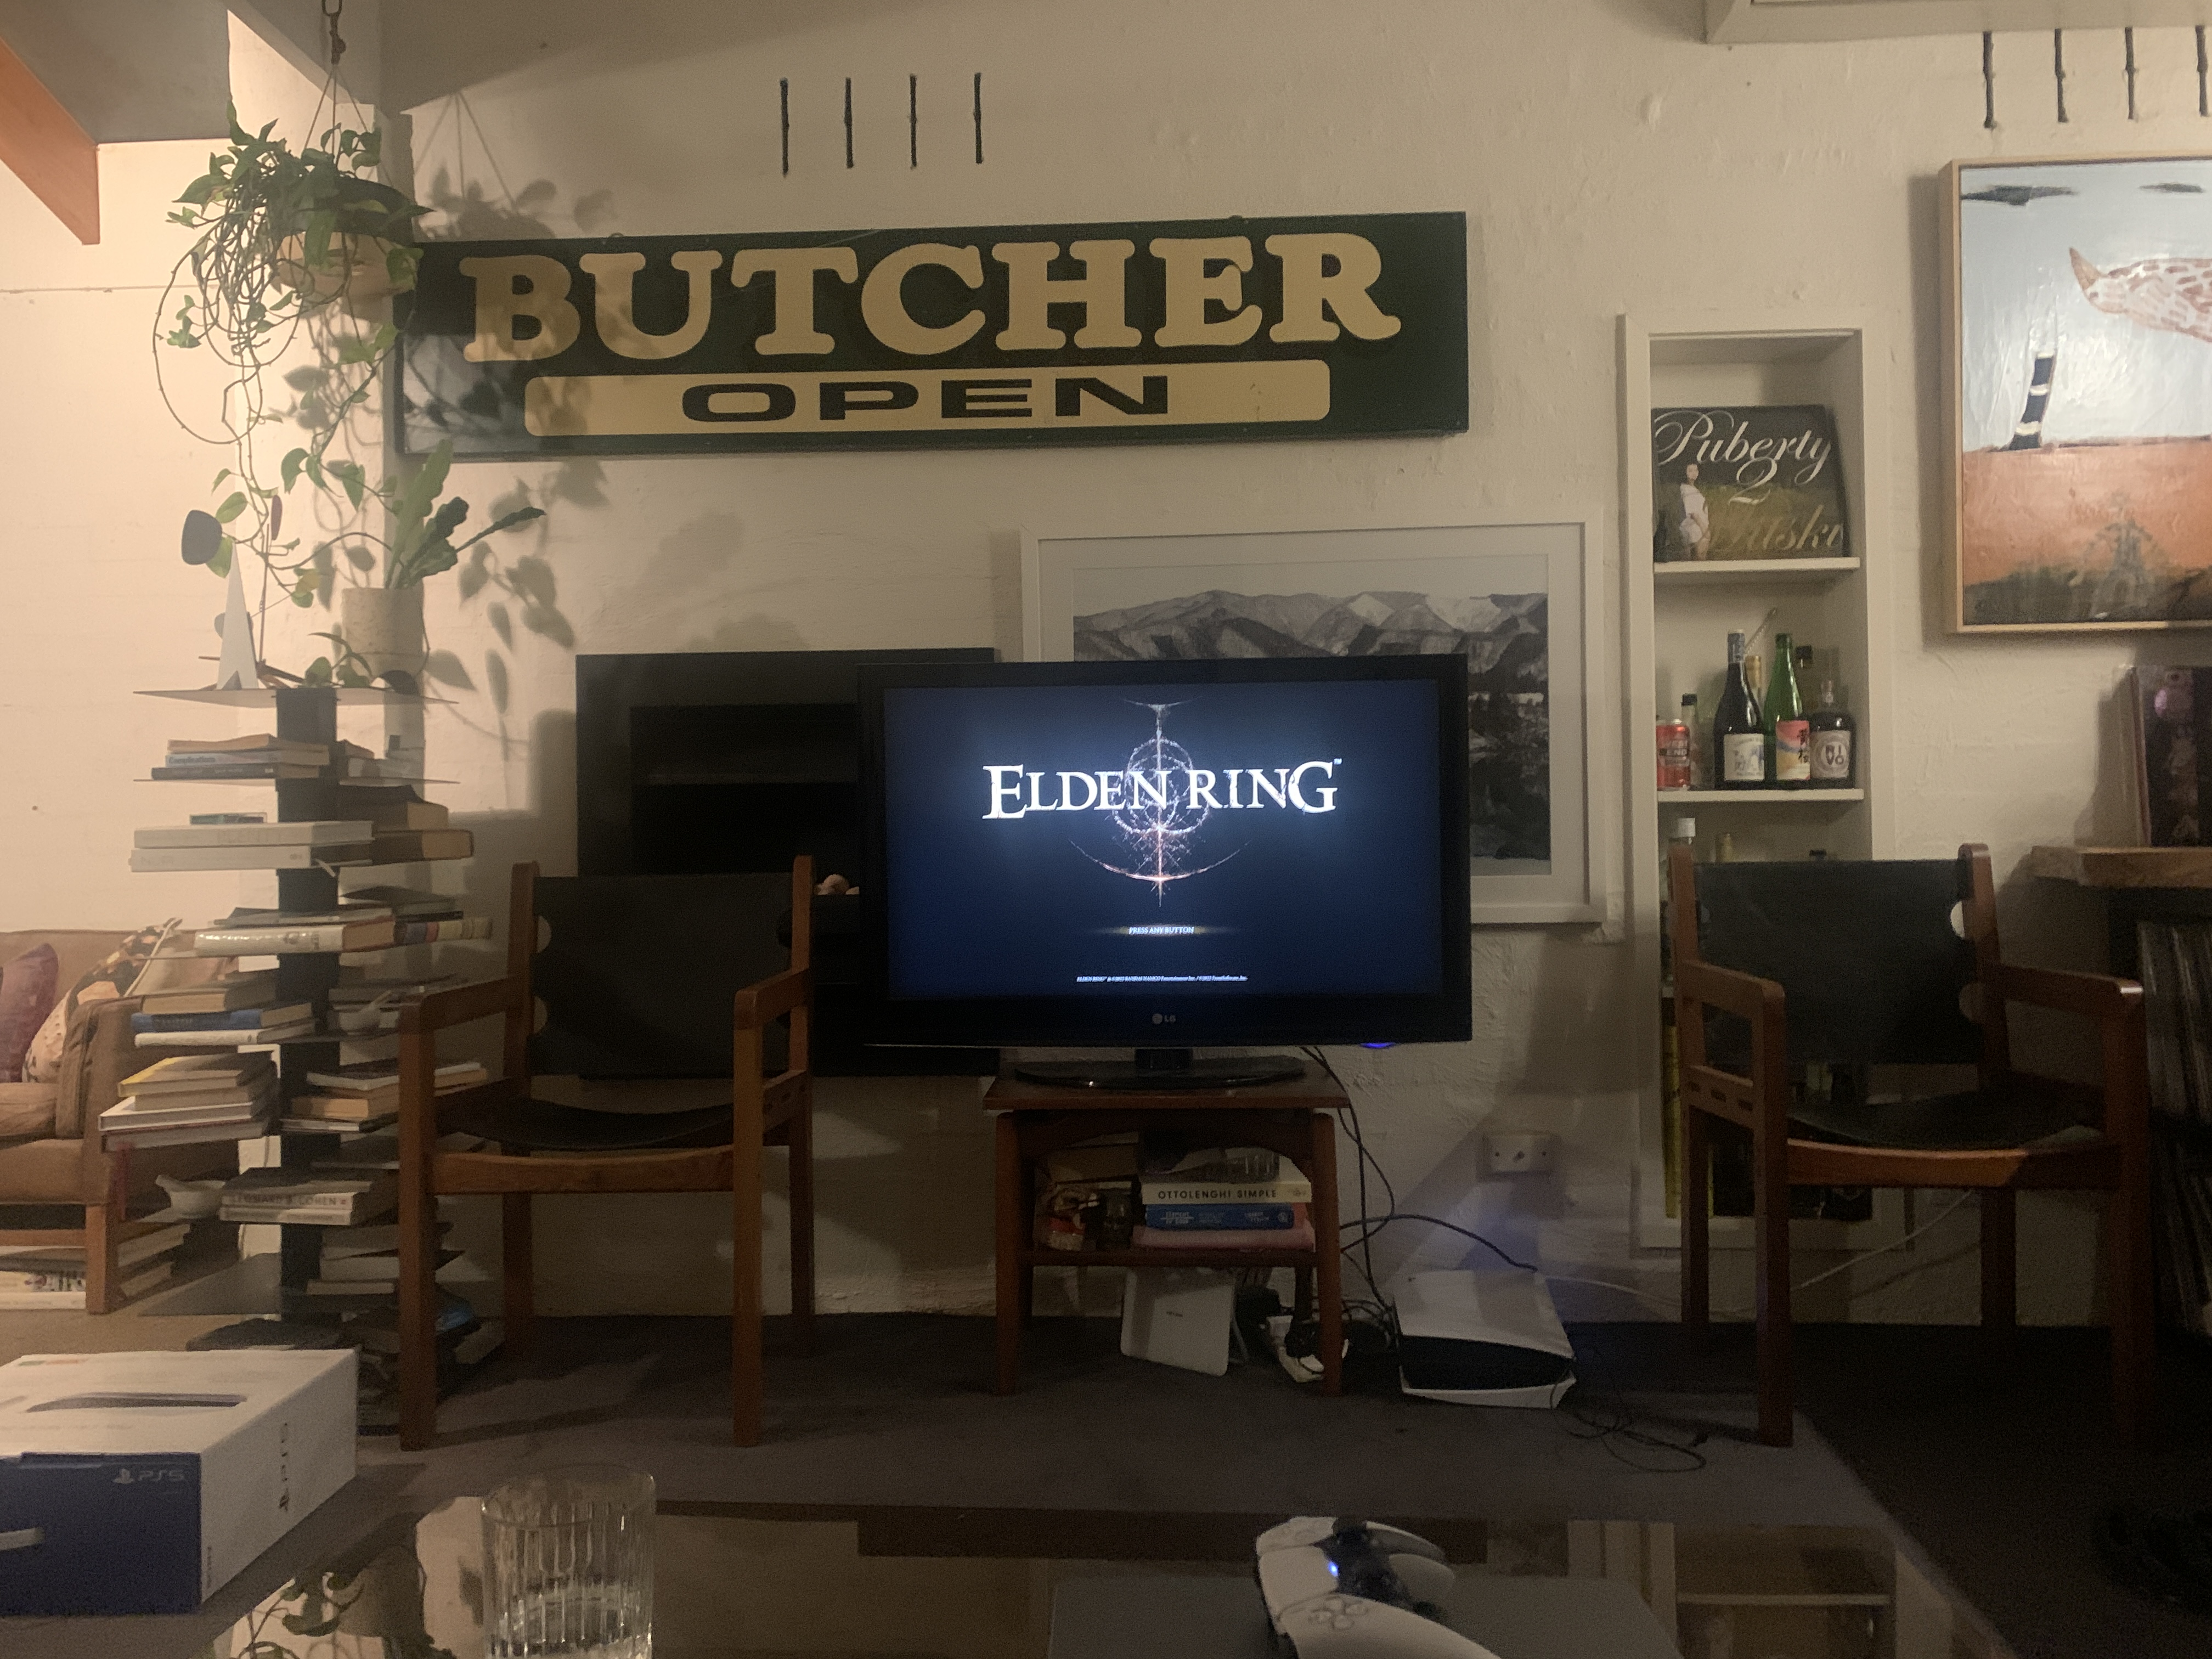




Hi! I’m Steph

Slide 4
Systems immunologist with expertise in transcriptional profiling and data integration to identify mechanisms of susceptibility and immunity to malaria and dengue
Plasmodium parasites are transmitted
by Anopheles mosquitoes
Dengue virus is transmitted
by Aedes mosquitoes

Slide 5
Systems immunologist with expertise in transcriptional profiling and data integration to identify mechanisms of susceptibility and immunity to malaria and dengue
Plasmodium parasites are transmitted
by Anopheles mosquitoes
Dengue virus is transmitted
by Aedes mosquitoes

Slide 7

Workshop scope and learning outcomes

Slide 8
Workshop schedule

