Slide 1
ASSIGNMENT – 9
HOME SECURITY SYSTEM
Connecting PIR sensor and RF receiver
By :- Dixaben Shah (group-4)

Slide 2
Content
Arduino nano
PIR sensor
NRF24L01 RF transreceiver
Pin connection
Pin description
Code
Reference

Slide 3
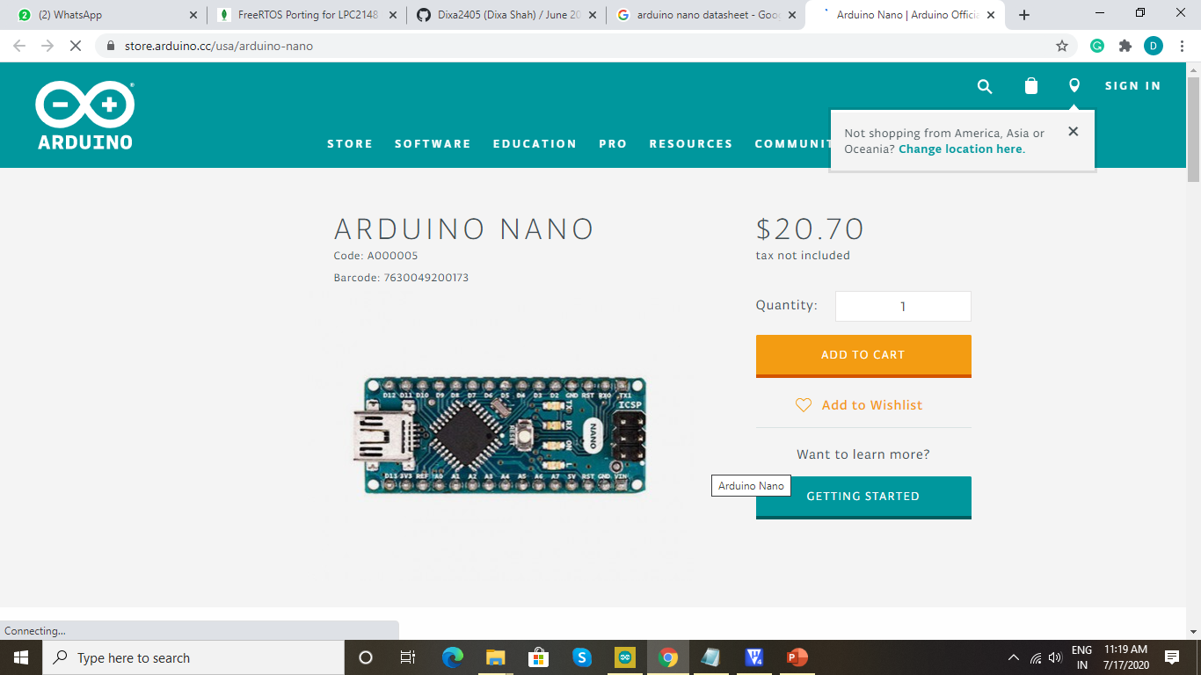
Arduino Nano
ATmega328P – 8 bit microcontroller.
It has 14 digital Pins and 8 Analog pins.
Analog pins used for measuring voltage and function
like analog read.
Digital pin use for interfacing with sensor as input pins.

Slide 4
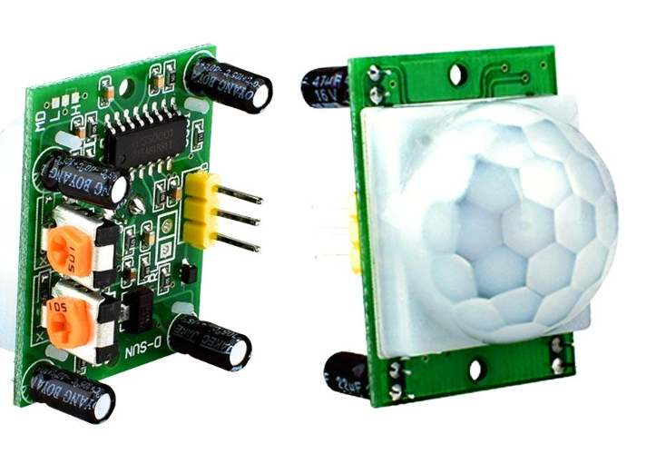
PIR Sensor
Working range: 5M to 12 M.
It has three output pins:
Pin1:GND
Pin 2:Output which gives 3.5V when motion detected.
Pin3:VCC which provides supply voltage to PIR element and internal circuit.
To detects human or animal body movement.

Slide 5
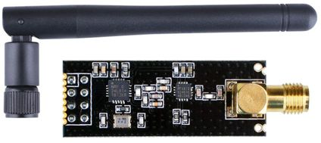
NRF24L01 RF Transceiver
It is a 2.4GHZ transceiver.
Operating voltage: 3.3V.
126 RF channels and common RX and TRX interface.
It operates at a band rate from 250 kbps to 2Mbps.

Slide 6
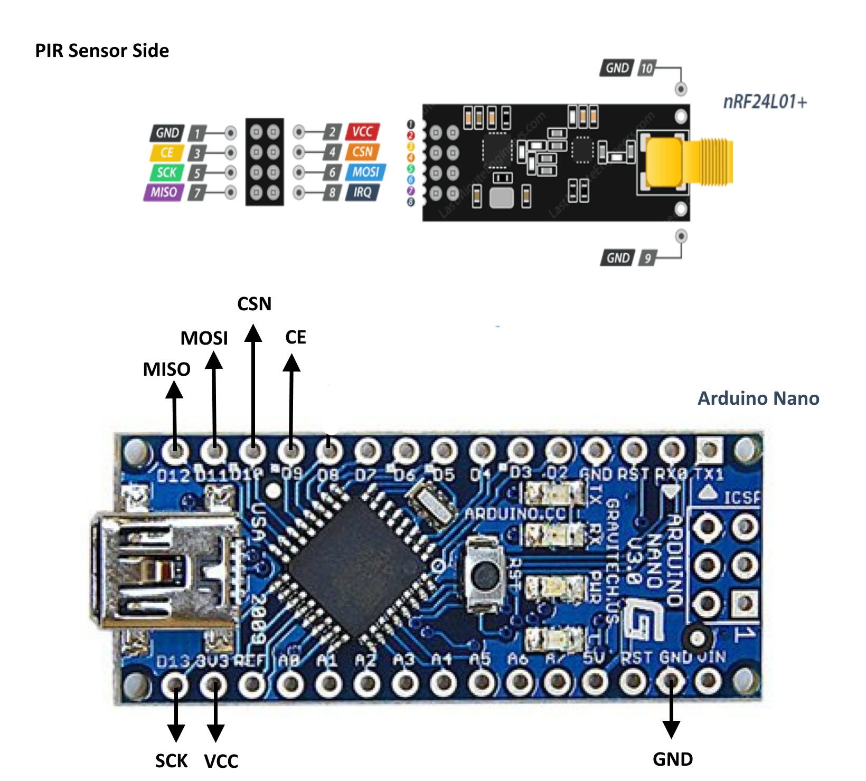
Pin Connection

Slide 7
Pin Description
The output pin of PIR Sensor is connected to digital pin of Arduino nano.
NRF24L01 is connected to Arduino nano through SPI1.
Pin 1 and Pin 2 of NRF24L01 are connected to ground and VCC respectively.
CE and CSN of NRF24L01 have connection with digital pins- 9 & 10.
CSK and MOSI are mounted on pin 13 & 11 of Arduino nano respectively.
Digital pin 12 is used to make connection with MISO.

Slide 8
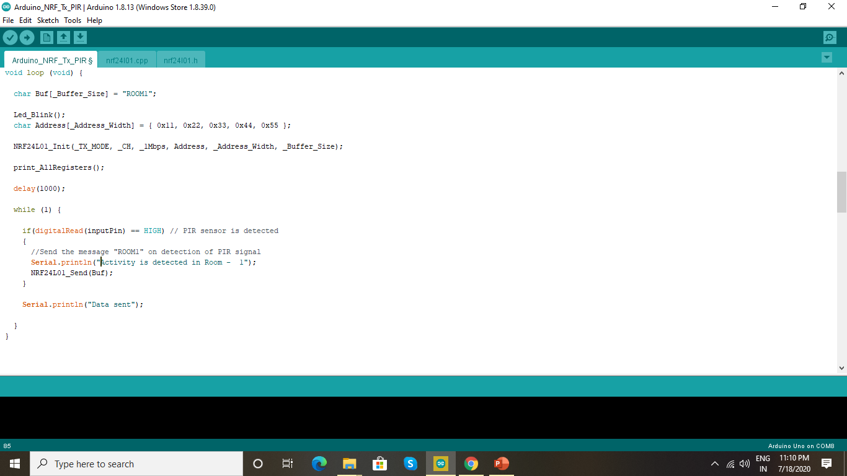
Program output

Slide 9
References
NRF24L01 Single chip 2.4GHZ transceiver specifications. Retrieved from: https://www.sparkfun.com/datasheets/Components/SMD/nRF24L01Pluss_Preliminary_Product_Specification_v1_0.pdf
PIR sensors. Retrieved from: https://www.electronicwings.com/sensors-modules/pir-sensor
Arduino nano. Retrieved from:
https://components101.com/microcontrollers/arduino-nano
Arduino nano and PIR sensor connection. Retrieved from:
https://randomnerdtutorials.com/arduino-with-pir-motion-sensor/

