Slide 1
ASSIGNMENT-11 HOME SECURITY SYSTEM Interfacing of ESP-32 CAM & LPC 2148
SUBMITTED BY: JASMINE(748300)

Slide 2
CONTENTS
ESP-32 CAM
ESP 8266
PIN DIAGRAM OF ESP 8266
CONNECTION OF ESP32-CAM & LPC 2148
CODING
REFERENCES

Slide 3
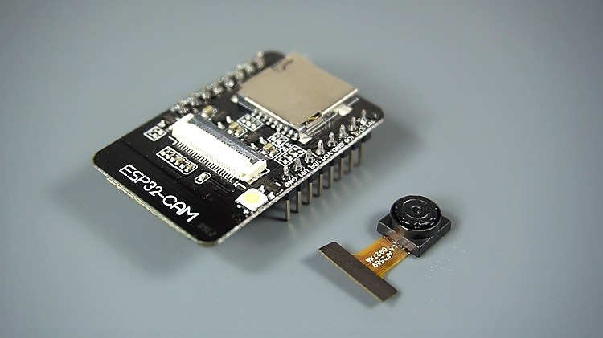
ESP 32-CAM
Small camera module with ESP32-S chip.
In addition to OV2640 Camera, several GPIOs are included to connect peripherals. Also, features microSD card (upto 4GB) slot that can be useful in storing images taken by camera & can be used to store files to serve clients.
Supports UART/SPI/I2C.
Has Wi-Fi BT SoC module & support image WiFI upload.
Embedded FreeRTOS.

Slide 4
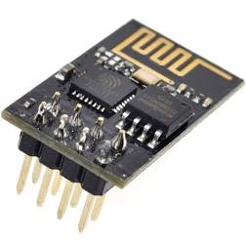
ESP 8266
This WiFi module is self-contained SOC that provides any microcontroller access to WiFi network.
Has pre-programmed feature with AT command set firmware.
Has powerful enough on-board processing and storage capability that allows it to be integrated with the sensors and other specific devices through its GPIOs.
Supports SPI, UART & low power consumption.

Slide 5
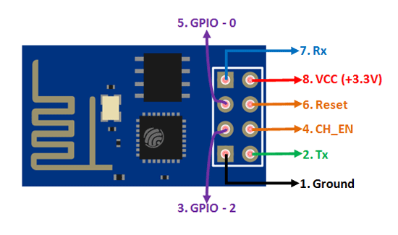
PIN DIAGRAM OF ESP8266

Slide 6
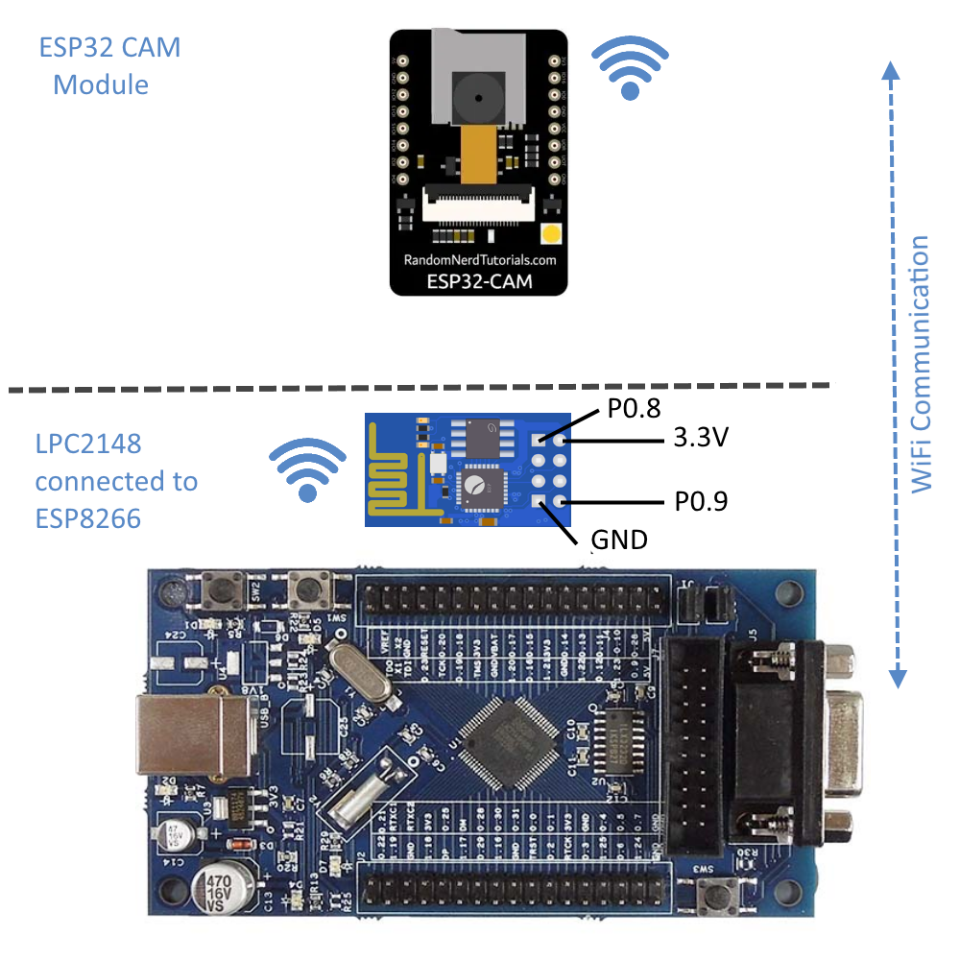
CONNECTION OF ESP32-CAM & LPC 2148
Pin 7(Rx) of ESP 8266 is connected to pin 8 (port 0) of LPC 2148.
VCC of ESP 8266 is connected to 3.3V of LPC 2148.
Pin 2 (Tx) of ESP 8266 is connected to pin 9 of LPC on port 0.
Pin 1 is grounded with LPC 2148.

Slide 7
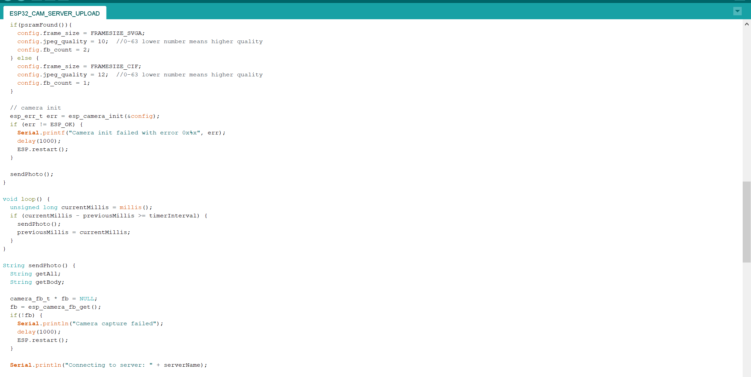
CODE FOR INTERFACING

Slide 8
REFERENCES
ESP 8266 Datasheet PDF. (n.d.). Retrieved from
https://espressif.com/sites/default/files/documentation/0aesp8266ex_datasheet_en.pdf
ESP-32 CAM Datasheet PDF. (n.d.). Retrieved from
https://www.espressif.com/sites/default/files/documentation/esp32_datasheet_en.pdf
Pinout Configuration ESP8266. Retrieved from
https://components101.com/wireless/esp8266-pinout-configuration-features-datasheet

