Slide 1
ASSIGNMENT-8
HOME SECURITY SYSTEM
Interfacing of RF Transmitter & LPC 2148
Submitted By: Jasmine(748300)

Slide 2
CONTENTS
LPC 2148
NRF24L01 RF TRANSCEIVER
CONNECTION DIAGRAM
PIN DESCRIPTION
VALIDATION
REFERENCES

Slide 3
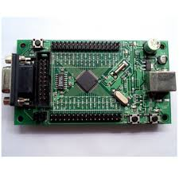
LPC 2148
Features:
ARM7TDMI-S based high performance 32 bit microcontroller.
Has two 32 bit timers and supports UARTs, SPI, SSP to I2C bus.
Role in existing Project:
Works as a master MCU .
Interfacing with RF transmitter.
Has two SPI pins and here we are using SPI 1 for interfacing.

Slide 4
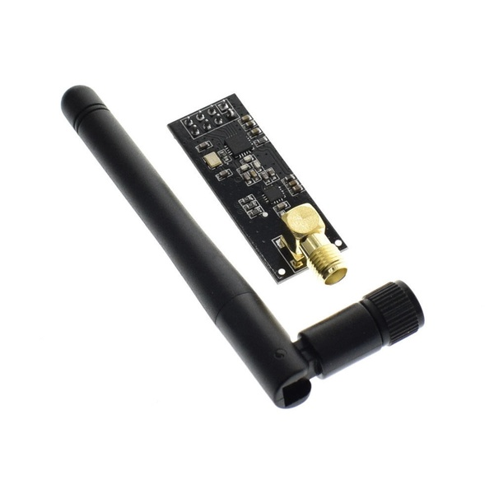
NRF24L01 RF TRANSCEIVER
Features –
Single chip 2.4GHZ transceiver.
Operating voltage: 3.3V.
Ultra low power consumption.
Role in the existing Project –
Transmits and receives data from PIR Sensor and LPC 2148 through radio frequency.
Ports to be used in interfacing –
CE - Chip enable(enables transmitter or receiving mode)
CSN – Chip select not pin
SCK – Serial clock for SPI communication
CLK – Clock
MISO – Master In serial out
MOSI – Master out serial in

Slide 5
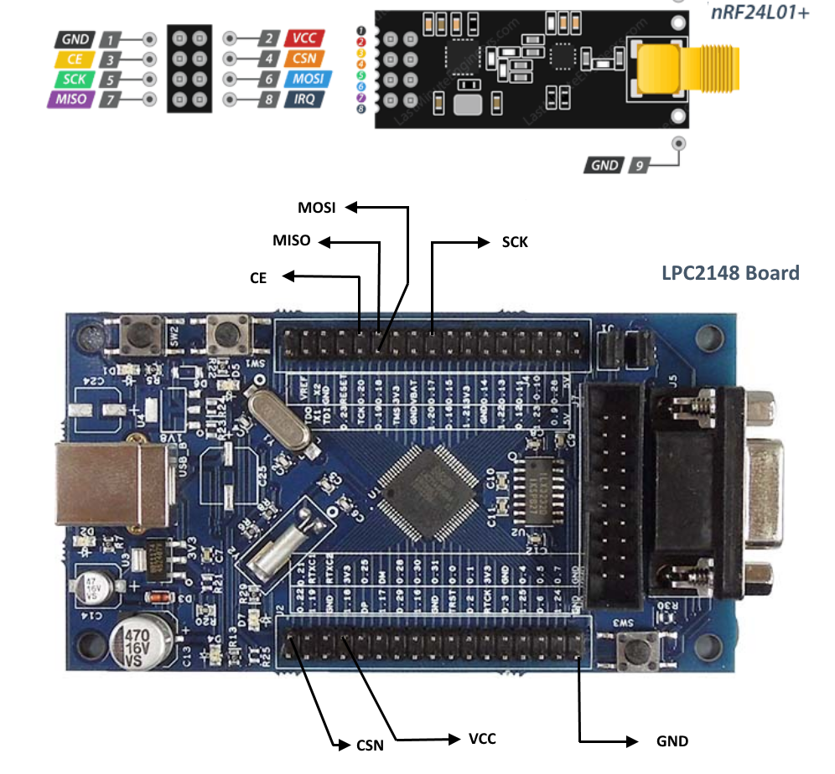
CONNECTION DIAGRAM

Slide 6
PIN DESCRIPTION
NRF24L01 is connected with LPC 2148 through SPI 1 (Serial peripheral interface).
Two GPIO pins are used namely – CE and CSN.
1. CE is mounted on port 0 at pin 20.
2. CSN is connected on port 0 at pin 21.
SCK is connected with SPI 1 on pin 17.
Connection of MOSI and MISO is done with pin 19 and 18 respectively.

Slide 7
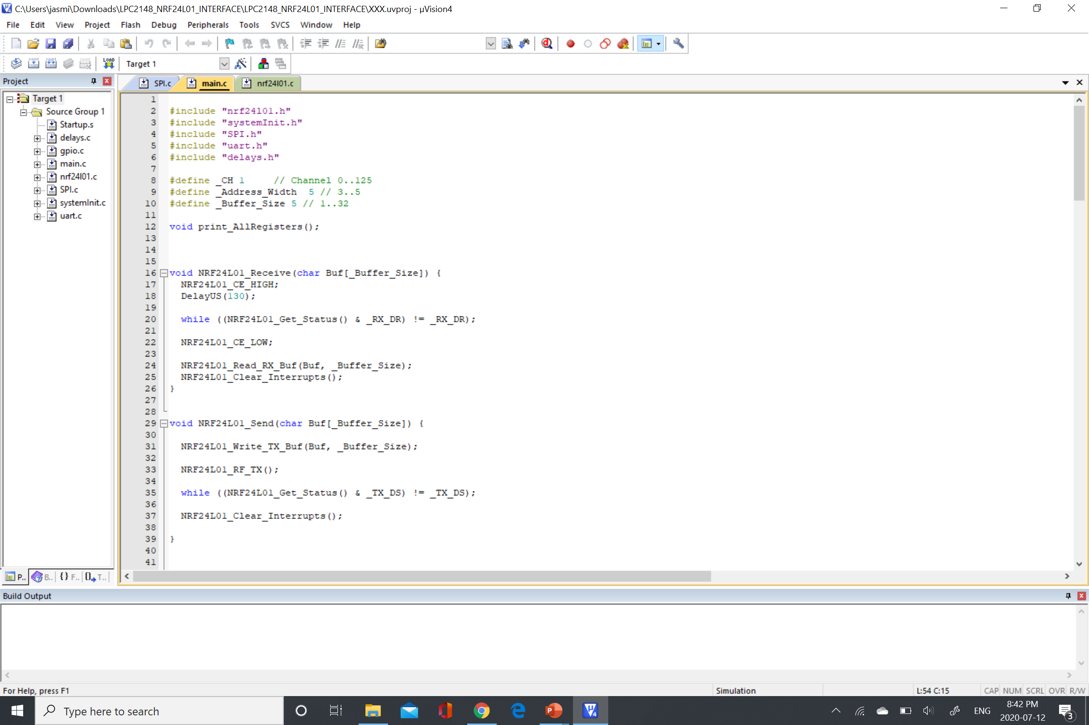
Validation of Successful Transmission

Slide 8
REFERENCES
nRF24L01 Datasheet PDF. (n.d.). Retrieved from
https://www.sparkfun.com/datasheets/Components/SMD/nRF24L01Pluss_Preliminary_Product_Specification_v1_0.pdf
nRF24L01 library files PDF. (n.d.). Retrieved from
http://www.cs.mun.ca/~paul/cs4723/material/nordic/nRF24L01_Tutorial_1.pdf
LPC 2148 Datasheet PDF.(n.d.). Retrieved from
https://www.nxp.com/docs/en/data-sheet/LPC2141_42_44_46_48.pdf
FreeRTOS Porting for LPC2148 Using Keil. (2018, November 15). Retrieved July 13, 2020, from https://embetronicx.com/tutorials/rtos/freertos/freertos-porting-for-lpc2148-using-keil/

