Slide 1
Communicating buzzer with LPC2148
By | Group-4 | Dixaben Shah

Slide 2
Contents
Piezoelectric Buzzer
Interfacing buzzer
Connecting Buzzer and LPC 2148 through LCD

Slide 3
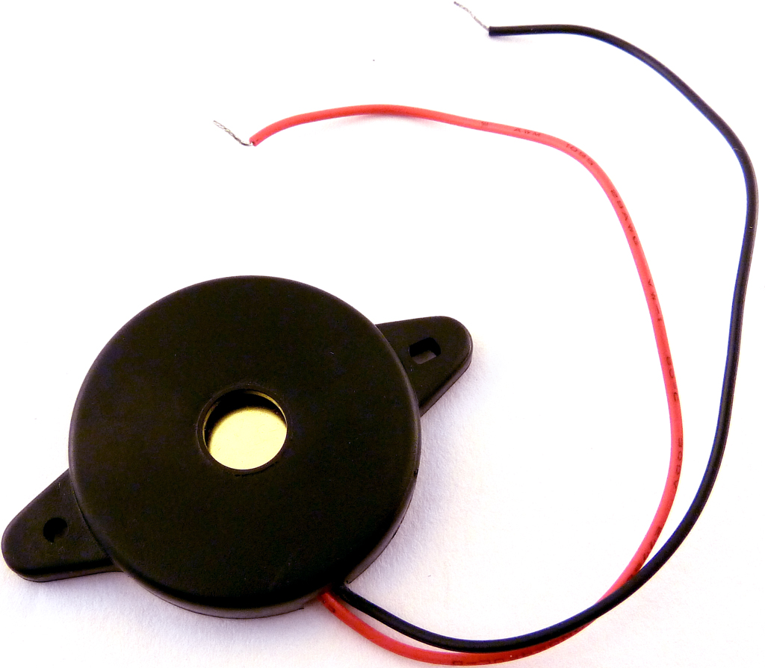
Piezoelectric buzzer
In its essence, it is a speaker that uses a piezoelectric effect to generate the sound.
By applying a voltage to a piezoelectric material, it creates the initial mechanical motion.
diaphragms and resonators typically convert the motion into audible sound.
piezoelectric speakers operate well in the range of 1-5 kHz and up to 100 kHz.

Slide 4
Interfacing buzzer
Piezoelectric buzzer has only two wire one is for I/P and another is ground
When input port status has been changed by any microcontroller, than sound wave is change in buzzer.
Buzzer is connected to LCD through Black Header pin.

Slide 5
References
https://soundbridge.io/piezoelectric-speaker/
https://www.engineersgarage.com/arm/how-to-interface-buzzer-with-lpc2148-part-4-9/

