Slide 1
ASSIGNMENT- 10 HOME SECURITY SYSTEM INTERFACING LCD WITH LPC 2148
SUBMITTED BY - Jasmine(748300)
GROUP-4

Slide 2
CONTENTS
FULL GRAPHIC SMART CONTROLLER.
ST7920 GLCD.
CONNECTION BETWEEN LCD & LPC 2148.
PIN DESCRIPTION.
CODING
REFERENCES.

Slide 3
FULL GRAPHIC SMART CONTROLLER
This graphic smart controller consists of
128 x 64 dot matrix LCD display.
a SD-Card reader.
An rotary encorder.
Easy to connect by using smart adapter included in it.

Slide 4
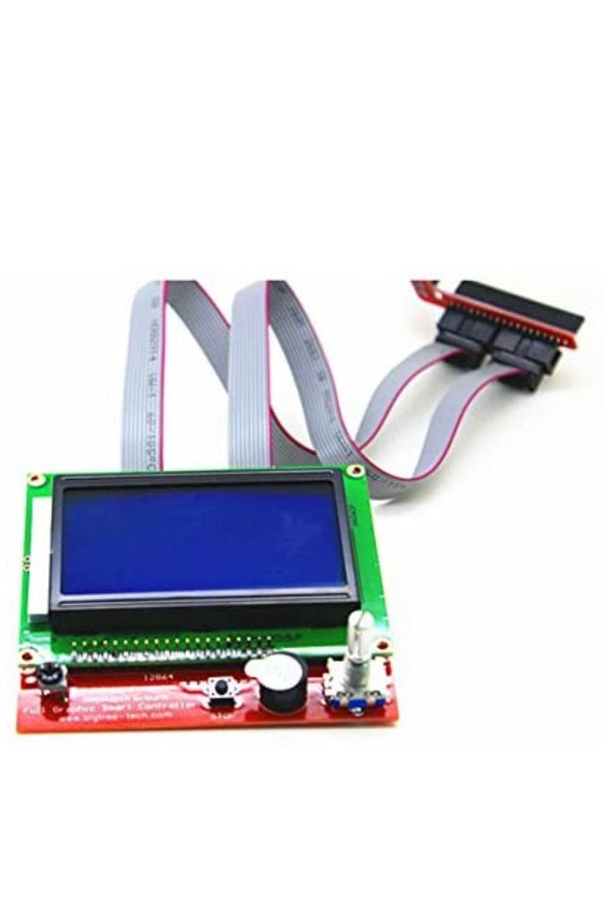
ST7920 GLCD
Operating voltage = -2.7 to 5.5 V.
Support 8 bit, 4 bit Serial bus interface.
64 X256- bits graphic display RAM.
Automatic power on reset.
Displays the current process in the system.

Slide 5
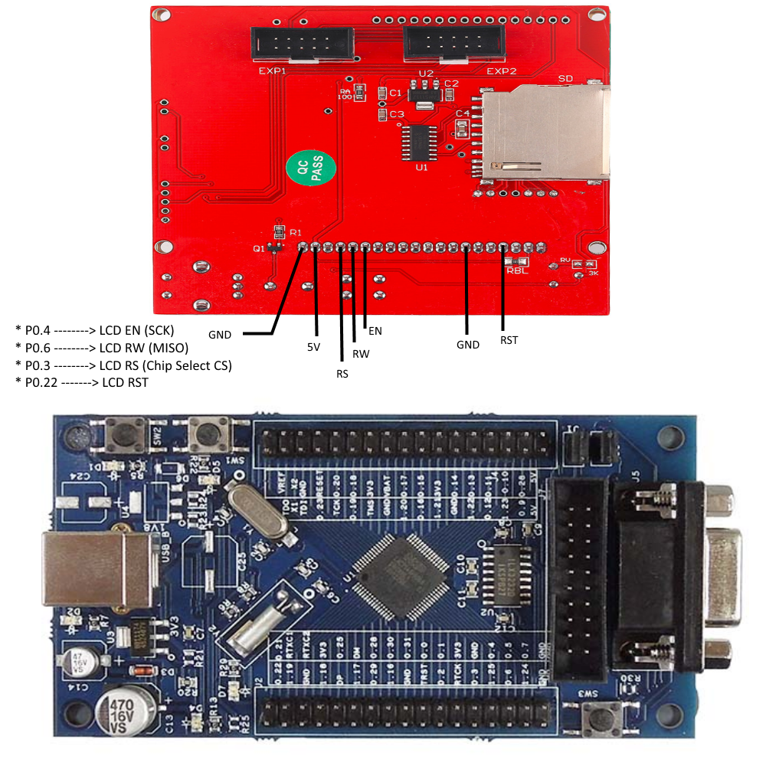
CONNECTION BETWEEN LCD & LPC 2148

Slide 6
PIN DESCRIPTION
Port 0 of LPC 2148 is used for interfacing with ST7920 GLCD.
Pin 4 of LPC board, which is SCK(Serial clock) is connected with EN(enable) of LCD.
Pin 6 (MISO) is connected with RW (Read/ Write Serial data) of LCD.
Pin 3, which is CS (chip select) is mounted with RS (Serial chip select).
Pin 22 (GPIO Digital pin) is connected to reset of LCD.

Slide 7
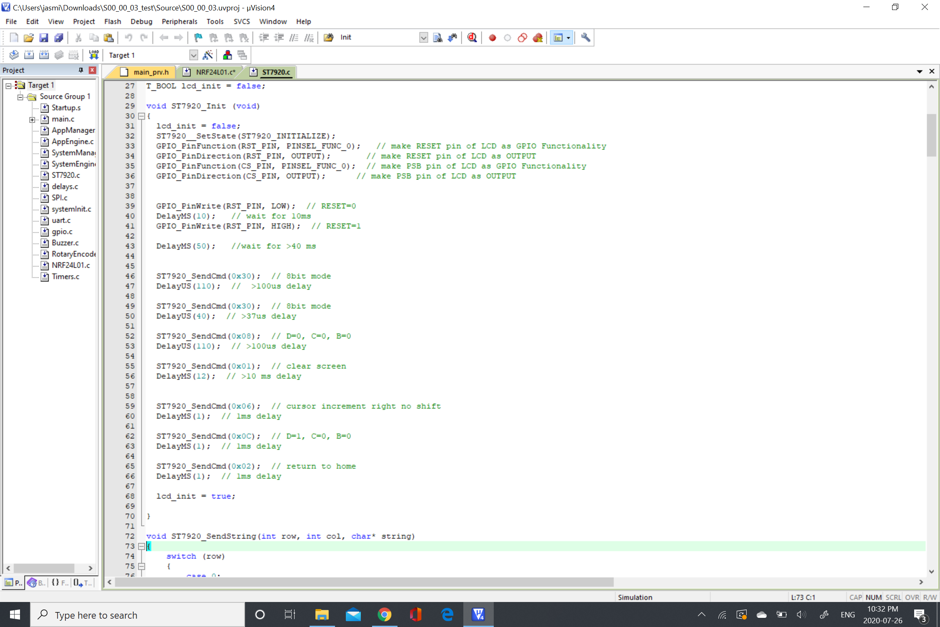
Initialization Function For ST7920 GLCD

Slide 8
REFERENCES
ST7920 product data sheet. Retrieved from: http://www.hpinfotech.ro/ST7920.pdf.
Implementing GLCD with LPC 2148. Retrieved from: https://dhananjaypawar.files.wordpress.com/2016/02/implementing_glcd_with_arm7_friendly.pdf
LPC2148 product data sheet. Retrieved from: https://www.nxp.com/docs/en/data-sheet/LPC2141_42_44_46_48.pdf
Interfacing GLCD with LPC 2148 Development Board. Retrieved from: https://www.pantechsolutions.net/blog/interface-glcd-with-lpc2148-arm7-2/

