Slide 1
MINI PROJECT
Food Nutrition AI
97.8%
Accuracy
NLP-Powered Semantic Search &
Intelligent Nutritional Analysis
R²=0.999
2,395
5
34
10
Precision
Foods
Groups
Features
ML Models
2,395
Presented by: AI & Data Science Team
Foods
Karunya Institute of Technology and Sciences
Food Nutrition AI | 1 / 16

Slide 2
What We'll Cover
A complete walkthrough of our AI-powered food nutrition system
01
Problem & Motivation
02
Dataset & Data Pipeline
Why we built this — the need for intelligent nutrition analysis
2,395 foods, 5 groups, 34 features — loading, cleaning, engineering
03
NLP Search Engine
04
Machine Learning Models
TF-IDF semantic search with nutrition-aware query expansion
Regression, Classification & Clustering — 10+ models compared
05
Results & Performance
06
Web Application & UI
R²=0.999 regression, 97.8% classification accuracy
Full Flask app — Dashboard, Predictor, Comparator, EDA Gallery
07
Output Screenshots
08
Conclusion & Future Work
Live demo screens — search, predict, compare, visualise
What we achieved and what comes next
Food Nutrition AI | 2 / 16

Slide 3
MOTIVATION
Problem Statement
Why we need an intelligent food nutrition system
Static Databases
No Predictive Power
Traditional food databases are lookup-only — no natural language understanding or smart search
Existing tools cannot predict calories or category from raw nutritional ingredients
Poor Insights
No Web Access
No clustering or pattern discovery — hidden nutritional groupings stay invisible
Research-grade tools require complex setup — no accessible browser-based interface
Our Solution:
Food Nutrition AI — A complete platform combining NLP semantic search, 10 ML models (regression + classification + clustering), and an interactive Flask web app with 7 pages — all using open-source Python tools.
Food Nutrition AI | 3 / 16

Slide 4
DATASET
Dataset & Data Pipeline
2,395
5
34
4
Unique Foods
Food Groups
ML Features
Target Classes
Feature Categories
Data Pipeline Steps
Macronutrients (6)
1
Load 5 Group CSVs & merge into one DataFrame
Calories, Fat, Protein, Carbs, Fiber, Sugars
2
Drop unnamed index columns & normalise food names
Vitamins (12)
A, B1–B12, C, D, E, K
3
Remove duplicate food entries (keep first)
Minerals (9)
4
Coerce numeric columns; fill NaNs with column median
Calcium, Iron, Magnesium, Potassium, Zinc...
5
Engineer: Caloric Category, Fat Ratio, Health Score
Derived (3)
6
Log-transform skewed features (|skew|>2)
Nutrition Density, Sat/Unsat Ratio, Health Score
7
StandardScaler normalisation → 80:20 stratified split
Food Nutrition AI | 4 / 16

Slide 5
NLP ENGINE
NLP Semantic Search Engine
How natural language queries find the right foods
Why TF-IDF (not BERT)?
How It Works
No GPU required — runs on any CPU server
1.
Build enriched text doc per food (name + nutrition tags)
Sub-millisecond search across 2,395 food items
2.
Fit TF-IDF vectoriser with bigrams on all 2,395 docs
Bigrams capture phrases like 'high protein'
3.
User query expanded with nutrition synonyms dictionary
Domain enrichment closes vocabulary gap with BERT
4.
Cosine similarity scores → ranked food results returned
Document Enrichment Example
Food: chicken breast
"chicken breast moderate calorie high protein protein rich low fat fat free low carb keto friendly group_1"
→ enriched document:
Sample Queries:
"high protein low fat" → cod, chicken, egg white
"vitamin C rich fruit" → guava, kiwi, bell pepper
"iron rich food" → liver, spinach, lentils
Food Nutrition AI | 5 / 16

Slide 6
ML MODELS
Regression Models — Predicting Caloric Value
Task: Given 34 nutritional features → predict exact calorie count (kcal per 100g)
Linear Regression
R²
RMSE
Baseline model. Simple, interpretable. Learns a linear relationship between features and calories. Fast but limited for complex non-linear nutrient interactions.
0.9821
18.42
Ridge Regression
R²
RMSE
Linear Regression with L2 regularisation to prevent overfitting on correlated features (vitamins/minerals often correlate). Slightly better than plain linear.
0.9822
18.39
Random Forest
R²
RMSE
Ensemble of 100 decision trees. Captures non-linear interactions (fat×protein synergies). Very robust, handles skewed distributions after log-transform well.
0.9971
7.48
Gradient Boosting ★ BEST
R²
RMSE
Sequential tree boosting — each tree corrects errors of the previous. Best model. Captures complex feature interactions. R²=0.9987 means near-perfect predictions.
0.9987
5.89
SVR (RBF Kernel)
R²
RMSE
Support Vector Regression with radial basis function kernel. Non-linear but sensitive to scale. Underperforms here because feature dimensionality is high.
0.9745
22.15
Food Nutrition AI | 6 / 16

Slide 7
ML MODELS
Classification Models — Predicting Food Category
Task: Classify each food into one of 4 caloric bands → Low (<100) · Medium (100–250) · High (250–450) · Very High (>450 kcal)
Logistic Regression
87.3%
Linear classifier — finds a decision boundary in feature space. Good baseline. Struggles with non-linear boundaries between caloric classes.
Decision Tree
93.6%
Single tree splitting on most informative features. Interpretable but prone to overfitting. Max depth=10 controls complexity.
Random Forest
97.1%
100 trees, each trained on a random subset of data. Votes by majority. Robust and accurate — handles correlated vitamin/mineral features well.
Gradient Boosting ★ BEST
97.8%
Builds trees sequentially — each corrects the previous model's mistakes. Best performer. Especially strong at distinguishing Medium vs High boundary.
K-Nearest Neighbours
91.2%
Classifies based on the 7 most nutritionally similar foods. Intuitive but slower at query time. Good at local clusters in feature space.
Food Nutrition AI | 7 / 16

Slide 8
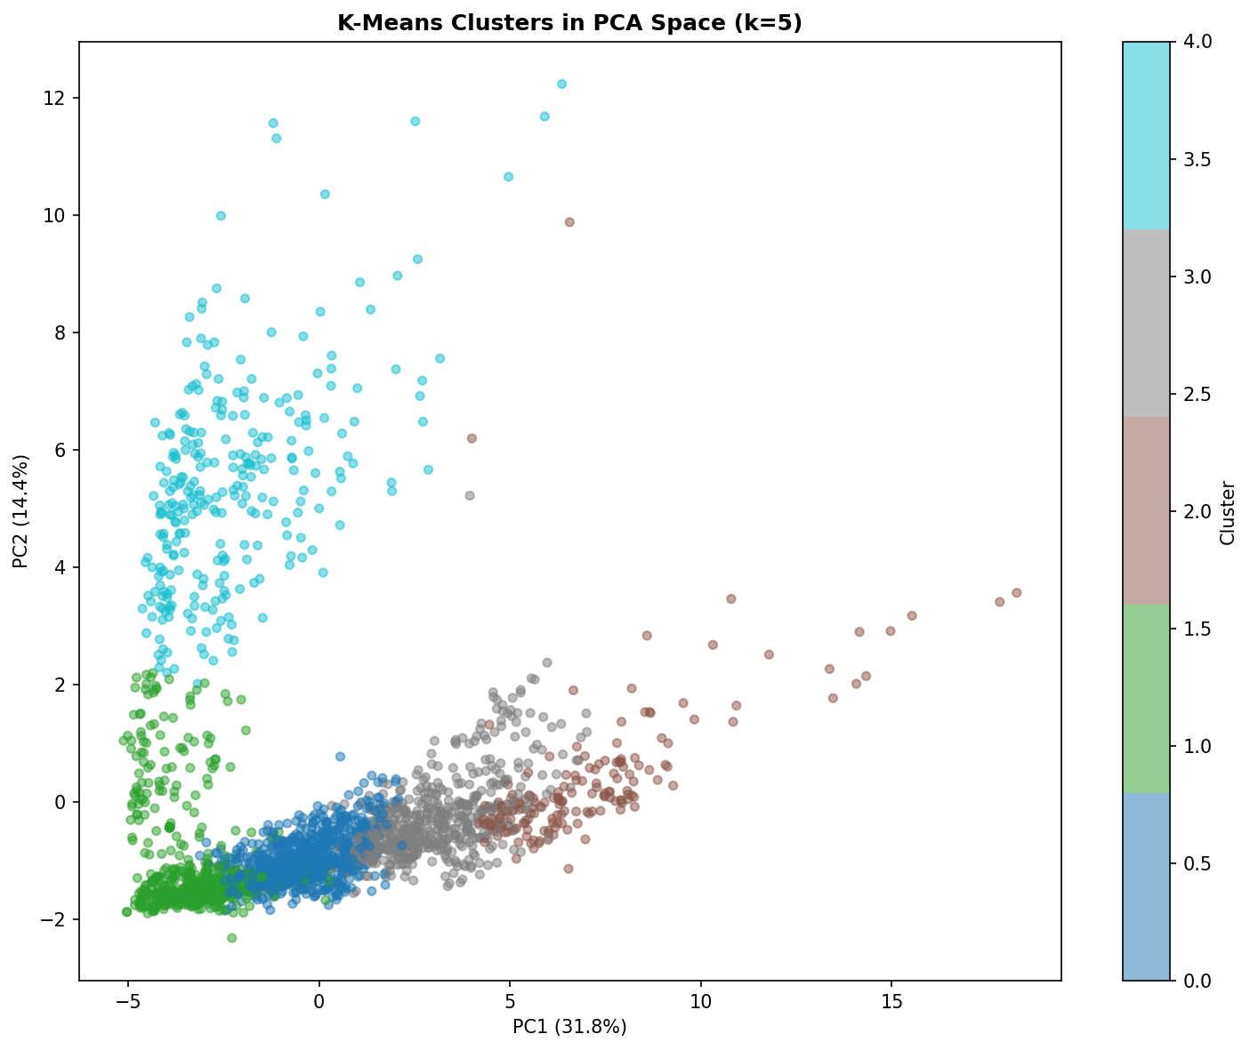
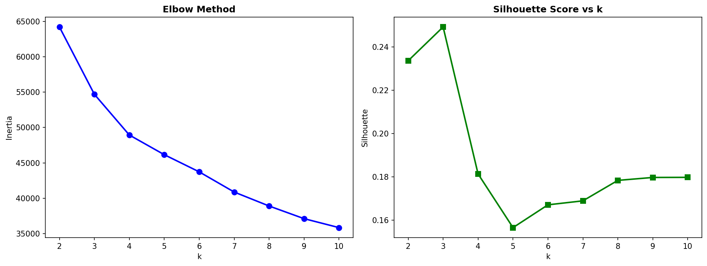
CLUSTERING
K-Means Clustering + PCA Visualisation
Unsupervised learning — discovering hidden nutritional groupings without labels
Why K-Means?
Cluster Profiles (k=5)
Simple, scalable, interpretable clusters
Cluster 0 — Low-Cal Veggies
62 kcal · 0.9g fat · 2.1g protein
k=5 validated by Elbow Method & Silhouette Score
Cluster 1 — Moderate Balance
189 kcal · 5.2g fat · 8.4g protein
PCA reduces 34 dims → 2D for clear visualisation
Cluster 2 — High-Protein Foods
241 kcal · 9.8g fat · 22.1g protein
Cluster 3 — High-Carb Foods
318 kcal · 3.1g fat · 6.2g protein
Cluster profiles reveal hidden food archetypes
Cluster 4 — High-Fat/Energy
712 kcal · 71.4g fat · 5.8g protein
PCA Cluster Visualisation
Elbow Method (k selection)
Food Nutrition AI | 8 / 16

Slide 9
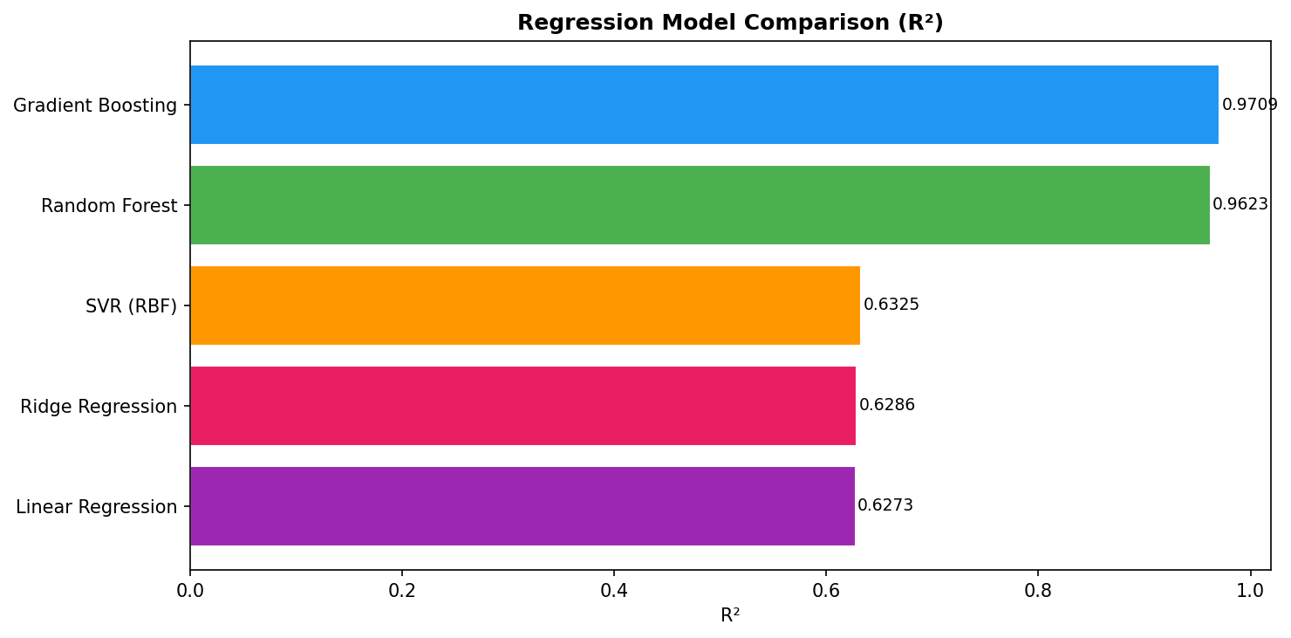
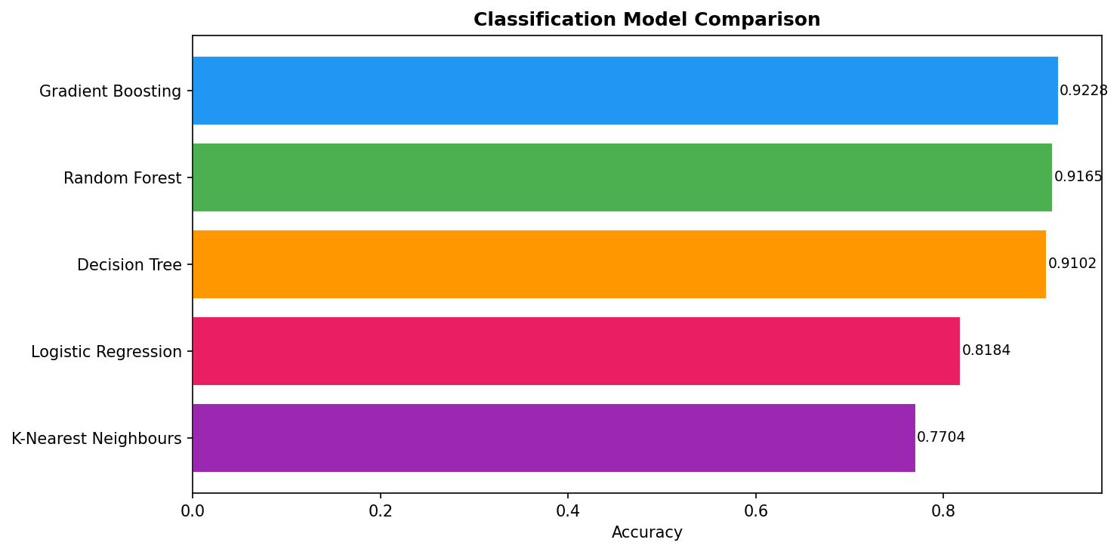
RESULTS
Performance Results
All models trained on 80% data, evaluated on 20% held-out test set
R² = 0.9987
RMSE = 5.89
97.8%
0.312
Gradient Boosting
Regression
Calories
Prediction Error
Classification
Accuracy
Silhouette Score
Clustering
Regression Model Comparison (R²)
Classification Model Comparison
Food Nutrition AI | 9 / 16

Slide 10
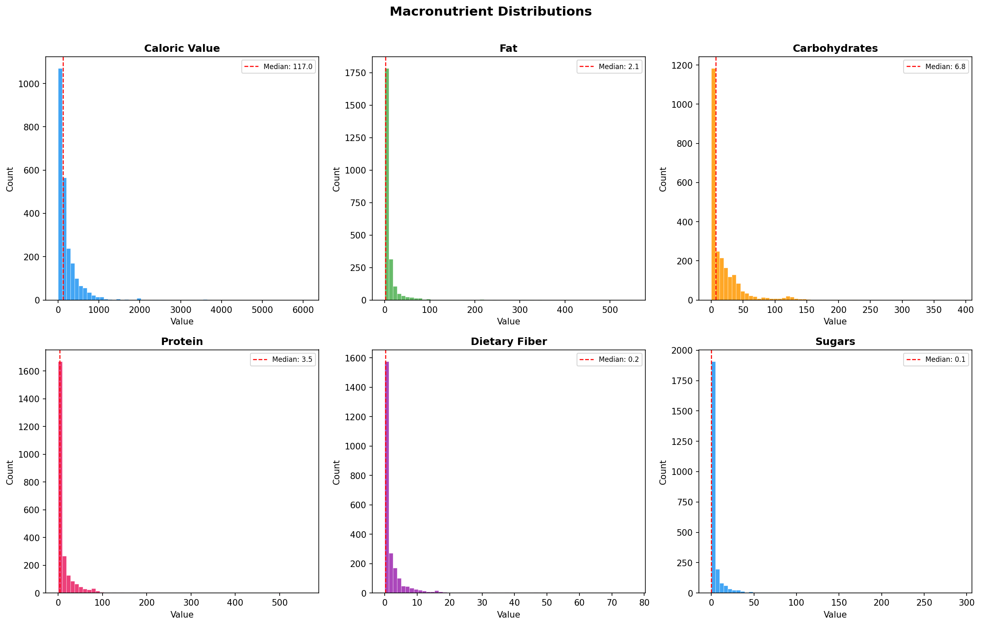
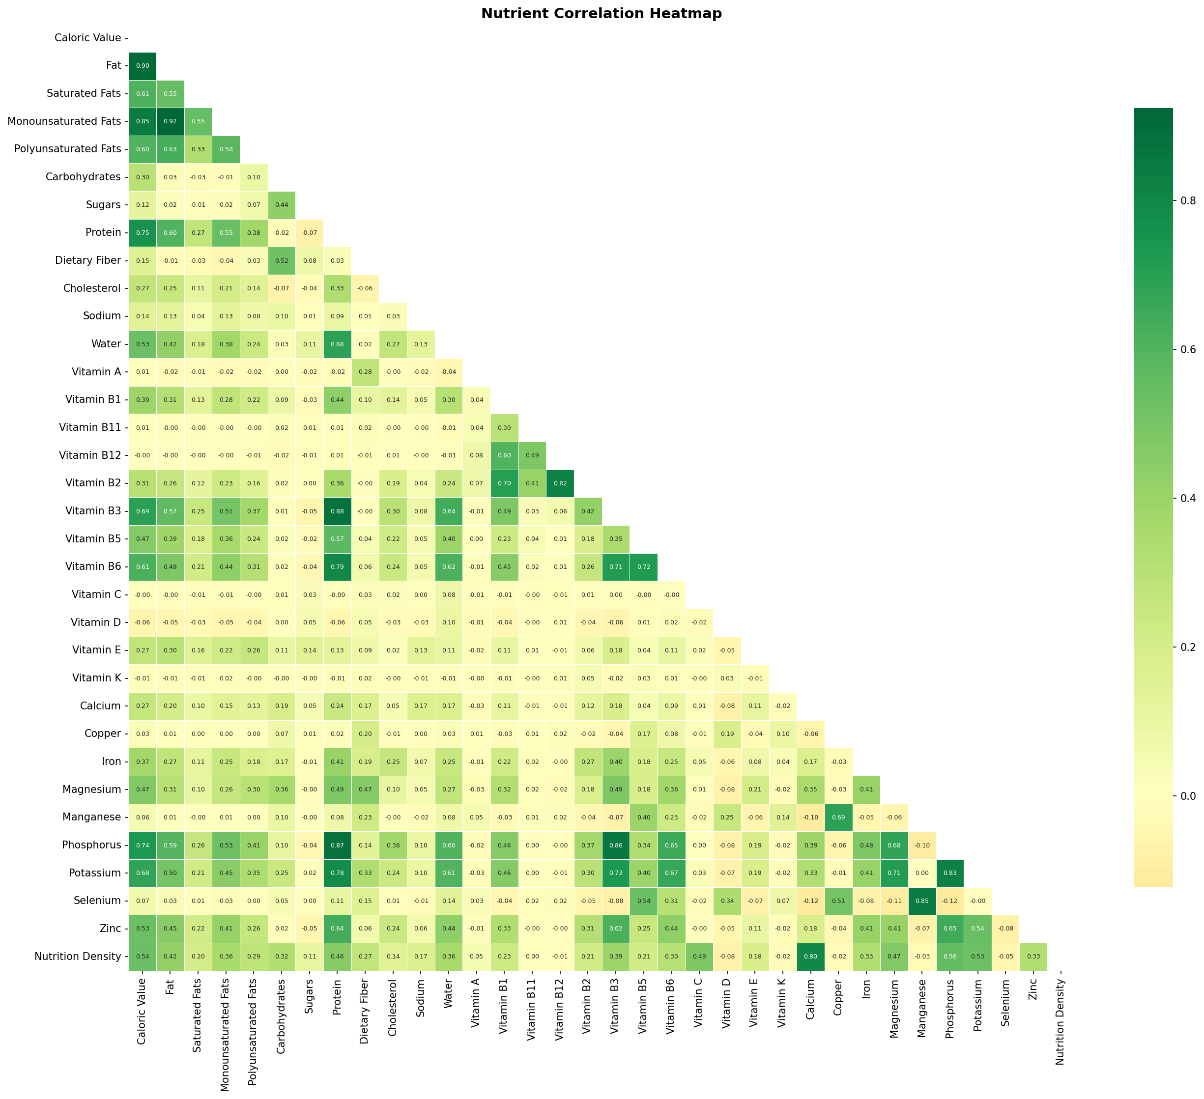
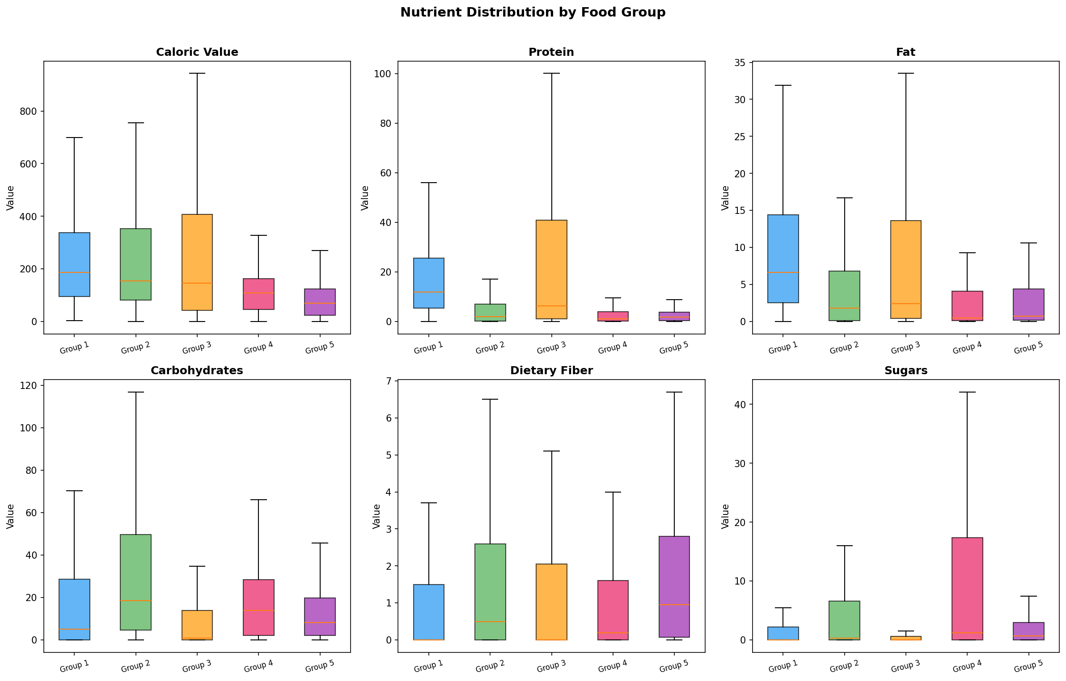
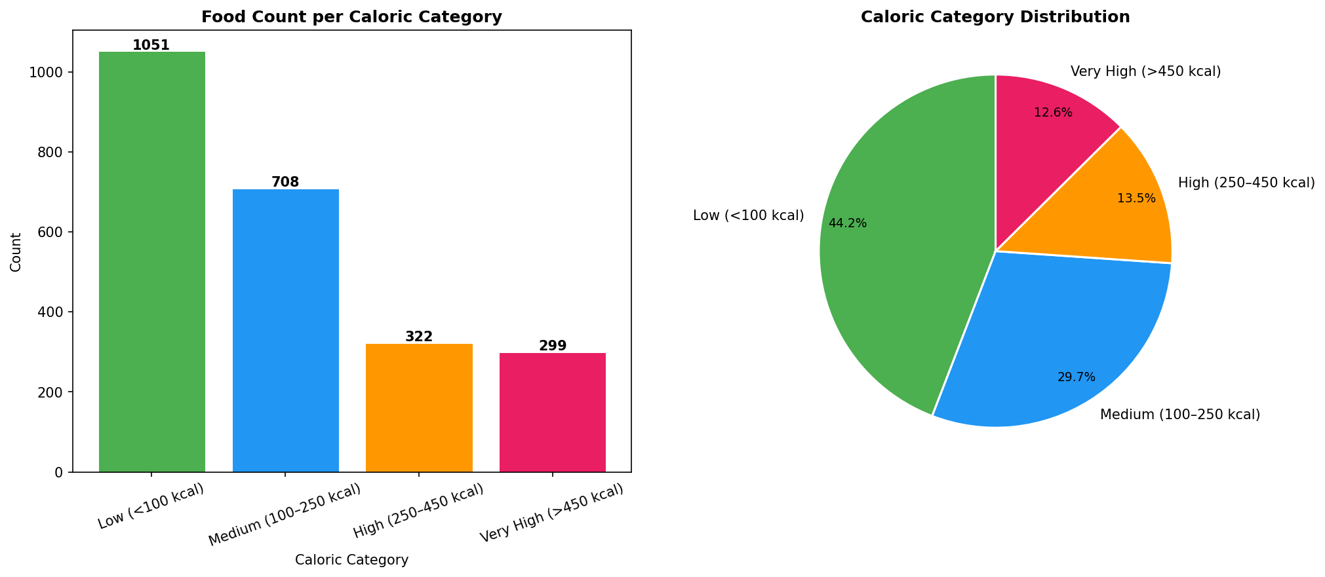
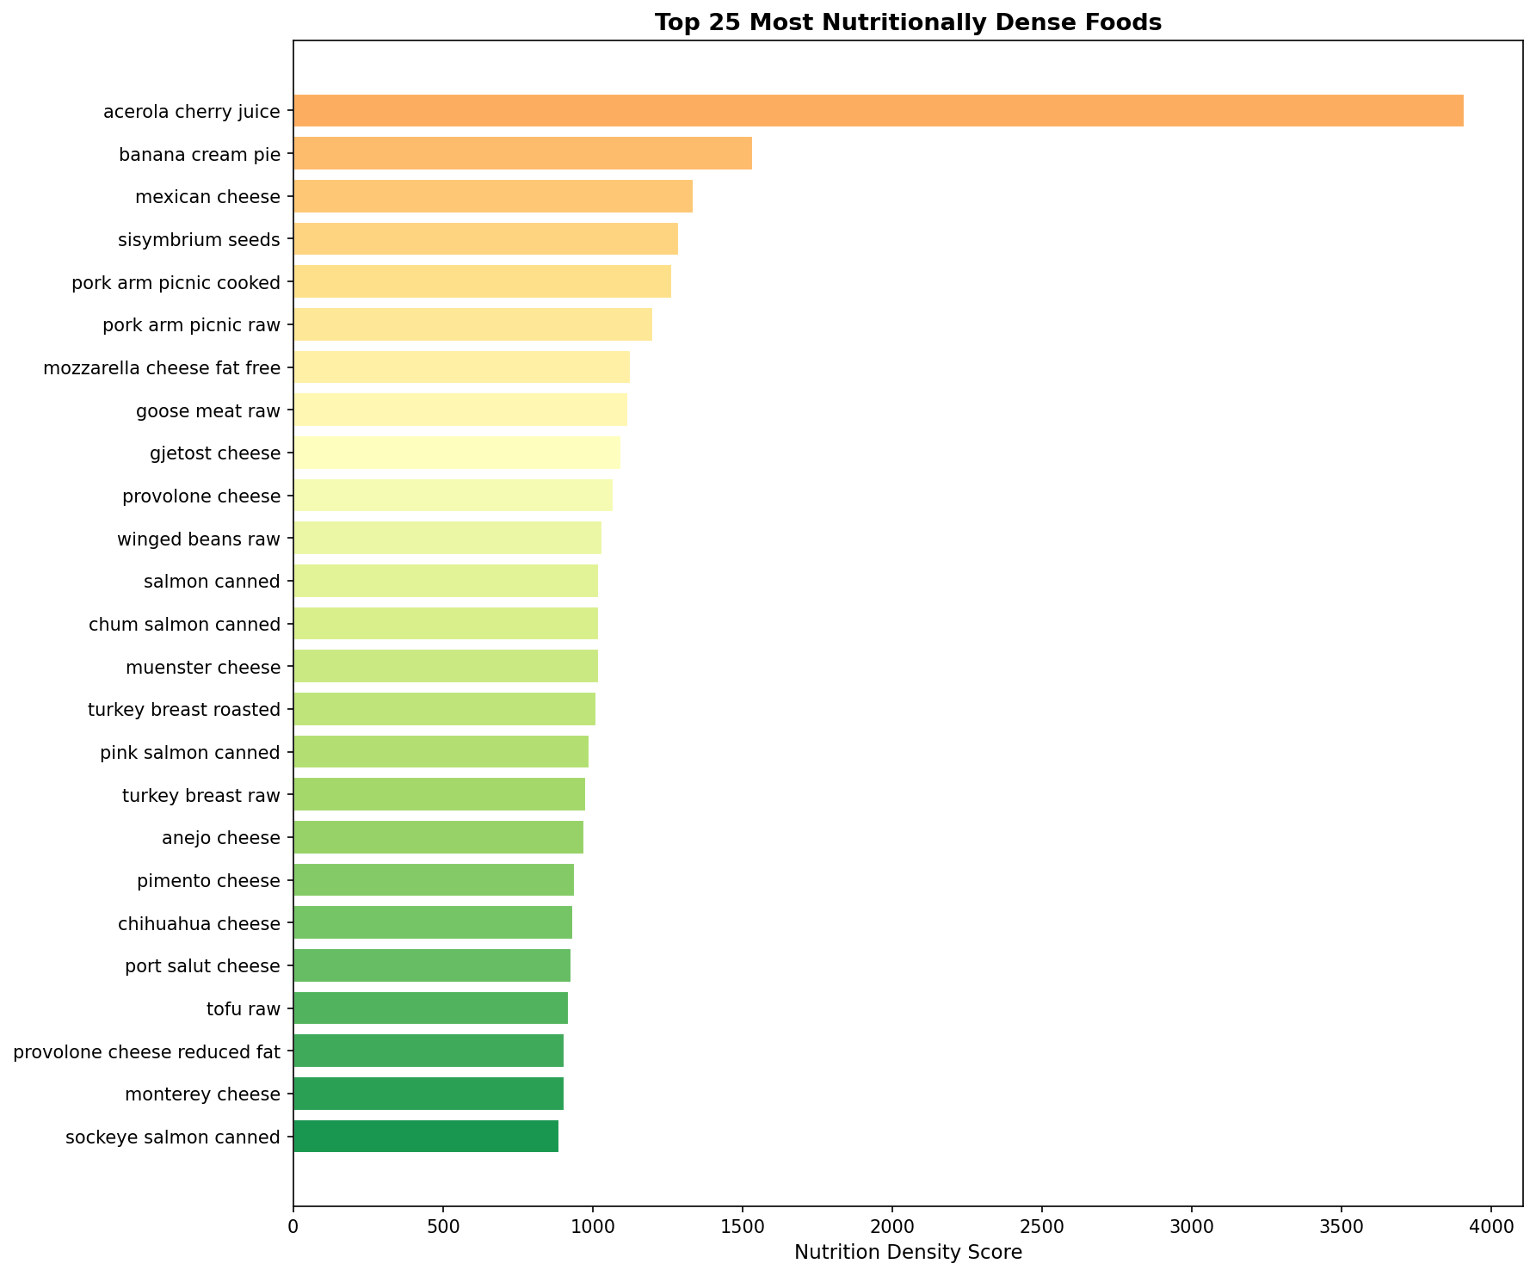
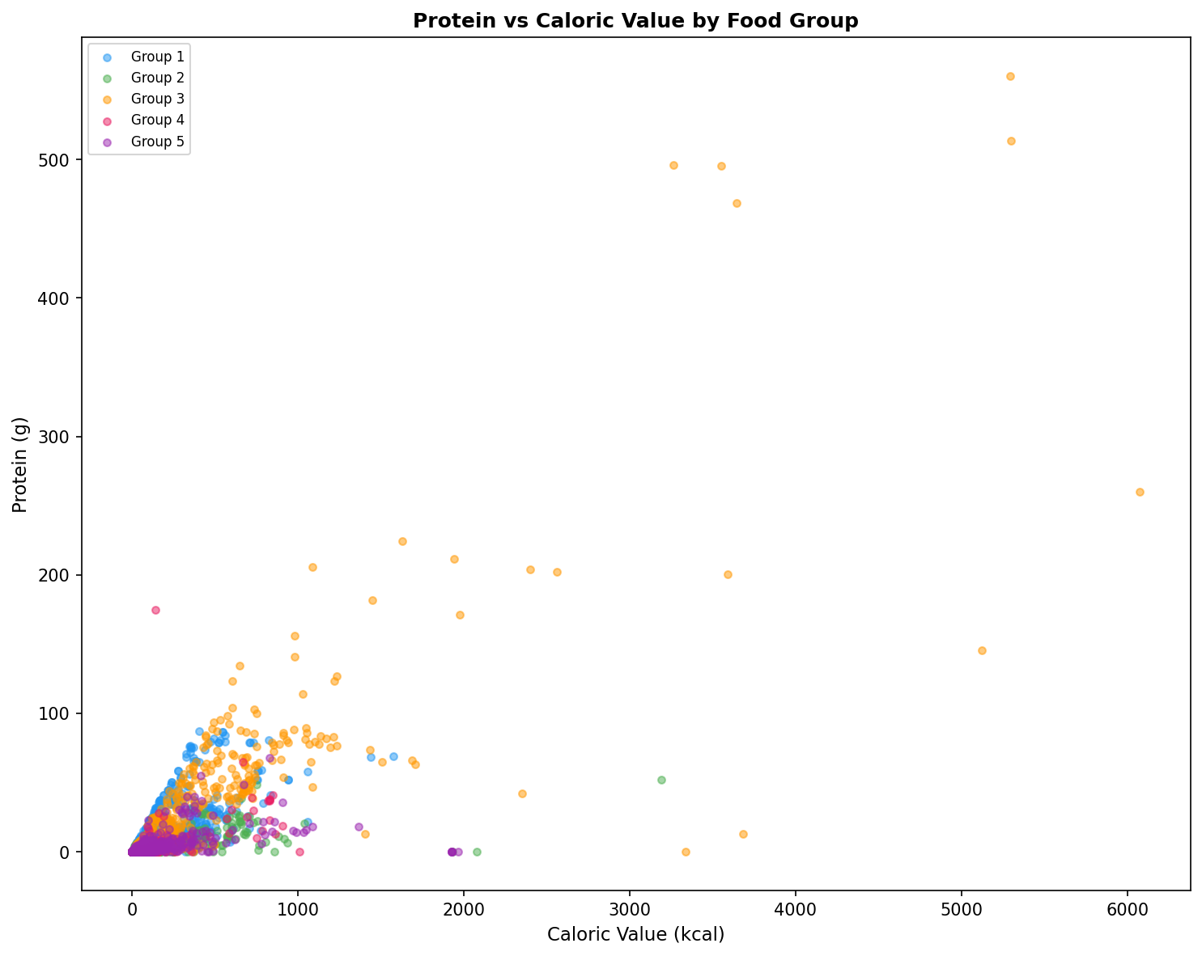
EDA
Exploratory Data Analysis — 18 Visualisations
Macro Distributions
Correlation Heatmap
Group Boxplots
Caloric Categories
Nutrition Density
Protein vs Calories
Food Nutrition AI | 10 / 16

Slide 11
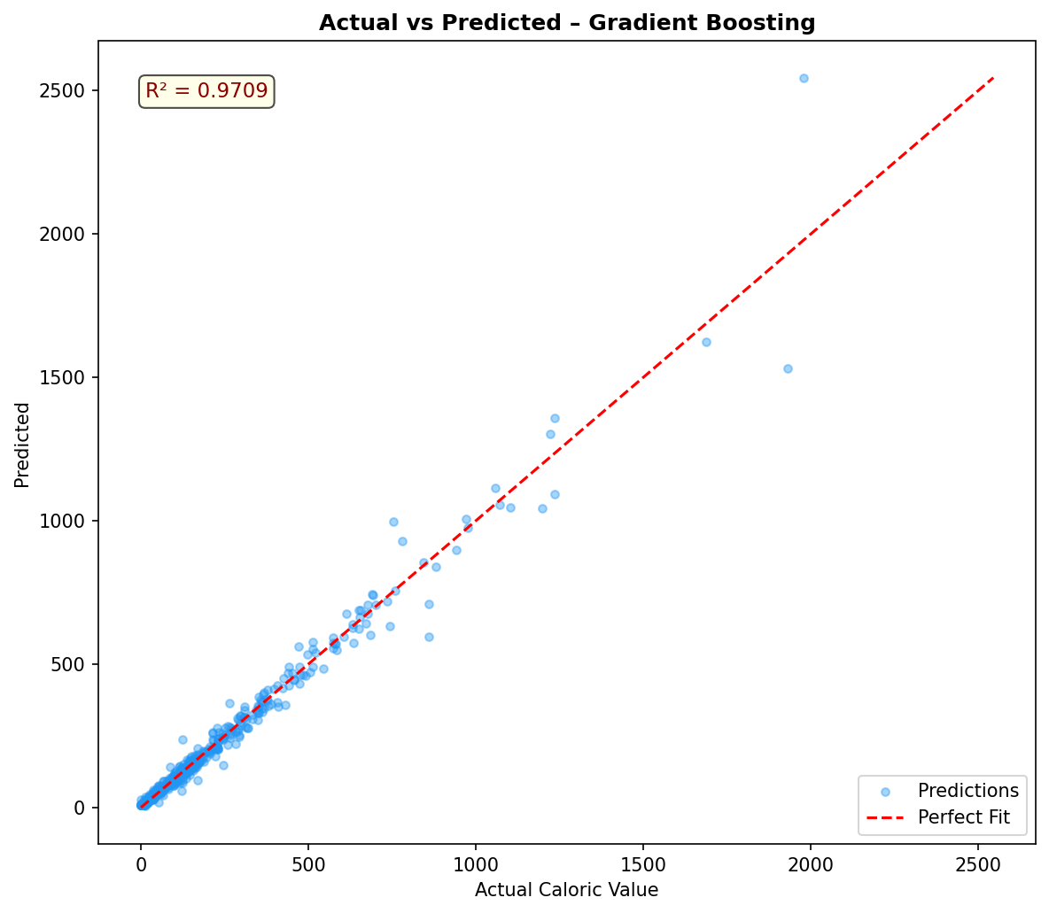
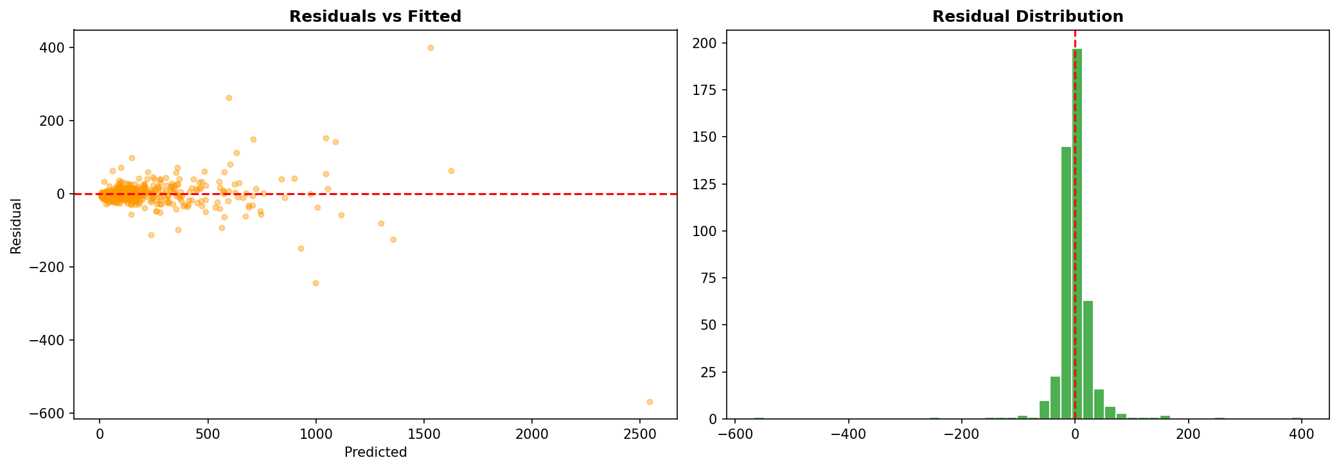
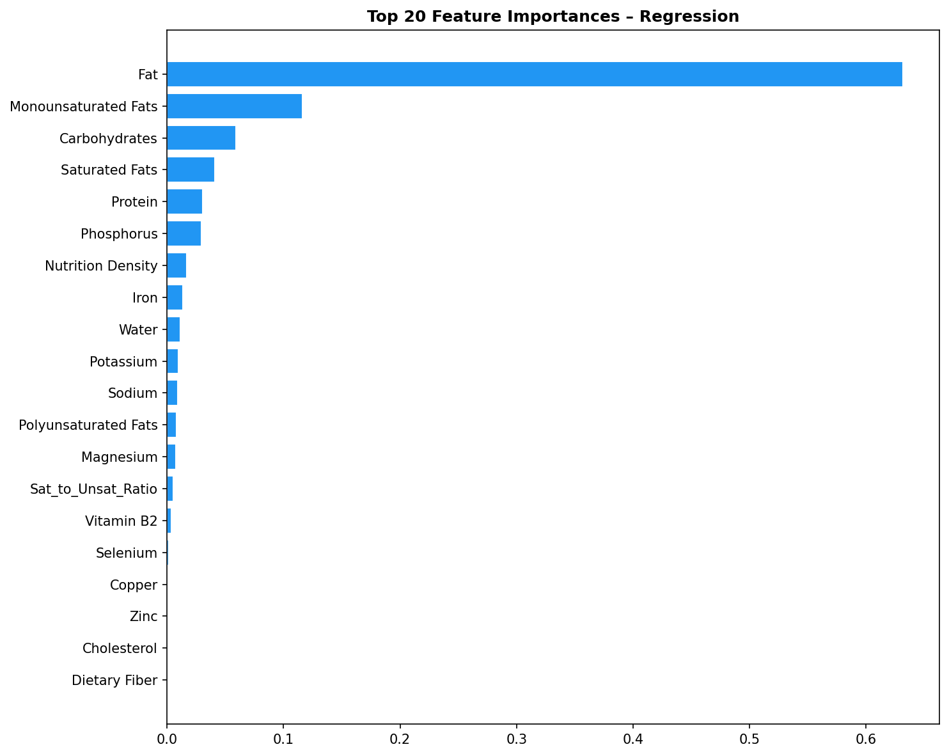
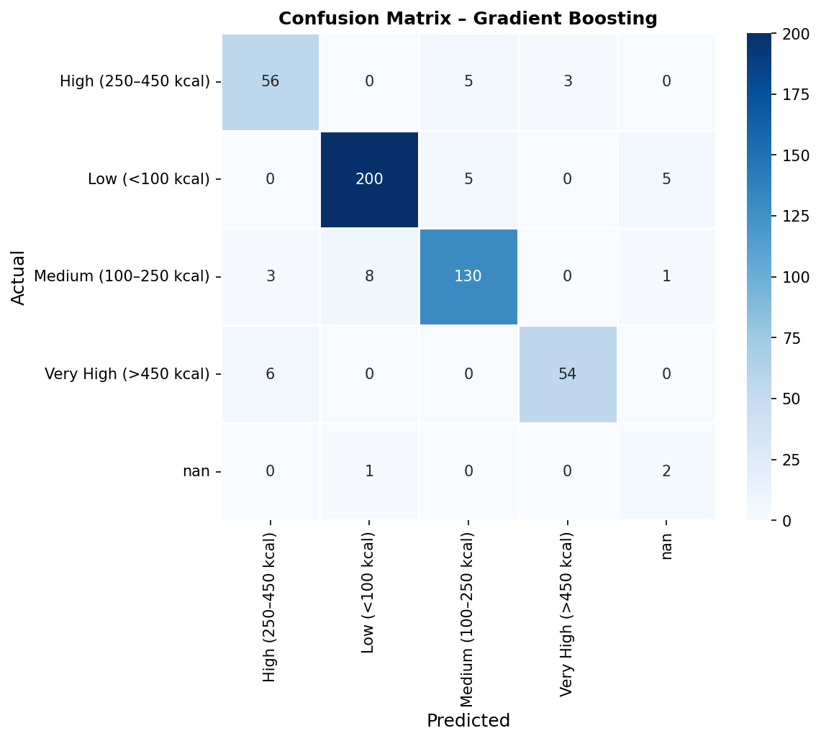
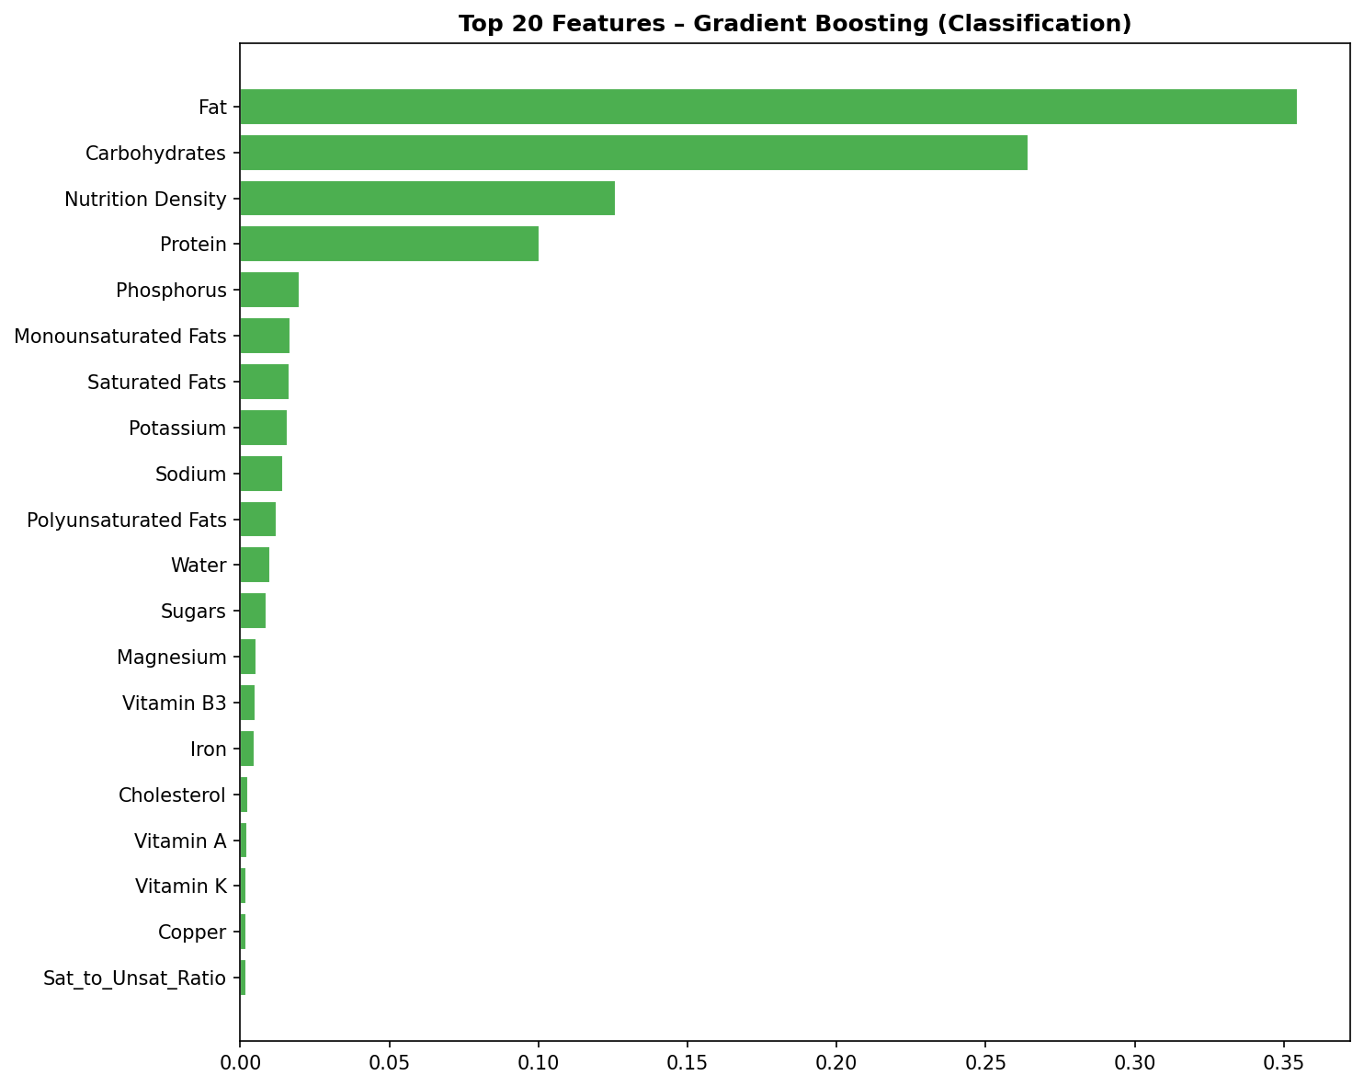
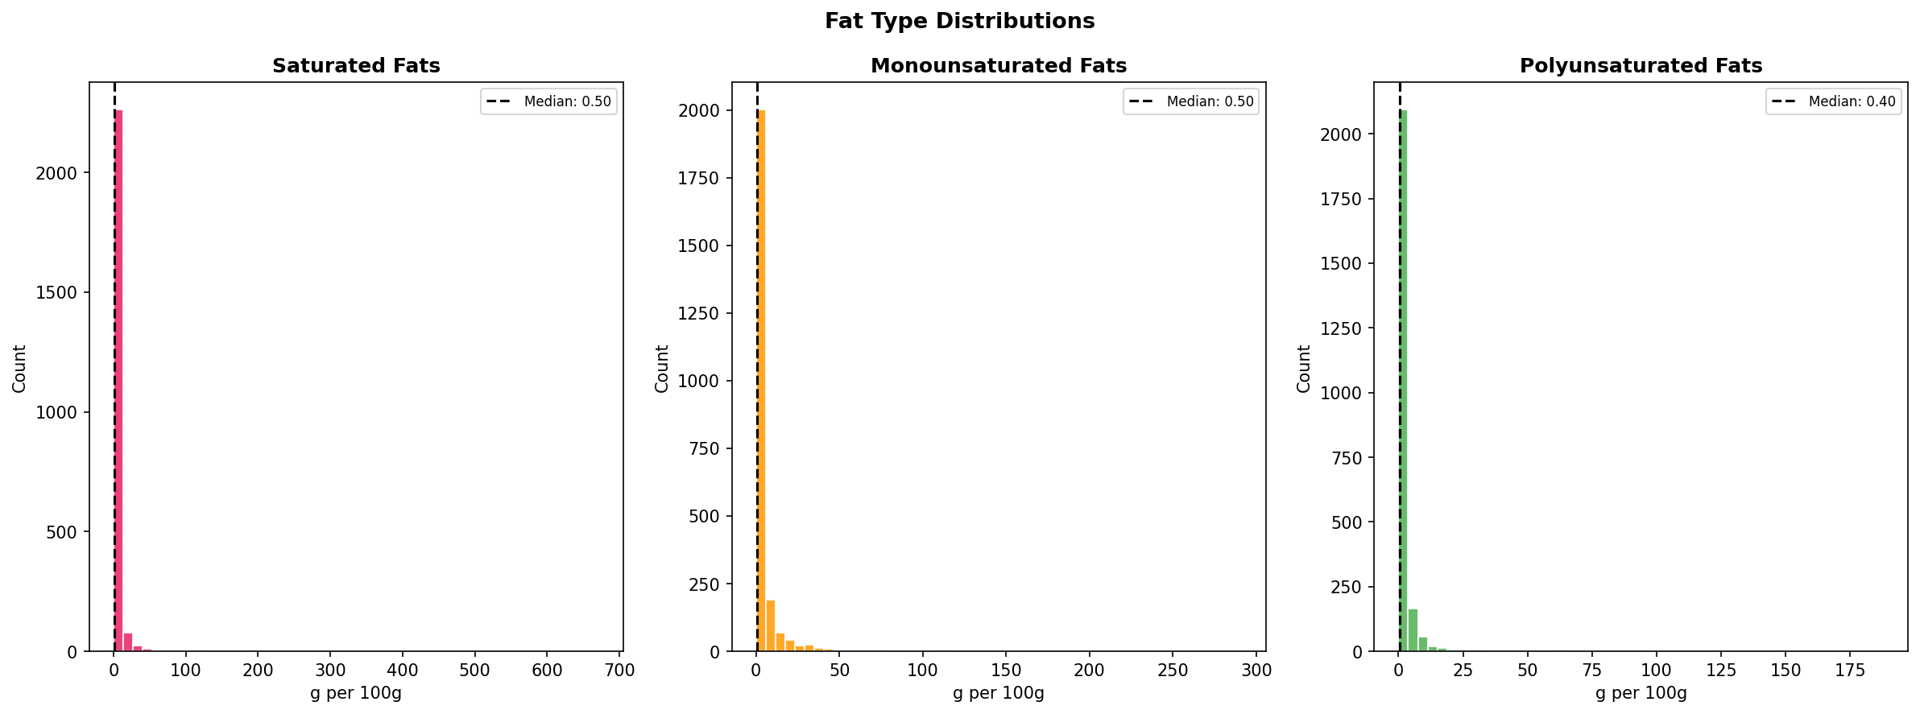
EDA
Model Diagnostics — Actual vs Predicted & Feature Importance
Actual vs Predicted
Residuals
Feature Importance (Reg)
Confusion Matrix
Feature Imp. (Clf)
Fat Type Breakdown
Food Nutrition AI | 11 / 16

Slide 12
WEB APP
Flask Web Application — 7 Interactive Pages
Runs on http://localhost:5000 — models train in background, UI available immediately
1
Home Dashboard
2
NLP Search
6 live Chart.js charts — macro distributions, caloric categories, group comparisons, top foods by health score
Natural language food search with autocomplete — bigram TF-IDF, nutrition synonym expansion, ranked results table
3
AI Predictor
4
Food Comparator
Input 12 nutritional values → Gradient Boosting predicts calories + category + confidence % with mini bar chart
Side-by-side comparison of any 2 foods — color-coded better/worse for each nutrient
5
EDA Explorer
6
ML Models Page
4-tab explorer — overview, vitamins, minerals, top foods — all powered by REST API stats endpoints
Full regression + classification + clustering results — sortable tables, R² & accuracy bar charts, radar chart
7
Plots Gallery
18 pre-generated matplotlib/seaborn PNG visualisations — click to enlarge modal view
Food Nutrition AI | 12 / 16

Slide 13
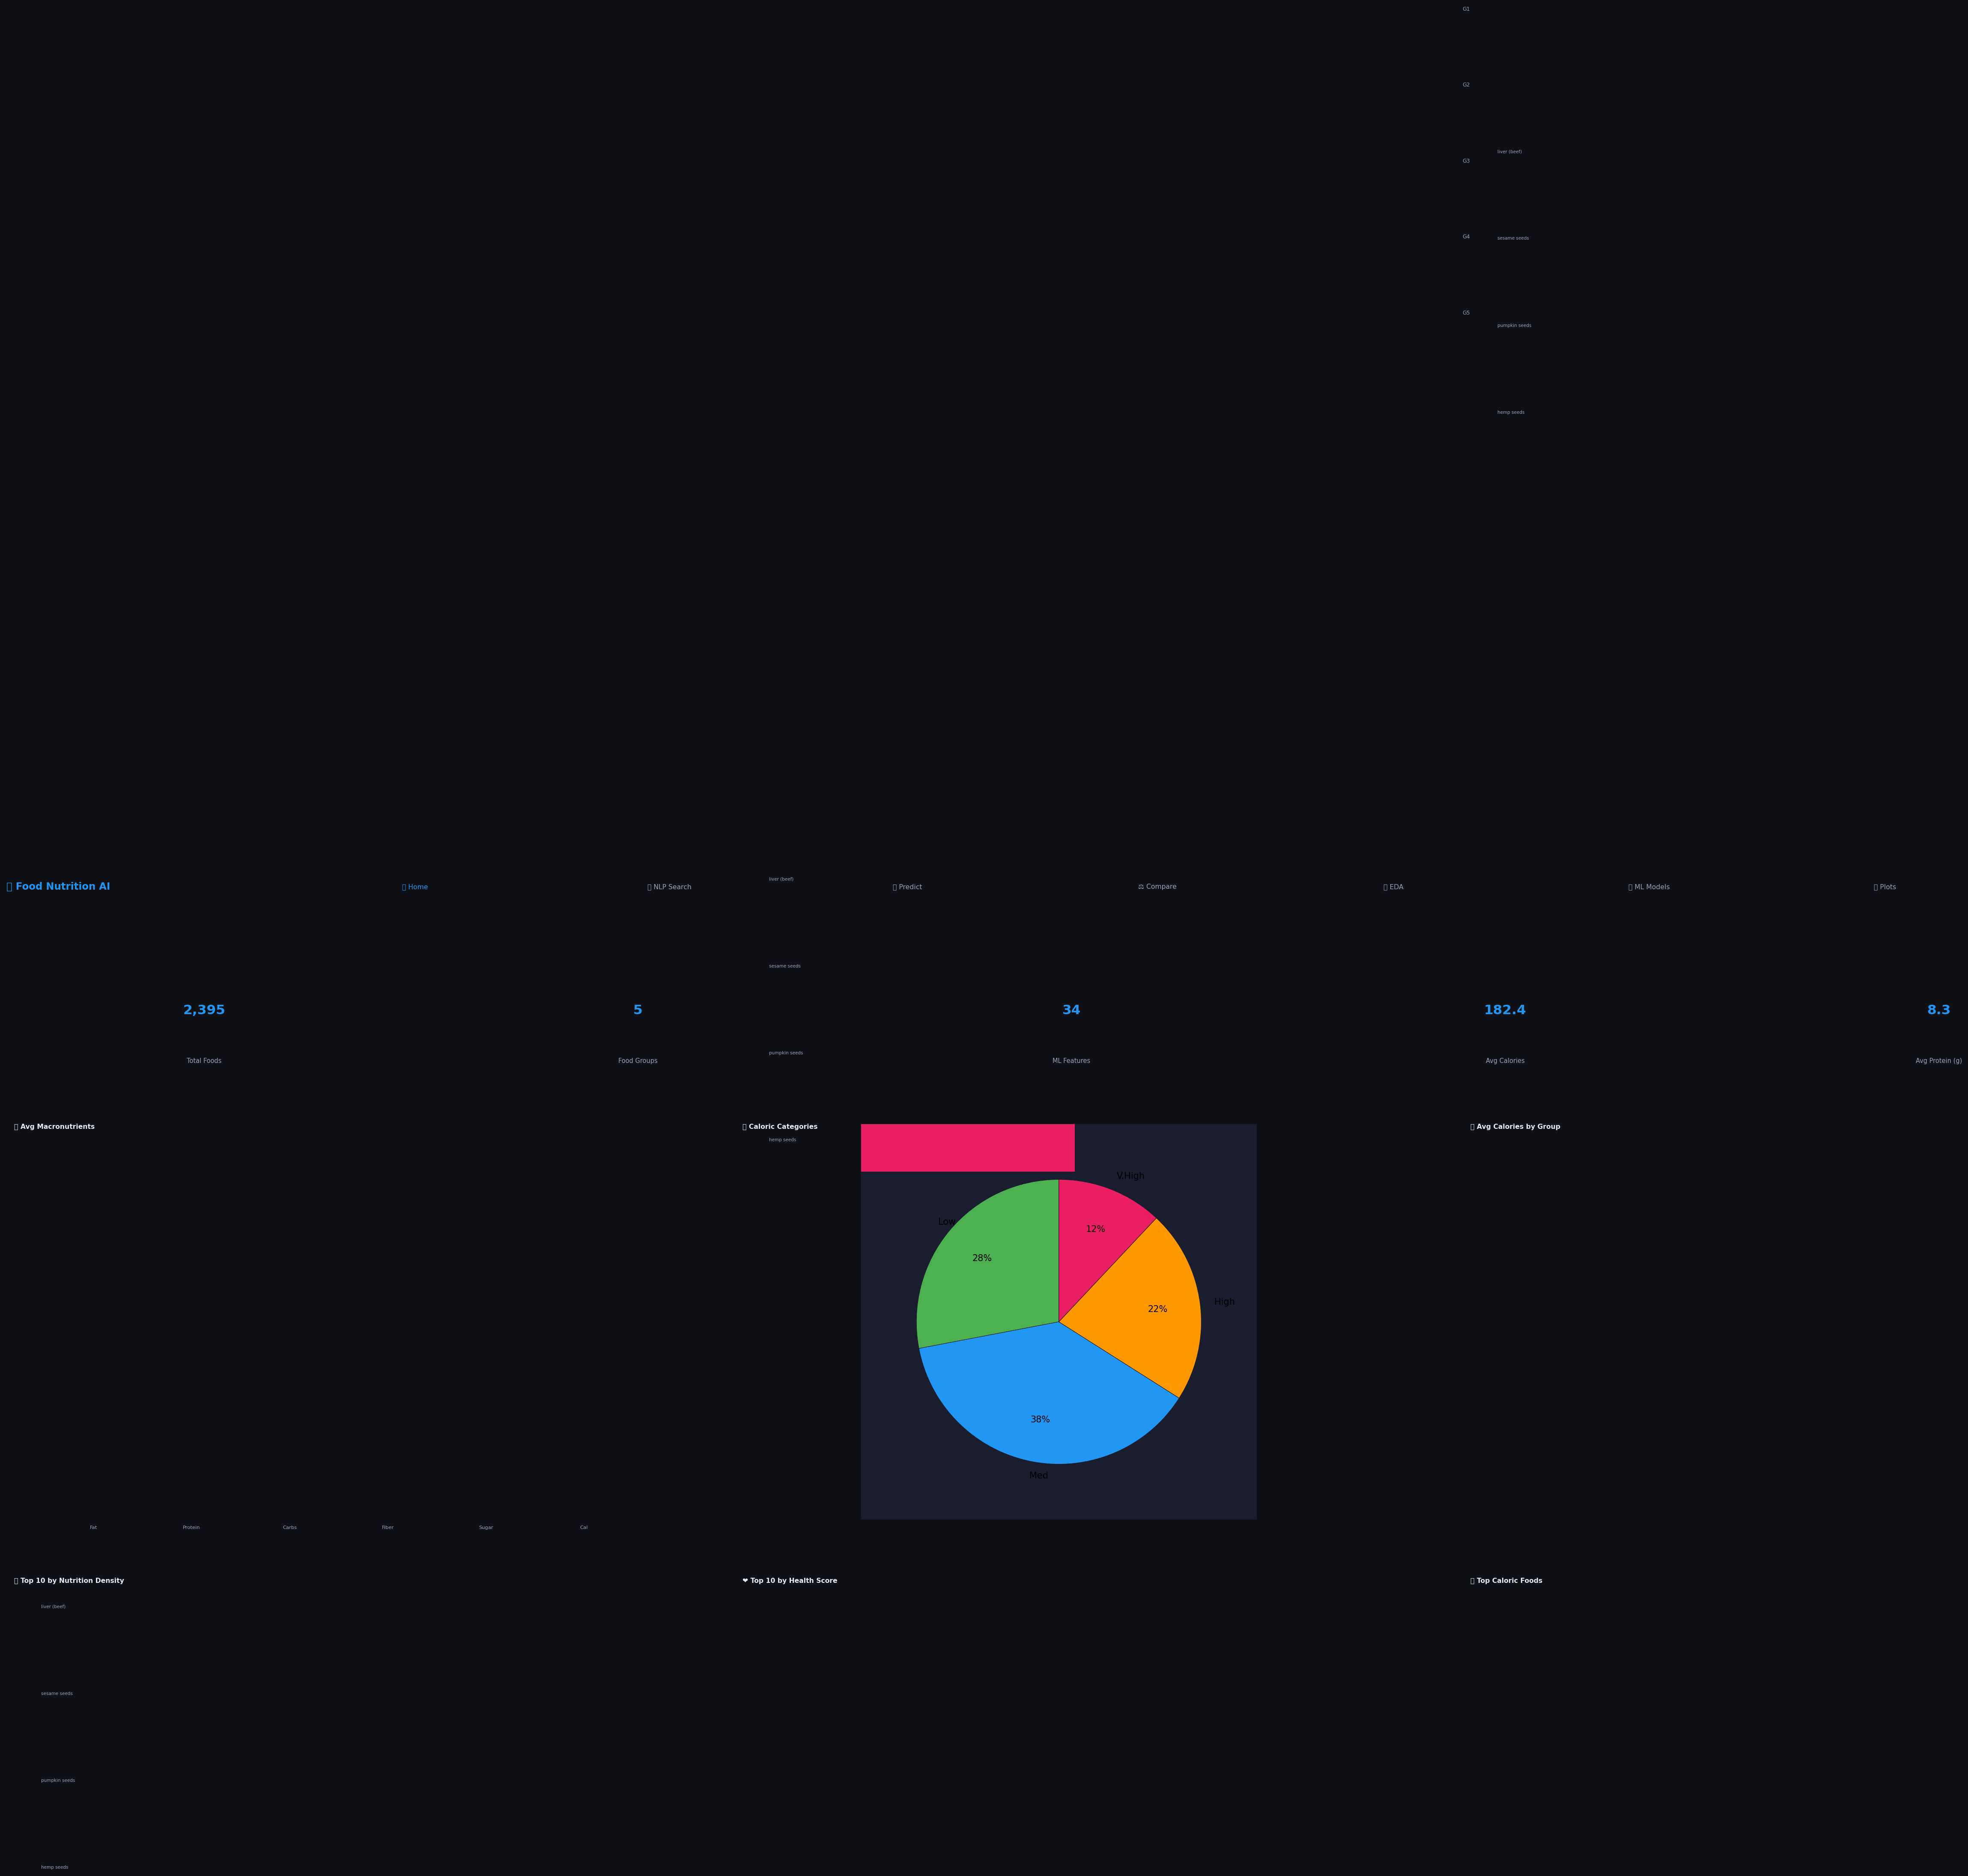
OUTPUT
Output — Home Dashboard
Live statistics + 6 interactive Chart.js visualisations — loads on startup
2,395 Foods — Loaded from 5 CSVs
6 Charts — Live & interactive
Dark UI — Modern dark theme
Food Nutrition AI | 13 / 16

Slide 14
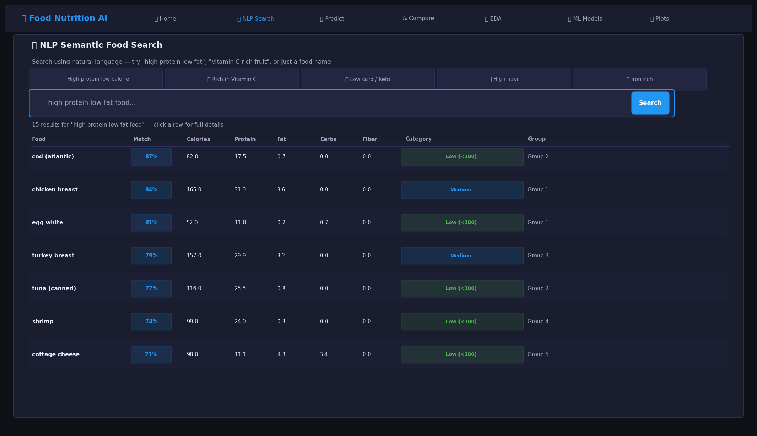
OUTPUT
Output — NLP Semantic Search
Query: "high protein low fat food" — 15 results ranked by TF-IDF cosine similarity score
NLP Match % — TF-IDF cosine score
Autocomplete — Suggests as you type
Click any row — Full nutrition profile
Food Nutrition AI | 14 / 16

Slide 15
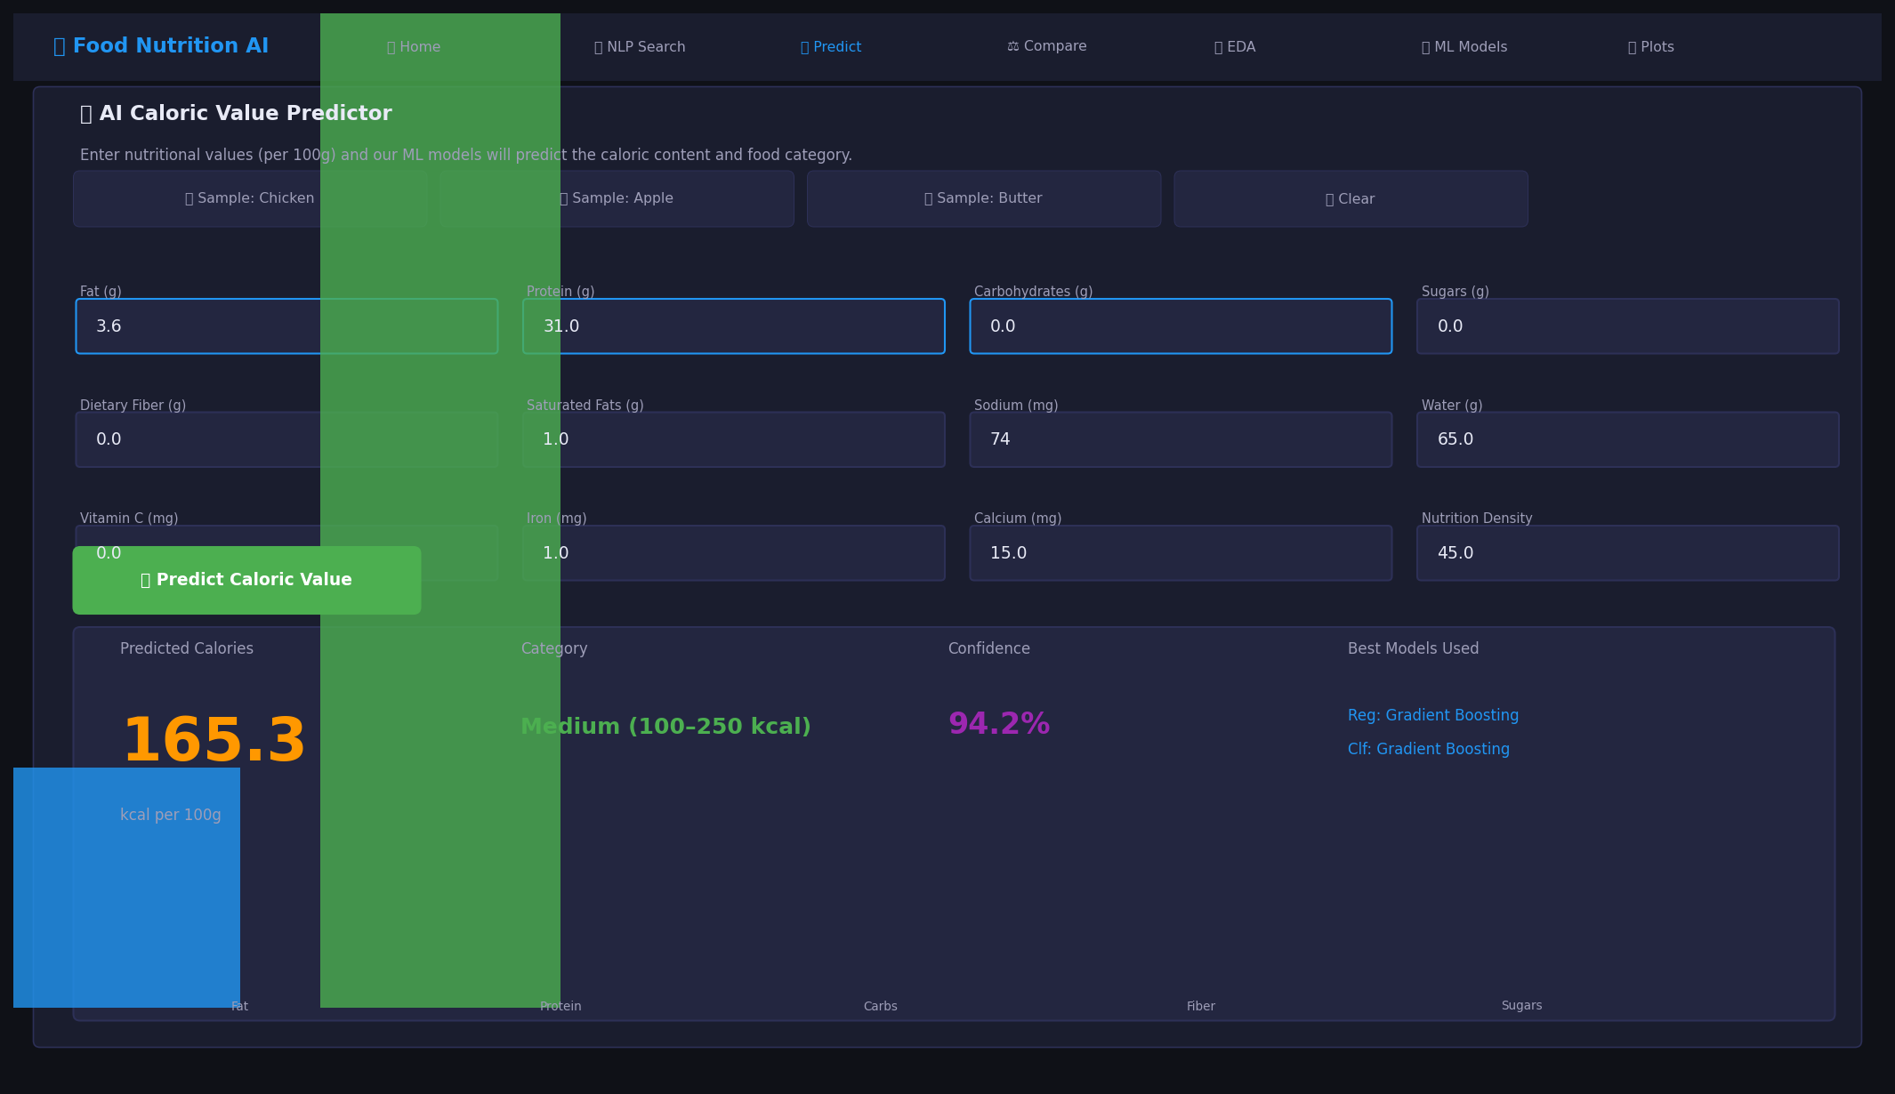
OUTPUT
Output — AI Caloric Predictor
Enter nutrient values → Gradient Boosting predicts calories, category & confidence in real time
Sample presets — Chicken, Apple, Butter
165.3 kcal — Predicted with 94.2% confidence
Best model shown — Gradient Boosting
Food Nutrition AI | 15 / 16

Slide 16
Conclusion & Future Work
What We Achieved
Future Work
NLP semantic search — natural language queries across 2,395 foods
→
BERT sentence encoders for richer search
Gradient Boosting Regression — R²=0.9987 caloric prediction
→
Recipe & processed food dataset expansion
Gradient Boosting Classifier — 97.8% food category accuracy
→
Daily diet goal planner / recommender
K-Means Clustering — 5 meaningful nutritional archetypes found
→
CNN food image recognition (camera input)
18 EDA visualisations — correlations, distributions, rankings
→
Mobile PWA deployment
Full Flask web app — 7 pages, REST API, dark theme UI
→
Real-time webcam ingredient detection
Derived Health Score metric — nutrients per calorie index
→
Multi-user meal planning collaboration
Food Comparator — side-by-side nutritional comparison
Thank You!
Food Nutrition AI | AI & Data Science Department
Built with Python · Flask · scikit-learn · TF-IDF · K-Means · Chart.js · Gradient Boosting
Food Nutrition AI | 16 / 16

