Slide 1

Passing By
Nathan Aun
Hugo Chávez
Stephanie Galván
Elisa Jiménez Todd
Mario Medina

Slide 2
Track: Community
Our team decided to tackle the community track, because El Paso’s strong sense of community is what makes El Paso Strong.
This project involves the creation of a community driven application that will encourage the growth of local businesses, participation in community events, and promote social well-being.

Slide 3
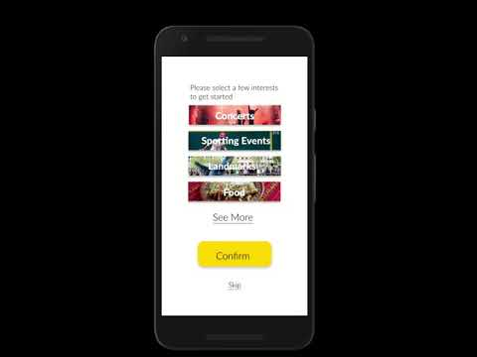
The look:
Sign-up / Login
Map
Feed
Leaderboard
Interested
Profile

Slide 4
Logo
Our logo is inspired by El Paso’s star.
A city (may remind you of buildings in El Paso) is represented on the back symbolizing how this app is intended to be a community work for all the city.
The star at the front is not only reminiscent of El Paso’s well known symbol, but also about reaching a goal,

Slide 5

Color and Font
#ffd500
The color yellow reminds us of a reward. Stars represent accomplishments, trophies, medals.
Our App intends for El Paso to reach a goal and get rewarded.
The font is a friendly thick font that shows up well in screens. It is a fun font without being too funky as to being uncomfortable.
#ffd500
Lato Black
Aa Bb Cc 1 2 3
Lato
Aa Bb Cc 1 2 3

Slide 6
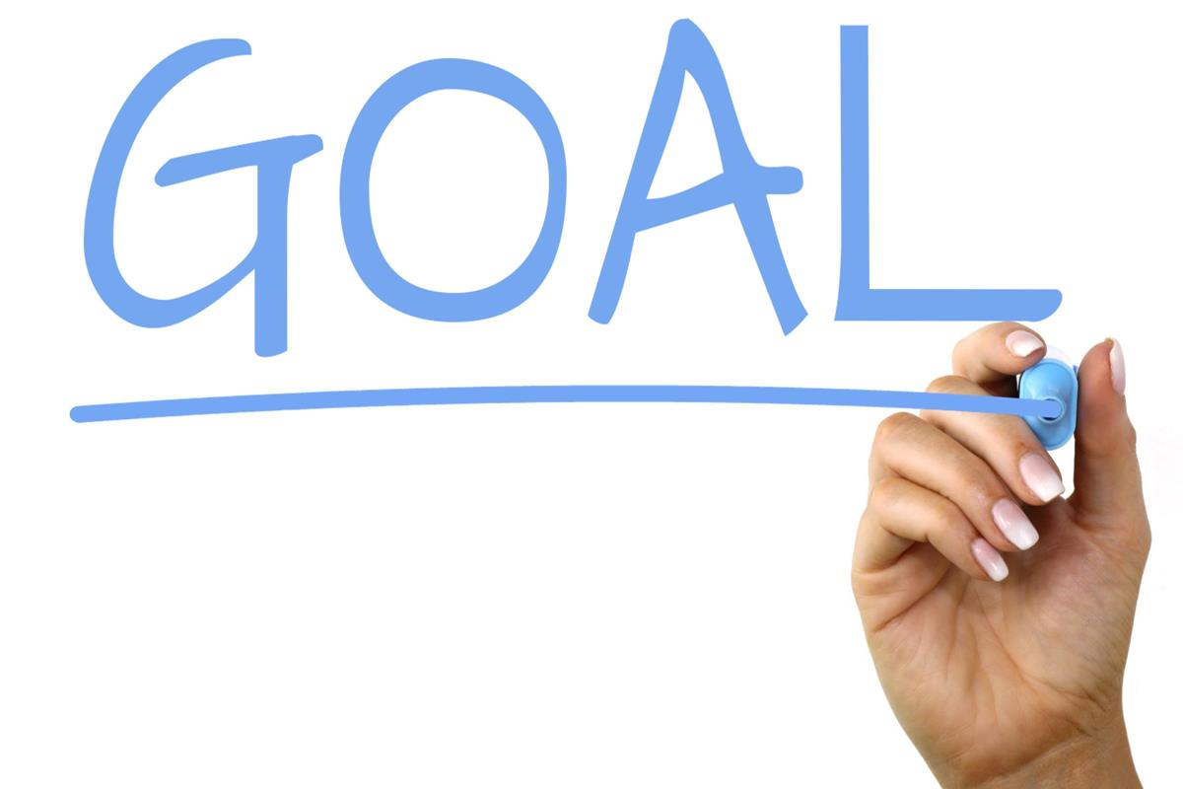
Impact / Usefulness
Our idea is to bring people together to reach a common goal. Setting goals is the main drive for someone to do something and take active participation on any project.
Competition, scores, and rewards can bring the best participation out of anyone. Which is why this app holds a personal leaderboard and an overall community scoreboard.
The fact that al El Pasoans can contribute to the scoreboard, brings the community together and promotes community events, activities and businesses.

Slide 7

Feasibility / Practicality
This app is adaptable for present and future events, as events are easy to be added and promoted, we expect as time passes, more and more events are created.
The idea of this app can be extended towards more cities, and as more cities participate, the better the competition gets, the more activities citizens participate in, and we achieve a greater sense of community.
Therefore, as time goes, the app is expected to become more effective.
At the end of the day, our app is a game and we want people to have fun, and fun never gets old. What better way to do it than meeting new people and learning about the city?

Slide 8

Technical Difficulty
The app contains many different features that require a different code.
We need a database for the users, events, and landmarks.
A database to store personal leaderboards as well as the overall leaderboard
We need admins of the app to regulate the events and landmarks, as well as manage the points awarded.
Google maps for the location service will be required.

Slide 9
Polish / Design / Functionality
The app is neat looking, using only black, white, grey and yellow.
It is well sectioned for easy access of information.
User friendly.
It leaves a gratifying experience on the user because when they complete activities the goal achievement bar increases, and when milestones are reached, a star gets colored.

Slide 10
Commercial Viability
Pitch: El Paso is a strong community that has shown it can become united in harsh times. However, there are many opportunities that pass unnoticed to many. There are events not made because of lack of promotion and uncertainty of attendance.
We are creating an easy access to this information through an app which also creates both a community goal and a competition which creates a positive reinforcement on participating on community events.

Slide 11
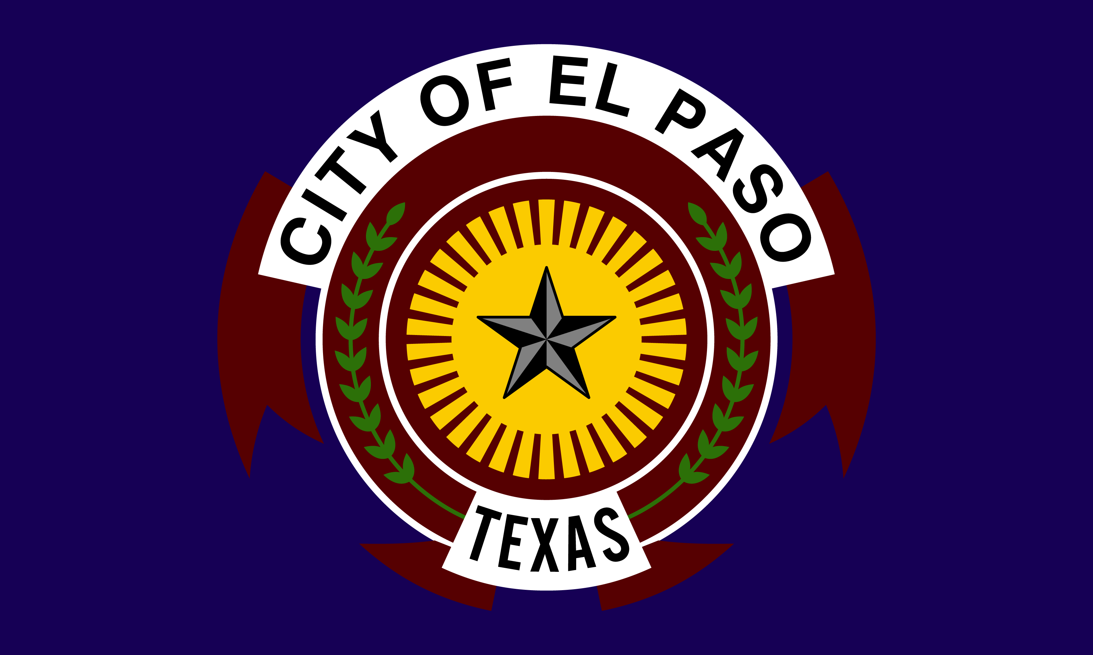
Commercial Viability
Viability: We intend to offer this services to the El Paso City Government, hopefully to promote events hosted by them and maybe for targeted renewal of different city areas. Another client we want to offer this service to is the Chamber of Commerce to be able to increment investment towards local businesses.
We also expect to hear from local businesses to host events and have the chance of providing some discounts as rewards. We intend to increase their sales efficiently and increment the flow of investment. Also we see the Student Council from different high schools and universities as clients by promoting their names and helping get students to relate more to their community and participate in academic and educational events.

Slide 12
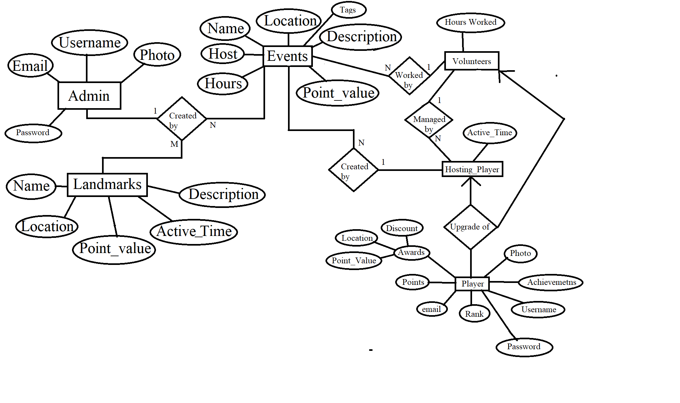
Entity Relationship model

