Slide 1
MINI PROJECT – EDA AND STATISTICS
TEAM MEMBERS :-
PRATYASA PATI
M R LAKSHMI PRIYA
PREETHI
DARSHANA SANTOSH PHALKE
SHWETA PURI

Slide 2
OVERVIEW OF PROJECT :-
Using the core statistical theoretical concepts and knowledge to solve real time problem statements.
Visualize a real time industry scenario where one can use these statistical concepts.
Detailed data analysis and number crunching using statistics
Exhaustive report building using EDA and visualization techniques to help the business take decisions using insights from the data

Slide 3


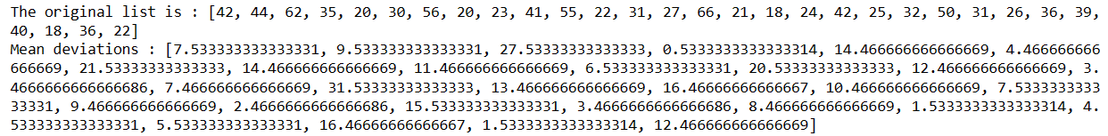
STATISTICAL ANALYSIS ON THE DATASET :-
PART A
The Dataset in the picture below is used for answering the following questions
Q1. Compute the mean, median and the mode of the data
Q2. Compute the range , variance and standard deviation of customer ages.
Q3. Find the mean deviation for the data.
print("The original list is : " + str(age))
res = []
# getting mean
mean_val = np.mean(age)
for ele in age:
# getting deviation
res.append(abs( ele - mean_val ))
print("Mean deviations : " + str(res))

Slide 4
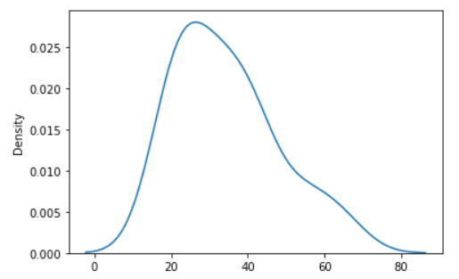


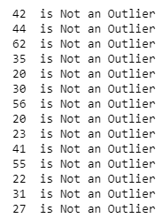
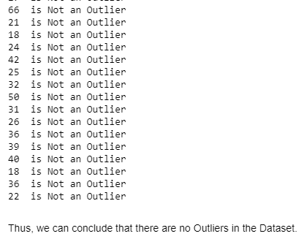
Q4. Calculate the Pearson coefficient of skewness and comment on the skewness of the data.
sns.kdeplot(age)
From the KDE Plot, we can determine that the list is slightly right skewed.
from scipy.stats import skew
skew(age)
Q6. Find the three quartiles and the interquartile range (IQR).
q1 = np.percentile(age,25)
q2 = np.percentile(age,50)
q3 = np.percentile(age,75)
iqr = q3 - q1
print('First Quartile =',q1)
print('Second Quartile =',q2)
print('Third Quartile =',q3)
print('Inter Quartile Range =',iqr))
Q7. Are there any outliers in the data set ?
ul= q3 + 1.5 * iqr # Upper Bound
ll= q1 - 1.5 * iqr # Lower Bound
# Checking if any element in the age list is not falling under the range of Upper Bound and Lower Bound
for i in age:
if (i>ul) | (i < ll) :
print(i)
else:
print(i,' is Not an Outlier')

Slide 5
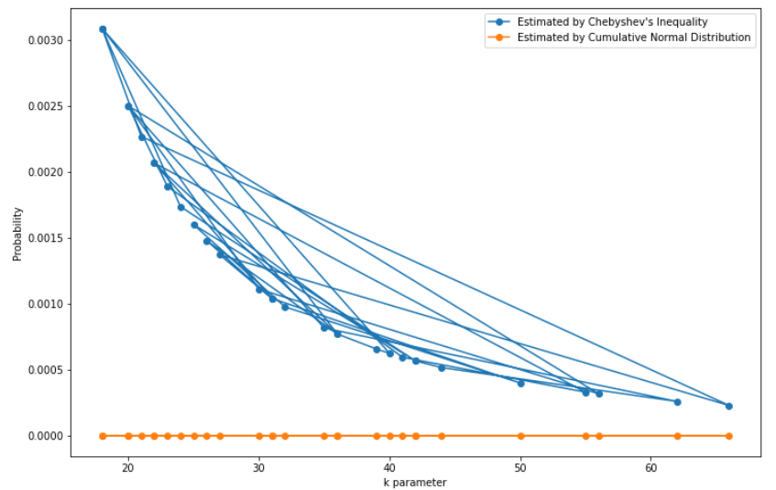
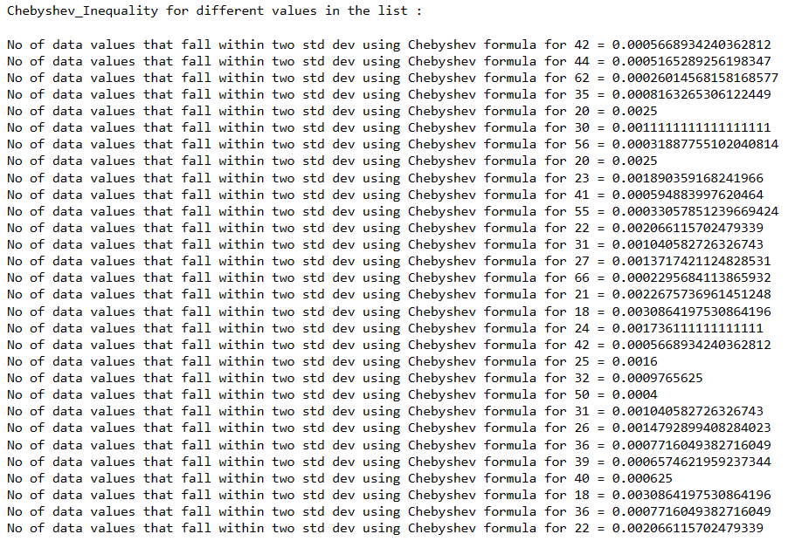
Q5. COUNT THE NUMBER OF DATA VALUES THAT FALL WITHIN TWO STANDARD DEVIATIONS OF THE MEAN. COMPARE THIS WITH THE ANSWER FROM CHEBYSHEV’S THEOREM.
from scipy.stats import norm
# Chebyshev's inequality formula
def chebyshev_inequality(k):
return 1 / k**2
# function to find probability for different values in the list
p_cheb = np.zeros(len(age))
print('Chebyshev_Inequality for different values in the list :\n')
for i in range(len(age)):
p_cheb[i] = chebyshev_inequality(age[i])
print('No of data values that fall within two std dev using
Chebyshev formula for',age[i],'=', p_cheb[i])
# Probability using normal distrbution
p_norm = np.zeros(len(age))
for i in range(len(age)):
p_norm[i] = (1 - norm.cdf(age[i])) * 2
plt.figure(figsize=(12,8))
plt.plot(age,p_cheb,'-o')
plt.plot(age,p_norm, '-o')
plt.xlabel('k parameter')
plt.ylabel('Probability')
plt.legend(["Estimated by Chebyshev's Inequality","Estimated by Cumulative Normal Distribution"]);
The figure shows that Chebyshev's Inequality provides an upper bound (the blue curve) for the true ratio of large numbers that can be drawn from a unit normal distribution (the orange curve). Note that Chebyshevs's Inequality provides tighter bounds for larger k values.

Slide 6
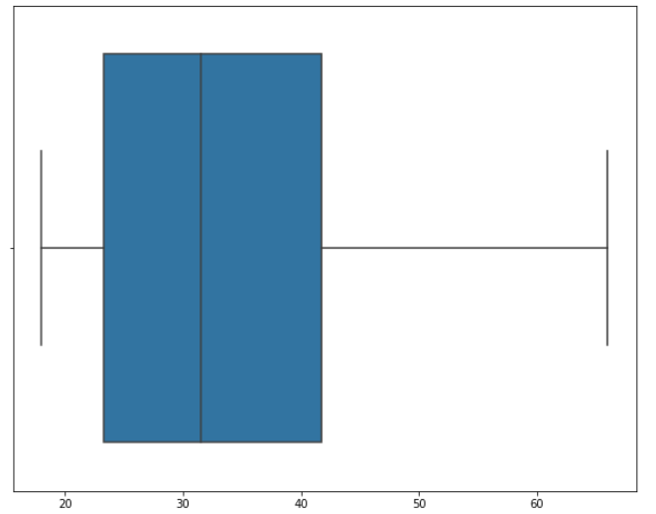

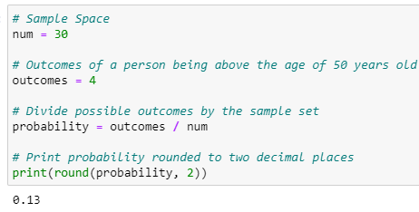
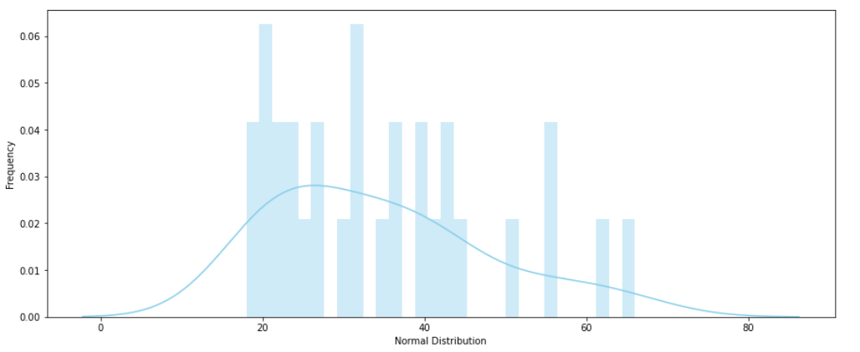
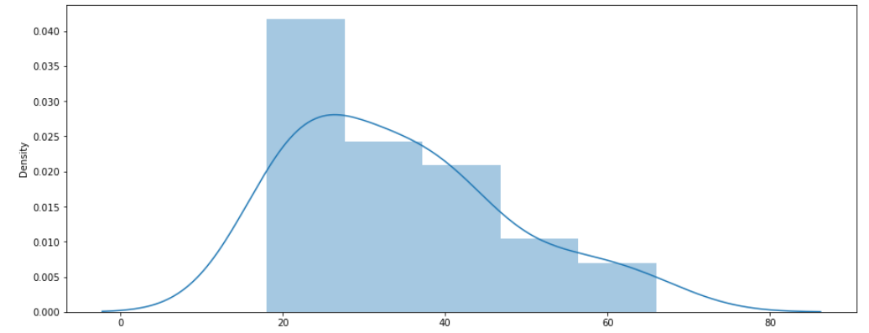
Q8. Draw a boxplot of the dataset to confirm there are no outliers in the dataset.
Q9. Find the percentile rank of the datapoint 50.
There are no outliers in the dataset.
Q10. What is the probability that a person ordering an EV scooter is above 50 years old?
Q11. Create a frequency distribution for the data and visualize it appropriately
#define Series
data = pd.Series(age)
#find frequencies of each value
data.value_counts()
plt.figure(figsize=(15,6))
sns.distplot(age)
Q12. Create a probability distribution of the data and visualize it appropriately.

Slide 7
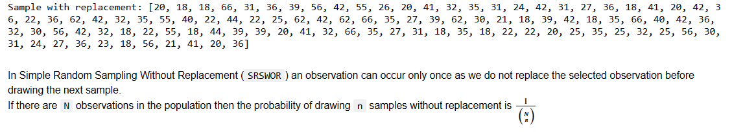

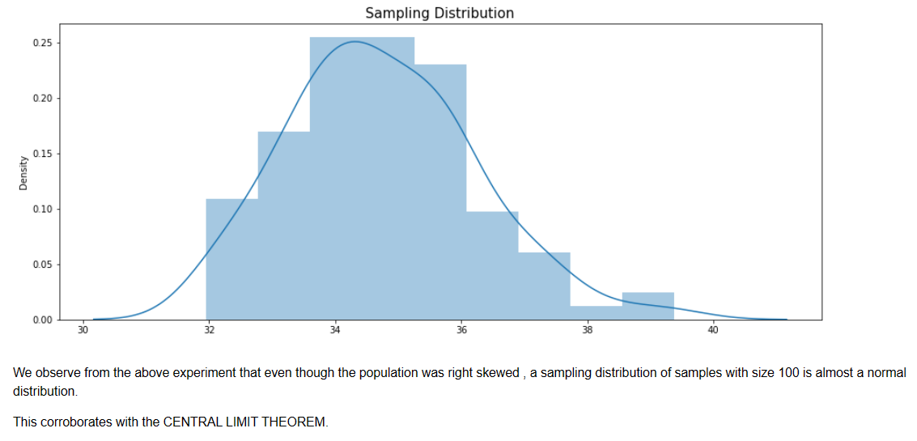
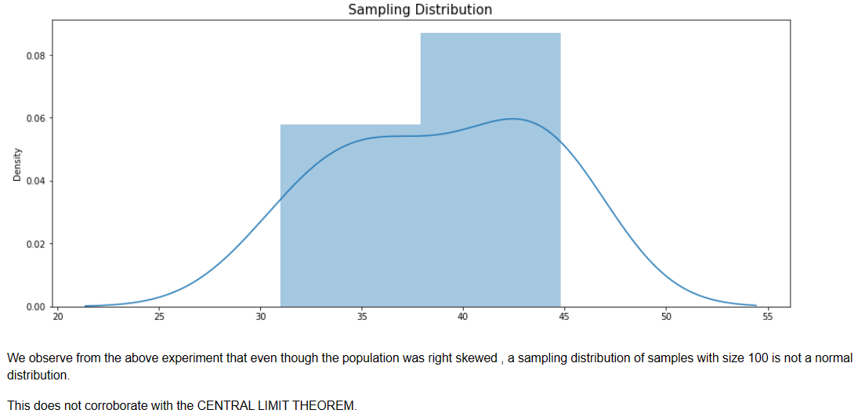
Sampling Distribution of Sample size 100
# pass the data to the parameter, 'population'
# pass the required sample size to the parameter, 'k'
sample_wr = random.choices(population = age, k = 100)
# print the sample
print('Sample with replacement:', sample_wr)
n_samples=100
sample_means = []
for i in range(n_samples):
sample = np.random.choice(sample_wr, size=100, replace=True)
sample_mean = np.mean(sample) sample_means.append(sample_mean) plt.figure(figsize=(15,6))
sns.distplot(sample_means)
plt.title("Sampling Distribution", fontsize=15)plt.show()
Q13. WHAT IS THE SHAPE OF THE DISTRIBUTION OF THIS DATASET? CREATE AN APPROPRIATE GRAPH TO DETERMINE THAT. TAKE 100 RANDOM SAMPLES WITH REPLACEMENT FROM THIS DATASET OF SIZE 5 EACH. CREATE A SAMPLING DISTRIBUTION OF THE MEAN AGE OF CUSTOMERS. COMPARE WITH OTHER SAMPLING DISTRIBUTIONS OF SAMPLE SIZE 10, 15, 20, 25, 30. STATE YOUR OBSERVATIONS. DOES IT CORROBORATE THE CENTRAL LIMIT THEOREM?
print("The skewness is: ",skew(sample_wr))
Sampling Distribution of Sample size 10

Slide 8
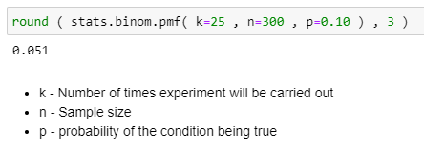
Q14. TREAT THIS DATASET AS A BINOMIAL DISTRIBUTION WHERE P IS THE PROBABILITY THAT A PERSON ORDERING AN EV IS ABOVE 50 YEARS AGE. WHAT IS THE PROBABILITY THAT OUT OF A RANDOM SAMPLE OF 10 BUYERS EXACTLY 6 ARE ABOVE 50 YEARS OF AGE?
prob = stats.binom.pmf(k = 6, n = 10, p = 4/50)
print('The probability that out of a random sample of 10 buyers exactly 6 are above 50 years of age :', prob)
Q15. A STUDY CLAIMS THAT 10% OF ALL CUSTOMERS FOR AN EV SCOOTER ARE ABOVE 50 YEARS OF AGE. USING THE NORMAL APPROXIMATION OF A BINOMIAL DISTRIBUTION, FIND THE PROBABILITY THAT IN A RANDOM SAMPLE OF 300 PROSPECTIVE CUSTOMERS EXACTLY 25 WILL BE ABOVE 50 YEARS OF AGE. [ NOTE THAT THE NORMAL DISTRIBUTION CAN BE USED TO APPROXIMATE A BINOMIAL DISTRIBUTION IF NP>=5 AND NQ>=5 WITH THE FOLLOWING CORRECTION FOR CONTINUITY P(X=Z) = P(Z-0.5 < X < Z+0.5 ) ]
Q16. COMPUTE A 95% CONFIDENCE INTERVAL FOR THE TRUE MEAN AGE OF THE POPULATION OF EV SCOOTER BUYERS FOR THE DATASET USING APPROPRIATE DISTRIBUTION.( STATE REASONS AS TO WHY DID YOU USE A Z OR T DISTRIBUTION)
# Data:
# (Normal) : Normal ?? (Shapiro Test) (Hypothesis)
stat, p_value = shapiro(age)
stat, p_value
# alpha = 0.05
# p = 0.032
# p > alpha
# Donot reject null hypothesis.
scipy.stats.ttest_1samp(age, np.mean(age))

Slide 9
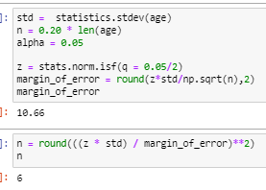
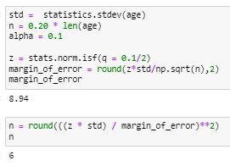

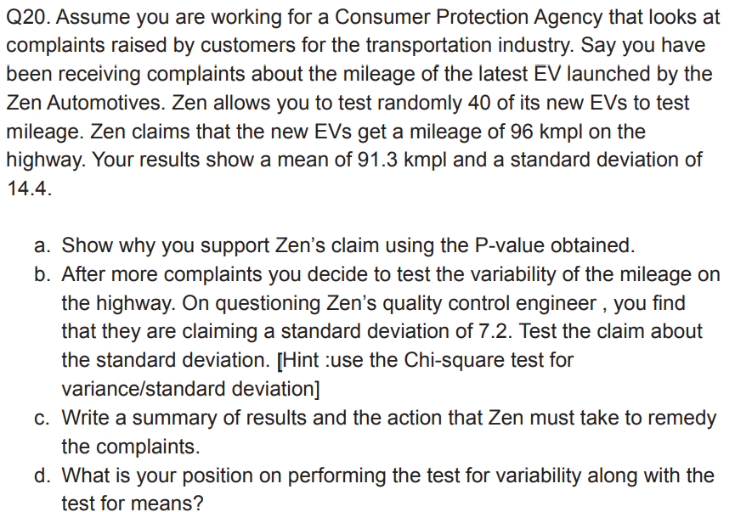
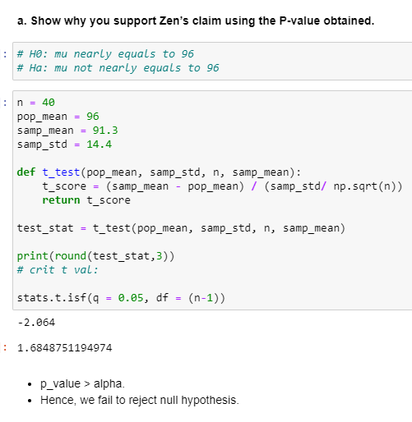
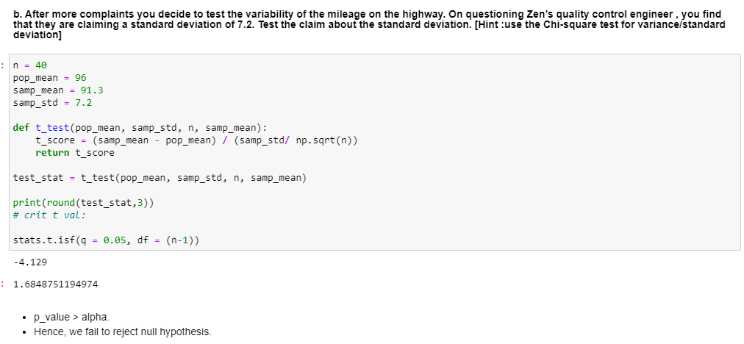
Q17. A DATA SCIENTIST WANTS TO ESTIMATE WITH 95% CONFIDENCE THE PROPORTION OF PEOPLE WHO OWN AN EV IN THE POPULATION. A RECENT STUDY SHOWED THAT 20% OF PEOPLE INTERVIEWED HAD AN EV. THE DATA SCIENTIST WANTS TO BE ACCURATE WITHIN 2% OF THE TRUE PROPORTION. FIND THE MINIMUM SAMPLE SIZE NECESSARY.
Q18. THE SAME DATA SCIENTIST WANTS TO ESTIMATE THE PROPORTION OF EXECUTIVES WHO OWN AN EV. SHE WANTS TO BE 90% CONFIDENT AND ACCURATE WITHIN 5% OF TRUE PROPORTION. FIND THE MINIMUM SAMPLE SIZE NECESSARY.
Q19. A RESEARCHER CLAIMS THAT CURRENTLY 20% OF THE POPULATION ARE OWNING EVS. TEST HIS CLAIM WITH AN ALPHA =0.05 IF OUT OF A RANDOM SAMPLE OF 30 TWO-WHEELER OWNERS ONLY 5 OWN AN EV.

Slide 10
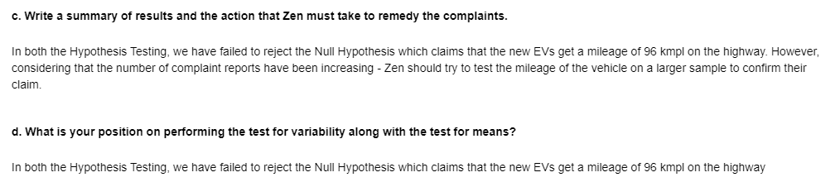
Q21. WRITE A REPORT COMPARING AND CONTRASTING DESCRIPTIVE VS INFERENTIAL STATISTICS IN ABOUT 200-500 WORDS AND HOW EACH HELPS TO GET MORE INSIGHT INTO THE DATA AT HAND.
Descriptive statistics are used to describe the characteristics or features of a dataset. The term ‘descriptive statistics’ can be used to describe both individual quantitative observations (also known as ‘summary statistics’) as well as the overall process of obtaining insights from these data. We can use descriptive statistics to describe both an entire population or an individual sample. Because they are merely explanatory, descriptive statistics are not heavily concerned with the differences between the two types of data.
So the measures which are usually used to perform any descriptive statistics are :
Distribution
Central tendency
Variability
In Inferential Statistics, the focus is on making predictions about a large group of data based on a representative sample of the population. A random sample of data is considered from a population to describe and make inferences about the population. This technique allows you to work with a small sample rather than the whole population. Since inferential statistics make predictions rather than stating facts, the results are often in the form of probability.
In our set of data as well, the Deferential Statistic measures we have used have given us information about raw data regarding its description or features and Inferential statistics, on the other hand, has helped us to draw inferences about the population by using data extracted from the population.

Slide 11
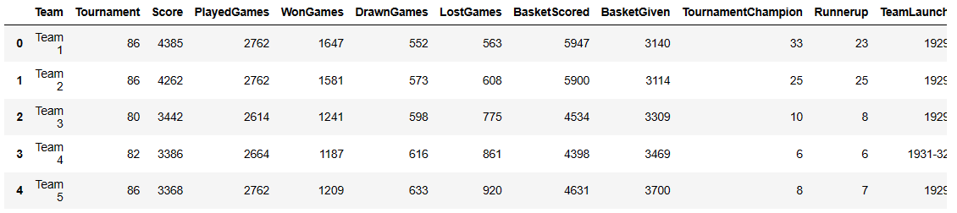
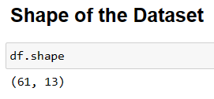
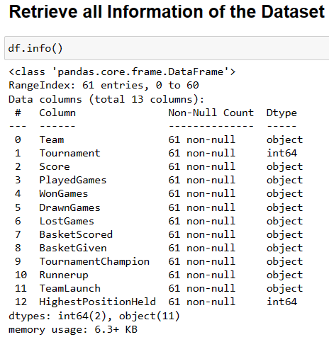
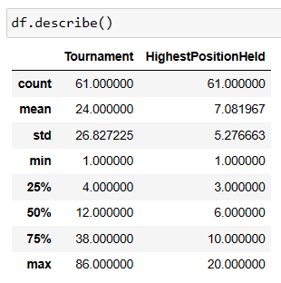
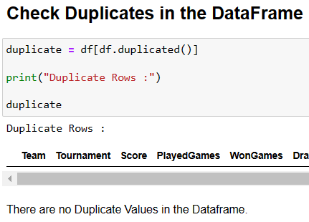
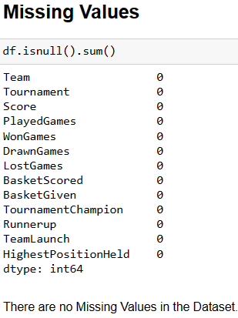
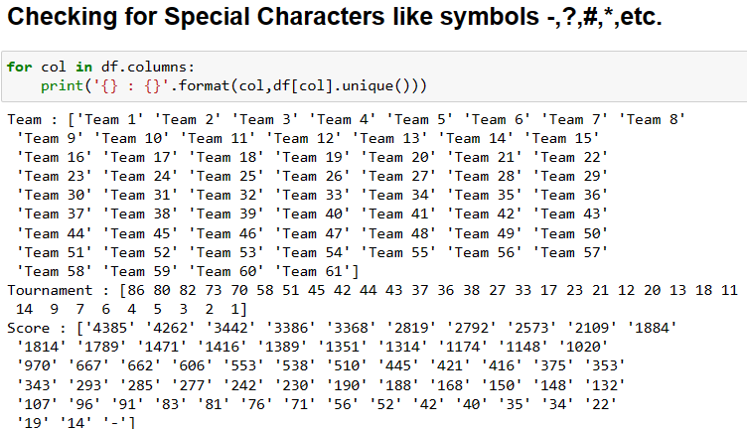
Read the data set, clean the data and prepare a final dataset to be used for analysis
PART B
1. Performing some analysis on the dataset

Slide 12
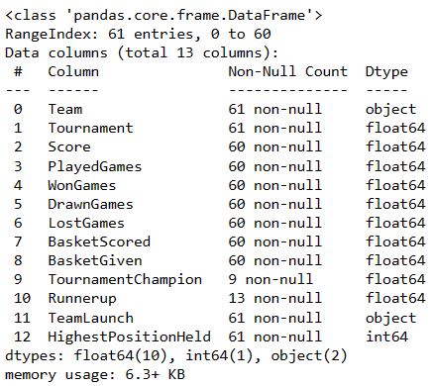
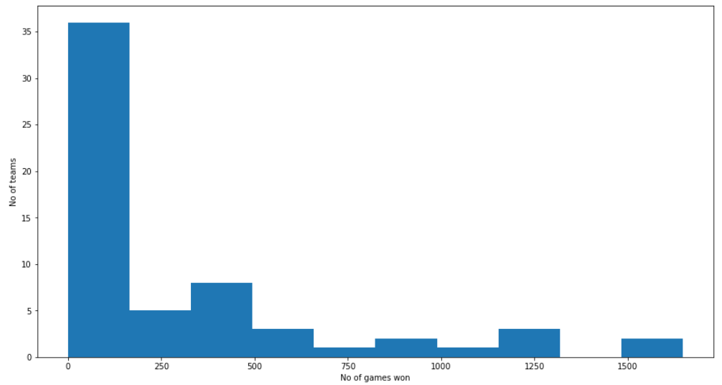
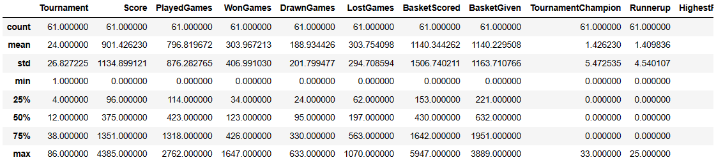
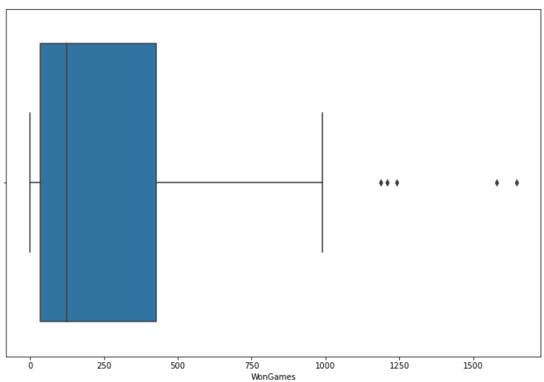
2. Cleaning the dataset
Converting Columns 2 to 11 into flat type to perform EDA
cols=['Tournament', 'Score', 'PlayedGames', 'WonGames', 'DrawnGames',
'LostGames', 'BasketScored', 'BasketGiven', 'TournamentChampion',
'Runnerup’]
df[cols] = df[cols].apply(pd.to_numeric, errors='coerce', axis=1)
df.info()
3. EDA ON THE DATASET
Replacing the NaN Values with 0
Total avg matches played by each team is around 800 out of which, winning and losing percentange is almost equal.
df.replace(np.nan, 0, inplace=True)
plt.figure(figsize=(15,8))
plt.hist(df['WonGames'])
plt.xlabel('No of games won')
plt.ylabel('No of teams')
plt.show()
For the column Team Launch, let's take the first year as year of origin
df['TeamLaunch']= df['TeamLaunch'].apply(lambda x: x[0:4])
df.describe()
Inference - We can see that the winning column is left skewed and most of teams won 0-200 matches
plt.figure(figsize=(12,8))
sns.boxplot(df['WonGames'])

Slide 13
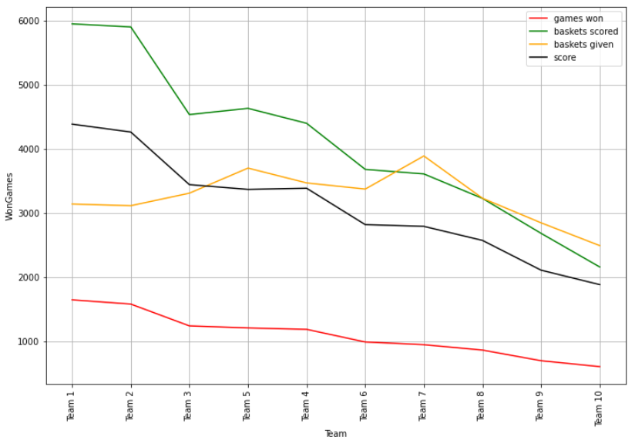
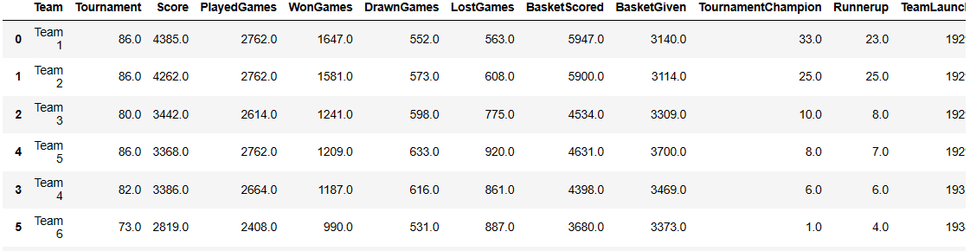
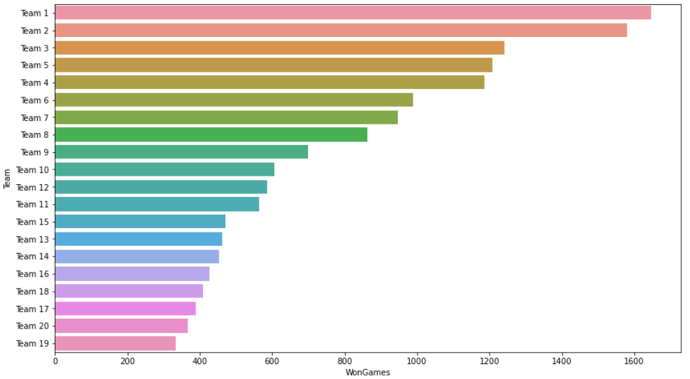
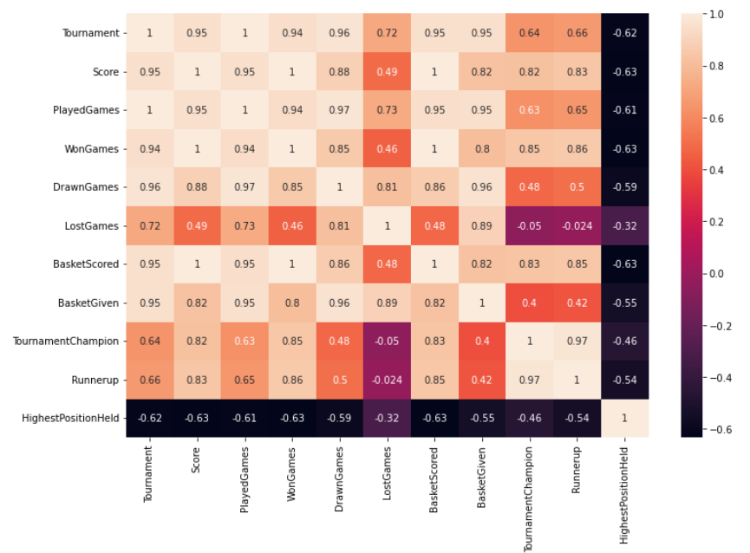
We have to find the best performing teams so now we will be focusing on individual rows instead of finding patterns in the whole dataset
We will find if the teams with max number of matches won also has the max number of baskets scored
# Details of the top 20 winning teams, also the teams with highest score
df_wongames = df.nlargest(20, ['WonGames'])
df_wongames
TOP 20 TEAMS WITH HIGHEST SCORE AND MOST NUMBER OF MATCHES WON
plt.figure(figsize=(14,8))
sns.barplot(y=df_wongames['Team'], x= df_wongames['WonGames'])
plt.show()
Inference -
TEAM 1 has the highest score, max games won and baskets scored.
Baskets given increases as number of matches won decreases
Inference - There is a very strong correlation between games won,baskets scored and the score

Slide 14
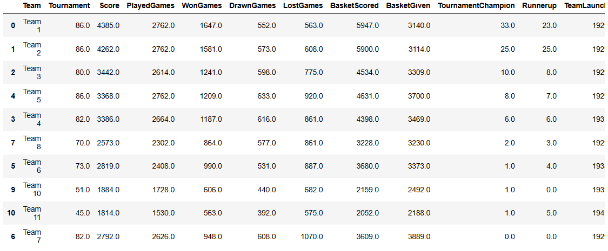
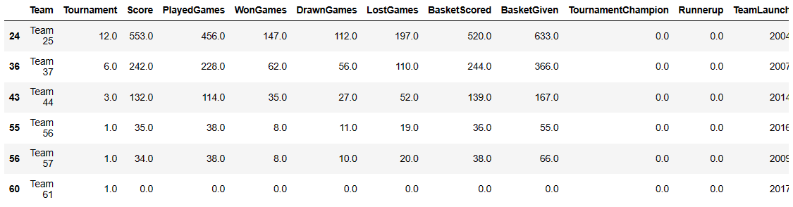
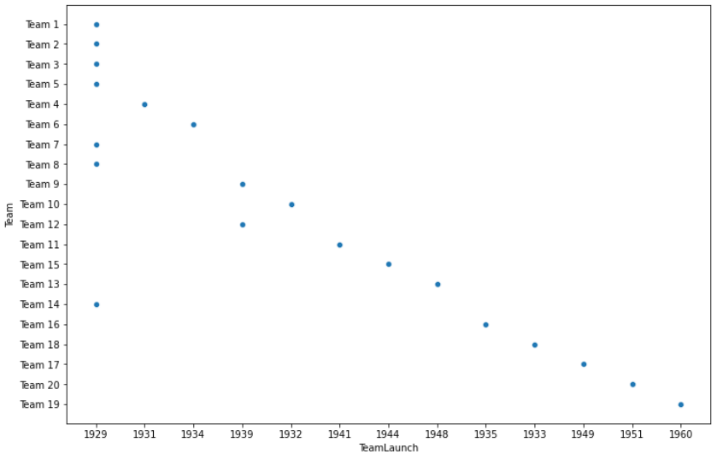

Teams who have been tournament champions for the max number of times
df.nlargest(10, 'TournamentChampion')
df[df['TeamLaunch']>='2000']
We can see that only 6 teams were launched after 2000s and their performance is below average so we will be discarding these
We can see that most of the top winning teams were launched in 1929-60s.
plt.figure(figsize=(12,8))
sns.scatterplot('TeamLaunch','Team', data=df_wongames)
We can add another column of probability of Winning and Losing a game of each team
x=0
df['Prob_Win']=0
for x in range(61):
df['Prob_Win'].iloc[x]= df['WonGames'].iloc[x]/ df['PlayedGames'].iloc[x]
x=0
df['Prob_Lose']= 0
for x in range(61):
df['Prob_Lose'].iloc[x]= df['LostGames'].iloc[x]/ df['PlayedGames'].iloc[x]

Slide 15
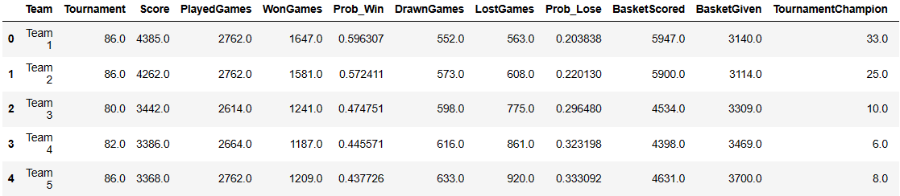
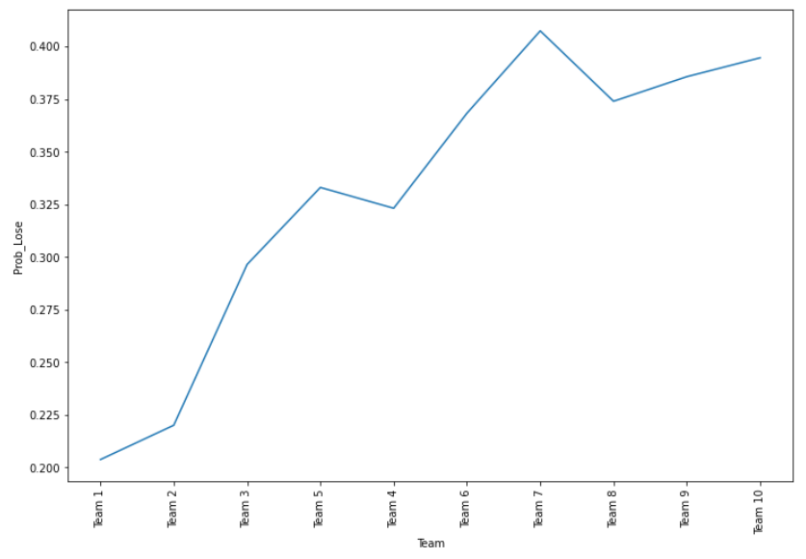
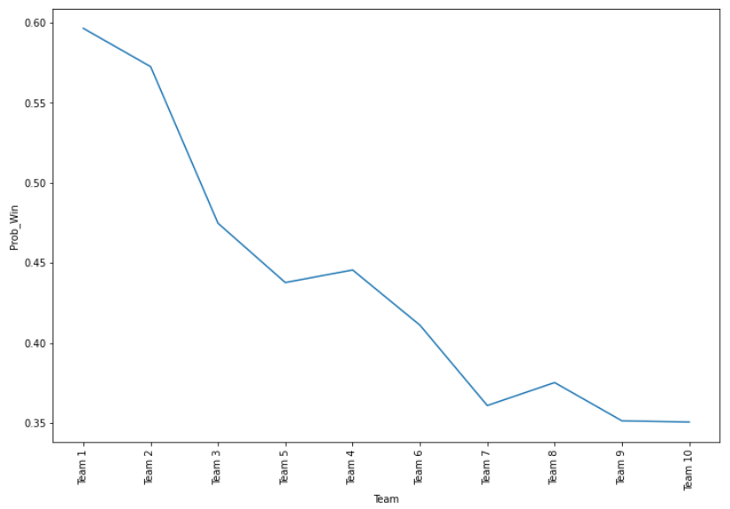
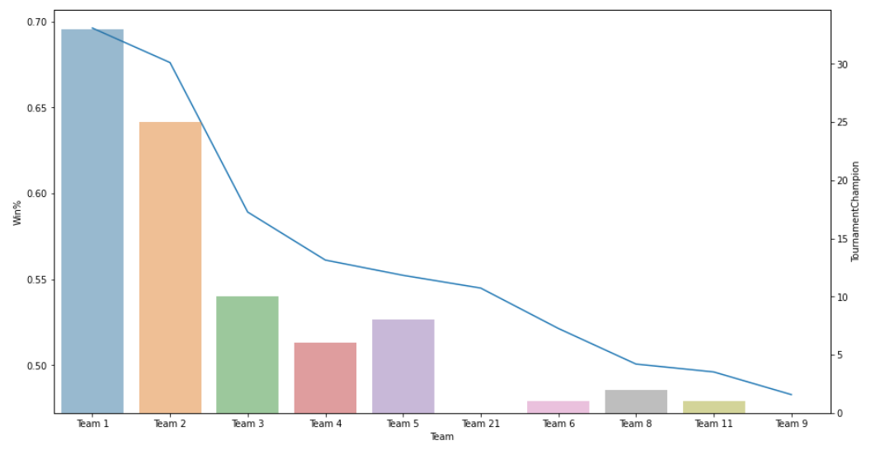
Rearranging the columns
df=df[['Team', 'Tournament', 'Score', 'PlayedGames', 'WonGames', 'Prob_Win', 'DrawnGames',
'LostGames', 'Prob_Lose','BasketScored', 'BasketGiven', 'TournamentChampion',
'Runnerup', 'TeamLaunch', 'HighestPositionHeld'
]]
Analyse the Probability of a Team wining the game
Analyse the Probability of a Team losing the game
plt.figure(figsize=(12,8))
sns.lineplot( 'Team', 'Prob_Lose',data=df_wongames.head(10))
plt.xticks(rotation=90)
plt.show()
df_wongames= df.nlargest(20, ['WonGames’])
plt.figure(figsize=(12,8))
sns.lineplot( 'Team', 'Prob_Win',data=df_wongames.head(10))
plt.xticks(rotation=90)
plt.show()
While looking for top performing teams, we can give less significance to the number of baskets scored because sometimes teams win after scoring even 1-2 baskets.
Teams with highest win%
ax1 = sns.set_style(style=None, rc=None )
fig, ax1 = plt.subplots(figsize=(15,8))
sns.lineplot('Team', 'Win%', data = df.nlargest(10, 'Win%'))
ax2 = ax1.twinx()
sns.barplot(data = df.nlargest(10, 'Win%'), x='Team', y='TournamentChampion', alpha=0.5, ax=ax2)

Slide 16
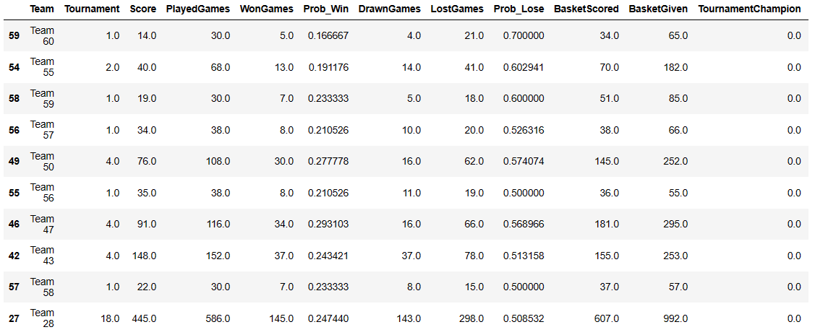
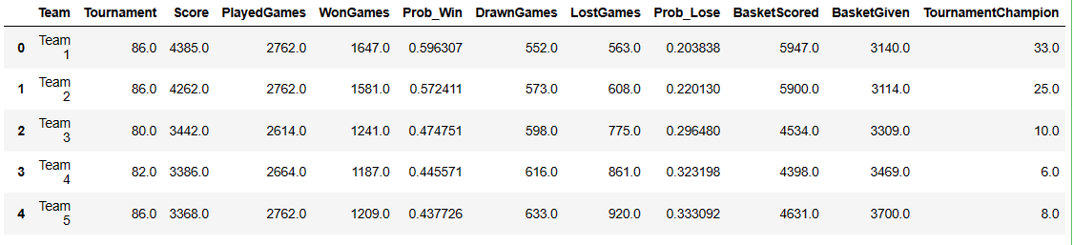
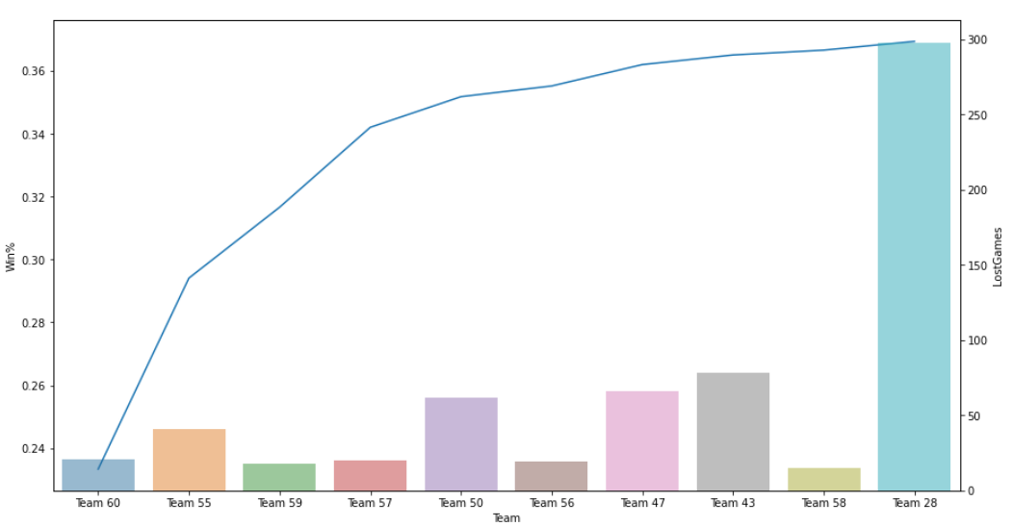
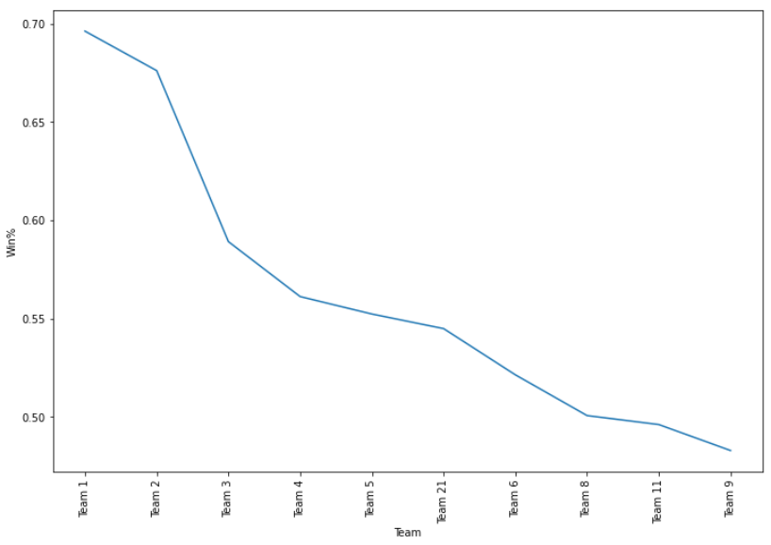
Teams with lowest performance: we will be considering the winning % because relatively newer teams have played less games so number of games won will not be a fair paramete
df.nsmallest(10, 'Win%')
Teams with lowest performance
We will now calculate the winning percentage according to the following formula: wins+ 0.5*ties/total games * 100%
x=0
df['Win%']=0
for x in range(61):
df['Win%'].iloc[x]= (df['WonGames'].iloc[x]+ 0.5* df['DrawnGames'].iloc[x])/ df['PlayedGames'].iloc[x]
df.replace(np.nan, 0)
df_wongames['TeamLaunch'] = df_wongames['TeamLaunch'].apply(pd.to_numeric, errors='coerce’)
ax1 = sns.set_style(style=None, rc=None )
fig, ax1 = plt.subplots(figsize=(15,8))
sns.lineplot('Team', 'Win%', data = df.nsmallest(10, 'Win%'))
ax2 = ax1.twinx()
sns.barplot(data = df.nsmallest(10, 'Win%'), x='Team', y='LostGames', alpha=0.5, ax=ax2)
plt.figure(figsize=(12,8))
df.nlargest(20, ['Win%'])
sns.lineplot( 'Team', 'Win%',data=df.nlargest(10, ['Win%']))
plt.xticks(rotation=90)
plt.show()

Slide 17
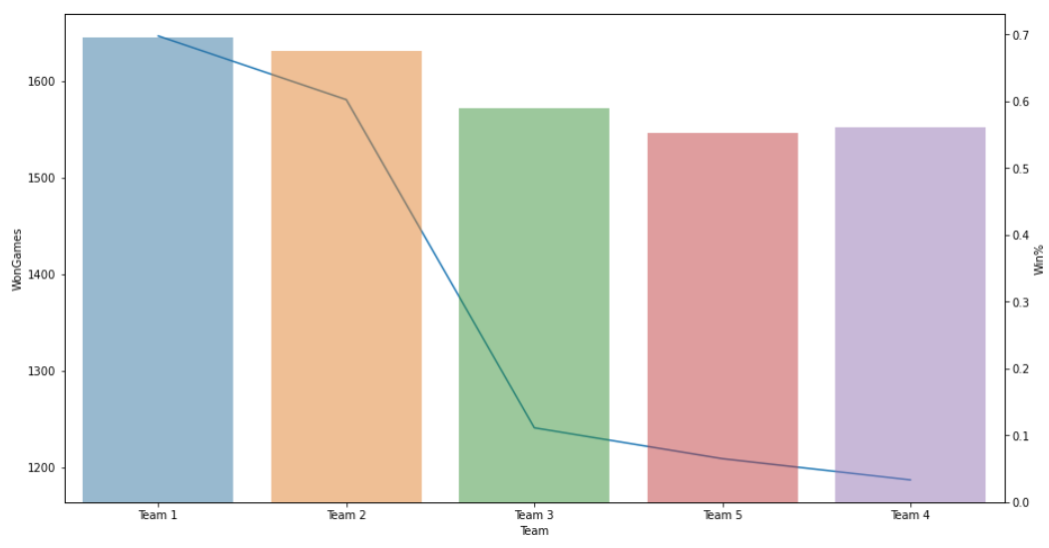
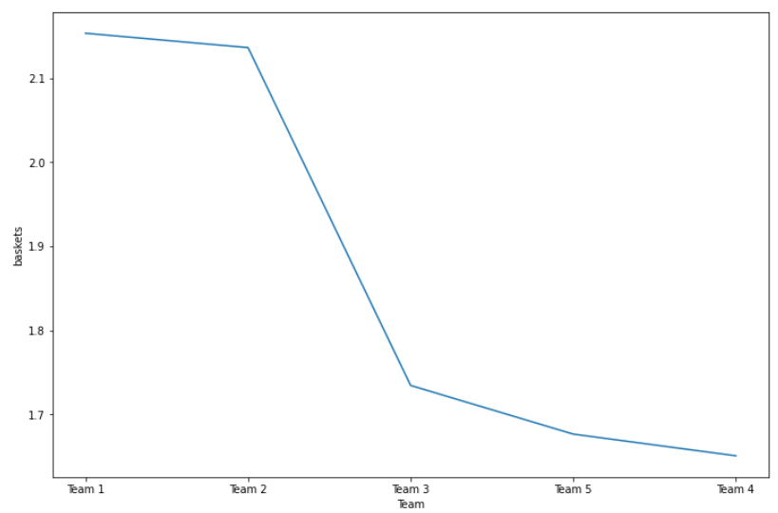
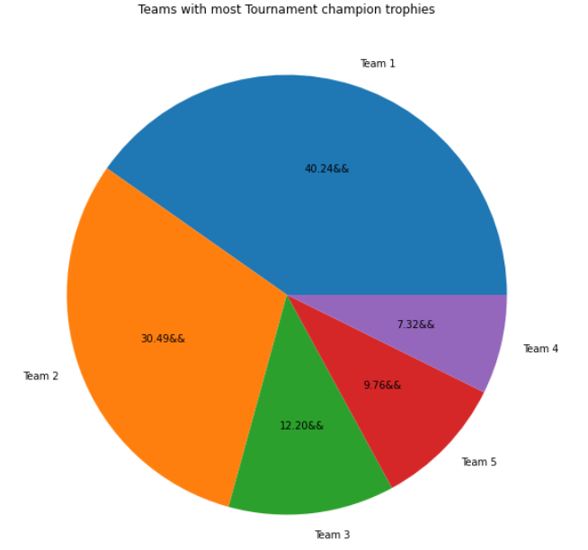
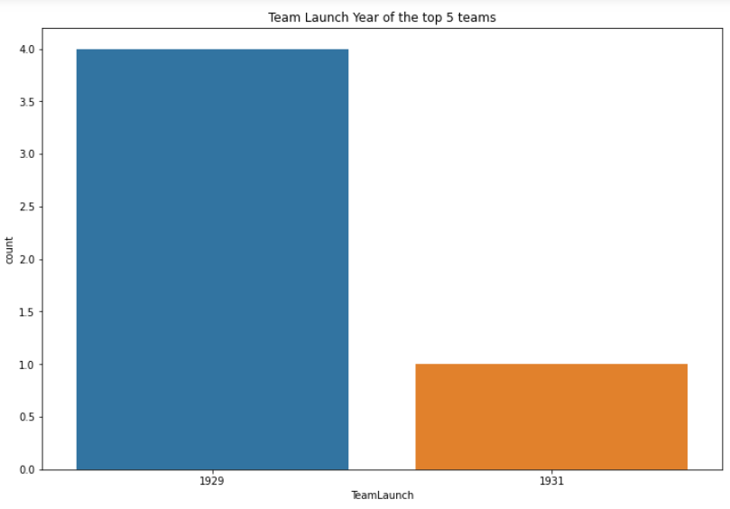
From the top 20 teams with highest scores, highest matches won, we'll combine it with teams having highest winning % to find the intersecting teams
df_winpercent = df.nlargest(20, 'Win%')
df_winpercent['TeamLaunch']=df_winpercent['TeamLaunch'].apply(pd.to_numeric, errors='coerce')
intersected_df = pd.merge(df_wongames, df_winpercent, how='inner’)
ax1=sns.set_style(style=None, rc=None)
fig,ax1= plt.subplots(figsize=(15,8))
sns.lineplot('Team', 'WonGames', data = intersected_df.head())
ax2 = ax1.twinx()
sns.barplot( x='Team', y='Win%', data= intersected_df.head(), alpha=0.5, ax=ax2)
Teams who scored max baskets per game
Team Launch Year of the Top 5 Games
Thus, we can approach any of the top 5 teams, TEAM 1,2,3,4,5 for the next matches

Slide 18

4. IMPROVEMENTS AND SUGGESTIONS FOR DATA POINTS
1. Quality:
Some of the columns had mixed data like TeamLaunch, special instructions can be mentioned while adding the data like 'only enter the year of team formation' to avoid this
For more options - here are the top 10 teams with their winning % which can be approached by the company's management
2. Quantity:
Since our dataset had only 61 entries, we couldn't figure out more trends. We can include information about the players of each team, at least of the captains. It would have given us some information about the team's performance under different captains.
3. Velocity:
Efficient speed of data collection can be achieved if we maintain a regular record of the games, keep adding data after every match
4. Variety:
Again, more information about the team players can help us add variety to the data and will help us understand trends over the years.
Conclusion:
Company X can approach the top 5 teams namely Team 1,2,3,4,5 since they have the highest score, max no of baskets scored, max winning % and maximum probability of winning the matches as well.

Slide 19
THANK YOU

