Slide 1
MINI PROJECT – PYTHON ANALYSIS ON BANK MARKETING
TEAM MEMBERS :-
PRATYASA PATI
M R LAKSHMI PRIYA
PREETHI
DARSHANA SANTOSH PHALKE
SHWETA PURI

Slide 2
OVERVIEW OF PROJECT :-
The problem is that the Bank Marketing Campaigns of a Portuguese Banking Institution need to identify the factors that cause the customers to tend to take the subscription, as well as Bank Marketing Campaigns of the institution need to identify the reasons behind the customer which make them not take the subscription.
The aim is to Determinate and analyse the factors for the subscription and non-subscription of the Bank Customers.

Slide 3
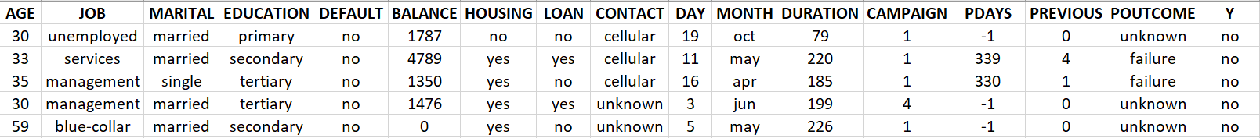
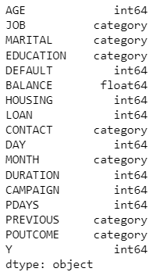
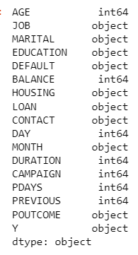
ANALYSE THE DATASET :-
The Dataset in the picture below represents the first few records of the Dataset which gives us information regarding the Bank Marketing Campaign Conducted -
Identify the Datatypes of the Features :-
bank.dtypes
After converting the Datatypes as per the Business Domain :-
def change_dtype():
for i in bank.columns:
if i == 'AGE' and type(i) != 'int64’:
bank.AGE = bank.AGE.astype('int64')
elif i == 'JOB' and type(i) != 'category':
bank.JOB = bank.JOB.astype('category’)
( To be continued similarly for other columns. )

Slide 4
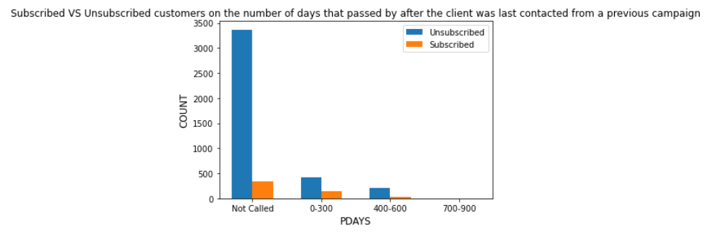
Use the Pdays feature and find does it cause any effect on the subscription of the term
unsubscribed = [unsub_not_called,unsub_called1,unsub_called2,unsub_called3]
subscribed = [sub_not_called,sub_called1,sub_called2,sub_called3]
fig, ax= plt.subplots()
bar1 = ax.bar(x-width/2 , unsubscribed , width, label='Unsubscribed')
bar2 = ax.bar(x+width/2 , subscribed , width, label='Subscribed')
plt.title("Subscribed VS Unsubscribed customers on the number of days that passed by after the client was last contacted from a previous campaign",fontsize=12)
plt.xticks([i for i in x],days) # Set text labels for X-axis
plt.xlabel('PDAYS', fontsize=12)
plt.ylabel('COUNT', fontsize=12)
days = ['Not Called','0-300','400-600','700-900’]
for i,j in zip(bank.PDAYS,bank.Y):
if j == 0:
if i == -1:
unsub_not_called += 1
elif i>=0 and i<=300:
unsub_called1 +=1
elif i>300 and i<=600:
unsub_called2 +=1
elif i>600 and i<=900:
unsub_called3 +=1
if j == 1:
if i == -1:
sub_not_called += 1
elif i>=0 and i<=300:
sub_called1 +=1
elif i>300 and i<=600:
sub_called2 +=1
elif i>600 and i<=900:
sub_called3 +=1

Slide 5
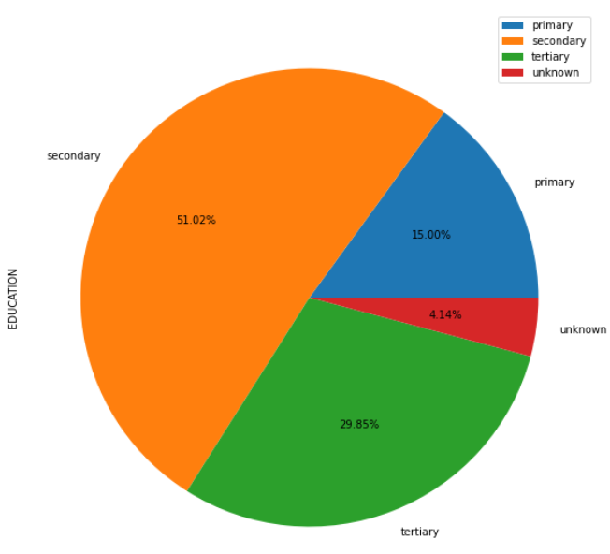
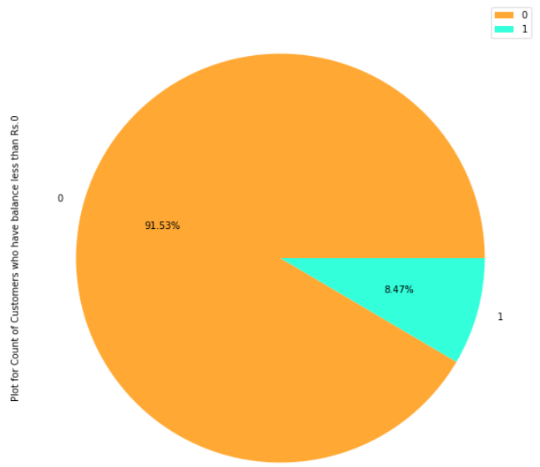
ANALYSE THE distribution(frequency) of the education
Does the customer take the term subscription who has less than 0 balance?
bank.groupby('EDUCATION').size().plot(kind='pie' , autopct='%.2f%%' , radius =1 ,legend=True ,label="EDUCATION" )
bank3 = bank[bank['BALANCE']<0]
mycolors=["#FFA833","#33FFDA"] bank3.Y.value_counts().plot(kind='pie',autopct='%.2f%%' , radius =1 , legend=True, colors=mycolors ,label="Plot for Count of Customers who have balance less than Rs.0")

Slide 6
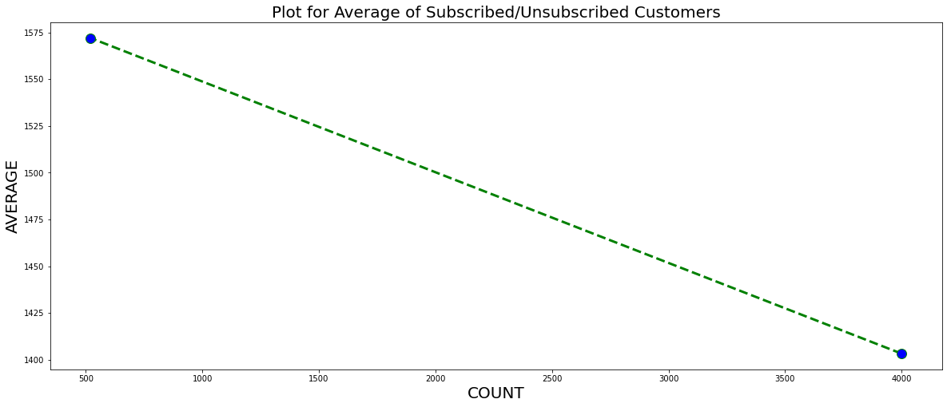
Find the average balance of the customer who belongs to the subscribed customer and non-subscribed customer
# Initializing variables for storing the count of the number of the customers in each category
count_unsubsribed = bank.Y.value_counts().loc[0]
count_subsribed = bank.Y.value_counts().loc[1]
# Initializing variables for storing the sum and average of the balance of the customers
avg_unsubsribed = 0
avg_subsribed = 0
sum_unsubsribed = 0
sum_subsribed = 0
# Using for loop to check if user is subscribed or not from Y column and take the sum of the balance accordingly
for i,j in zip(bank.Y,bank.BALANCE) :
if i==0:
sum_unsubsribed += j
else:
sum_subsribed += j
# Finding the average and rounding the value upto 2 decimals
avg_unsubsribed = round((sum_unsubsribed/count_unsubsribed) , 2)
avg_subsribed = round((sum_subsribed/count_subsribed) , 2)
count=[count_unsubsribed, count_subsribed]
average=[avg_unsubsribed, avg_subsribed]
plt.figure(figsize=(20,8))
plt.title('Plot for Average of Subscribed/Unsubscribed Customers', fontsize=20)
plt.xlabel('COUNT', fontsize=20)
plt.ylabel('AVERAGE', fontsize=20)
plt.plot(count,average,color='green', linestyle='dashed', linewidth = 3, marker='o', markerfacecolor='blue', markersize=12)
plt.show()

Slide 7
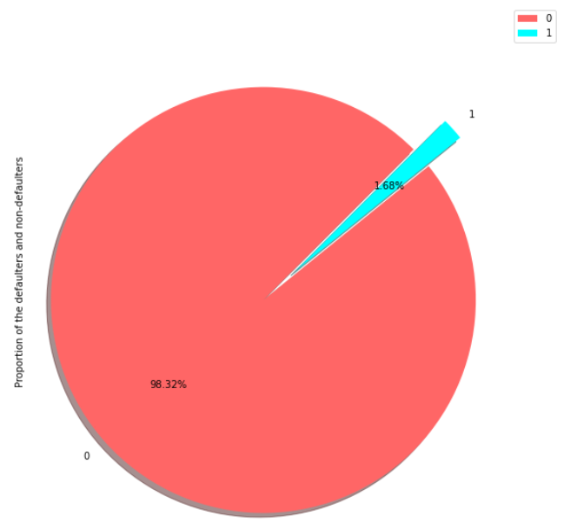
Use a pie plot to know the Proportion (distribution) of the defaulters and non-defaulters.
# The explode parameter, if specified, and not None, must be an array with one value for each wedge.
myexplode = [0.2,0]
# Add a shadow to the pie chart by setting the shadows parameter to True
# Set the color of each wedge with the colors parameter
mycolors = ["#ff6666", "cyan"]
bank.DEFAULT.value_counts().plot(kind='pie',autopct='%.2f%%', explode = myexplode, shadow = True , startangle = 45 , radius =1 ,legend=True , colors = mycolors ,label="Proportion of the defaulters and non-defaulters")

Slide 8
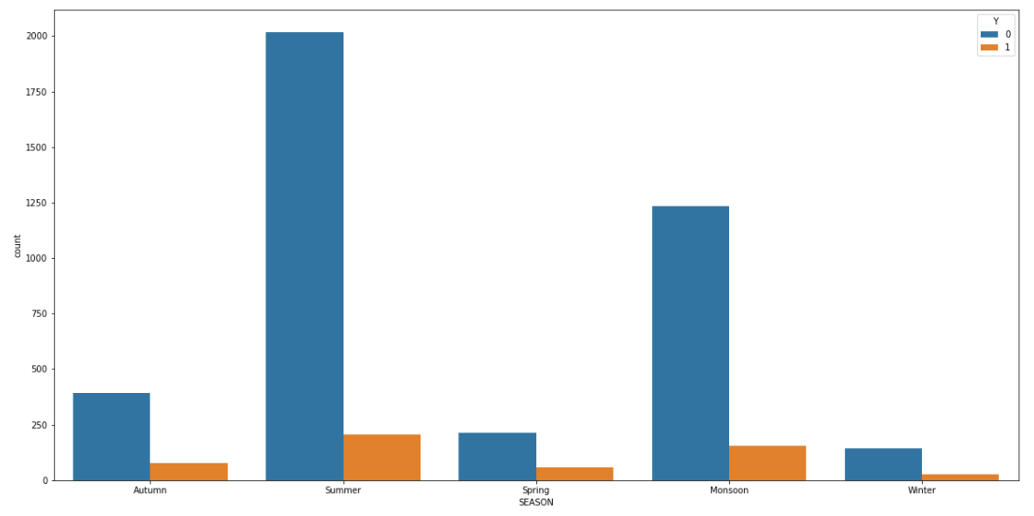
to create a new feature called season using the month column and analyse the new feature with the y feature
def check_season():
seasons = {'jan': 'Winter','feb':'Spring','mar': 'Spring', 'apr':'Summer’ , 'may':'Summer' , 'jun':'Summer' , 'jul':'Monsoon' , 'aug':'Monsoon’ , 'sep':'Monsoon' , 'oct':'Autumn' , 'nov':'Autumn' , 'dec':'Winter'}
Bank['SEASON'] = bank['MONTH'].apply(lambda x : seasons[x])
print(bank)
sns.countplot(x ='SEASON', hue='Y' ,data = bank)

Slide 9
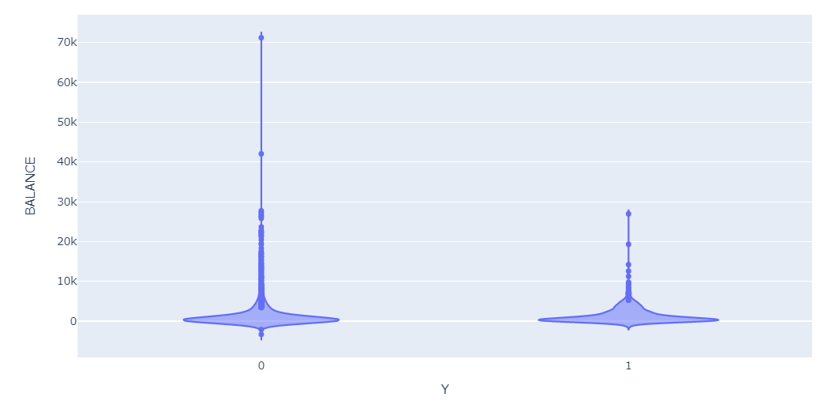
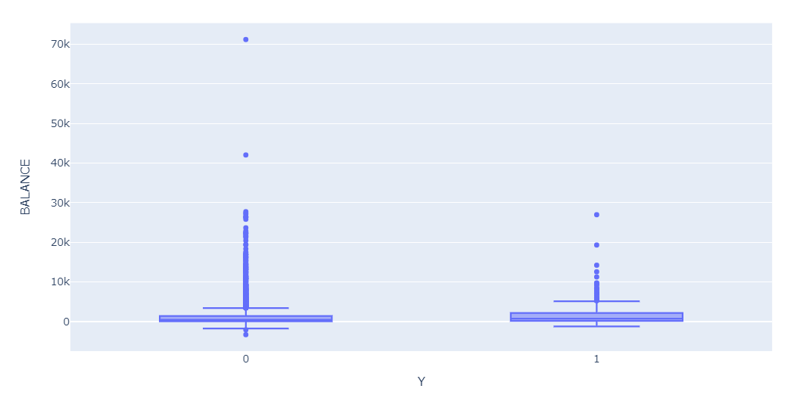
find the distribution of the balance for each class of the Y column USING THE the violin plot and the box ploT
fig = px.violin(bank, x="Y", y="BALANCE")
fig = px.box(bank, x="Y", y="BALANCE")

Slide 10
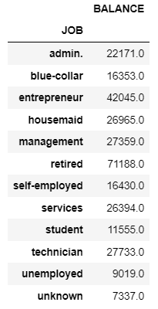
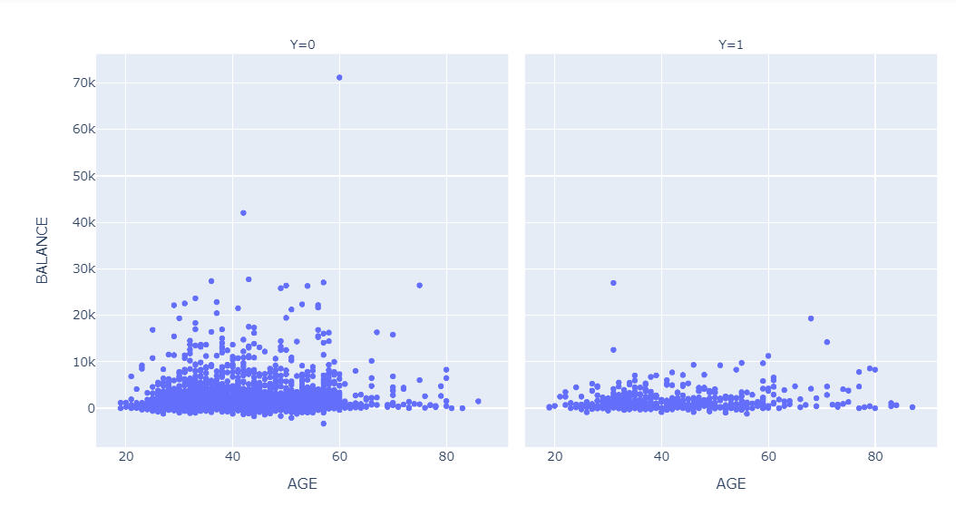
Use Pivot table to find the maximum balance for each type of job
pd.pivot_table( bank , index='JOB' , values='BALANCE' , aggfunc='max' )
RELATIONSHIP BETWEEN the Age, balance and Y FEATURES USING SCATTER PLOT
# Importing Plotly
import plotly.express as px
px.scatter(bank, x="AGE", y="BALANCE", facet_col="Y")

Slide 11
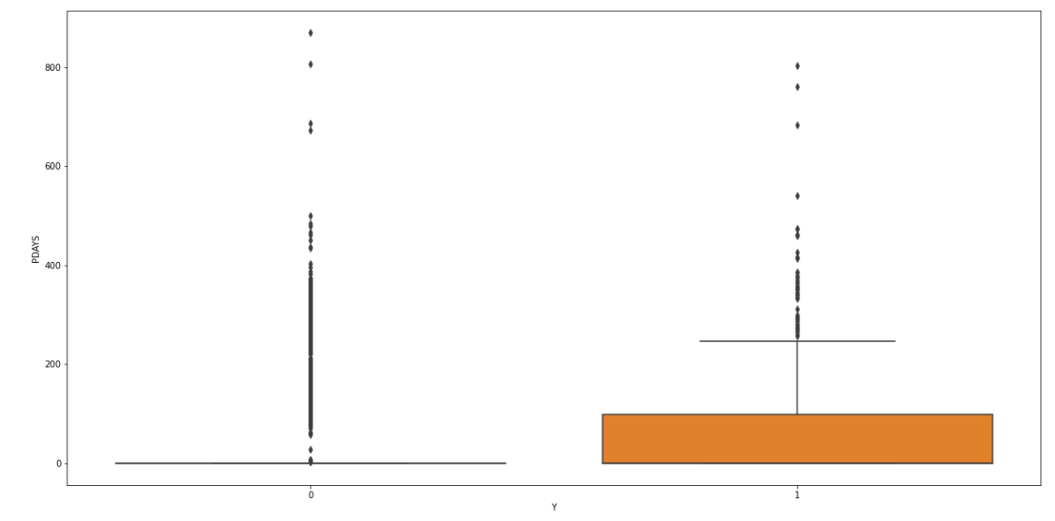
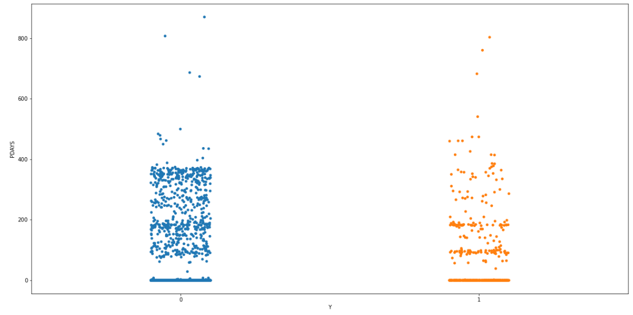
Use Box plot and strip plot to know the distribution of the Pdays with respect to Y classes and differentiate both plots
sns.boxplot(bank['Y'],bank['PDAYS'])
sns.stripplot(bank['Y'],bank['PDAYS'] )

Slide 12
THANK YOU

