Slide 1
MINI PROJECT – SLR, SLC & ULC
TEAM MEMBERS :-
PRATYASA PATI
M R LAKSHMI PRIYA
PREETHI
DARSHANA SANTOSH PHALKE
SHWETA PURI

Slide 2
OVERVIEW OF PROJECT:-
Stroke is a severe cerebrovascular disease caused by an interruption of blood flow from and to the brain. As a direct consequence of this interruption, the brain is not able to receive oxygen and nutrients for its correct functioning.
The other way around, the brain is not able to drain and expel through blood vessels all of its waste, like dead cells. In a question of minutes, the brain is in a critical condition as brain cells will imminently begin to die.
The dataset provides relevant data regarding the likelihood of patients suffering from stroke disease. It is easy to understand that a patient with high glucose levels and BMI, who has suffered from heart disease and/or hypertension, is more likely to suffer from stroke.
In this project, with the aid of machine learning (ML), several models are developed and evaluated to design a robust framework for the long-term risk
prediction of stroke occurrence.

Slide 3
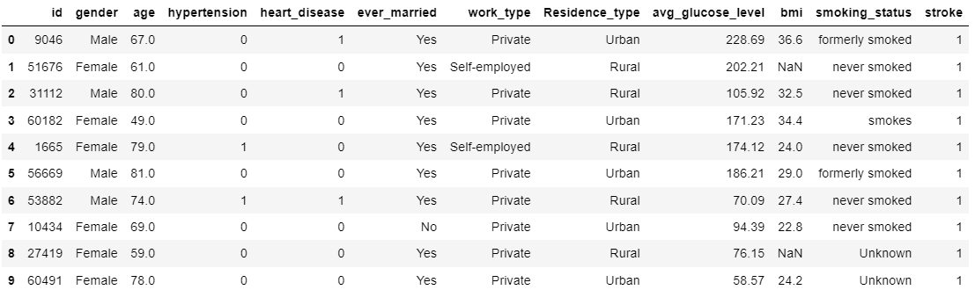

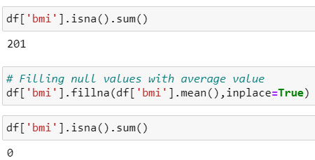
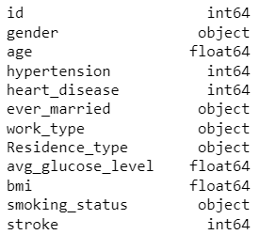
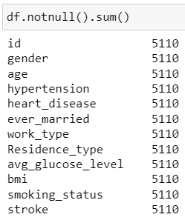
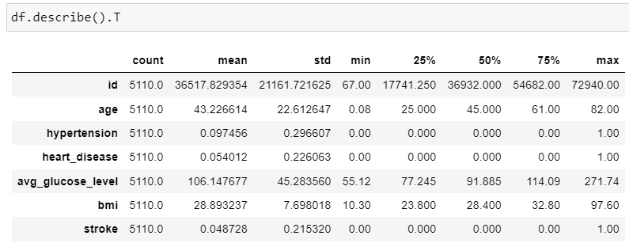
1. Read the dataset and view the first 10 rows of it.
2. Check the shape/dimension of the dataset.
3. Check for the missing values. Display the number of missing values per column.
4. Investigate and predict the missing BMI Value.
5. Check the datatype, number of non-null values, and name of each variable in the dataset.
6. Check the descriptive statistics of the dataset.

Slide 4
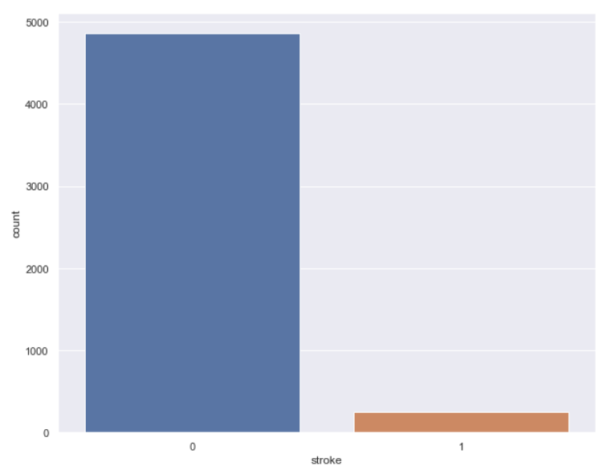
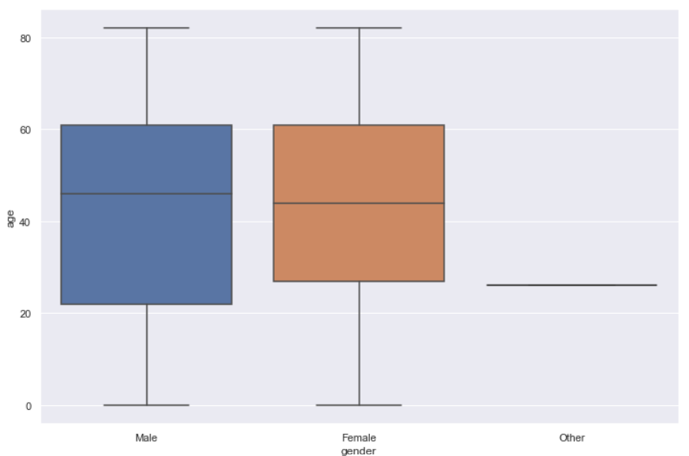
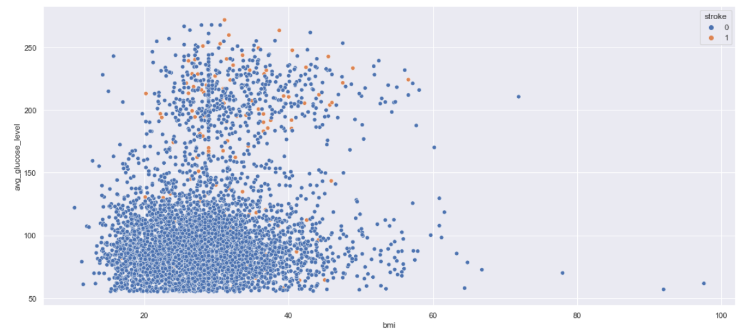
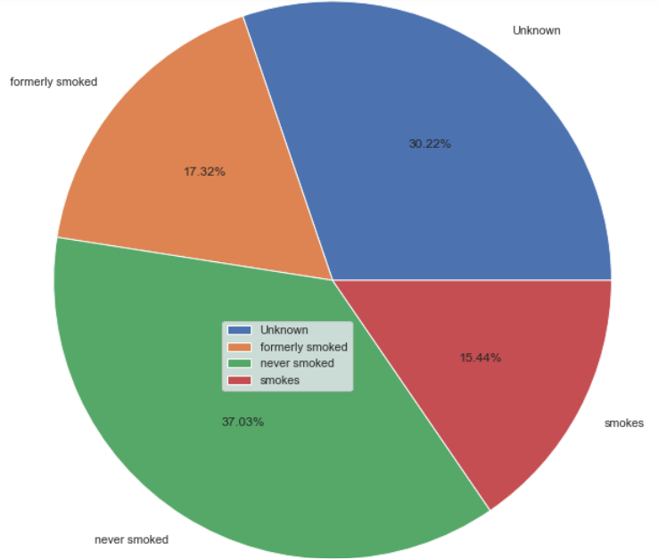
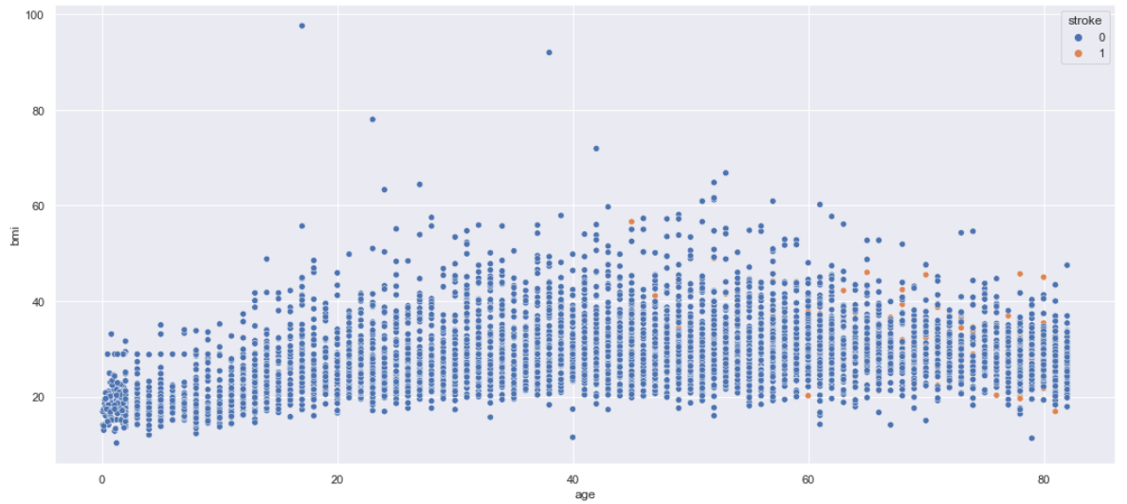
7. Visualize the proportion of Stroke samples in the dataset.
8. Visualize the Distribution of Male and Female Ages.
9. Visualize the stroke sample based on -
a) BMI and Glucose Level
b) BMI and Age
10. Using the pie chart visualizes the proportion of different smoking categories among the stroke population.

Slide 5
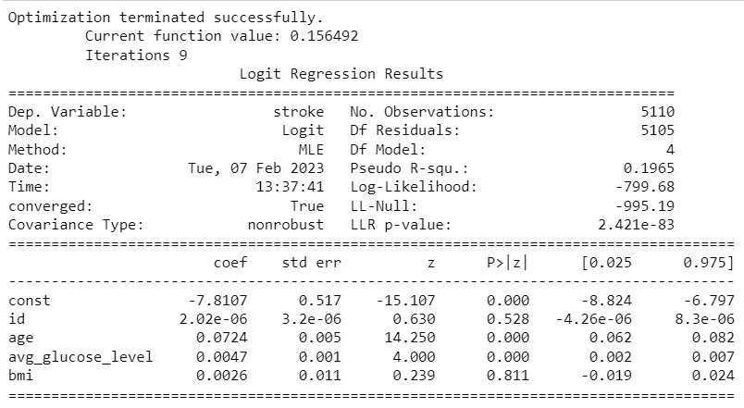
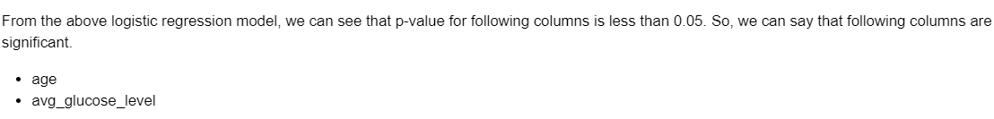
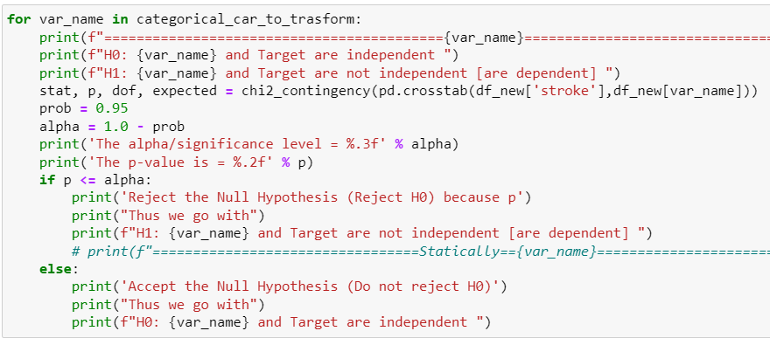
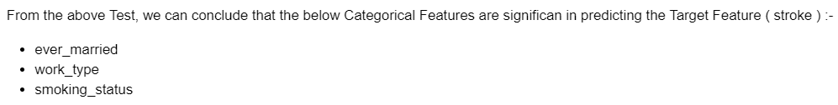
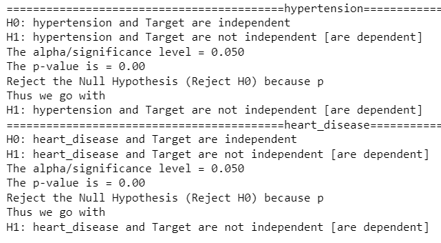

11. Perform hypothesis testing to find the significant variables.
Using a Linear Regression Model to generate the p-value of all the Numerical Columns to test the Significance of the columns on the Target Column.
Performing Chi-Square Contingency Test to check the significance of the Categorical Columns on the Target Column.
To check the Significance of the Numerical Features having Categorical Values, we first encoded all the features using the Label encoding Technique and then performed Chi-Square Contingency Test to check the significance.

Slide 6
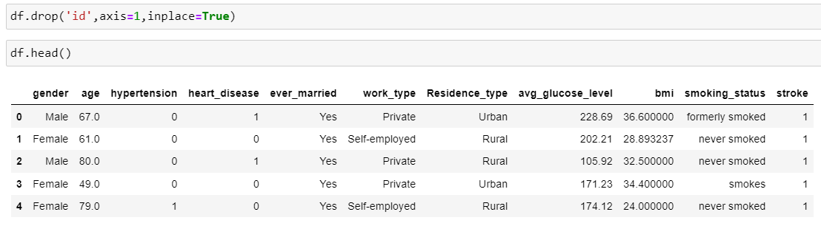
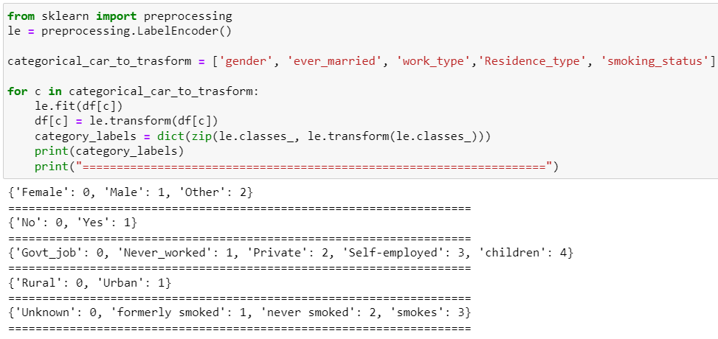
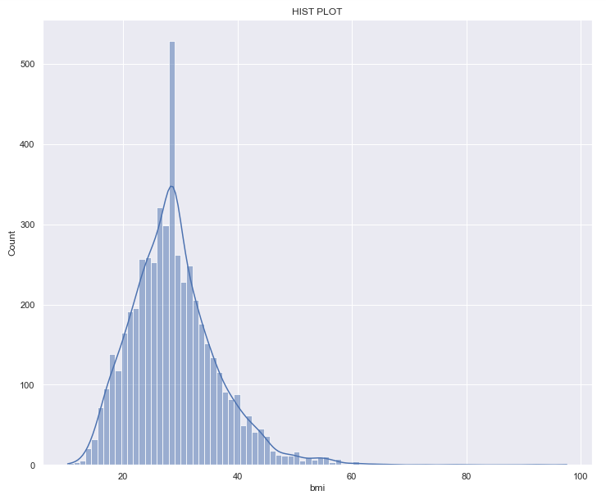
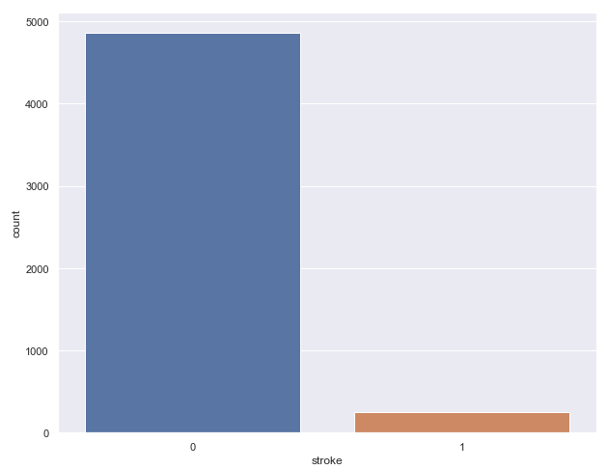
12. Drop the unnecessary columns.
13. Write the code to encode the Categorical Features.
14. Check the distribution of 'bmi' and 'stroke' columns in the dataset.

Slide 7
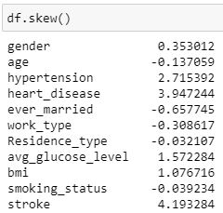
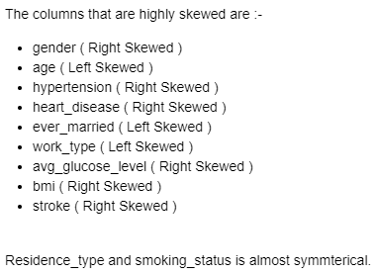
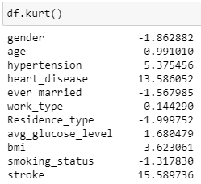
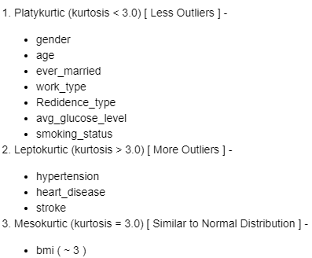
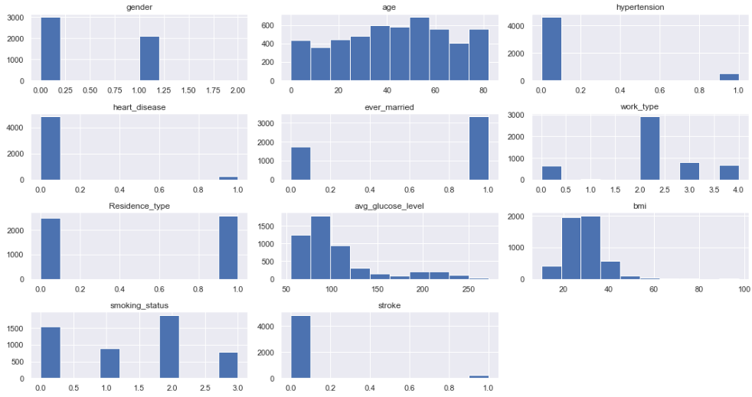
15. List down columns that are highly skewed.
16. List down columns that are highly kurtosis.
17. Find the distribution of all variables with respect to the outcome 'stroke' variable.

Slide 8
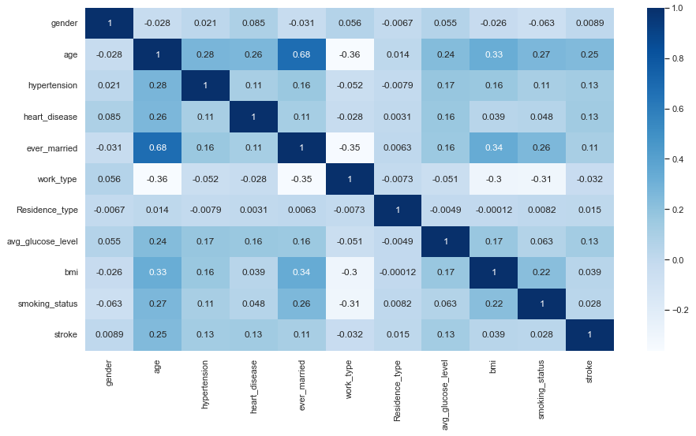
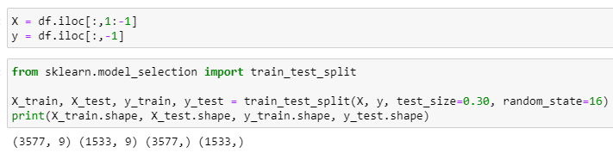
18. Plot the heatmap for the correlation matrix for the given dataset.
There are no columns in our data frame which are Highly Correlated ( within the range of 0.7 to 1 ).
The age and ever-married features moderately correlated with a value of 0.68.
19. Split the dataset randomly into train and test datasets. Use a training ratio of 70:30 ratio.

Slide 9
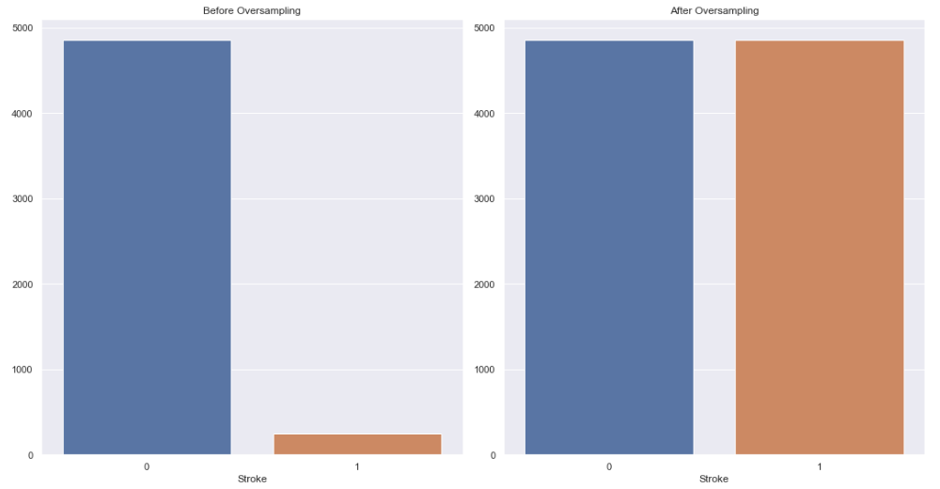
20. Check whether the dataset is balanced or imbalanced. If it is highly investigated, a different approach is to balance the dataset by using the correct technique.
The data is highly imbalanced.
Since STROKE is highly imbalanced, there are two ways to deal with it. We can either under-sample the majority class or we could oversample the minority class.
We will be using the oversampling technique for this project.
The simplest approach involves duplicating examples in the minority class, although these examples don’t add any new information to the model. Instead, new examples can be synthesized from the existing examples. This is a type of data augmentation for the minority class and is referred to as the Synthetic Minority Oversampling Technique, or SMOTE for short.

Slide 10
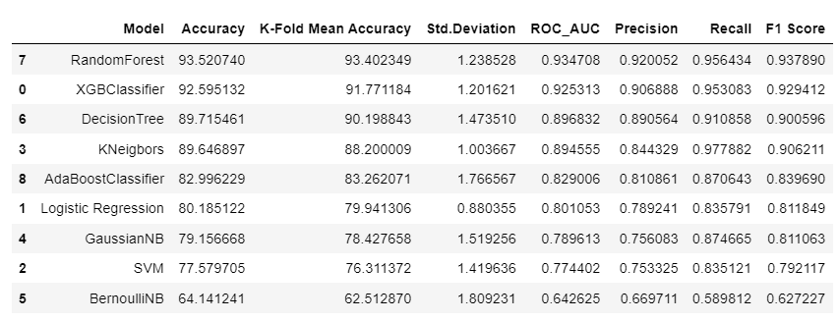
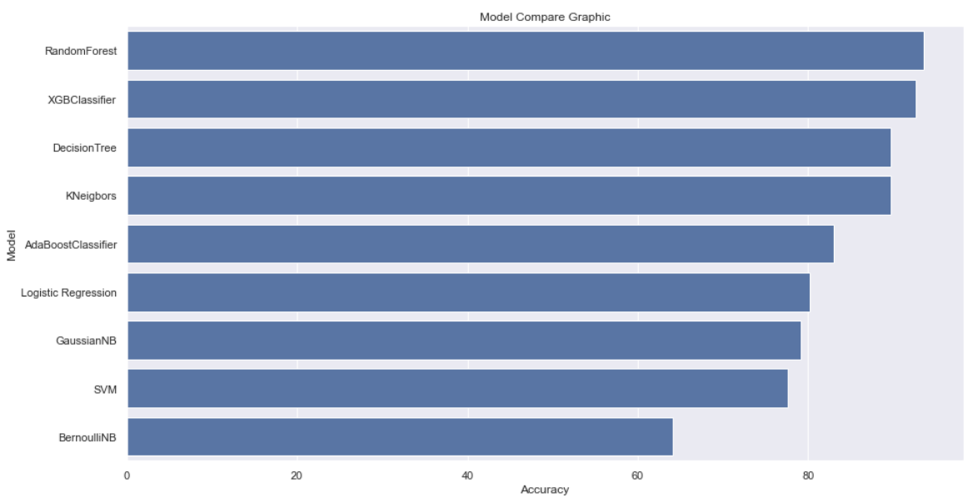
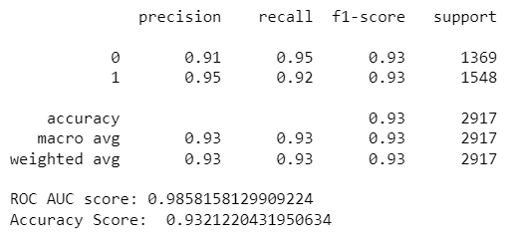
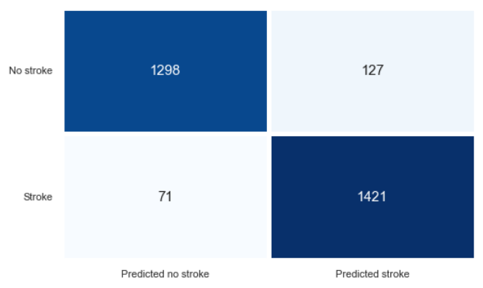
21. Model Selection & Tuning.
We have tried the following models on the dataset: XGBClassifier, Logistic Regression, SVM, Kneigbors, GaussianNB, BernoulliNB, DecisionTree, RandomForest, and AdaBoostClassifier.
Out of all the models, we would be selecting the Random Forest Model as the performance of the model is better than all the other models and has High Accuracy.
Model Comparision -
Model Tuning using the Random Forest Model -
Conclusions –
Precision: Out of all the Patients who would have a stroke which the model predicted, 95% actually did.
Recall: Out of all the Patients that actually did have a stroke, the model predicted this outcome correctly for 92% of the patients.
F1 Score: Since the value is 0.93 which is quite close to 1, we can conclude that the model does a good job in predicting whether a patient will have a Stroke or not.
Support: 1369 patients did not have a stroke and 1548 patients did have a stroke.
According to the Confusion Matrix, we have 2719 correct predictions and 198 incorrect predictions.
Classification Report :
Confusion Matrix :

Slide 11
THANK YOU.

