Slide 1
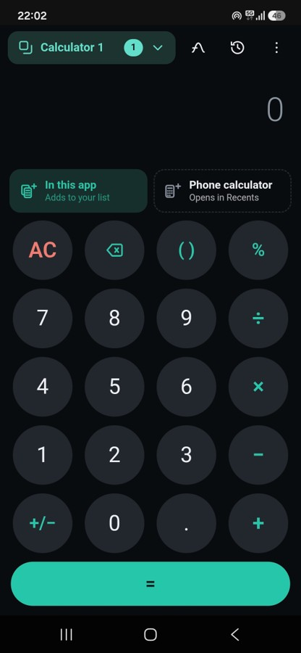
Every calculator keeps its own display

Slide 2
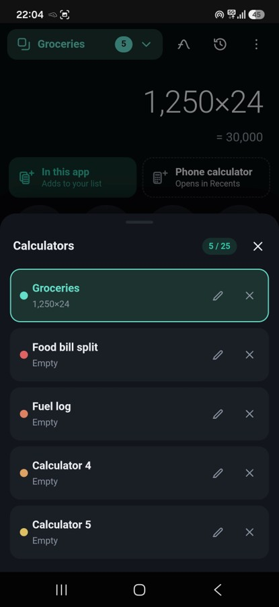
Name them, color them, switch in a tap

Slide 3
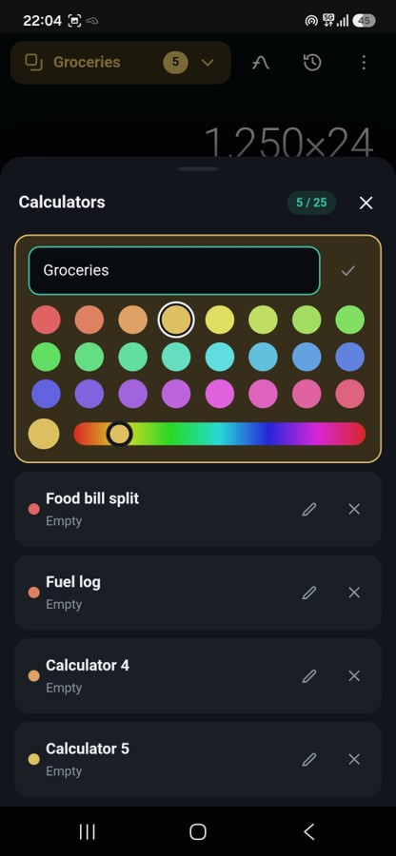
Any color you like, not a fixed set

Slide 4
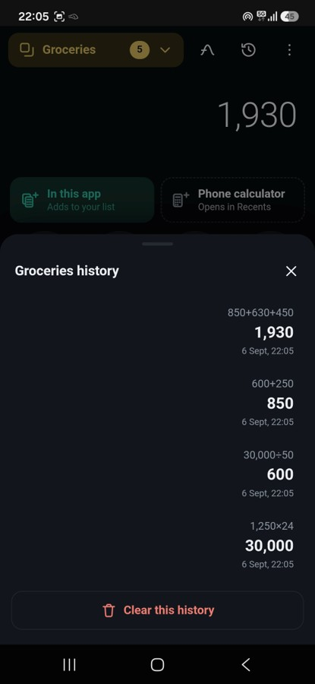
A separate history tape for each one

Slide 5
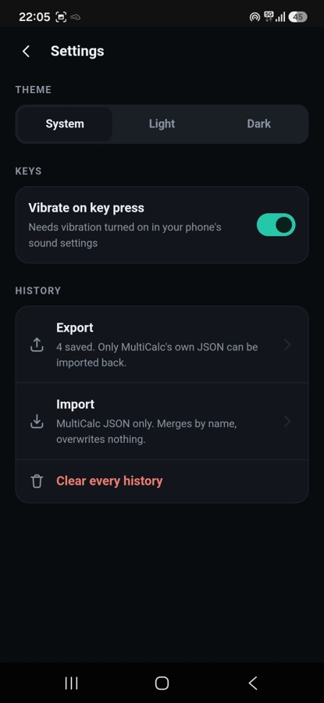
Export and import your history

Slide 6
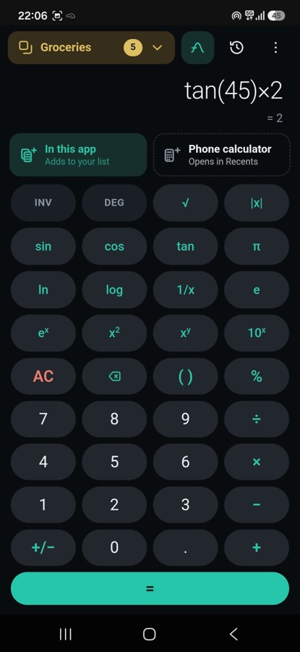
Turn it into a scientific calculator

Slide 7
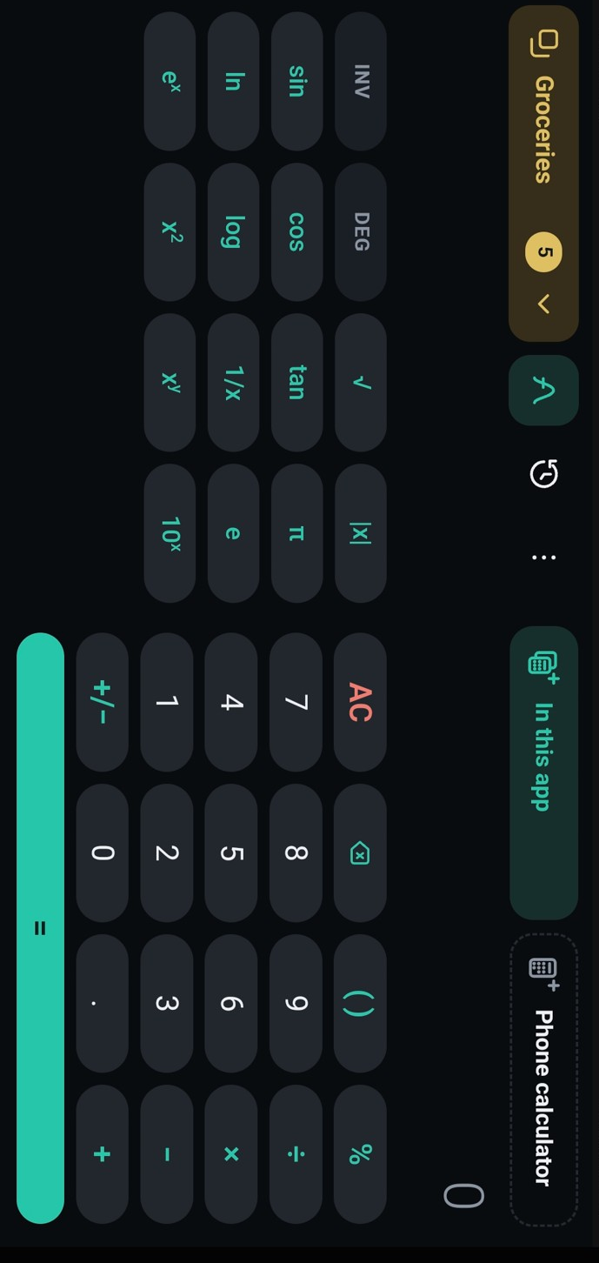
Use it in Landscape mode

Slide 8
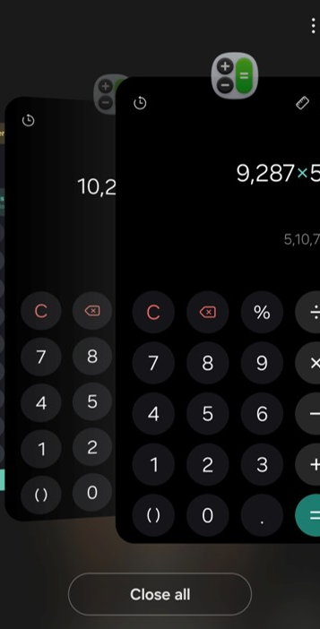
If your phone supports, then open multiple instances of its own calculator in the recent apps

