Slide 2
28 June 2026

Slide 3


Slide 4
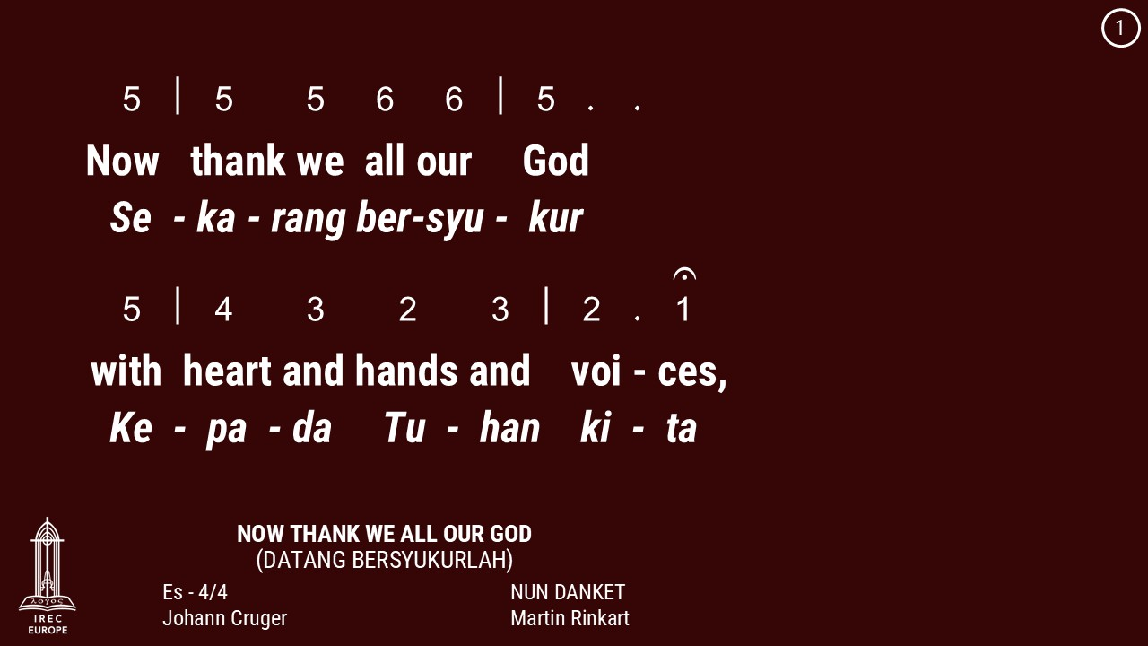

Slide 5
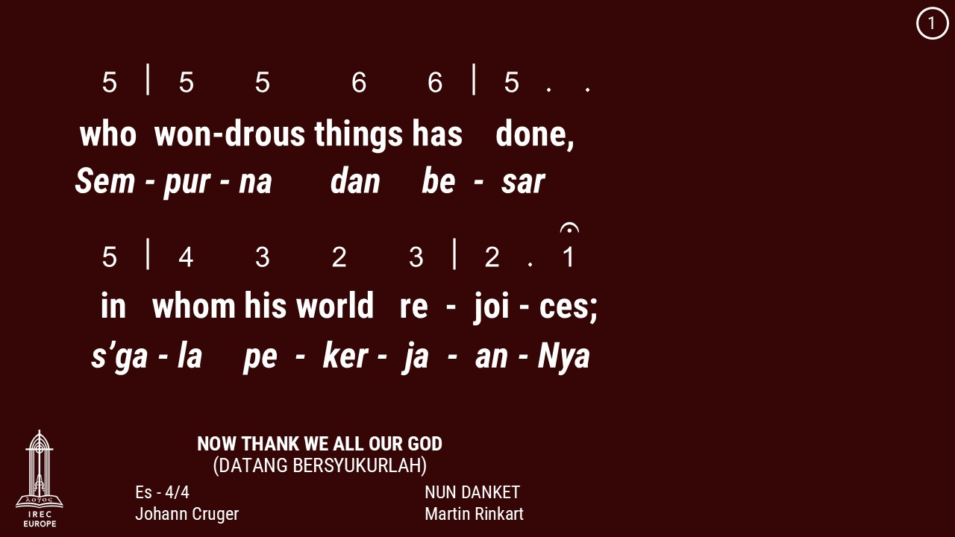

Slide 6
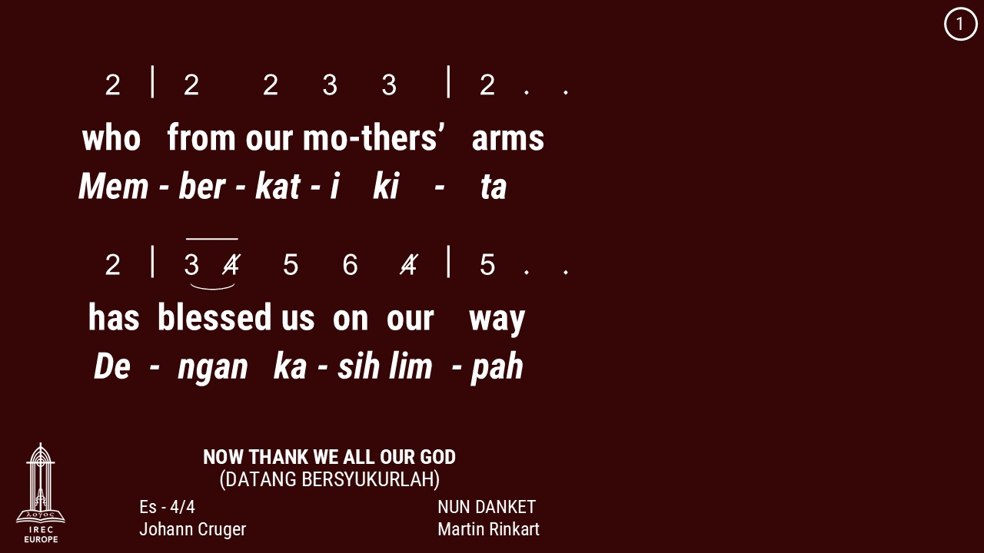

Slide 7
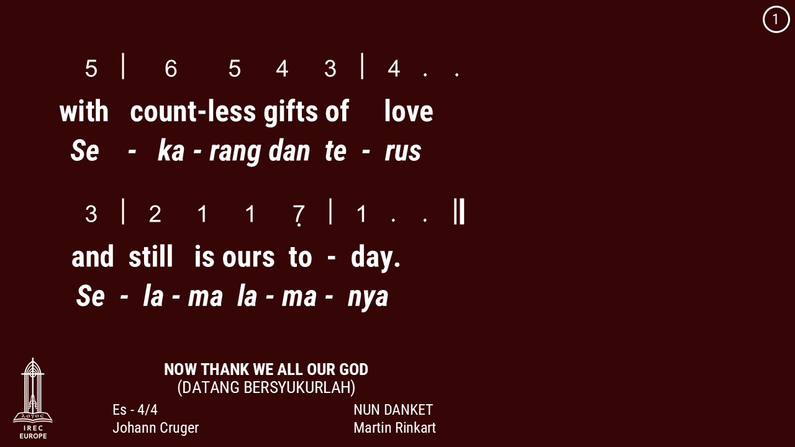

Slide 8
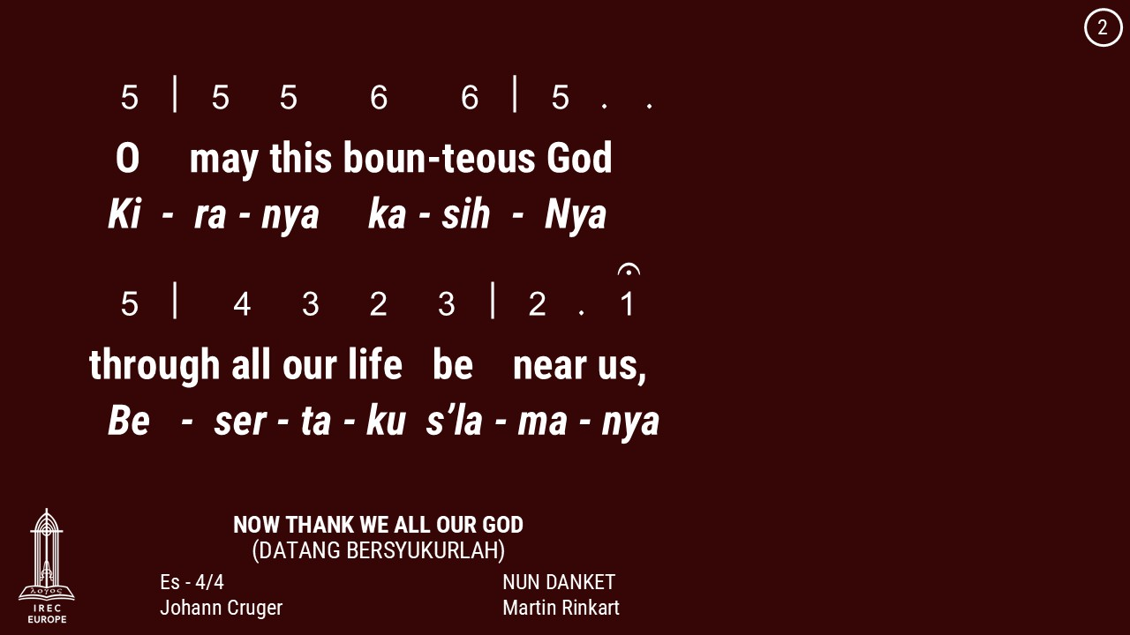

Slide 9
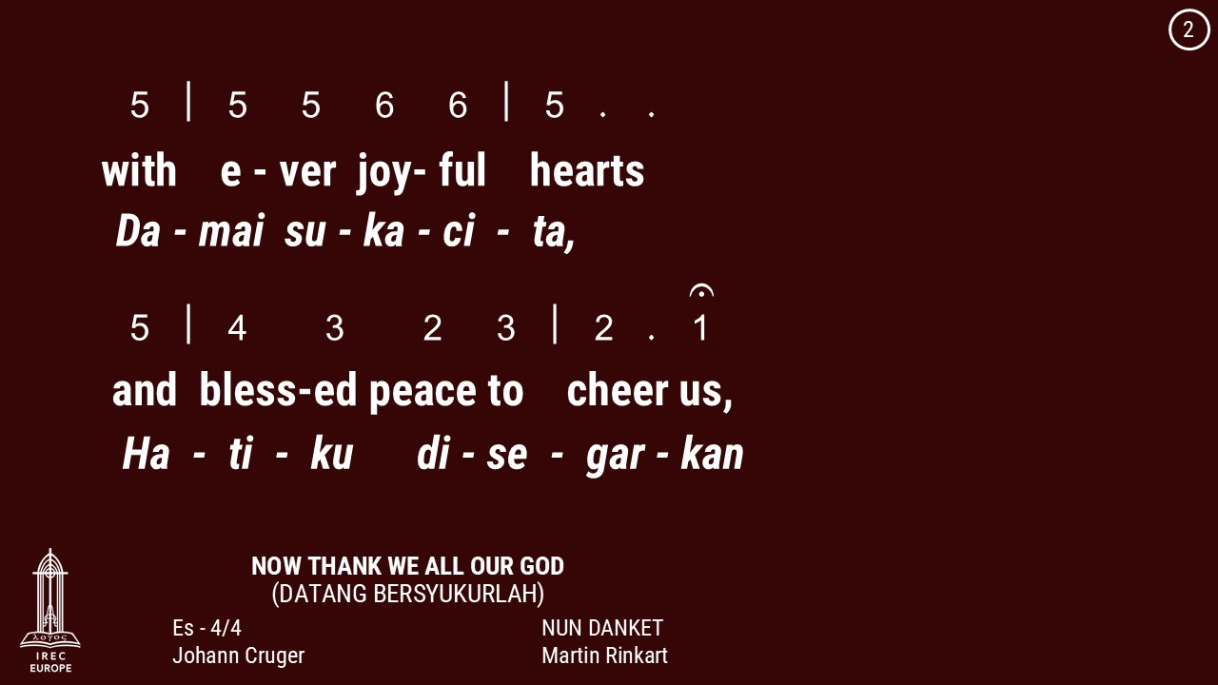

Slide 10
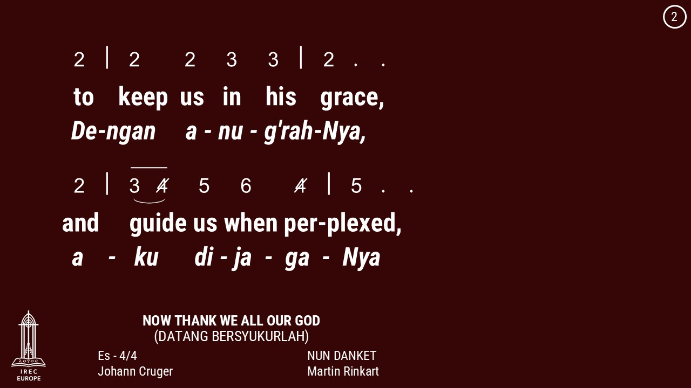

Slide 11
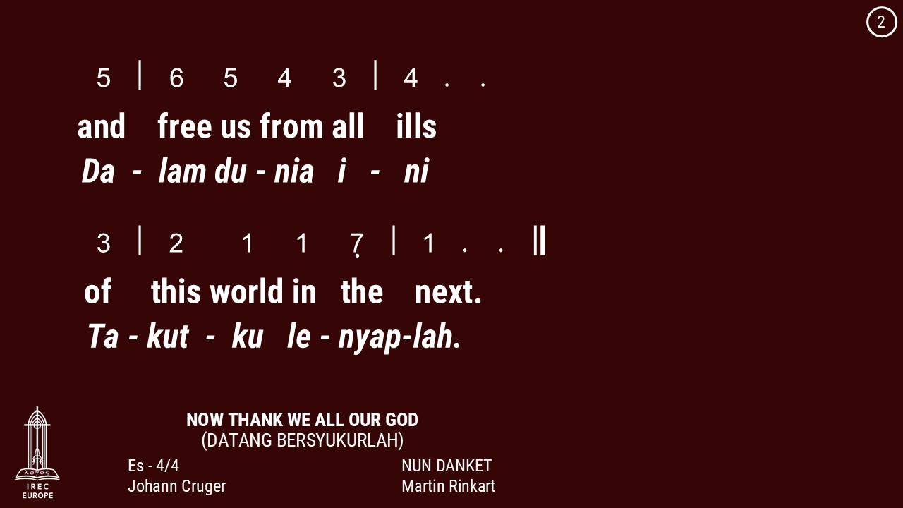

Slide 12
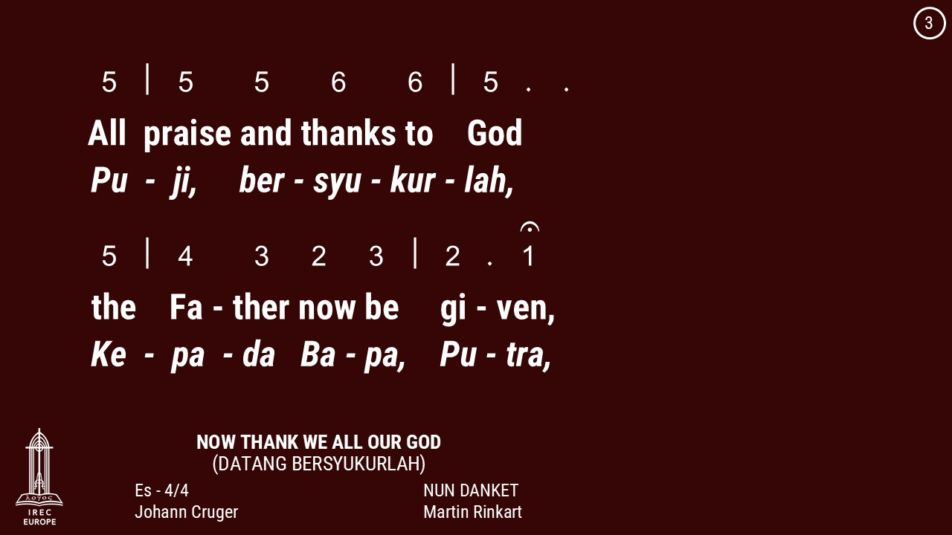

Slide 13
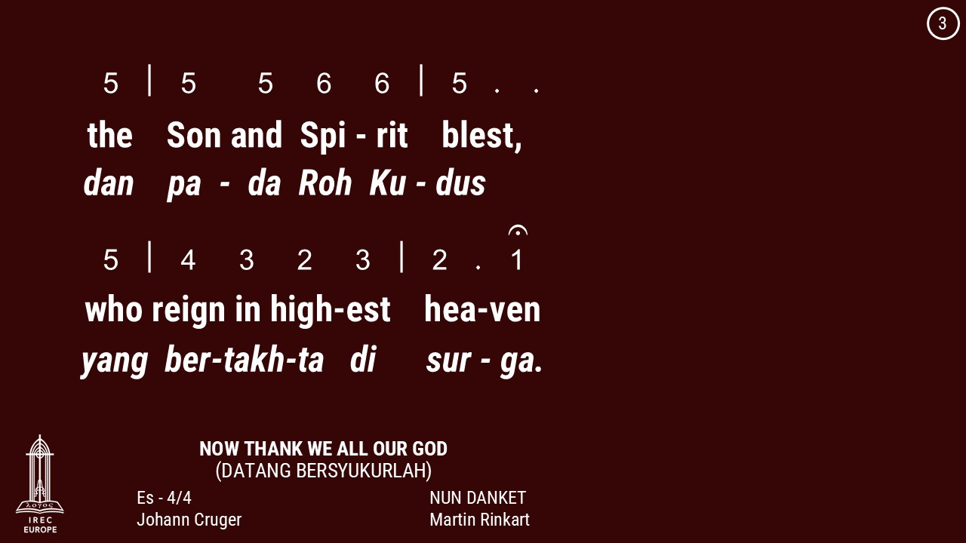

Slide 14
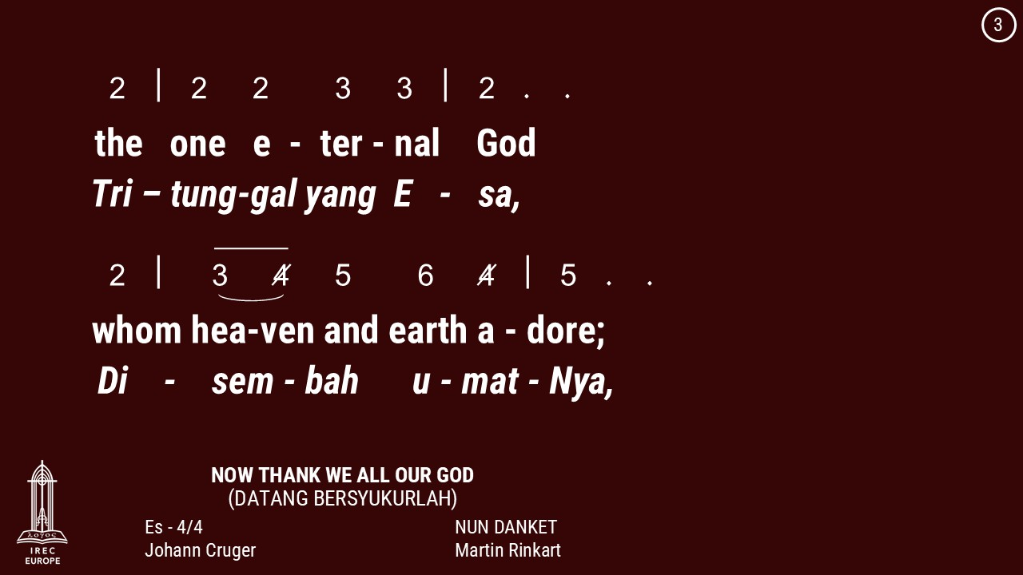

Slide 15
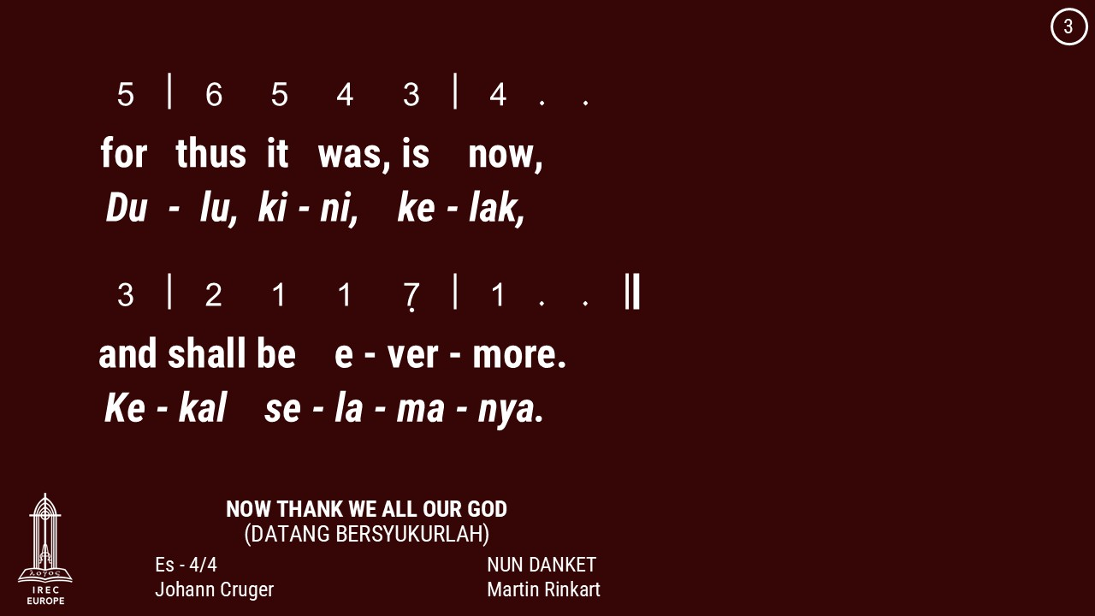

Slide 16
28 June 2026

Slide 17


Slide 18
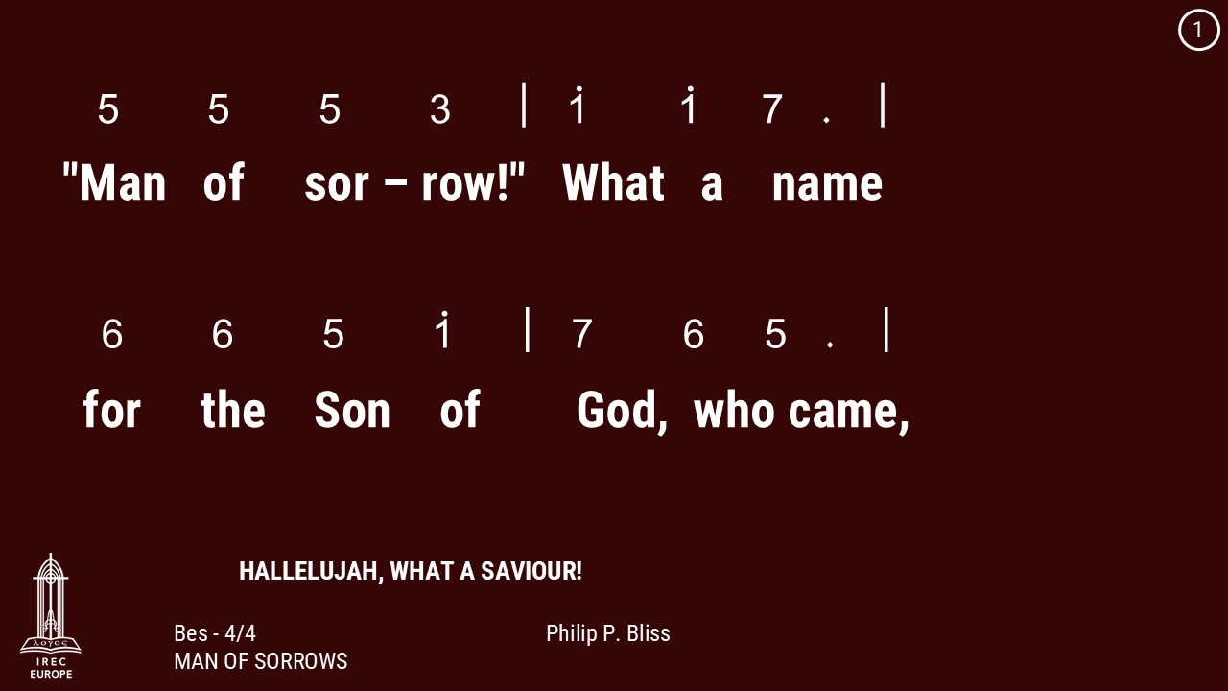

Slide 19
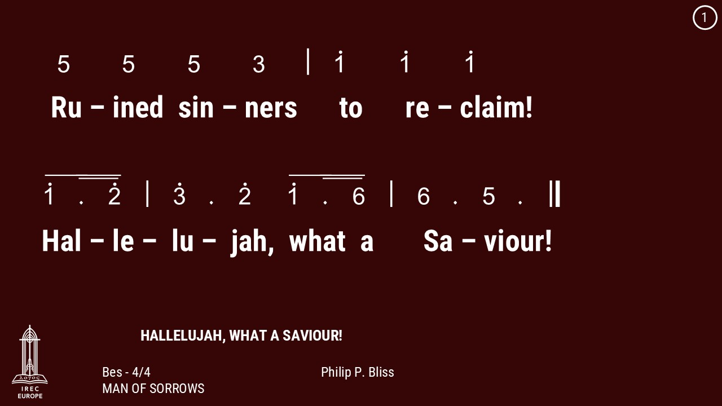

Slide 20
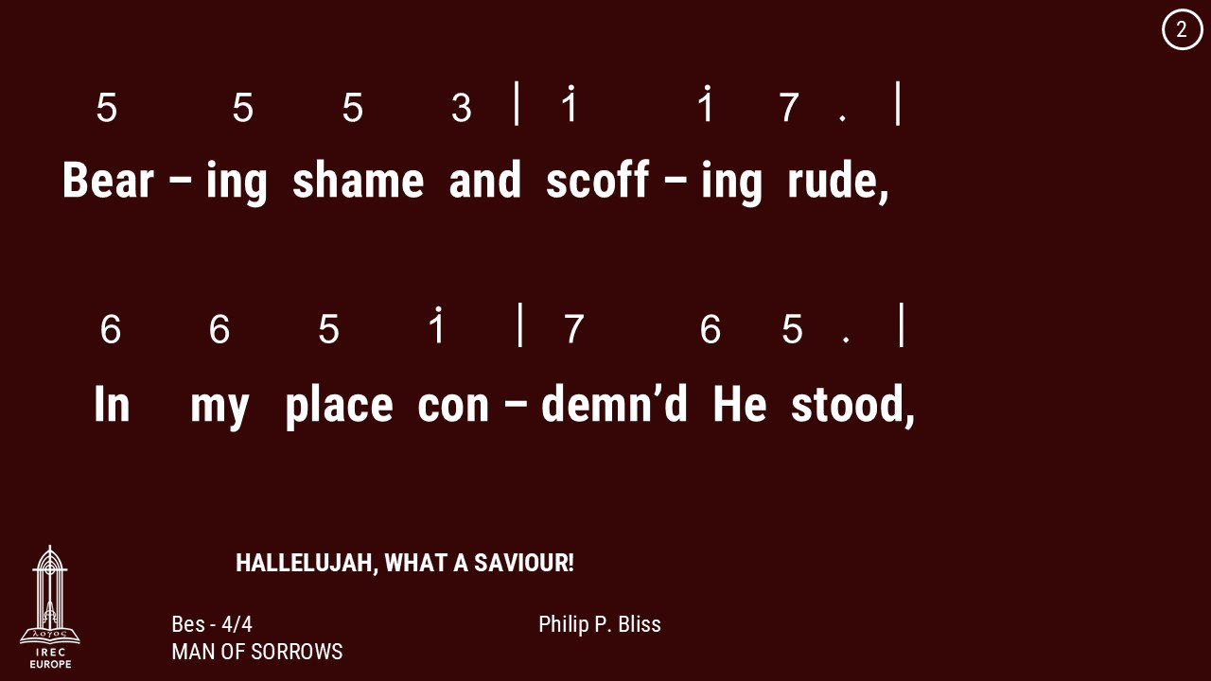

Slide 21
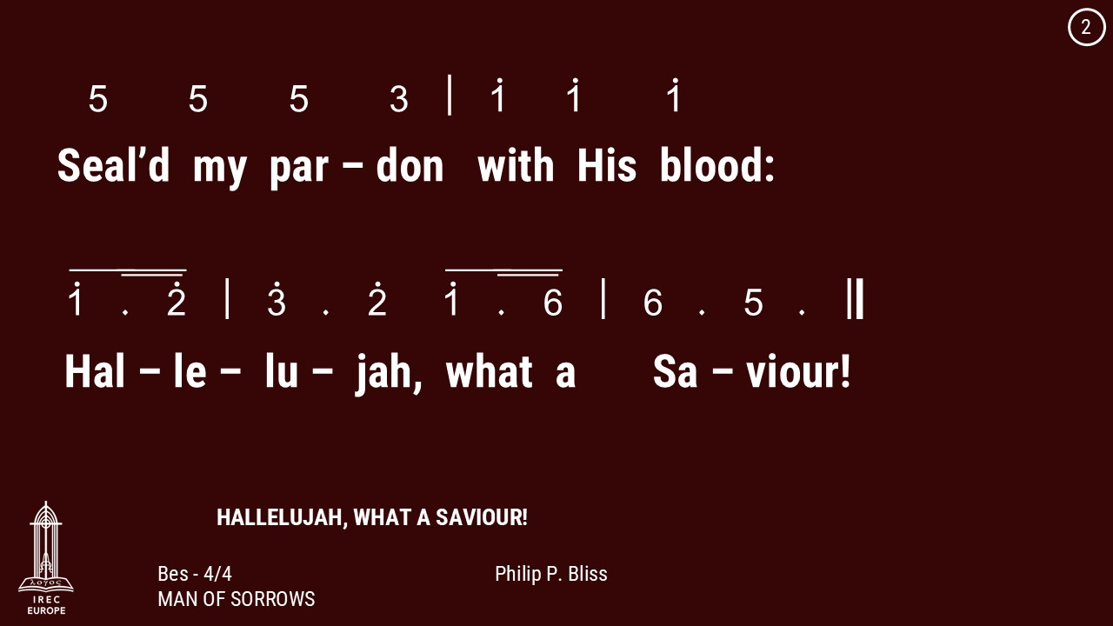

Slide 22
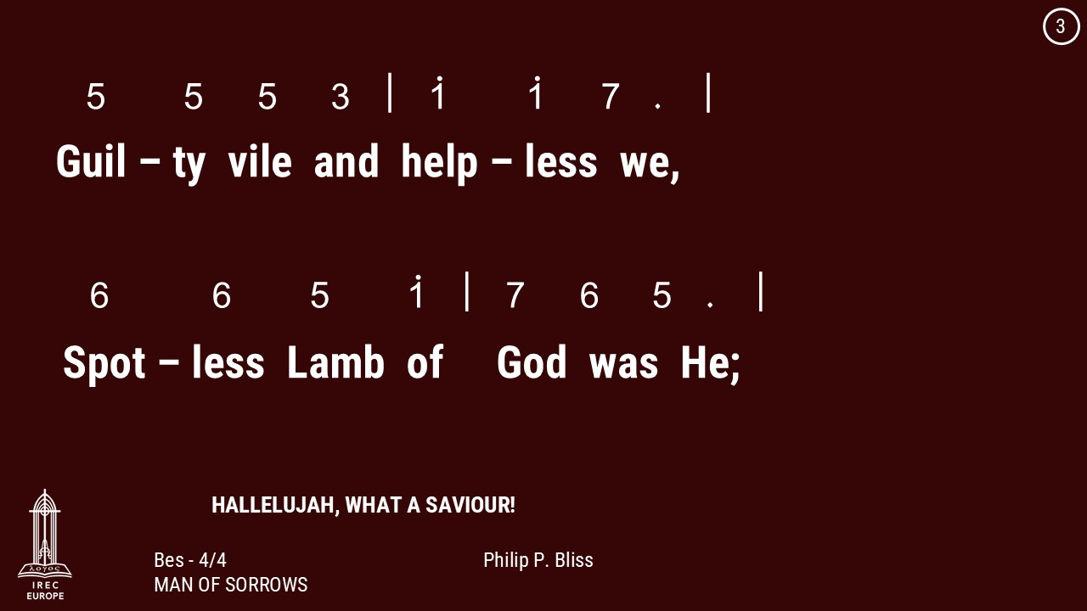

Slide 23
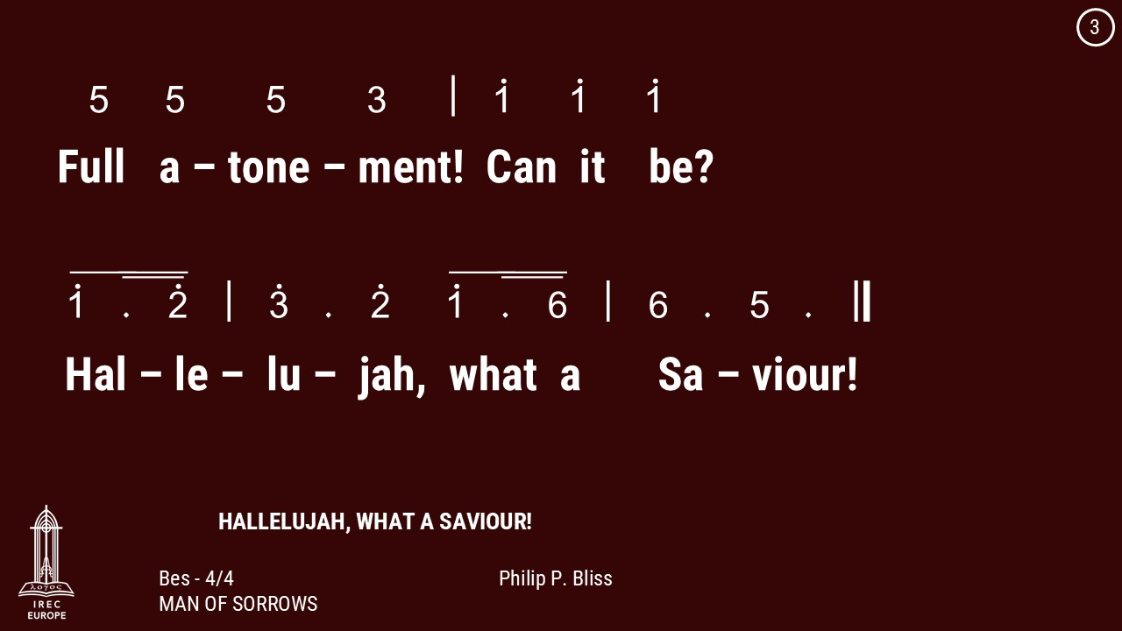

Slide 24
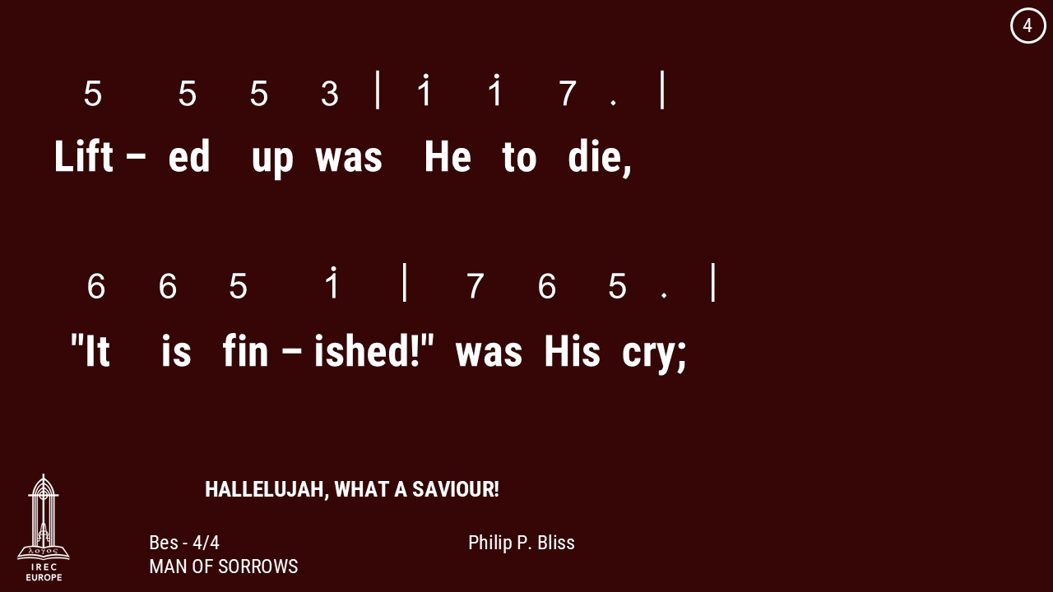

Slide 25
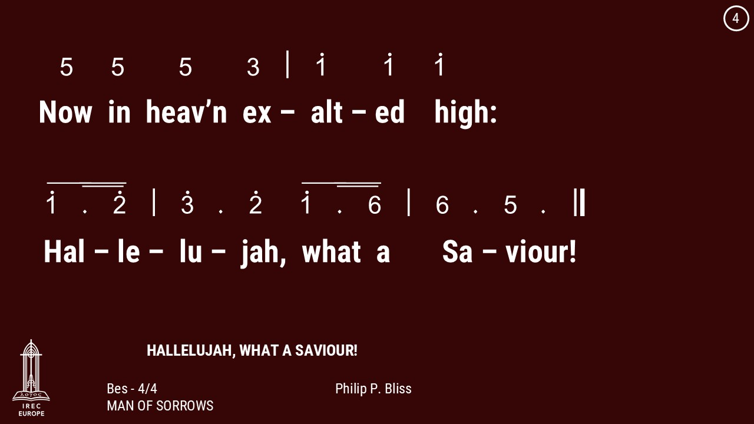

Slide 26
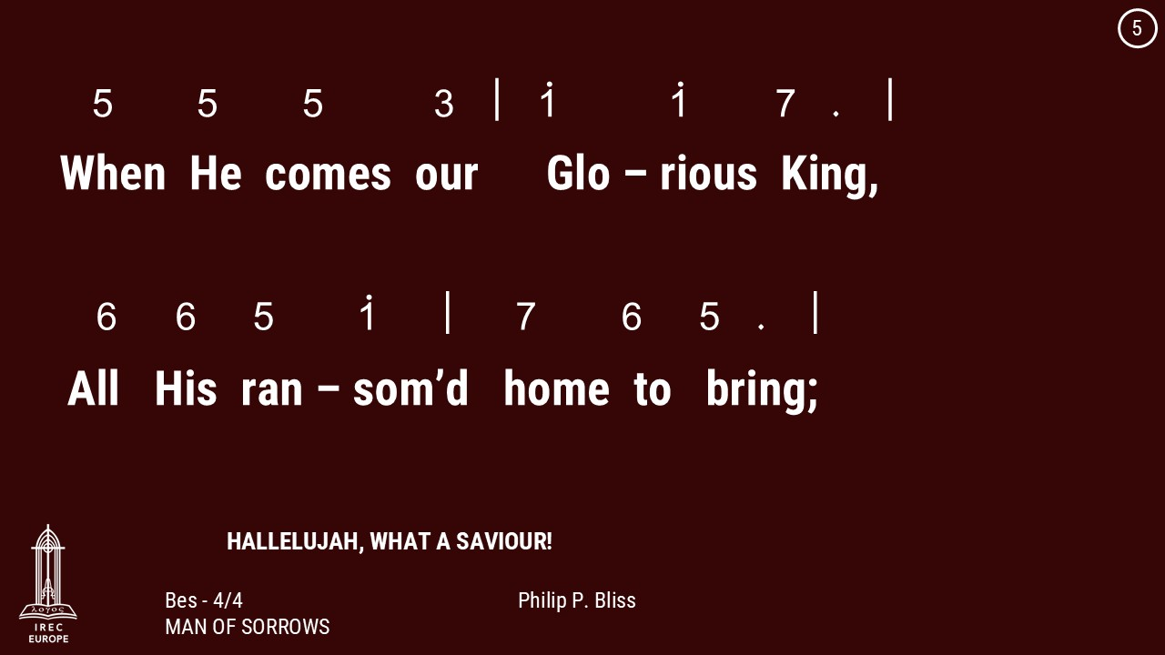

Slide 27
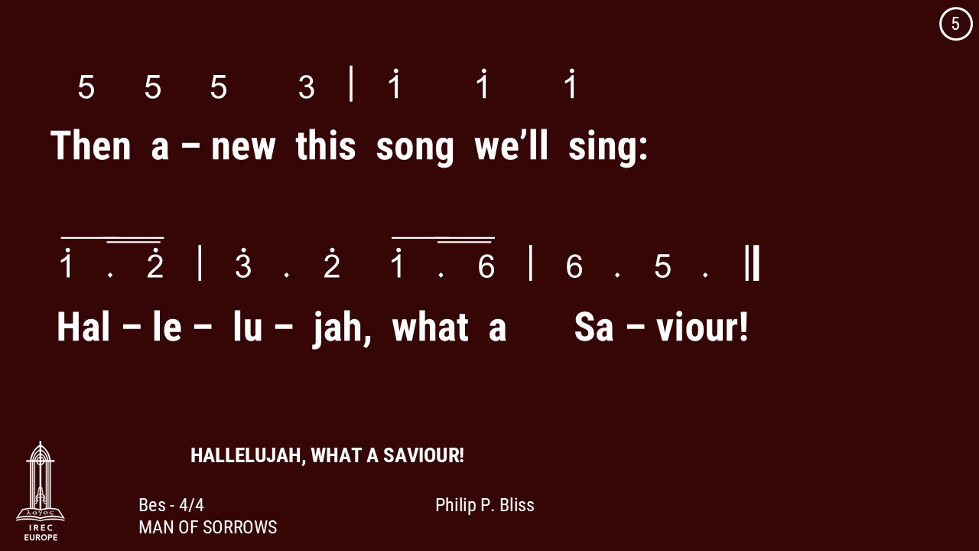

Slide 28
28 June 2026

Slide 29
Genesis 1:2-3
Kejadian 1:2-3

Slide 30
Genesis 1:2 : The earth was without form and void, and darkness was over the face of the deep. And the Spirit of God was hovering over the face of the waters.
Kejadian 1:2 : Bumi belum berbentuk dan kosong; gelap gulita menutupi samudera raya, dan Roh Allah melayang-layang di atas permukaan air.

Slide 31
Genesis 1:3 : And God said, “Let there be light,” and there was light.
Kejadian 1:3 : Berfirmanlah Allah: "Jadilah terang." Lalu terang itu jadi.

Slide 32
28 June 2026

Slide 33


Slide 34
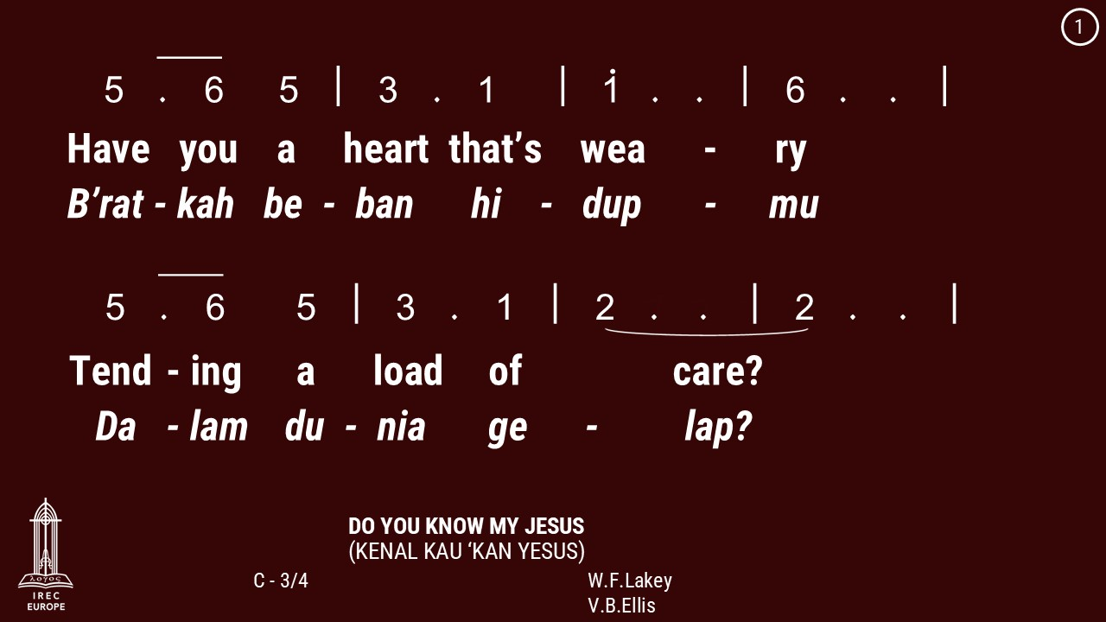

Slide 35
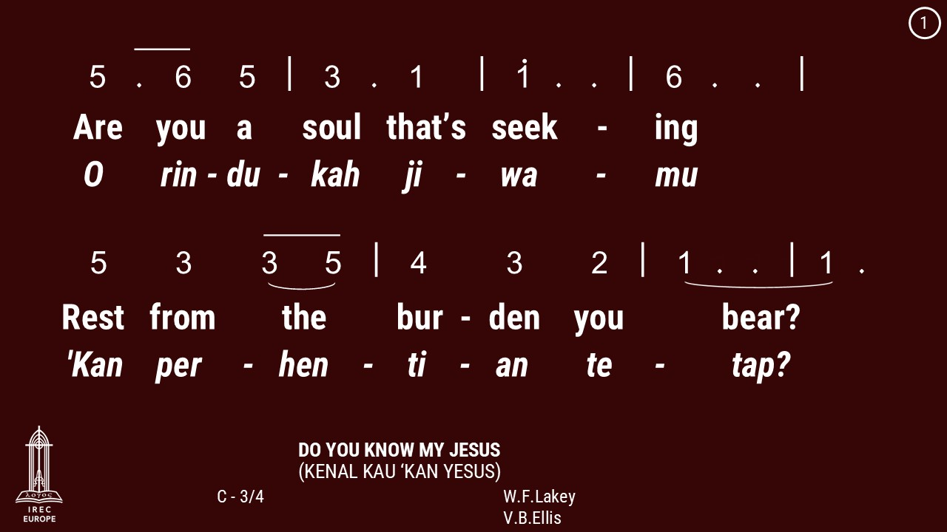

Slide 36
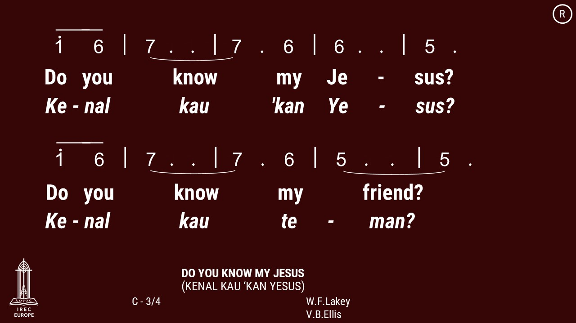

Slide 37
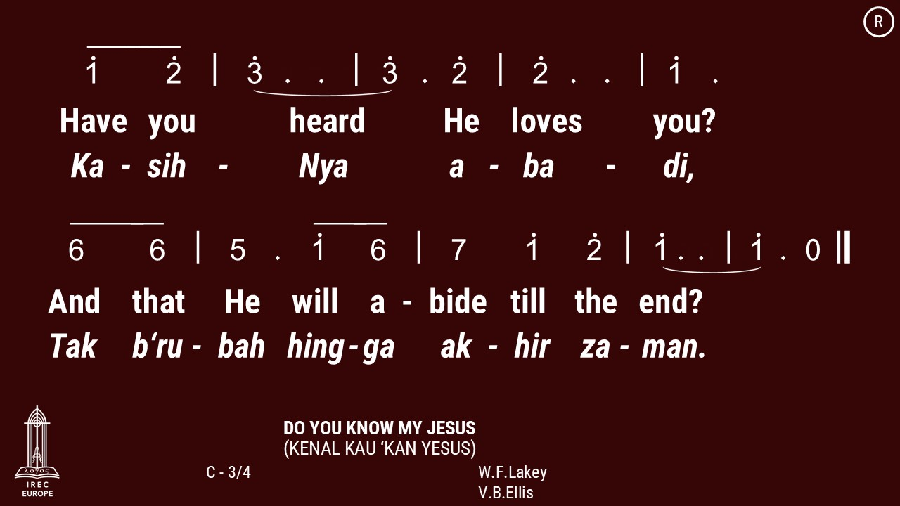

Slide 38
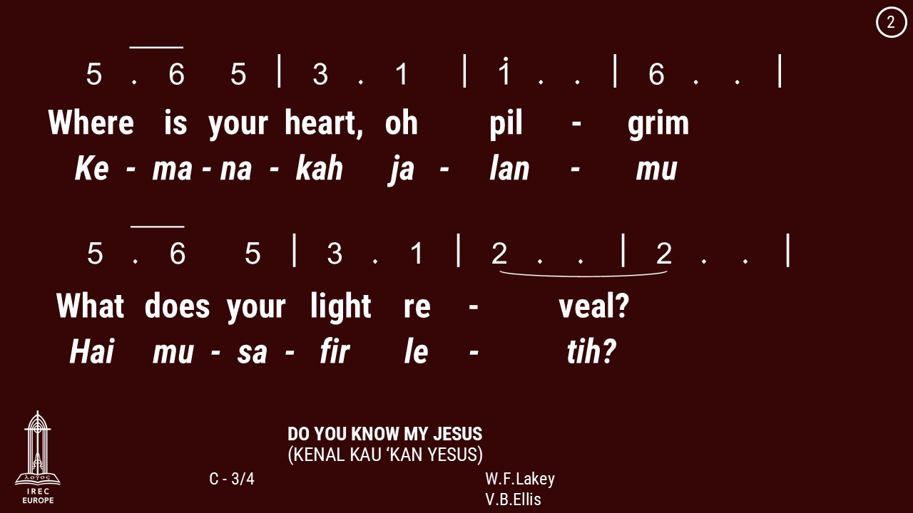

Slide 39
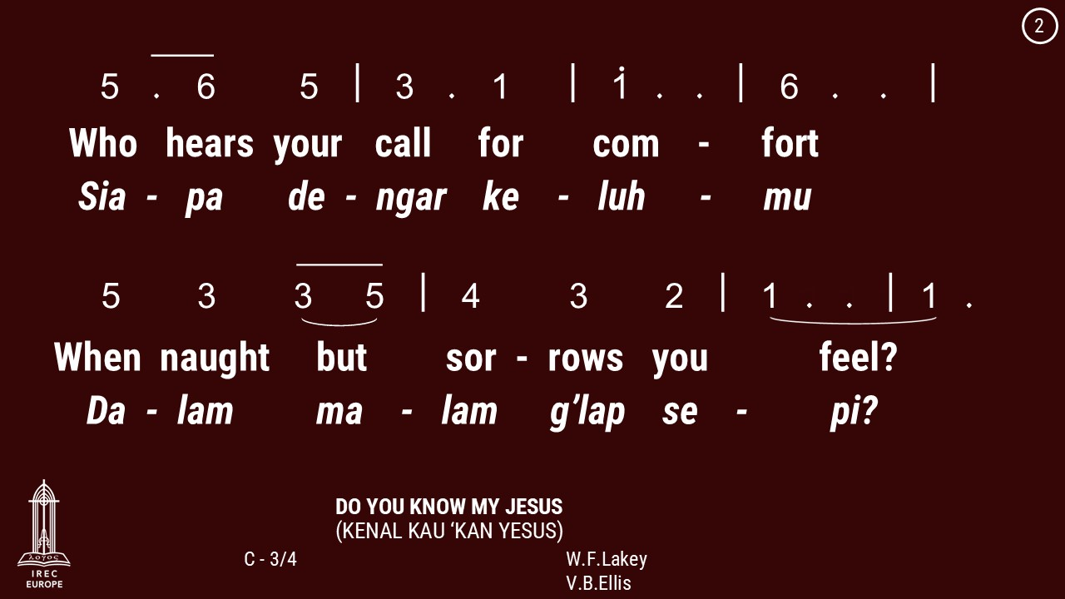

Slide 42
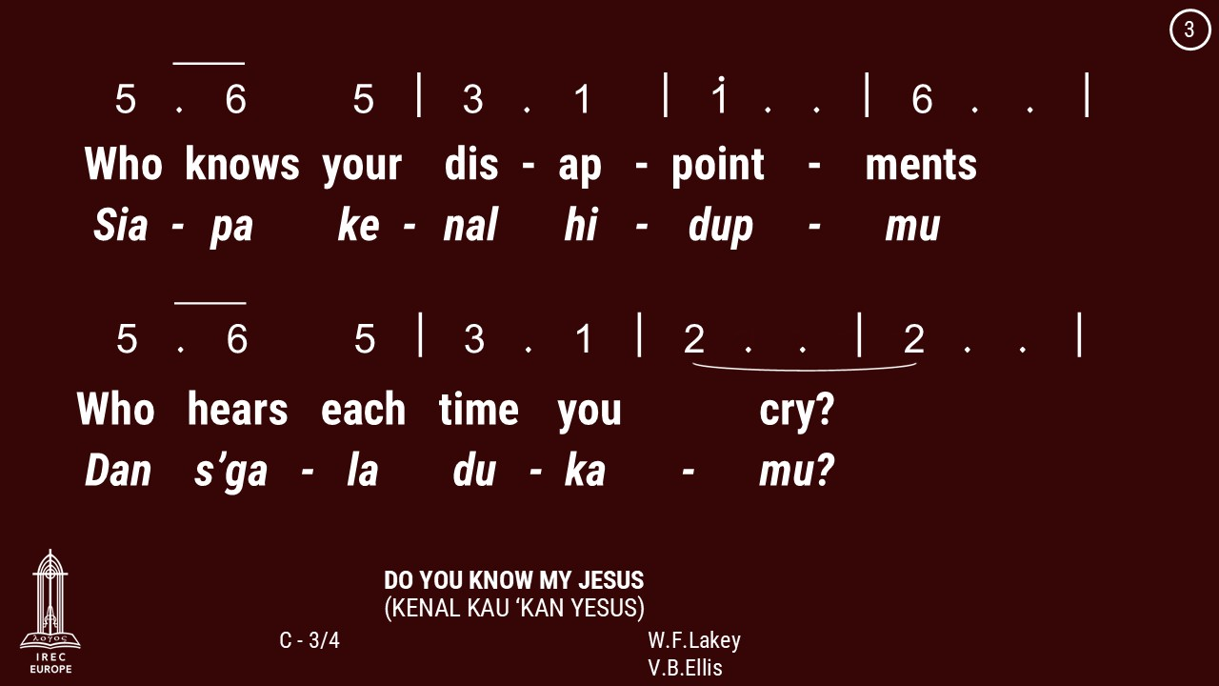

Slide 43
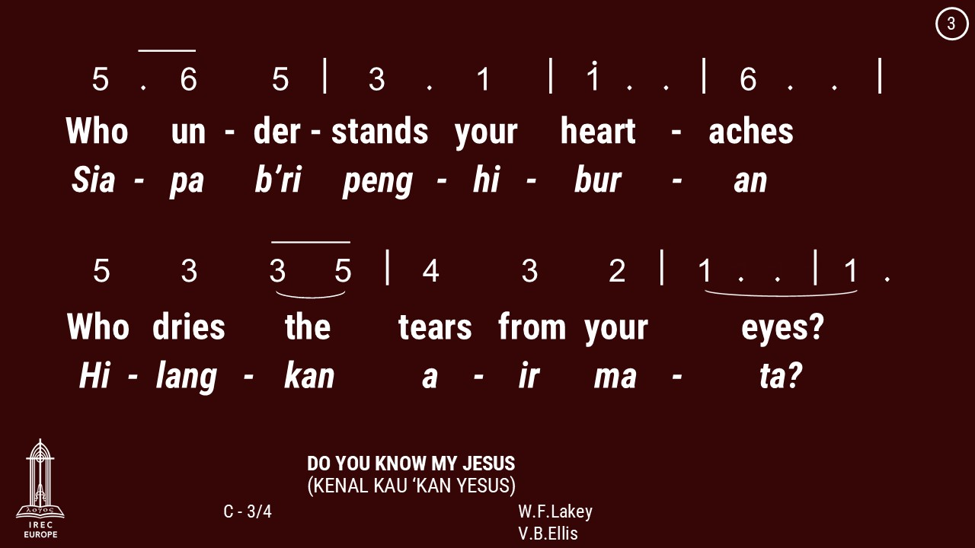

Slide 46
28 June 2026

Slide 51
28 June 2026

Slide 52
Rev. Billy Kristanto
Pdt. Billy Kristanto

Slide 53
28 June 2026

Slide 60
28 June 2026

Slide 62


Slide 63
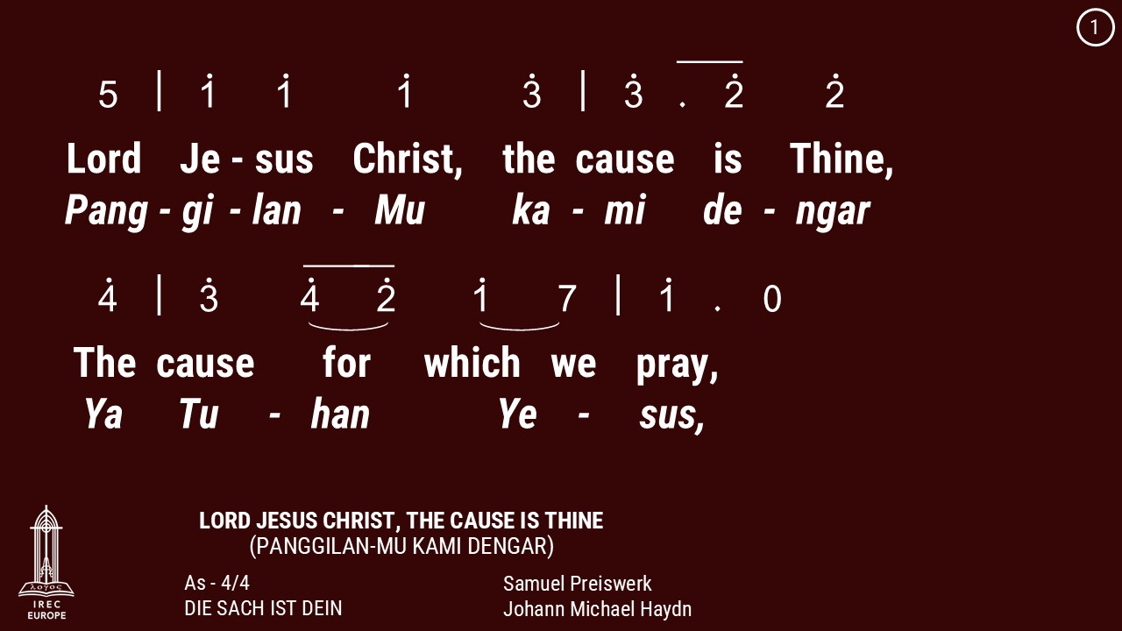

Slide 64
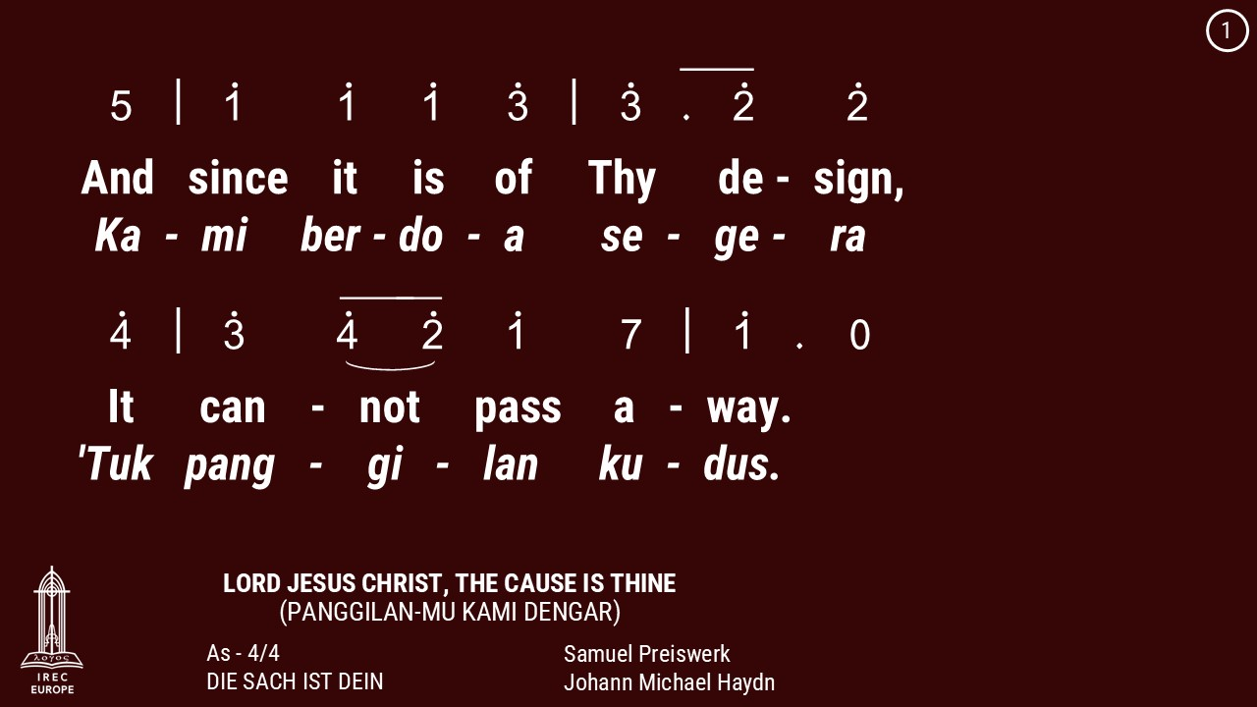

Slide 65
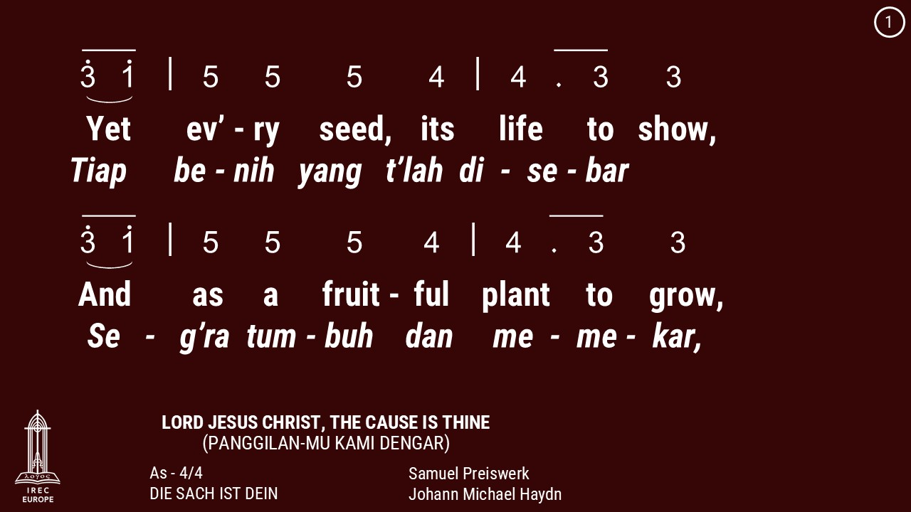

Slide 66
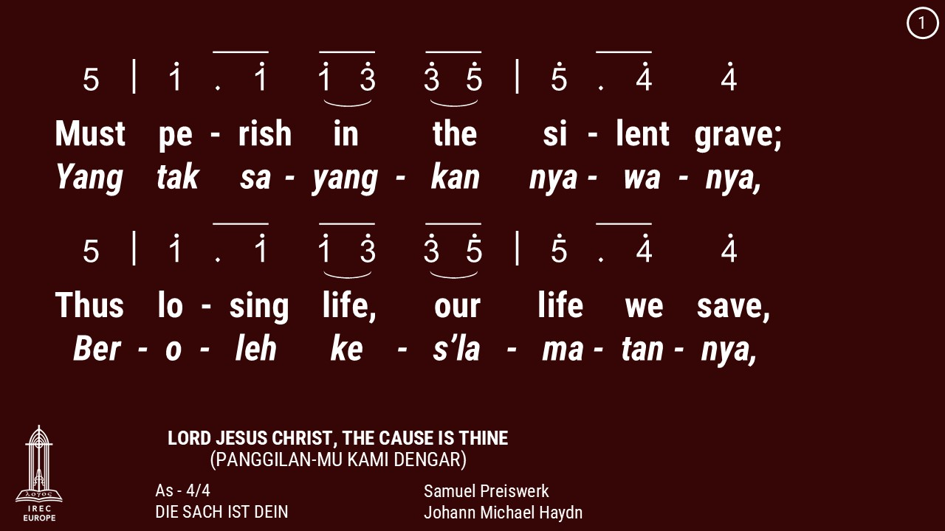

Slide 67
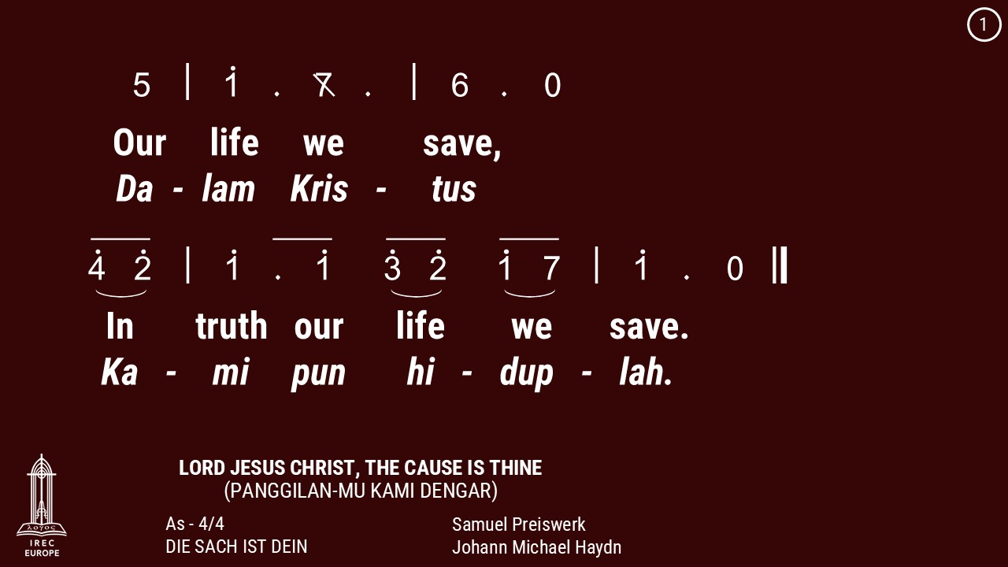

Slide 68
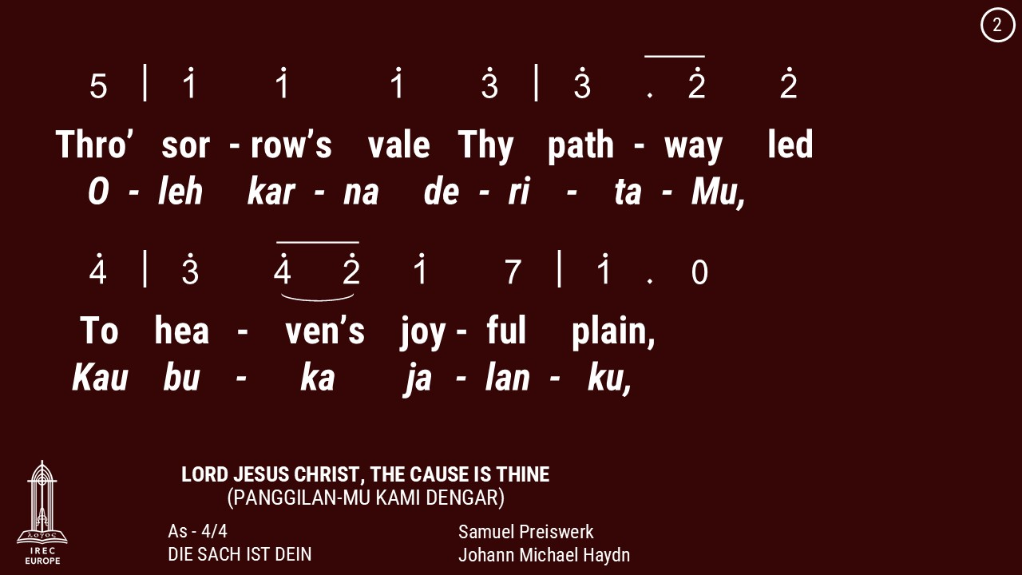

Slide 69
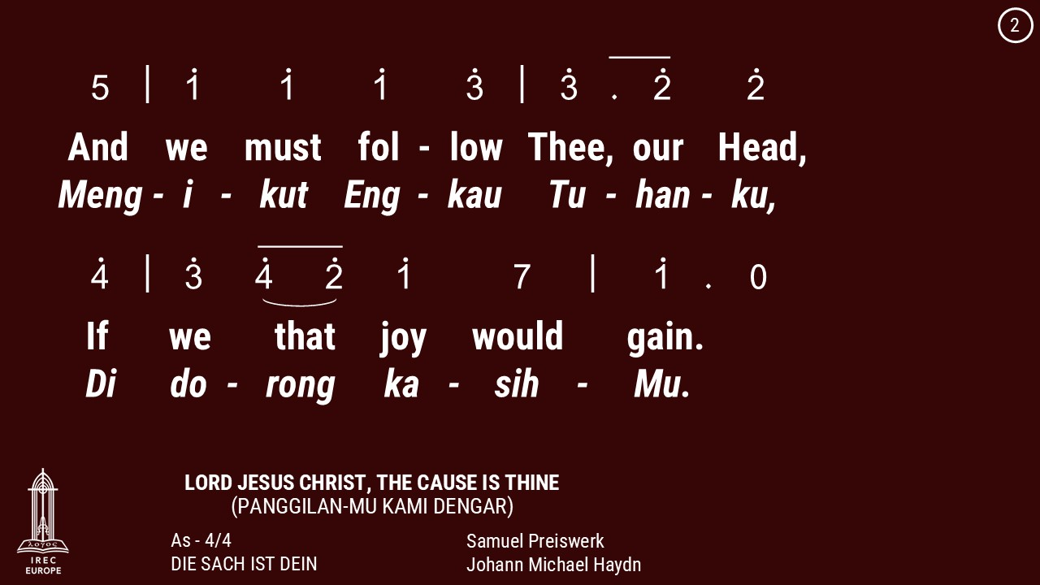

Slide 70
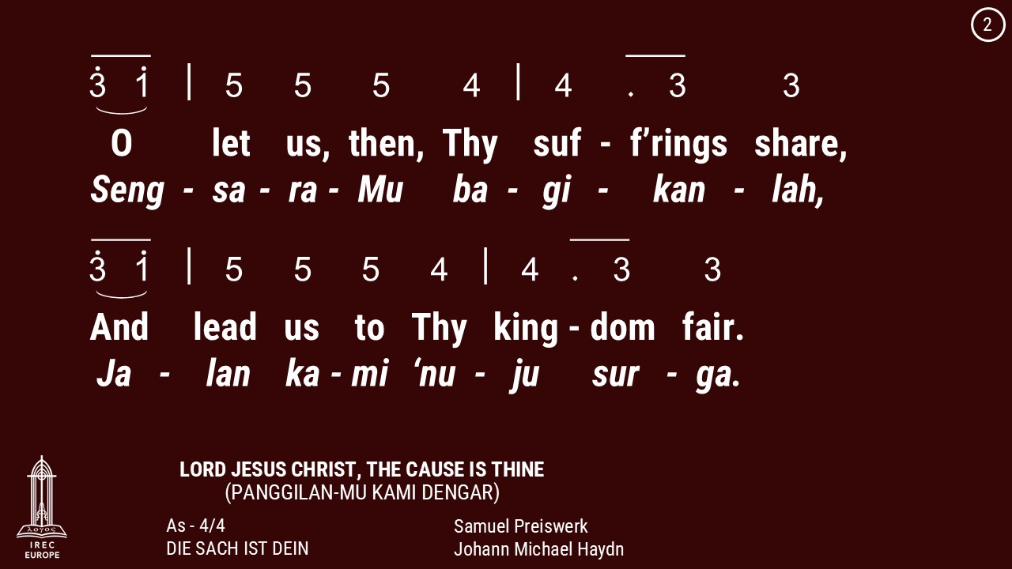

Slide 71
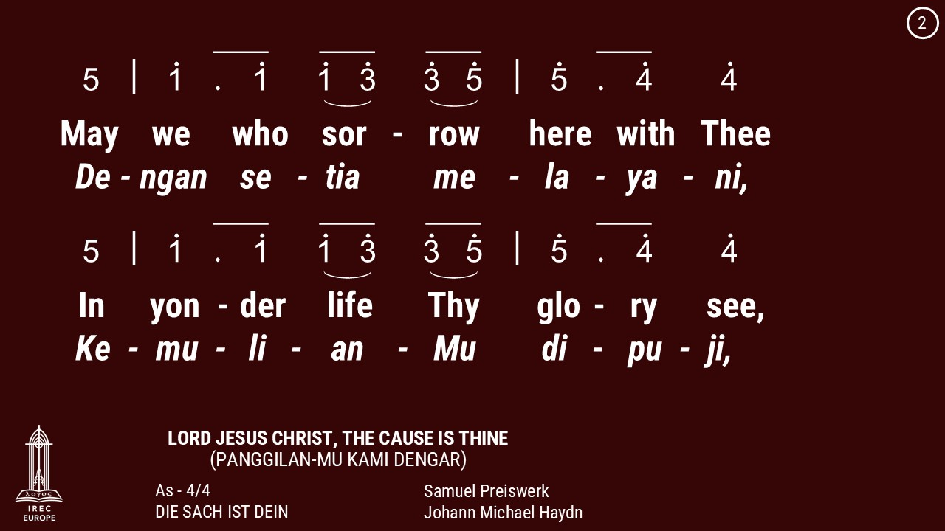

Slide 72
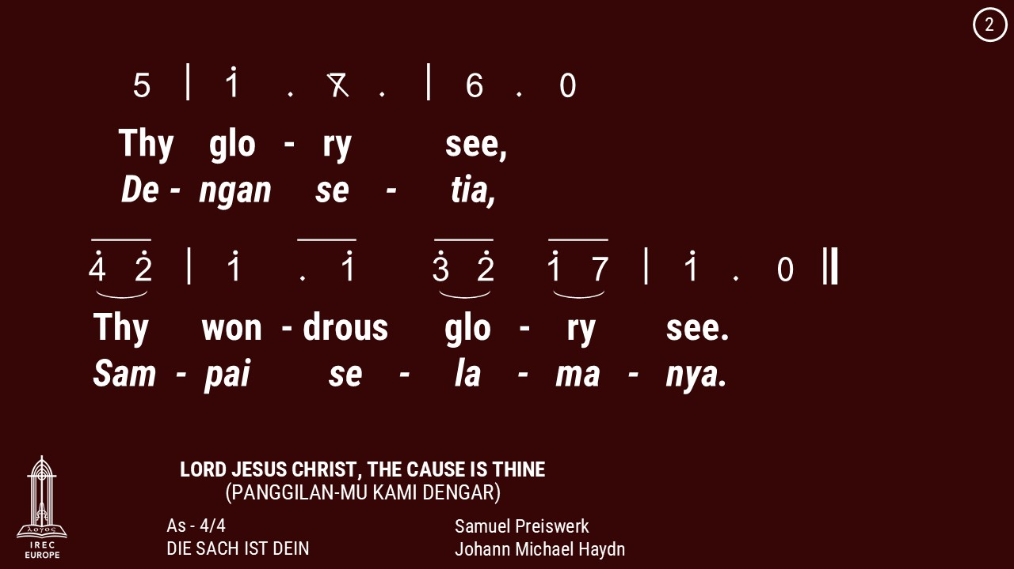

Slide 73
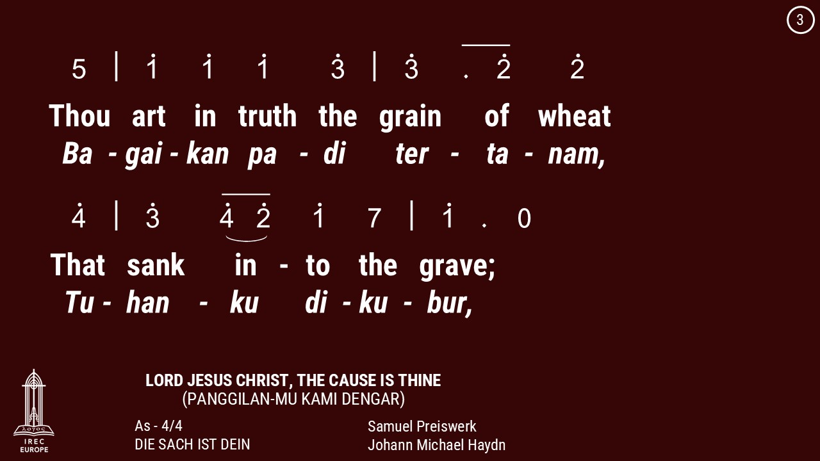

Slide 74
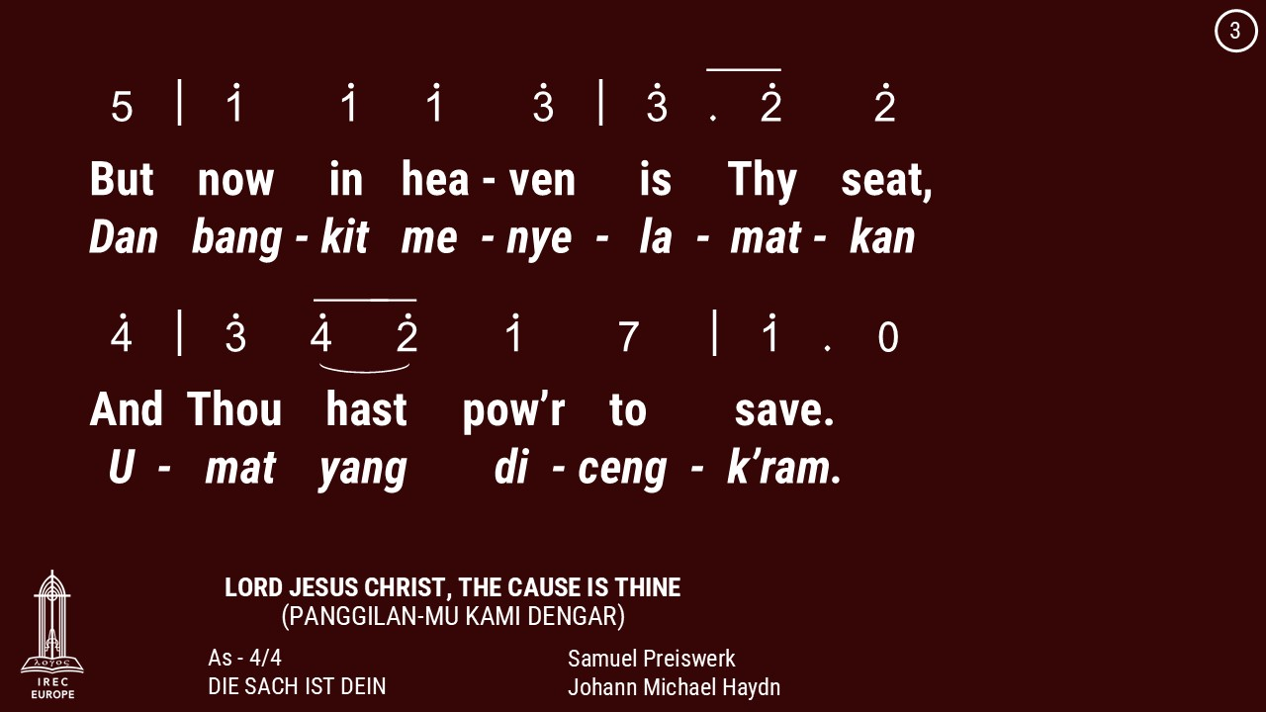

Slide 75
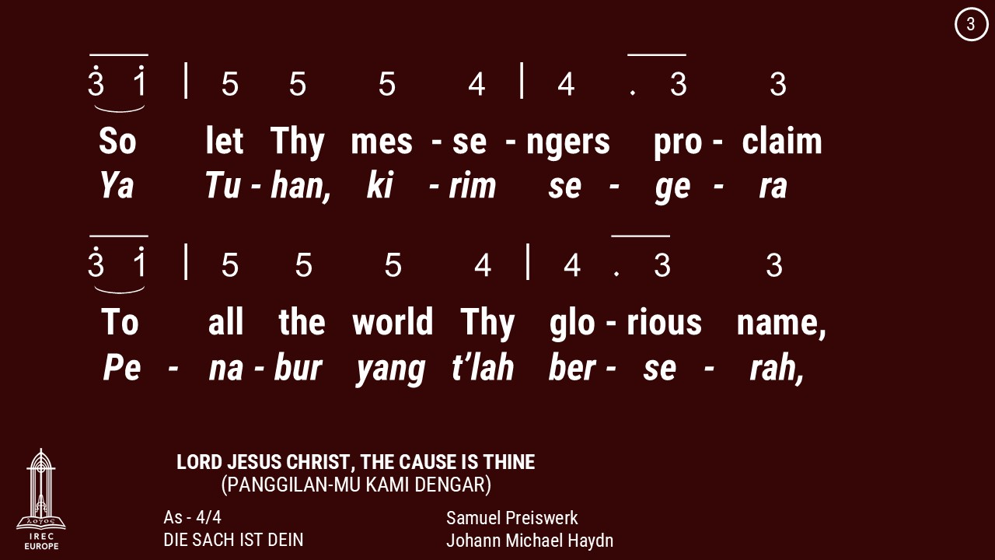

Slide 76
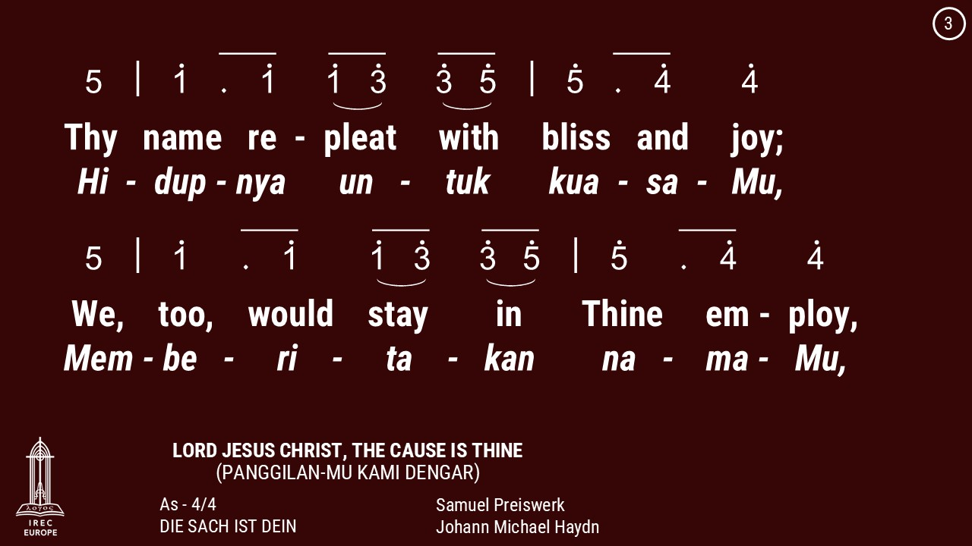

Slide 77
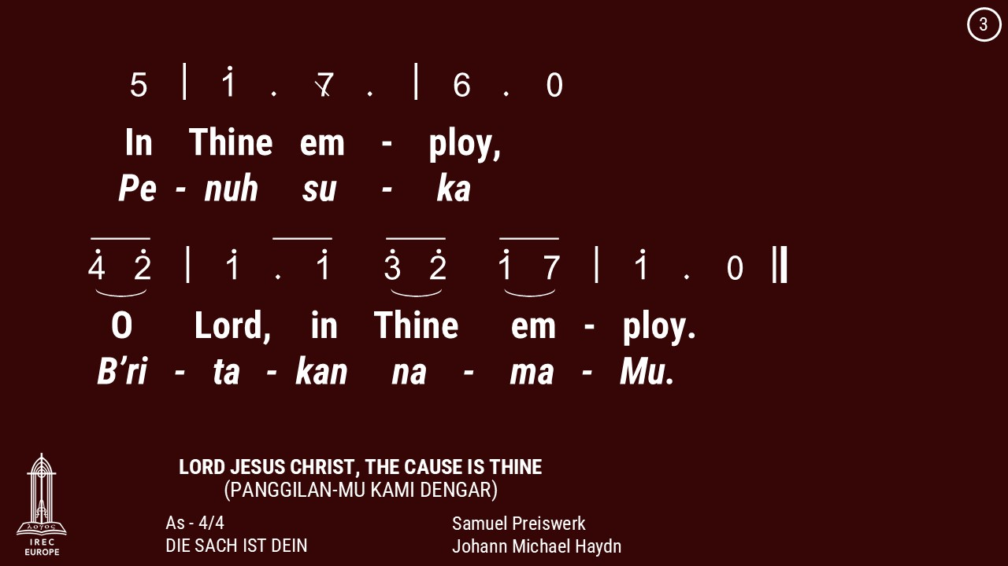

Slide 78
28 June 2026

Slide 81
28 June 2026

Slide 83
28 June 2026

Slide 86
Makan Malam &
Persekutuan Doa
Setiap Jumat di minggu genap
18:30
Dinner & Prayer Meeting
Fridays on Even week
18:30

Slide 87
Latihan Koor
Minggu, 14:00 - 15:00
Berner Heerweg 60
Choir Practice
Sundays, 14:00 - 15:00
Berner Heerweg 60

Slide 88
Persekutuan Doa
Setiap Minggu, 15:30
Berner Heerweg 60
Prayer Fellowship
Sundays, 15:30
Berner Heerweg 60

Slide 89
Ibadah Minggu
Setiap Minggu, 16:00
Berner Heerweg 60
Sunday Worship
Every Sunday, 16:00
Berner Heerweg 60

Slide 90
Ibadah Minggu & Perjamuan Kudus
Minggu, 16:00
Berner Heerweg 60
Sunday Worship & Holy Communion
Sunday, 16:00
Berner Heerweg 60

Slide 91
Makan Siang &Persekutuan Doa
Sabtu, 12:30
Berner Heerweg 60
Lunch & Prayer Fellowship
Saturday, 12:30
Berner Heerweg 60

Slide 92
Sekolah Minggu
Setiap Minggu, 16:00
Berner Heerweg 60
Sunday School
Every Sunday, 16:00
Berner Heerweg 60

Slide 95
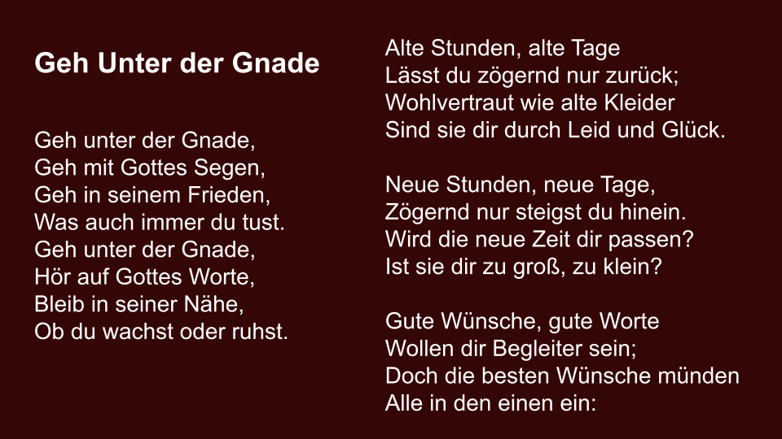

Slide 96


Slide 97
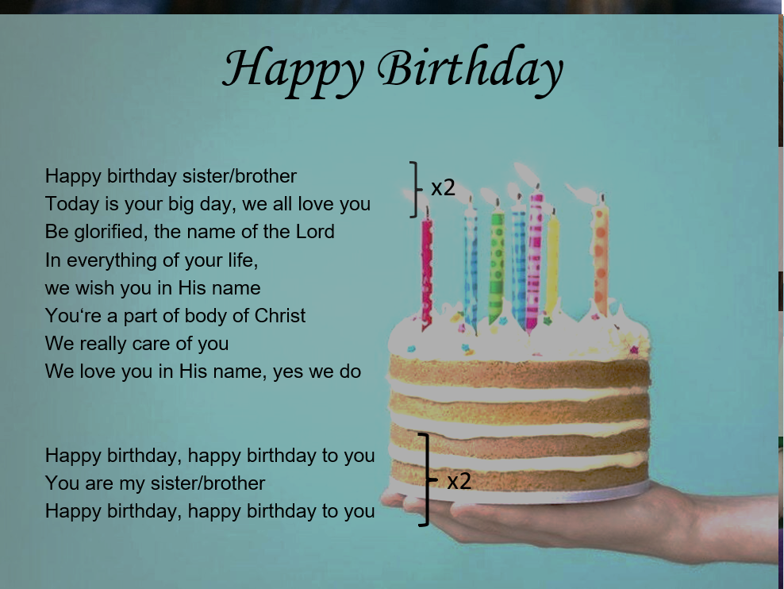

Slide 98


