Slide 2
23 March 2025

Slide 3


Slide 4
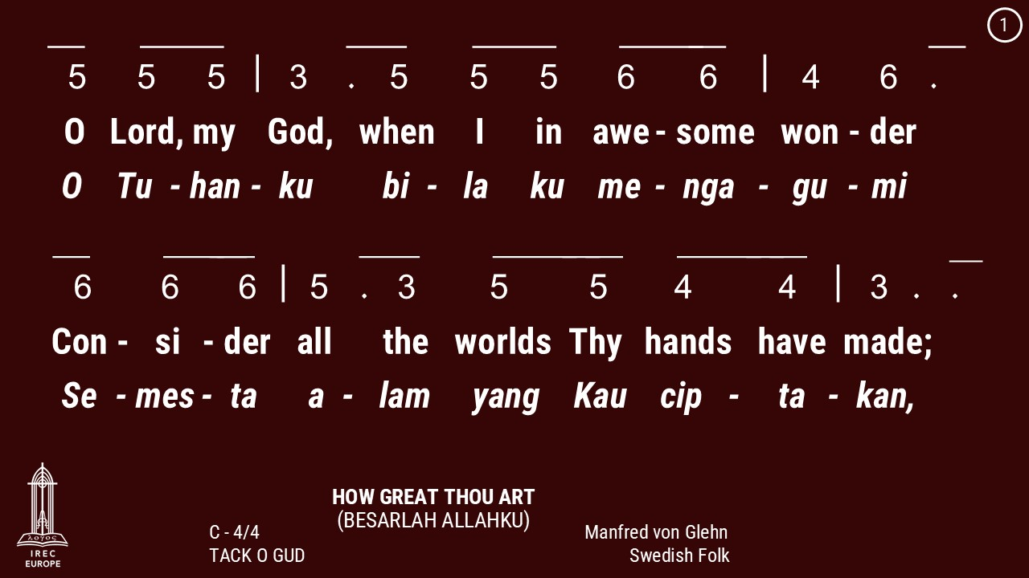

Slide 5
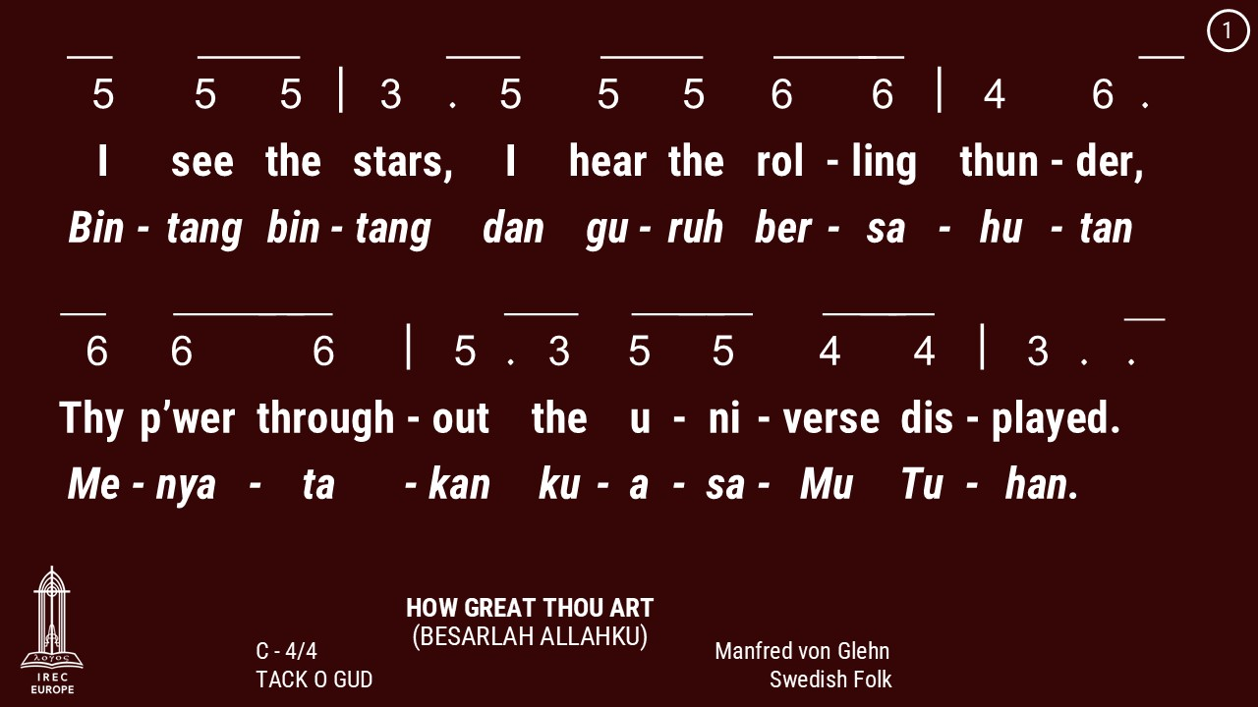

Slide 6
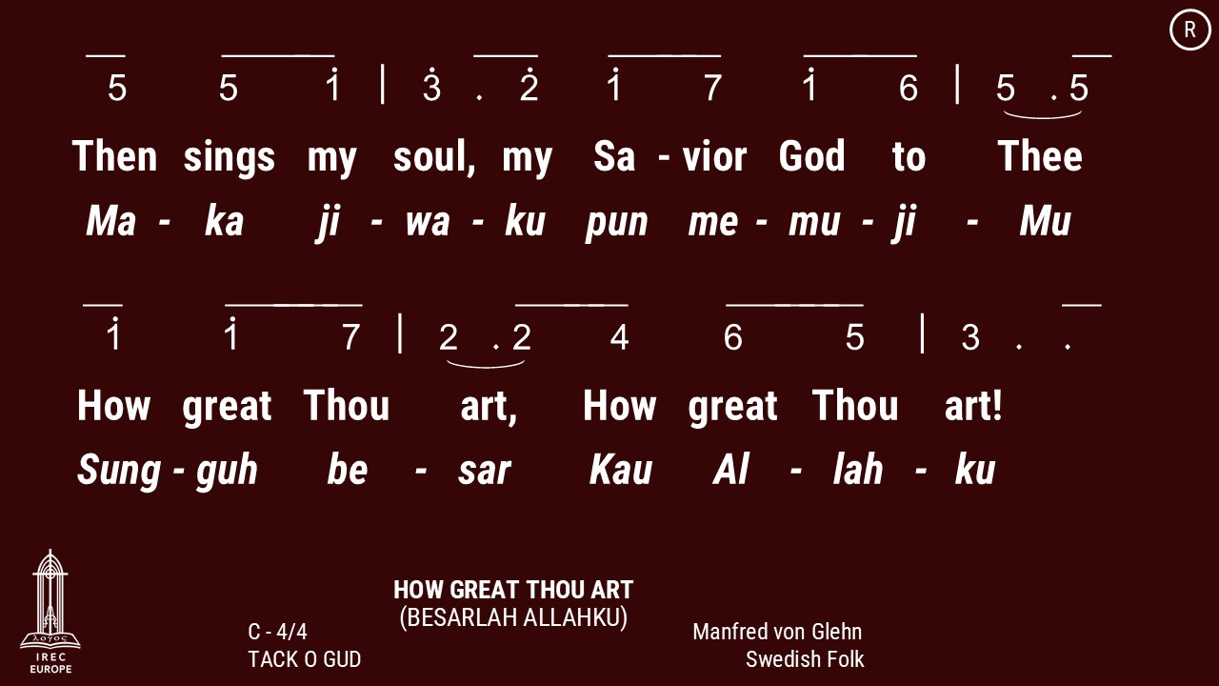

Slide 7
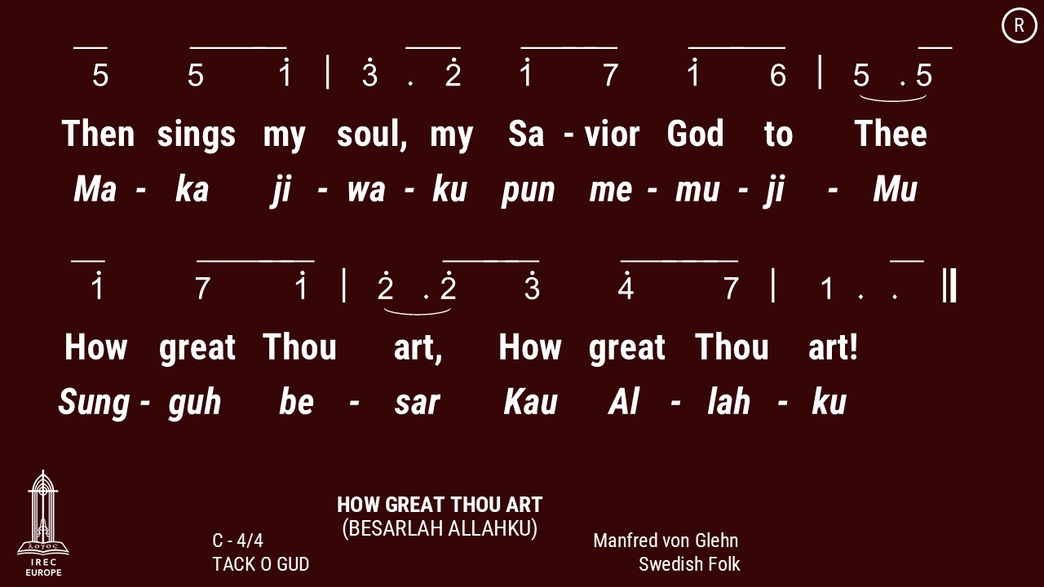

Slide 8
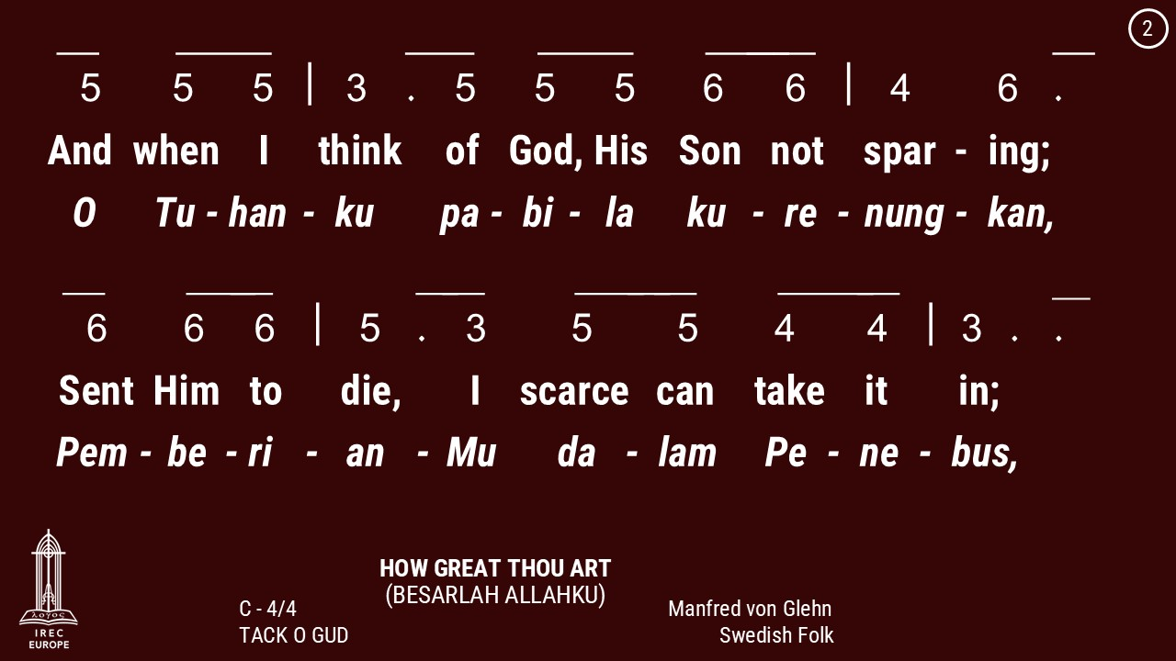

Slide 9
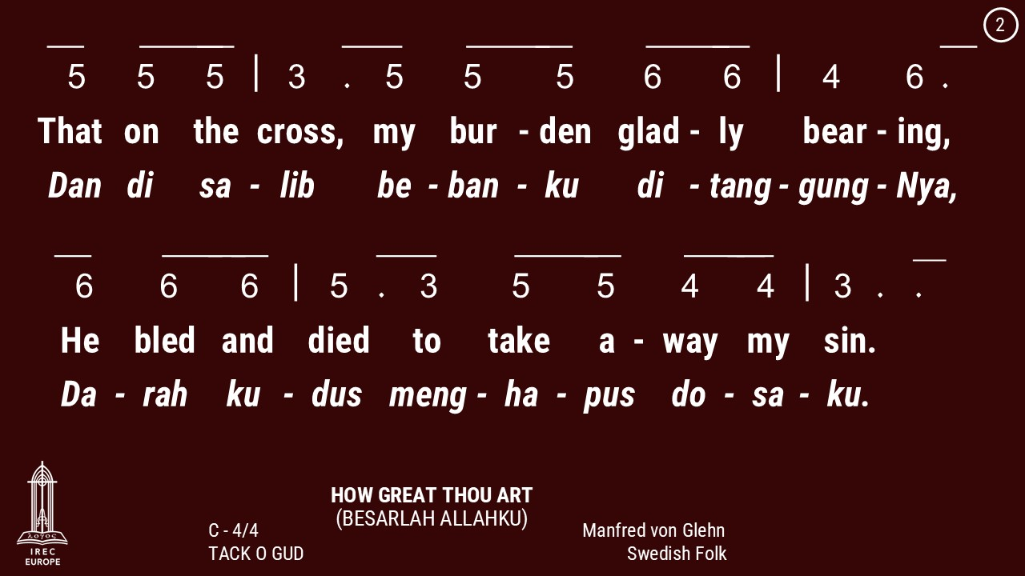

Slide 12
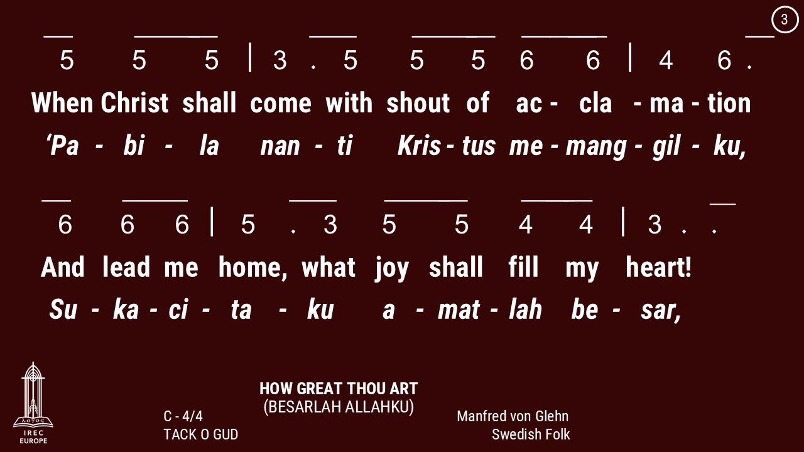

Slide 13
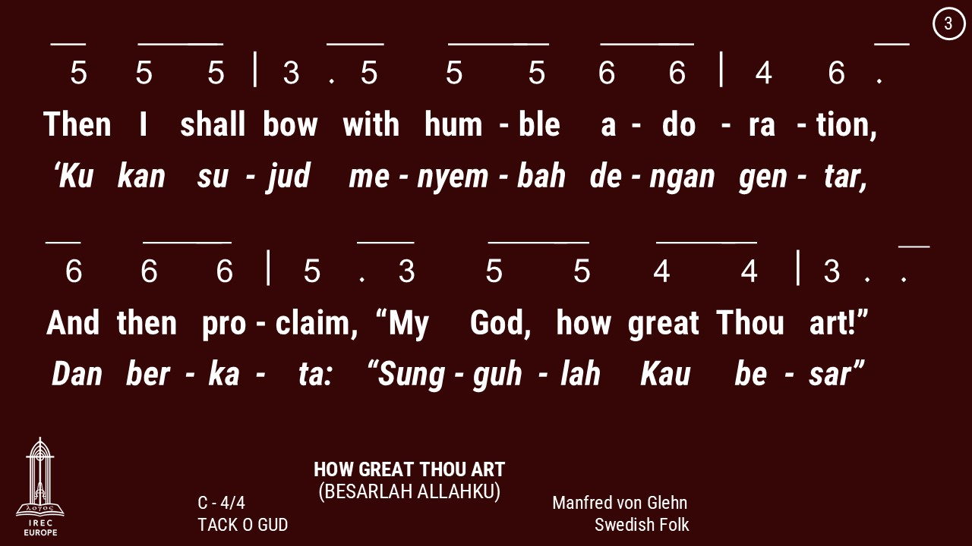

Slide 16
23 March 2025

Slide 17
23 March 2025

Slide 18
Genesis 1:2-3
Kejadian 1:2-3

Slide 19
Genesis 1:2 : And the earth was without form, and void; and darkness was upon the face of the deep. And the Spirit of God moved upon the face of the waters.
Kejadian 1:2 : Bumi belum berbentuk dan kosong; gelap gulita menutupi samudera raya, dan Roh Allah melayang-layang di atas permukaan air.

Slide 20
Genesis 1:3 : ¶ And God said, Let there be light: and there was light.
Kejadian 1:3 : Berfirmanlah Allah: "Jadilah terang." Lalu terang itu jadi.

Slide 21
1 Kings 1:1-2
1 Raja-raja 1:1-2

Slide 22
1 Kings 1:1 : ¶ Now king David was old and stricken in years; and they covered him with clothes, but he gat no heat.
1 Raja-raja 1:1 : Raja Daud telah tua dan lanjut umurnya, dan biarpun ia diselimuti, badannya tetap dingin.

Slide 23
1 Kings 1:2 : Wherefore his servants said unto him, Let there be sought for my lord the king a young virgin: and let her stand before the king, and let her cherish him, and let her lie in thy bosom, that my lord the king may get heat.
1 Raja-raja 1:2 : Lalu para pegawainya berkata kepadanya: "Hendaklah dicari bagi tuanku raja seorang perawan yang muda, untuk melayani dan merawat raja; biarlah ia berbaring di pangkuanmu, sehingga badan tuanku raja menjadi panas."

Slide 24
23 March 2025

Slide 25
23 March 2025

Slide 29
23 March 2025

Slide 30
Past. Billy Kristanto
Pdt. Billy Kristanto

Slide 31
23 March 2025

Slide 38
23 March 2025

Slide 40
23 March 2025

Slide 43
23 March 2025

Slide 45
23 March 2025

Slide 49
Makan Malam &
Persekutuan Doa
Setiap Jumat di minggu genap
18:30
Dinner & Prayer Meeting
Fridays on Even week
18:30

Slide 50
Pemahaman Alkitab
Sabtu, 15:00
Berner Heerweg 60
Bible Study
Saturdays, 15:00
Berner Heerweg 60

Slide 51
Online Catechism
Saturdays, every 2 weeks, 13:00

Slide 52
Master Class
Every Saturdays, odd weeks
14:00
untuk pengurus & pokja
For Administrators & Working Groups

Slide 53
Marriage Catechism
Registration: Nina

Slide 54
Latihan Koor
Minggu, 14:00 - 15:00
Berner Heerweg 60
Choir Practice
Sundays, 14:00 - 15:00
Berner Heerweg 60

Slide 55
Persekutuan Doa
Setiap Minggu, 15:30
Berner Heerweg 60
Prayer Fellowship
Sundays, 15:30
Berner Heerweg 60

Slide 56
Ibadah Minggu
Minggu, 14:00
Berner Heerweg 60
Sunday Worship
Sunday, 14:00
Berner Heerweg 60

Slide 57
Ibadah Minggu
Setiap Minggu, 16:00
Berner Heerweg 60
Sunday Worship
Every Sunday, 16:00
Berner Heerweg 60

Slide 58
Ibadah Minggu & Perjamuan Kudus
Minggu, 9:00
Berner Heerweg 60
Sunday Worship & Holy Communion
Sunday, 9:00
Berner Heerweg 60

Slide 59
Persekutuan Doa
Minggu, 11:00
Berner Heerweg 60
Prayer Fellowship
Sunday, 11:00
Berner Heerweg 60

Slide 60
Persekutuan Doa
Setiap Minggu, 15:30
Berner Heerweg 60
Prayer Fellowship
Sundays, 15:30
Berner Heerweg 60

Slide 61
Sekolah Minggu
Minggu, 9:00
Berner Heerweg 60
Sunday School
Sunday, 9:00
Berner Heerweg 60

Slide 62
Sekolah Minggu
Setiap Minggu, 16:00
Berner Heerweg 60
Sunday School
Every Sunday, 16:00
Berner Heerweg 60

