Slide 2
27 July 2025

Slide 3
27 July 2025

Slide 4
27 July 2025

Slide 5
Genesis 1:2-3
Kejadian 1:2-3

Slide 6
Genesis 1:2 : And the earth was without form, and void; and darkness was upon the face of the deep. And the Spirit of God moved upon the face of the waters.
Kejadian 1:2 : Bumi belum berbentuk dan kosong; gelap gulita menutupi samudera raya, dan Roh Allah melayang-layang di atas permukaan air.

Slide 7
Genesis 1:3 : ¶ And God said, Let there be light: and there was light.
Kejadian 1:3 : Berfirmanlah Allah: "Jadilah terang." Lalu terang itu jadi.

Slide 8
27 July 2025

Slide 9


Slide 10
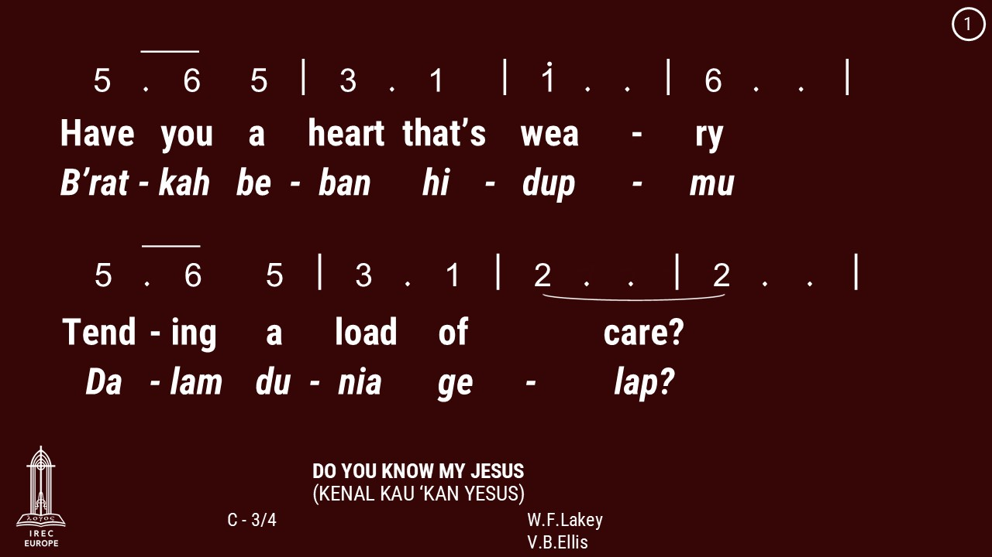

Slide 11
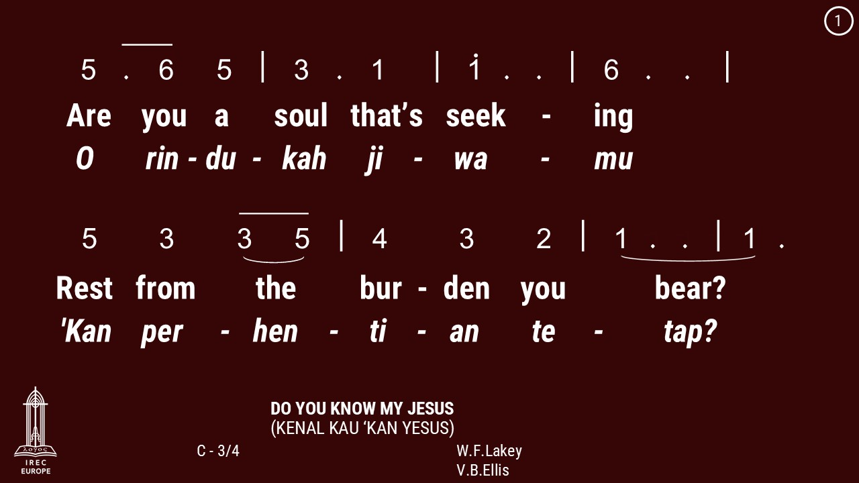

Slide 12
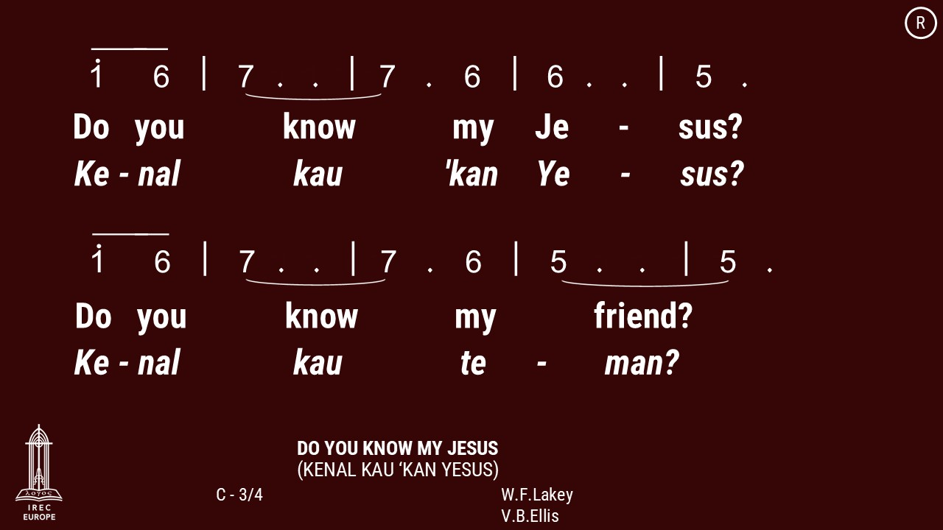

Slide 13
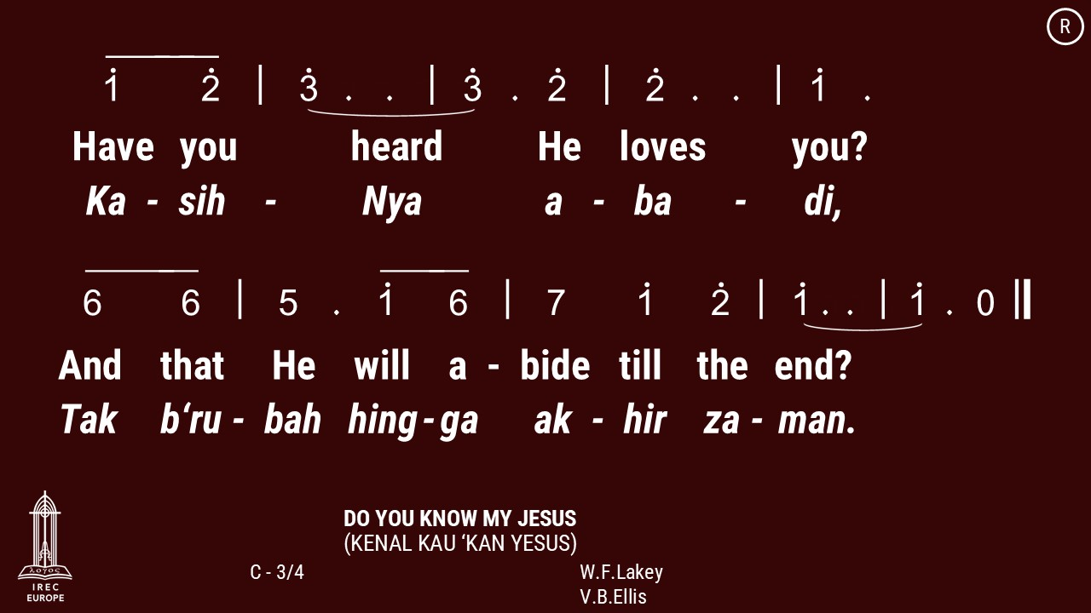

Slide 14
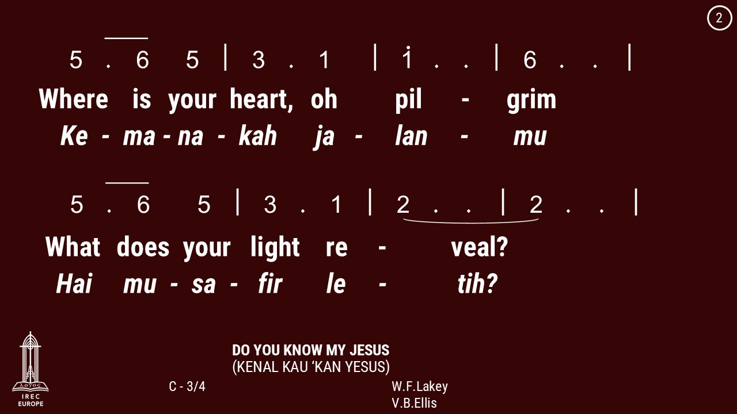

Slide 15
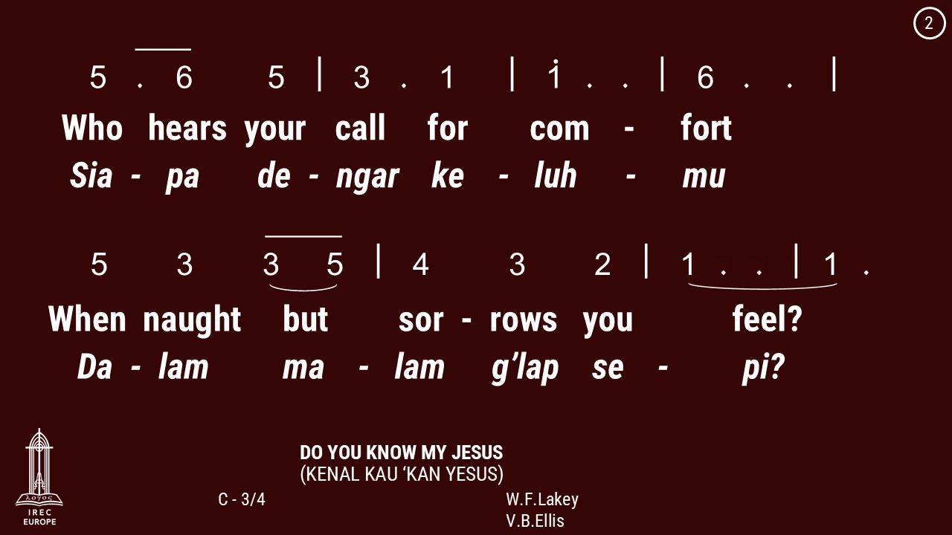

Slide 18
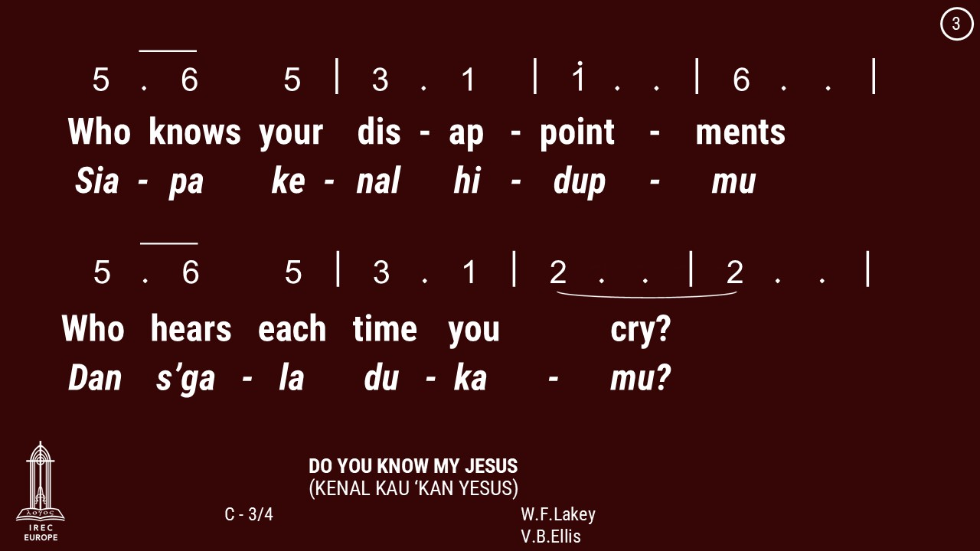

Slide 19
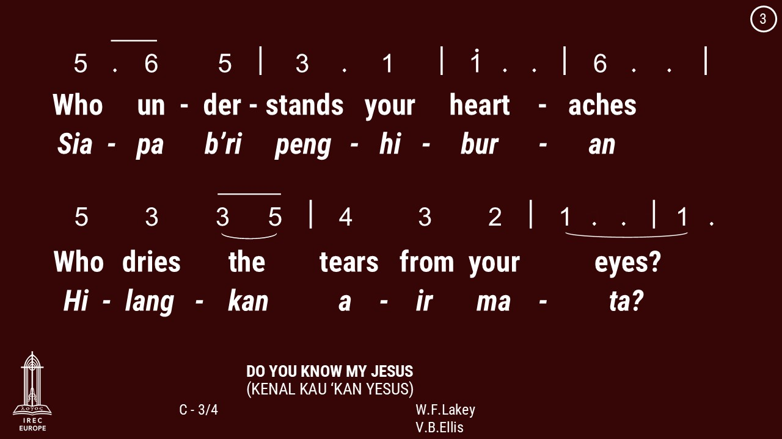

Slide 22
27 July 2025

Slide 27
27 July 2025

Slide 41
27 July 2025

Slide 42
Rev. Billy Kristanto
Pdt. Billy Kristanto

Slide 43
27 July 2025

Slide 50
27 July 2025

Slide 52


Slide 53
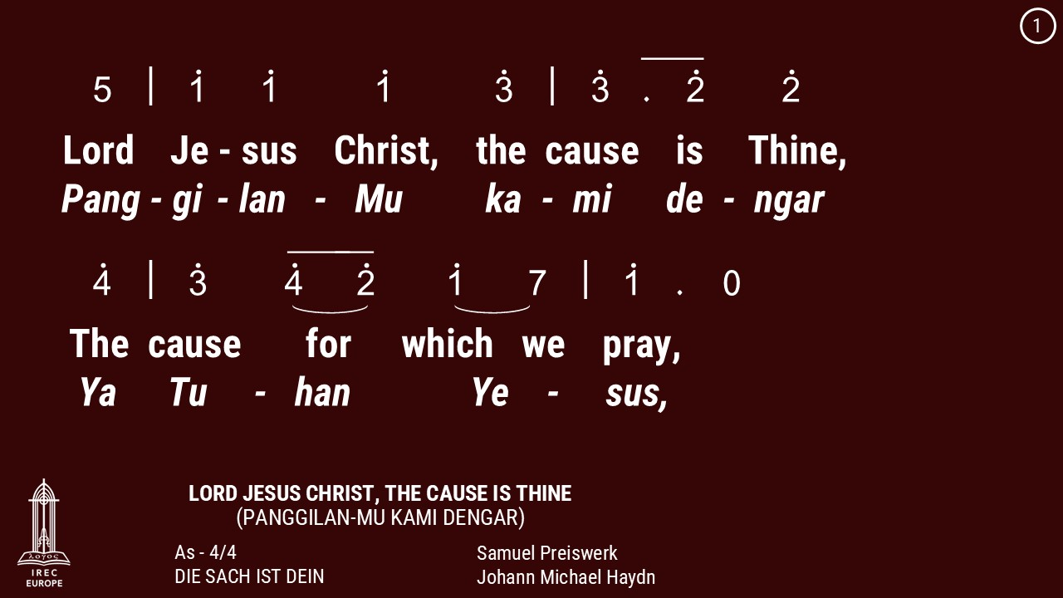

Slide 54
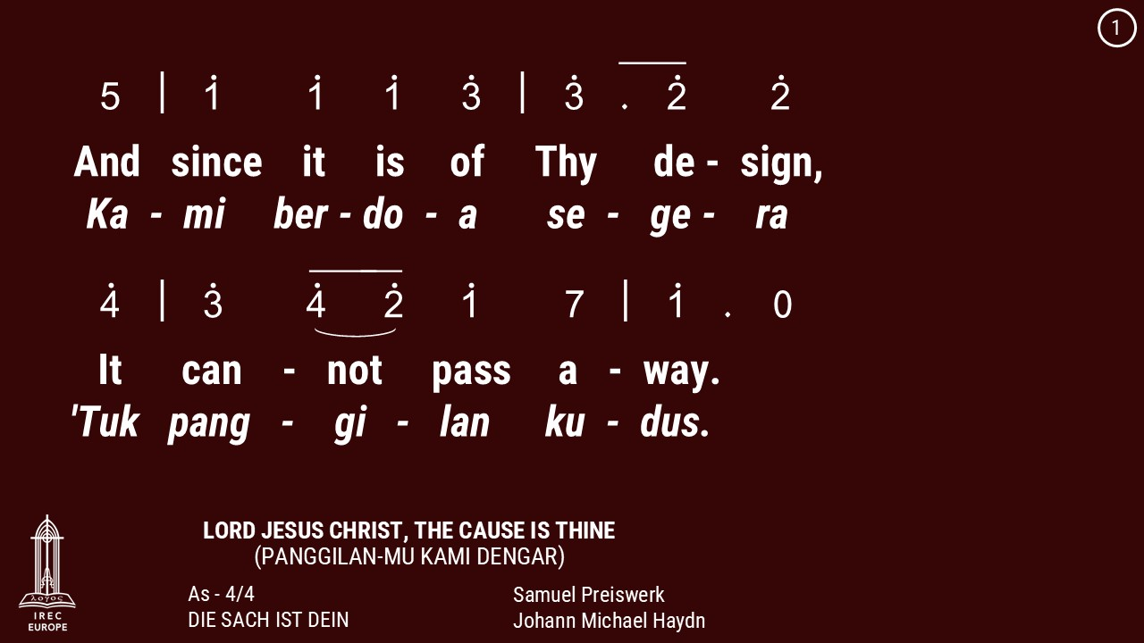

Slide 55
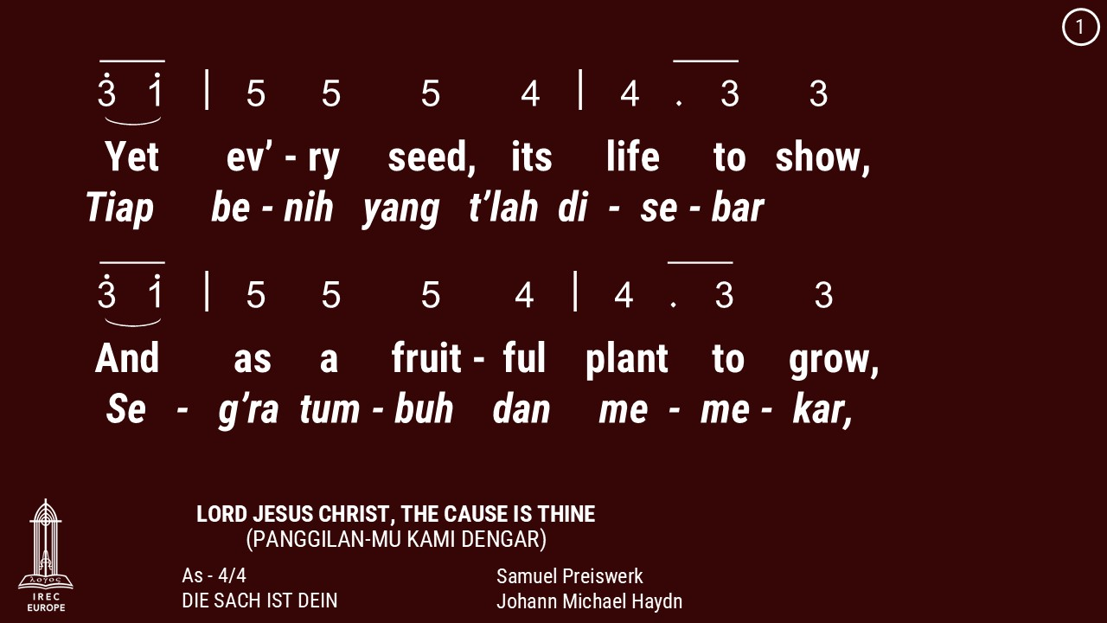

Slide 56
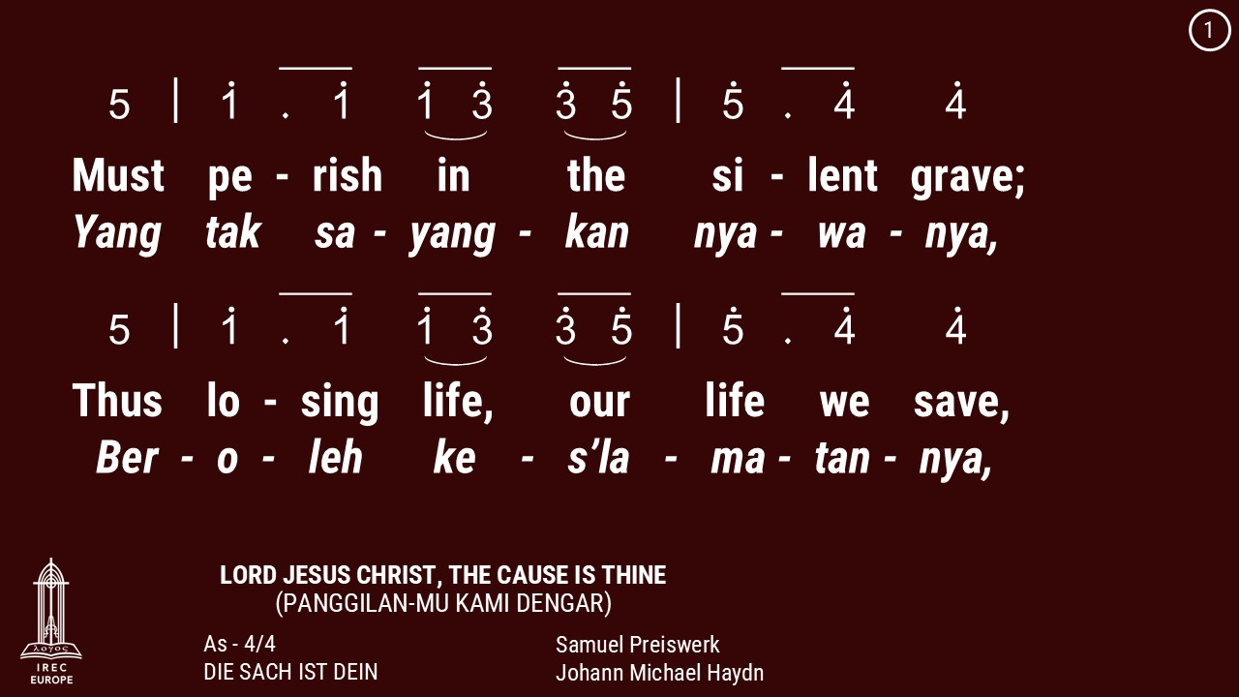

Slide 57
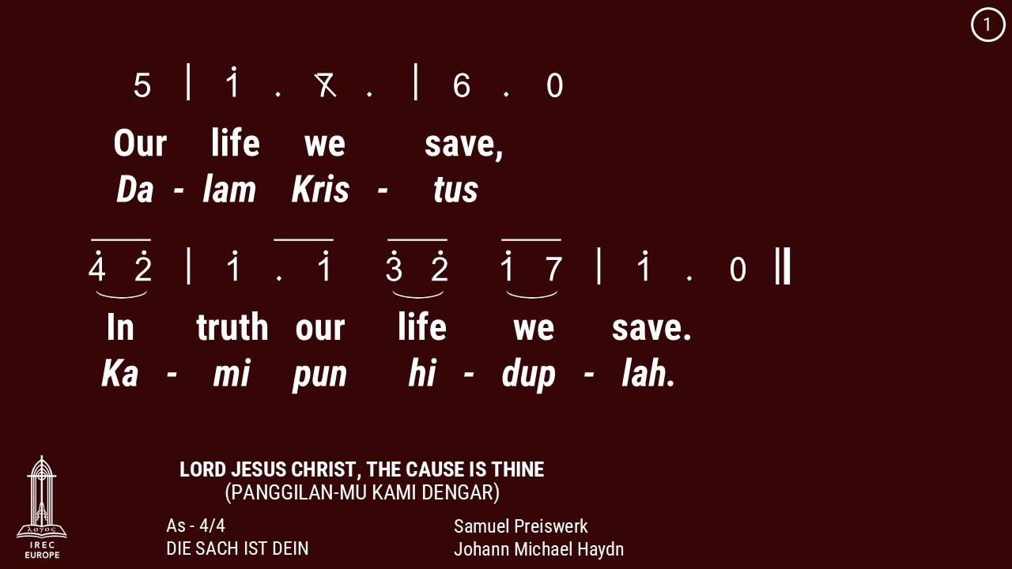

Slide 58
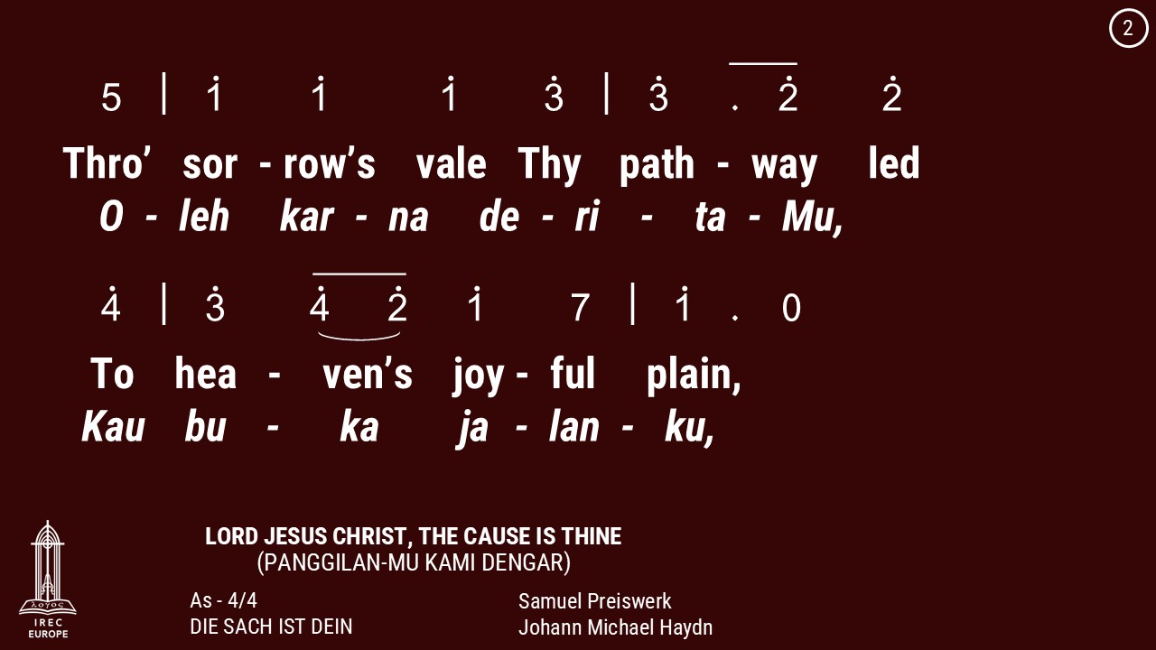

Slide 59
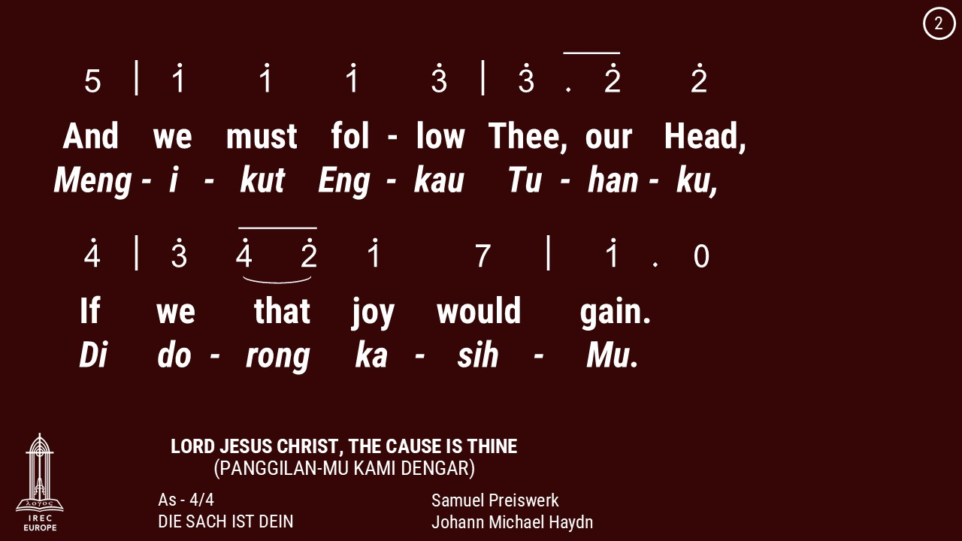

Slide 60
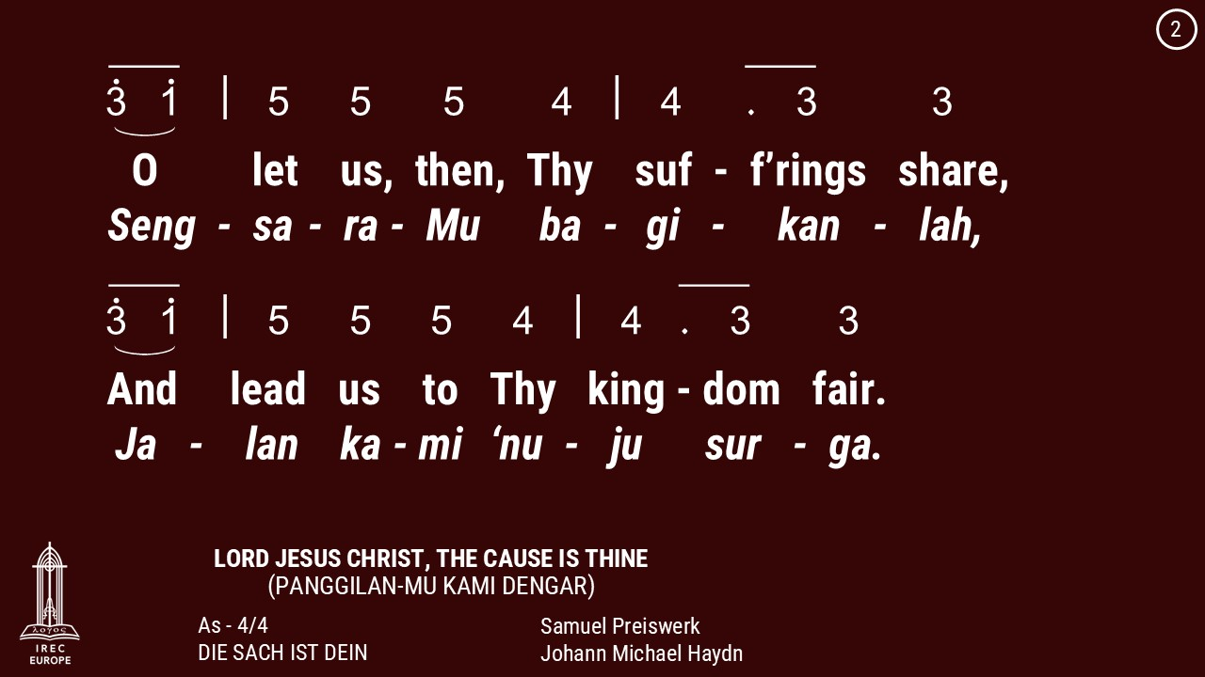

Slide 61
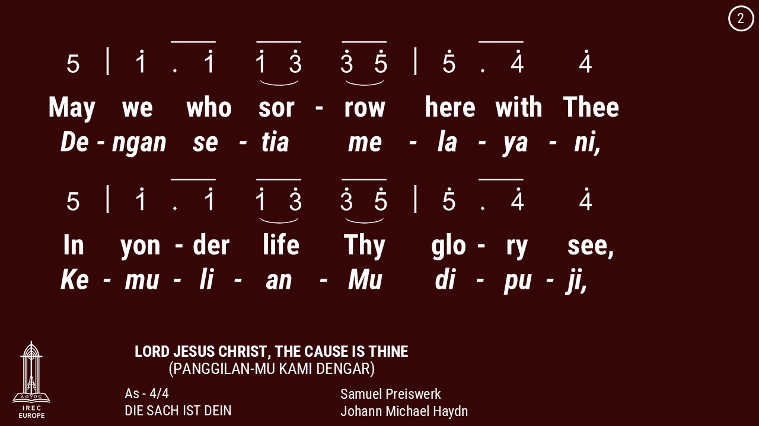

Slide 62
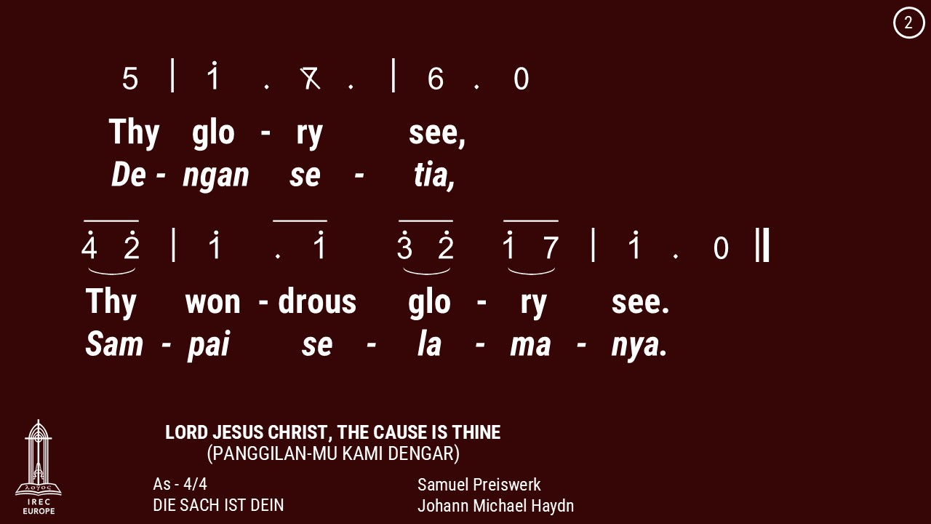

Slide 63
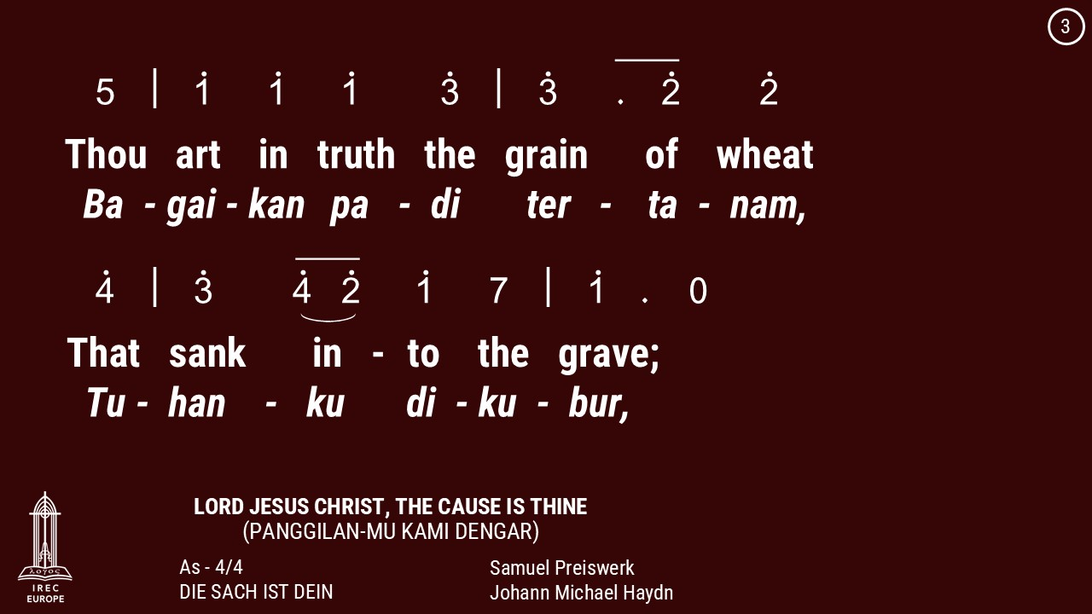

Slide 64
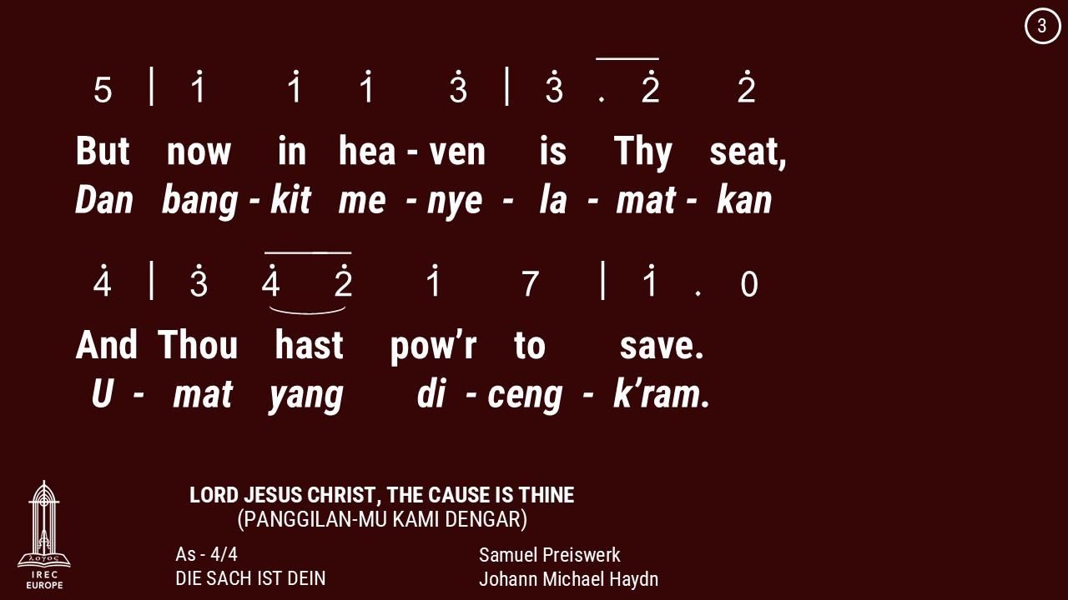

Slide 65
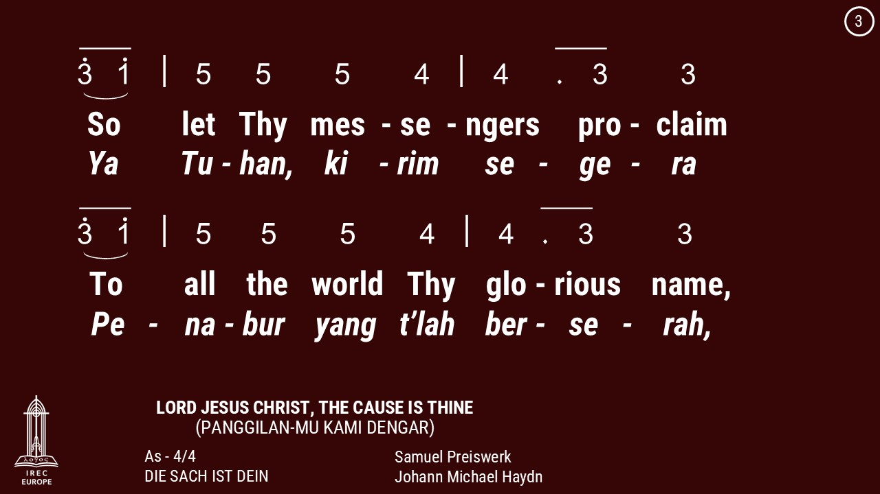

Slide 66
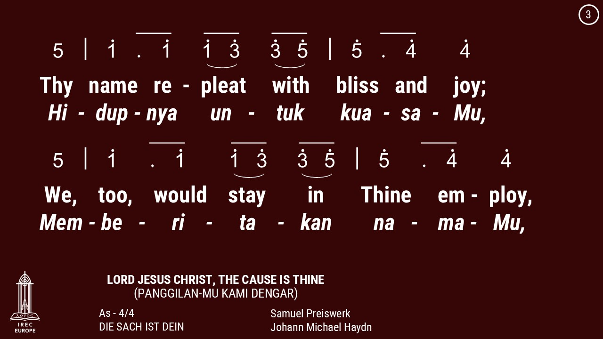

Slide 67
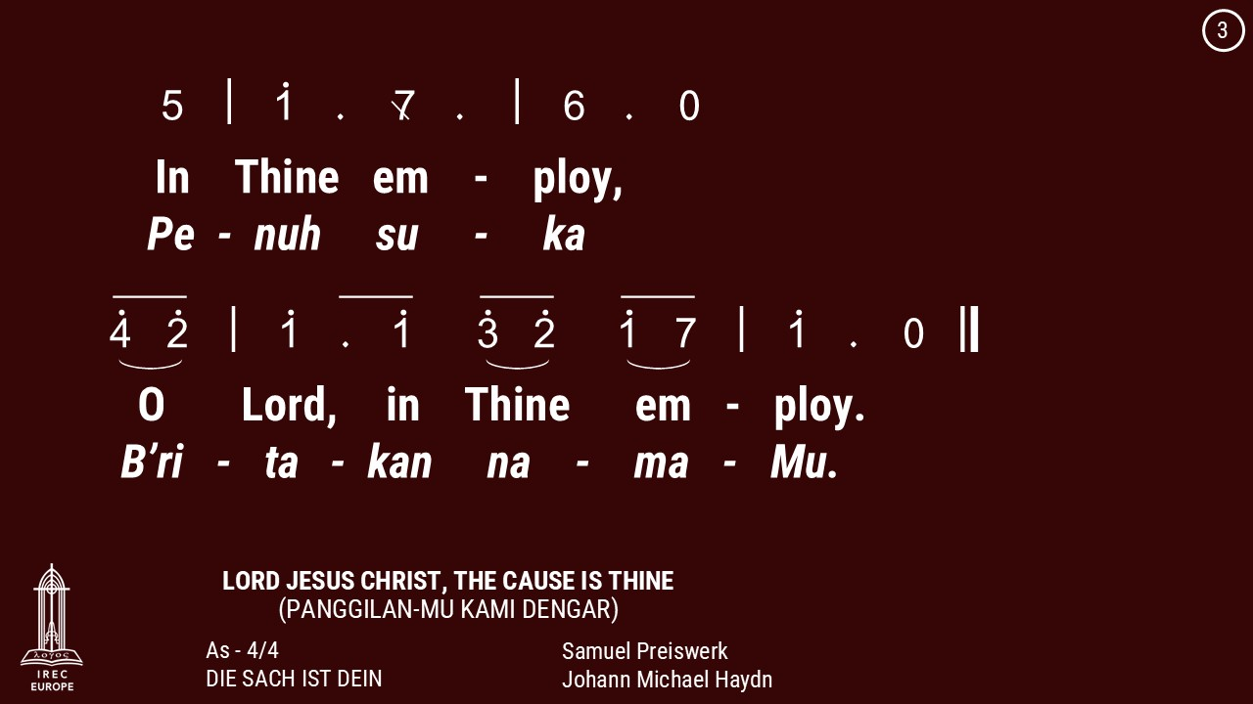

Slide 68
27 July 2025

Slide 71
27 July 2025

Slide 73
27 July 2025

Slide 77
Makan Malam &
Persekutuan Doa
Setiap Jumat di minggu genap
18:30
Dinner & Prayer Meeting
Fridays on Even week
18:30

Slide 78
Pemahaman Alkitab
Sabtu, 15:00
Berner Heerweg 60
Bible Study
Saturdays, 15:00
Berner Heerweg 60

Slide 79
Online Catechism
Saturdays, every 2 weeks, 13:00

Slide 80
Master Class
Every Saturdays, odd weeks
14:00
untuk pengurus & pokja
For Administrators & Working Groups

Slide 81
Marriage Catechism
Registration: Nina

Slide 82
Latihan Koor
Minggu, 14:00 - 15:00
Berner Heerweg 60
Choir Practice
Sundays, 14:00 - 15:00
Berner Heerweg 60

Slide 83
Persekutuan Doa
Setiap Minggu, 15:30
Berner Heerweg 60
Prayer Fellowship
Sundays, 15:30
Berner Heerweg 60

Slide 84
Ibadah Minggu
Minggu, 14:00
Berner Heerweg 60
Sunday Worship
Sunday, 14:00
Berner Heerweg 60

Slide 85
Ibadah Minggu
Setiap Minggu, 16:00
Berner Heerweg 60
Sunday Worship
Every Sunday, 16:00
Berner Heerweg 60

Slide 86
Ibadah Minggu & Perjamuan Kudus
Minggu, 9:00
Berner Heerweg 60
Sunday Worship & Holy Communion
Sunday, 9:00
Berner Heerweg 60

Slide 87
Persekutuan Doa
Minggu, 11:00
Berner Heerweg 60
Prayer Fellowship
Sunday, 11:00
Berner Heerweg 60

Slide 88
Persekutuan Doa
Setiap Minggu, 15:30
Berner Heerweg 60
Prayer Fellowship
Sundays, 15:30
Berner Heerweg 60

Slide 89
Sekolah Minggu
Minggu, 9:00
Berner Heerweg 60
Sunday School
Sunday, 9:00
Berner Heerweg 60

Slide 90
Sekolah Minggu
Setiap Minggu, 16:00
Berner Heerweg 60
Sunday School
Every Sunday, 16:00
Berner Heerweg 60

