Slide 2
07 September 2025

Slide 3
07 September 2025

Slide 4
07 September 2025

Slide 5
Genesis 1:2-3
Kejadian 1:2-3

Slide 6
Genesis 1:2 : The earth was without form and void, and darkness was over the face of the deep. And the Spirit of God was hovering over the face of the waters.
Kejadian 1:2 : Bumi belum berbentuk dan kosong; gelap gulita menutupi samudera raya, dan Roh Allah melayang-layang di atas permukaan air.

Slide 7
Genesis 1:3 : And God said, “Let there be light,” and there was light.
Kejadian 1:3 : Berfirmanlah Allah: "Jadilah terang." Lalu terang itu jadi.

Slide 8
07 September 2025

Slide 9
07 September 2025

Slide 14
07 September 2025

Slide 15
Rev. Billy Kristanto
Pdt. Billy Kristanto

Slide 16
07 September 2025

Slide 23
07 September 2025

Slide 25
07 September 2025

Slide 28
07 September 2025

Slide 30
07 September 2025

Slide 34
Makan Malam &
Persekutuan Doa
Setiap Jumat di minggu genap
18:30
Dinner & Prayer Meeting
Fridays on Even week
18:30

Slide 35
Latihan Koor
Minggu, 14:00 - 15:00
Berner Heerweg 60
Choir Practice
Sundays, 14:00 - 15:00
Berner Heerweg 60

Slide 36
Persekutuan Doa
Setiap Minggu, 15:30
Berner Heerweg 60
Prayer Fellowship
Sundays, 15:30
Berner Heerweg 60

Slide 37
Ibadah Minggu
Setiap Minggu, 16:00
Berner Heerweg 60
Sunday Worship
Every Sunday, 16:00
Berner Heerweg 60

Slide 38
Ibadah Minggu & Perjamuan Kudus
Minggu, 9:00
Berner Heerweg 60
Sunday Worship & Holy Communion
Sunday, 9:00
Berner Heerweg 60

Slide 39
Makan Siang &Persekutuan Doa
Sabtu, 12:30
Berner Heerweg 60
Lunch & Prayer Fellowship
Saturday, 12:30
Berner Heerweg 60

Slide 40
Sekolah Minggu
Setiap Minggu, 16:00
Berner Heerweg 60
Sunday School
Every Sunday, 16:00
Berner Heerweg 60

Slide 43
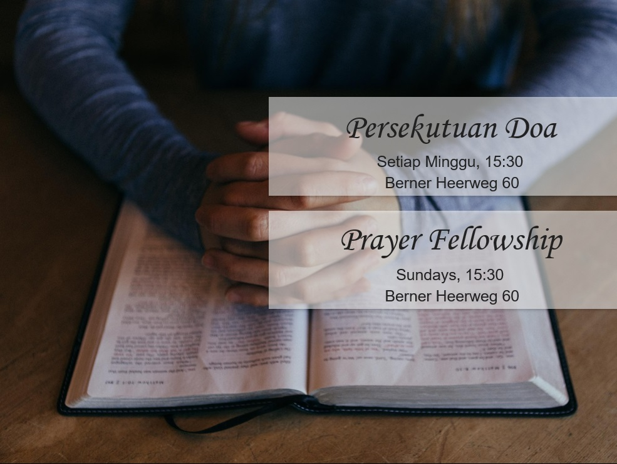

Slide 44
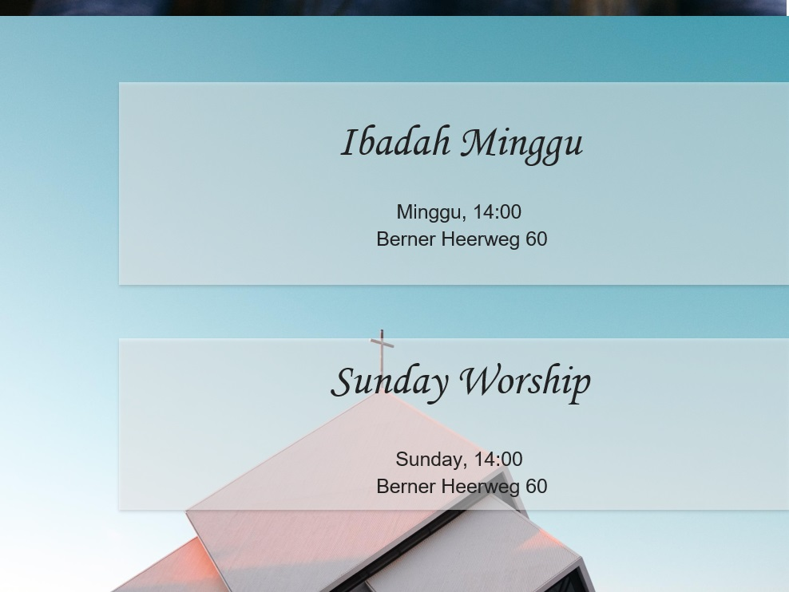

Slide 45
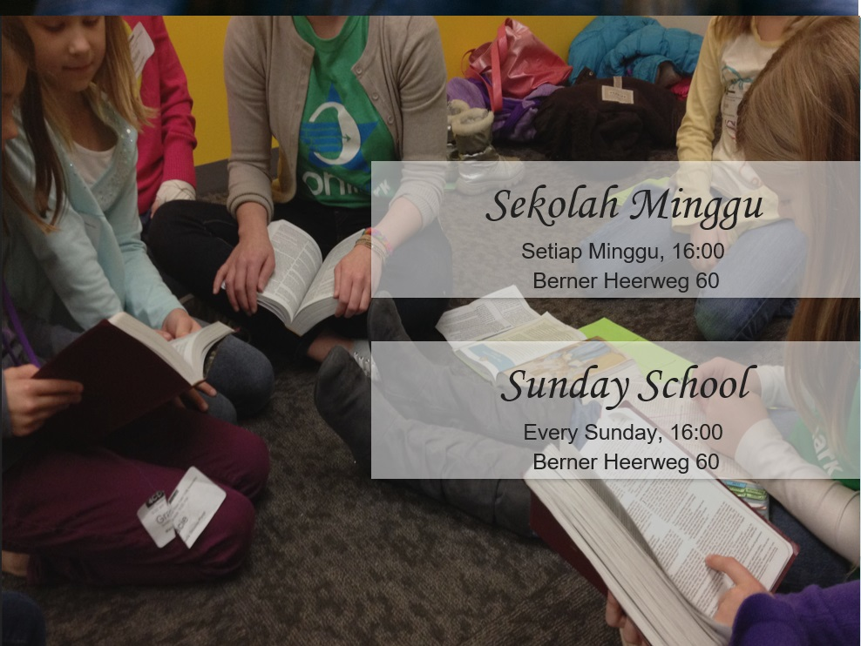

Slide 46


Slide 47
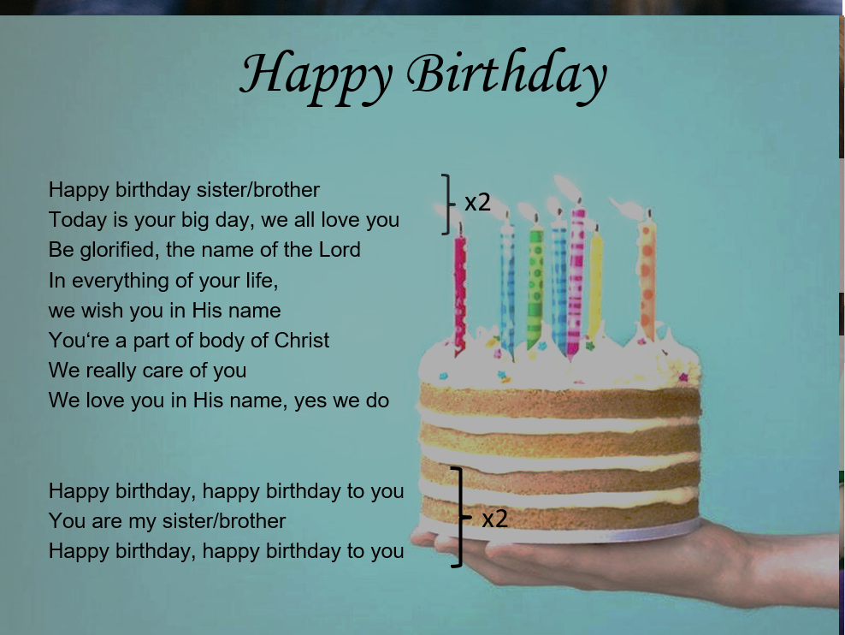

Slide 48


Slide 49
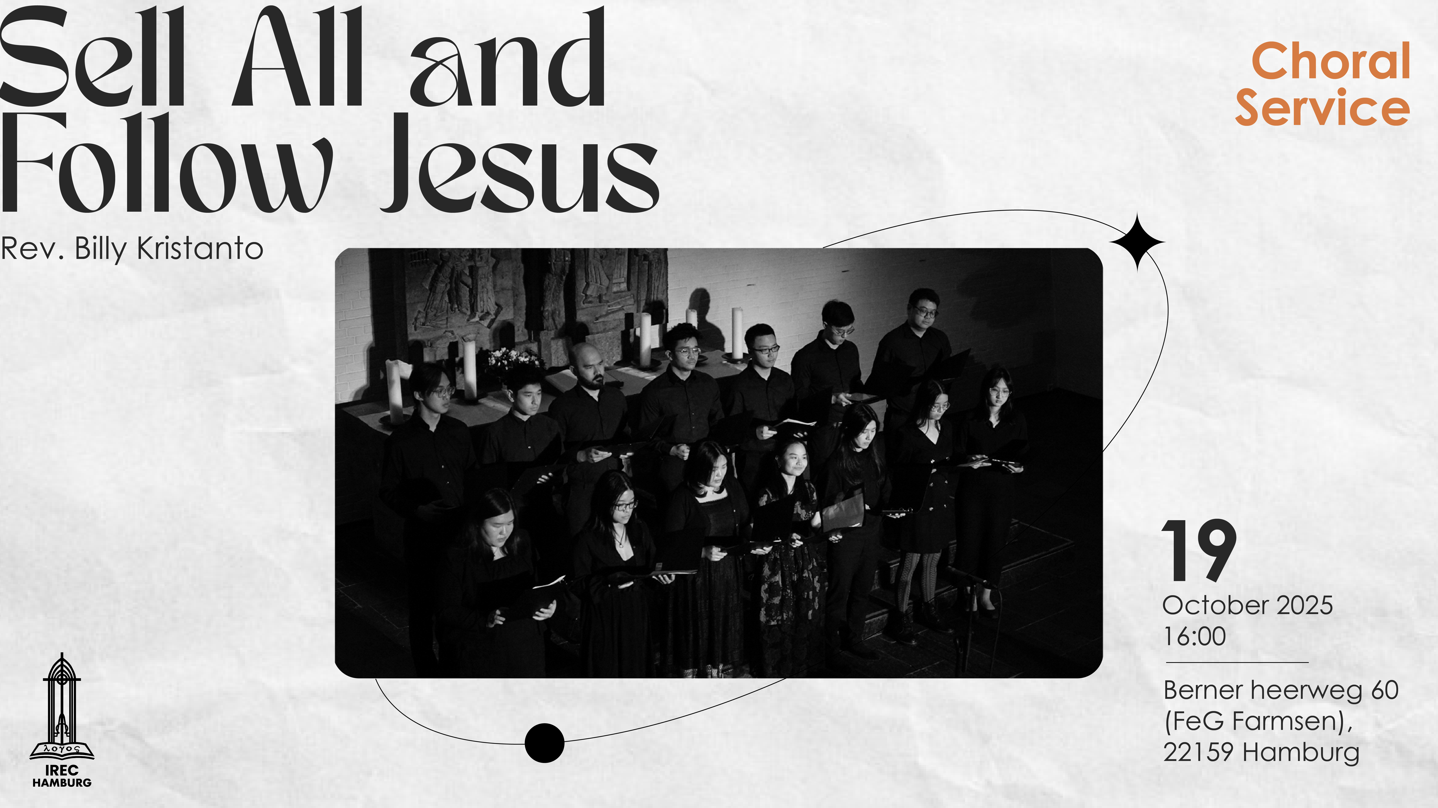

Slide 50
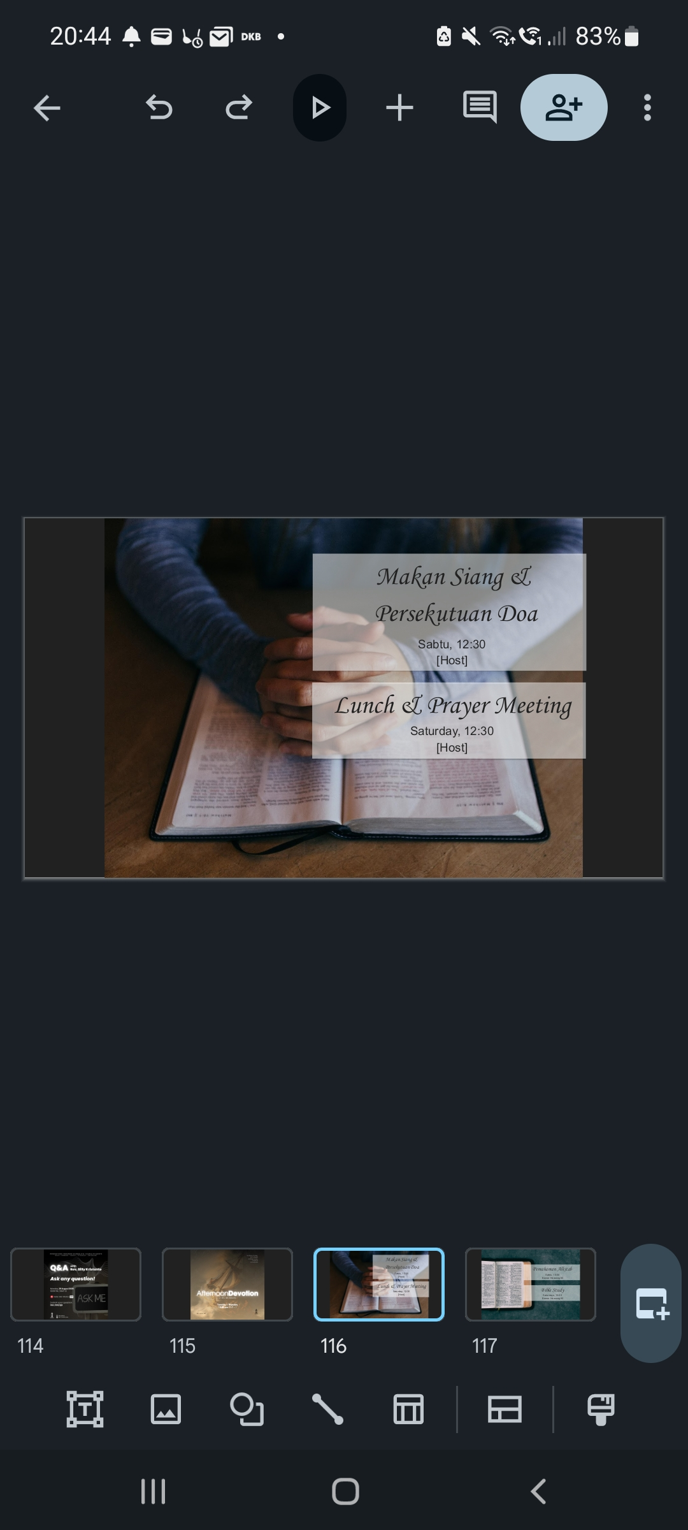

Slide 51
