Slide 1

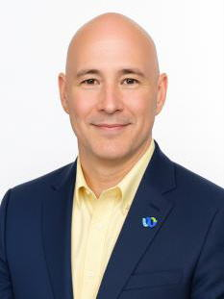
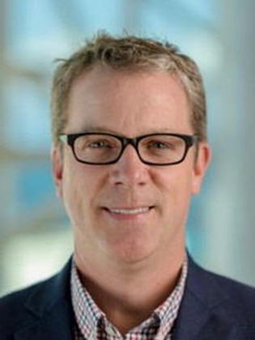
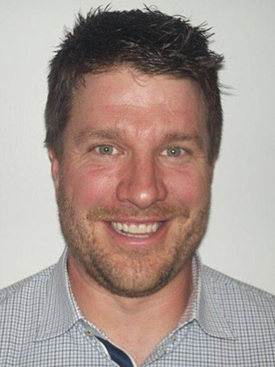
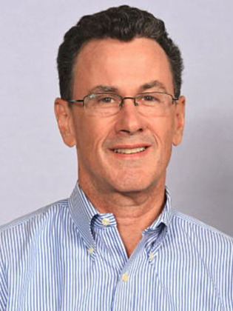
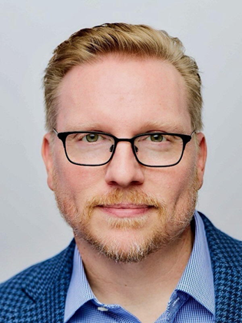
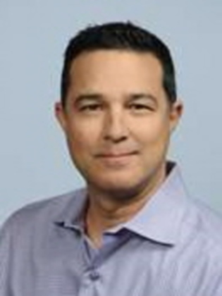
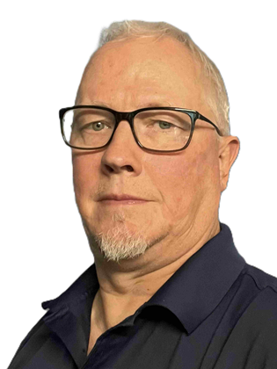
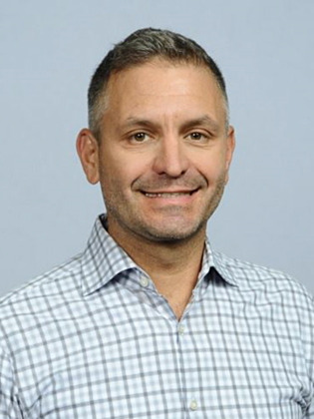
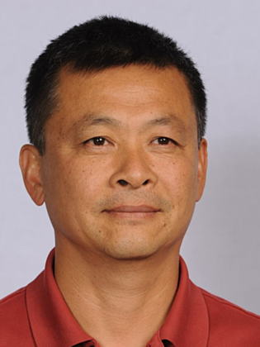
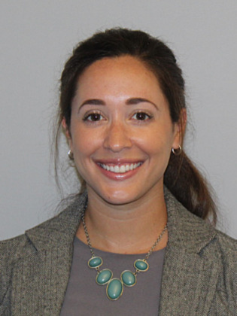
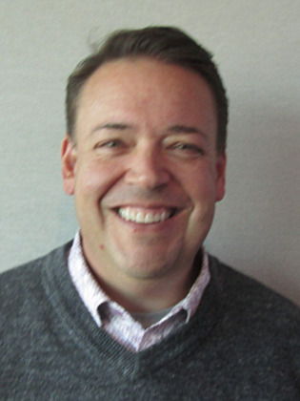
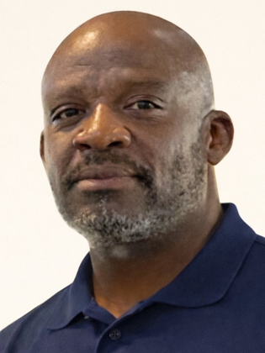

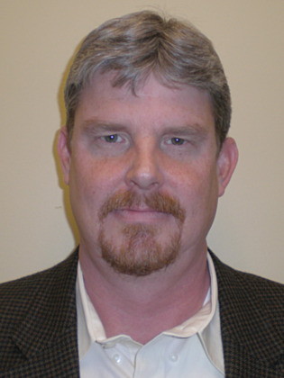
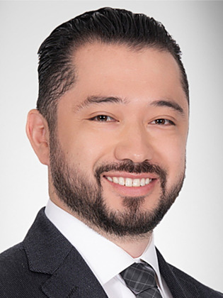
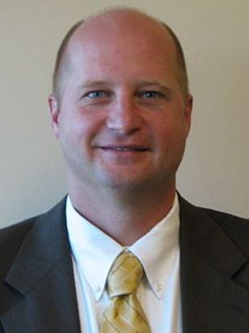
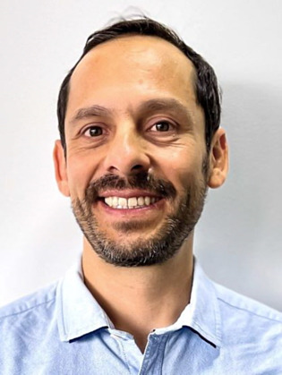
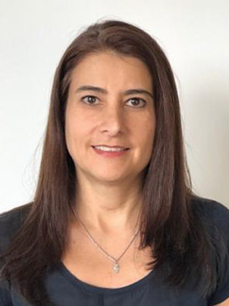
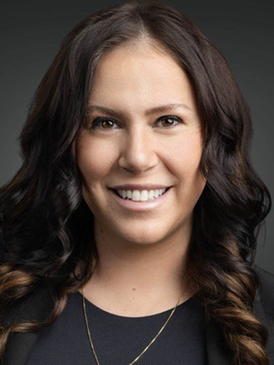

Americas Collaboration Partner Sales & Solution Engineering
Combined team overview
Partner Sales · Chad Bullock
Partner Sales · Kristeen Webb
Solution Engineering · Stephanie Ross
Chad Bullock
Leader, Partner Sales
Kristeen Webb
Leader, Partner Sales
Stephanie Ross
Leader, Solution Engineering
Robb Garth
Account Executive
Gregg Mills
Account Executive
Brian Peterson
Solutions Engineer
Open HC
Account Executive
Brian Narcum
Solutions Engineer
Andrew Cook
Account Executive
Craig Tait
Solutions Engineer
Jon Seiniger
Account Executive
Kevin Haddad
Account Executive
Steve Qin
Solutions Engineer
Jennifer Ruggiano
Account Executive
Tim Sisneros
Account Executive
Emenike Whitfield
Solutions Engineer
Courtney Palmer
Account Executive
Dolan Spitler
Solutions Engineer
Jaime Rivera
Account Executive
Gregg McCaw
Account Executive
Javier Cuadros
Solutions Engineer
Maria Claudia Martinez
Account Executive
Christa Mancino
Account Executive
Michelle Williams
Solutions Engineer

