Slide 1
Sensor Fusion and Multi-Object Tracking with Kalman Filter and Parameter Optimization on NuScenes
Stefano Ruggiero

Slide 2
Project Goal
Design, implement, and evaluate a multi-object tracking system using sensor fusion (LiDAR + Camera) with Kalman filter on NuScenes dataset.
Optimize parameters to maximize tracking accuracy in dynamic urban scenarios.

Slide 3
Technologies Used
NuScenes dataset: Mini version with synchronized LiDAR point clouds & camera images.
FilterPy: For Kalman filter.
OpenCV, Matplotlib: Visualization & image processing.
Optuna: Parameter optimization (Bayesian).
NumPy, SciPy: Data processing, clustering, and math operations.

Slide 4
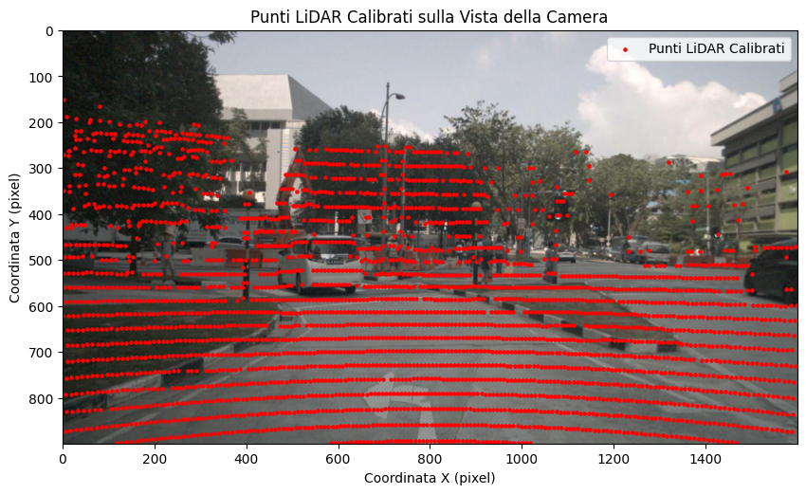
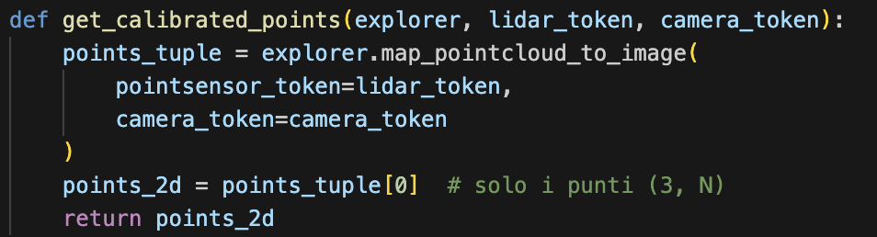
Pipeline 1/6 Data Loading & Calibration
Synchronized LiDAR and camera data loaded from NuScenes mini.
Calibration aligns point clouds to camera frame (extrinsics + intrinsics).

Slide 5
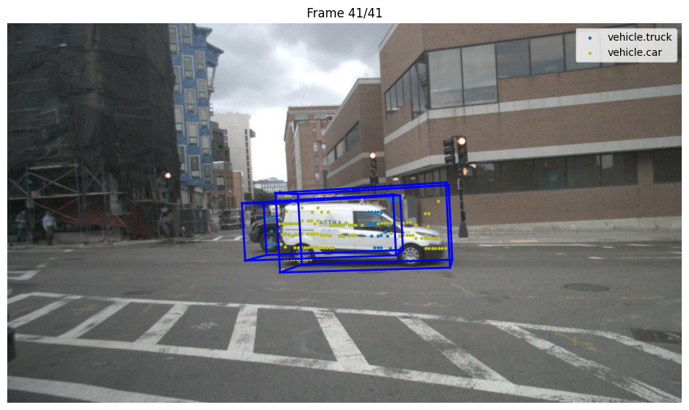
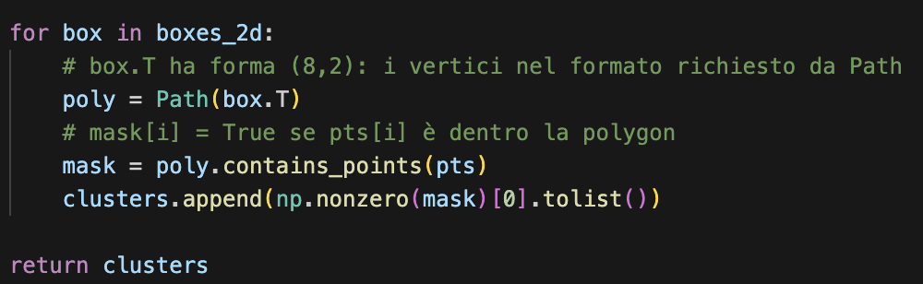
Pipeline 2/6 Bounding Box Extraction & Point Clustering
3D bounding boxes projected onto images.
LiDAR points projected in 2D; clusters built for each detected object.

Slide 6
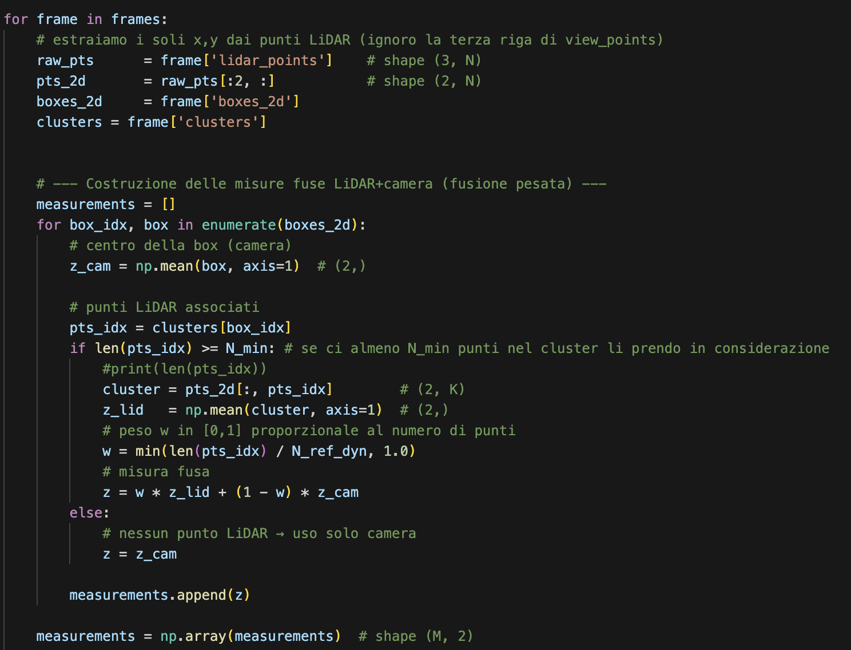
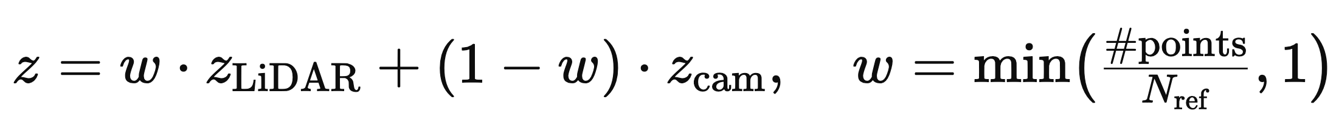
Pipeline 3/6 Measurement Fusion
Weighted average of camera box center and LiDAR cluster centroid.
Adaptive weighting by LiDAR density per box.
https://www.researchgate.net/publication/380765355_Multi-Sensor_Adaptive_Weighted_Data_Fusion_Based_on_Biased_Estimation

Slide 7
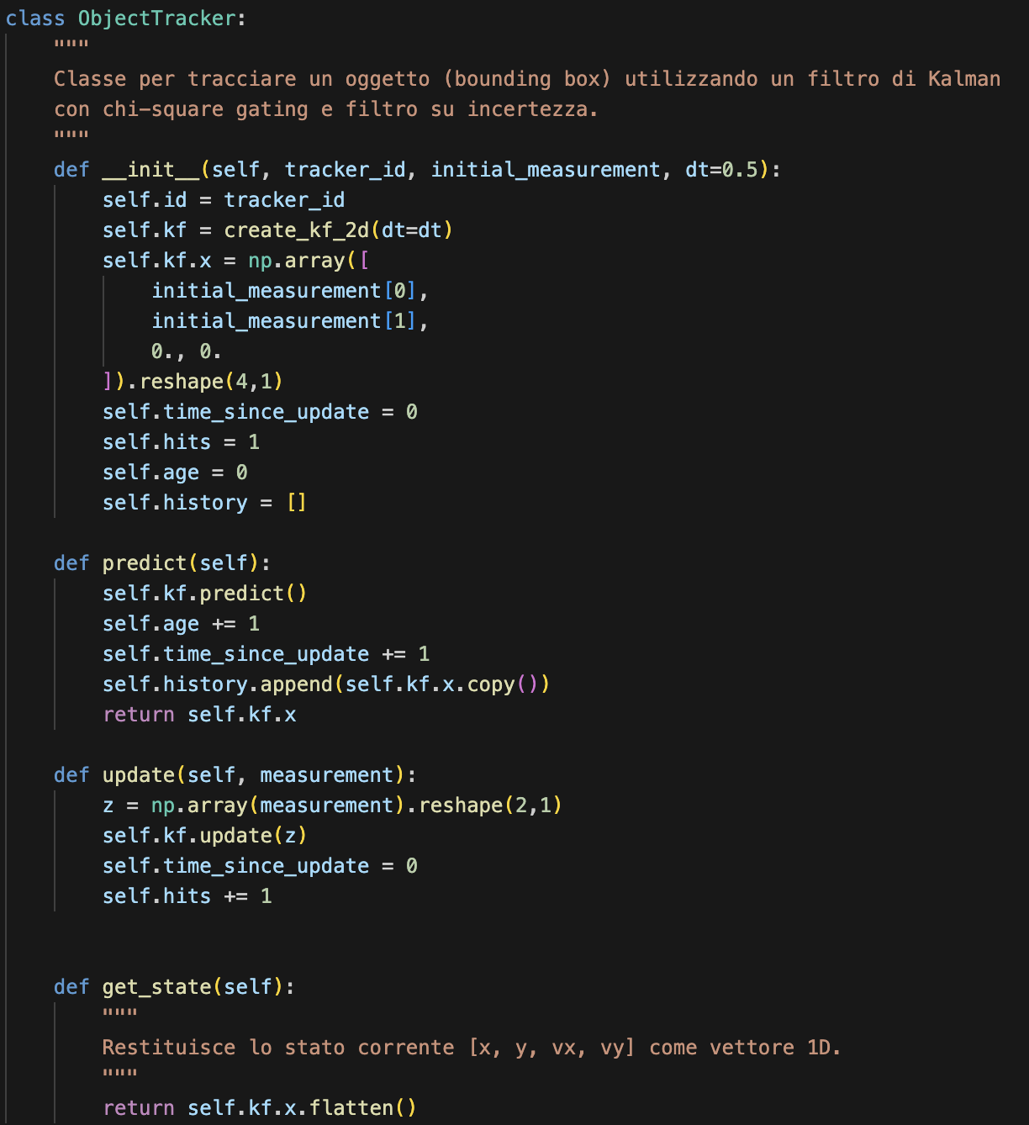
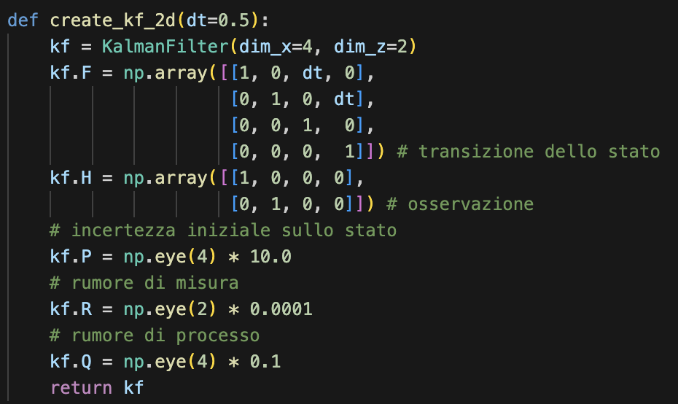
Pipeline 4/6 Multi-Object Tracking
Constant velocity Kalman filter (2D state).

Slide 8
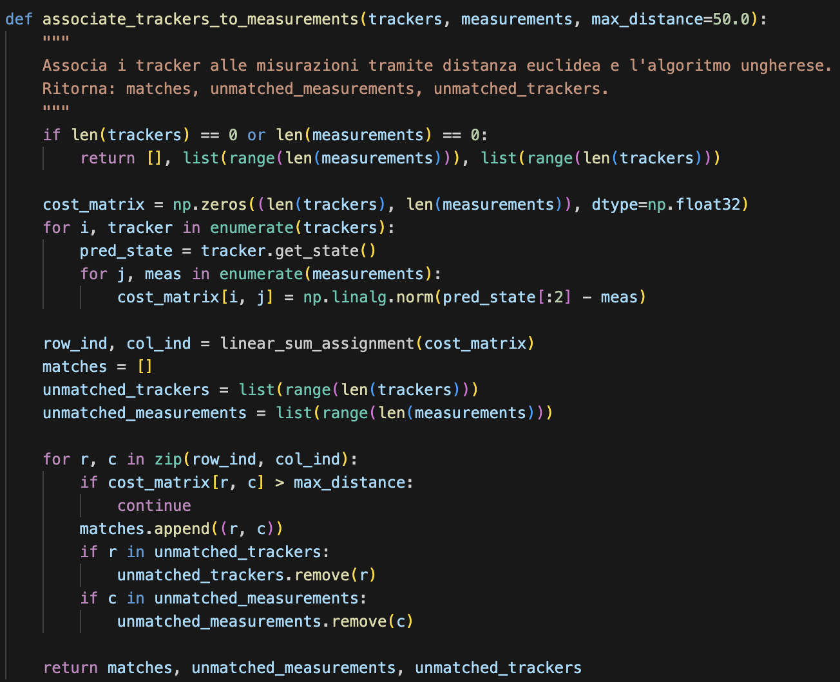
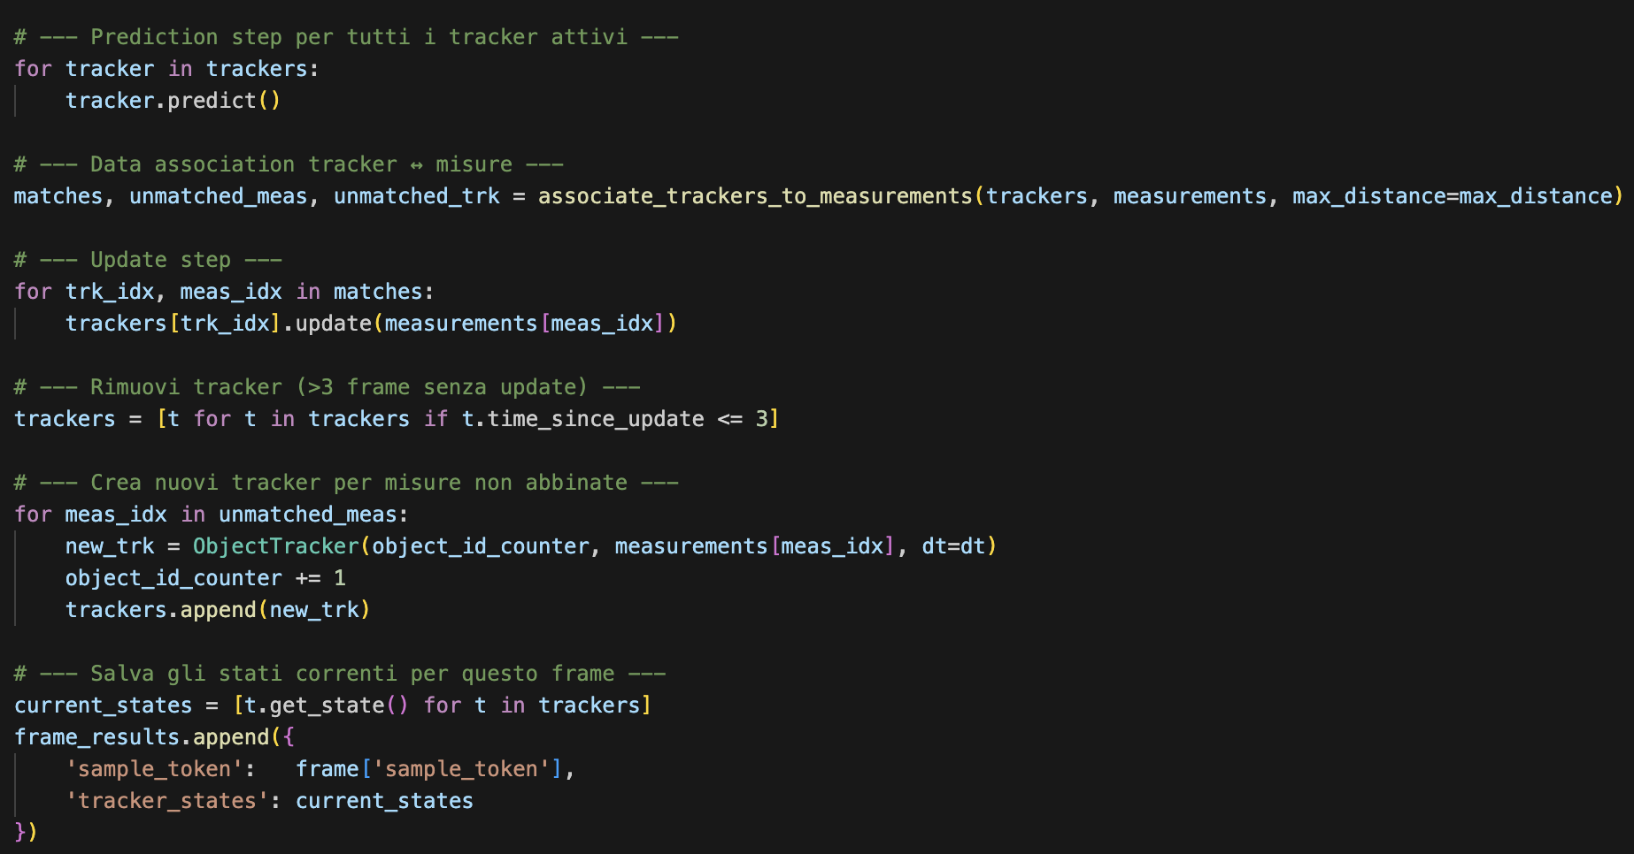
Pipeline 4/6 Multi-Object Tracking
Data association via Hungarian algorithm.

Slide 9
Pipeline 4/6 Multi-Object Tracking
Trackers updated/created/removed as objects move in/out of view.

Slide 10
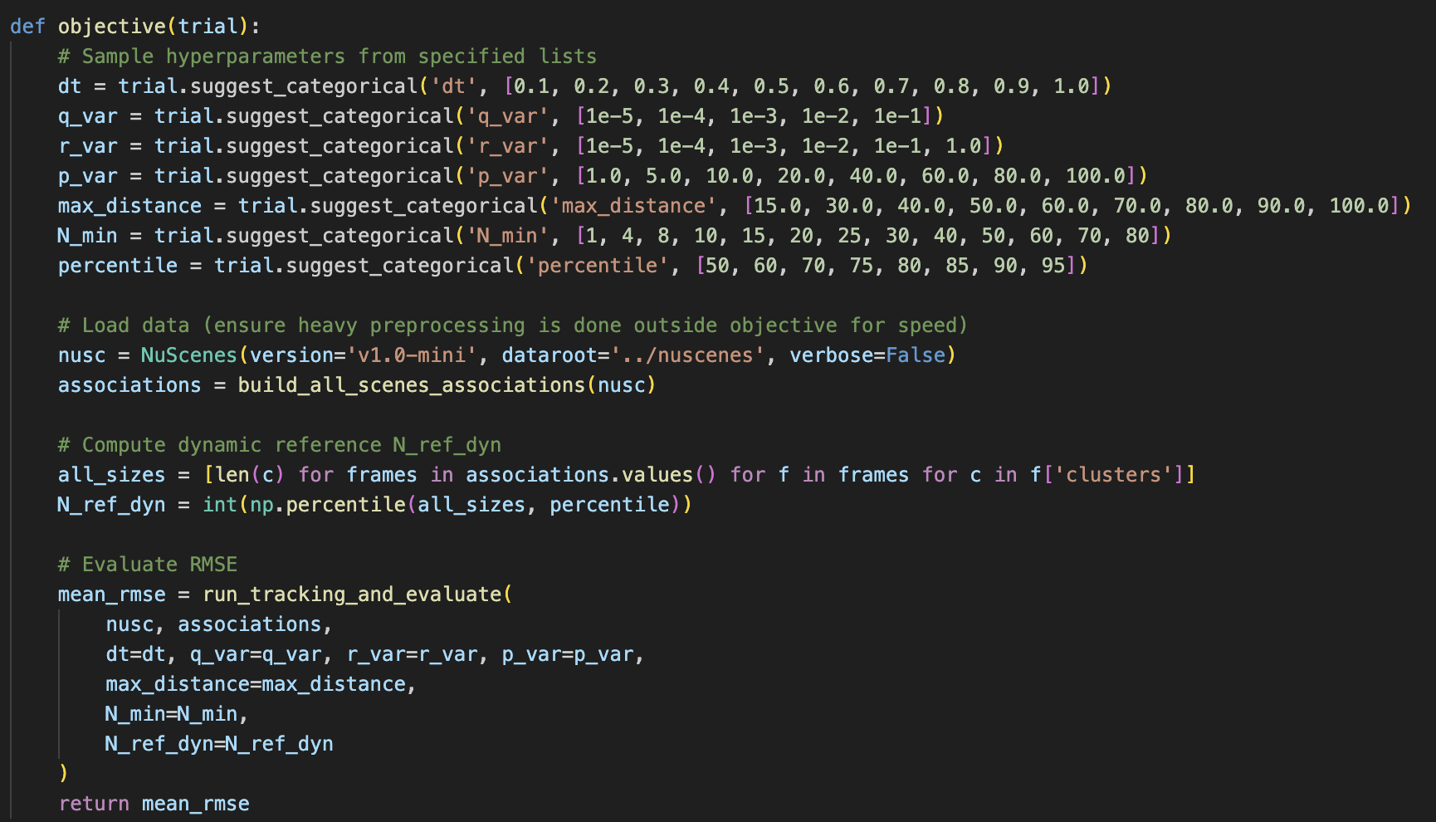
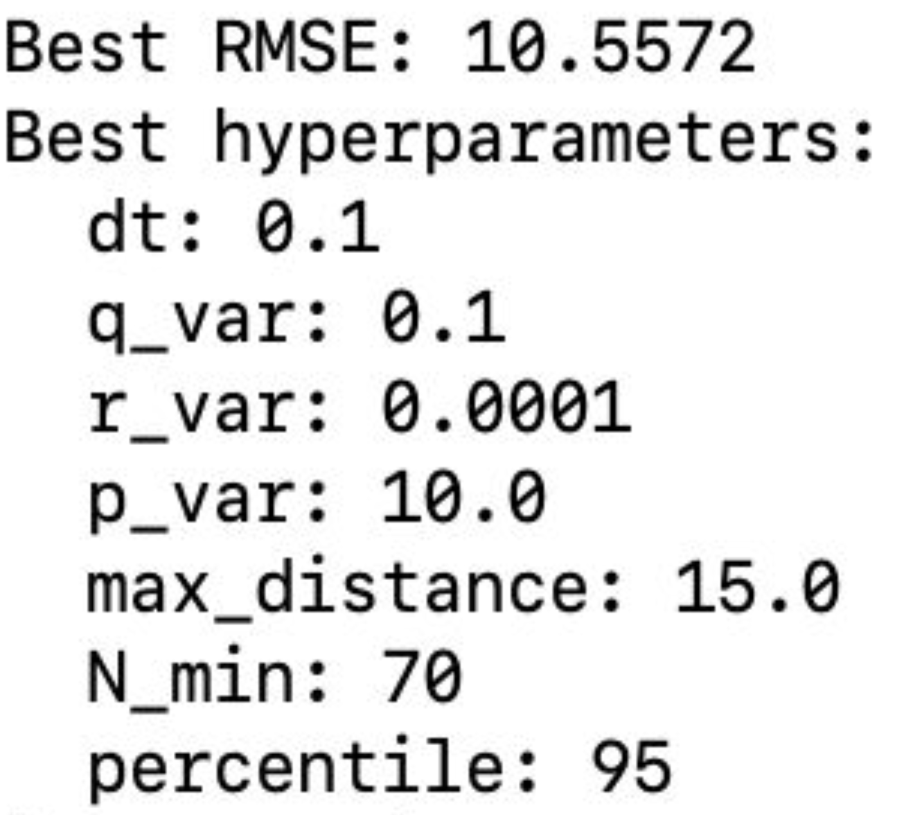
Pipeline 5/6 Parameter Optimization
Kalman parameters & fusion thresholds tuned via Optuna.
Objective: minimize RMSE between tracker and ground truth.

Slide 11
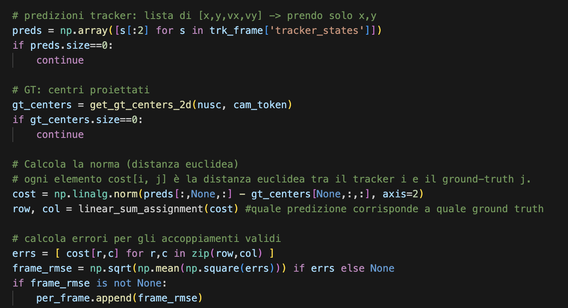
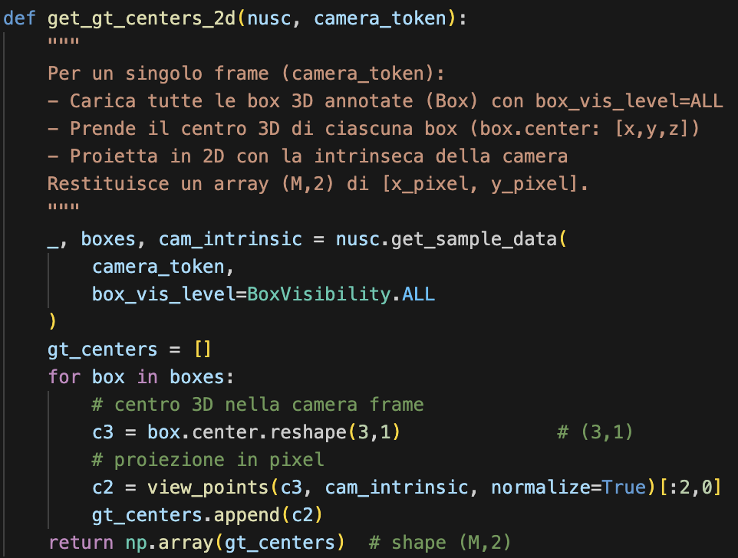
Pipeline 6/6 Evaluation
Per-frame and per-scene RMSE.

Slide 12
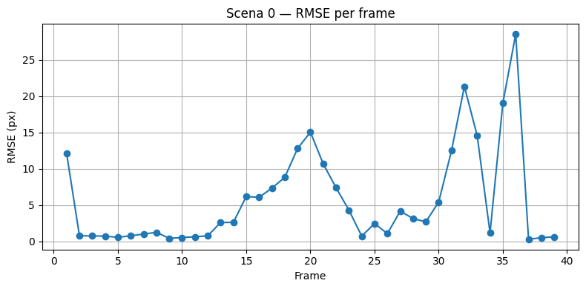
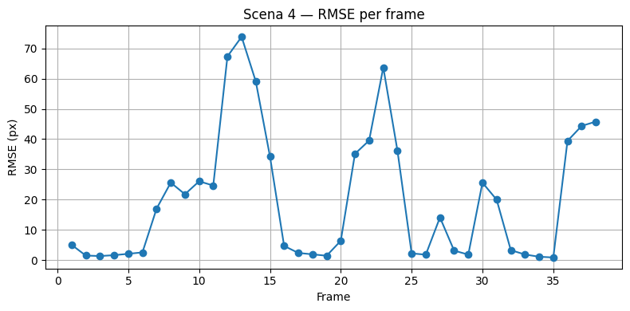
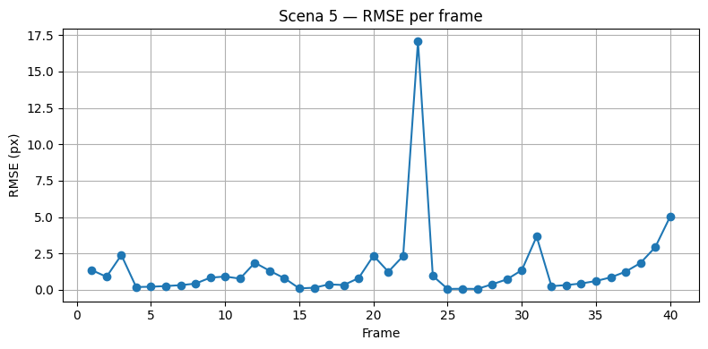
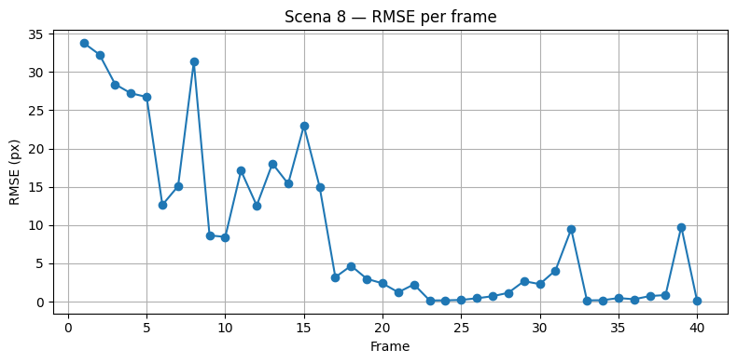
Results

Slide 13
Results
Scene | Mean RMSE
0 | 5.62
1 | 5.40
2 | 8.09
3 | 4.32
4 | 30.36
5 | 1.45
6 | 8.06
7 | 1.47
8 | 8.43
9 | 3.33
Good tracking in most scenes (e.g., 5 and 7: low RMSE, stable).
High RMSE in challenging scenes (4: occlusions, dense objects).

Slide 14
Takeaways
Memeasurement-level fusion
Kalman filter for multi-object tracking
Nuscenes
Parameter-optimized Kalman filter with Optuna
Future improvements: advanced fusion, nonlinear filters.

