Slide 1

Dream Job
Functional walkthrough and technical architecture
An AI-assisted job discovery and application platform: profile in, ranked and explained opportunities out, every message reviewed and sent by the job seeker.
Prepared for Stephane van der Aa
Live application walkthrough, system architecture and the full source catalogue · September 2026
Dream Job · Functional walkthrough and technical architecture
1

Slide 2
OVERVIEW
What this deck contains
A working tour of the platform, the architecture behind it, and the complete list of external sources it can read.
• Part 1 · A functional walkthrough: a screenshot of every working screen, captured from the live application, with what each screen is for and how the job seeker uses it.
• Part 2 · Technical architecture: the layered system, the five chokepoints, the campaign pipeline end to end, the adapter contract, the path of one LLM call and one outbound request, and the data model.
• Part 3 · Data sources: every registered adapter, grouped by type, with coverage, access method, terms status and whether it needs the language model.
• The principle throughout: nothing is sent or applied on its own. Every score is advisory and every message waits for the job seeker.
Dream Job · Functional walkthrough and technical architecture
2

Slide 3
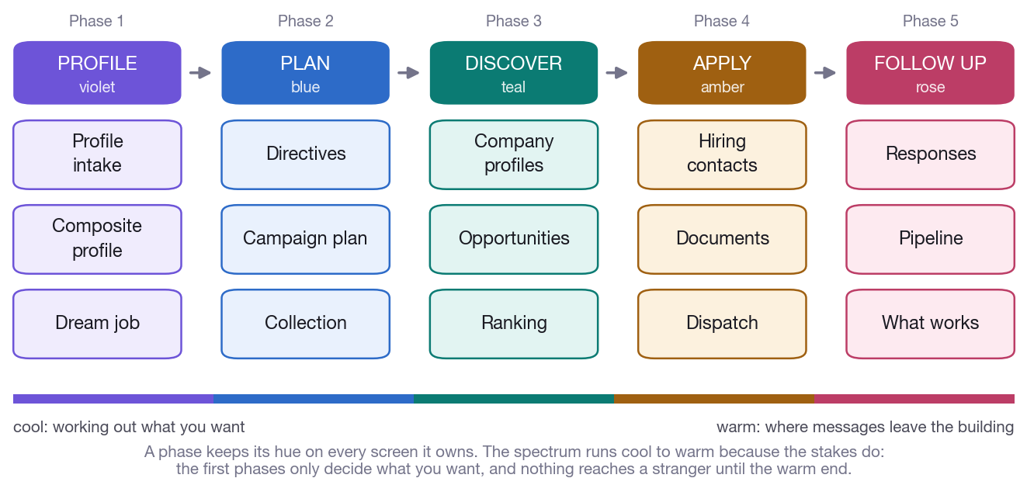
OVERVIEW
The product in one picture
• Profile — import the facts about you and describe the job you want.
• Plan — bound the search with structured directives and review the plan.
• Discover — collect, profile, analyse and rank the market.
• Apply — write, check and dispatch applications you approve.
• Follow up — read the outcomes and redirect the next search.
The five phases of the journey. Each phase owns a colour that follows it through every screen of the application.
Dream Job · Functional walkthrough and technical architecture
3

Slide 4
PART 1
A functional walkthrough
Every screen, in the order a job seeker meets it. The screenshots are taken from the running application with real data.
Dream Job · Functional walkthrough and technical architecture
4

Slide 5
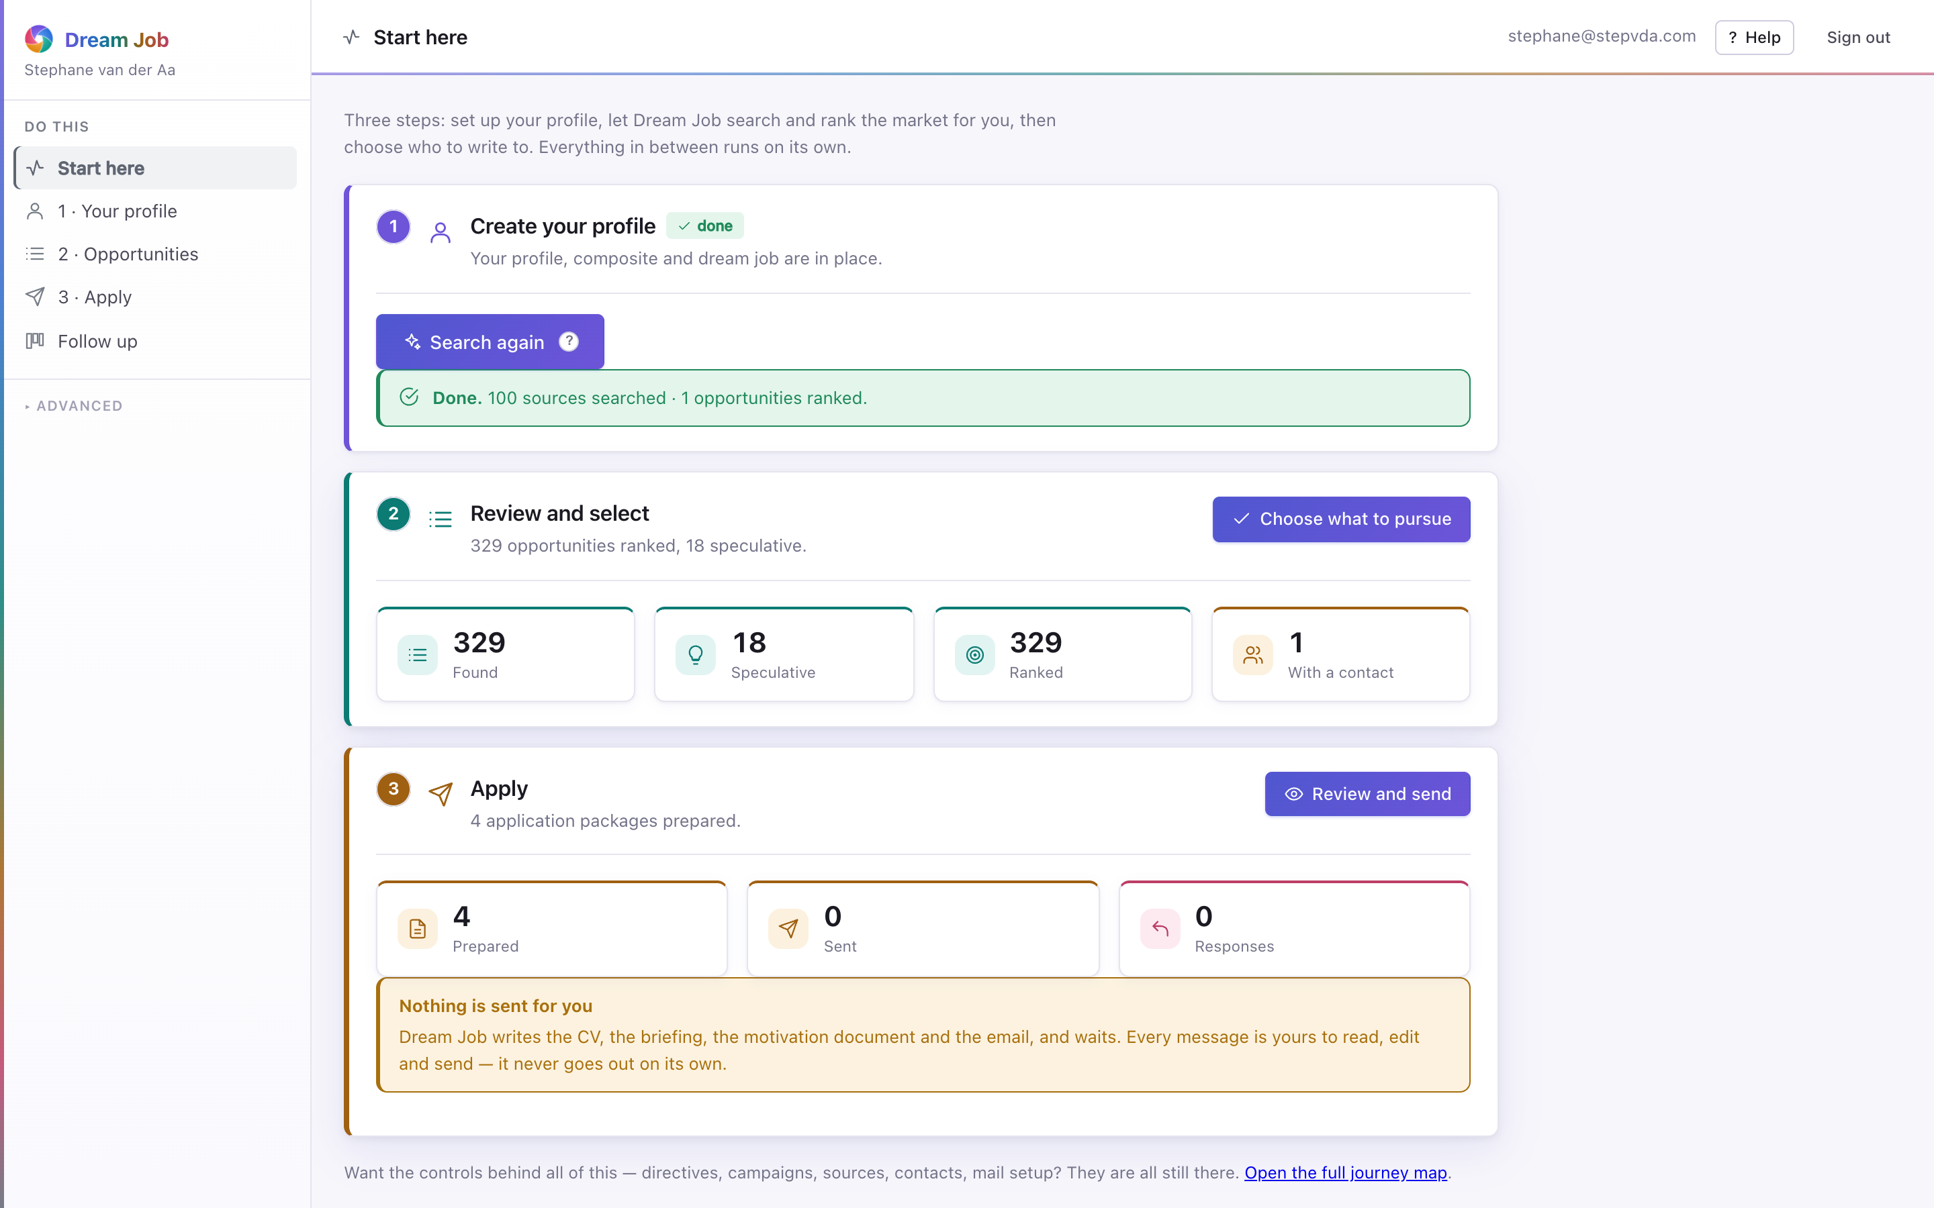
PART 1 · PROFILE
Start here
Three steps and nothing else: set up your profile, let Dream Job search and rank the market, then choose who to write to. Everything in between runs on its own.
• The whole search runs in the background; the page can be closed.
• Live counts: 100 sources searched, 329 opportunities ranked, 18 speculative.
• Nothing is ever sent on its own — every message waits for approval.
• A speculative opening is labelled everywhere so an email never claims a vacancy exists.
home · captured from the running application
Dream Job · Functional walkthrough and technical architecture
5

Slide 6
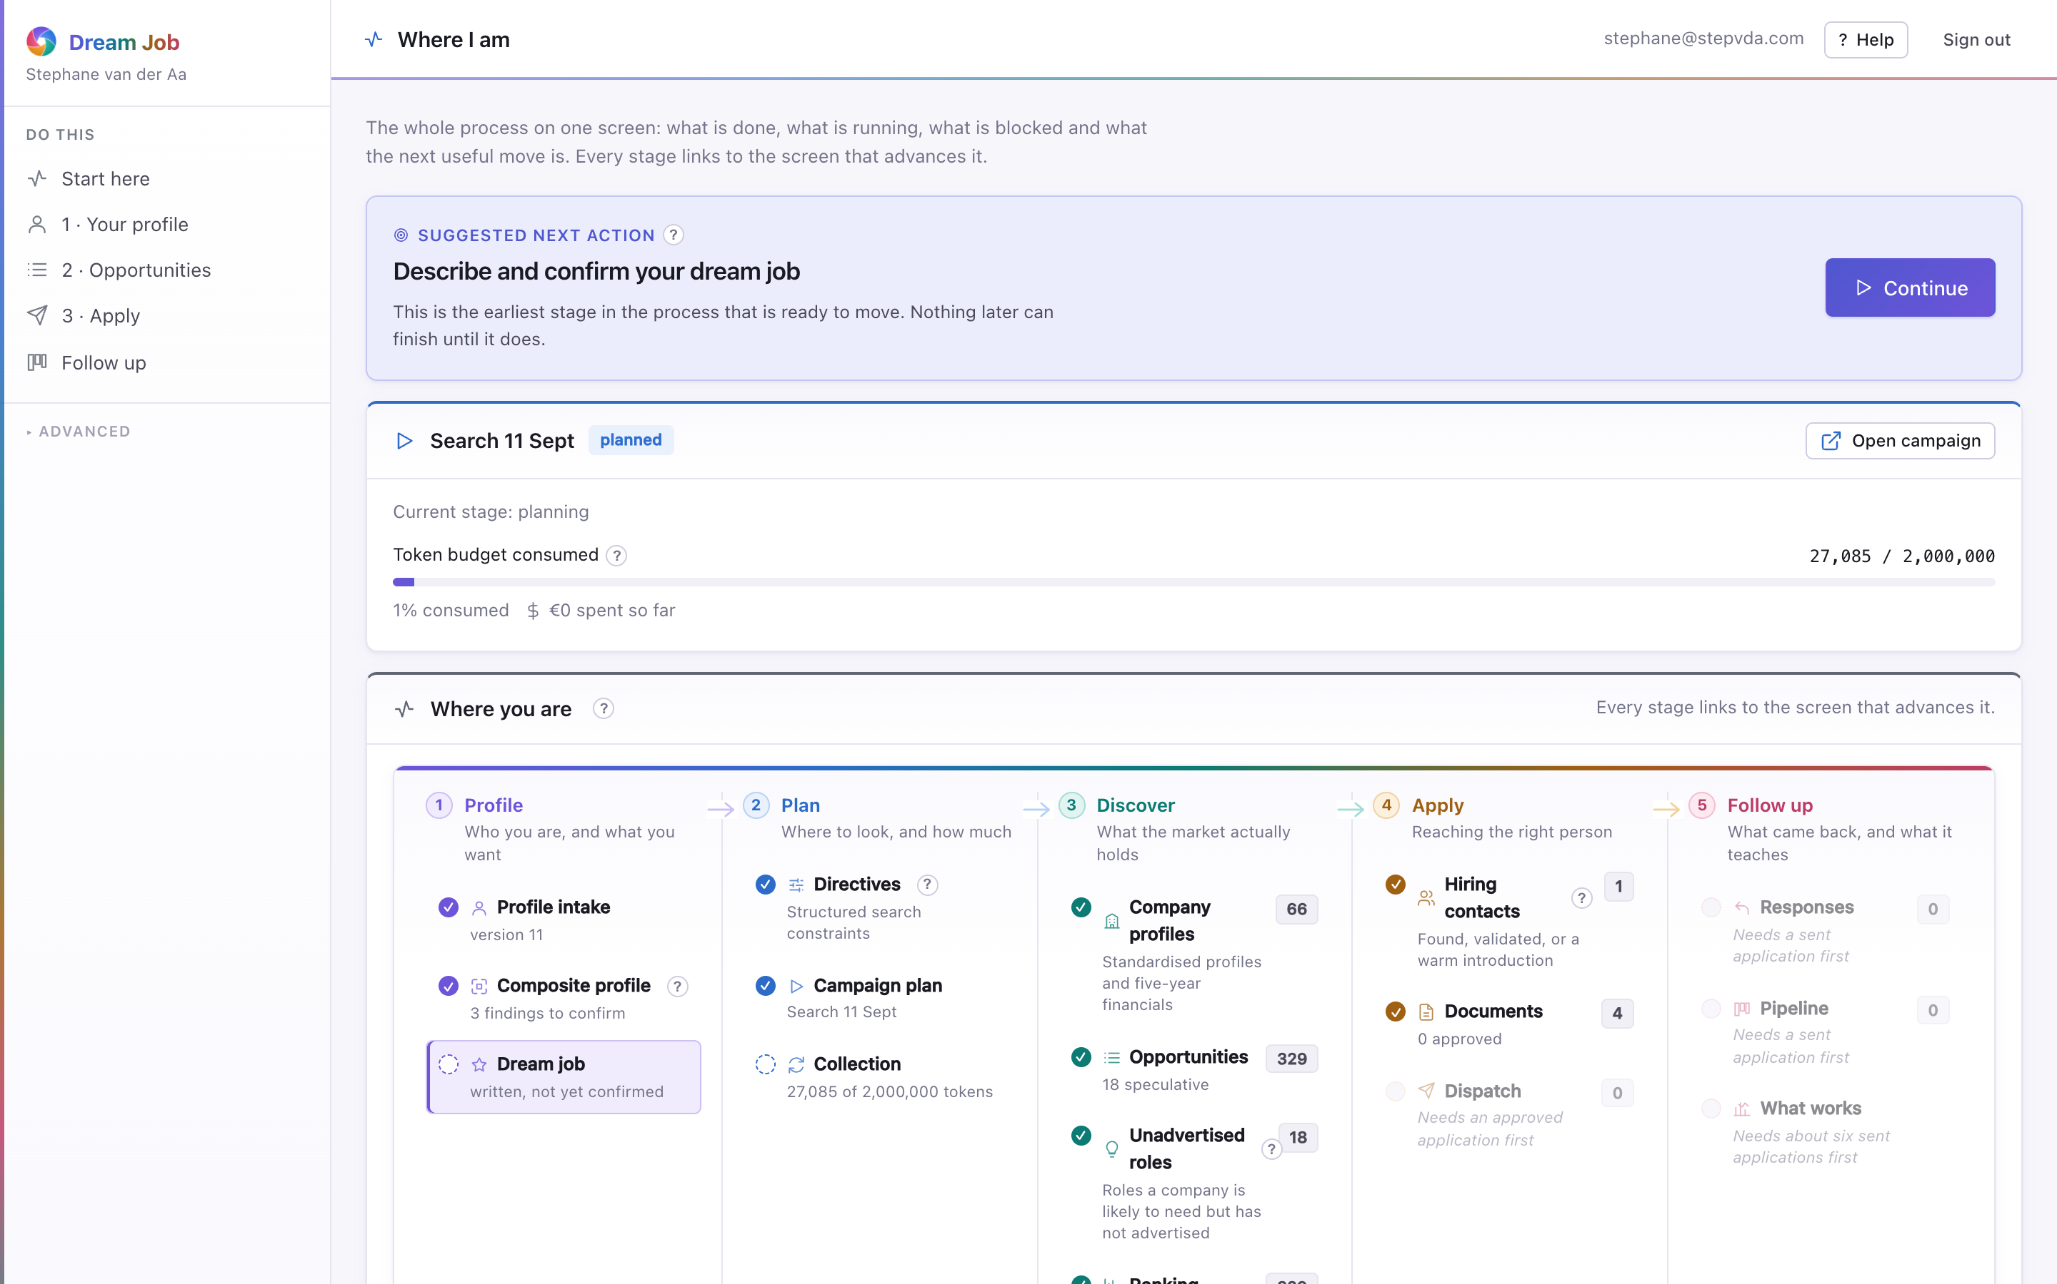
PART 1 · SYSTEM
Where I am — the full journey map
The whole process on one screen: what is done, what is running, what is blocked, and what the next useful move is. Every stage links to the screen that advances it.
• A green mark is finished, a pulsing one is running, a dotted one is waiting on an earlier stage.
• Headline counts are links to the screens their numbers come from.
• While a campaign runs, its token budget and cost refresh every few seconds.
• A blocked stage says what it needs, so the next move is never a guess.
overview · captured from the running application
Dream Job · Functional walkthrough and technical architecture
6

Slide 7
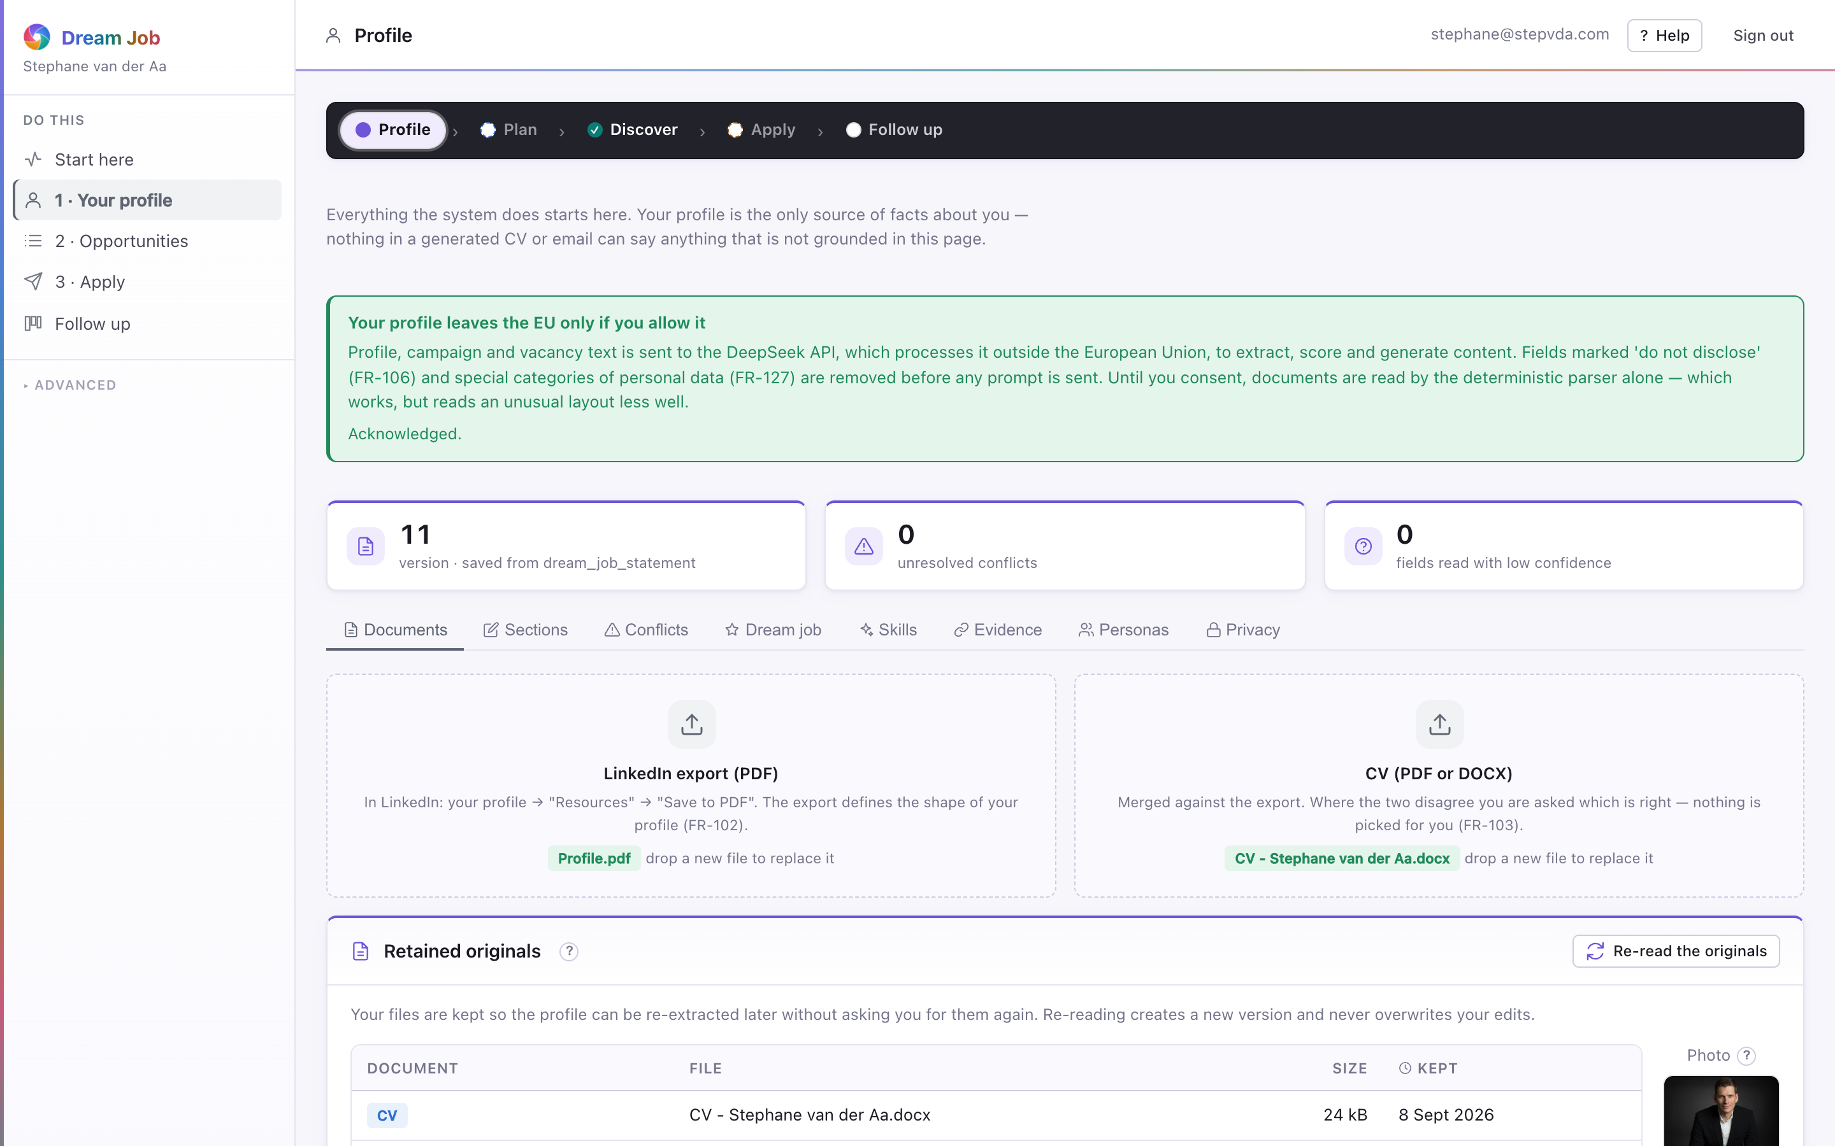
PART 1 · PROFILE
Your profile
Everything the system does starts here. The profile is the only source of facts about the job seeker; nothing in a generated CV or email can say anything not grounded in this page.
• Import the LinkedIn export and the CV; the two are merged, and conflicts are surfaced, not silently resolved (FR-102/103).
• This account holds 11 saved versions and 0 unresolved conflicts.
• Every save is a new version; campaigns record which version they used.
• Fields marked 'do not disclose' are stripped before anything reaches the AI provider (FR-106).
profile · captured from the running application
Dream Job · Functional walkthrough and technical architecture
7

Slide 8
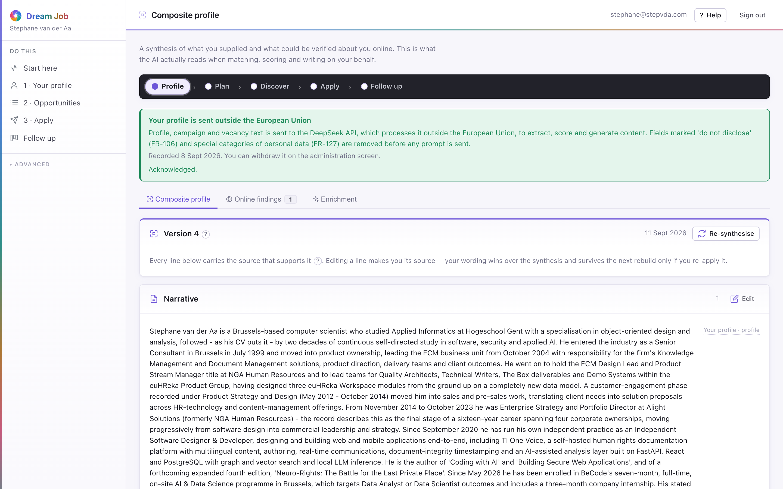
PART 1 · PROFILE
Composite profile
A synthesis of what the job seeker supplied and what could be verified online. This is what the model actually reads when matching, scoring and writing.
• Every statement carries its source and a confidence.
• Online findings are queued for confirm or reject; a rejection is permanent.
• Identity matching folds name variants, employer overlap, cross-links, location, timeline and photo similarity.
• Enrichment can be switched off; the profile is then built from documents alone.
composite · captured from the running application
Dream Job · Functional walkthrough and technical architecture
8

Slide 9
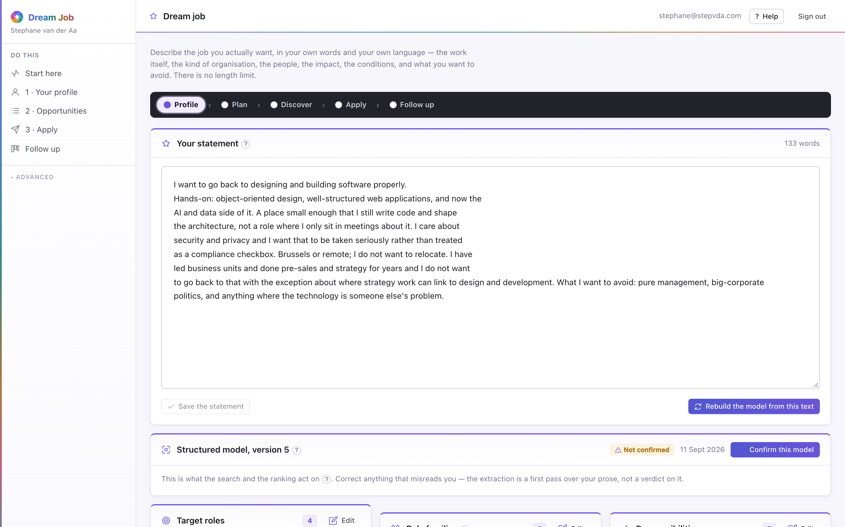
PART 1 · PROFILE
Dream job
Describe the job you actually want, in your own words and language. The model reads it for nuance — target roles, responsibilities, values and deal-breakers.
• Deal-breakers filter more decisively than preferences; they become directive defaults.
• The structured model is used for matching; the prose is not.
• The screen flags when the statement and the model have drifted apart.
• Nothing acts on the model until the job seeker confirms it.
dream job · captured from the running application
Dream Job · Functional walkthrough and technical architecture
9

Slide 10
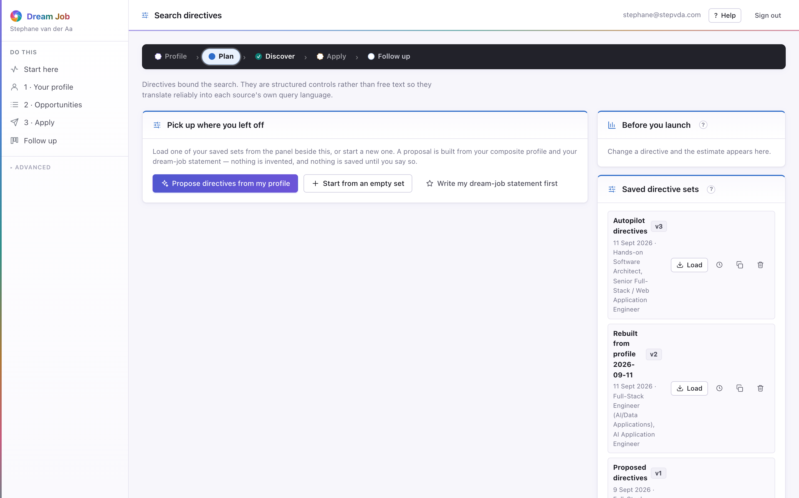
PART 1 · PLAN
Search directives
Directives bound the search. They are structured controls rather than free text, so they translate reliably into each source's own query language.
• Five groups: job content, company type, location, work arrangement and compensation.
• Values pre-filled from the composite profile are suggestions, not facts.
• Discretion mode excludes the current employer and its group entities from every search and message.
• The collection estimate beside the form says how many sources and pages the settings imply.
directives · captured from the running application
Dream Job · Functional walkthrough and technical architecture
10

Slide 11
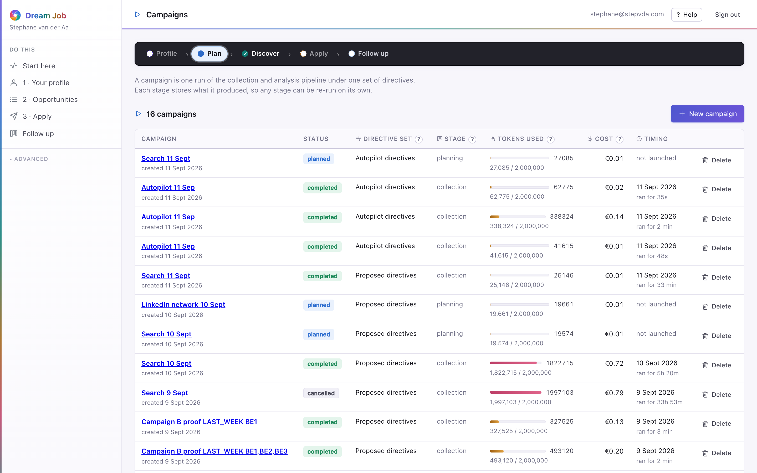
PART 1 · PLAN
Campaigns
A campaign is one run of the collection and analysis pipeline under one set of directives. Every stage stores what it produced and can be re-run on its own.
• The plan is reviewed before launch: sources, queries, expected volume, duration and cost.
• The planner checks the shared knowledge base first and collects only what is missing or stale.
• Pause, resume or cancel at any point; a crash loses at most the page in flight (NFR-401).
• The token budget caps AI spend and degrades gracefully near the limit.
campaigns · captured from the running application
Dream Job · Functional walkthrough and technical architecture
11

Slide 12
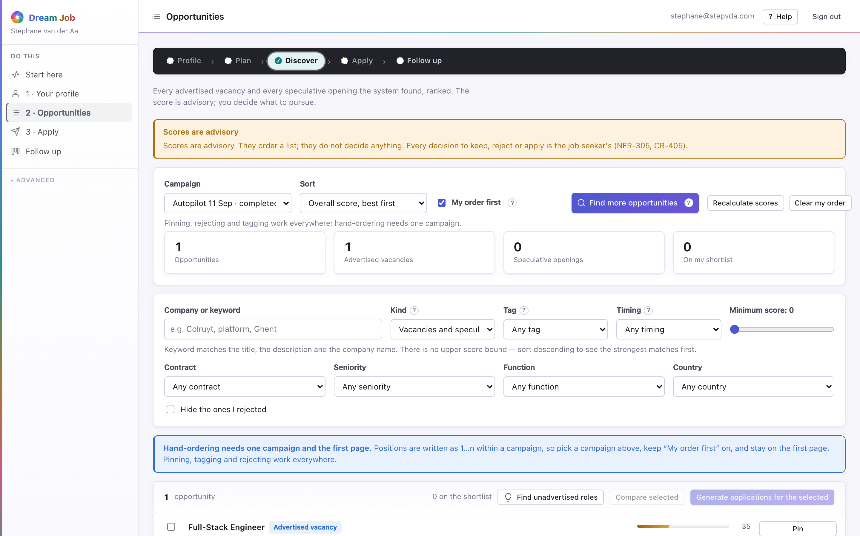
PART 1 · DISCOVER
Opportunities
Every advertised vacancy and every speculative opening the system found, ranked. The score is advisory; the job seeker decides what to pursue.
• Filter and sort by kind, arrangement, seniority, country, score floor or keyword.
• 'Why this rank?' opens the seven sub-scores and the dream-job criteria behind them.
• Manual ordering overrides the computed ranking and survives recalculation.
• Rejection reasons feed back into the weights, which is why a reason is required.
opportunities · captured from the running application
Dream Job · Functional walkthrough and technical architecture
12

Slide 13
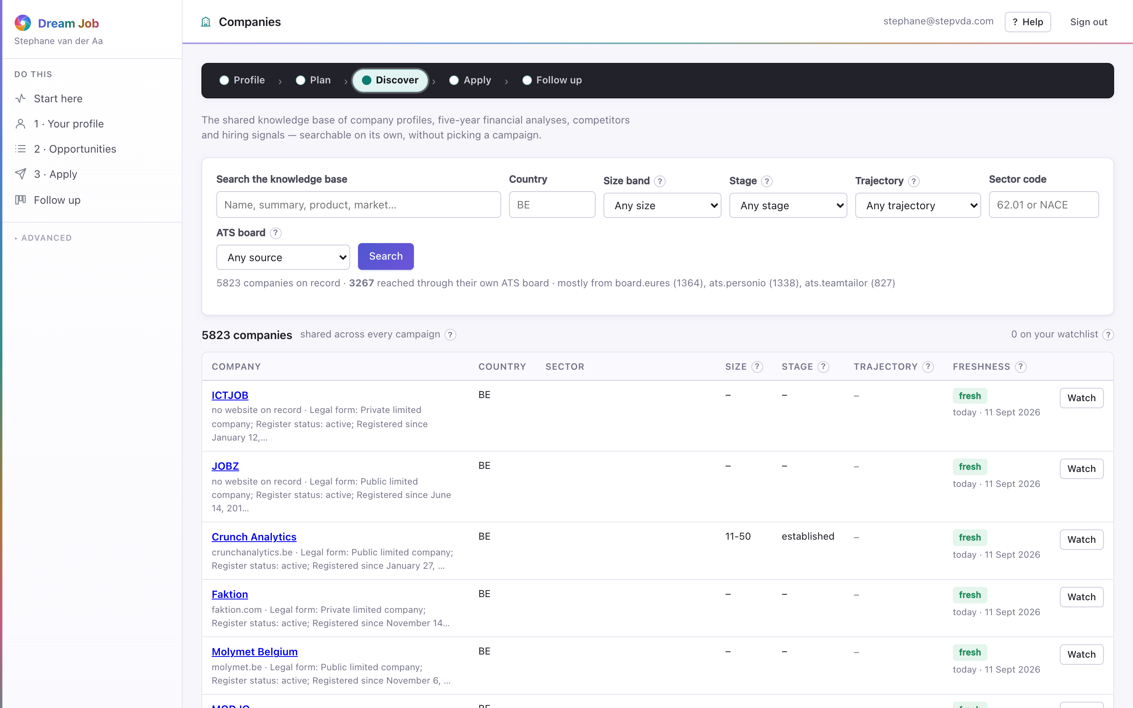
PART 1 · DISCOVER
Companies and the knowledge base
The shared knowledge base: company profiles, five-year financial analyses, competitors and hiring signals — searchable without picking a campaign.
• Company research is shared across job seekers and reused while fresh, so a second search costs nothing.
• Five filed years, revenue and headcount trends, and two 0–100 scores that cite their figures.
• Freshness is shown before the figures: a stale row describes the company as it was.
• Ability to pay and investment capacity are advisory and derived from filed accounts.
companies · captured from the running application
Dream Job · Functional walkthrough and technical architecture
13

Slide 14
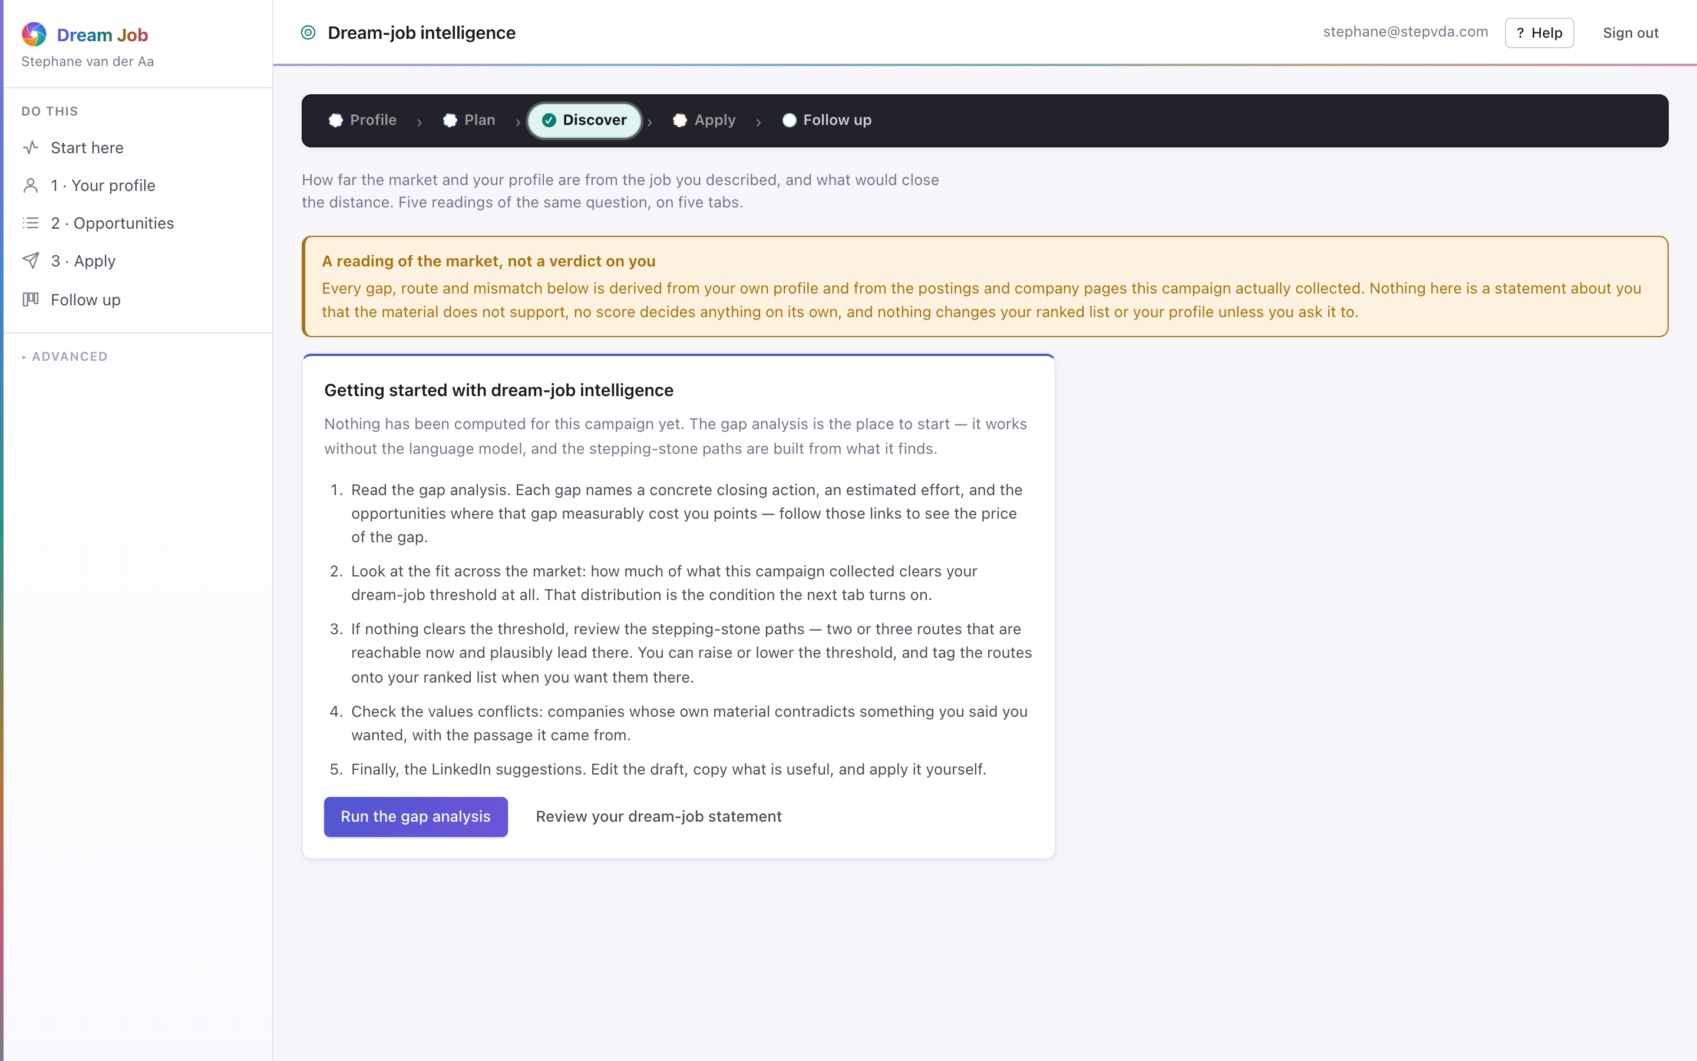
PART 1 · DISCOVER
Dream-job intelligence
How far the market is from the dream job, and the stepping-stone routes that lead there. Gap analysis and paths work without the language model.
• Gaps are computed against the structured dream-job model, with a threshold the job seeker controls.
• Stepping-stone paths are reached by tagging routes onto the ranked list.
• The numbers and routes are deterministic; a model only sharpens the wording.
intelligence · captured from the running application
Dream Job · Functional walkthrough and technical architecture
14

Slide 15
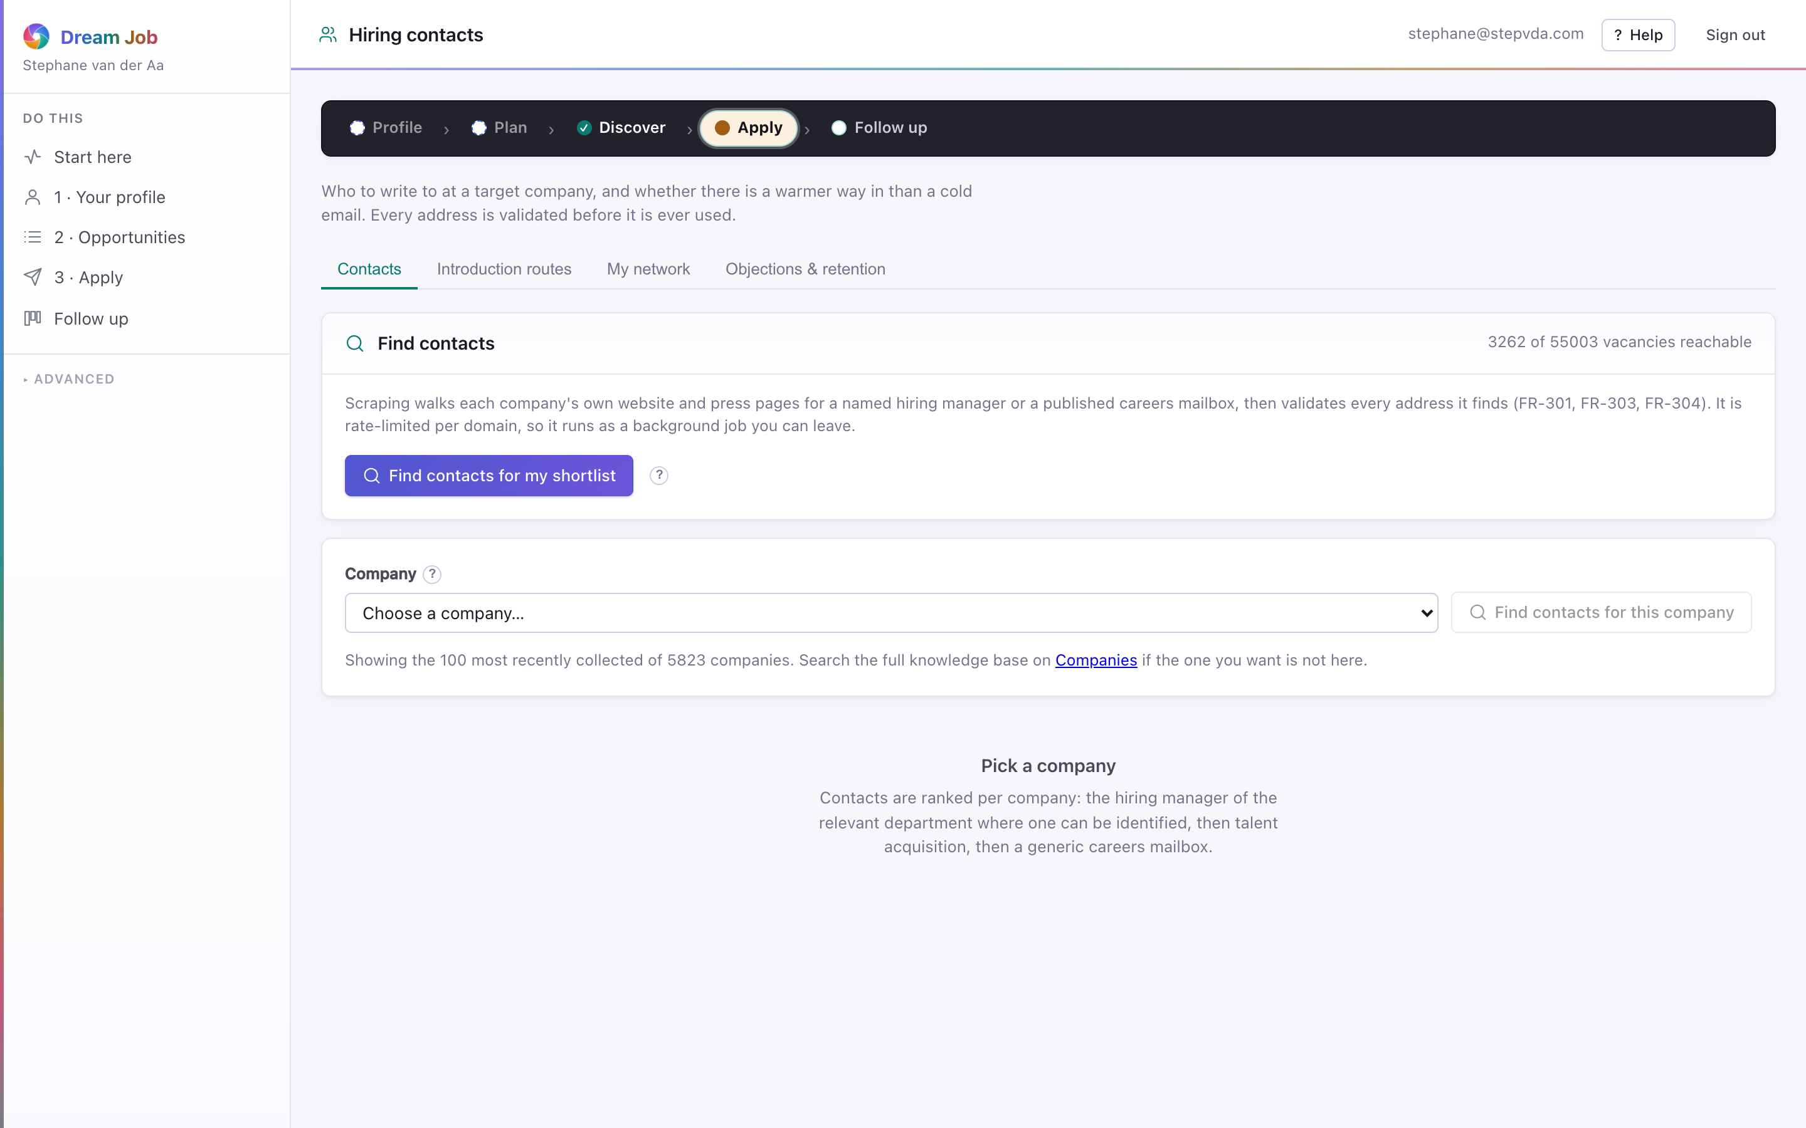
PART 1 · APPLY
Hiring contacts
The people behind the opportunities, found by walking a ladder of sources and validated rather than guessed.
• A company showing 'unreachable' is a real finding: nothing survived the ladder.
• Contacts are shared unless collected by browser automation, then restricted (NFR-302/303).
• An objection blocks the address permanently for everyone on the installation.
contacts · captured from the running application
Dream Job · Functional walkthrough and technical architecture
15

Slide 16
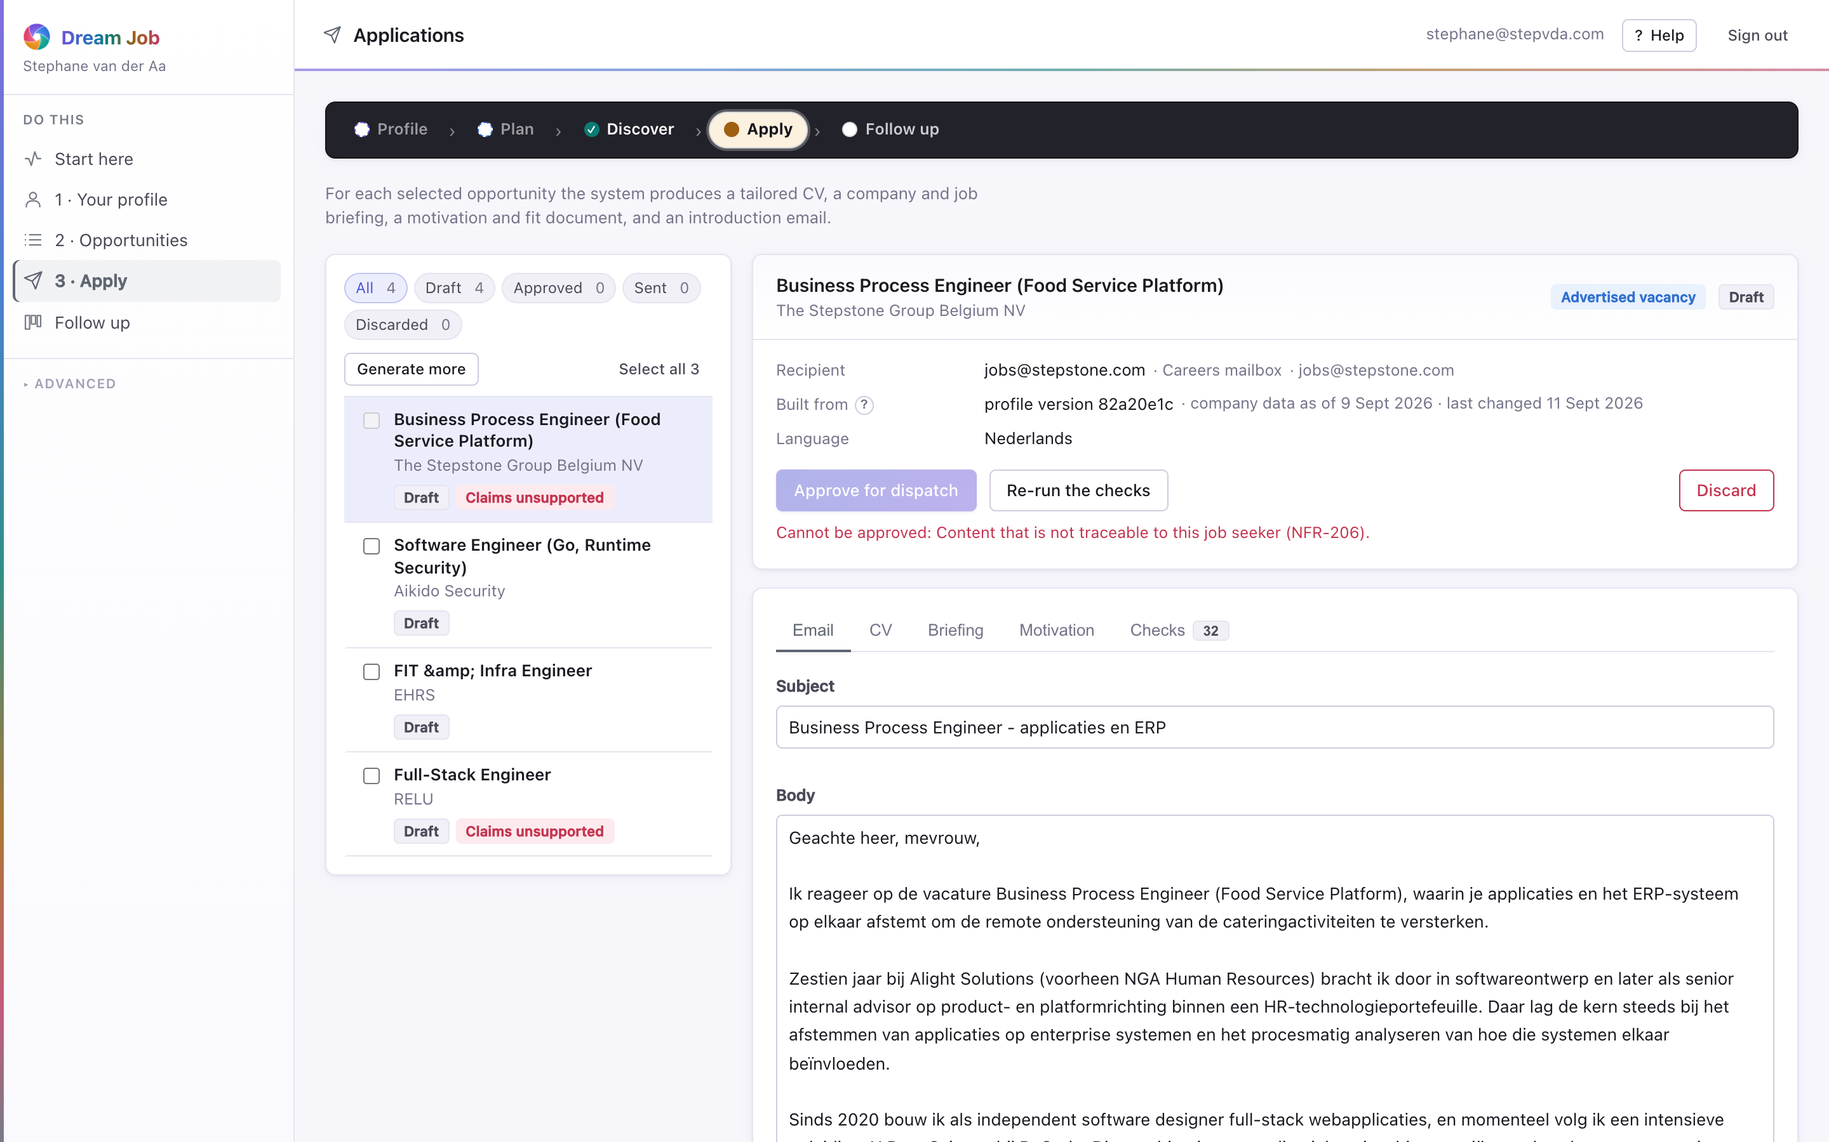
PART 1 · APPLY
Applications
The generated CV, briefing, motivation document and email for each shortlisted role — all for the job seeker to read, edit and approve.
• A consistency check catches invented employers, dates and titles.
• Approving authorises dispatch but sends nothing; messages go from the seeker's own mailbox.
• The generated CV is grounded in the profile: nothing appears that is not traceable to it.
• The job seeker is the last line of defence for anything technically true and still wrong for the audience.
applications · captured from the running application
Dream Job · Functional walkthrough and technical architecture
16

Slide 17
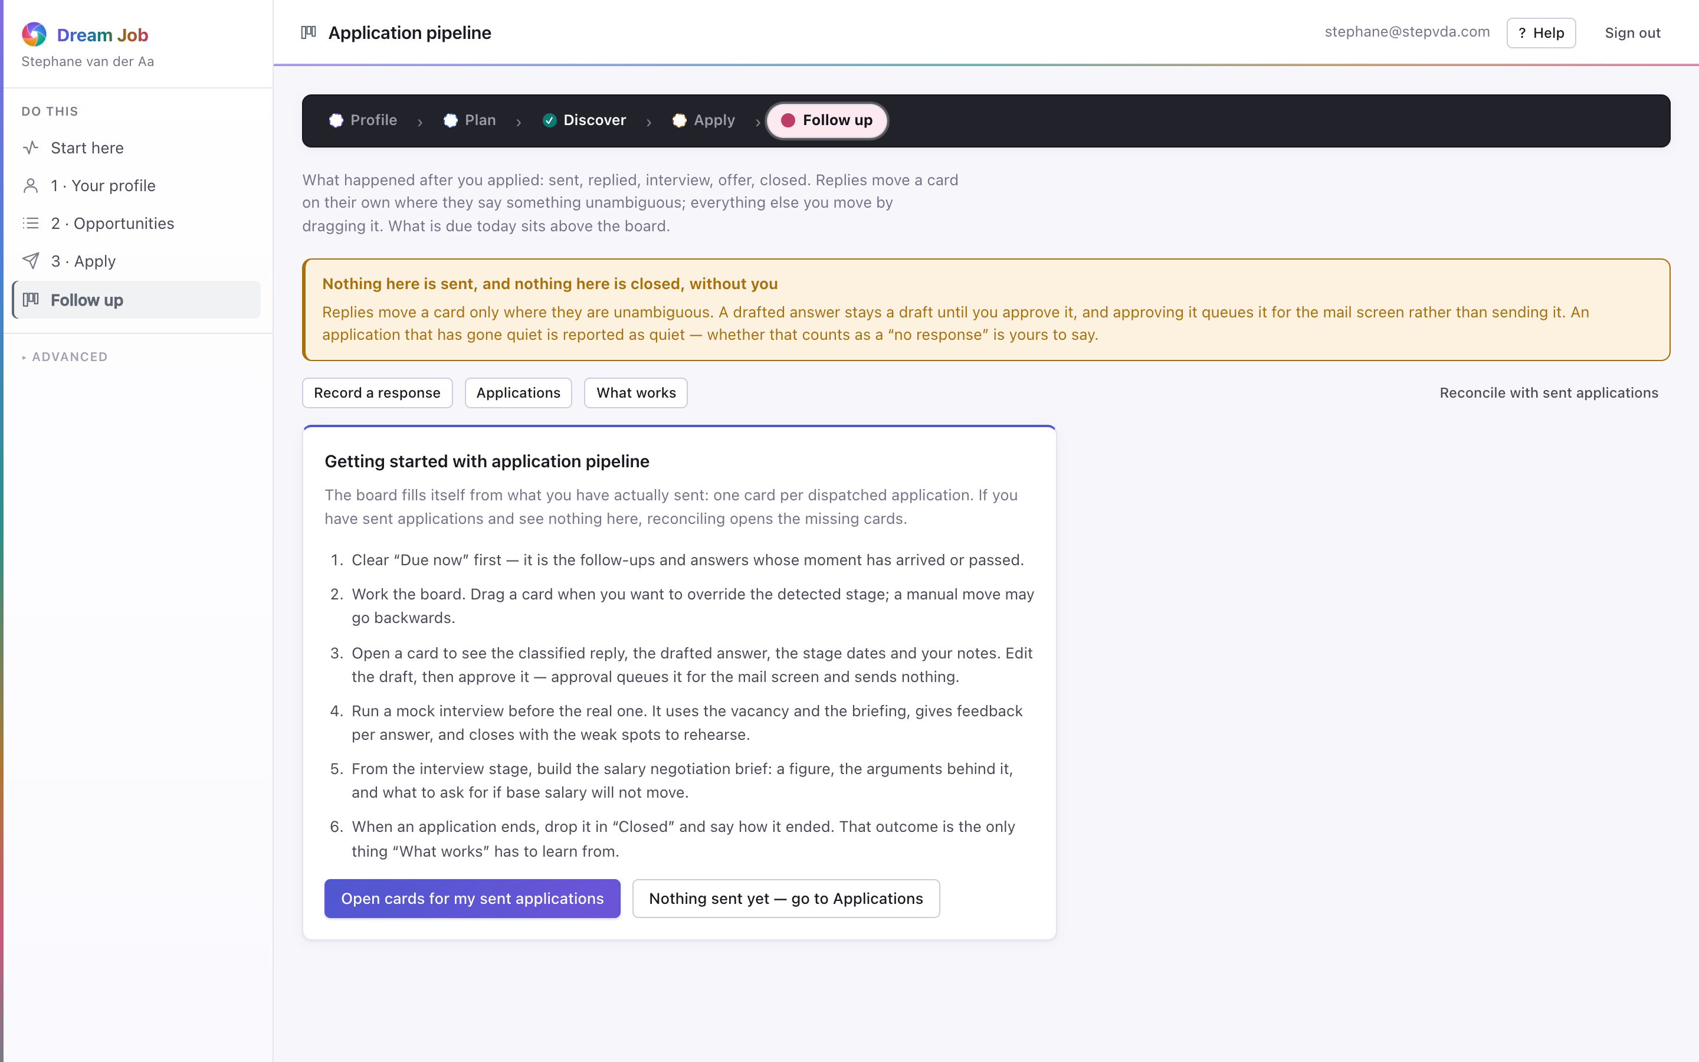
PART 1 · FOLLOW UP
Application pipeline
Every authorised application and its stage, from sent to reply, interview and outcome, on one board.
• Open a card for the classified reply, the drafted answer and the stage dates.
• Approving a draft queues it for the mail screen; it still sends nothing.
• Outcomes feed back into generation defaults and scoring weights.
• Learned effects are reported with the sample size they rest on.
pipeline · captured from the running application
Dream Job · Functional walkthrough and technical architecture
17

Slide 18
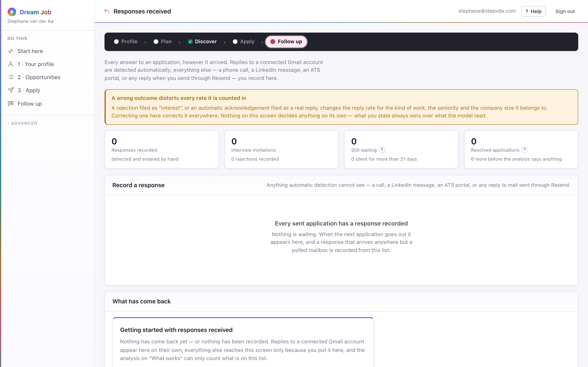
PART 1 · FOLLOW UP
Responses received
Every answer to an application, however it arrived: detected automatically from Gmail, or recorded by hand for a call, a portal or a LinkedIn message.
• Recording rejections matters as much as good news; both feed the pattern analysis.
• An application counts as answered or as silence, and nothing in between until 21 days pass.
• Recording a response moves the card on the pipeline board automatically.
responses · captured from the running application
Dream Job · Functional walkthrough and technical architecture
18

Slide 19
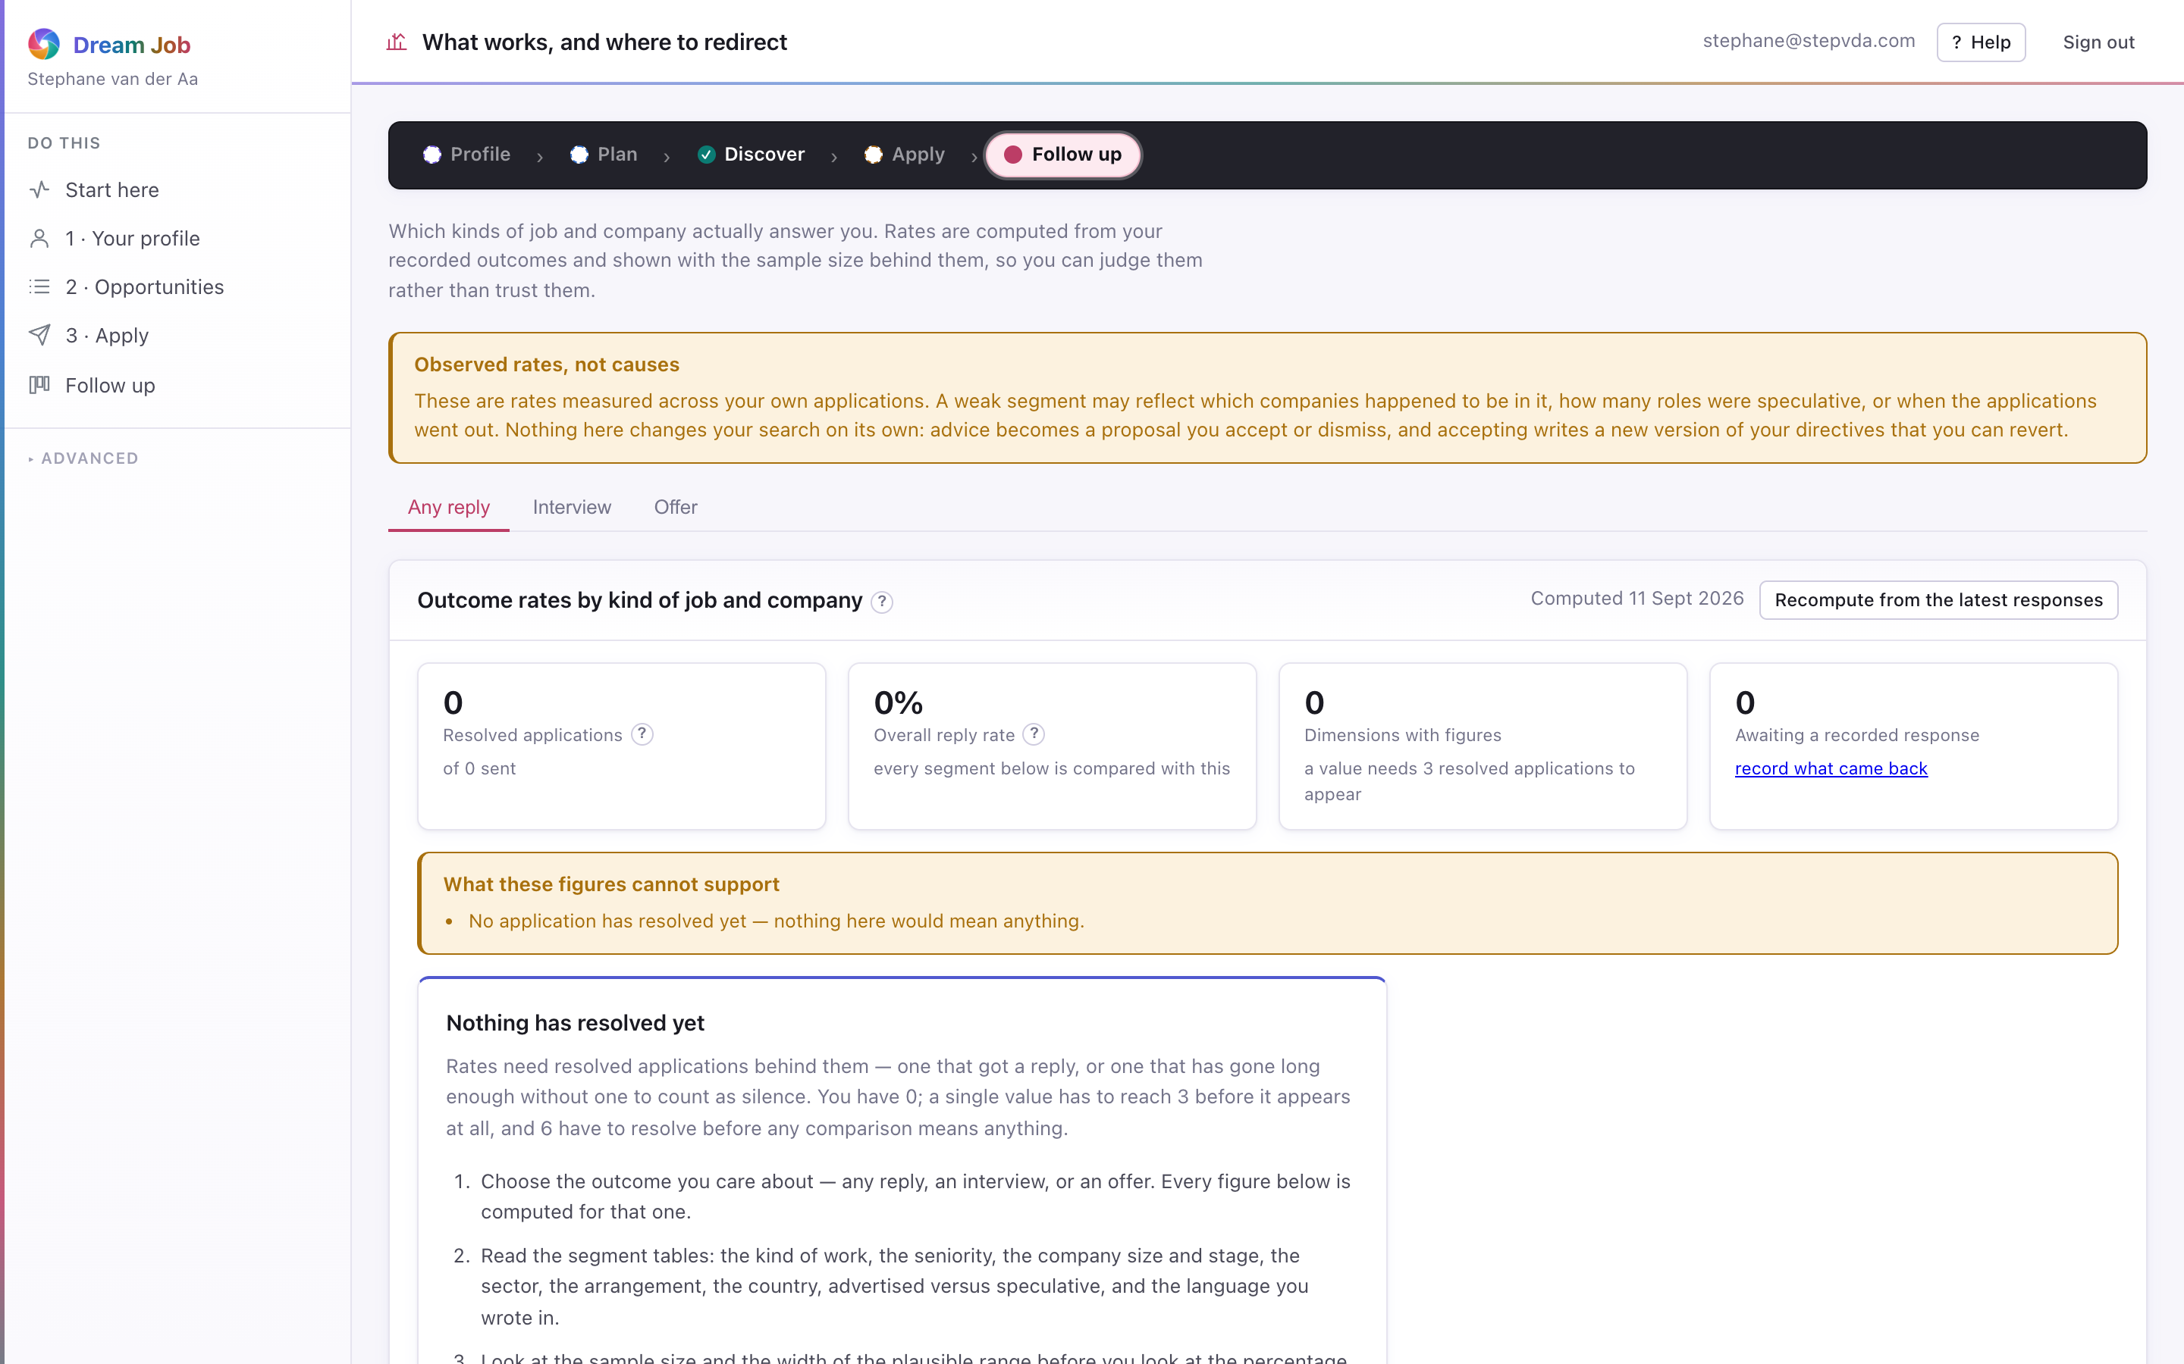
PART 1 · FOLLOW UP
What works, and where to redirect
Which kinds of job and company actually answer, computed from recorded outcomes and always shown with the sample size behind them.
• Rates are drawn with a plausible range, so a thin segment cannot look decisive.
• Advice needs roughly six resolved applications before it will say anything.
• Applying a proposal creates a new directive version — it never overwrites.
• The data does not get to overrule the dream job; it only shows what the mismatch costs.
insights · captured from the running application
Dream Job · Functional walkthrough and technical architecture
19

Slide 20
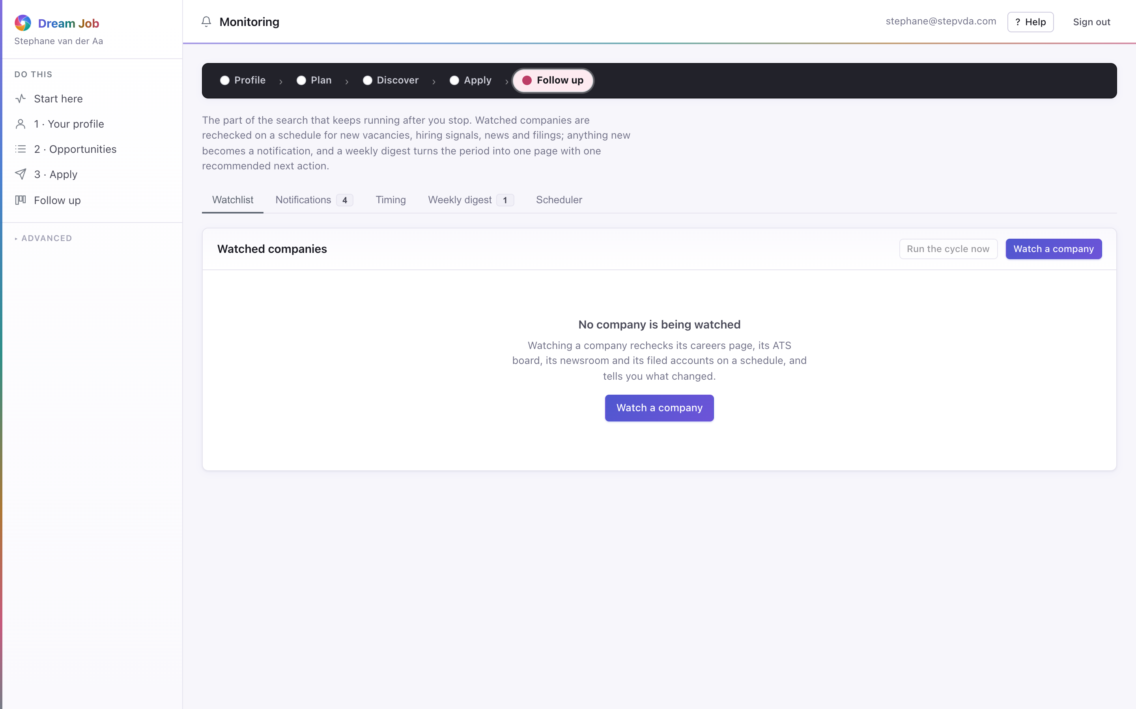
PART 1 · SYSTEM
Monitoring
The operational surface: campaign health, token spend, extraction rates and the audit trail, plus the scheduled re-checks of watched companies.
• Extraction-rate monitoring surfaces adapter breakage (NFR-403).
• Every LLM call, egress request and score is audited with its provenance.
• Watched companies are rechecked on a schedule, and what changed becomes one weekly digest.
monitoring · captured from the running application
Dream Job · Functional walkthrough and technical architecture
20

Slide 21
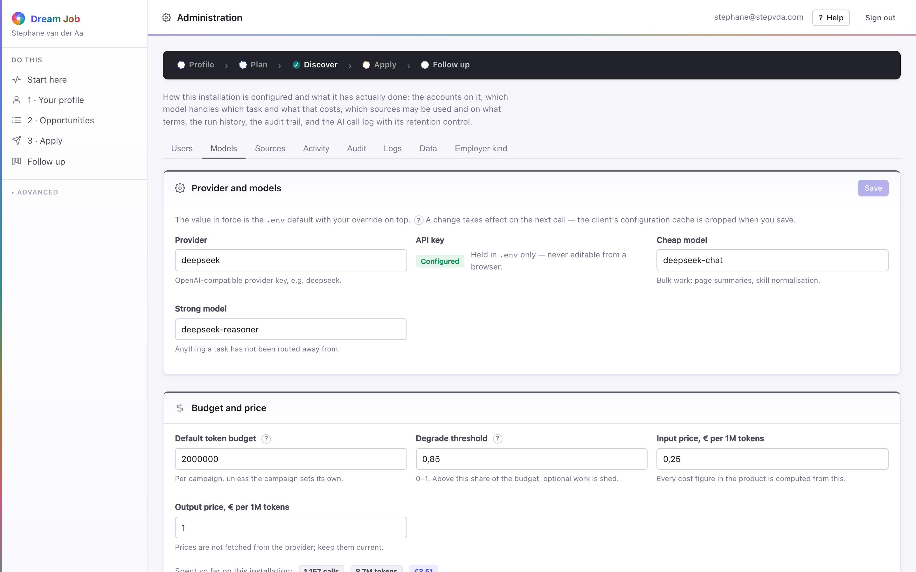
PART 1 · SYSTEM
Administration
The installation-level controls: the source catalogue and its terms acknowledgements, the server logs, model routing and the data-rights tools.
• Sources that require acknowledgement stay disabled until an administrator confirms their terms (IR-101).
• Model routing chooses the provider per task and can point at a local endpoint for private data (FR-362, NFR-306).
• Two actions cannot be undone: the redaction sweep and erasing a job seeker.
• Erasing a job seeker deletes the private rows and leaves the shared market data standing (FR-108).
admin · captured from the running application
Dream Job · Functional walkthrough and technical architecture
21

Slide 22
PART 2
Technical architecture
The layered system, the five chokepoints that make its requirements enforceable, and the path one campaign takes through the pipeline.
Dream Job · Functional walkthrough and technical architecture
22

Slide 23
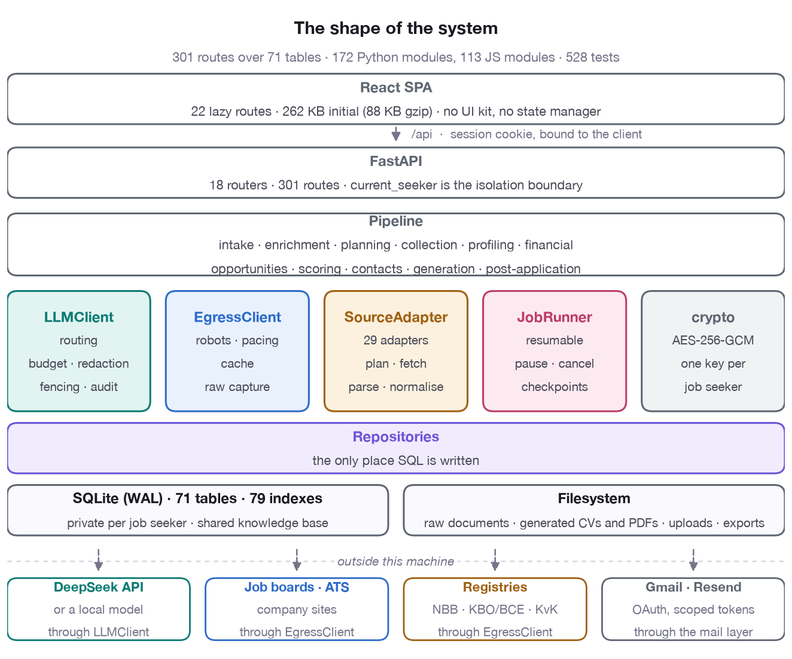
ARCHITECTURE · SHAPE
The shape of the system
• 172 Python modules and 113 JS modules; 301 routes over 71 tables.
• Every outbound concern passes through one service: the LLM through LLMClient, HTTP through EgressClient.
• Repositories are the only place SQL is written.
• SQLite in WAL mode holds two scopes: private rows per job seeker and the shared knowledge base.
• The filesystem keeps raw documents, generated CVs, uploads and exports.
A React SPA over a FastAPI API, a pipeline of stages, and five services — LLMClient, EgressClient, SourceAdapter, JobRunner and crypto — over a repository layer and SQLite.
Dream Job · Functional walkthrough and technical architecture
23

Slide 24
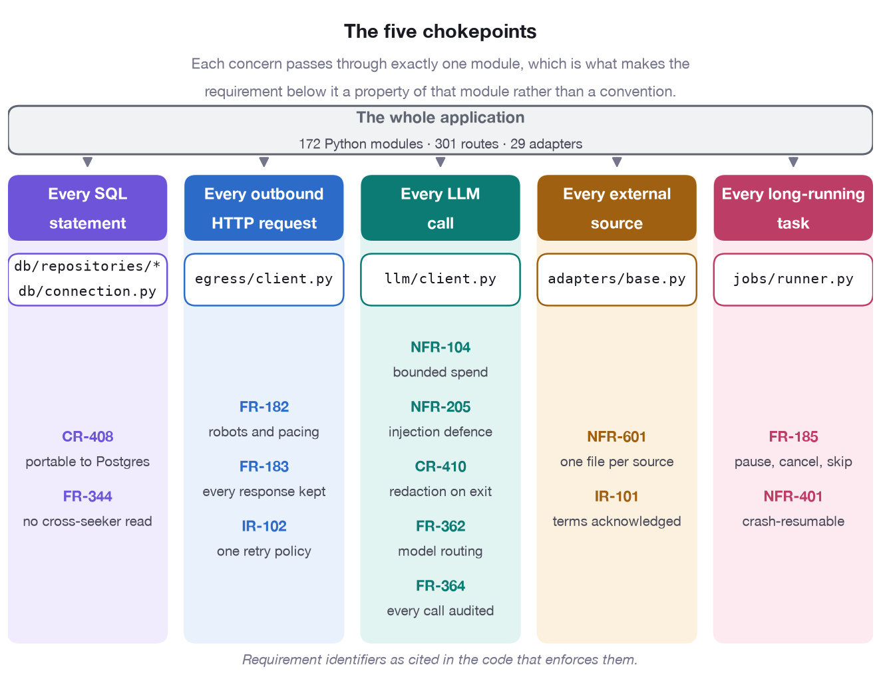
ARCHITECTURE · CHOKEPOINTS
The five chokepoints
• Every SQL statement — db/repositories/*, db/connection.py: portability and isolation (CR-408, FR-344).
• Every outbound HTTP request — egress/client.py: robots, pacing and raw capture (FR-182/183).
• Every LLM call — llm/client.py: budget, injection defence, redaction, routing, audit.
• Every external source — adapters/base.py: one file per source, terms status (NFR-601, IR-101).
• Every long-running task — jobs/runner.py: pause, cancel, resume (FR-185, NFR-401).
The architecture funnels five concerns through exactly one module each, which is what makes the requirements below them enforceable rather than aspirational.
Dream Job · Functional walkthrough and technical architecture
24

Slide 25
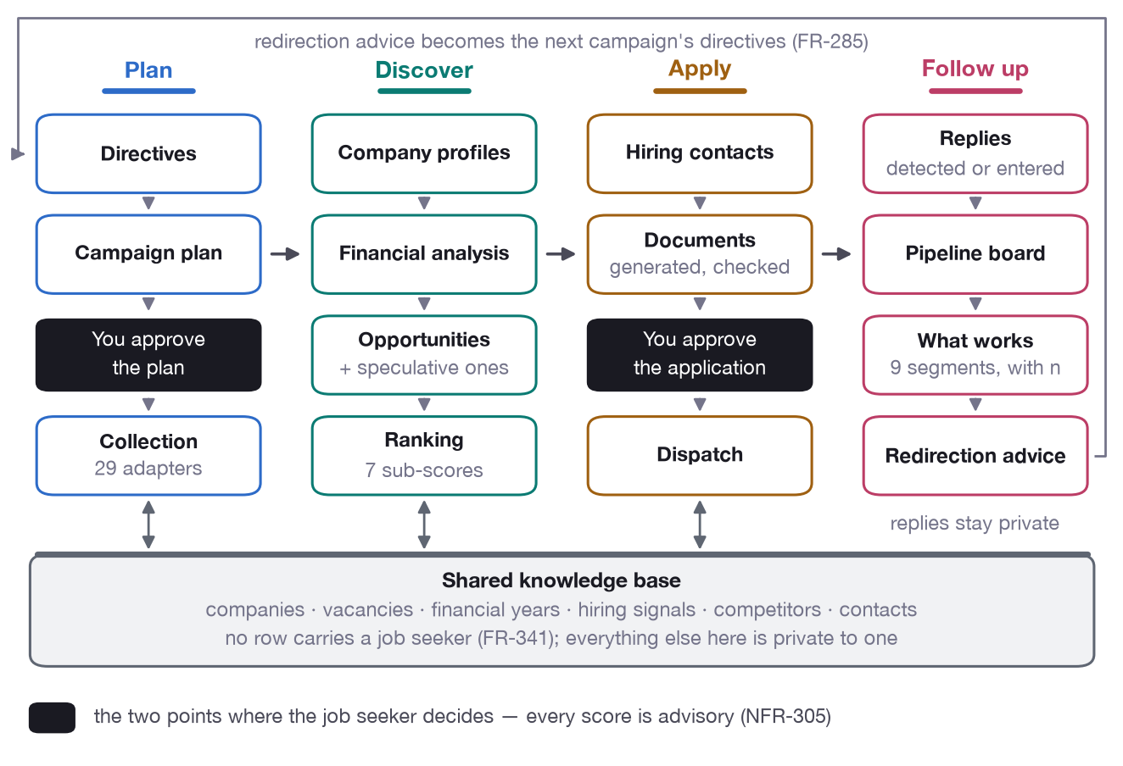
ARCHITECTURE · PIPELINE
The pipeline, end to end
• Plan: directives, the campaign plan and a human gate before collection.
• Discover: collection, company profiles, financial analysis, opportunity synthesis and ranking.
• Apply: hiring contacts, generated and checked documents, a second human gate, then dispatch.
• Follow up: replies, the pipeline board, segmentation and redirection advice that becomes the next campaign's directives (FR-285).
From directives to redirection advice. The middle of the flow reads and writes the shared knowledge base; replies stay private to one job seeker.
Dream Job · Functional walkthrough and technical architecture
25

Slide 26
TECHNICAL ARCHITECTURE · THE PIPELINE
One campaign, stage by stage
Plan
Campaign plan
sources · queries · cost
FR-161..166
Reuse
Knowledge base
what is fresh enough
FR-342/343
Collect
Adapters + egress
raw documents
FR-181..185
Profile
Company profiles
shared knowledge base
FR-221..225
Financials
Five-year analysis
ability to pay
FR-241..246
Enrich
Signals, employer kind
attractiveness inputs
FR-201..207
Synthesise
Opportunities
+ speculative openings
FR-261/262
Price
Compensation
estimate vs minimum
FR-264
Score
Seven sub-scores
ranked list
FR-281..285
Contacts
Hiring contacts
validated, ranked
FR-302..306
Generate
Documents
CV · briefing · email
FR-301..306
Dispatch
Send (approved)
from your mailbox
FR-311..
Learn
Replies and outcomes
pipeline · segments
FR-285
Every stage persists its own artefacts and can be re-run on its own (NFR-603). The user-facing pipeline is the five phases: Profile, Plan, Discover, Apply, Follow up.
Dream Job · Functional walkthrough and technical architecture
26

Slide 27
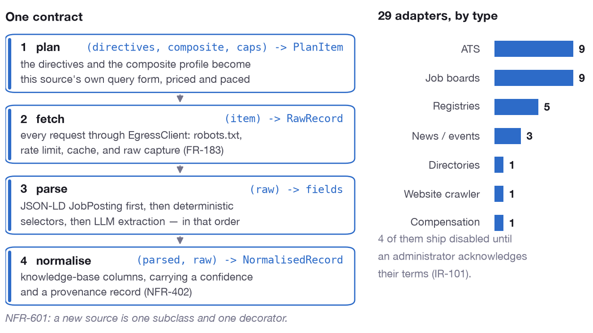
ARCHITECTURE · SOURCES
The adapter contract
• plan: directives, composite profile and caps become this source's own query form, priced and paced.
• fetch: every request goes through EgressClient — robots, rate limit, cache and raw capture.
• parse: JSON-LD first, then deterministic selectors, then LLM extraction, in that order.
• normalise: knowledge-base columns carrying a confidence and a provenance record (NFR-402).
One contract — plan, fetch, parse, normalise — and every source is one subclass and one decorator (NFR-601).
Dream Job · Functional walkthrough and technical architecture
27

Slide 28
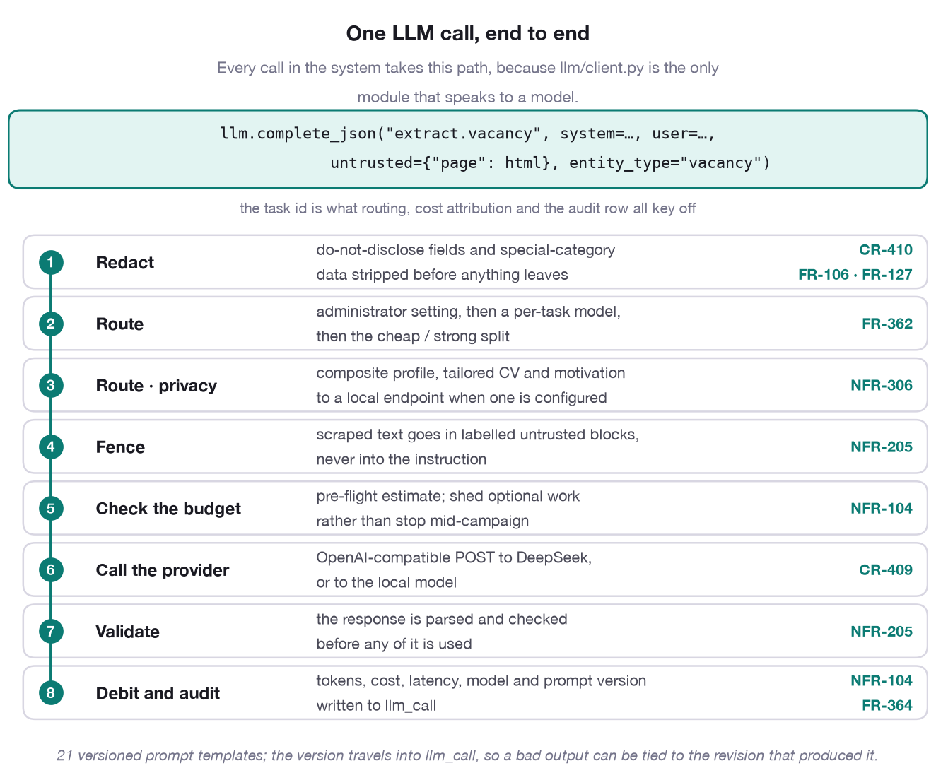
ARCHITECTURE · LLM
The path of one LLM call
• Redact, route, fence: do-not-disclose fields stripped, a model chosen per task, scraped text quarantined.
• Check the budget pre-flight, then shed optional work rather than stop mid-campaign (NFR-104).
• Validate the response before any of it is used; injection defence is at the boundary (NFR-205).
• Debit and audit: tokens, cost, latency, model and prompt version recorded (FR-364).
Every call in the system takes this path, because llm/client.py is the only module that speaks to a model.
Dream Job · Functional walkthrough and technical architecture
28

Slide 29
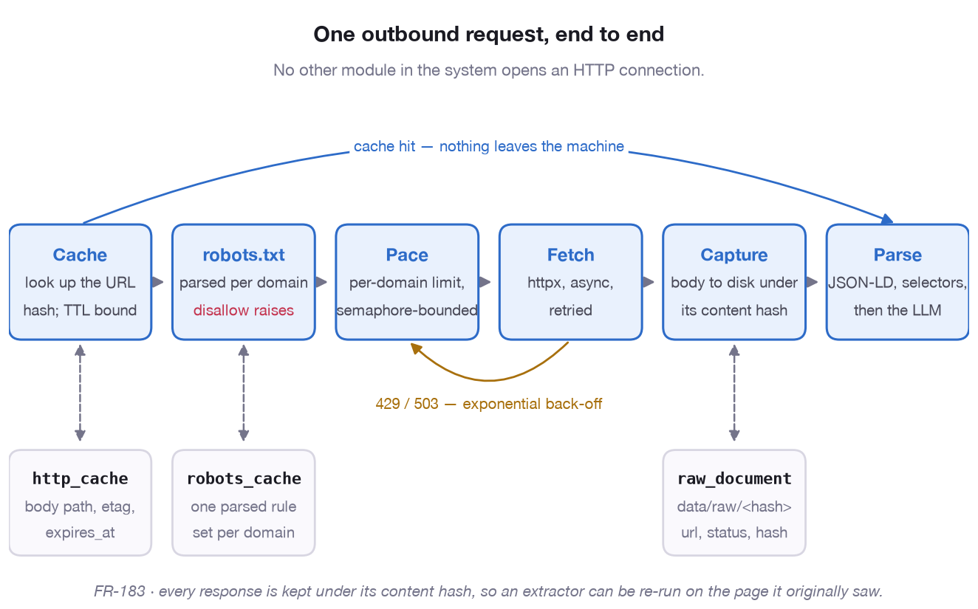
ARCHITECTURE · EGRESS
One outbound request, end to end
• A cache hit never reaches the network.
• robots.txt is parsed per domain; a disallow raises rather than being ignored.
• A 429 or 503 backs off exponentially under one retry policy (IR-102).
• Raw bodies are stored on disk so an extractor can be re-run on the page it originally saw.
No other module opens an HTTP connection. Cache, robots.txt, pacing, fetch, capture, parse — every response kept under its content hash (FR-183).
Dream Job · Functional walkthrough and technical architecture
29

Slide 30
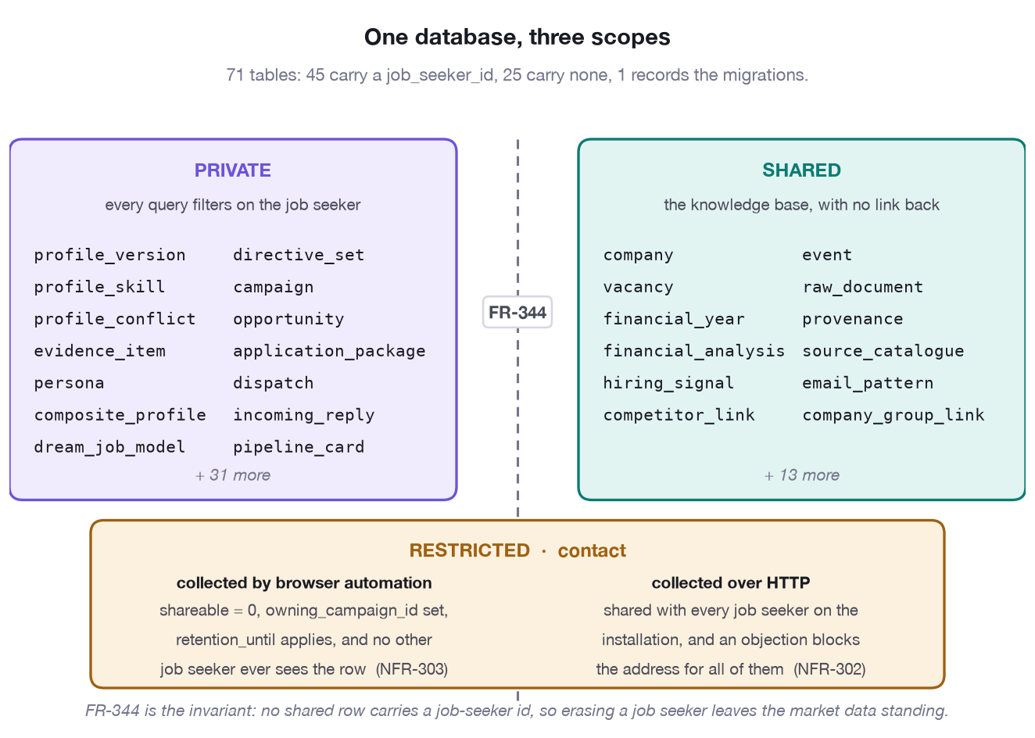
ARCHITECTURE · DATA
One database, three scopes
• Private: profile versions, campaigns, opportunities, applications, replies.
• Shared: companies, vacancies, financial years, signals, competitors, events.
• Restricted: contact straddles the boundary — browser-collected rows are private to the campaign that made them (NFR-303).
• Erasing a job seeker leaves the market data standing (FR-108).
45 private tables carry a job_seeker_id; 25 shared tables carry none. FR-344 is the invariant: no shared row links back to a job seeker.
Dream Job · Functional walkthrough and technical architecture
30

Slide 31
PART 3
Data sources
Every adapter registered in the codebase — 29 today — what each one covers, how it is reached, and whether it needs consent.
Dream Job · Functional walkthrough and technical architecture
31

Slide 32
DATA SOURCES · OVERVIEW
The source catalogue at a glance
29 adapters register themselves at import time. 4 ship disabled until an administrator acknowledges their terms (IR-101).
Source type | Adapters
Applicant tracking systems | 9
Job boards | 9
Company registries | 5
Directories | 1
News and RSS | 1
Events and communities | 2
Company websites | 1
Compensation | 1
Dream Job · Functional walkthrough and technical architecture
32

Slide 33
DATA SOURCES · ATS
Applicant tracking systems
Structured job feeds hosted by the employer's own recruiting system. Machine-readable, so collection costs no tokens.
Source | Coverage | Access | Terms | LLM extract
Ashby | Global | API | Permitted | no
Greenhouse | Global | API | Permitted | no
Lever | Global | API | Permitted | no
Personio | 8 countries (EU+) | API | Permitted | no
Recruitee | NL, BE, DE, FR, GB, PL | API | Permitted | no
SmartRecruiters | Global | API | Ack. required | no
Teamtailor | Global | API | Permitted | no
Workable | Global | API | Permitted | no
Workday | Global | API | Permitted | no
Dream Job · Functional walkthrough and technical architecture
33

Slide 34
DATA SOURCES · JOB BOARDS
Job boards and public employment services
Advertised vacancies across Belgium, the Netherlands, the EU and globally. Terms status decides whether a source is enabled by default.
Source | Coverage | Access | Terms | LLM extract
Actiris (Brussels public employment service) | BE | HTTP | Permitted | no
Arbeitnow | Global | API | Permitted | no
EURES (European Job Mobility Portal) | 30 countries (EU+) | API | Permitted | yes
Generic HTML job board | Global | HTTP | Permitted | yes
Indeed | Global | HTTP | Ack. required | yes
Jobat.be | BE | HTTP | Permitted | yes
StepStone | BE, DE, NL, AT, GB, FR | HTTP | Ack. required | yes
VDAB (Vind een job) | BE | HTTP | Permitted | yes
Welcome to the Jungle | FR, BE, ES, CZ, GB | API | Permitted | yes
Dream Job · Functional walkthrough and technical architecture
34

Slide 35
DATA SOURCES · REGISTRIES AND MORE
Registries, directories, news, events, websites, compensation
The non-vacancy sources: statutory filings that price a company, news and events that signal hiring, the company's own site, and the pay benchmark.
Source | Coverage | Access | Terms | LLM extract
Companies House (UK) | GB, UK | API | Permitted | no
KBO/BCE (Belgian enterprise register) | BE | HTTP | Permitted | no
KvK Handelsregister (NL) | NL | API | Permitted | no
NBB Central Balance Sheet Office | BE | API | Permitted | no
SEC EDGAR (US) | US | API | Permitted | no
OpenCorporates | Global | API | Permitted | no
Company newsroom / RSS | Global | HTTP | Permitted | no
Conference sites and community calendars | Global | HTTP | Permitted | no
Meetup and Eventbrite (public listings) | Global | HTTP | Ack. required | no
Company website | Global | HTTP | Permitted | no
Eurostat Structure of Earnings Survey | 32 countries (EU+) | API | Permitted | no
Dream Job · Functional walkthrough and technical architecture
35

Slide 36
DATA SOURCES · COVERAGE
What the catalogue implies
The catalogue is not a fixed list: the planner selects from it using the coverage metadata each adapter declares (FR-161/164).
• Coverage is declared per adapter, so a Belgian search runs the registries and boards that cover Belgium and skips the rest.
• Terms status is first-class: SmartRecruiters, Indeed, StepStone and Meetup and Eventbrite ship disabled until an administrator acknowledges their terms (IR-101).
• Adapters that return machine-readable payloads set llm_fallback = false, so the structured forms are read deterministically at zero token cost.
• Every source is reached through EgressClient, so robots.txt, per-domain pacing, caching and raw capture apply to all of them equally.
• A new source is one subclass and one decorator — no registration list and no pipeline edit (NFR-601).
Dream Job · Functional walkthrough and technical architecture
36

Slide 37
SUMMARY
The system in five sentences
• Profile in: a LinkedIn export, a CV and a description of the job actually wanted, merged into one composite profile with every conflict surfaced.
• Plan and collect: structured directives become a per-source plan, reviewed and priced before anything runs, then executed through 29 registered adapters behind one contract.
• Analyse and rank: company profiles, five years of filings and seven sub-scores produce an explained, advisory ranking of advertised and speculative opportunities.
• Apply: documents are generated from grounded facts, checked, and sent from the job seeker's own mailbox only after explicit approval.
• Follow up and learn: replies become a pipeline, outcomes become segment rates shown with their sample size, and redirection advice becomes the next campaign's directives.
Dream Job · Functional walkthrough and technical architecture
37

