Slide 1
Banking Campaigns Comparator
How Belgian banks communicate similar products differently,
and what ING can learn from it.
Two-week proof of concept for ING DACI / Customer AI
Camus Siegried (marketing framework) · Ukendi Dan (collection, extraction) · van der Aa Stephane (analysis, GenAI)
14 – 25 September 2026 · 14 banks · 18 current-account pages of 51 collected · 104 features
Notes:
As part of the ING DACI two-week P of C, we set out to answer one question: how do Belgian banks communicate about similar products on the open web, and what can ING learn from it?
To move away from subjective design opinions, we built a fully reproducible, ..

Slide 2
The brief, and the constraint that shapes everything
• Compare how Belgian banks communicate comparable products
Campaign pages only: the open web, one language, one product family at a time.
• Turn that comparison into advice ING can act on
Measured differences, argued from named features — not opinion dressed as data.
• The hard constraint: no performance data exists
No clicks, no conversions, no sales. So nothing here may claim that a design choice caused an outcome.
• Therefore every recommendation is a hypothesis to test
The project's value is a defensible, repeatable measurement — and an honest statement of its limits.
This single constraint drives the guardrails you will see on every slide that follows.
Banking Campaigns Comparator · ING DACI / Customer AI · September 2026
2
Notes:
"As part of the ING DACI two-week P of C, we set out to answer one question: how do Belgian banks communicate similar products on the open web, and what can ING learn from it? To move away from subjective design opinions, we built a fully reproducible, end-to-end measurement pipeline across 14 banks and 104 features. First disclaimer before we start: we have no internal data, nothing here claims a design choice caused a commercial outcome — every recommendation is an argued hypothesis worth testing.

Slide 3
Strategic context and positioning
• The hybrid model
ING blends the direct, feature-focused, mobile-first tone of a neobank with the institutional weight of a Tier-1 retail bank — regulatory authority and an established brand.
• A level playing field on regulation
Neobanks like Revolut hold the same European banking licenses and face the same Belgian compliance checks — including the mandatory CCP credit-registry query for consumer lending. Their speed comes from modern architecture, no branch network, and faster decision loops — not lighter rules.
• Different monetization engines
Traditional banks have long used the basic current account as a loss leader — a produit d'appel — to acquire clients and monetize later through mortgages, insurance and wealth management. Neobanks flip that: transparent freemium tiers, paid subscriptions, and transactional FX / fee income, upfront.
• Who each side is chasing
Neobanks win volume among young adults, digital nomads and casual spenders. ING's acquisition budget targets high lifetime-value segments instead: first-time investors, expats and high-net-worth individuals, and first-time buyers in mortgage and real estate. Professional and business banking is out of scope for this comparison — retail only.
Banking Campaigns Comparator · ING DACI / Customer AI · September 2026
3
Notes:
ING is a hybrid. You carry the direct, feature-first, mobile-first tone of a neobank, and the institutional weight of a Tier-1 bank. That's a position, not an accident.
The speed of the neobanks come from their architecture, faster decision loops and no branches: they don't have lighter European or compliance rules, they simply don't the same business model.
Where you differ is the engine. Traditional banks use the current account as loss leader and monetise later through mortgages, insurance, wealth managmt... Neobanks monetise upfront — freemium tiers, free or paid subscriptions, abonnements, FX. They chase volume among young adults and digital nomads. You chase lifetime value: expats, first-time investors and buyers, high net worth individuals.
So, the question ….

Slide 4
What we built, end to end
• A measurement pipeline: 14 banks, 51 pages across 6 product families (18 of them current-account), 104 declared features, one frozen contract.
• A scoring workflow: automatic extraction, model-assisted extraction, and a human rubric for the 13 judgement features.
• An analysis library: positioning, similarity, category comparison, AI score, cross-sell, plus generated limitations.
• One web UI with ten tabs: four business views (Analysis, Trends, Reputation, Recommendations), the generated-site builder, and six read-only operator views carried over from the Streamlit dashboard.
• Two optional signals, both fenced off from the performance claim: search interest, and news themes.
• A generated ING website: ten pages built from the selected recommendations — an illustration of what a recommendation means in practice, not a proposal for ING's own site.
Each of those pieces is the next few slides; the pipeline diagram overleaf is the map.
Banking Campaigns Comparator · ING DACI / Customer AI · September 2026
4

Slide 5
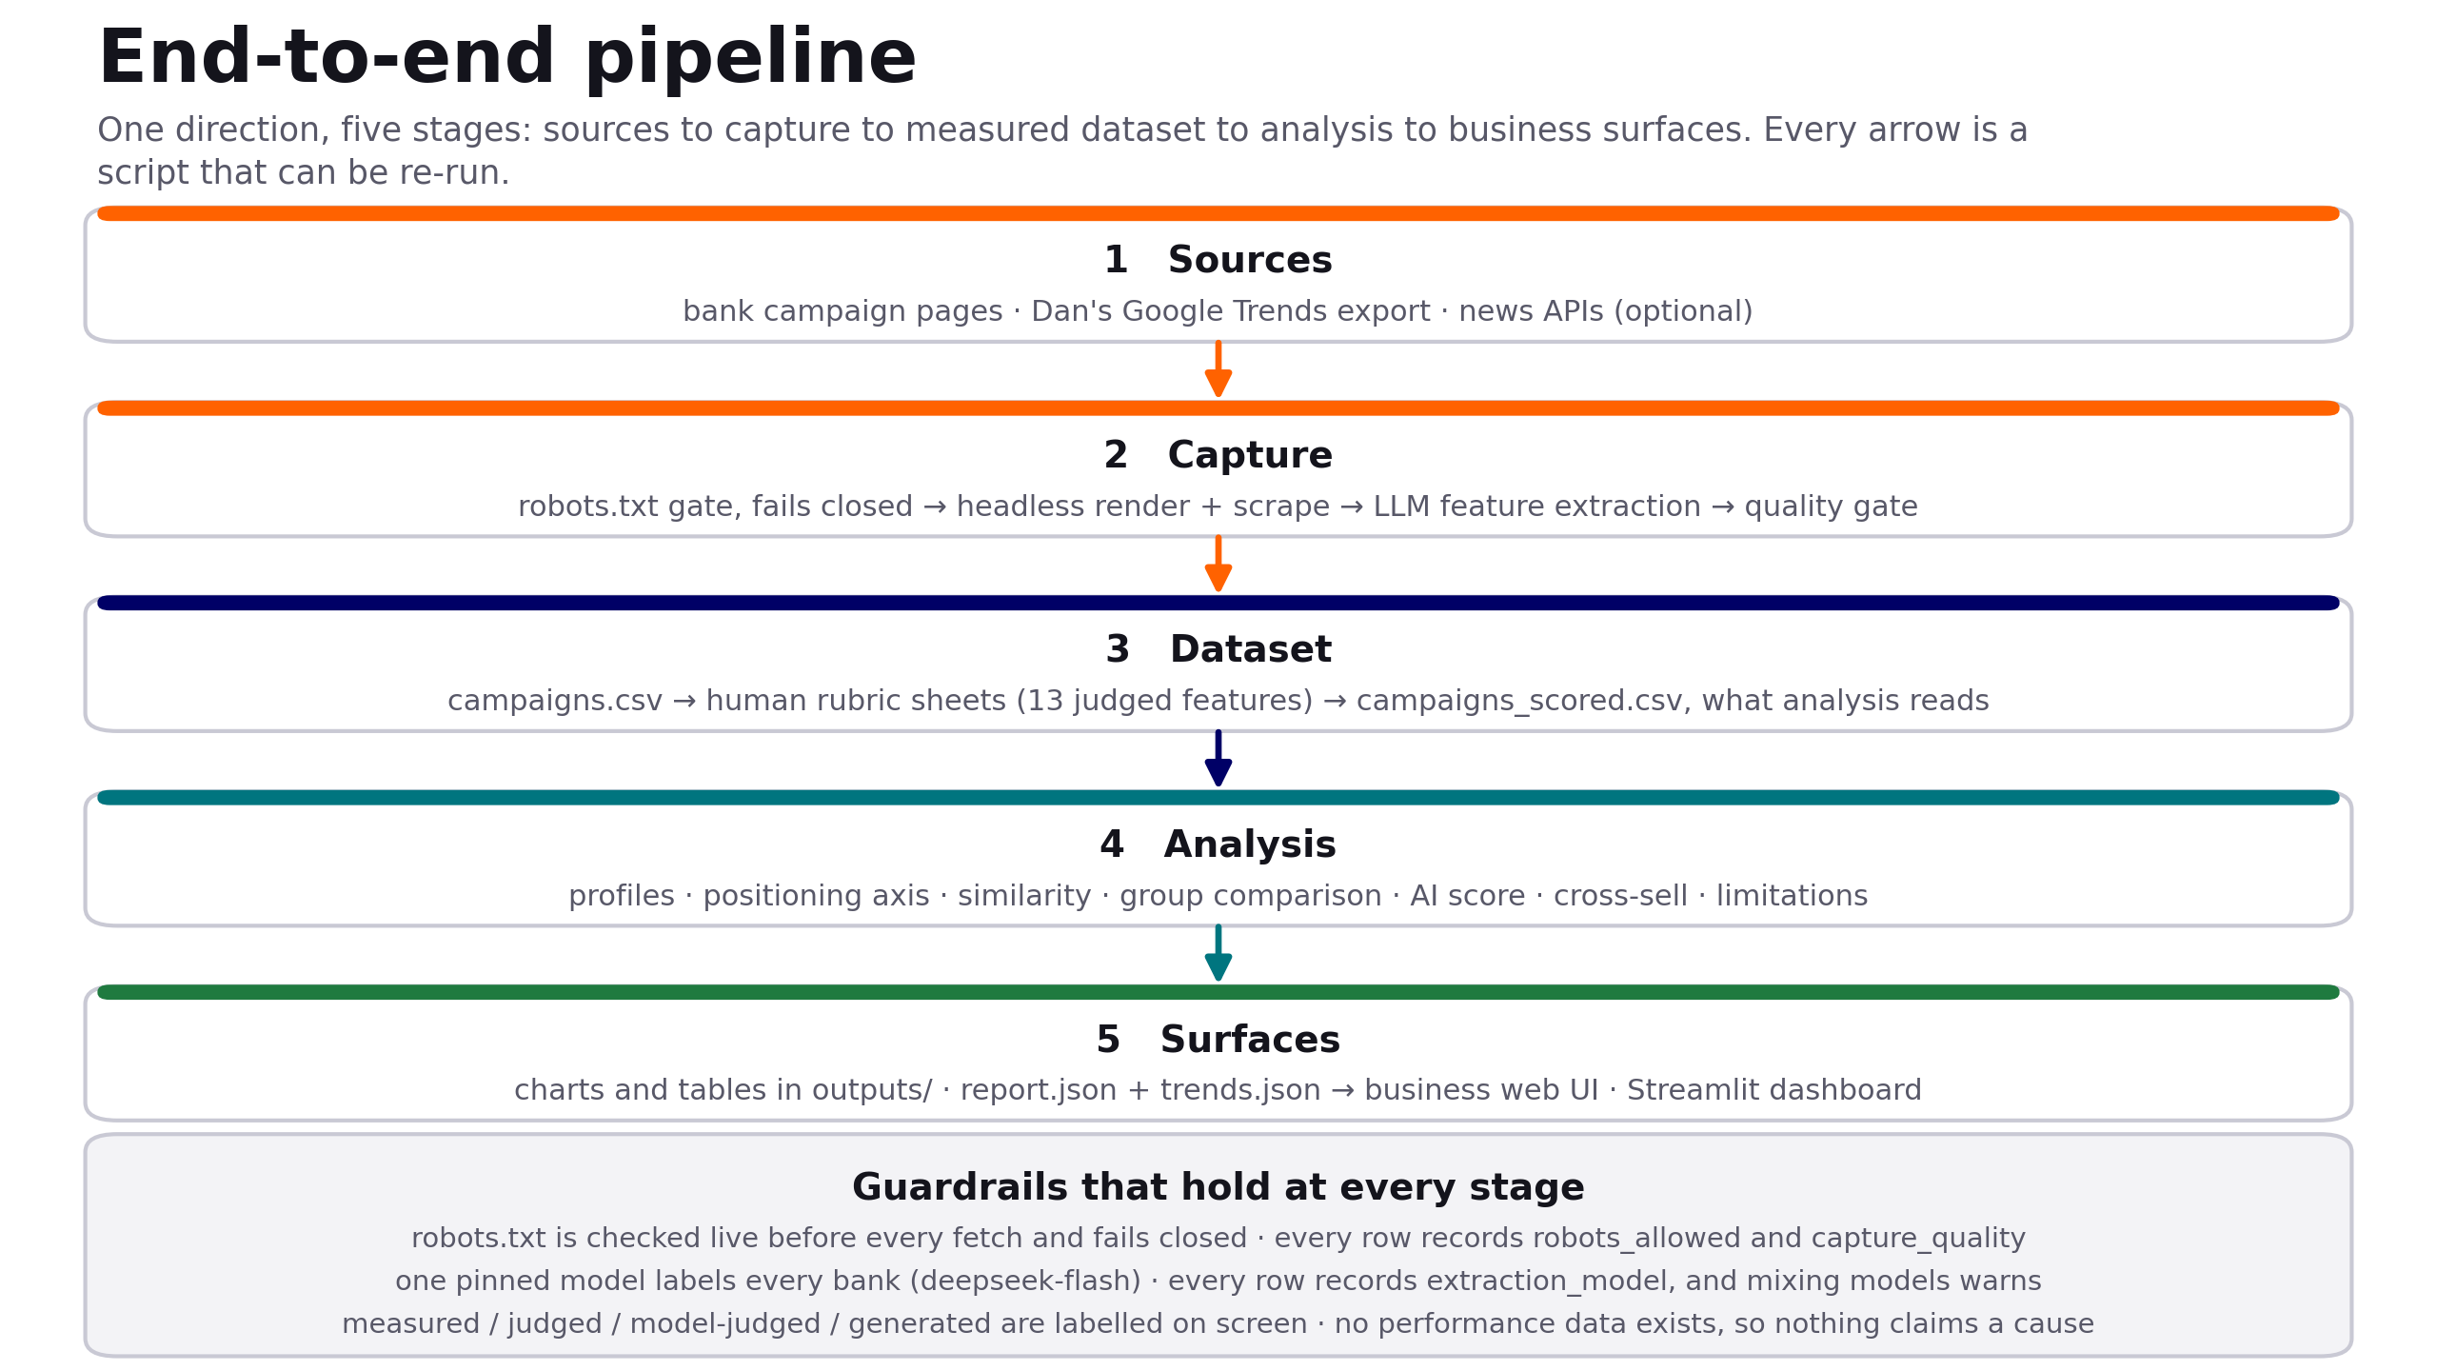
The pipeline, end to end
One direction, five stages. Every arrow is a script that can be re-run; the guardrail band holds at every stage.
Banking Campaigns Comparator · ING DACI / Customer AI · September 2026
5

Slide 6
The dataset behind this analysis
• 51 pages scored across 6 product families. This comparison: the 18 current-account pages, 14 banks, 33 comparable features
Argenta · Belfius · Beobank · BNP Paribas Fortis · bunq · CBC · Crelan · Hellobank · ING · KBC · Keytrade · N26 · Revolut · Vdk
• Mostly Belgian French — plus two English pages and one Dutch
Word counts and readability are within-language features, so with more than one language present the comparison drops eight of them rather than compare across languages.
• Split for like-for-like comparison
10 traditional banks and 4 challengers, compared one product family at a time — a mortgage page and a current-account page differ because the products differ.
• The dataset is in git, alongside the contract
Captures, datasets and outputs are tracked, so any figure on a slide traces back to the exact committed run that produced it.
A snapshot is the honest shape for a finding: true for one dataset, one capture date, one scope.
Banking Campaigns Comparator · ING DACI / Customer AI · September 2026
6
Notes:
"So the question is whether that hybrid position shows up in how you actually communicate.
51 pages, 14 banks, 6 product families, 104 documented features. We only ever compare within one product family — pages do different jobs. The headline runs on 18 current-account pages, 14 banks.
Deciding what was relevant was part of the work."

Slide 7
Rubric scoring: one human judge, and a model measured against it
• 13 features are judgements, not measurements
Clarity of the offer, layout archetype, AIDA coverage, persuasion levers — scored against a written scale, one sheet per rater.
• One human judge for this pass, stated plainly
Every judged feature on all 51 pages comes from one sheet. Earlier passes split pages between raters; this one does not, and we say so rather than presenting a single opinion as a consensus.
• A model sheet exists, and it is not a second opinion
50 pages, written to its own file, never into a human sheet - a pre-filled sheet gets rubber-stamped. But the pinned model has no vision, and 12 of the 13 judged features are declared in the dictionary as judged from the screenshot.
• Only one was scored from text, and that was a choice we can now revisit
formality_score is the one the dictionary sources from html_text, and there the model lands within one point of the human 73% of the time. Its scores on the twelve visual features answer a question the text alone cannot settle — on value_prop_clarity it ranked the pages close to the opposite of the human. Tested since: the pinned model returns nothing at all when handed an image. OCR is the route we have not used, and it is a real one — it returns each word with its position and type size, which is most of what rate prominence, layout and mobile-first actually ask.
• So the model sheet is kept as a reference, not used as a rater
Averaging it into the human scores would import guesses as judgements. One named human judge, said out loud, is more honest than a consensus that was never there.
Banking Campaigns Comparator · ING DACI / Customer AI · September 2026
7

Slide 8
What the analysis found
• ING sits with the traditional banks, not the challengers
Traditional↔challenger positioning score 0.41 across 14 banks, and its nearest neighbour is Belfius.
• Where ING is furthest above its peers
Deadline language: 4.0 markers vs peers 0.6 (+3.69 SD) — the largest gap in the set · Persuasion levers used: 5.0 vs 1.7 (+3.68 SD, rubric) · The offer feels worth having: 5.0 vs 4.0 (+1.36 SD, rubric) · Claims fast digital onboarding: 0.67 vs 0.15 (+1.42 SD) · Page height: 11,149px vs 6,412px (+1.42 SD).
• Where ING is below
Image alt text: no ING page carries it, against 23% of peers (-0.55 SD). Animation and calls to action were withdrawn — neither rule measured what its name claims, so neither is ranked here.
• What separates the two groups
Traditional pages are brighter (d = -2.36) and show more without scrolling (d = -2.12); challengers are far likelier to show a rate and to frame the account as a subscription (each d = +2.00), and to target expats (d = +1.23).
• Read as description, not proof
These are descriptive effect sizes over 14 banks, not significance tests. The rubric-sourced ones rest on a single judged sheet, and the deadline count was re-derived from the stored pages — all 14 banks re-measured with the same rule.
Banking Campaigns Comparator · ING DACI / Customer AI · September 2026
8

Slide 9
KBC leads; ING and Belfius are level
KBC
21.30%
Belfius
18.44%
GAP BELFIUS – ING
ING
18.13%
BNP Paribas Fortis
15.40%
0.31 pts
Argenta
9.18%
Crelan
7.07%
Beobank
4.46%
Removing one raw point per week from Belfius brings it to 18.15% — ING’s own figure. Read them as level, not ING in third.
CBC *
2.05%
Revolut
1.64%
VDK Bank *
1.24%
Keytrade Bank *
0.41%
Hello bank! *
0.37%
Incumbents 97.6% · challengers 2.3% of brand search
N26 *
0.29%
bunq *
0.01%
Share of brand search, 261 weeks, Sep 2021 – Sep 2026 · * too low-volume to read share or change
Banking Campaigns Comparator · ING DACI / Customer AI · September 2026
9

Slide 10
Where the banks to benchmark come from
Bank | 2021–22 | 2025–26 | Change | Direction | Selected as
KBC | 21.75% | 20.13% | −1.62 | Down −2.8%/yr | Largest traditional share
Belfius | 18.21% | 18.79% | +0.58 | Flat +0.9%/yr
ING | 19.28% | 16.79% | −2.49 | Down −3.7%/yr | Subject of the study
BNP Paribas Fortis | 17.99% | 13.60% | −4.39 | Down −6.2%/yr
Argenta | 8.32% | 9.42% | +1.10 | Flat +2.0%/yr
Crelan | 5.12% | 8.96% | +3.84 | Up +16.4%/yr | Fastest-rising traditional
Beobank † | 4.38% | 4.34% | −0.04 | Flat −1.3%/yr
Revolut | 0.59% | 3.22% | +2.63 | Up +37.8%/yr | Measurable challenger
Share per 52-week period · flat = within ±2%/yr, a convention, not a test · † direction flips without the first period
Banking Campaigns Comparator · ING DACI / Customer AI · September 2026
10

Slide 11
What ING’s pages do that theirs don’t
● Mean of KBC, Crelan, Revolut
● ING
Vertical tick = market average (z-score 0)
Deadline language
−0.35 vs +2.53
Clarity of the offer
+0.23 vs +1.23
Page length
−0.67 vs +1.28
Selected on search attention alone. The three brands search attention picks out do the opposite of ING here — this is not why they are searched for.
Pages measured: KBC 3 · Crelan 1 · Revolut 1. Beyond these three choices the brands diverge: no single recipe.
z-scores over the comparable page-feature set · today’s pages, not the pages of 2021–2025
Banking Campaigns Comparator · ING DACI / Customer AI · September 2026
11

Slide 12
Why challengers look small in search
> 1M
1.64%
Revolut private customers in Belgium, +~25,000/month
vs
of brand search, 9th of 14
Navigational searches
App-first journeys
Measurement floor
Incumbent searches include logins, branches, opening hours. A working hypothesis, not verified at query level.
Sign-up via app stores and referral links, then daily app use without searching the name.
Six brands never clear 10/100 in their own request; their share is partly rounding.
Read challenger shares as a floor on attention, not a customer count.
Customer figure: Belga News Agency, 11 Mar 2026 (retrieved 21 Sep 2026) · never compared to a market-share figure
Banking Campaigns Comparator · ING DACI / Customer AI · September 2026
12
Notes:
BRIDGE from slides 9–11: incumbents hold 97.6% of brand search, challengers 2.3%. This slide is the caveat before anyone reads that as market share.
THE CONTRAST: Revolut reports more than 1 million private customers in Belgium, adding about 25,000 a month (Belga News Agency, 11 Mar 2026) — yet holds 1.64% of brand search, 9th of 14. Both are true; they measure different things.
THREE REASONS search undercounts a challenger — none of them is "Revolut is small":
1. Navigational searches. Incumbents are searched for logins, branches, opening hours. Say it as a working hypothesis — not verified at query level.
2. App-first journeys. Sign-up through app stores and referral links, then daily use inside the app; the brand name is never typed.
3. Measurement floor. Six of the 14 brands never clear 10/100 in their own Trends request, so their share is partly rounding. Revolut itself is above the floor (peak 19), so its 1.64% is a real reading.
LAND: challenger shares are a floor on attention, not a customer count. The 1M figure is deliberately never set against a market-share figure.
TRANSITION: search tells us who gets attention, not who wins. From here on we stop measuring and start advising.

Slide 13
Where each brand is searched from
• Every challenger peaks in Brussels
Revolut, N26 and bunq all index 100 in Brussels and drop away outside it — N26 to 27 in Flanders, bunq to 29 in Wallonia. Three brands, three different products, one geography.
• Every incumbent is regional, and predictably so
KBC indexes 100 in Flanders and 11 in Wallonia; Argenta 100 and 27. Belfius, BNP Paribas Fortis and Crelan all peak in Wallonia. Five of six sit exactly where their history put them, which is the sanity check on this data rather than the finding.
• ING is the one incumbent that does not
Brussels 100, Wallonia 98, Flanders 73 — national, with no regional home. On this measure ING behaves like the challengers and unlike the banks it sits with everywhere else in this deck.
• A second signal pointing the same way, from a different source
This comes from search behaviour, not from a single page feature, and it lands where the traditional↔challenger score already put ING: with the incumbents, leaning.
• What it is not
Where people search from, never what a campaign achieved. Google Trends indexes each brand against its own peak, so these are shapes to compare, not volumes.
Google Trends, Belgium, by region. Regional index 0–100 per brand, each brand normalised to its own maximum.
Banking Campaigns Comparator · ING DACI / Customer AI · September 2026
13

Slide 14
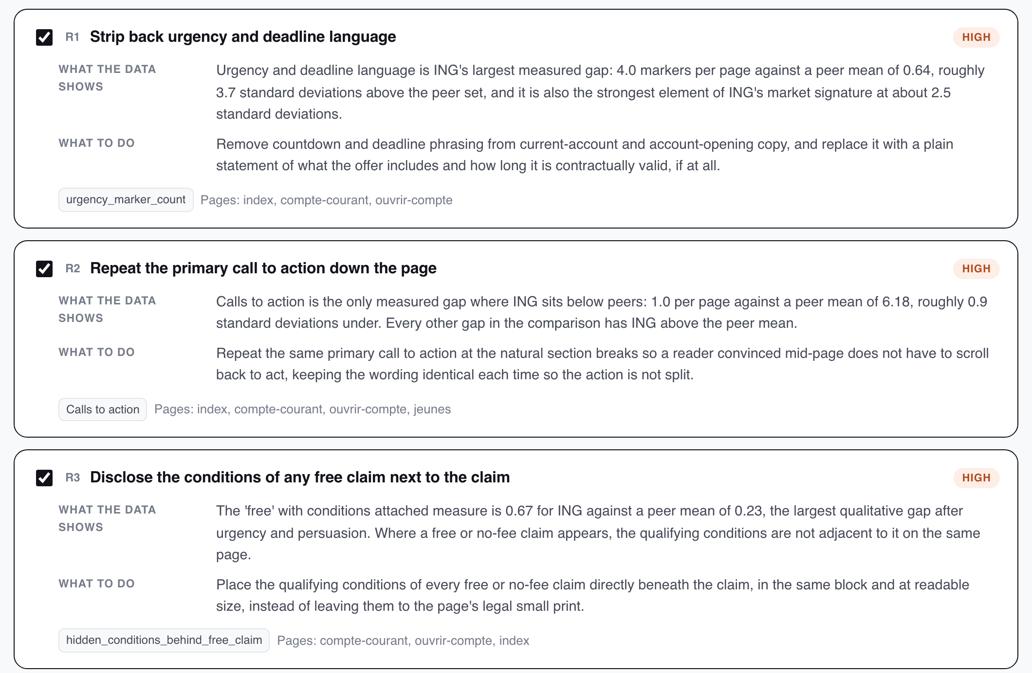



Every recommendation carries the evidence it was argued from
Finding and action, kept apart
What the data shows sits above what to do. A reader can reject our suggested action and still keep the measured finding.
Named features, checked before release
Each card names the measured features it was argued from and the pages it applies to. Those ids are verified against the report — an invented one never leaves the module.
No figure the analysis did not produce
The prompt receives only numbers already in the report, and the output is not trusted to add any.
Three of the eleven, as the team reviews them.
Banking Campaigns Comparator · ING DACI / Customer AI · September 2026
14
Notes:
WALK THE CARD (R1, top): title and priority · WHAT THE DATA SHOWS — the finding with its numbers: 4.0 urgency markers per page vs a peer mean of 0.64, about 3.7 SD · WHAT TO DO — the action · chips: the feature it was argued from (urgency_marker_count) and the pages it applies to.
THREE GUARDRAILS (right column):
1. Finding and action kept apart. Anyone can reject the action and keep the finding — nobody has to buy the advice to accept the measurement.
2. Named features, checked before release. Every feature id on a card is verified against the report; an id the model invented is dropped before the list is shown.
3. No figure the analysis did not produce. The prompt receives only numbers already in the report; the output is not trusted to add any.
ONE LINE: the model is a writer, not a source.
IF ASKED about R2 in the screenshot ("Repeat the primary call to action"): it rests on cta_count, withdrawn on 23/09 — the captured HTML holds every pack card, but no counting rule reproduced a human count across the fourteen banks, so the figure would have reported markup convention rather than the page. A recommendation dying with its feature is the mechanism working. The screenshot predates the withdrawal.
TRANSITION: so what did it conclude about ING?

Slide 15
What it concluded about ING
4.0
11,149px
0.67
urgency markers per page
page height, against 6,412px
‘free’ claims with conditions elsewhere
against a peer mean of 0.64 — about 3.7 standard deviations above the set, and ING's strongest measured signature.
ING's pages run about 74% longer than the set, so the offer sits further from the top.
against a peer mean of 0.23 — the qualifying conditions are not adjacent to the claim they qualify.
The three it ranked highest
Strip back urgency and deadline language
urgency_marker_count
Bring the offer higher up the page
page_height_px
Disclose the conditions of any free claim next to the claim
hidden_conditions_behind_free_claim
Design observations, not performance findings. The pages span several product families and languages, the judged features come from a single rater, and no click or conversion data exists — so every item is a hypothesis ING could test.
Banking Campaigns Comparator · ING DACI / Customer AI · September 2026
15
Notes:
THREE NUMBERS, all from the current-account comparison — 14 banks, 33 comparable features:
1. 4.0 urgency and deadline markers per page vs a peer mean of 0.64 — about 3.7 SD above, the largest gap in the set and ING's strongest measured signature.
2. Page height 11,149 px vs 6,412 — about 74% longer, so the offer sits further from the top (about 1.4 SD).
3. 0.67 'free' claims with their conditions elsewhere vs 0.23 — where a free or no-fee claim appears, the qualifying conditions are not next to it.
THE THREE IT RANKED HIGHEST: strip back urgency and deadline language · bring the offer higher up the page (the current run words it "shorten the pages and cut non-informative imagery" — same measure, page_height_px) · disclose the conditions of any free claim next to the claim.
THE SHAPE: two of the three are about removing things. ING's pages carry the densest persuasion in the set (5.0 levers per page vs 1.7). The advice is restraint, not more features.
CAVEAT — read it, do not skip it: design observations, not performance findings. Pages span product families and languages, judged features come from one rater, no click or conversion data — every item is a hypothesis ING could test.
TRANSITION: a list is easy to nod at and forget. So we built the thing.

Slide 16
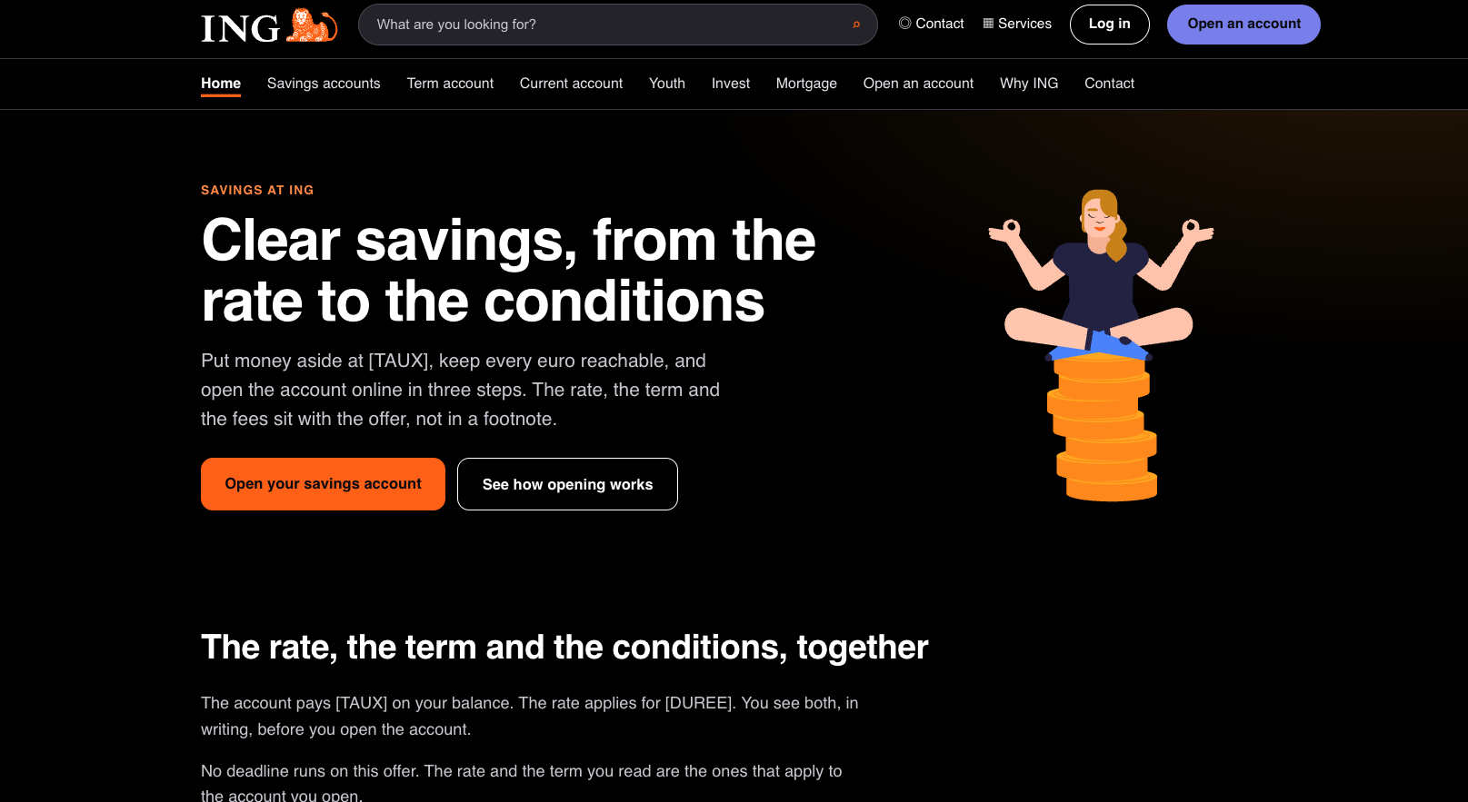


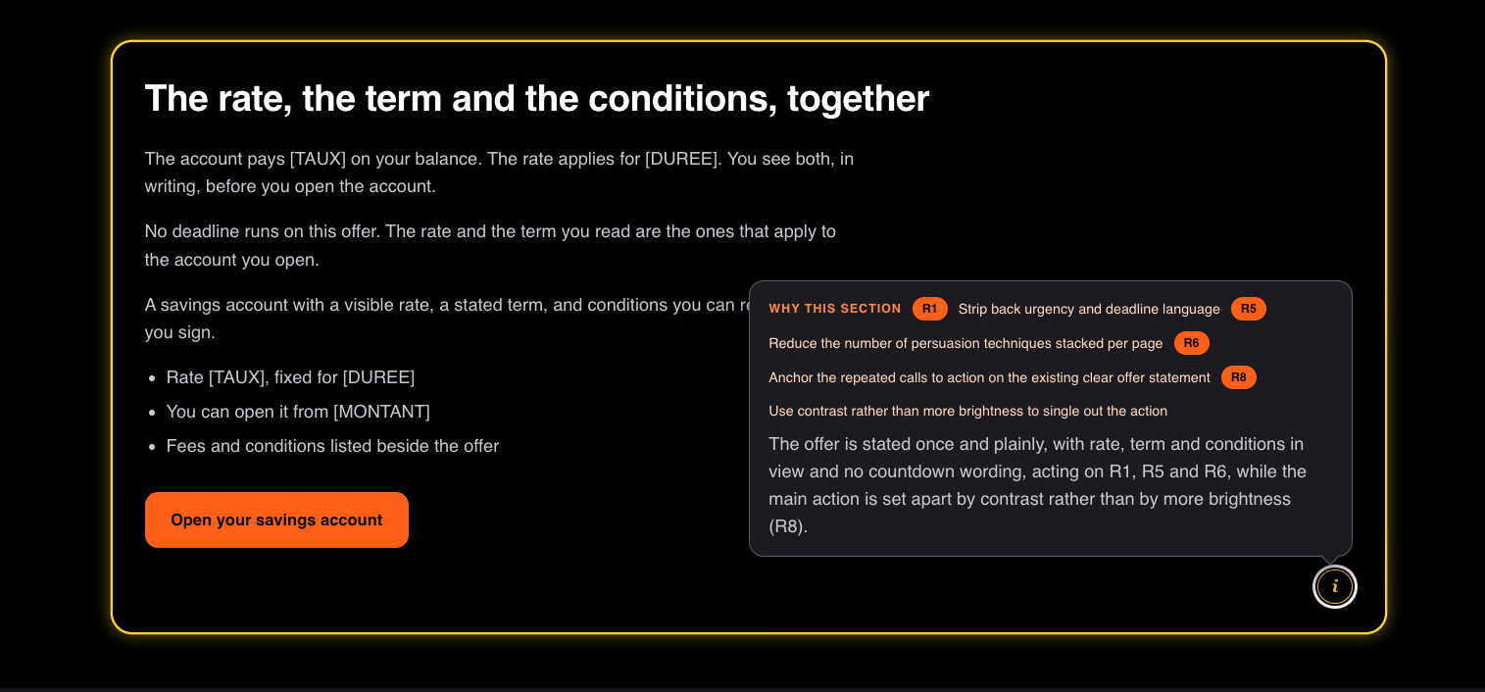
From a list of changes to a site you can actually look at
The team chooses what gets built
Every recommendation is a checkbox. Nothing reaches the generator that a person did not tick.
Ten ING-styled pages, in fr-BE or nl-BE
Home, savings, term account, current account, youth, investing, mortgage, opening, why ING, contact.
Each section can name its own source
In explained mode, the orange blocks say which recommendation produced that section and why — so the site is auditable, not just persuasive.
This is what makes the analysis arguable: a stakeholder can look at the change rather than read about it.
Generated, never published: rates and amounts stay as [TAUX] and [MONTANT] placeholders.
Banking Campaigns Comparator · ING DACI / Customer AI · September 2026
16
Notes:
ON SCREEN: top — the generated home page in ING styling (hero, two calls to action). Bottom — one section in explained mode: orange frame, and the (i) button that opens the rationale for that section.
THREE POINTS:
1. The team chooses what gets built. Every recommendation is a checkbox; nothing reaches the generator that a person did not tick.
2. Ten ING-styled pages, fr-BE or nl-BE: home, savings, term account, current account, youth, investing, mortgage, opening, why ING, contact.
3. Each section can name its own source. Explained mode shows which recommendation produced the section and why — auditable, not just persuasive.
SAY PLAINLY: an illustration — generated, never published, not a proposal for ING's site. Rates and amounts stay as [TAUX] and [MONTANT]: no figure appears that a compliance team has not supplied.
ORANGE LINE: this is what makes the analysis arguable — a stakeholder can look at the change instead of reading about it. Invite it: "which of these would you untick?"
TRANSITION: put together, the whole thing runs in one direction.

Slide 17
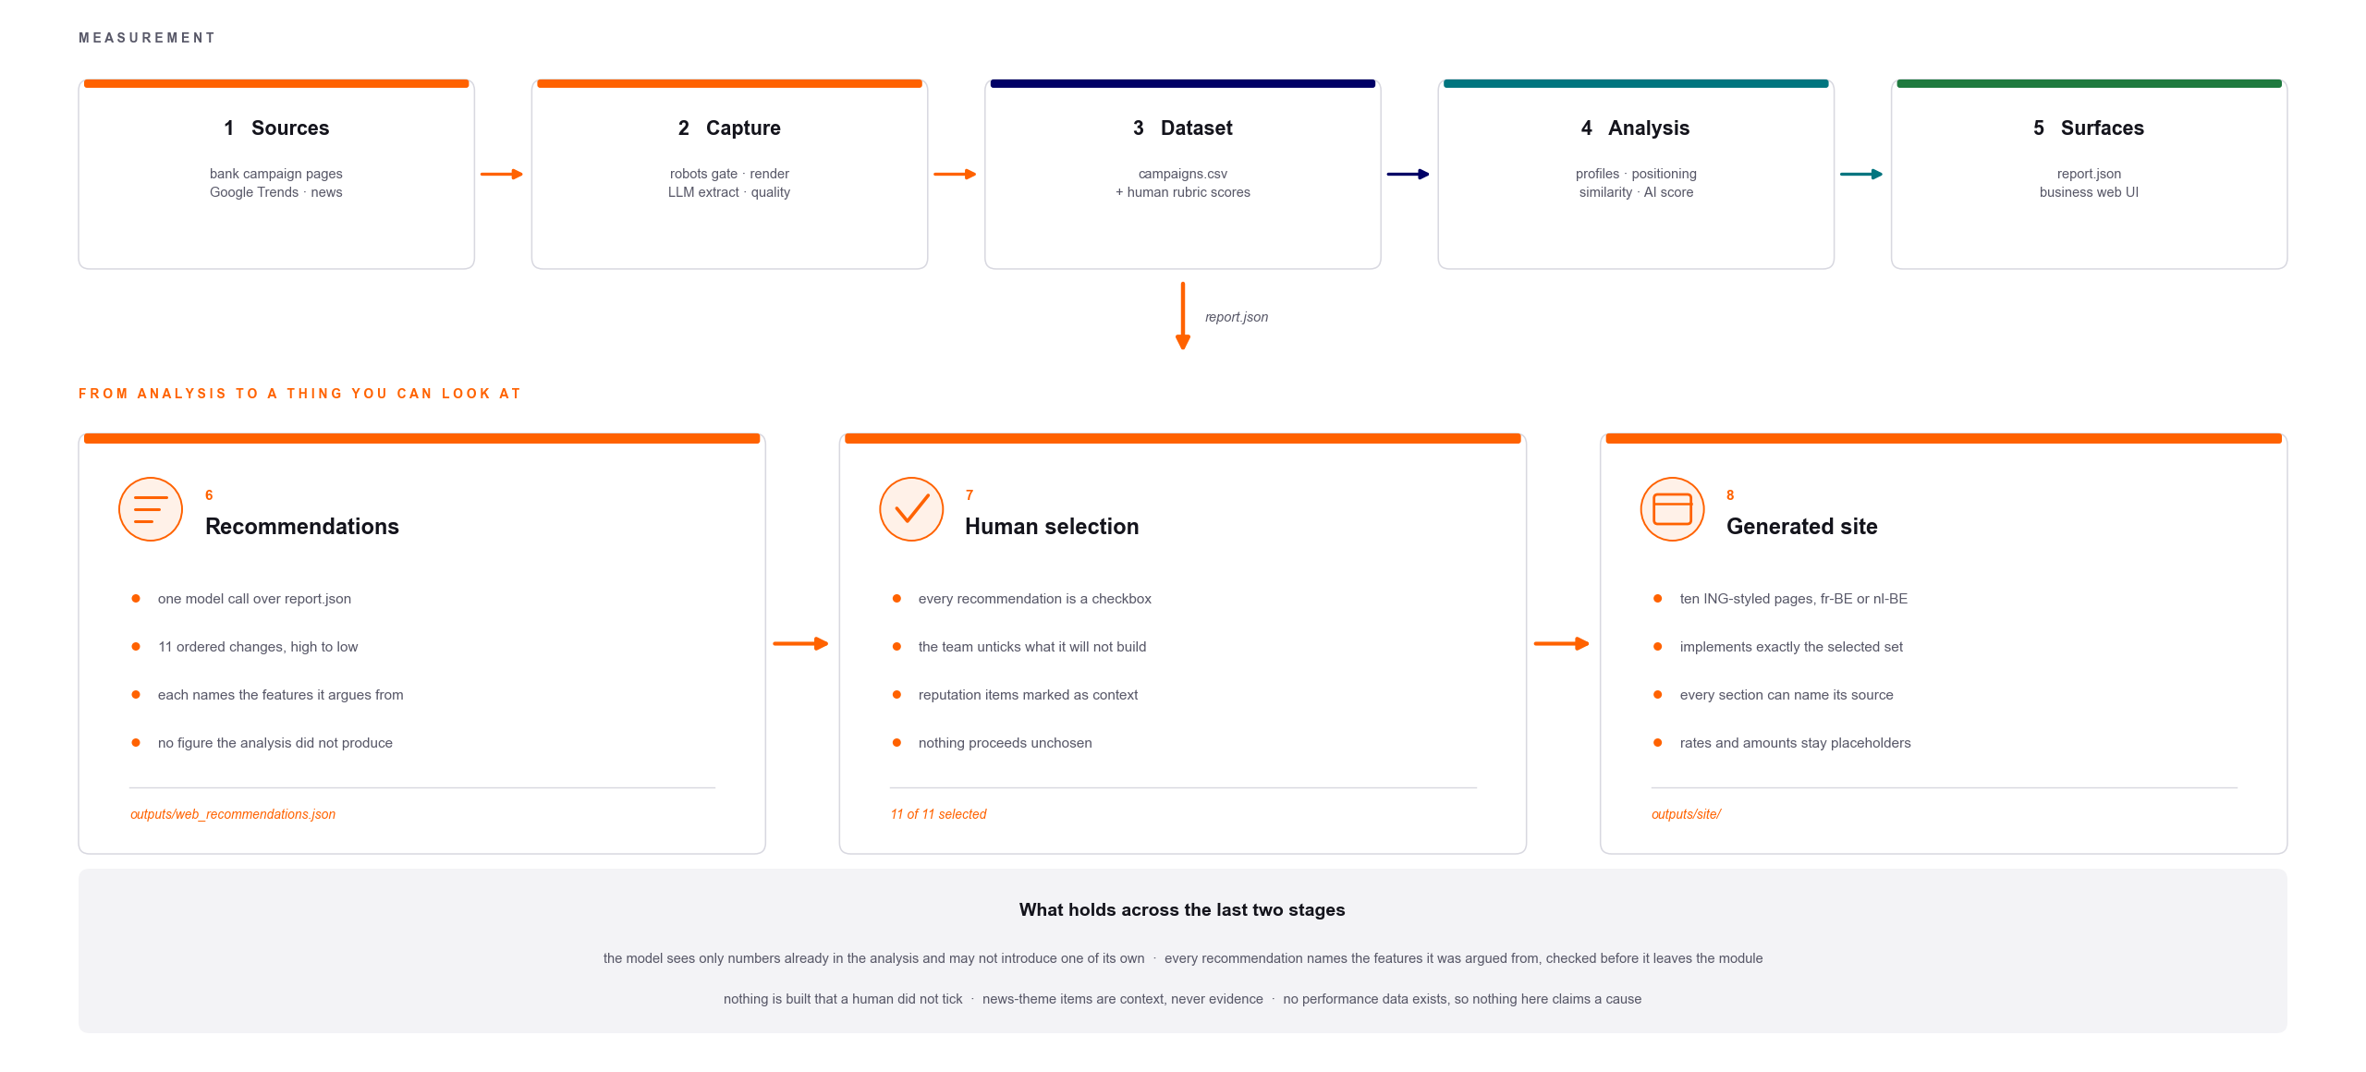
The complete pipeline
Stages 1–5 are the measurement half shown in the main deck. Stages 6–8 are this one.
Banking Campaigns Comparator · ING DACI / Customer AI · September 2026
17
Notes:
TOP ROW, stages 1–5 — the measurement half already walked: sources → capture (robots gate, pages rendered as a visitor sees them) → dataset with the human rubric scores → analysis → surfaces (report.json, the web UI). One arrow carries report.json down.
BOTTOM ROW, stages 6–8 — this section: recommendations (one model call, ordered list, each naming its features) → human selection (checkboxes; nothing proceeds unchosen) → generated site (ten pages, exactly the selected set, placeholders for every figure).
GREY BAND — read it as one sentence: the model sees only numbers the analysis produced; every recommendation names its features and is checked before it leaves the module; nothing is built that a human did not tick; news-theme items are context, never evidence; no performance data exists, so nothing here claims a cause.
WHY ONE DIRECTION MATTERS: every arrow is a script and can be re-run, so a correction made upstream flows all the way through. That is how the cta_count withdrawal propagated this week — once it was made in the analysis rather than patched into an output file.
NOTE: the diagram's "11 of 11 selected" and "11 ordered changes" predate the withdrawal — ten now.
TRANSITION to slide 18: that last guardrail — no performance data — is the limit of the whole project. Next slide.

Slide 18
What this cannot support
• No performance data exists here
Nothing links a design choice to a click, a conversion or a sale. Every recommendation is a hypothesis ING could test.
• Small groups, by design
Four challengers against ten traditional banks, and most banks contribute a single page — so a group mean is an anecdote and an effect size describes separation, not significance.
• The judgement features are thinner than they look
All thirteen come from one judged sheet by one person, so single-judge bias is present and un-measured - there is no second sheet to measure it against. A finding resting on persuasion levers or accent placement is a hypothesis, not a reading.
• Search interest is context, and covers part of the market
It measures what people searched for, not what a campaign achieved, and the pages captured are today's pages.
• Only the open web is covered
Social, in-app and email banners are out of scope — and may be where a bank's real communication happens.
outputs/limitations.md is regenerated from the dataset on every run, so these cannot quietly go stale.
Banking Campaigns Comparator · ING DACI / Customer AI · September 2026
18
Notes:
"104 features in, 33 out. Every reduction is on screen.
And five withdrawn outright, because they measured our tooling, not your pages.
Calls to action: no counting rule held across fourteen banks. Navigation, repeated links, clickable cards — each bank marks them up differently.
Animation: our rule asked whether the stylesheet declared an animation, not whether the page moves. Across eighteen pages, exactly one has real motion — Revolut, a video. Your kickoff deck said ING was the only traditional bank animating. That is now marked not testable, not disproved. We will not rule on it with a broken instrument.
The fifth we found while rehearsing this: a feature that tested whether a page uses an HTML table element. Traditional banks do. N26 and Revolut build the same plan comparison in CSS. It was reporting a markup convention as a strategic difference.
OPTIONAL, about 15 s, cut it if you are running long: "That is why four of the five observations in your kickoff deck now read not testable rather than not supported. Three were being judged on a word-count band that reads 'long' for all fourteen banks — a measure that separates nobody cannot refute anyone. One claim is genuinely not supported: text is still beside the picture."
And one whole axis of our AI Score returns nothing.
We would rather hand you 33 numbers we can defend."

Slide 19
Measure one way. Label the trust. Claim only what the data supports.
The pipeline, the contract and the guardrails are in the repository:
README.md · docs/design.md · docs/pipeline.md · web/README.md · docs/decisions.md

Slide 20
Backup
Slides we did not walk through — here if you ask

Slide 21
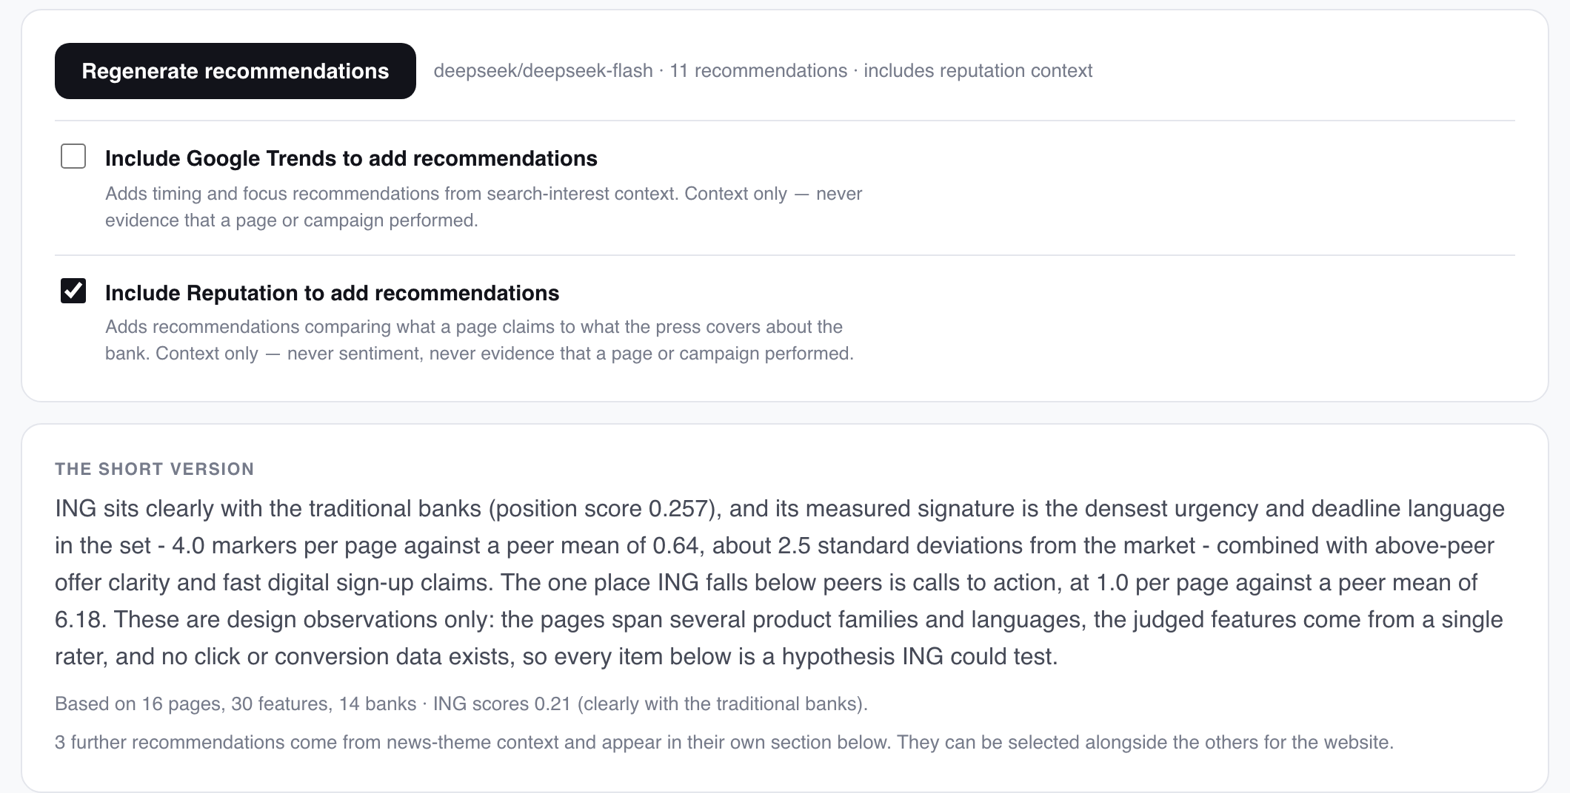
A recommendation system on top of the measurement
One model call over the finished analysis
Reads report.json only — the same numbers the charts are drawn from. This run turned 33 measured features across 14 banks into 10 ordered changes.
Ordered by priority, not by confidence
2 high, 6 medium, 2 low. The order is the argument: what the measurement most supports acting on first.
Two contexts, both opt-in and both marked
The panel as the team sees it: one button, two opt-in contexts, and the run it produced.
Search interest for timing, and news themes for reputation (3 of the 10 here). Context is never allowed to stand as evidence that a page performed.
It writes what to change. It does not re-derive a single number — that direction is one-way by design.
Banking Campaigns Comparator · ING DACI / Customer AI · September 2026
21
Notes:
FRAMING, say first: everything up to here measured. This is the one place in the project where a model is allowed to interpret; the next four slides are about how that is kept honest.
WHAT IT IS: one model call (DeepSeek, pinned version) over the finished analysis. It reads report.json — the same file the charts are drawn from. Nothing is re-scraped, nothing is re-scored.
WHAT COMES OUT: an ordered list of changes. Current run: ten — two high, six medium, two low. The order is the argument: what the measurement most supports acting on first. Ordered by priority, not by the model's confidence.
TWO CONTEXTS (checkboxes in the screenshot), both opt-in, both labelled on every card they touch: search interest for timing, news themes for reputation — three of the ten. Context can never stand as evidence that a page performed.
ORANGE BOX: it writes what to change; it never re-derives a number. One-way by design — if a figure is wrong the fix is upstream, and the next run carries it through.
NOTE: the panel screenshot and the counts printed on this slide predate the cta_count withdrawal of 23/09 (11 → 10). Say ten.
TRANSITION: here is what one of them looks like.

Slide 22
What we chose to measure, and why
• 104 declared features, 36 actually compared
Nothing is hidden in that reduction — the run prints it: 18 provenance fields that identify a page rather than describe a campaign, 4 free-text identifiers no two pages share, 8 within_language features that stop being comparable once the set spans three languages, 27 categorical or list features a euclidean distance cannot take raw, 2 missing on at least one bank, 8 identical everywhere, and 1 withdrawn because its capture is missing what it counts.
• 51 pages collected and scored, 18 compared
One product family at a time (DR-04). A mortgage page and a current-account page differ because the products differ, not because the banks communicate differently, so pooling them would confound every result with the product. The other 33 pages are scored and in the dataset, ready for the same comparison on savings or on mortgages.
• 14 Belgian retail banks, both sides of the market
Ten incumbents and four challengers, so the traditional↔challenger axis has banks on both sides of it. Belgian market only, confirmed with the client — ING.nl is out of scope, and so is professional and business banking.
• The open web, and only the open web
Public campaign pages, fetched once, robots.txt checked before every request. Social, in-app and email are out of scope and may be where a bank's real communication happens — that is a limit of this study, not of the market.
• Description, never causation
No click, conversion or performance data exists in this project, so nothing here says a design choice produced a result. Every finding is a difference, and every recommendation a hypothesis ING could test.
Scope is a decision, not a leftover: each line above is a thing we chose not to measure, and why.
Banking Campaigns Comparator · ING DACI / Customer AI · September 2026
22

Slide 23
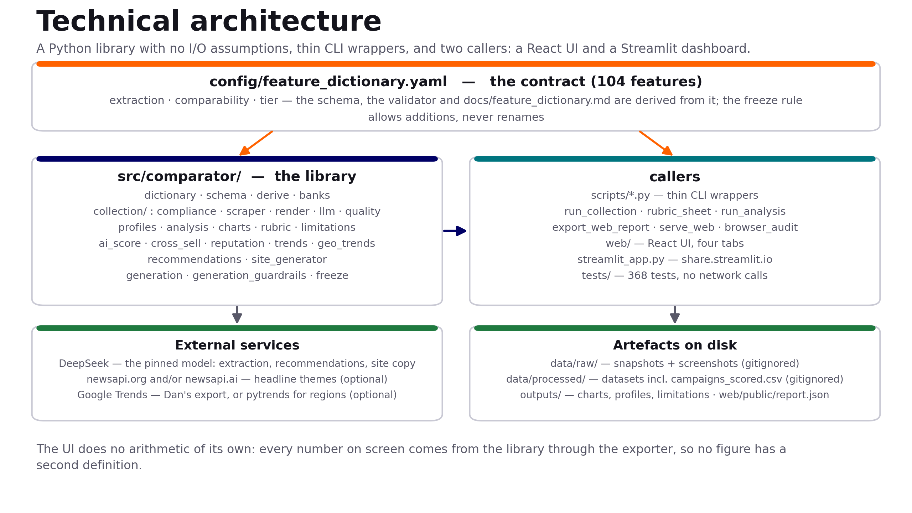
Technical architecture
A library with no I/O assumptions, thin CLI wrappers, and two callers — so no figure has a second definition.
Banking Campaigns Comparator · ING DACI / Customer AI · September 2026
23

Slide 24
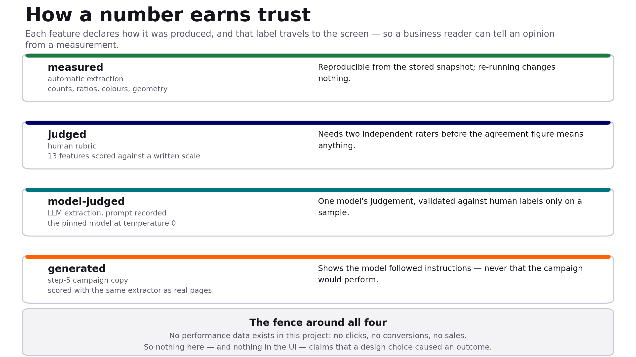
How a number earns trust
Each feature declares how it was produced, and that label travels all the way to the screen.
Banking Campaigns Comparator · ING DACI / Customer AI · September 2026
24

Slide 25
The feature dictionary is the contract
• 104 features, each declaring three things
how it was extracted (automatic / rubric / model-assisted / derived), how it may be compared, and whether it is core or extended.
• Everything else is derived from it
The dataset schema, the validator and the published feature dictionary are generated from the same YAML, so they cannot drift apart.
• The freeze rule: add, never rename
After the Day 2 freeze, columns may be added; renames and removals need all three of us, because analysis code depends on them.
• Two checks, deliberately different
A byte-equality test catches an accidental edit; the semantic freeze check catches a rename that happens to keep the bytes matching.
• It grew twice, legitimately
3 features added after the freeze, and the bank list extended to 12 values — both additions, both recorded.
Banking Campaigns Comparator · ING DACI / Customer AI · September 2026
25

Slide 26
Collection and compliance
• robots.txt is checked live before every fetch, and fails closed
If robots.txt cannot be read, the URL is treated as not allowed. Every row carries robots_allowed; the validator refuses a row where it is false.
• Pages are rendered, not just downloaded
A headless browser reads the page as a visitor sees it, which also fills the geometry features — page height, above-fold elements, image area.
• A quality gate judges the capture, not just the numbers
Two early captures passed every range check while being an empty JavaScript shell and a maintenance notice. capture_quality now travels with the row.
• When a site will not serve us, a person saves the page
BNP Paribas Fortis blocks automated traffic (HTTP 503) and Revolut's headless render is refused; the importer takes a browser-saved page, re-checks robots, and marks it manual_capture.
Banking Campaigns Comparator · ING DACI / Customer AI · September 2026
26

Slide 27
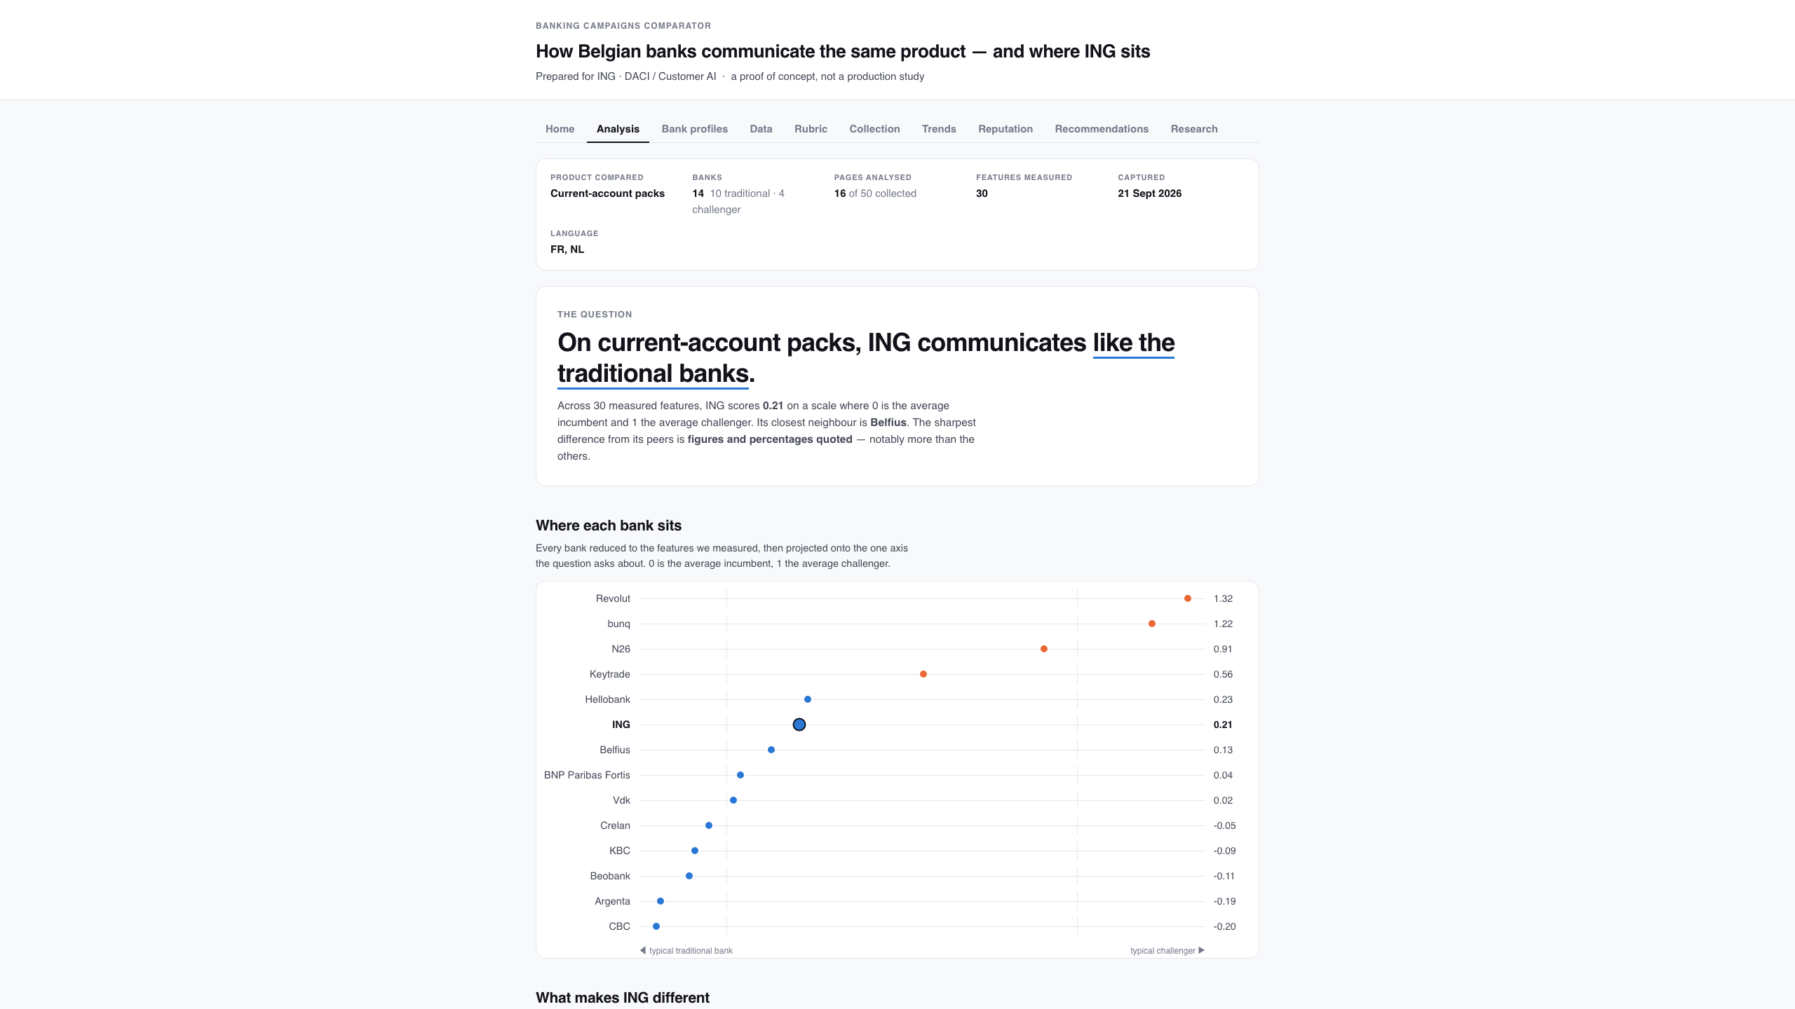
The Analysis tab
Scope, focus and the verdict above the first number — the reader cannot see a figure without seeing what it covers.
Banking Campaigns Comparator · ING DACI / Customer AI · September 2026
27

Slide 28
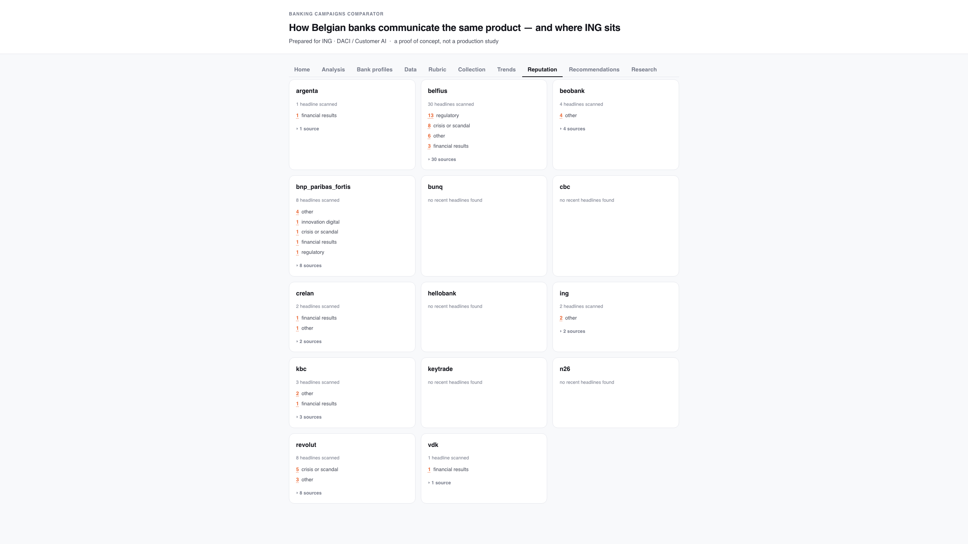
The Reputation tab: what each bank is in the news about
Headline themes — innovation, crisis, results — counted, never scored for sentiment. Two news providers are merged, in three languages.
Banking Campaigns Comparator · ING DACI / Customer AI · September 2026
28

Slide 29
Reputation: themes, not sentiment
• Sentiment scoring was out of scope; themes turn the brief's own 'reputation, innovations, crises' framing into a closed, countable list.
• Two similarly named providers are supported at once (newsapi.org and newsapi.ai); headlines from both are merged and de-duplicated.
• Every provider is queried in English, French and Dutch — Belgian bank news is mostly not in English.
• The module degrades to 'not configured' when no key is present, rather than inventing a number for a bank it has no data on.
• Themes are context about the bank, never evidence that a page or campaign performed. Asked whether reputation shows how well campaigns are doing, the honest answer is no: press coverage says what a bank is written about, not whether its page worked.
Banking Campaigns Comparator · ING DACI / Customer AI · September 2026
29

Slide 30
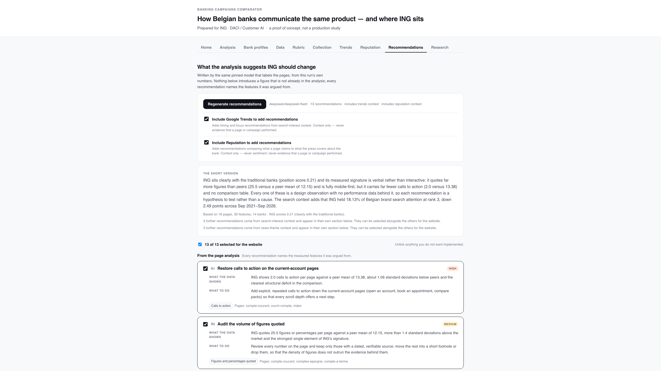
The Recommendations tab
The one place a model is allowed to opine: advice grounded in this run's numbers, each item shown next to the features it was argued from, and selectable.
Banking Campaigns Comparator · ING DACI / Customer AI · September 2026
30

Slide 31
Recommendations, and how they stay honest
• Every recommendation names the measured features it was argued from; an invented feature id is dropped before the list is shown.
• A second, opt-in group can be added from news themes (reputation context).
• The search-interest group was removed on 22/09; Trends now selects three brands on attention alone and the tab reports what their pages measurably do differently from ING's.
• A reader ticks the ones worth building; only the ticked subset reaches the site builder.
• Nothing here re-runs collection or analysis — it reads one report and writes advice.
Banking Campaigns Comparator · ING DACI / Customer AI · September 2026
31

Slide 32
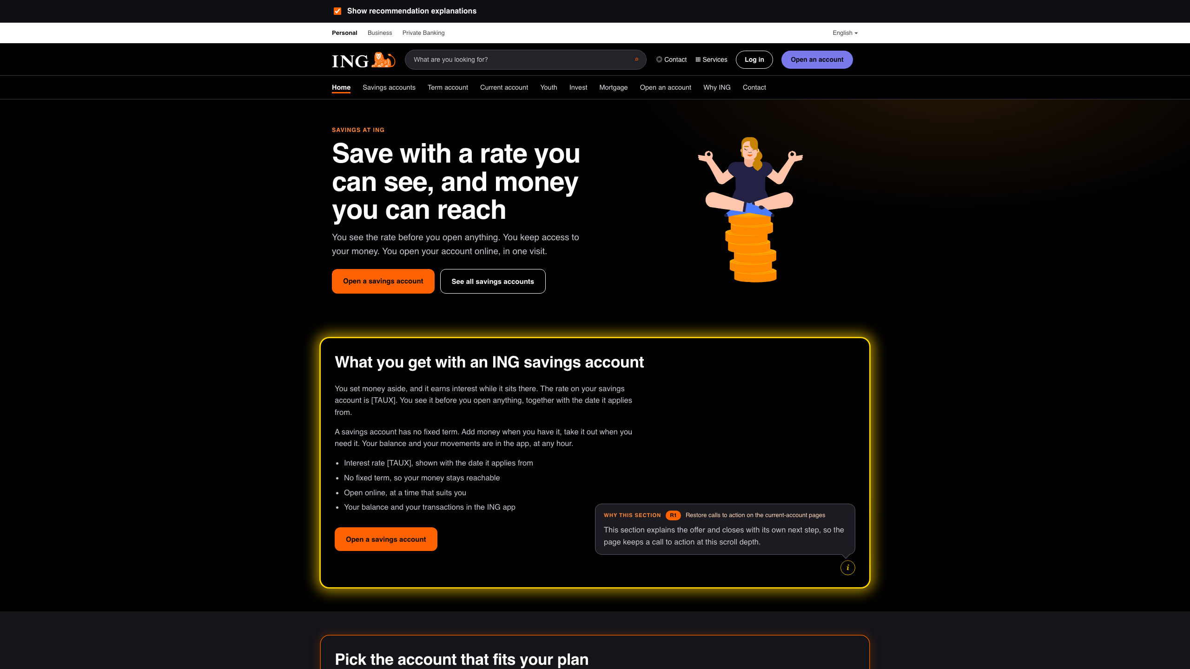
The generated ING website, with explanations on
An illustration, not a proposal for ING's site: each section that implements a recommendation is boxed, the (i) button opens the reasoning above it, and that section's glow switches to a slow yellow flicker.
Banking Campaigns Comparator · ING DACI / Customer AI · September 2026
32

Slide 33
Explanation mode: showing the work
• Tick 'Explain each section' and every generated section that acts on a recommendation is boxed, with an (i) button and a one-sentence rationale in the page language.
• Yellow flicker while an explanation is open — deliberately not ING orange, so the explanation state cannot be mistaken for the brand treatment.
• A switch above the site turns the whole layer off, and the choice is remembered across the ten pages — so the same site can be shown as a normal site.
• Every page gets at least one box; pages no recommendation targets borrow the site-wide advice that applies.
• The first explained run produced copy about the recommendations themselves, so the page prompt now forbids meta copy and confines 'why' to the rationale.
Banking Campaigns Comparator · ING DACI / Customer AI · September 2026
33

Slide 34
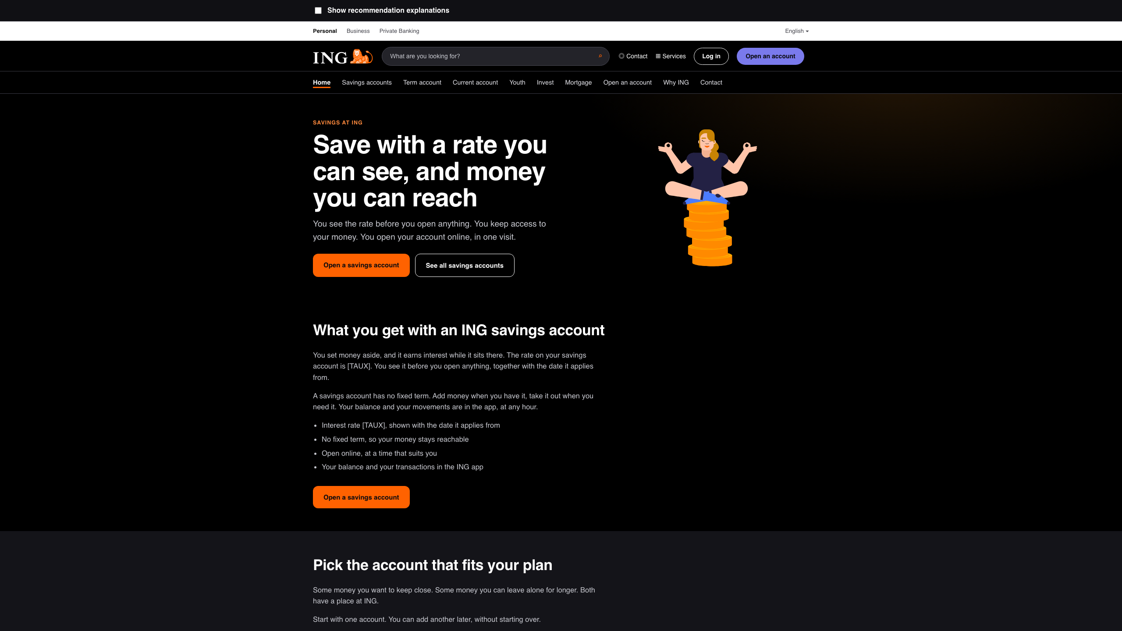
The same site, explanations off
One checkbox above the site hides every box, balloon and rationale — the identical pages, shown as a normal site.
Banking Campaigns Comparator · ING DACI / Customer AI · September 2026
34

Slide 35
The operator tabs, and what they refuse to do
• Six read-only views, moved out of the Streamlit dashboard
Home, Bank profiles, Data, Rubric, Collection and Research now render in the same UI as the findings, from one snapshot the exporter writes: operations.json.
• No pipeline control
Collection is slow and needs a job model, and the robots.txt gate must stay server-side and non-overridable — so there is no 'run collection' button in a browser.
• No dataset or dictionary editing
The dictionary is the frozen contract (P-04); a form that edited it would undo the freeze rule, and a form that edited an extracted feature would destroy its audit trail.
• No live scoring screen
The Rubric tab shows finished sheets only. A screen that displayed a rater's neighbours would make the agreement figure measure visibility, not independent judgement (NFR-05).
• One direction only
The UI does no arithmetic: every number is computed in Python and handed over already labelled, so no figure on screen has a second definition.
The Streamlit file stays in the repository for share.streamlit.io; it is no longer the only place these views exist.
Banking Campaigns Comparator · ING DACI / Customer AI · September 2026
35

Slide 36
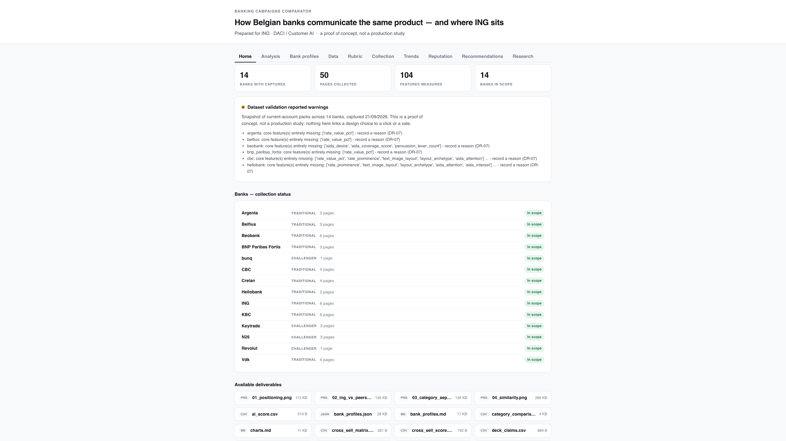
Home: what was collected, and what comes out
Four counts from the run, the validation verdict, every bank's status, and a download per deliverable.
Banking Campaigns Comparator · ING DACI / Customer AI · September 2026
36

Slide 37
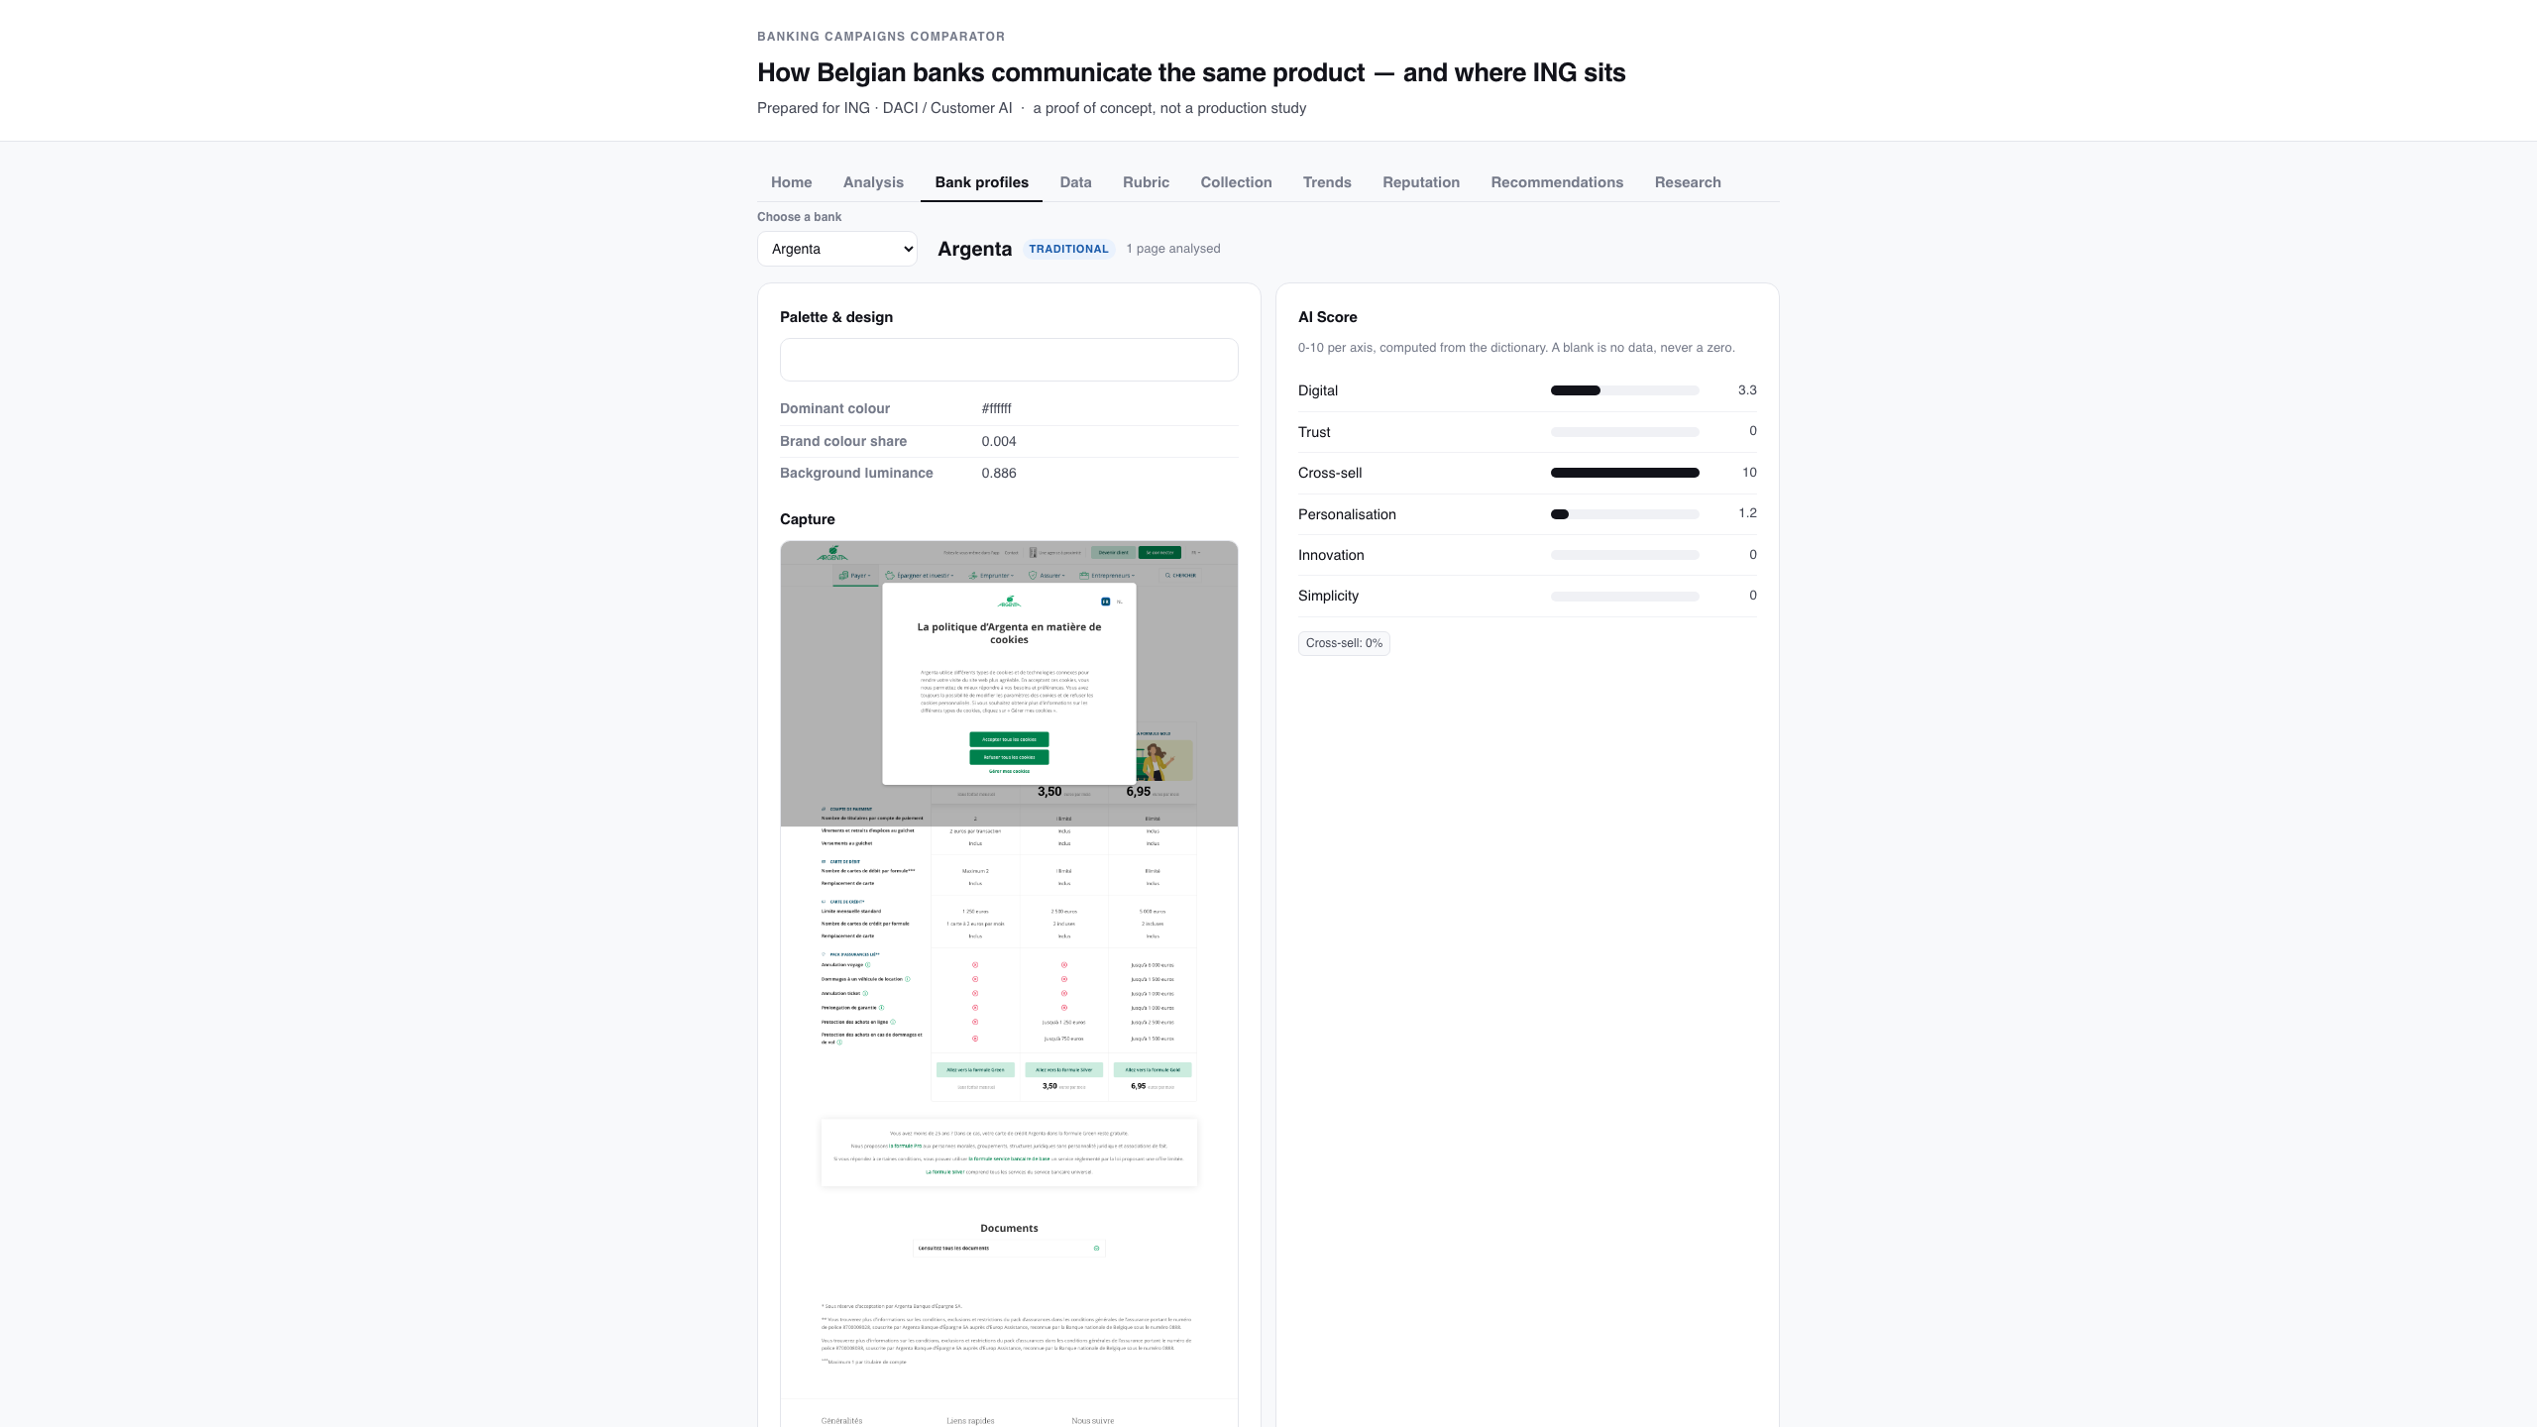
Bank profiles: one bank, every measured field
Palette, tone, imagery, layout, value proposition, the z-score signature, personas and the AI Score.
Banking Campaigns Comparator · ING DACI / Customer AI · September 2026
37

Slide 38
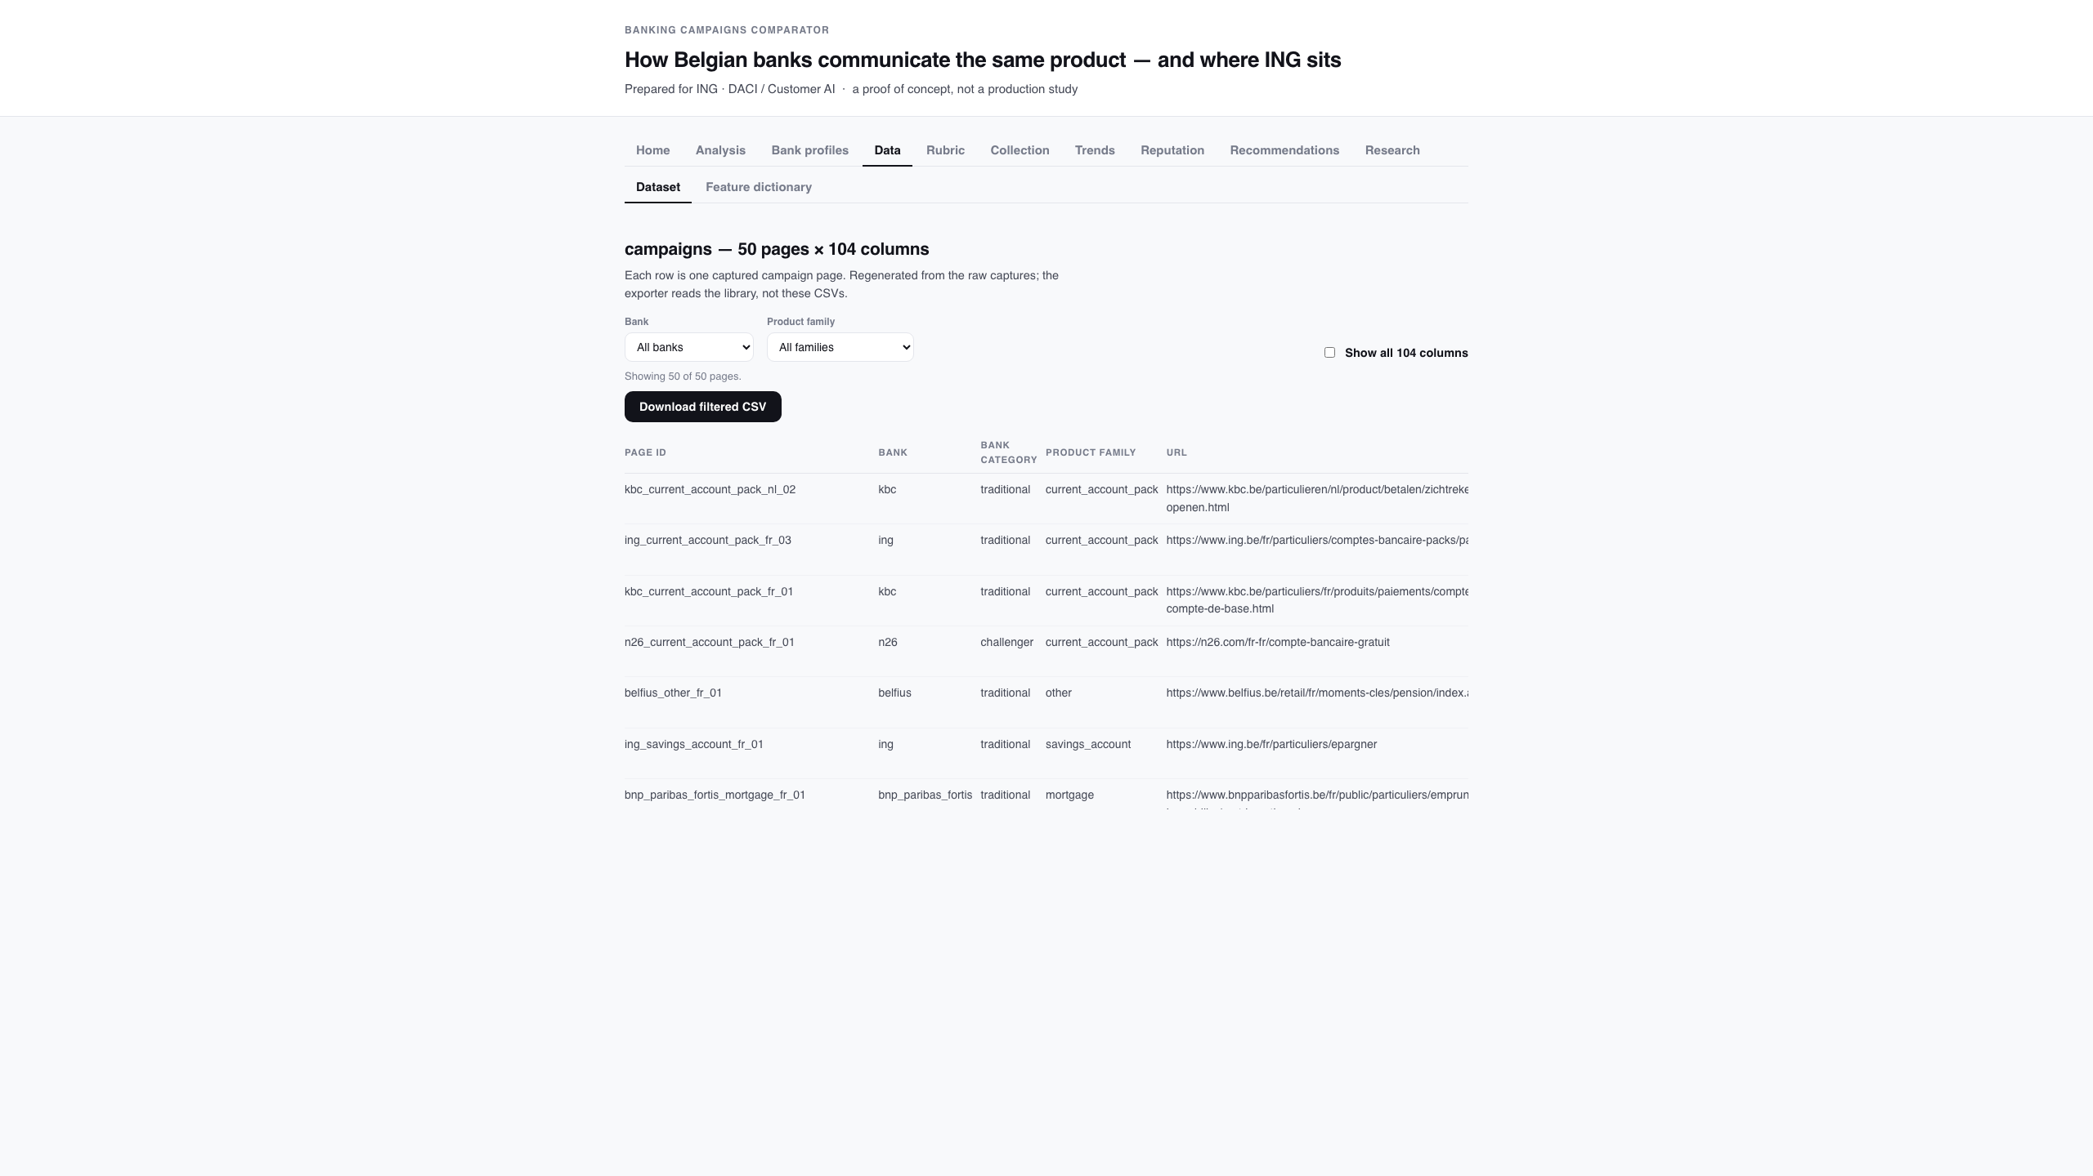
Data: the dataset and the frozen dictionary
Every capture with its provenance, filterable and exportable, read against the 104-feature dictionary.
Banking Campaigns Comparator · ING DACI / Customer AI · September 2026
38

Slide 39
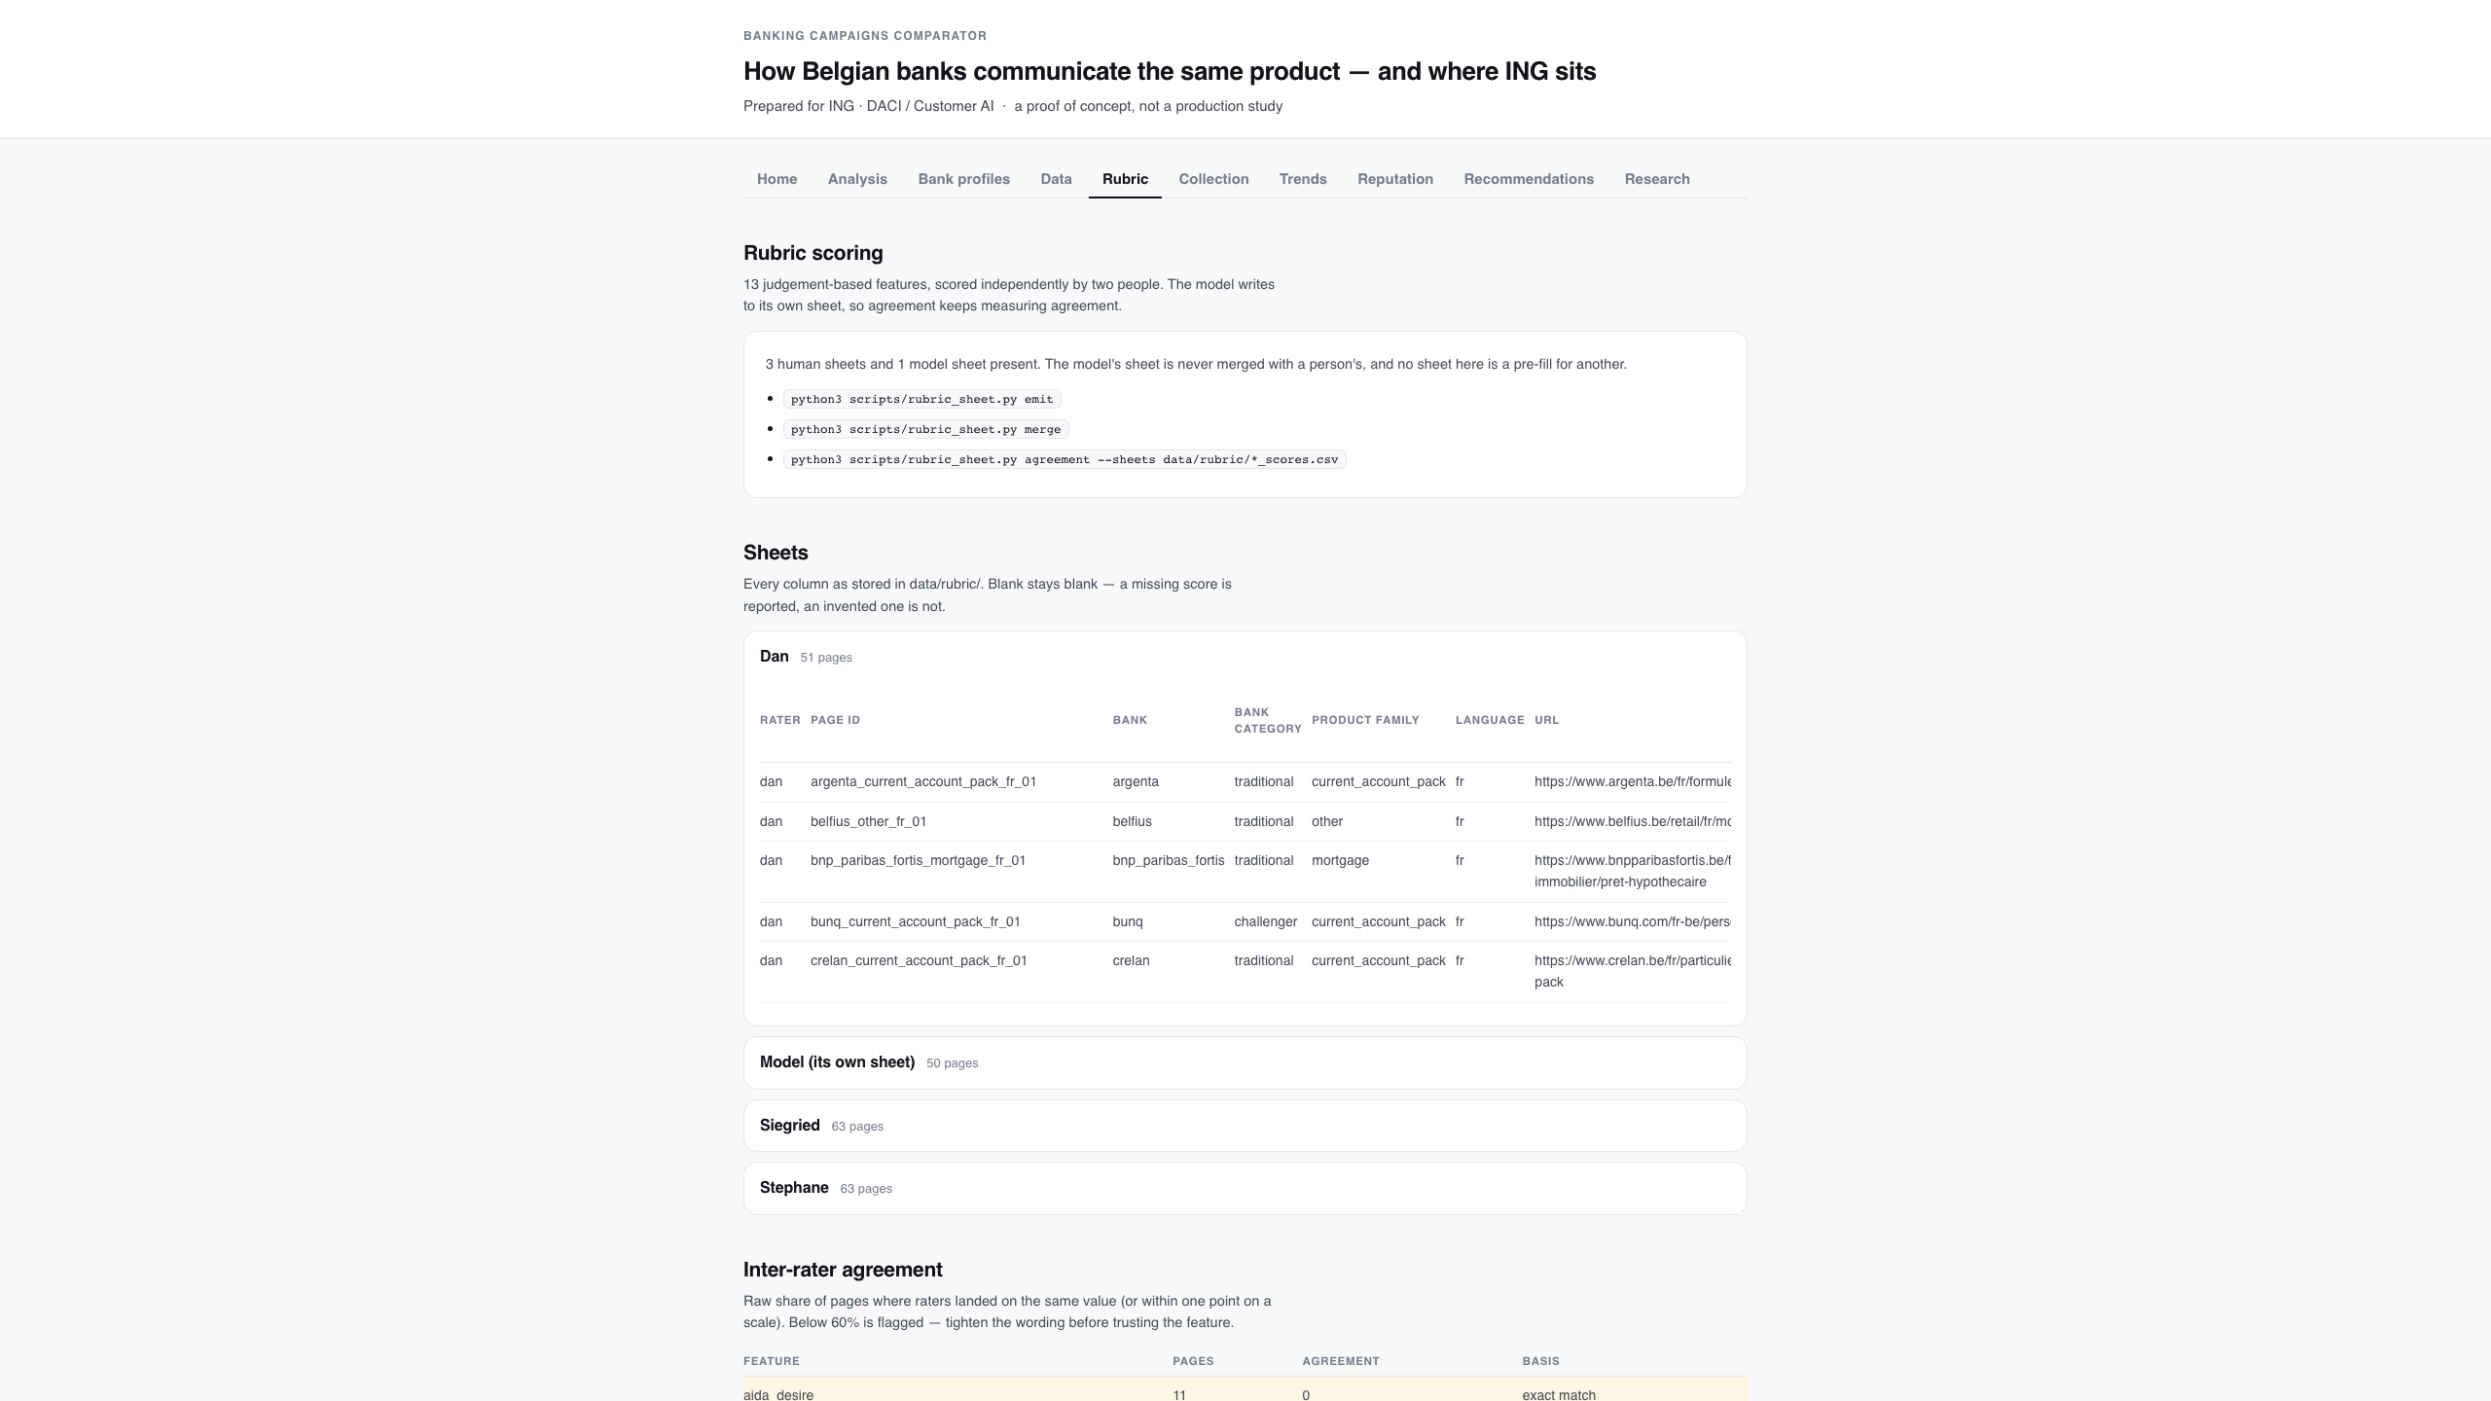
Rubric: the sheets, and where they disagree
Every sheet, raw agreement, chance-corrected kappa, and the scoring guide — never merged into one score.
Banking Campaigns Comparator · ING DACI / Customer AI · September 2026
39

Slide 40
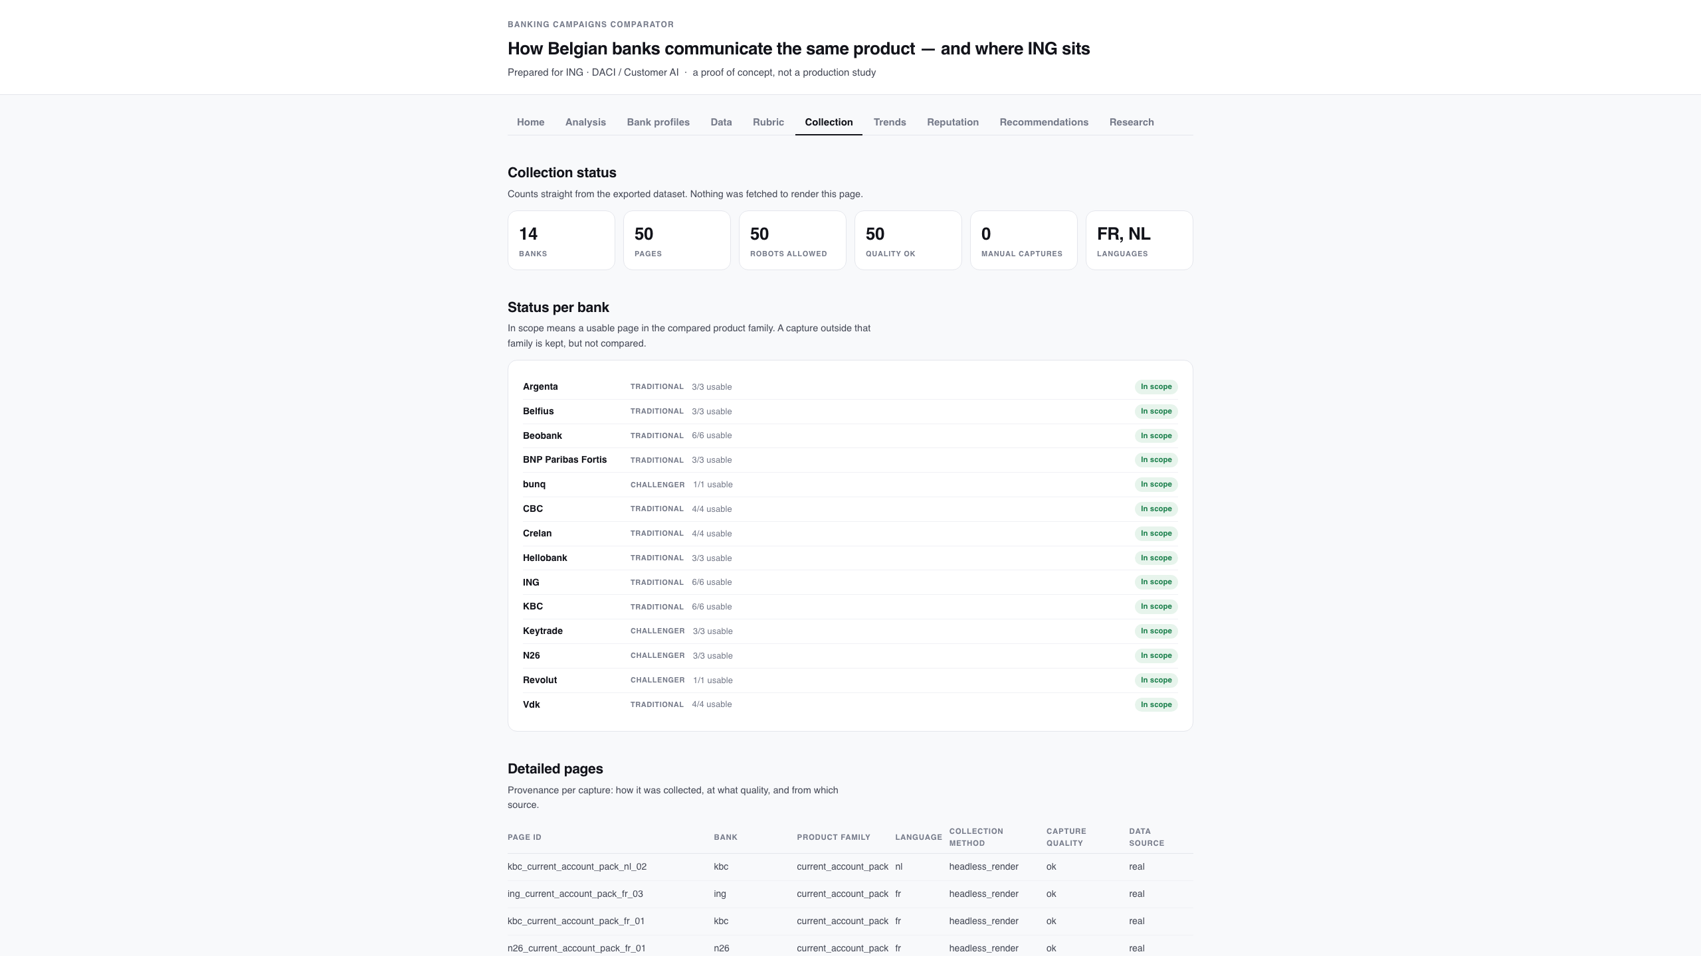
Collection: status, provenance and the pipeline
Counts straight from the export, per-bank status, capture provenance, and the commands that produced it.
Banking Campaigns Comparator · ING DACI / Customer AI · September 2026
40

Slide 41
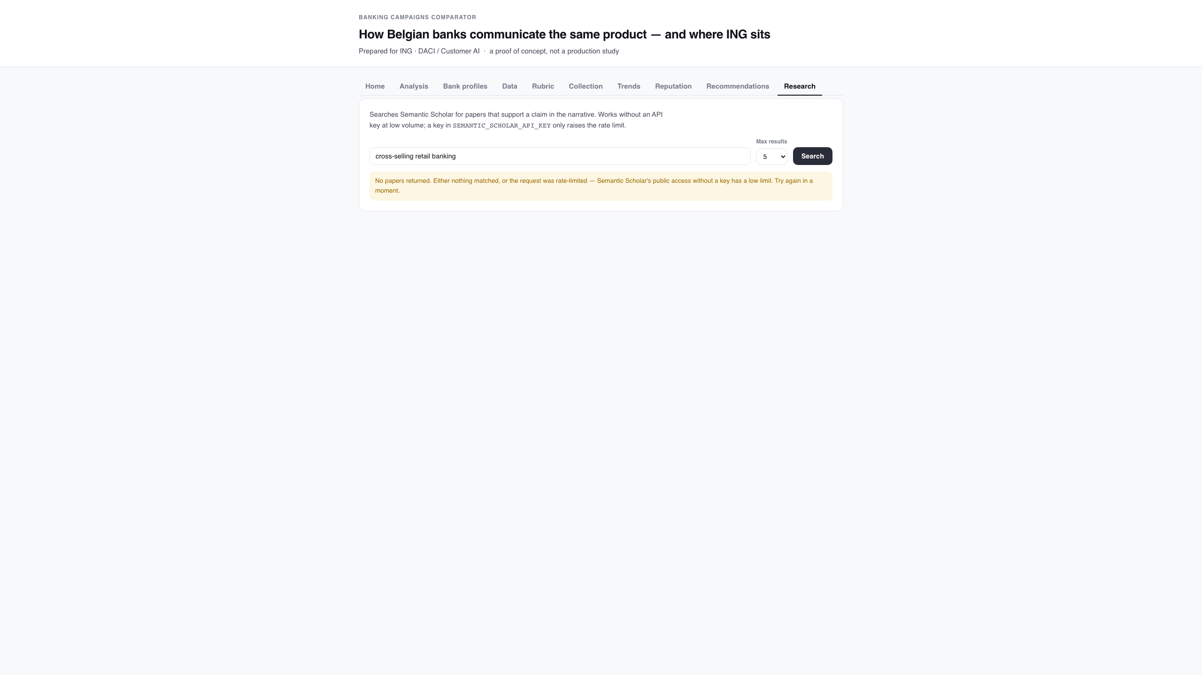
Research: sourcing a claim
Semantic Scholar, on demand. Empty is reported as empty — a rate limit must not read as 'no evidence'.
Banking Campaigns Comparator · ING DACI / Customer AI · September 2026
41

Slide 42
Roadmap
• 1. Repair the three captures taken behind a cookie banner
Re-capture the three pages taken behind a cookie banner — Argenta, BNP Paribas Fortis and Crelan — so their colour and layout features describe the page rather than the modal.
• 2. Fill the remaining sheet rows
Every bank now has its rows, including the two English pages restored on 23/09; what is missing is filled scores, not sheets.
• 3. Re-run and re-export
rubric_sheet.py merge → run_analysis.py → export_web_report.py, then re-verify the narrative's figures against the new snapshot.
• 4. Decide on outputs/ in git
It is regenerated on every run yet tracked, so each analysis leaves a large binary diff.
• 5. Then, if the team wants it
Savings, mortgage, pension, investment and term accounts are already collected (51 pages, 6 families); comparing each family the same way is the next step, plus a wider bank set.
Banking Campaigns Comparator · ING DACI / Customer AI · September 2026
42

