Slide 1
ORANGE BUSINESS
Innovation Radar Walkthrough
A guided tour of the working application — every screen, in the order somebody would actually use them, against the live corpus.
418 opportunity spaces · 11,354 signals · weight set w-2026-08-a

Slide 2
WALKTHROUGH
Seven chapters, in this order
The order is not arbitrary — each chapter uses something the one before it produced.
1
The radar, and one opportunity space
2
Role modes
Four channels on one chart, the filter rail, and every number opened up
The same data, three genuinely different rankings — and the screen says which one you are in
3
One space, full screen
4
The workflow board
Four tabs, in the order the questions arrive
Who owns this now — and the input to a plan nobody has to re-enter
5
Analytics
6
Creating a space
Where the portfolio is thin, and where the team and the evidence disagree
Two routes in, and one gate the corpus holds
7
The Planner
Which set, in what order, and what it earns
Orange Business · Innovation Radar · walkthrough
2

Slide 3
CHAPTER 1
The radar, and one opportunity space
Four channels on one chart, the filter rail, and every number opened up

Slide 4
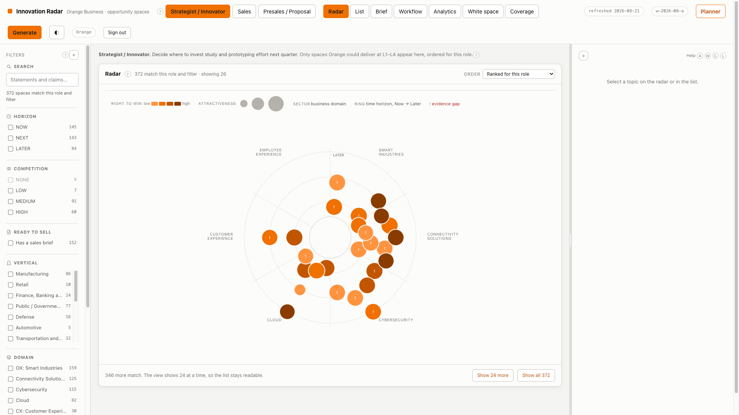
WALKTHROUGH
The radar
Four channels at once, no legend to study
Angular sector is the domain
Six sectors around the circle. Position carries identity, which frees colour to carry a quantity instead.
Distance from the centre is time
Now in the middle, Later at the rim. A topic drifts inward as its evidence matures.
Size is attractiveness; colour is right to win
The two questions the radar exists to answer, visible in one glance and never combined into a single number.
A ! inside a marker is an evidence gap
Orange has few or no published references in that vertical. A glyph as well as a colour, so the warning never depends on colour alone.
Orange Business · Innovation Radar · walkthrough
4

Slide 5
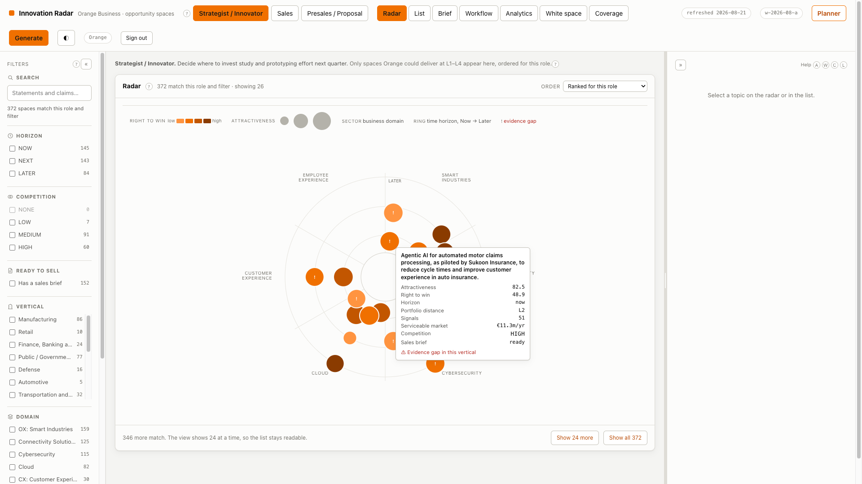
WALKTHROUGH
One space, at a glance
Four questions answered without a click
The statement, not a keyword
Specific enough to open a customer meeting with. “AI” and “cloud” fail validation as topics; this is the bar.
Both scores, side by side
Attractiveness and right to win are shown as two numbers because they answer two questions owned by two different people.
Horizon, portfolio distance, signal count
L0 means an existing offer already covers it. L4 is white space. That one number decides whose conversation this is.
Serviceable market and competition
Both computed, both filterable — a number the radar computes but cannot be sorted on is a number nobody uses.
Orange Business · Innovation Radar · walkthrough
5

Slide 6
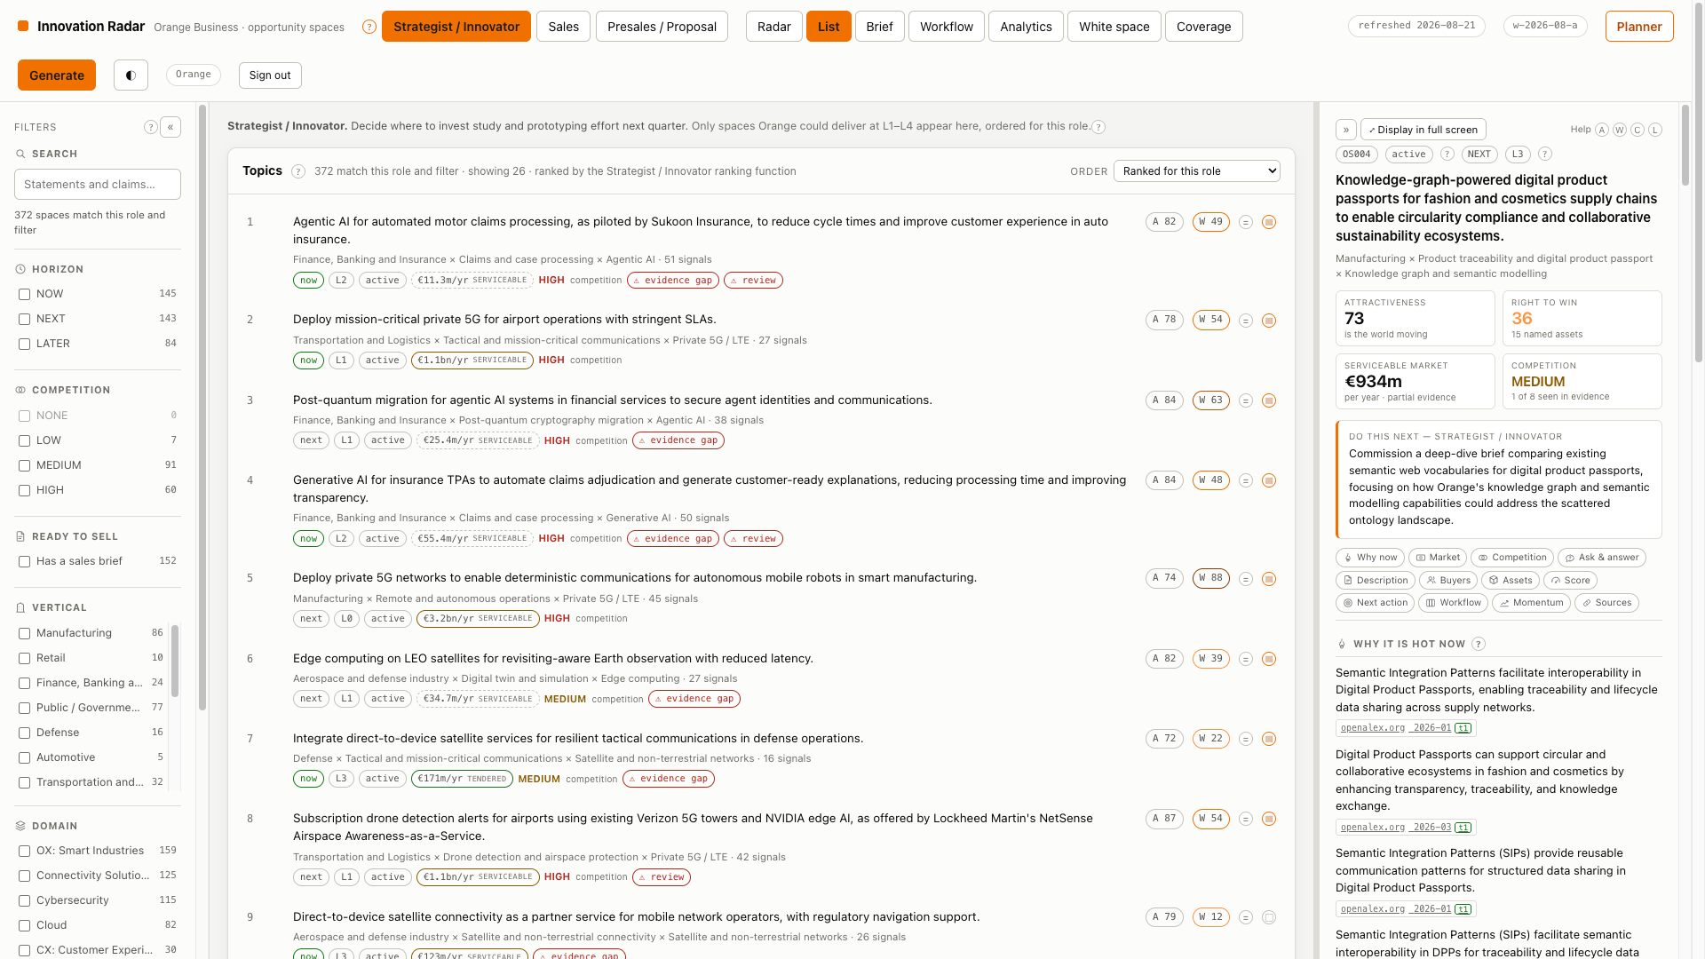
WALKTHROUGH
The filter rail and the list
Multi-select, and the counts are real
Counts cover the whole set, not the page
Not over the page. “CISO: 0” once meant “none on this screen” while 37 matched — the facets are now server-computed.
Filters that answer a question
Horizon, competition band, has-a-sales-brief, vertical, use case, technology, portfolio distance, evidence gap.
The list is the same data, ranked
Same corpus, same scores. What changes between the radar and the list is only what you can scan quickly.
Any view is a link
Role, tab, filters, sort and selection are all in the address bar, so a prepared view can be sent to a colleague.
Orange Business · Innovation Radar · walkthrough
6

Slide 7
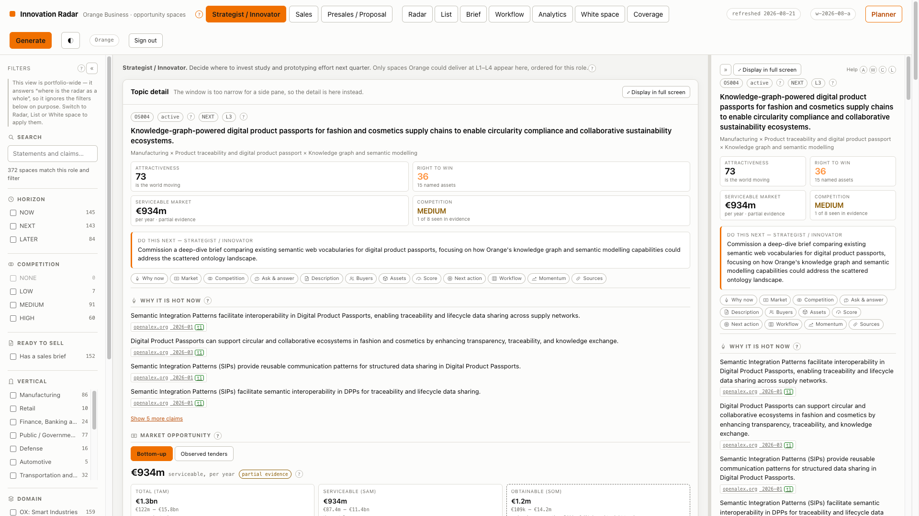
WALKTHROUGH
The detail pane
In the order the questions arrive
What is it, and why now
Each claim carries the signal identifiers it was written from. An uncited claim is removed rather than rewritten.
Where the value lands, and for whom
The buyer, the trigger, and the job the technology does — not a description of the technology.
Can we play, can we win
Itemised against named Orange offers, references, partners and certifications. Query results, never a model's assertion.
The next action, for this role
Different per role, because a strategist and a salesperson do not do the same thing with the same topic.
Orange Business · Innovation Radar · walkthrough
7

Slide 8
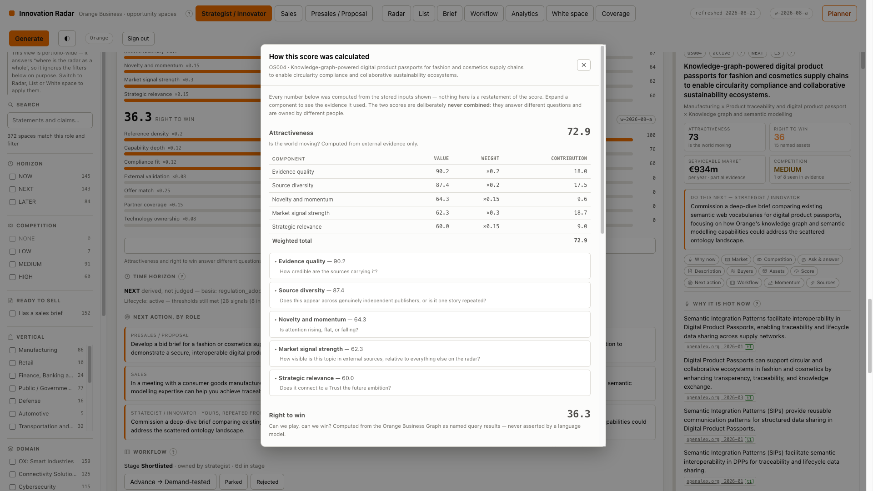
WALKTHROUGH
How this score was calculated
Checkable, rather than asserted
The weight table and the total
Every component with the arithmetic that produced it, not a tooltip saying the score is “based on” something.
The evidence behind each component
Publisher entropy and the publishers counted, the tier distribution, the periods the momentum slope was fitted to.
The reproducibility stamps
Weight set, pipeline, prompt and model version. A number you cannot re-derive is not explained — only displayed.
Reachable wherever a number appears
The detail pane, every list row and the workflow board, and it deep-links.
Orange Business · Innovation Radar · walkthrough
8

Slide 9
CHAPTER 2
Role modes
The same data, three genuinely different rankings — and the screen says which one you are in

Slide 10
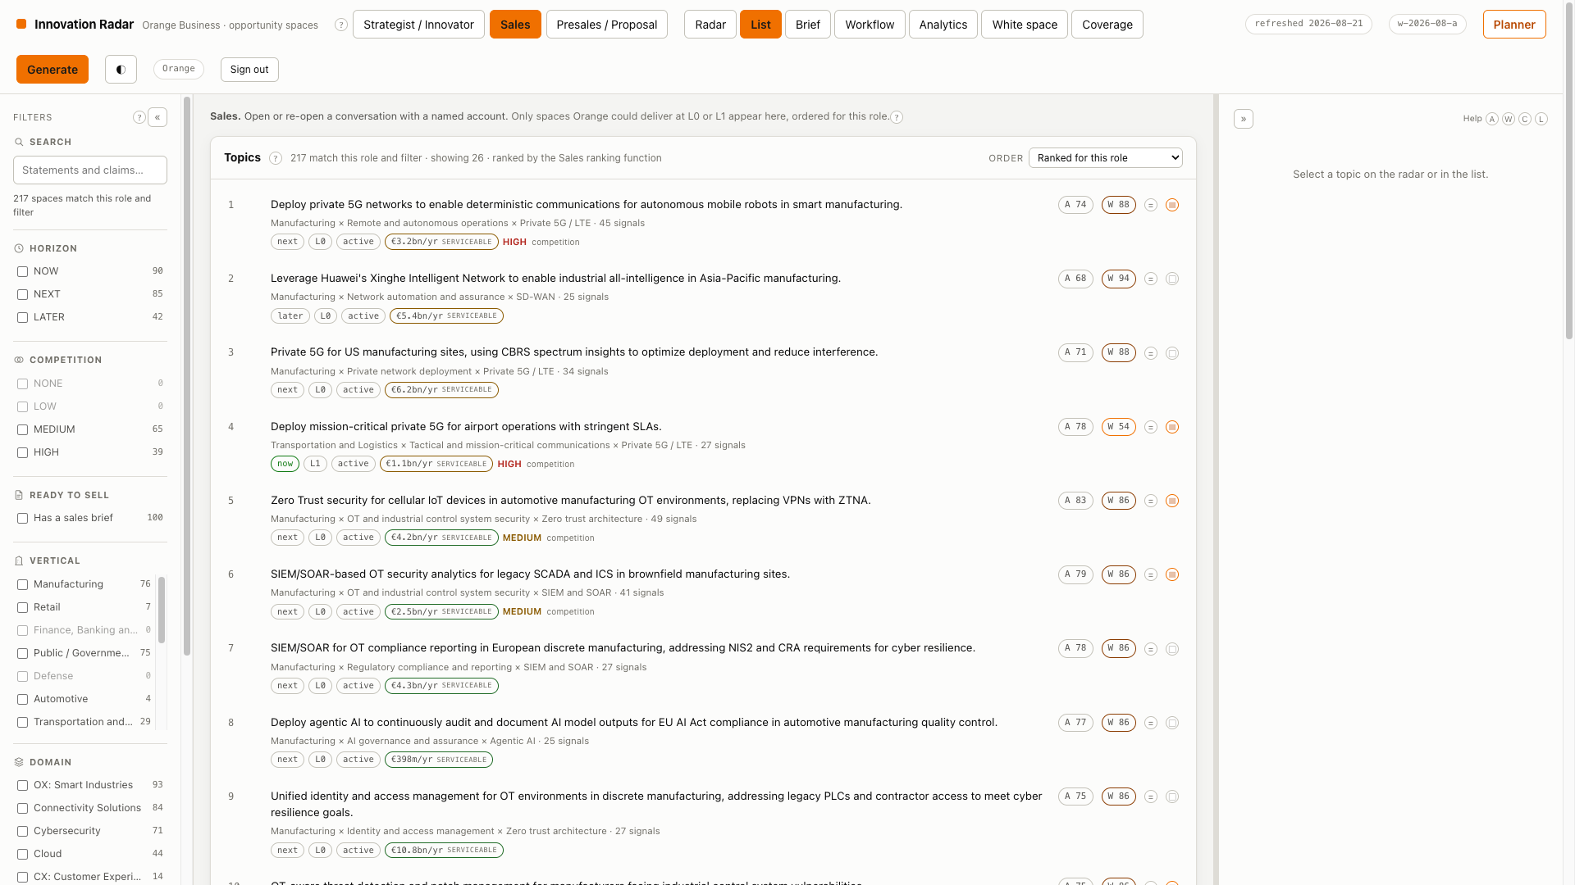
WALKTHROUGH
Three role modes
They fall out of portfolio distance
The instruction line, on every screen
“Strategist / Innovator. Decide where to invest study and prototyping effort next quarter.” The screen says which question it is answering.
Strategist sees L1–L4
Ranks on attractiveness and novelty. Low right-to-win is a flag, not a penalty — white space is the point.
Sales sees L0–L1 only
Ranks on right to win and proof-point density, and only shows topics with a delivery path, a published reference in the vertical, and no evidence gap.
Presales sees L0–L2
Ranks on differentiation: where Orange has assets and the market has few credible providers.
Orange Business · Innovation Radar · walkthrough
10

Slide 11
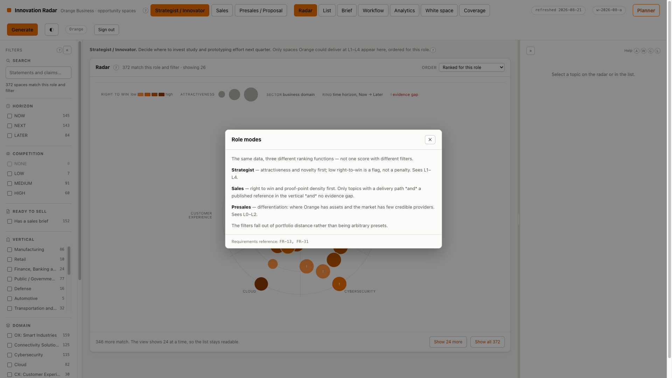
WALKTHROUGH
Why the roles differ
Every dense concept explains itself
The same data, three ranking functions
Not one score shown through three filters. Each role has its own weighted blend, and the blend is configuration, not code.
A high-attractiveness L4 topic
Is exactly the strategist's innovation agenda — and exactly what a salesperson should never be shown, because there is nothing to sell.
Help says what, why, and which requirement
So the answer is checkable rather than merely confident. One registry, so the explanation and the behaviour cannot drift apart.
Orange Business · Innovation Radar · walkthrough
11

Slide 12
CHAPTER 3
One space, full screen
Four tabs, in the order the questions arrive

Slide 13
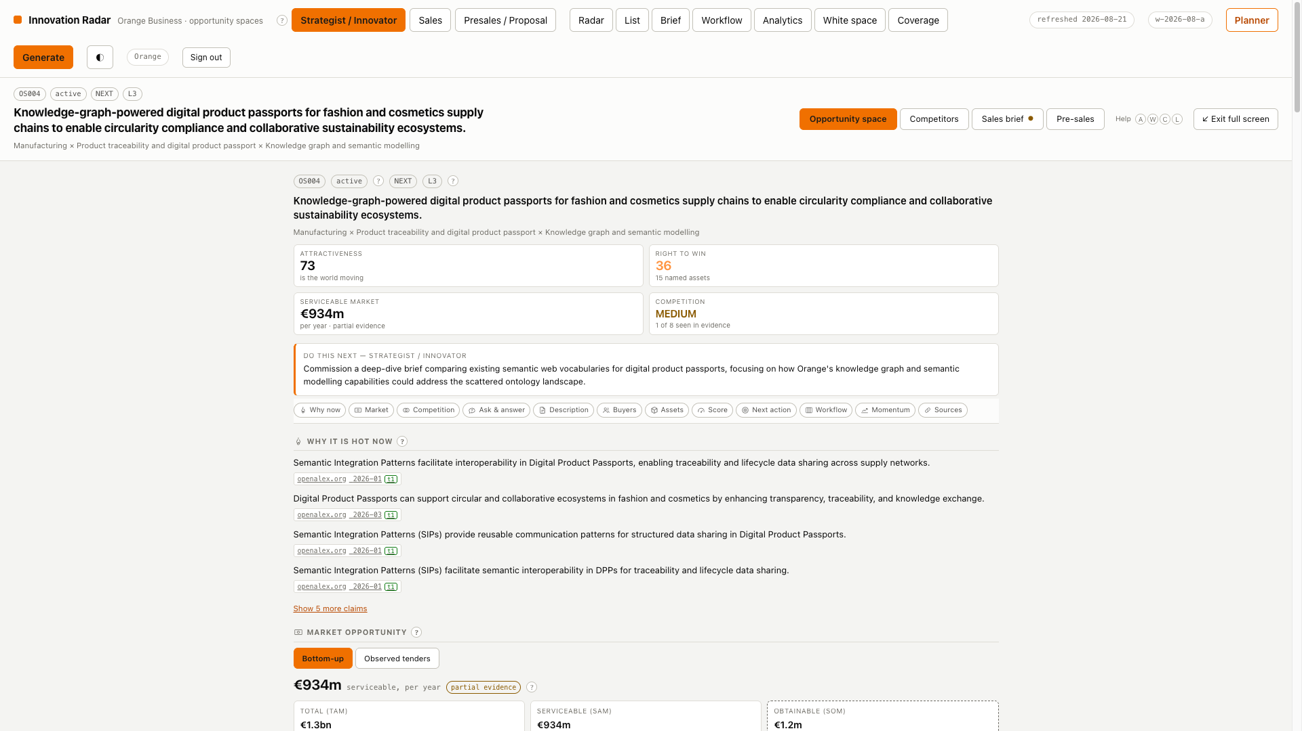
WALKTHROUGH
Tab 1 — the opportunity space
The same content with the panes out of the way
Why full screen exists
The three-pane layout is right for working THROUGH the radar. It is wrong for the moment somebody reads a space: ten sections in a 420px column.
Everything the space knows
Statement, triple, both scores, sizing with its working, competition, evidence timeline, links, stage, and the delete.
Escape returns you to the radar
With the selection, filters and role intact, because the address bar carried them the whole time.
Orange Business · Innovation Radar · walkthrough
13

Slide 14
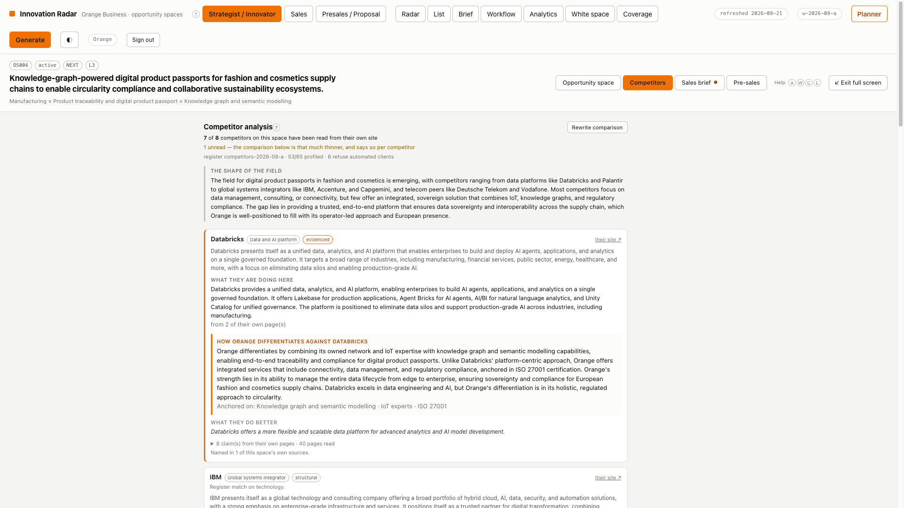
WALKTHROUGH
Tab 2 — competitors
Who else is here, and what we say
A named field, not just a band
The band is on the space; this is per competitor: what they say they sell here, from pages they published, each claim carrying the page.
A differentiation angle per competitor
And a paragraph naming an Orange asset the graph does not hold is stripped, while the half describing the competitor survives.
A refusal is marked, not omitted
Not omitted. A gap in the register is reported as a gap rather than read as “no competitor found”.
Orange Business · Innovation Radar · walkthrough
14

Slide 15
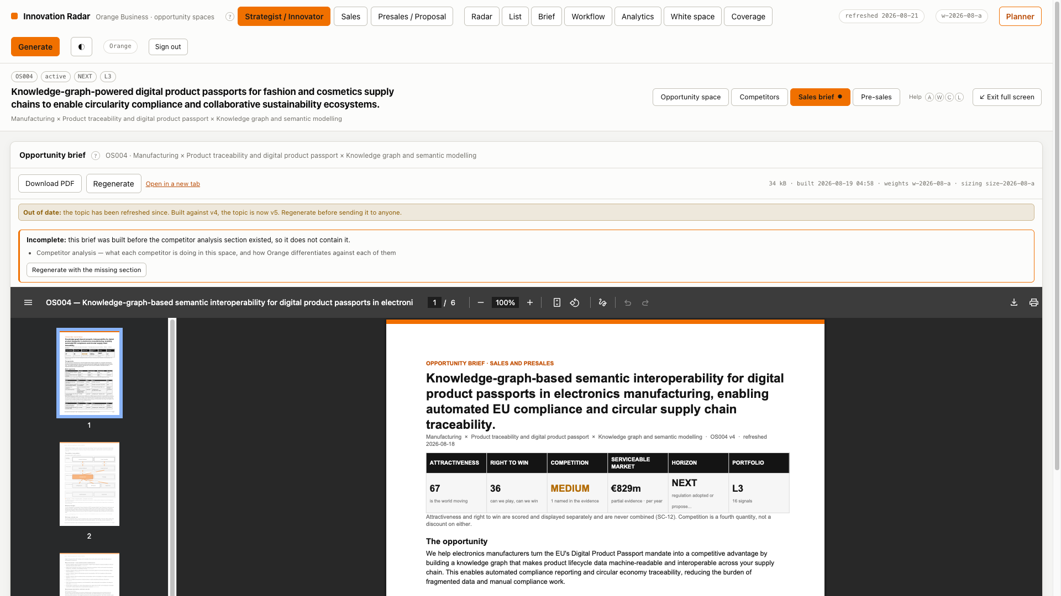
WALKTHROUGH
Tab 3 — the sales brief
The meeting PDF, rendered in place
Six pages, every figure stamped
Weight set, sizing version, prompt and model version on the last page, so a brief can be checked against the run that produced it.
It knows when it is out of date
The topic has been refreshed since this was built, and the banner says so. That is why the brief sits beside the space rather than behind a download.
Incomplete is not the same as stale
A stale brief was correct when built. An incomplete one never had a section that current briefs carry — and waiting does not fix it.
Orange Business · Innovation Radar · walkthrough
15

Slide 16
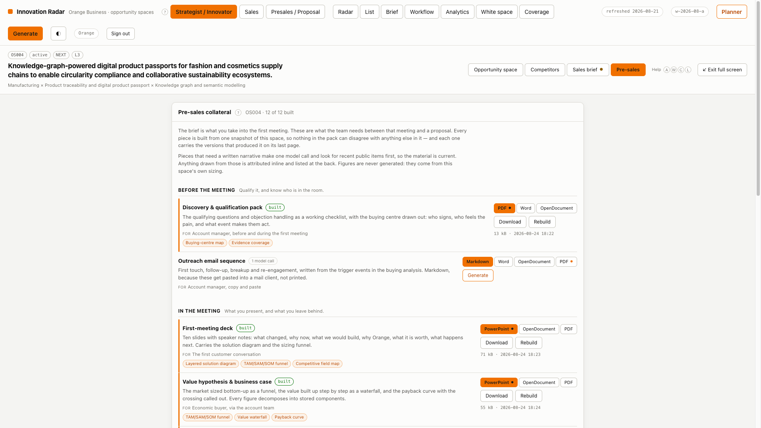
WALKTHROUGH
Tab 4 — pre-sales collateral
For the work between meeting and proposal
All twelve are listed, built or not
What COULD be produced is as much of the answer as what has been, and a screen that starts empty is one nobody presses a button on.
Grouped by when they are used
Before the meeting, in the meeting, after it, and in the bid — qualification, battlecards, a solution outline, tender blocks, a risk register.
The format is your choice, per piece
PDF, Word or OpenDocument for documents; PowerPoint, OpenDocument or PDF for decks. Asking for Word after the PDF gives you both.
Built from ONE snapshot of the space
So nothing in a pack can quote a different market size from anything else in it.
Orange Business · Innovation Radar · walkthrough
16

Slide 17
CHAPTER 4
The workflow board
Who owns this now — and the input to a plan nobody has to re-enter

Slide 18
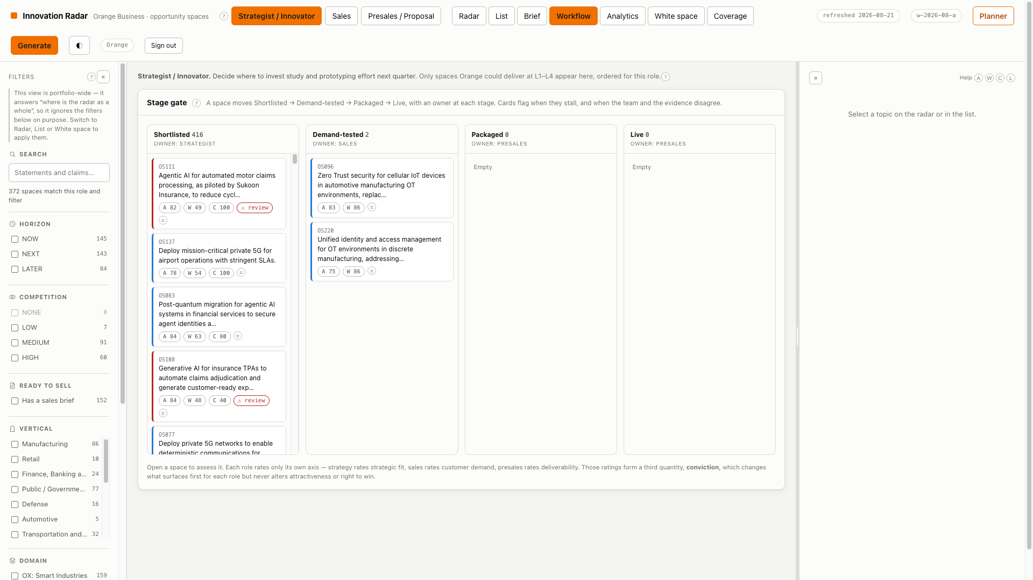
WALKTHROUGH
The stage gate
Shortlisted → Demand-tested → Packaged → Live
Ownership follows the stage
Strategist, then sales, then presales. Every transition records who moved it and why.
Stalled cards are flagged
Latency is the known weakness of a stage gate — a topic dies waiting for its owner — so age-in-stage is computed rather than left to be noticed.
Each role rates only its own axis
0–5 with written anchors. Those ratings become conviction, which changes what surfaces first and never touches either score.
This board is an input to the Planner
Everything past Demand-tested can be planned directly — chapter 7 uses exactly this, as a portfolio the business already committed to.
Orange Business · Innovation Radar · walkthrough
18

Slide 19
CHAPTER 5
Analytics
Where the portfolio is thin, and where the team and the evidence disagree

Slide 20
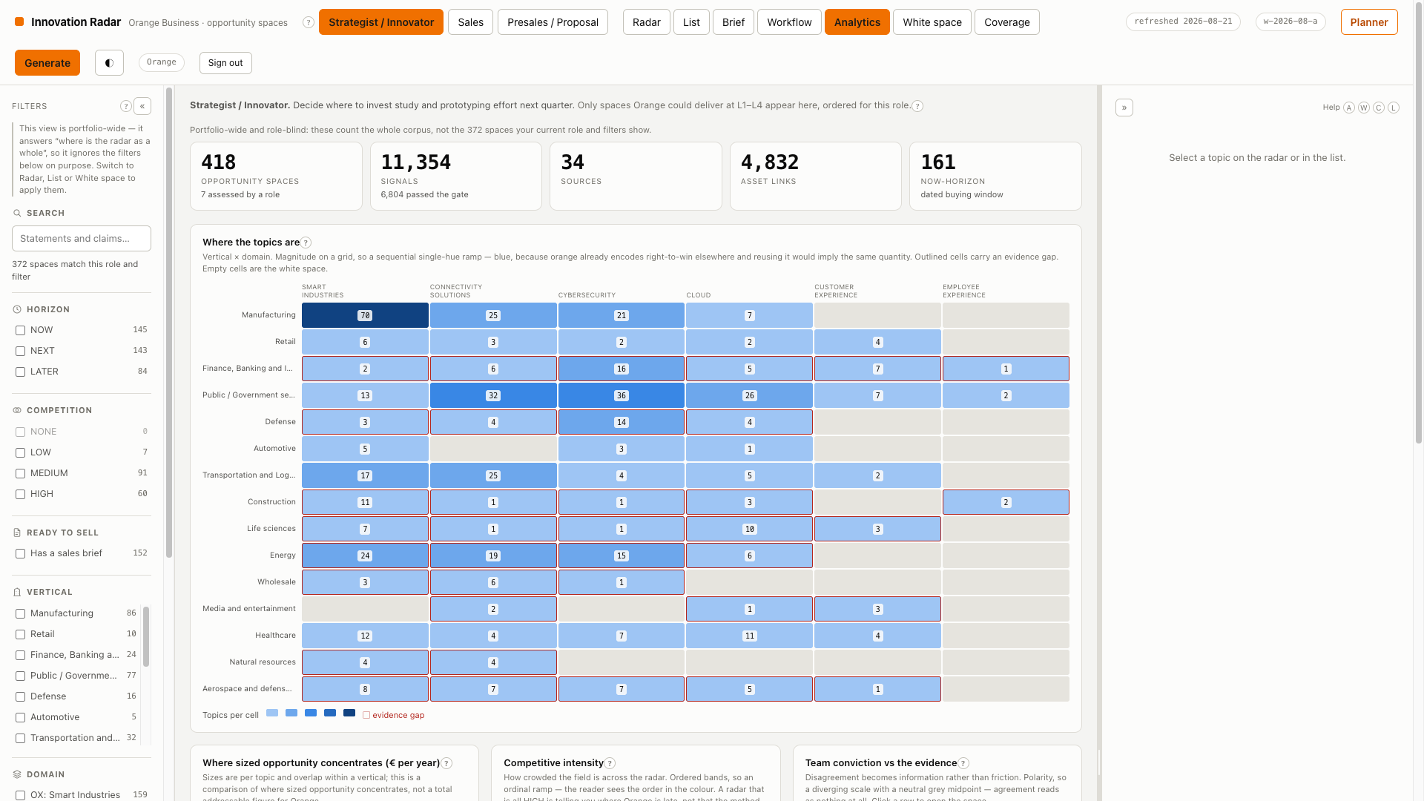
WALKTHROUGH
Analytics
Charts chosen by the job the data does
Vertical × domain is magnitude
So it is sequential, and blue — orange already means right to win, and reusing it would imply the same quantity.
Conviction vs evidence is polarity
So it is diverging with a neutral midpoint: agreement reads as nothing, and only disagreement draws the eye.
The stage funnel is ordered
So it is ordinal. Only the signal-type mix is genuinely categorical, and it ships a legend and a table.
What it is for
Where the portfolio is thin, where the team and the evidence disagree, and how much of the grid has evidence at all.
Orange Business · Innovation Radar · walkthrough
20

Slide 21
CHAPTER 6
Creating a space
Two routes in, and one gate the corpus holds

Slide 22
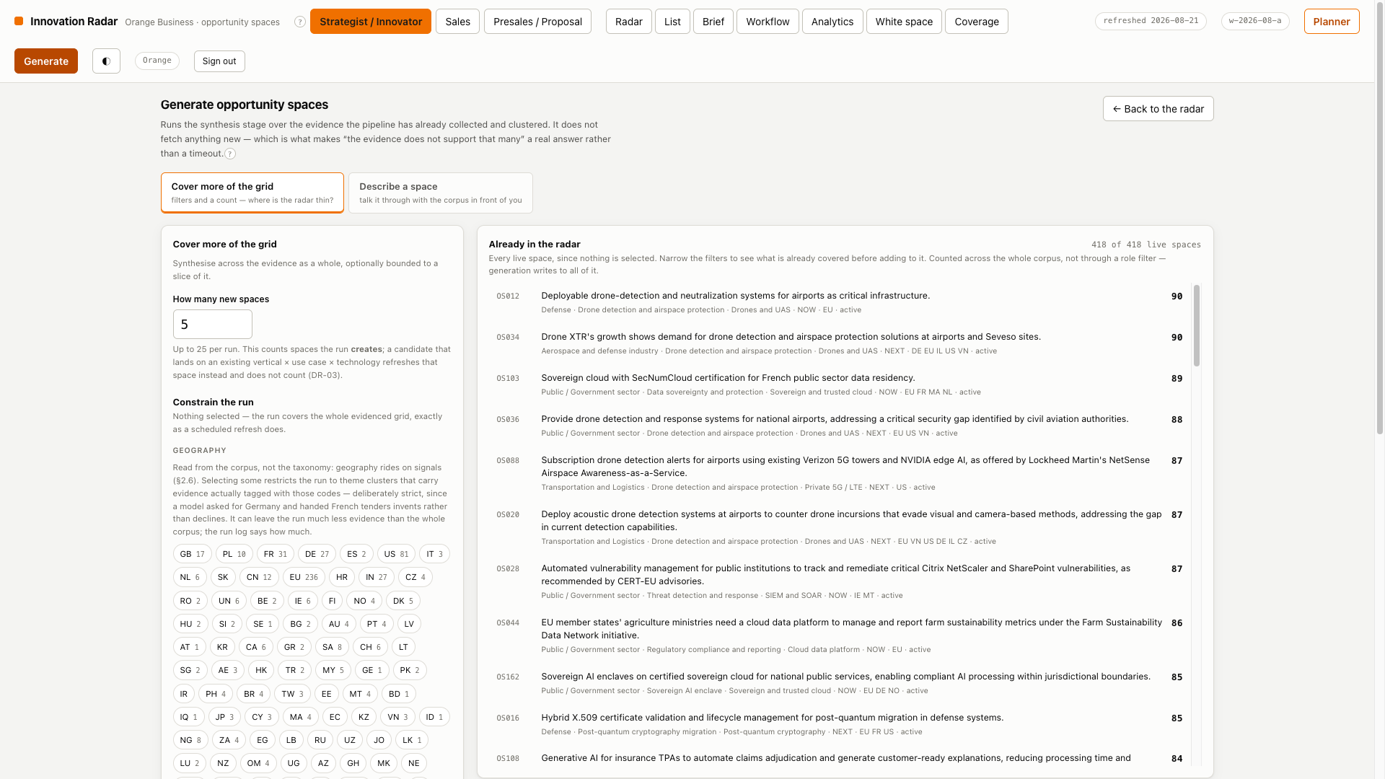
WALKTHROUGH
Route 1 — parameters
For somebody who knows the taxonomy
Pick the cell you want covered
A vertical, a use case, a technology, a horizon — and the screen counts how much evidence is behind that combination before you spend anything.
It shows what ALREADY matches
The most common outcome of an on-demand run is rediscovering what the last refresh produced, and finding that out afterwards costs four model calls.
The same pipeline, the same guards
A space created here goes through the identical evidence binding, closed vocabulary, no-generated-numbers and entailment checks.
Orange Business · Innovation Radar · walkthrough
22

Slide 23
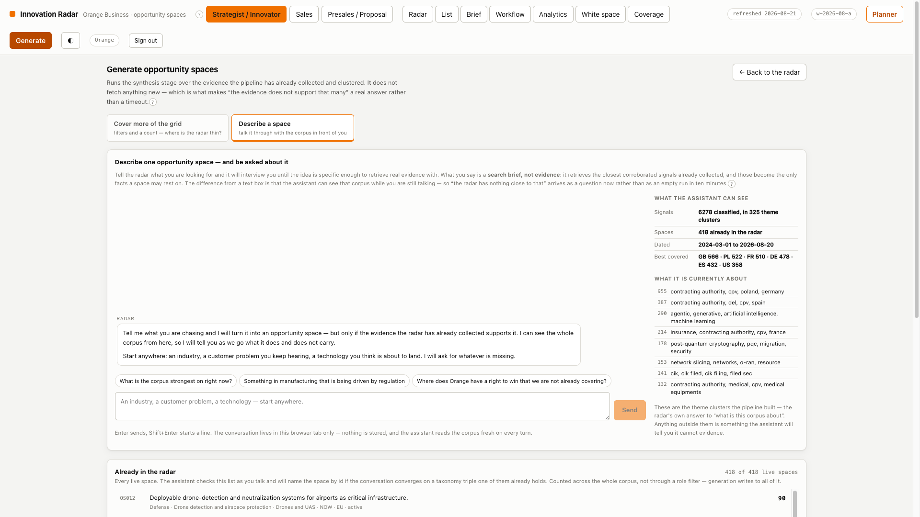
WALKTHROUGH
Route 2 — a scoping conversation
For somebody who knows their market
The assistant interviews, corpus in hand
Every turn re-embeds the whole transcript against the same signal vectors the run will read, and shows what came back beside the answer.
Publisher, date and cosine, per signal
So the conversation is about evidence rather than about phrasing, and an answer that sharpens the idea sharpens the next question.
The corpus enables the button
Asked “do you have enough?” a model says yes. A brief must clear the run's own retrieval floor AND be corroborated on its use case or technology.
A refusal comes before the spend
Not after. And where a brief cannot be run, the contributed-evidence route opens instead — the path that can actually build it.
Orange Business · Innovation Radar · walkthrough
23

Slide 24
CHAPTER 7
The Planner
Which set, in what order, and what it earns

Slide 25
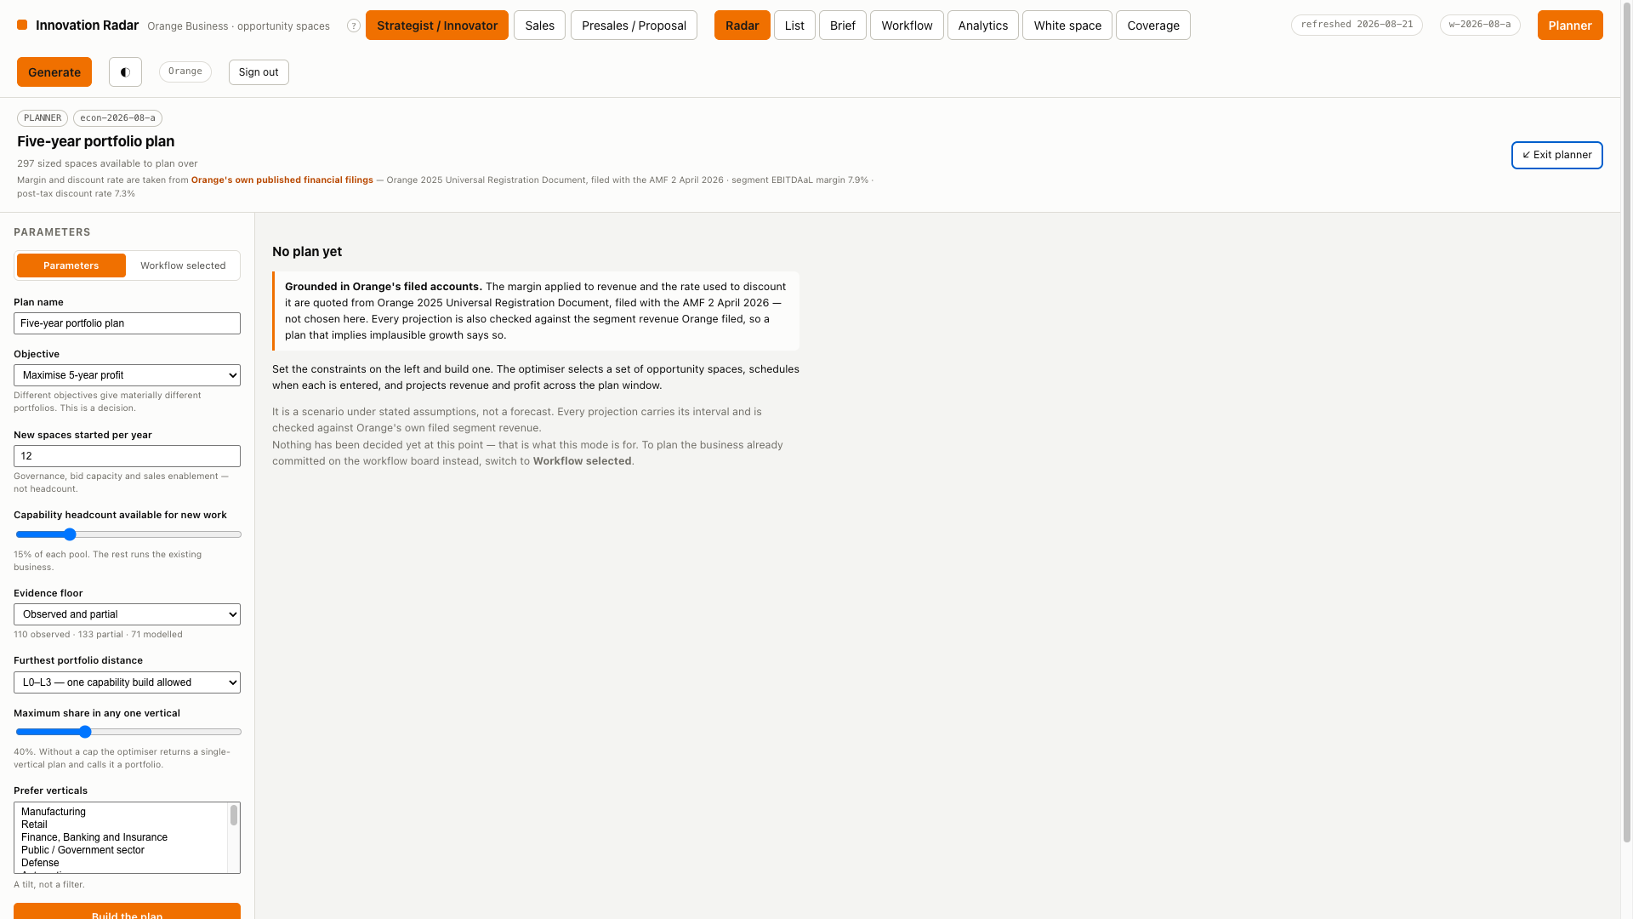
WALKTHROUGH
Source 1 — parameters
State the constraints; it chooses the set
A ranked list cannot answer this
It assumes you can take the top N, and you cannot — not 400 spaces at once, and not twelve in one vertical.
The constraints you would state aloud
Entry slots per year, capability headcount available for new work, an evidence floor, a distance cap, a concentration cap, a horizon mix.
Selection and projection are arithmetic
No model call, so it is immediate. The written business plan is a separate step, and it may not introduce a figure.
A different objective, a different set
Profit, revenue, NPV or strategic coverage. That is a decision, and the screen says so rather than defaulting silently.
Orange Business · Innovation Radar · walkthrough
25

Slide 26
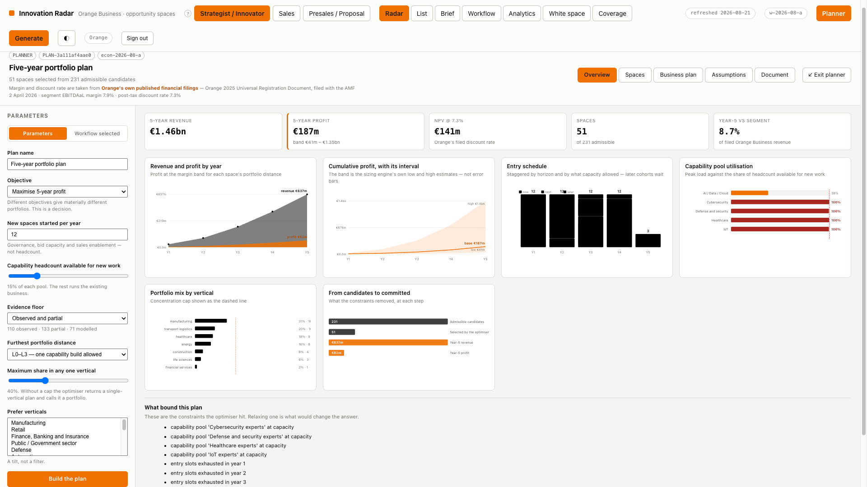
WALKTHROUGH
What the plan reports
Including which constraint bound it
Revenue and profit, with the band
The interval is the sizing engine's own low and high estimates, not error bars invented for the chart.
The entry schedule
Staggered by horizon and by what capacity allowed. A cohort bigger than a year's slots cascades forward rather than pretending the capacity exists.
Capability pool utilisation
Peak load against the share of headcount available for new work — the constraint that binds first in most plans.
From candidates to committed
What each constraint removed, at each step. That is the thing a ranked list cannot tell you, because the answer is a constraint rather than a score.
Orange Business · Innovation Radar · walkthrough
26

Slide 27
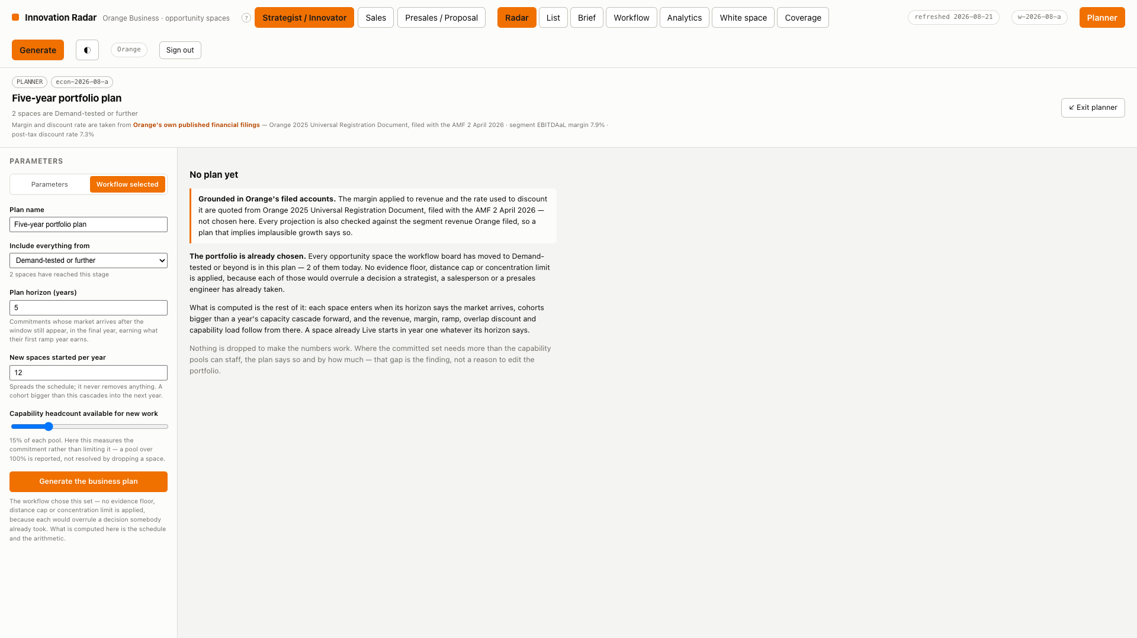
WALKTHROUGH
Source 2 — workflow selected
Already decided — this only schedules it
Everything past Demand-tested is in
No evidence floor, no distance cap, no concentration limit and no objective — each would overrule a decision somebody already took.
Horizon spreads it across time
Each space enters when its market arrives; a space already Live starts in year one whatever its horizon says.
Nothing is dropped to make it fit
Where the committed set needs more than the pools can staff, the plan says so and by how much. That gap is the finding, not a reason to edit the portfolio.
A committed space with no size
Listed by id and flagged, and the totals are described as a floor — rather than silently missing from a number the reader believes is complete.
Orange Business · Innovation Radar · walkthrough
27

Slide 28
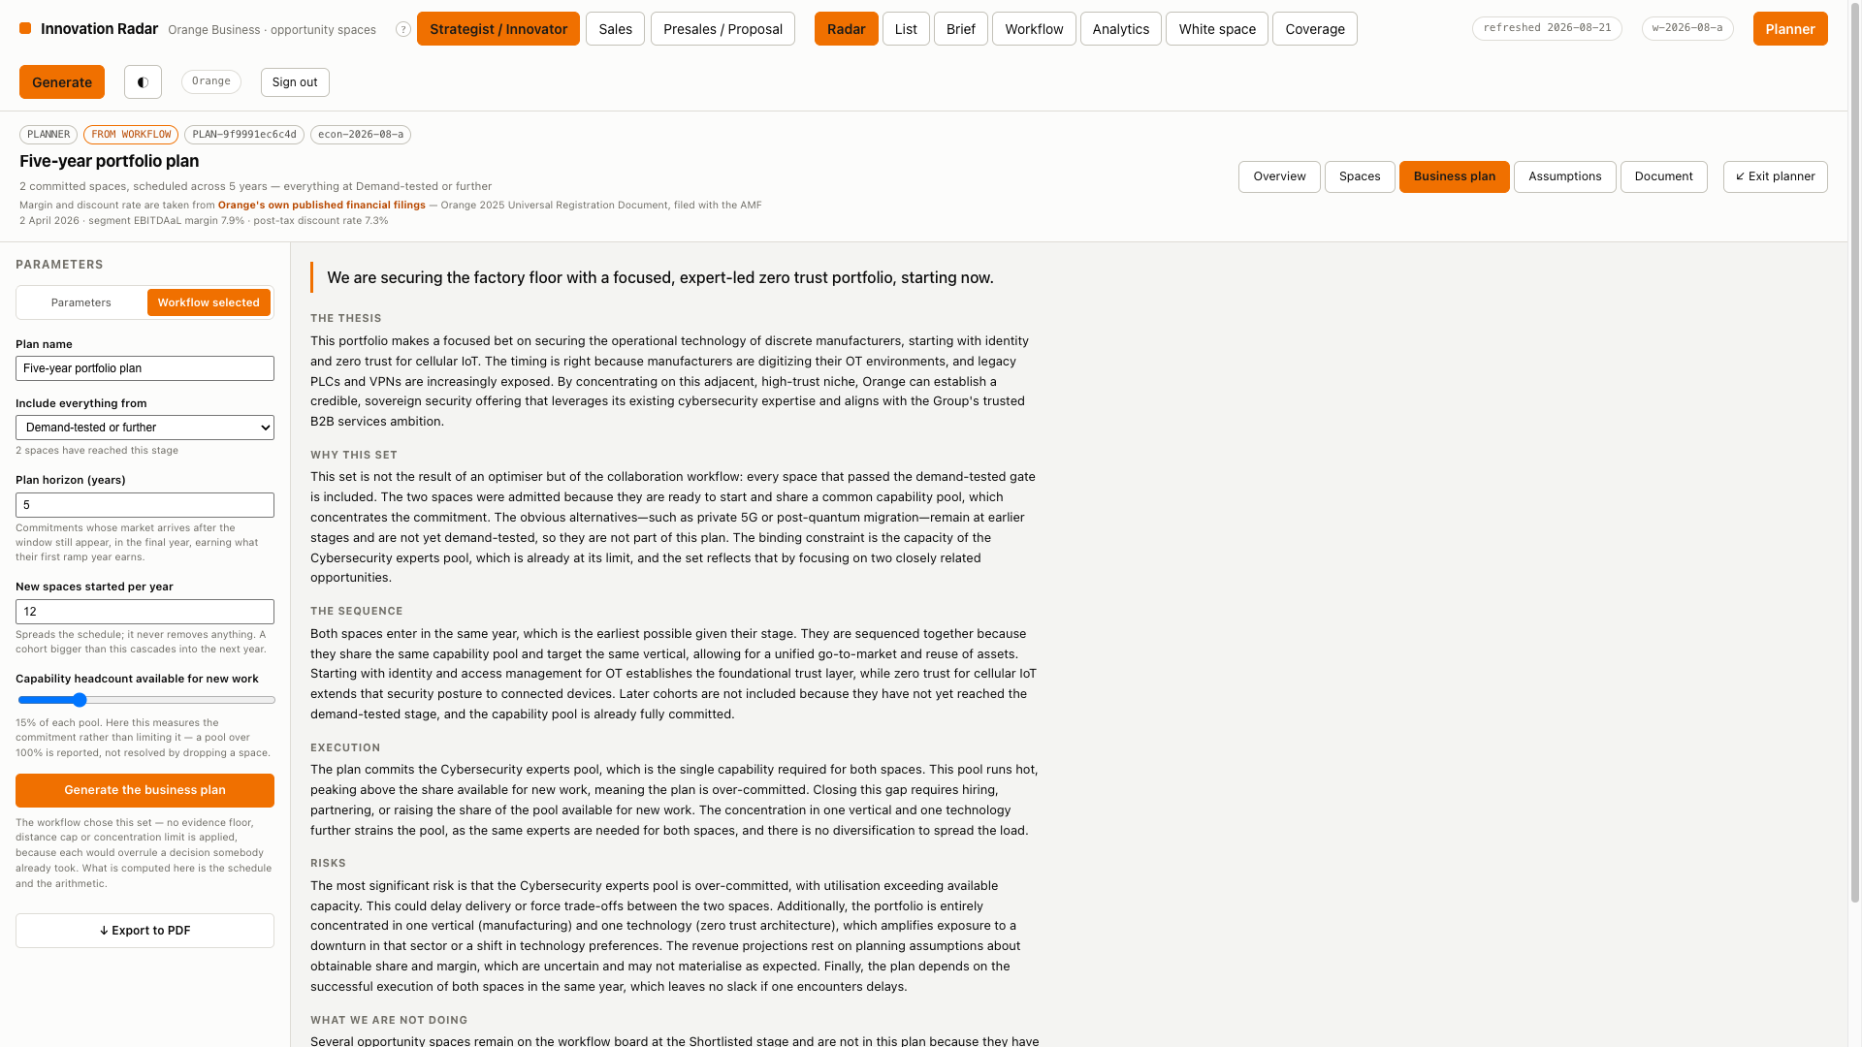
WALKTHROUGH
The business plan
Written about the projection, under guard
Thesis, set, sequence, execution, risks
Written after every figure is fixed, so the prose cannot disagree with the table beside it.
It may not state a new figure
A section that introduces a number the plan does not hold is stripped and listed — the same discipline the topic description works under.
The prose knows its own question
A narrative for a committed set may not describe alternatives being weighed, because none were. The prompt splits on the source.
Over-commitment is stated plainly
“This pool runs hot, peaking above the share available for new work, meaning the plan is over-committed.” And what closes the gap.
Orange Business · Innovation Radar · walkthrough
28

Slide 29
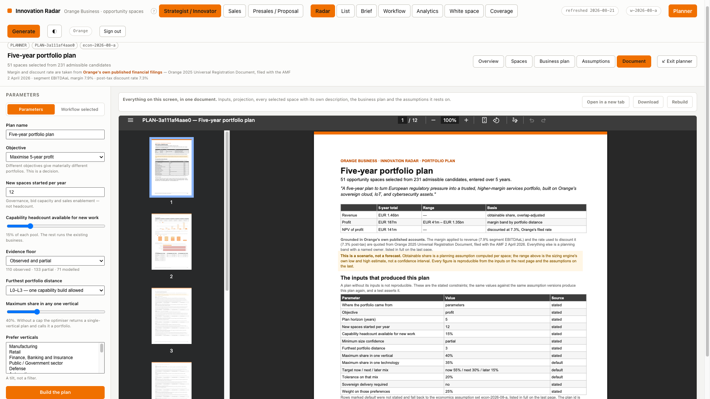
WALKTHROUGH
The plan as a document
In the order a committee reads it
Rendered in place, not downloaded
A plan that has to leave the tool to be read is a plan that gets read in a stale copy.
Inputs first
Including the effective value of anything you did not state, and where it came from. A plan without its inputs is not reproducible.
Every selected space, with its economics
Entry year, margin band, overlap discount, capability pool — and the near-misses with the constraint that excluded each.
The assumptions, last
Every band, its owner and its version, exactly as the sales brief does it. The margin and the discount rate are quoted from Orange's own filed accounts.
Orange Business · Innovation Radar · walkthrough
29

Slide 30
Everything you just saw is live
No screen in this walkthrough is a mock-up. Every number came out of the database at the moment the frame was captured, every document was rendered by the application, and every claim on every screen traces back to a dated, attributable source.
radar · filter · open full screen · move it on the board · plan the set

