Slide 1
ORANGE BUSINESS
Opportunity Spaces
Innovation Radar
A regularly refreshed view of specific innovation opportunities — each scored on how attractive it is, how urgent the window is, and how strong Orange's right to win is.
MVP walkthrough · concepts · functionality · planning · architecture

Slide 2
WHY
The problem is not a shortage of information
The difference is specificity: from generic technology themes to an opportunity a salesperson can use.
REJECTED AS TOPICS
WHAT A TOPIC MUST LOOK LIKE
Generic, undated, unsourced — and disconnected from what Orange can actually sell.
Private 5G plus edge vision for safety compliance in mining
×
“AI”
TECHNOLOGY
Private 5G + edge vision
×
“Cloud”
×
“Cybersecurity”
USE CASE
Safety compliance
×
“Digital transformation in retail”
VERTICAL
Mining
Specific enough for a salesperson to use in a meeting
Orange Business · Opportunity Spaces / Innovation Radar
2

Slide 3
CONCEPT
An opportunity space is a triple
Identity is the triple. The statement is a rendering of it — both are stored.
1
STRUCTURED IDENTITY
VERTICAL
USE CASE
TECHNOLOGY
×
×
Retail
Contact centre automation
Agentic AI
Deploy industry-specific agentic AI agents to automate retail contact center interactions.
The triple gives deduplication and filtering. The statement gives the specificity a salesperson needs. A candidate that does not resolve to exactly one of each fails validation.
Orange Business · Opportunity Spaces / Innovation Radar
3

Slide 4
CONCEPT
How each opportunity is scored
The three scores stay separate.
ATTRACTIVENESS
RIGHT TO WIN
CONVICTION
Is the world moving?
Can Orange play & win?
Do our own people believe it?
30%
Signal strength
25%
Offer match
Strategy
Strategic fit
20%
Reference density
Sales
Customer demand
20%
Source diversity
15%
Partner coverage
20%
Evidence quality
Presales
Deliverability
12%
Compliance fit
15%
Novelty / momentum
12%
Capability depth
15%
Strategic relevance
8%
External validation
8%
Technology ownership
EXAMPLE SCORE
EXAMPLE SCORE
EXAMPLE SCORE
61.23 / 100
88.00 / 100
75.6 / 100
Market evidence
Orange Business Graph
Human assessment
4
Orange Business · Opportunity Spaces / Innovation Radar

Slide 5
CONCEPT
Evidence before generation
The model never invents a topic from its own knowledge. It reorganises retrieved, dated, attributable evidence.
1
2
3
4
EVIDENCE BINDING
CLOSED VOCABULARY
NO GENERATED NUMBERS
ENTAILMENT CHECK
Every claim cites signal IDs
→
Taxonomy values are validated
→
Looked up + attributed, or absent
→
Does the evidence support the claim?
The signal IDs must exist in the cluster that produced the candidate. Un-cited claims are stripped, not rewritten.
Values must match the enumerations. A recognised synonym is repaired once; anything else is dropped.
Market sizes, growth rates and percentages are looked up and attributed, or they are absent. Backstopped by a regex.
A second model pass verifies each claim against the cited span.
LIVE RUN
345 of 644 candidates rejected
with specific, written reasons
A separate critic prompt scores 1–5 as the MINIMUM across five tests, so one failure caps the whole score.
Orange Business · Opportunity Spaces / Innovation Radar
5

Slide 6
CONCEPT
Portfolio distance decides whose conversation it is
The shortest path from a topic to a configuration Orange could actually deliver.
L0
Direct
An existing offer addresses it as it stands
Sales — sell it
L1
Bundle
Two or more existing offers combined
Presales — package it
L2
Partner-dependent
Needs a capability a partner already holds
Presales / alliances — assemble it
L3
Adjacent
Needs one capability built; nearby assets exist
Strategy — study it
L4
White space
No plausible path from the current portfolio
Strategy — watch or reject
This is what drives the role modes — they are not arbitrary presets. A high-attractiveness L4 topic is exactly the strategist's innovation agenda, and exactly what a salesperson should never be shown.
Orange Business · Opportunity Spaces / Innovation Radar
6

Slide 7
CONCEPT
Sizing and competition, with the working shown
Two questions a topic cannot be acted on without: how big is it, and who else is already there?
1 MARKET SIZE — BOTTOM UP, NOT QUOTED
2 COMPETITIVE INTENSITY
WHY NOT QUOTE A HEADLINE?
VERSIONED COMPETITOR REGISTER
+ evidence actually collected
Paid research can be quoted without methodology and can conflict by an order of magnitude.
↓
THE RADAR BUILDS ITS OWN
Who is visibly playing here?
Enterprise counts
×
Observed
adoption rate
×
Plausible
contract value
by sector + size class
CROWDED FIELD
NO COMPETITOR FOUND
=
MARKET
ESTIMATE
Not a reason to walk away → win on a specific differentiator.
Reported as unverified — the register may simply have a gap.
Every estimate carries its method, inputs and a confidence label — and can be rejected on its arithmetic.
BOTH ARE FILTERABLE + SORTABLE
so a strategist does not have to eyeball the number across 418 rows.
Orange Business · Opportunity Spaces / Innovation Radar
7

Slide 8
CONCEPT
Two routes into a new opportunity space
A refresh answers the questions the corpus was already asked. These answer the one somebody has right now.
ROUTE 1 · PARAMETERS
ROUTE 2 · A SCOPING CONVERSATION
For somebody who knows the taxonomy
For somebody who knows their market
VERTICAL
USE CASE
TECHNOLOGY
HORIZON
Assistant
interviews
→
Whole transcript
re-embedded
→
Same signal
vectors
↓
↓
Show spaces that ALREADY satisfy those criteria
Show what came back: publisher · date · cosine
Before anything is spent
beside the answer
BOTH ROUTES GO THROUGH THE SAME GATE
1
Enough evidence?
Brief must retrieve at least the run's own floor of signals using the run's own retrieval.
2
Independent support?
A second reason is required on the use case or technology
— never just the vertical.
The corpus holds the gate — not the model.
Orange Business · Opportunity Spaces / Innovation Radar
8

Slide 9
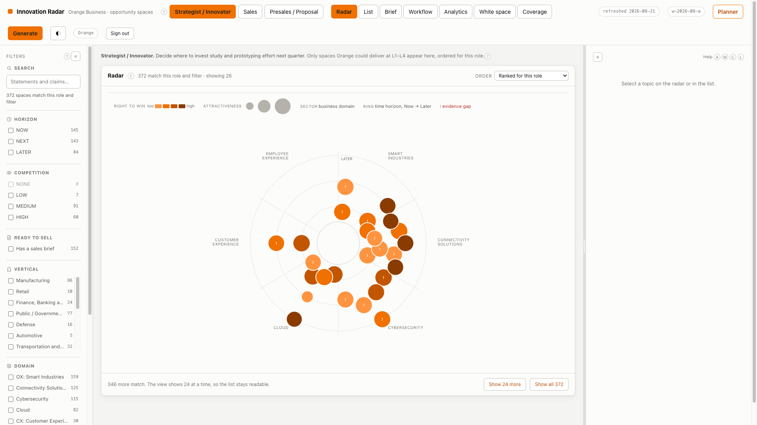
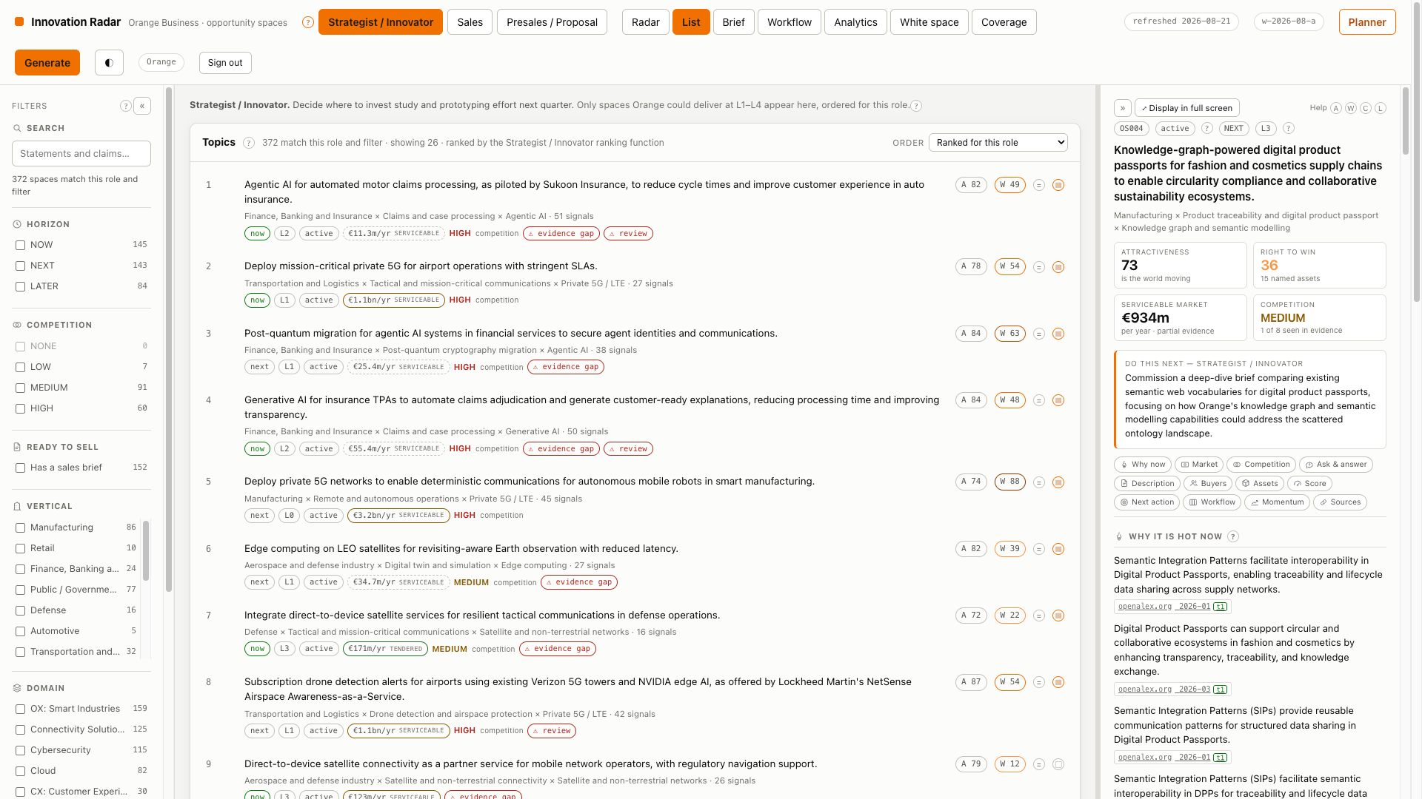
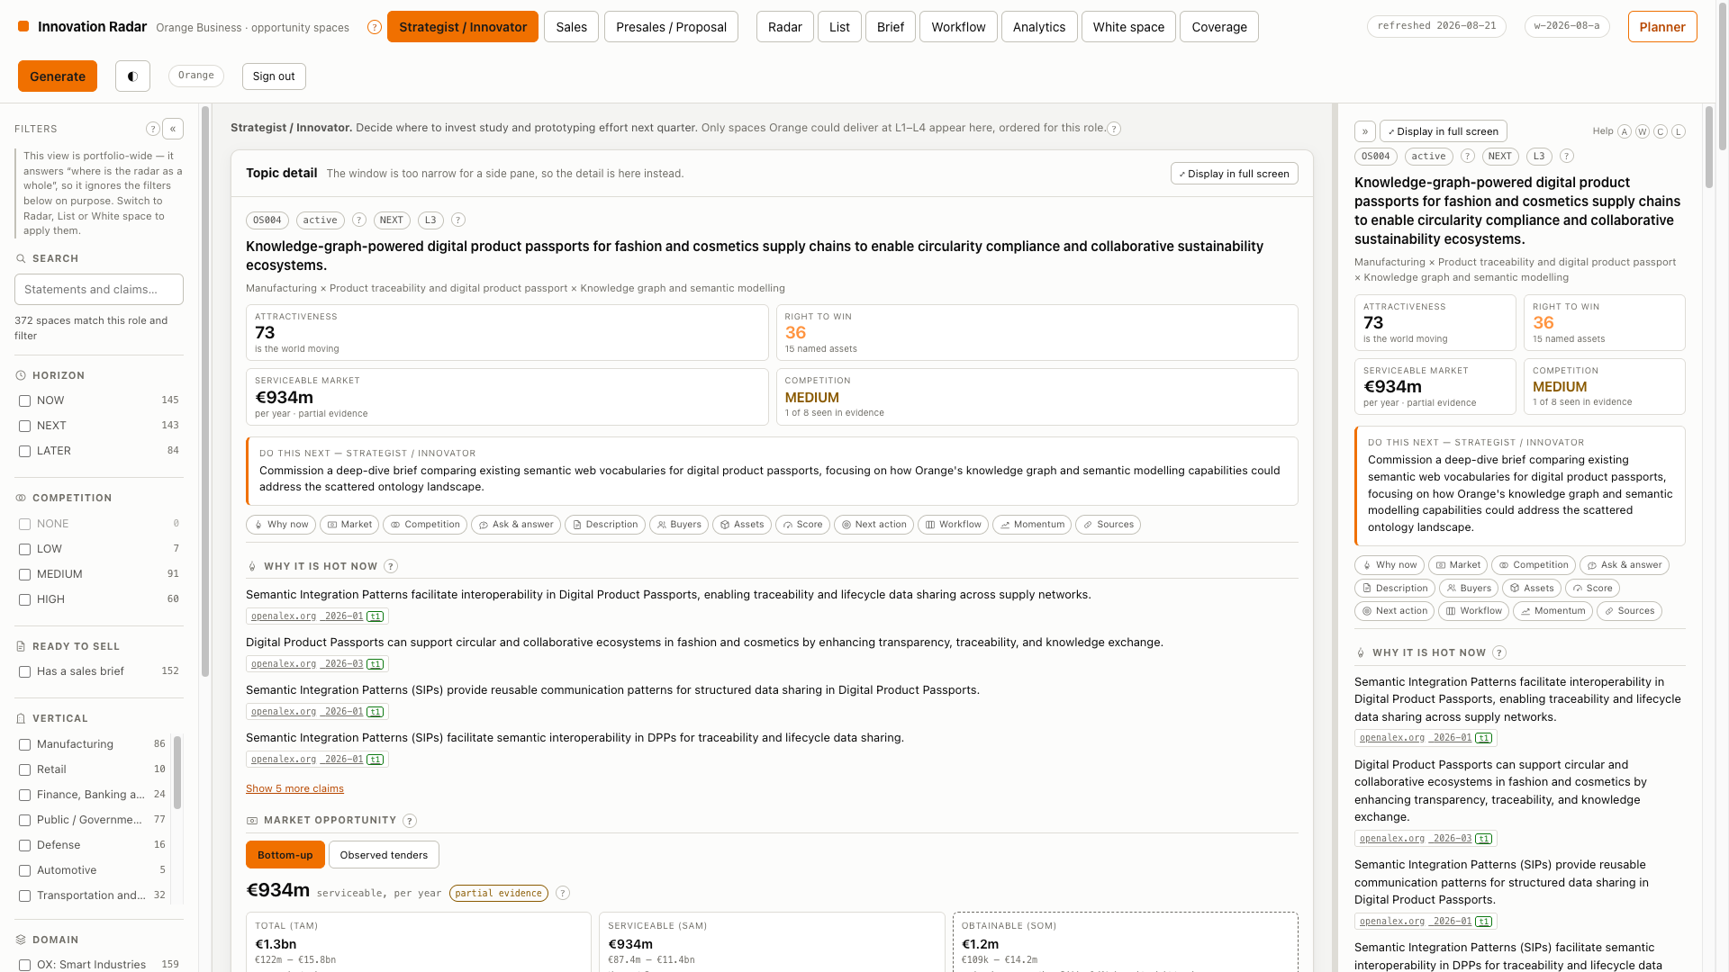
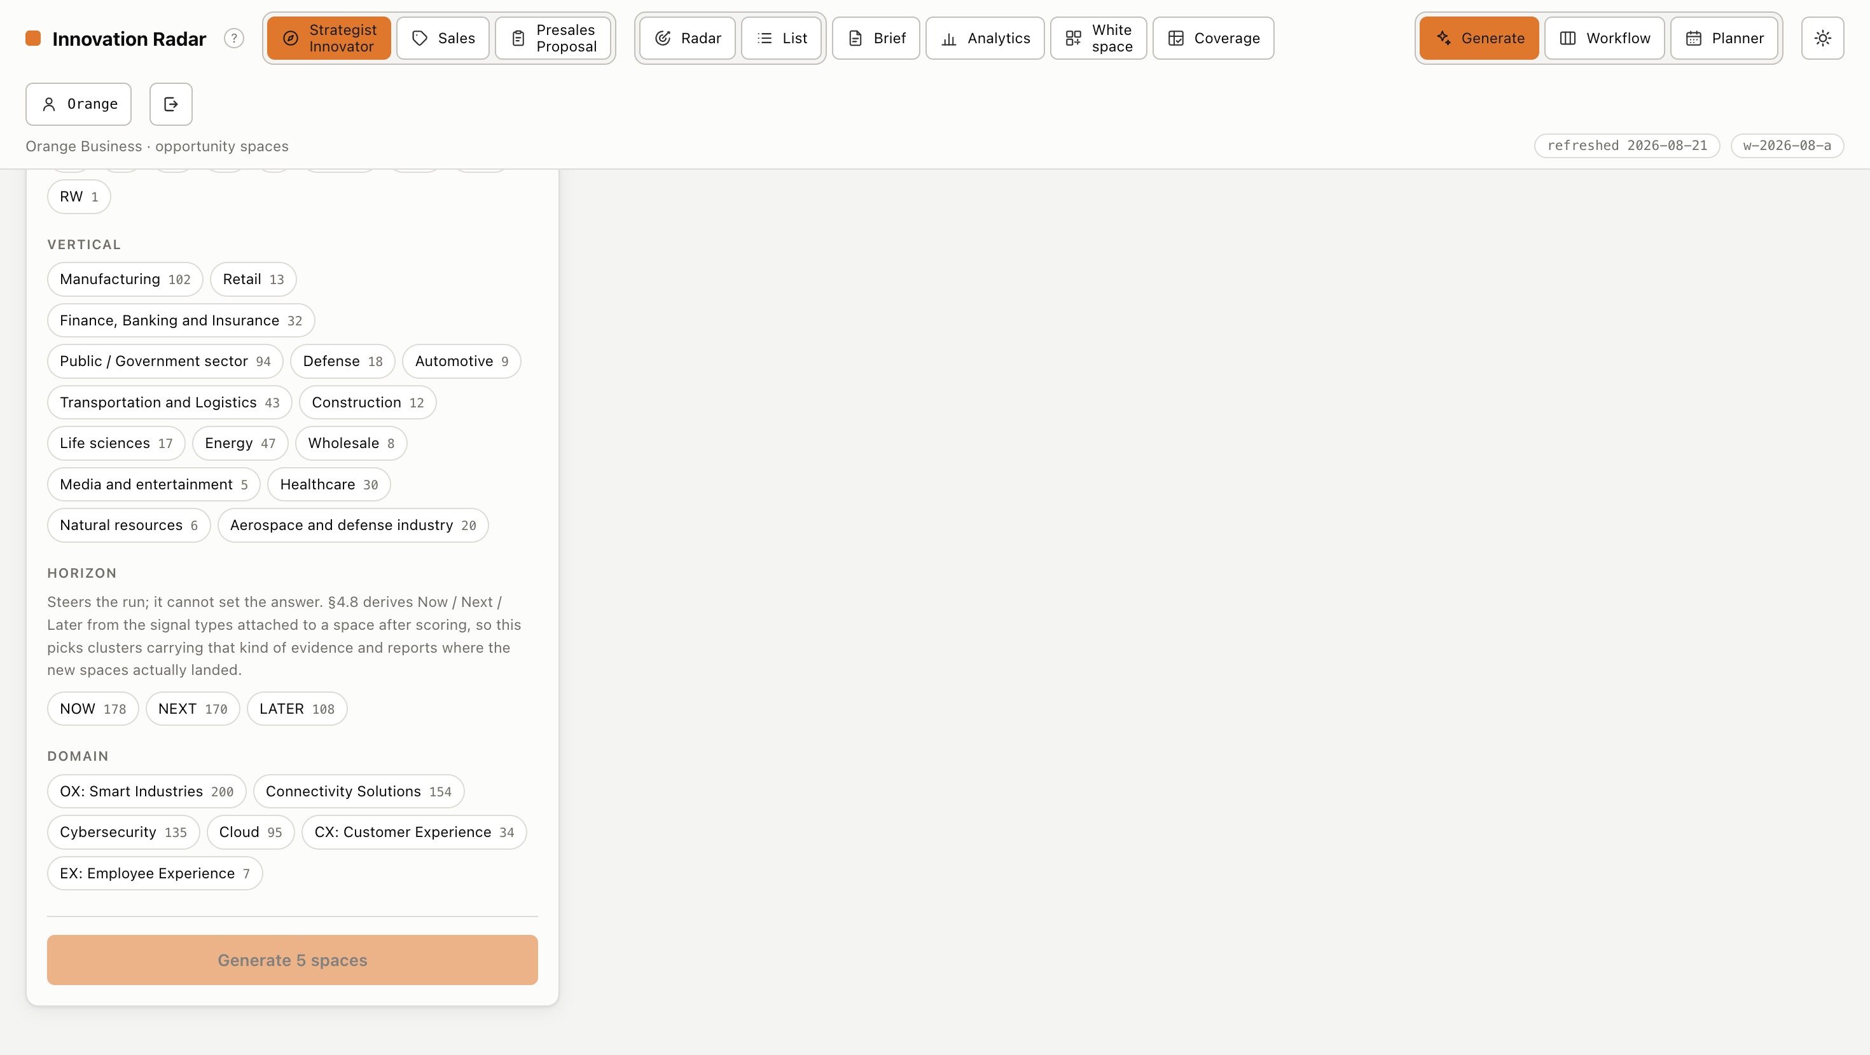
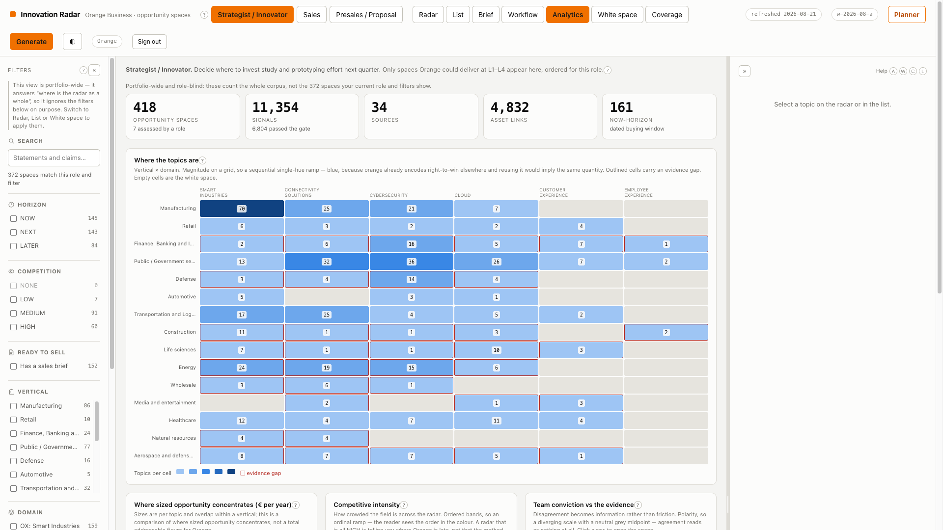
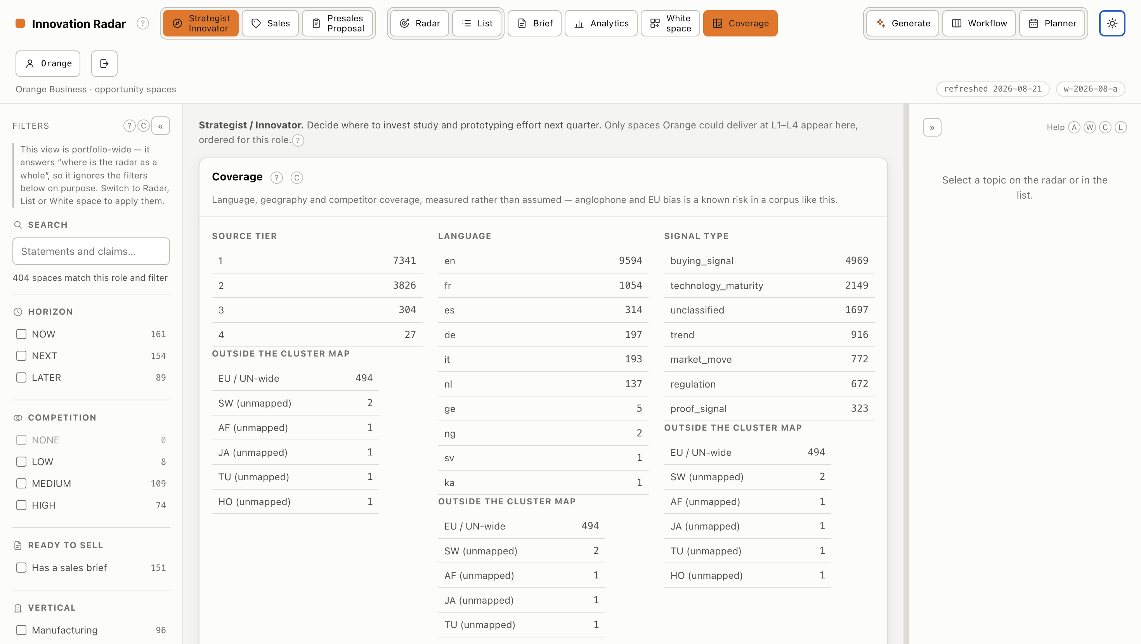
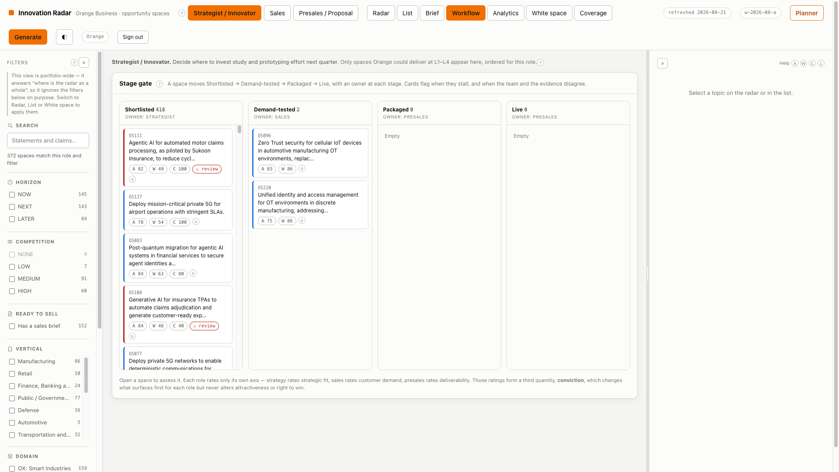
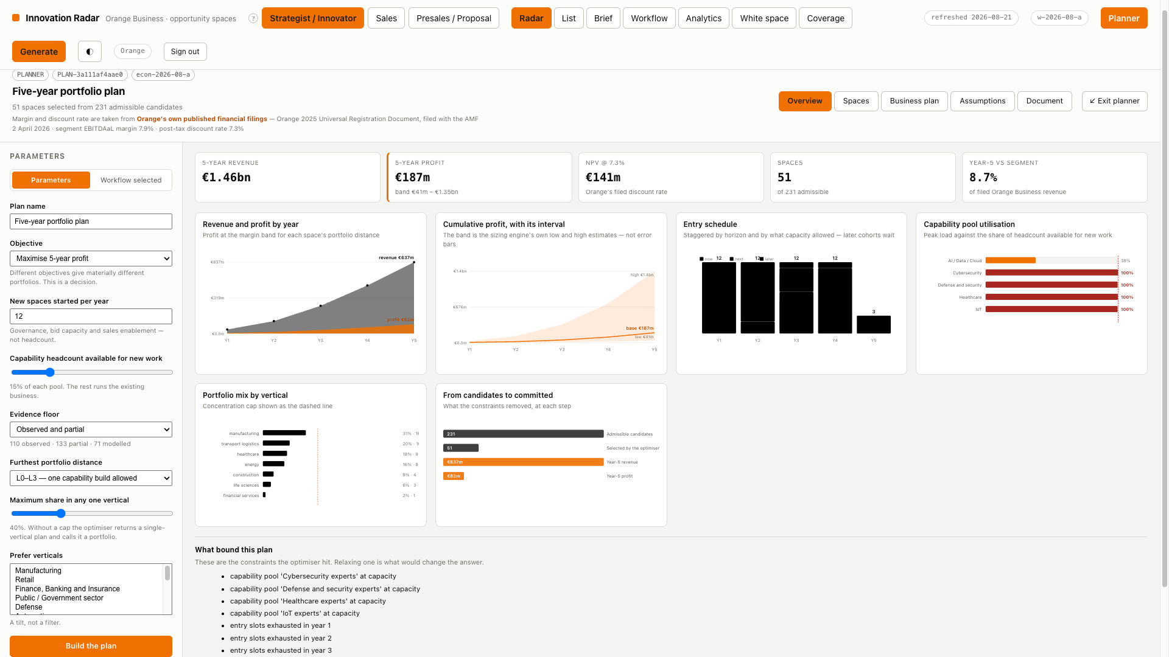
FUNCTIONALITY
MVP
Use the product for the functionality that was previously explained across separate slides.
Radar view
Role-ranked list
Topic detail
Generate
Analytics
Coverage
Workflow
The Planner
9
Orange Business · Opportunity Spaces / Innovation Radar

Slide 10
STATUS
What the MVP has actually produced
Every figure below is read from the live database, not typed into this deck.
418
11,354
34
4,832
26.7
OPPORTUNITY SPACES
SIGNALS INGESTED
LIVE SOURCES
ASSET LINKS
SIGNALS PER TOPIC
15/15 verticals covered
6,804 passed the gate
33 enabled + internal intake
181 graph nodes
after enrichment
Coverage of the evidenced grid
47 of 59 use cases, 33 of 38 technologies appear in at least one topic — the grid is sparse by design.
7,267 tier-1 signals from regulators, procurement portals, standards bodies and official statistics.
1,054 French-language signals so the anglophone bias named as a principal risk is measured, not assumed.
314 sized bottom-up · 181 competition-scored · 174 briefed each with its method and its confidence grade, never a quoted headline.
8 portfolio plans · 12 kinds of pre-sales artefact built the two things that turn a ranked list into a decision and a bid.
Orange Business · Opportunity Spaces / Innovation Radar
10

Slide 11
ARCHITECTURE
Seven pipeline stages, each with a contract
Stages can be developed, tested and replaced independently.
1 Collect
2 Normalise
3 Classify
4 Themes
5 Synthesise
5b Enrich
6 Score
7 Serve
connectors
ingest
ingest
themes
synthesis
enrich
graph + scoring
read model + api
source config → raw items
raw items → signal records
→ typed, tiered signals
→ theme clusters
→ candidate spaces
→ more evidence per topic
→ ranked spaces
→ radar, briefs, API
↑
PARALLEL, SLOWER PATH
Orange Business Graph
joins at stage 6
Offers · references · partners with tiers · certifications · analyst positions · capability pools · research assets
Links are typed L0–L4 and carry the evidence that justified them. Right-to-win can improve without re-running discovery.
TWO SUBSYSTEMS SIT BESIDE THE PIPELINE
THE PLANNER
planner.py · plan_report.py
PRE-SALES COLLATERAL
presales/
Reads the read model + assumptions → selects a set → schedules it → projects five years → writes one PDF.
Reads ONE snapshot of a space → emits 12 artefacts in 5 formats.
One model call, after every number is fixed.
Nothing in a pack can disagree with anything else in it.
Orange Business · Opportunity Spaces / Innovation Radar
11

Slide 12
ARCHITECTURE
Stack and separation of concerns
INGESTION
INTELLIGENCE
SERVING
33 enabled sources across 17 connector
types: TED, BOAMP, UK Contracts,
EUR-Lex SPARQL, Have-your-say, GDELT,
news RSS (EN/FR), Hacker News, OpenAlex,
Crossref, arXiv, CORDIS, NIST, CERT-FR
Parallel fetch · circuit breaker ·
per-host pacing · replay-safe dates
DeepSeek behind a provider-agnostic
client (swap to Ollama via .env alone)
Local sentence-transformers for
embeddings and clustering
Deterministic where possible,
generative only where it earns its place
SQLite — the graph is thousands of
nodes, not millions
FastAPI read API behind a session
guard applied to the whole app,
not route by route
React + Vite + TypeScript
Hand-drawn SVG radar, no chart library
scipy milp for portfolio selection
reportlab / python-pptx / python-docx
for every document it emits
Taxonomies, weights, thresholds, sources, the business graph and the crosswalks are all configuration, not code — and are validated at load time, so a dangling id is a startup error rather than a wrong number three stages later.
Orange Business · Opportunity Spaces / Innovation Radar
12

Slide 13
ARCHITECTURE
What makes the numbers defensible
The governing constraint: if a user cannot explain why a topic is ranked where it is, the scoring is not good enough.
Decomposable
Reproducible
Every displayed number breaks into named components; no opaque scores.
Every component stores the inputs used to compute it, so any number can be re-derived.
Traceable
Versioned
Full lineage from a displayed claim back to the raw ingested item, including prompt and model version.
Every score records its weight set. Trajectories are never plotted across a boundary silently.
Auditable
Bounded
A reviewer outside the project can reconstruct why any topic holds its rank.
Counting, diversity, recency and momentum are arithmetic — never a model. A model asked to count is unverifiable.
Orange Business · Opportunity Spaces / Innovation Radar
13

Slide 14
STATUS
What is deliberately not built — and what needs a decision
NOT BUILT, WITH THE REASON
NEEDS A DECISION FROM ORANGE
CRM integration deferred; public assets give a sufficient right-to-win proxy
Who is the curator? 4,832 links are machine-proposed and unconfirmed
Learned scoring models no labels exist on day one; the capture and replay harness ships instead
Margin by portfolio distance one table from Orange finance moves five-year profit by 1.66x
Patent connector needs EPO registration; technology ownership uses a portfolio-level prior
Headcount free for new work the constraint that binds first in most plans is currently a guess
Learned ranking per role needs 300-600 expert comparisons; the capture widget ships first
Terms of use unconfirmed for several enabled sources — a Sprint 0 blocker
ROI on a plan there is no cost data at the granularity a space needs, anywhere the pipeline can reach
Refresh cadence drives connector design and cost more than any other choice
Per-role authorisation sign-in answers WHO; it does not yet answer MAY THEY
The radar reports its own gaps rather than hiding them: evidence-gap warnings, language coverage, unconfirmed links, skipped sources, unsized spaces and an over-committed capability pool are all surfaced in the interface rather than left to be discovered.
Orange Business · Opportunity Spaces / Innovation Radar
14

Slide 15
The join is the product
Without it the radar is a competent trend feed, and trend feeds already exist. With it, the radar answers a question nobody else can answer for Orange.
418 opportunity spaces · 11,354 signals · 34 live sources · 4,832 named asset links
314 sized bottom-up · 174 sales briefs · 12 pre-sales artefacts per space · 8 portfolio plans

