Slide 1
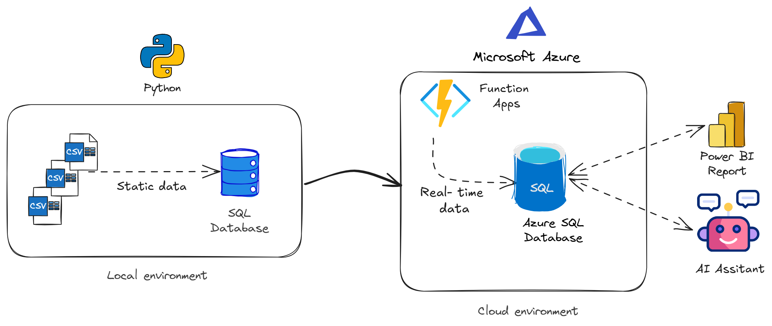
RailPulse
Sprint 1 — Local Ingestion & Relational Modelling Enterprise-grade ELT pipeline over the SNCB/NMBS national timetable 2.17 million scheduled departures 652 stations · 1,801 routes 9 data-quality rules · 47 labelled queries Streamlit dashboard + text-to-SQL preview
Belgian Transit SQL Analysis
Stephane van der Aa · BeCode AI & Data Science · 24 July 2026
1

Slide 2
Agenda
📋
01
Mission & Context
02
Data & Architecture
RailPulse consulting firm, SNCB client, winter scheduling optimisation
GTFS feed, ELT pipeline, SQLite 3NF model, repository structure
03
Data Quality
04
The Five Analytical Questions
9 DQ rules, quarantine system, 3 feed quirks that shaped the analysis
Peak hour, platform bottlenecks, morning destinations, service frequency, accessibility
05
Key Findings
06
Nice-to-Haves & Dashboard
Bruxelles-Central bottleneck, annualisation insight, accessibility gap
Network leaderboard, index optimisation, Streamlit dashboard, SQL Chat
07
Database Theory
08
Project Deliverables & Timeline
Key interview topics from the study guide
Evaluation criteria, timeline, deliverables checklist
2

Slide 3
Mission & Context
Section 01
01
The Mission
RailPulse is an urban mobility consulting firm. The Belgian National Railway company (SNCB/NMBS) wants a clear overview of operational performance and delay patterns to optimise their winter scheduling. Our mission is to extract liveboard data directly from the iRail API, build a normalized database, and provide an analytical report detailing network bottlenecks.
Learning Objectives
• Design and build an SQL database schema from API data structures
• Query relational tables to extract performance metrics
• Handle date/time objects and calculate delays in SQL
• Present an operational efficiency analysis to a business client
• Consolidate: JOINs, GROUP BY, aggregations, time-series in SQLite
Challenge Parameters
• Duration: 4 days · Deadline: 24/07/2026 5:00 PM
• Team challenge (in spirit), individual delivery
• NO pandas for filtering/aggregating — Python only for network I/O + sqlite3
• All analytical questions solved with standard SQL operations only
• Team feedback: 5 min overview + random Q&A from study guide (SQL&DB_theory.md)
3

Slide 4
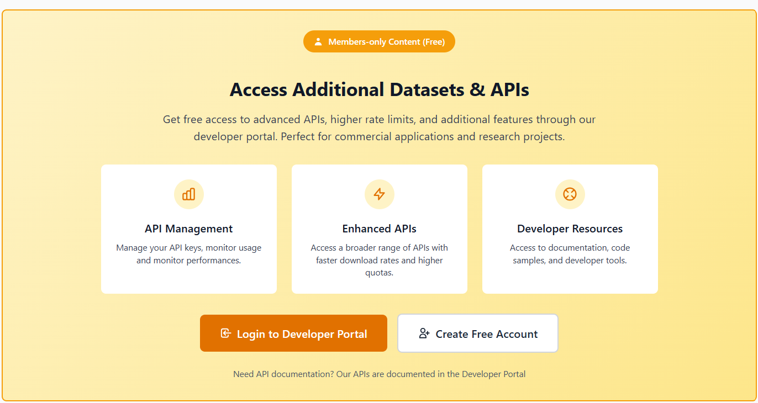
Data & The GTFS Feed
Section 02
02
Data Source: Belgian Mobility Open Data Portal
We ingest GTFS Static (26 MB ZIP) and GTFS Realtime (JSON, every 30 s) from the official SNCB/NMBS developer portal. The static feed covers the full national timetable for 358 operating dates (2025-12-20 → 2026-12-12). A free Standard subscription key provides 12,000 requests/day at 500/min — our pipeline uses 1 request per rebuild.
2.17M
Timetabled Calls
134,809
Trips
652
Stations
1,801
Routes
4.7M
Service Dates
1 GB
Database
4

Slide 5
Project Roadmap — Four Sprints
Section 02
02
SPRINT 1
Sprint 1 Local Ingestion & Relational Modelling
────────────────────────
• SQLite database + 3NF schema
• GTFS Static feed ingestion
• 9 DQ rules, quarantine system
• 5 analytical questions (SQL only)
• Streamlit dashboard, 47 queries
SPRINT 2
Sprint 2 Cloud Migration & Serverless Pipelines
────────────────────────
• Azure SQL / PostgreSQL
• Azure Functions, Timer Trigger CRON
• Poll GTFS-RT trip updates + alerts
• Every 15-30 min, budget-controlled
• Environment variables for secure connections
SPRINT 3
Sprint 3 Enterprise BI (Power BI)
────────────────────────
• Power BI Desktop connected to Azure
• Semantic data model (star/snowflake)
• DAX measures: On-Time Rate %, peak matrices
• Interactive drill-down, bookmarks
• Cross-hub comparison dashboards
SPRINT 4
Sprint 4 Conversational Transit Assistant (GenAI)
────────────────────────
• Local LLM via Ollama / HuggingFace
• Text-to-SQL with schema-aware prompts
• Regex guardrails: block DROP, DELETE
• Execution caps: timeout + row limit
• Streamlit chat interface — preview included!
🛠️ Tools: Python, SQLite / PostgreSQL, Azure, Power BI, Ollama, LangChain, Streamlit
5

Slide 6
Pipeline Architecture — ELT, not ETL
Section 02
02
Python does network I/O and executes SQL. Every cleaning rule, every constraint, and every metric lives in a .sql file. Python never inspects a value — raw CSV rows land verbatim in staging tables (all TEXT, no constraints), and the transform layer decides what is clean, what is quarantined, and why.
Pipeline Stages
• stg_* (verbatim CSV → TEXT columns, no constraints)
• 02_schema.sql (3NF core: 11 entity + 6 ref_ tables, 20 FKs)
• 03_transform.sql (9 DQ rules, quarantine → rejected_row)
• 04_indexes.sql (1 index per named query, built post-load)
• 05_views.sql (semantic layer: v_departure, v_service_frequency, …)
• 06_realtime.sql (GTFS-RT additive tables, survives rebuild)
• 07_cleanup.sql (drop staging, VACUUM — database shrinks to ~1 GB)
• sql/analysis/q1..q7.sql (47 labelled queries → output/*.csv)
6

Slide 7
Repository Structure
Section 02
02
Every rule and every metric lives under sql/. Python has exactly two jobs: network I/O and executing SQL. Nothing in src/ inspects, filters or aggregates a data value.
sql/
schema, transform, indexes, views, analysis — every number traces to a .sql file
src/railpulse/
thin Python layer: build, analyse, verify, benchmark, ingest, poll
scripts/
poll_realtime.sh (cron/launchd), setup_api_key.py (Playwright)
tests/
149 tests over a synthetic broken feed — each DQ rule tested
dashboard/
Streamlit report + optional SQL Chat (text-to-SQL, local model)
docs/
ERD, data dictionary, analysis report, ADRs, data quality, glossary, API compliance
output/
generated: one CSV per analysis query
7

Slide 8
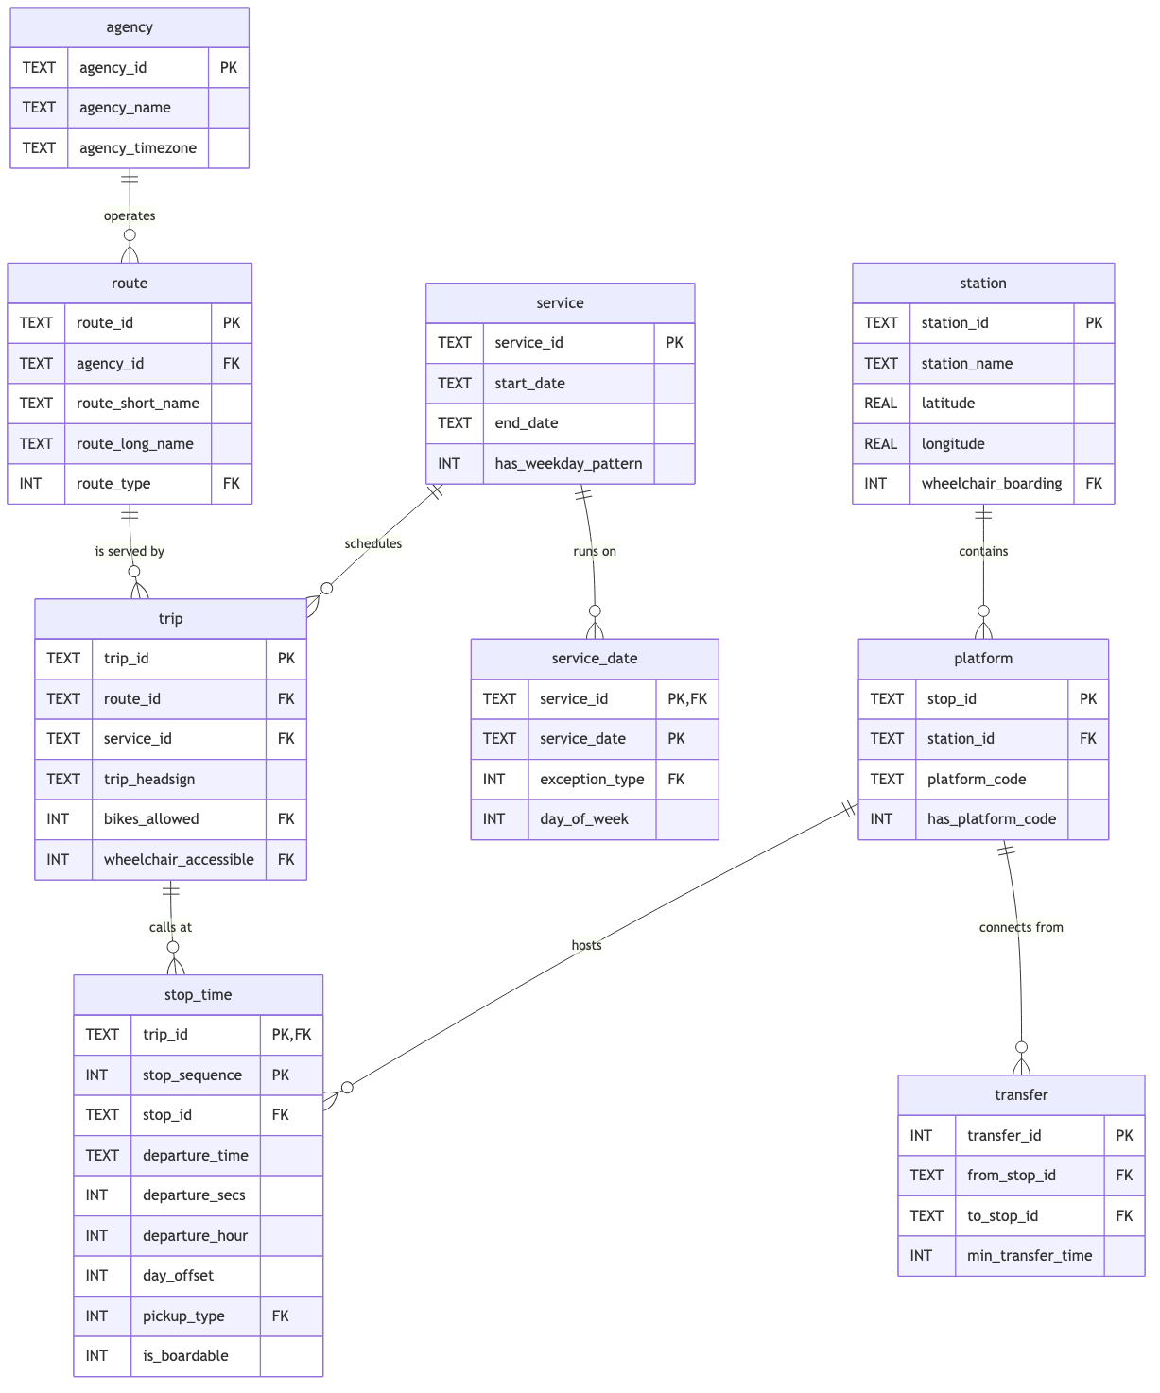
Entity Relationship Diagram
Section 02
02
3NF model with 11 entity tables, 6 ref_ lookup tables and 20 enforced foreign keys. station and platform are split (not a single stops table). stop_time is the fact table at 2,165,507 rows — event grain: one scheduled call of one trip at one platform.
Key Modelling Decisions
• station / platform split (2 grains in one GTFS file → 2 tables)
• service keeps weekday columns + has_weekday_pattern flag (DQ-01)
• stop_time materialises departure_hour, is_boardable (SARGability)
• WITHOUT ROWID on service_date saves ~190 MB
• Every GTFS code column → FOREIGN KEY into ref_ table
• rt_trip_update.trip_id is a soft link (not FK) by design
• PRAGMA foreign_key_check returns clean
8

Slide 9
Data Quality — 9 Rules, 12 Quarantined Rows
Section 03
03
7,057,090 rows staged → 7,057,078 loaded → 12 quarantined (0.00017%). Nothing is silently dropped. Each rejected row lands in rejected_row with its rule, reason, source file, physical line number and a JSON snapshot of the payload.
DQ-01 — calendar.txt empty
DQ-02 — Code 0 ≠ 'no'
DQ-03 — Implausible times
All 51,593 services have zeroed weekday flags — the real calendar is 4.7M rows in calendar_dates.txt
wheelchair/bike code 0 means 'no information', not refusal. ref_accessibility.is_guaranteed encodes the distinction
12 calls at 63:18–87:39 into service day → quarantined. 2 trips affected, truncated in core model
DQ-04 — Orphan FKs
DQ-05 — Duplicate keys
0 rows — screen before FK enforcement to convert fatal error → quarantined row
0 rows — ROW_NUMBER() partition guard + audit pass on INSERT OR IGNORE
Three feed quirks that changed the answers: (1) empty calendar.txt weekday flags, (2) 577K pass-through calls, (3) 31K calls at ≥ 24:00:00 — each requires explicit handling
9

Slide 10
The Five Analytical Questions
Section 04
04
Q1
The Peak Hour Problem
↳ 17:00–17:59 · 950,651 annual departures
What hour experiences the highest volume of scheduled departures?
Q2
Platform Bottlenecks
↳ Platforms 4, 3, 2 · up to 12.8 trains/hour
Top 3 busiest platforms at Bruxelles-Central?
Q3
Morning Destinations
↳ Anvers-Central, Louvain, Charleroi-Central
Top 3 terminal destinations for trips before 12:00?
Q4
Service Frequency
↳ 45.2% High · 34.7% Medium · 20.1% Low
Classify each service: High (5+), Medium (2-4), Low (1) d/wk?
Q5
Accessibility Audit
↳ 91.3% bike · wheelchair field empty for all 134,809 trips
Ratio of trips guaranteeing wheelchair/bike?
All answers solved with SQL only — no Python filtering or aggregation.
10

Slide 11
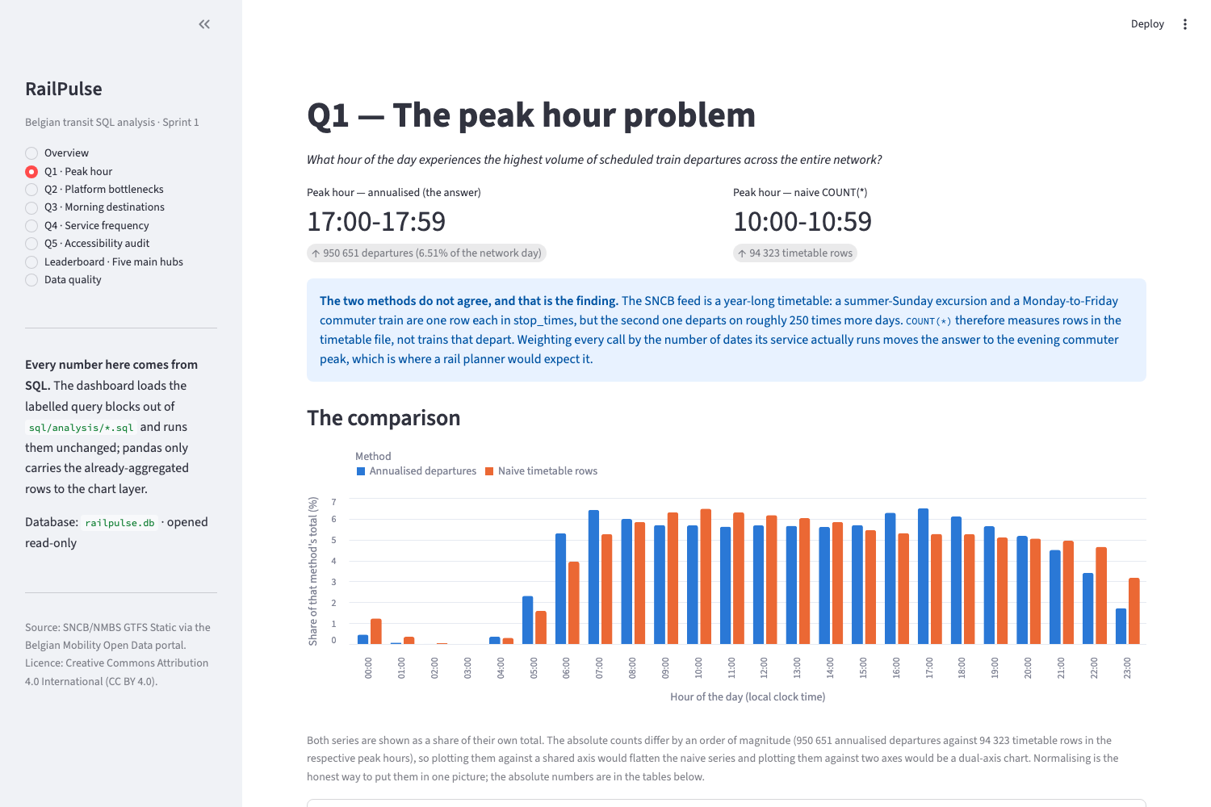
Q1 — The Peak Hour Problem
Section 04 · Question 1
Q1
Answer: 17:00–17:59 — 950,651 annual departures (6.51% of network day)
The obvious query — SELECT departure_hour, COUNT(*) ... GROUP BY departure_hour — gives a confidently wrong answer: 10:00. The problem is that counting rows counts timetable variants, not trains. A trip that runs once and a trip that runs 250 times are one row each. Weighting each call by v_trip_service_days.operating_days (annualisation) moves hour 17 from rank 10 to rank 1. The gap between the two rankings IS the finding.
How Ranks Shift
• Naïve rank 1: 10:00 (94,323 timetable rows)
• Annualised rank 1: 17:00 (950,651 departures)
• Hour 17: rank 10 → rank 1 (+9)
• Hour 07: rank 12 → rank 2 (+10)
• Hour 10: rank 1 → rank 8 (−7)
• Midday calls avg 8.8 days · Evening avg 12.4 days
• Seasonal services over-represented in raw count
11

Slide 12
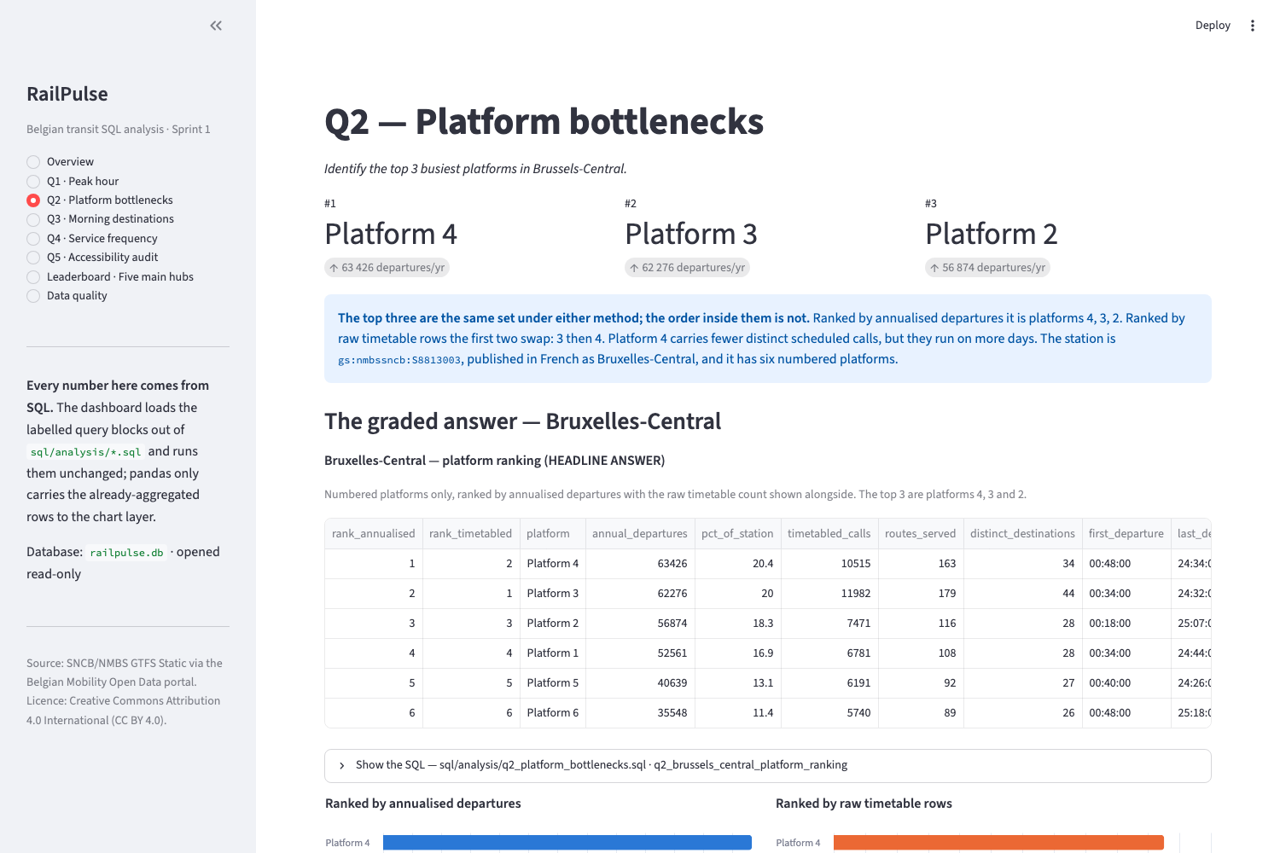
Q2 — Platform Bottlenecks at Bruxelles-Central
Section 04 · Question 2
Q2
Answer: Platforms 4 (63,426), 3 (62,276), 2 (56,874) annual departures
The top three platforms are robust across both measures (annualised and raw), but the order between platforms 3 and 4 swaps — platform 3 leads on raw timetable rows, platform 4 leads when weighted by operating days. 1,348 additional calls (2.69%) carry no platform allocation.
Platform peak-hour pressure
Platform 3 · 08:00 · 12.8 trains/day · one every 4.7 min Platform 4 · 16:00 · 11.3 trains/day · one every 5.3 min Platform 2 · 07:00 · 10.9 trains/day · one every 5.5 min Platform 6 · 16:00 · 8.5 trains/day · one every 7.1 min
12

Slide 13
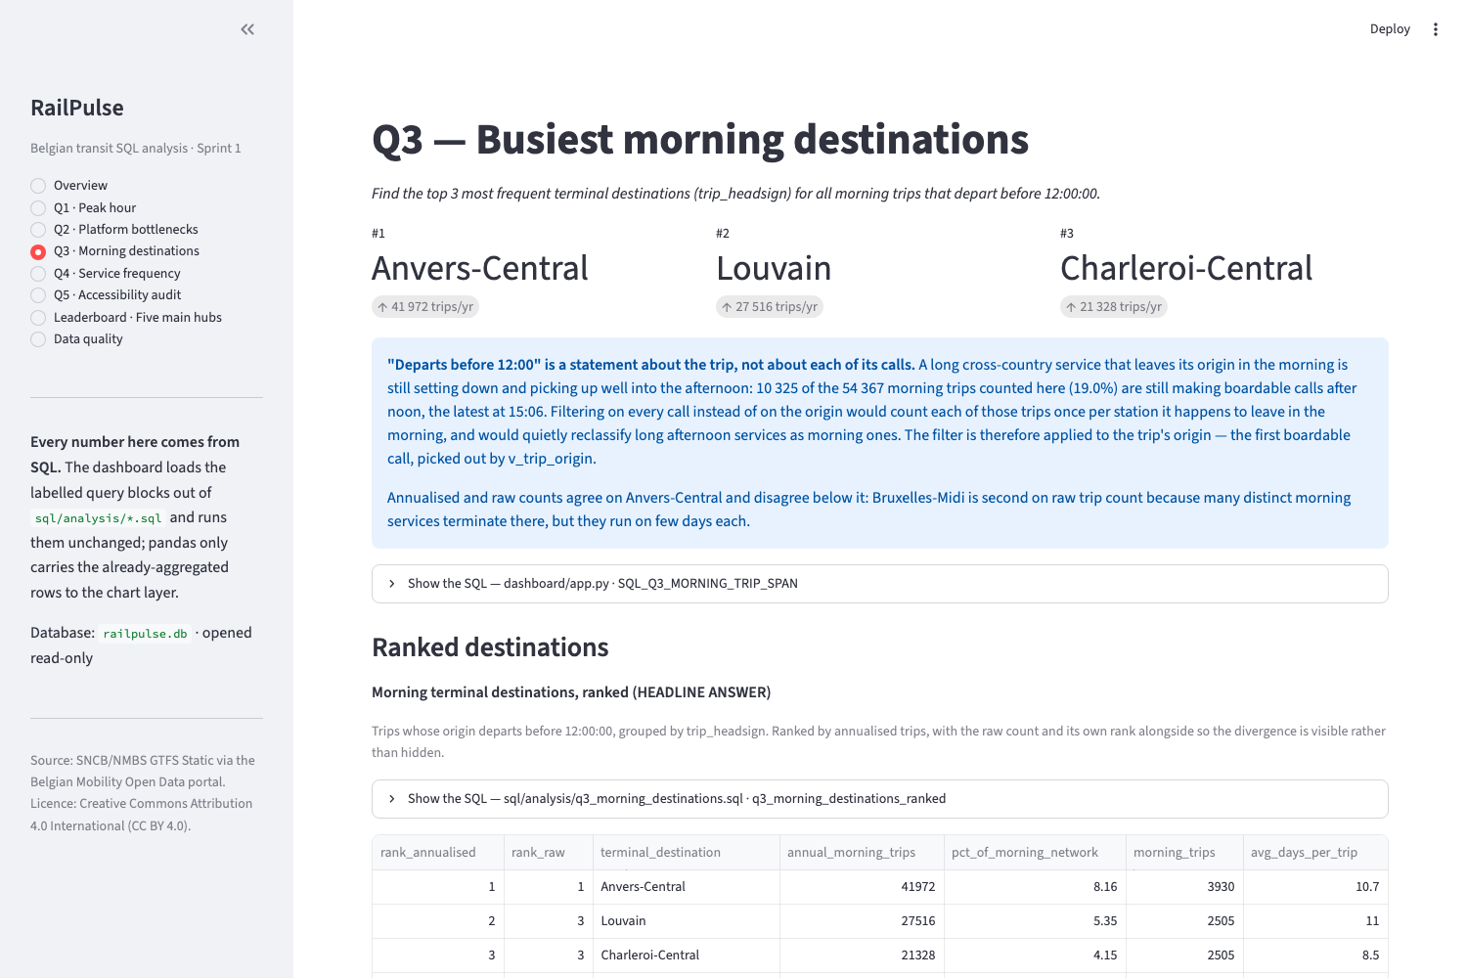
Q3 — Busiest Morning Destinations
Section 04 · Question 3
Q3
Answer: Anvers-Central (41,972), Louvain (27,516), Charleroi-Central (21,328)
'Morning' = trip that originates before 12:00:00. The ranking uses annualised trips (trips × operating days), not distinct trip IDs. Bruxelles-Midi is 2nd by distinct services but 4th by annualised trips — its morning services average only 5.3 operating days.
Most morning-skewed destinations
1. Schaerbeek — 65.8% of arrivals before noon 2. Eupen — 54.7% 3. Blankenberge — 51.7% 4. Wavre — 49.9% 5. Lille Flandres (FR) — 49.2% Schaerbeek is a depot + maintenance hub — consistent with strong morning positioning flow.
13

Slide 14
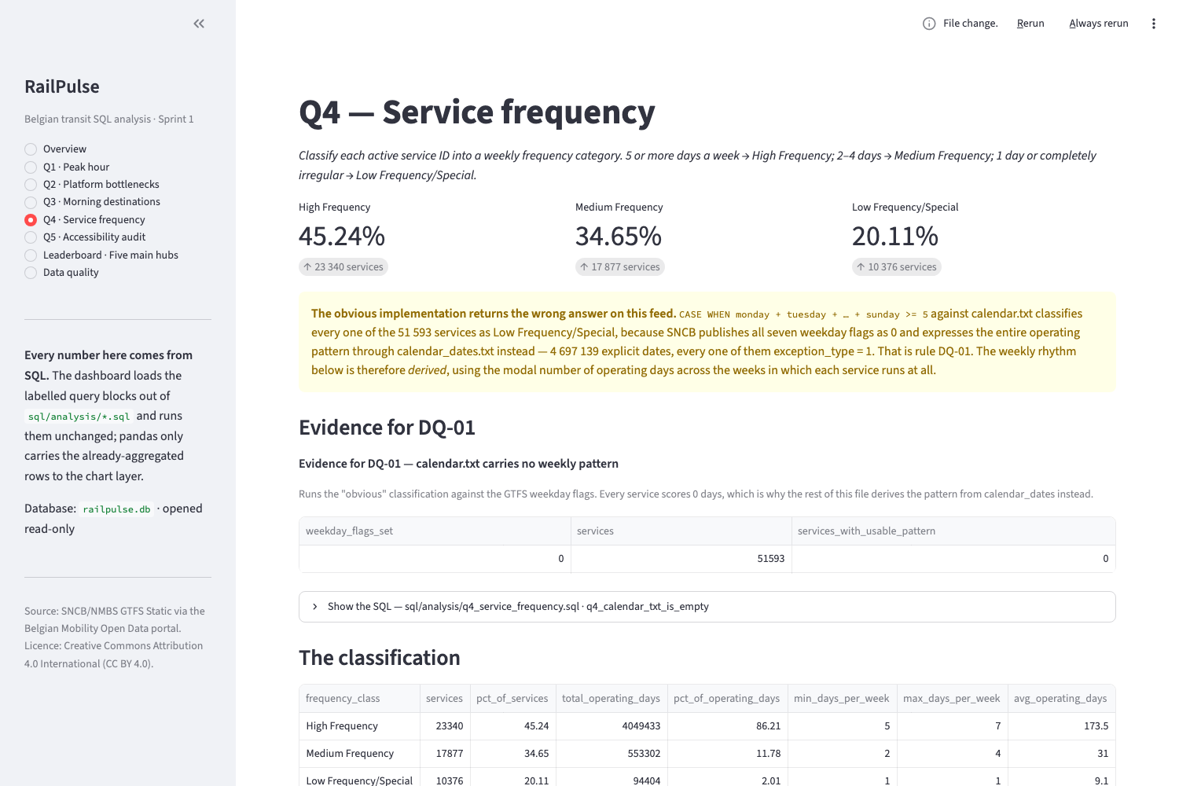
Q4 — Service Frequency Classification
Section 04 · Question 4
Q4
Answer: 45.2% High · 34.7% Medium · 20.1% Low/Special (but the 45% carries 86.2% of operating days)
A data problem had to be solved first: calendar.txt weekday flags are ALL ZERO for all 51,593 services (DQ-01). Without that fix, the textbook CASE WHEN query classifies 100% of the Belgian rail network as 'Low Frequency'. The weekly rhythm was derived from the 4.7M rows of calendar_dates.txt via v_service_frequency (modal days per active week).
Definition sensitivity
'High Frequency' share by definition: A. Modal days per active week → 45.24% B. Distinct weekdays ever touched → 62.26% C. Busiest single week → 52.10% Headline moves by 17 pp depending on definition. All three published — single number would imply precision the question doesn't have.
14

Slide 15
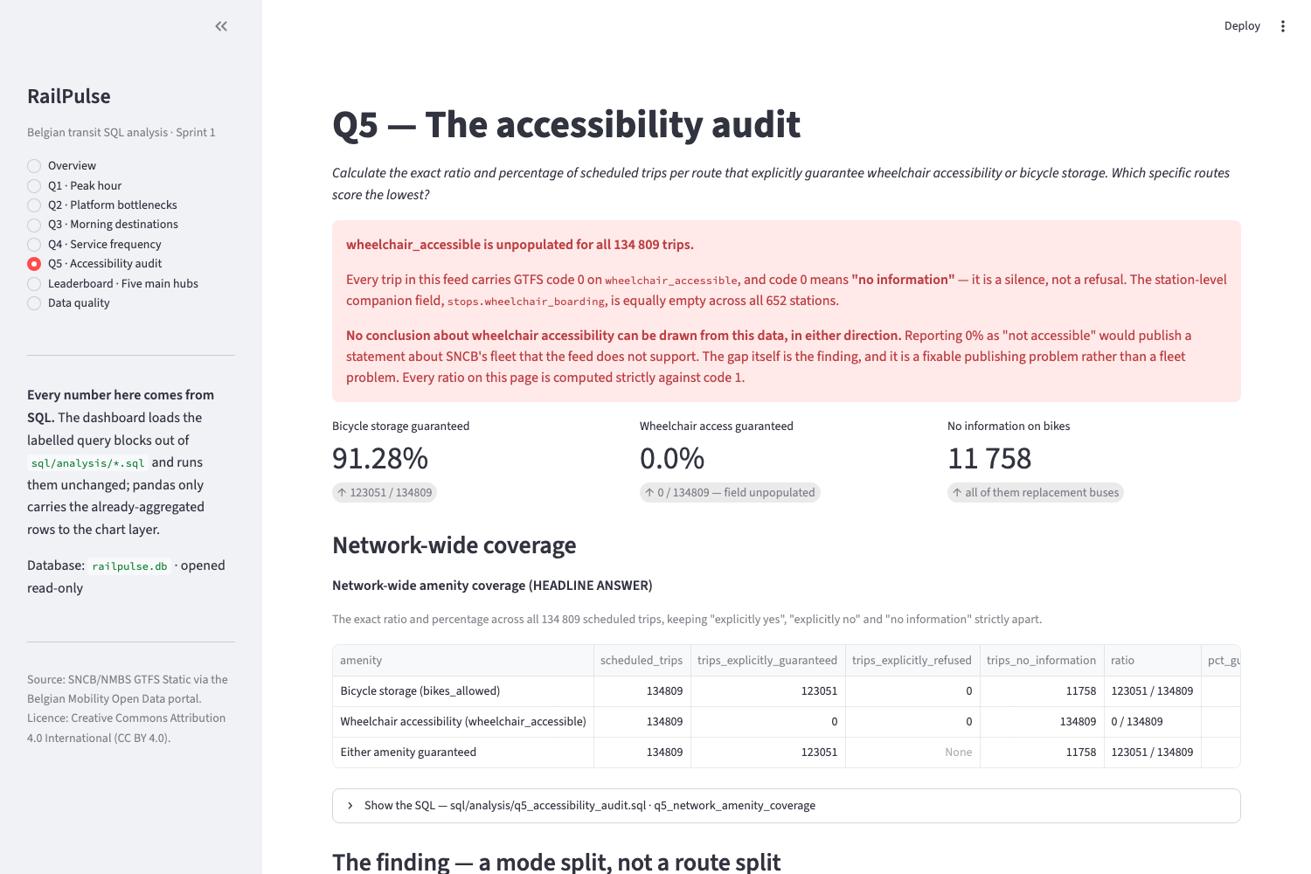
Q5 — The Accessibility Audit
Section 04 · Question 5
Q5
Bicycle storage: 91.3% guaranteed · Wheelchair: unpopulated for all 134,809 trips
The bicycle gap is a mode gap, not a route gap: 100% of 123,051 rail trips guarantee bike storage, 0% of 11,758 rail-replacement bus trips do. All 270 zero-scoring routes are buses. wheelchair_accessible is empty for ALL 134,809 trips — not a '0% accessible' finding, but a publishing gap: no journey planner using this feed can answer a wheelchair question at all.
Recommendations
1. Populate wheelchair_accessible at trip level and wheelchair_boarding at station level (single-digit cardinality fields, cheap to fix) 2. Set bikes_allowed on replacement buses explicitly (0=unknown, 2=no) — currently indistinguishable from an unset field 3. Procurement decision: bicycle capacity in the replacement-bus contract — not a route-by-route investigation
15

Slide 16
Key Findings — The Three Things Worth Acting On
Section 05
05
Finding 1
Bruxelles-Central is the network's structural bottleneck
Handles more annual departures than Bruxelles-Midi (311,324 vs 283,415) across 6 platforms instead of 21 — that is 8,113 timetabled calls per platform against Midi's 2,085, a 3.9× pressure differential. Its busiest platform turns over 12.8 trains in its peak hour, one every 4.7 minutes. No trough in the day to absorb disruption.
Finding 2
The evening peak is real and the timetable file hides it
Naïve COUNT(*) says the network peaks at 10:00. Annualised departures say 17:00. Hour 17 sits at rank 10 on the naïve measure and rank 1 on the real one. Capacity decisions taken from an unweighted timetable count would invest in the wrong hour. The mechanism: SNCB fragments each train number into ~21 trip rows, each covering ~9 dates.
Finding 3
The accessibility data cannot support an accessibility statement
Not because the network performs badly, but because the field is empty. wheelchair_accessible carries no value for any of 134,809 trips. wheelchair_boarding carries no value for any of 652 stations. This is a publishing gap — cheap to fix relative to what it blocks.
16

Slide 17
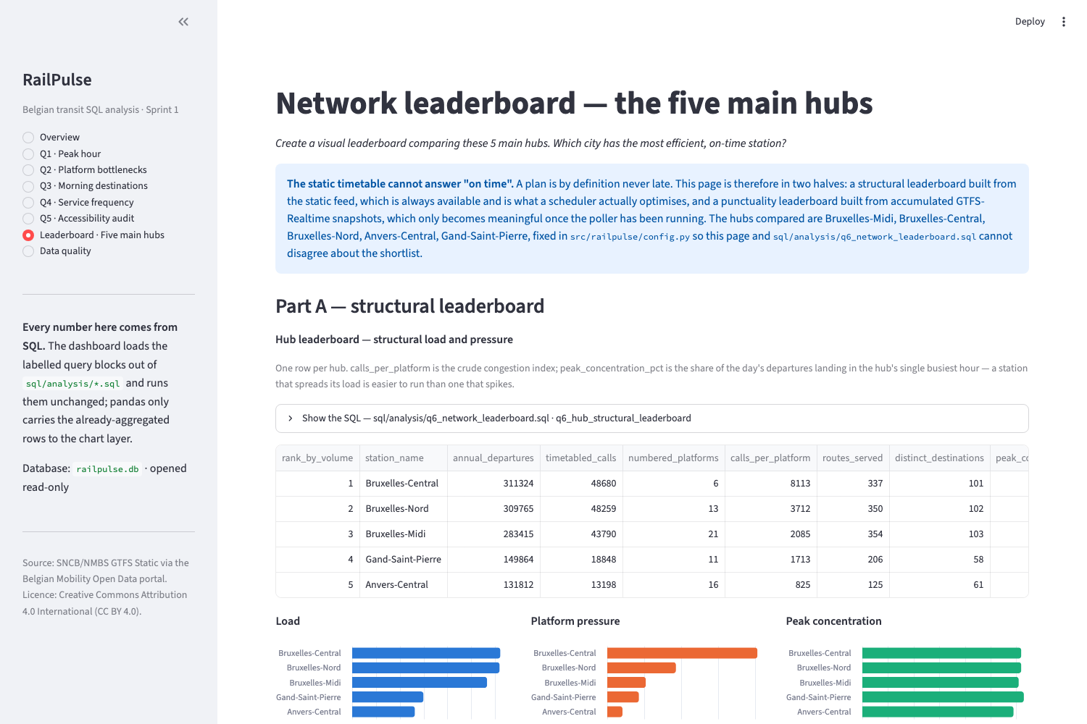
Nice-to-Have Features
Section 06
06
Live Stream Integration
GTFS-RT trip updates and service alerts polled every 30 s via scripts/poll_realtime.sh (cron / launchd). Append-only rt_* tables survive rebuilds. Idempotent: UNIQUE(feed, feed_timestamp_epoch) so over-polling skips duplicates. 100% of real-time trip IDs resolved against the static feed in observed window.
Network Leaderboard
Five main hubs compared: Bruxelles-Central, -Nord, -Midi, Anvers-Central, Gand-Saint-Pierre. Composite score (connectivity, platform headroom, load smoothness) + real-time punctuality. Punctuality from live GTFS-RT: observed delay distribution, on-time (<2 min) rates, cancellation tracking — mechanism works, needs a week of data for stable ranking.
Index Optimisation
EXPLAIN QUERY PLAN on every analytical query. Measured benchmarks: SARGable violations cost ~100× (Q1 histogram) to ~500× (Q2 platform lookup). Each index justified by a named query. Composite indexes led by the equality predicate, grouping column following. make benchmark reproduces all measurements.
17

Slide 18
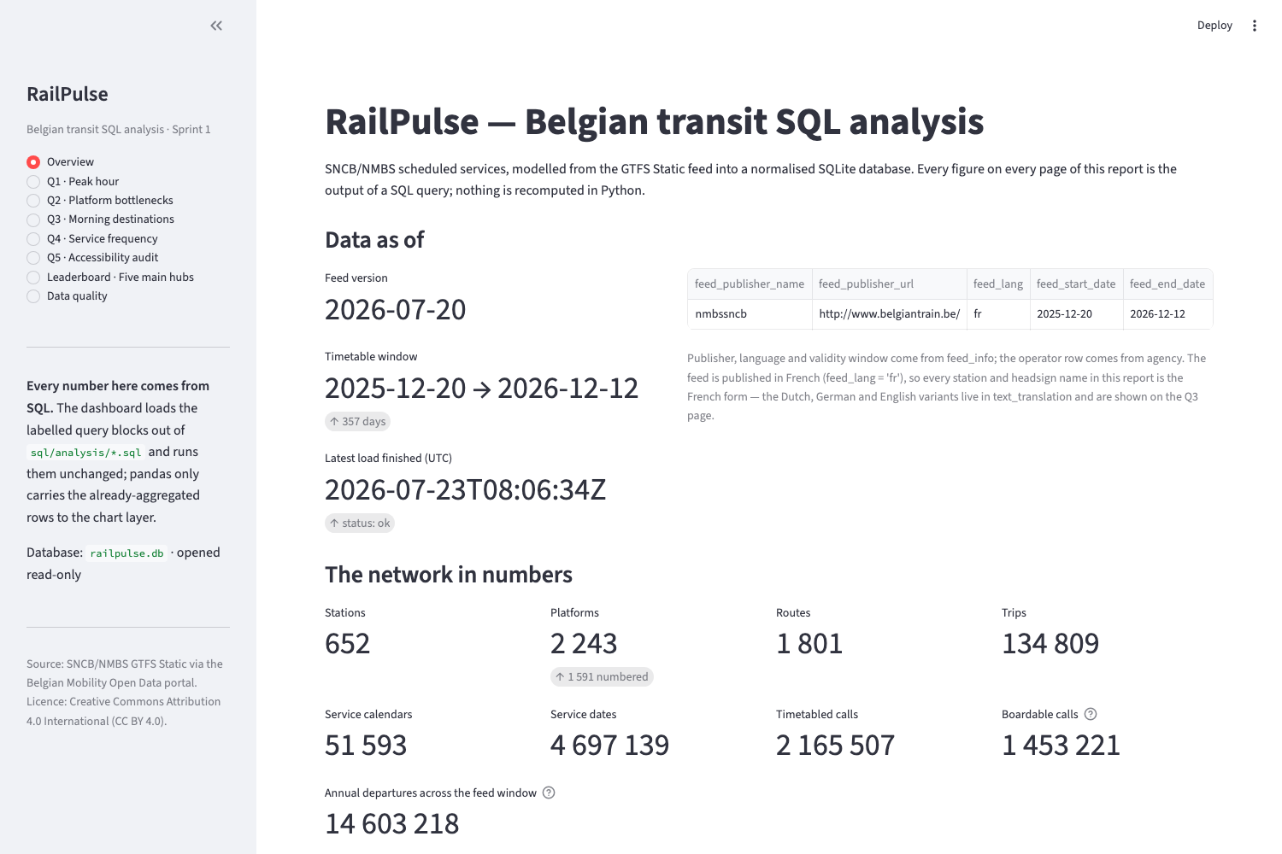
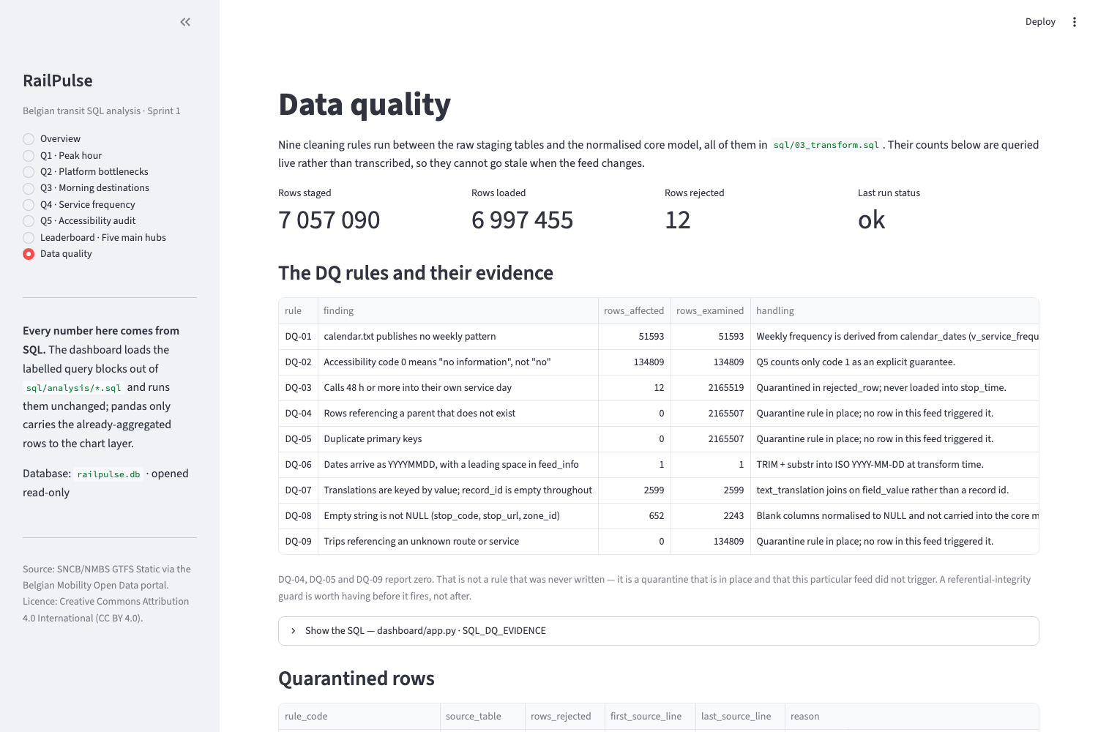
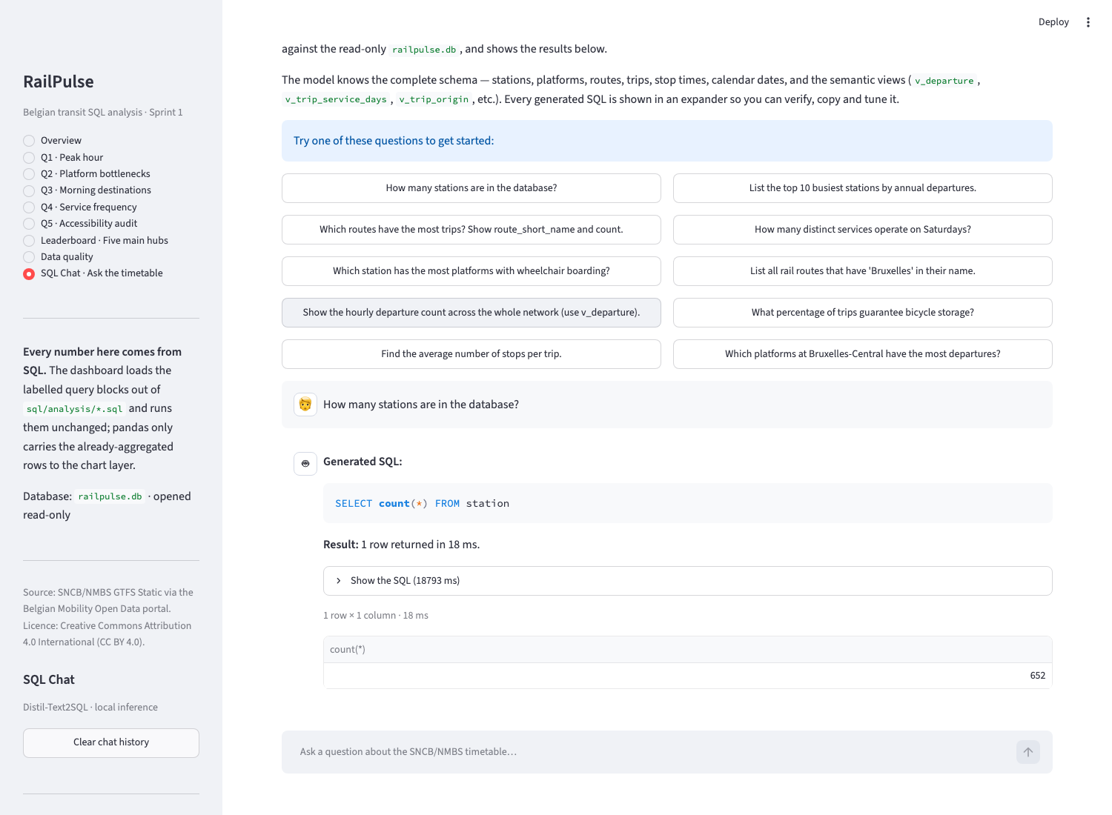
Streamlit Dashboard & SQL Chat
Section 06
06
The dashboard is a renderer, not an analyser. Every figure on every page is produced by a SQL query block loaded verbatim from sql/analysis/*.sql — the dashboard and graded deliverables cannot drift apart. pandas appears only to wrap already-aggregated rows for charting.
SQL Chat — Text-to-SQL (Sprint 4 preview, fully local)
Type a question in English → local HuggingFace model translates to SQL → SQL runs against read-only database → result tabled and auto-charted. Safety: (1) read-only connection — writes raise at the engine, (2) whole-statement guardrail blocks destructive keywords & stacked statements, (3) execution caps: 10 s timeout + 5,000 row limit. Optional install (~2 GB), degrades gracefully to install prompt if absent.
18

Slide 19
Database Theory — Interview Study Guide Highlights
Section 07
07
SQL&DB_theory.md covers 6 major topic areas, each with definitions, trade-offs and worked examples measured against this project's database. Here are the key highlights:
1. Database Paradigms
2. Relational Schema & Modelling
3. Analytical Modelling
• SQL vs NoSQL: schema-first, joins, ACID vs schema-flexible, horizontal scaling, eventual consistency • SQLite is embedded, not server-based — zero config, single file, one writer at a time • 50 concurrent scrapers → SQLITE_BUSY on 84-98% of writes → migrate to PostgreSQL (MVCC)
• 3NF: every non-key fact depends on the key, the whole key, and nothing but the key • This database is 3NF with one deliberate denormalisation (departure_hour — for SARGability) • PK vs FK vs UNIQUE: PK may or may NOT create a separate B-tree in SQLite (depends on type)
• stop_time is the fact table (2.17M rows, event grain). All others are dimensions • This schema is snowflaked: stop_time → platform → station (2-hop traversal) • The grain of a fact table is the first thing you state — and the first thing that gets wrong answers
4. ACID & CAP
5. Views / Window / Subquery
6. Index & SARGability
• ACID: Atomicity, Consistency, Isolation, Durability — 03_transform.sql runs as ONE transaction • CAP: SQLite is CP (Consistent + Partition-tolerant). When API goes down, it stays consistent • The 'C' in ACID ≠ the 'C' in CAP — different guarantees, shared letter by coincidence
• Views define a word once (v_departure = 'boardable call with a time'). Without it, 5 analysts give 5 answers • Window functions: aggregate WITHOUT collapsing rows. ROW_NUMBER, RANK, SUM OVER used throughout • Correlated subquery runs once per outer row — usually the performance problem
• SARGable = Search ARGument able = the engine can use an index. Wrap a column in a function → index unusable • WHERE strftime('%H', departure_time) = '17' is ~100× slower than WHERE departure_hour = 17 • Index Scan vs Index Seek: SEARCH cost grows with answer size, SCAN cost grows with TABLE size
19

Slide 20
Project Timeline
Section 08
08
Day 1
1
Portal registration + API subscription. Feed reconnaissance. Discovered the three quirks that shaped everything: empty calendar.txt flags, empty wheelchair_accessible, 577K pass-through calls.
2
Day 2
Schema design and the ELT pipeline — staging, 9 DQ rules, quarantine system, indexes, views. First full build.
3
Day 3
The five analytical questions, plus the annualisation insight that changed Q1 and Q3 answers. Nice-to-haves: real-time poller, network leaderboard, index benchmarks.
4
Day 4
Verification harness (21 assertions), 149-test suite, Streamlit dashboard, documentation, SQL Chat preview, study guide (SQL&DB_theory.md).
20

Slide 21
Evaluation Criteria & Deliverables
Section 08
08
Must-Have Criteria
Deliverables
• SQLite database with normalised schema and Foreign Keys ✓
• GitHub repository with source code
• Schema diagram (ERD + drawDB) ✓
• README.md — description, ERD, visuals, contributors, timeline, personal statement
• Clean data in every table (9 DQ rules, 12 quarantined of 7M rows) ✓
• All 5 core analytical questions accurately answered (SQL only) ✓
• team feedback: 5-minute overview + approach, DB design, answers
• Table definitions + queries in dedicated .sql files ✓
• Q&A: random question from SQL&DB_theory.md study guide
• Visualisation components match data queries (Streamlit dashboard) ✓
• PowerPoint presentation (this file!)
Nice-to-Have (all completed)
By the Numbers
• Live Stream Integration (GTFS-RT poller, cron/launchd) ✓
• 7,057,090 rows staged → 12 quarantined
• Network Leaderboard (5 hubs compared, structural + punctuality) ✓
• 149 tests · 47 labelled analysis queries
• Index Optimisation (EXPLAIN QUERY PLAN, benchmarks, make benchmark) ✓
• 34 enforced foreign keys · 21 verify assertions
• Team Study Guide (SQL&DB_theory.md — 6 major topic areas, 1,000+ lines) ✓
• ~3 min from ZIP to verified, indexed database
• SQL Chat — Text-to-SQL GenAI preview (local model, safety guardrails) ✓
• ~1,750 lines of Python · ~3,000+ lines of SQL
• PEP 517 package, editable install, Makefile
21

Slide 22
Thank You
RailPulse — Belgian Transit SQL Analysis
The interesting part of this project was not the SQL — it was discovering that the two most natural queries give the wrong answer. The query is the easy part. Knowing what the data actually is — and being willing to publish the number you did NOT pick, next to the one you did — is the job.
Stéphane van der Aa · BeCode AI & Data Science · July 2026 Data: NMBS-SNCB – Open Data – 2026-07-20 · Licensed CC BY 4.0
22

