Slide 1
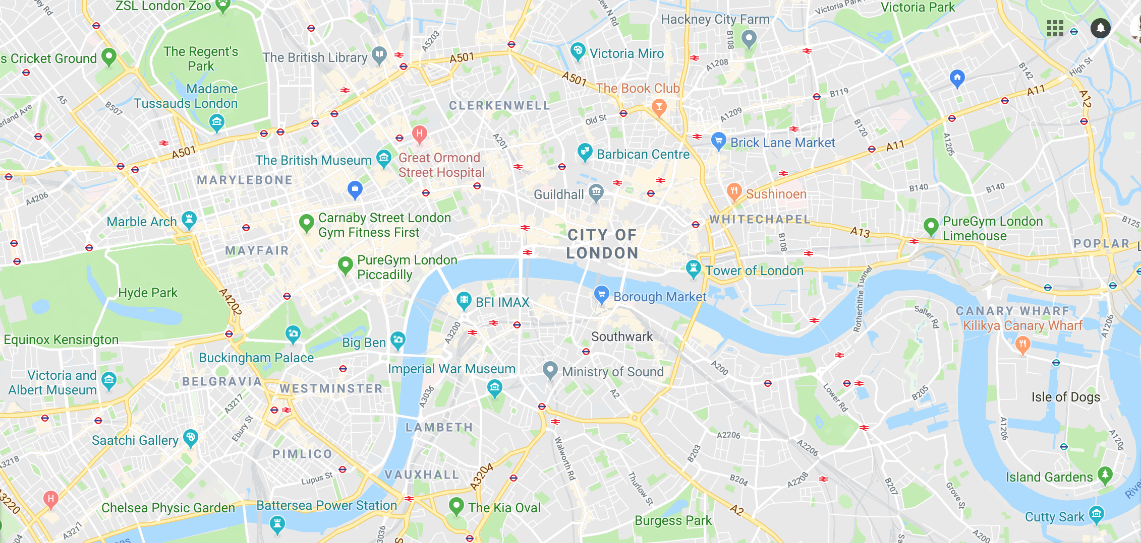

Pitch Deck
Ridesharing built by drivers for drivers and customers

Slide 2
EXECUTIVE SUMMARY
“The secret is to take an exciting product, service or concept and then to take it up a level, by applying your own vision and creativity”
Elope is a brand new ride-sharing app that rewards drivers and customers using gamification. In 2015 I lost my job. Around this time the first ride-sharing apps began emerging; at the forefront was Uber. Seeing that I needed a job, I decided to join Uber as a driver. Initially the experience was great: Uber offered me the opportunity to ‘be my own boss’ and work the hours I wanted, paid well, and above all listened to their drivers’ feedback.
But, eventually that all began to change–for the worst. Most notably:
- 20% commission taken at the start but that’s now increased to 35%
- No more driver discounts
- No rewards for drivers or customers
- Drivers having to work longer hours (most drivers now have to work 50/70 hours per week to make a decent living.
- Drivers feel exploited & mistreated
- The sense of autonomy that drivers felt at the start (being their own boss) is no longer there, and now drivers feel like their trapped in a system that’s taking advantage of them.
- Drivers are punished if they don’t accept jobs (regardless of their reasons)
- Uber recently has increased the waiting time drivers have to wait before they can cancel the ride to 8 minutes from 5 minutes this might not sound like a big change, but when TFL (Transport for London) only allows a driver to wait a maximum of 5 minutes to pick up customers, that is a huge change especially if as a driver you can be fined up to £180.
And this is how we plan to change things with Elope.
Build a strong sense of community so drivers become raving fans of the company. The driver’s are the ‘face’ of the business and the more passionate they are about the company the more this passion and enthusiasm will transfer over to the customers. Make each driver feel valued and wanted and not like another cog in the machine. A lot of ride-sharing companies have forgotten (or don’t realise) that the driver is a customer, too, and if the driver isn’t happy he/she will leave and move onto the next best platform or company. Currently 500 drivers are ready to sign up with Elope–this is without any marketing or promotion and hype. The vast majority have also said that they would be happy to recommend Elope to other drivers.
Why? Because Elope was designed by drivers for drivers.
This is already the case without any marketing, without sharing our core ideas with the drivers or reward sign-ups 500 drivers already want to sign up with the vast majority of them saying they will refer us to other drivers. Why? Because Elope is built by drivers, for drivers and customers.
2

Slide 3
FINANCIAL
We are looking for a £5 million investment to help us launch. This will allow us to pay for the TFL licence fee, staff, location, marketing and promotions to help attract drivers & customers.
500
Drivers
Target before launch and 2500 drivers before the end of 2019
£9 Billion
The value of the market in the UK
£14.63M
Revenue
With investment we can get 2500 drivers
3

Slide 4
PROJECTED REVENUE
(All numbers are in million £) | 2018-2019 2.5K DRIVERS | 2019-2020 5K DRIVERS | 2020-2021 10K DRIVERS
TOTAL REVENUE | 14.63 | 29.25 | 58.50
Driver Bonus & Rewards | 2.95 | - | -
Customer Bonus & Rewards | .37 | - | -
Payroll Expenses | .40 | .40 | .40
Marketing | .40 | .44 | .48
Legal, Profession & Subscriptions | .04 | .03 | .03
Office Rent | .03 | .03 | .04
Licenses Fee | .25 | .11 | .11
Total Expenditure | 4.43 | 1.02 | 1.07
Net | 10.19 | 28.23 | 57.43

Slide 5
RETURN ON INVESTMENT
We are asking investors to invest £5million in Elope.
By the third year, investors will make back 2x their investment.
£11.49M
£5.65M
£2.04M
YEAR 1
YEAR 2
YEAR 3

Slide 6



MAIN PROBLEMS
UNFAIR EARNINGS
EXPLOITATION
LACK OF LOYALTY
On average, ride sharing services take between 20-35% of total cost of active and cancelled trips
Drivers feel exploited due to unfair earnings and not being treated fairly
Drivers and customers are not loyal to the platform and will move to the next best thing
6

Slide 7



SOLUTIONS
PROPORTIONATE EARNINGS
BELONGING
LOYALTY
Elope will take 15% (which can go down to 10%) of completed trips
Drivers get fair earnings and feel valued for their work, thus creating a sense of belonging and forging a bond between the driver and Elope
Drivers take pride in their work and give top service, enhancing customer experience
Drivers and customers be given loyalty rewards, which will cultivate brand loyalty
7

Slide 8


LONDON MARKET VALIDATION
USED FOR FOUR HERO POINTS
4,800 drivers
£345.8M in revenue
31% increase in revenue
40,000 drivers
£36.9M in revenue
59% increase in revenue
8

Slide 9
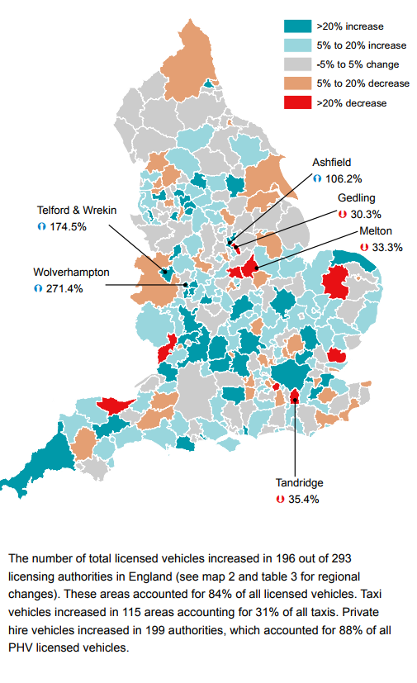
UK MARKET SIZE
Total licensed vehicles increased by 16% to 281.000 since 2015.
23.6% increase in licensed private hire
9

Slide 10
MARKET COMPARISON
 | EASY ENTRY | % TAKEN | FLEXIBLE HOURS | TIPS | DRIVER & CUSTOMER REWARDS | NO SURGE & PEAK CHARGES | NO DEAD WAITING HOURS | DRIVER DISCOUNTS | FUEL CARD | % TAKEN FROM CANCELLED TRIPS
Elope |  | 10-15% |  |  |  |  |  |  |  | 0%
Uber |  | 20-35% |  |  |  |  |  |  |  | 20-35%
Addison Lee |  | 20% |  |  |  |  |  |  |  | 20%
Private Hire |  | 20% |  |  |  |  |  |  |  | N/A
Gett |  | 20% |  |  |  |  |  |  |  | 20%
10

Slide 11
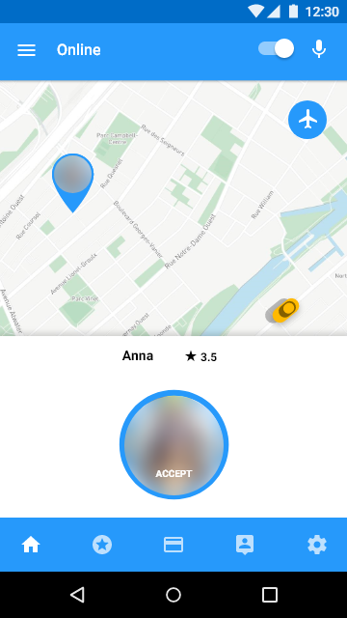
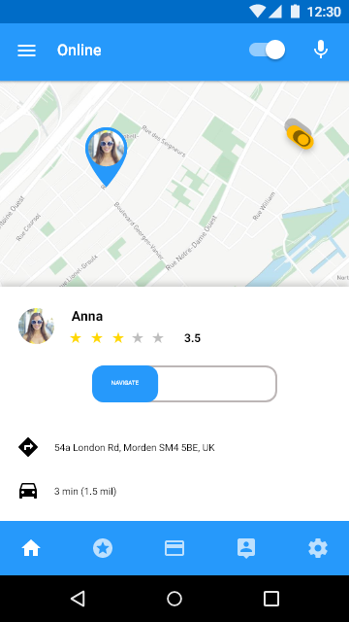
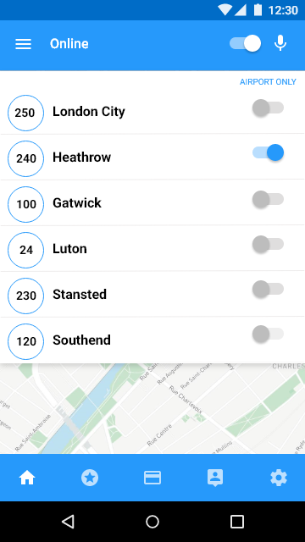
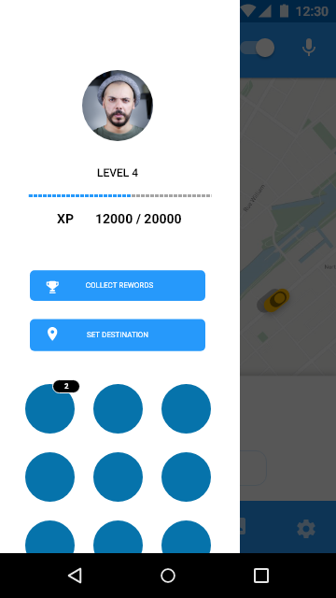
PRODUCT – DRIVER APP
Full Interactive design link
11

Slide 12
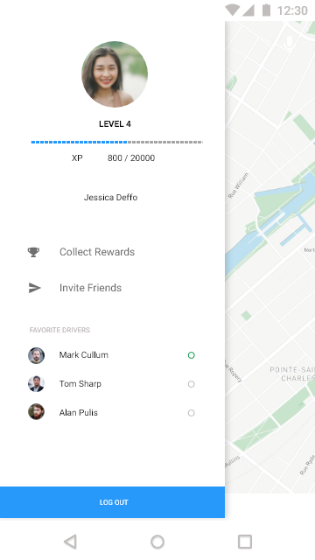
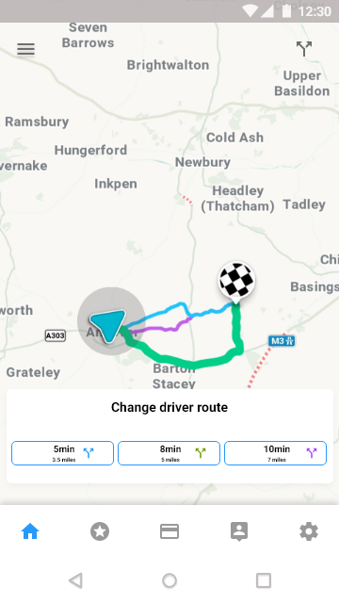
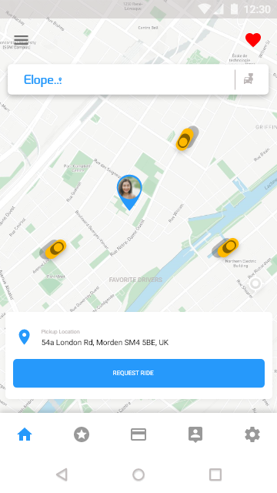
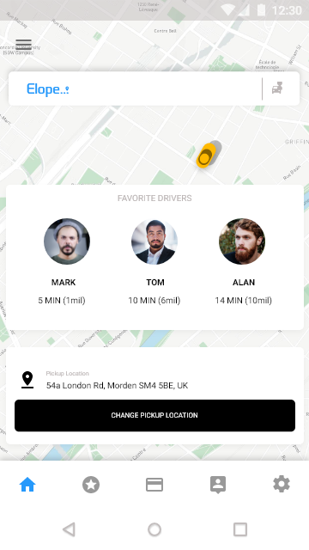
PRODUCT – CUSTOMER APP
Full Interactive design link
12

Slide 13
BUSINESS MODEL
15% COMMISSION ON EACH RIDE TAKEN
£9 BILLION
£750
£14.63 MILLION
UK MARKET VALUE
AVERAGE EARNINGS PER DRIVER PER WEEK
PROJECTED REVENUE BY 2019
13

Slide 14
MARKET ADOPTION
Marketing & Partnerships
Drivers
Customers
Marketing in key area of London
Airports
Train stations & bus stops
Events around London
Advertise outside Uber recruitment office
Sponsor UK based travel Vloggers
Fuel card deal done
Cheaper insurance for drivers
Cheaper car maintenance
£500 Sign up reward
£200 Referral reward
1st trip Free
£5 Referral reward
14

Slide 15






COMPETITIVE ADVANTAGE
First to Market
Built by drivers, combining gamification
with ridesharing
Driver Focused
Taking a lower % from drivers which can go down further. Clear progression path for drivers to move to the next class of cars – X/XL > Exec > Lux
Loyalty Rewards
Drivers and customers can collect rewards
When they level up such as discounted rides for the customer
Customer Control
See the route a driver is taking and change it. Request only your favourite drivers, Schedule pick ups
Ease of Use
One button click to request a driver or Favourite driver and change route.
Elope
Design & Brand with
Memorable name
15

Slide 16


TEAM
Saqib Munir - CEO
Business Development
Graduated in computer games design
Worked in Film and Video games marketing
Created a mobile gaming app company that launched a game on IOS and Android platforms
Worked as a Uber driver for 3 years
Slawomir Chmielewski - CEO
Developer
Games and App developer
Co-founder of Friendsbox Design Studio
Creator of two mobile games for iOS and Android platforms Zombie Run and Solar Defender
Worked as a Uber driver for 1 year
16

Slide 17
DRIVER FEEDBACK
Over 500 drivers spoken to
A vast majority loved and wanted to see our ideas go live, but finally just felt like a company
was going to be on their side rather then exploit or take advantage of the drivers
“Really like the Idea of a lower
percentage taken”
Asif Rana
“Hope this goes live as waiting in airports for my next job some times feels like a waist of a day so having to ability to be in a virtual queue for a airport job while doing normal jobs is amazing”
Lewis Miller
“Finally a company that isn’t trying to
take advantage of the drivers”
Marius Catalin
17

Slide 18
Saqib Munir
Email – saqib@elope.co.uk
Mobile - +44 (0) 7575649020
Slawomir Chmielewski
Email – slawomir@elope.co.uk
Mobile - +44 (0) 7934652069
www.elope.co.uk
18

