Slide 1



Slide 2



Slide 3



Slide 4
Know about our C.E.O
Pradipta Kumar Ghosh, Sole Trader of Prithvi Security, M.Sc.(Data Telecommunications Networks) from University of Salford, Manchester(UK), MBA, MCSE, and have more than 15 years experience in the field of IT business sector / industry.
Pradipta invited by Association of Computer Machinery (ACM), New York, US for delivering lecture on ‘Rabin’s Scheme and RSA Cryptography and Conversion of Power’.
He has extensive experience in managing IT infrastructure and operations at a senior level as well as demonstrated capabilities in project management and proven ability to lead target teams.

Slide 5

You may follow us on :
https://www.linkedin.com/company/prithvisecurity

Slide 6
Sensor
A device that measures or detects a real-world condition, such as motion, heat or light and converts the condition into an analog or digital representation. An optical sensor detects the intensity or brightness of light, or the intensity of red, green and blue for color systems.

Slide 7
A sensor is a small hardware device which is capable of generating response to change in physical environment.
Although sensors are of different type which are application specific but desired characteristics of a sensor node are small size and low power consumption

Slide 8
Wireless Sensor Networks
Wireless sensor network (WSN) is a wireless network consisting of spatially distributed autonomous devices using sensors to cooperatively monitor physical or environmental conditions, such as temperature, sound, vibration, pressure, motion or pollutants, at different locations .

Slide 9
Wireless Sensor Networks
• A collection of sensing devices that can communicate wirelessly
• Each device can sense, process, and talk to its peers
• Typically, centralized collection point (sink or base station)

Slide 10
Sensor Node
A sensing node has 3 basic components:
CPU
radio transceiver
sensor array

Slide 11
Sink
A
Internet and Satellite
E
C
D
B
Task Manager node
Sensor Field
Sensor Node
User
Sensor Node deployment and Communication Infrastructure

Slide 12
The role of Wireless Sensor Networks is essentially that of a monitor. What is being is monitored can usually be placed within one of the three groups:
• Area Monitoring: i.e., monitoring somewhere; examples include the Environment or area alarms (intrusion etc.)

Slide 13
• Entity Monitoring: i.e., monitoring something; examples include a civil structure (bridge, building etc.) or a human body.
• Area-Entity Interaction Monitoring: i.e., monitoring something, somewhere in context; examples include natural disaster sites, asset tracking or a manufacturing process.

Slide 14
There is presently great interest in Wireless Sensor Networks (WSNs). To clarify the issues, we have needed to separate technology push from market pull. Performing this separation has shown the push to often be greater than the pull. In particular, we have found no killer application for WSNs, although we expect a steady growth in the future market based on a diversity of industrial and automation application. WSNs are among the 5 emerging and innovative technologies that will change the world, for the better.

Slide 15
Sensor Network Concept
Sensors nodes are very close to each other
Sensor nodes have local processing capability
Sensor nodes can be randomly and rapidly deployed even in places inaccessible for humans

Slide 16
Several thousand nodes
Nodes are tens of feet of each other
Densities as high as 20 nodes/m3
Sink
Internet, Satellite, etc
Sink
Task
Manager

Slide 17
A WSN typically has little or no infrastructure. It consists of a number of sensor nodes (few tens to thousands) working together to monitor a region to obtain data about the environment.

Slide 18
Sensor nodes can organize themselves to communicate with an access point
Sensor nodes can collaboratively work

Slide 19

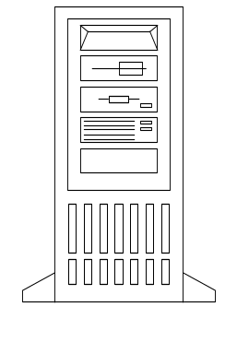

Soil Moisture etc.
Server
Mote
Communication’s barrier
Sensor field
Internet
Gateway

Slide 20

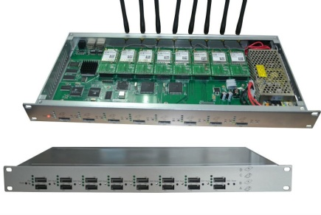

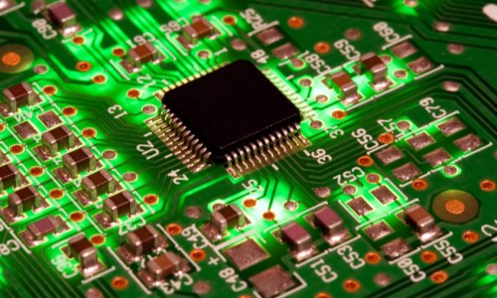
USB Connection
Gateway
Base Station
Radio Link
Node
Human

Slide 21
Hardware Requirements
Motes: A mote is a low-powered computer with a radio transmitter capable of forming ad-hoc communication with other motes. A mote may be connected to one or more sensor boards.

Slide 22
Gateway: A gateway is device which is responsible for injecting queries into the sensor network, gathering responses from the network, and presenting the responses to the user’s workstation. The gateway interacts with the user directly or remotely through mobile communication network.

Slide 23
Processes and services
Wireless Ad-hoc Sensor Networks (WSNs)
Wireless Ad-hoc Sensor Networks (WSNs) are quickly gaining popularity due to the fact that they are potentially low cost solutions to a variety of real- world challenges. WSNs have significant impact upon the efficiency of Military and Civil Applications, Disaster Detection and Management, e.g., earthquake, cyclone, flood, fire etc., Air and Water Pollution Control, Tele-health, Medical monitoring and micro-surgery; which may be classified into three classes:
• Data Collection
• Surveillance, and object tracking

Slide 24
Monitoring workstation: The monitoring workstation is a PC with required compatible software installed, and is used by the user to configure the WSN, to submit queries to the network, or to view the data collected by the network.

Slide 25




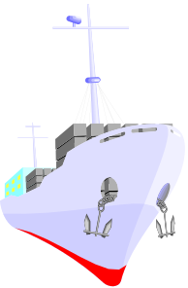



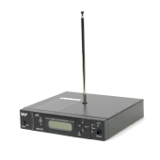
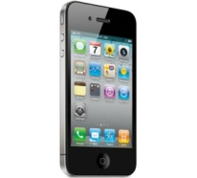




Machine Monitoring
Animal Monitoring
Vehicle Monitoring
Sensor
Wireless Data Collection Networks
Medical Monitoring
Management Centre
(Database, Large Storage, and Analysis
BSC(Base Station Controller, and Processing)
Ship Monitoring
BST
Data Acquisition Networks
Data Distribution Network
Roving Human Monitor PDA
Wireless(Ethernet WLAN Optical)
Online
Monitoring
Printer
Transmitter
Server
Wireless Wi-Fi, Bluetooth, Cellular Network(CDMA, GSM)
Any where and any time access
Laptop
Computer
Cellular Phone

Slide 26
Applications
WSN applications can be classified into two categories:
Monitoring
Tracking

Slide 27
Monitoring applications
indoor/outdoor environmental monitoring viz., agriculture, air / water pollution
health and wellness monitoring, power monitoring, inventory
location monitoring, factory and process automation viz., pipeline
seismic and structural monitoring.

Slide 28
Tracking objects
        humans
        vehicles.

Slide 29
Advantages of WSNs over traditional methods
• Wide coverage
• Long monitoring periods
• No individual tracking
• Data available directly to researcher’s location
• Land and Aquatic Coverage
• Continuous monitoring

Slide 30
Different Types of Sensors
Acoustic, sound, vibration sensor
Chemical sensor
Fire sensor
Environment, weather, moisture, humidity sensor
Optical, light, imaging, photon sensor
Pressure sensor
Thermal, heat, temperature sensor

Slide 31
WSN Operating Systems
TinyOS
Contiki
MANTIS
Btnut
SOS
Nano-RK

Slide 32
TinyOS:
Event-driven programming model instead of multithreading
TinyOS and its programs written in nesC

Slide 33
TinyOS Charactersitics:
Small memory footprint
  non-preemptable FIFO task scheduling
Power Efficient
  Puts microcontroller to sleep
  Puts radio to sleep

Slide 34
Concurrency-Intensive Operations
  Event-driven architecture
  Efficient Interrupts and event handling
No Real-time guarantees

Slide 35
Commercial Use
• Cost: The devices should have relatively low cost.
• Availability: The devices should be easily available and continue to be so
.
• Unlicensed usage: The devices should be usable without requiring any form of licensing, e.g., for use of the RF spectrum, or for the use of firmware or software which is used or modified during course of our work.
• Ease of Use: The devices chosen must be easy to program and must have software toolkits.
• Interworking and gateways: It should be easily possible to allow interworking of the sensor devices with other convenient network technologies, e.g., Internet Protocol (IP) gateways for sensors allowing inter action between the internet world and the world of the sensor network.
• System Software: There is a choice of operating system, but the officially supported platform is TinyOS, commonly accepted open-source development environment for sensor applications

Slide 36
WSN Emulators
TOSSIM
ATEMU
Avrora
EmStar

Slide 37
Market Information
As per the report of ON World, in 2018 global annual Wireless Sensor Network market revenues, including equipment and services, will reach $102 billion, up from
$23 billion in 2013. Residential application will account for more than half of unit shipments in 2018. During the same period, commercial, industrial and municipal WSNs are projected growth at a 38% compound annual growth (CAGR).

Slide 38
Despite a challenging economy, the industrial Wireless Sensor Network (WSN) market has doubled over the past two years. A recently completed ON World survey of 216 industrial automation professionals, in collaboration with ISA, HART Communication foundation (HCF) and the Wireless Industrial Networking Alliance (WINA), points to increasing WSN adoption and expanding markets.

Slide 39
When ON World started researching industrial wireless sensing 10 years ago, deployments of more than 20 nodes were rare. Today, network densities are increasing, and several sites have deployments of more than 3000 nodes. Within the next 5 years, installed wireless industrial field devices will increase by 553 % when there will be nearly 24 million wireless-enabled sensors and actuators, or sensing points, deployed worldwide. By 2016, 39% of deployed nodes will be used for new applications that are uniquely enabled by WSN technology.

Slide 40
Another report from Forecast Technologies Players, WSNs market will grow to $1.8 billion by 2024.
Overall we conclude that the WSN market is still at an early stage. Many of the providers are small or start-up companies rather than integrated large players. Thus indicates that the market still has to develop confidence in the use and acceptability of WSNs.

Slide 41
Competitors
Some examples of companies and new entrants in WSNs include:
• ArchRock
• Coronis
• Crossbow
• Emerson Process Management
• GE Sensing
• MeshNetics
• Moteiv
• NEC
• Sensicast / Adaptive Wireless UK

Slide 42
Project
Established major sensor / controls suppliers
• Siemens
• Honeywell (Partnering with Crossbow Inc.)
Although, the devices should be easily available and continue to be so.

Slide 43
Major Customer Group
➢ Government
1. Defense Department
2. Police
➢ University
➢ Shopping Complex
➢ Building
➢ Hospital and Nursing Home
➢ Environment and Pollution Control Department
➢ Meteorological Department etc.
➢ Railways / Airports

Slide 44
Conclusion
WSNs can be deployed almost anywhere (including underwater and underground).
The following organizations use WSNs for their industrial purpose:-
➢ British Petroleum (BP)
BP use WSNs for detecting hazardous storage condition for its petrochemical
products and for continuous vibration monitoring of the engines of oil tanks.
➢ The Pentagon building use WSNs extensively.
➢ Intel use sensor network for monitoring the state of semiconductor fabrication equipments to determine if the machines are about to fail.
➢ Boeing’s use its” pressure belt” sensor networks for measuring pressure distribution on the wing surfaces of airplanes.
➢ Space Exploration: NASA’s Jet Propulsion Laboratory use sensor networks for exploring other planets or asteroids.

Slide 45


