Slide 1


Tunisia
Empowering Your Business

Slide 2
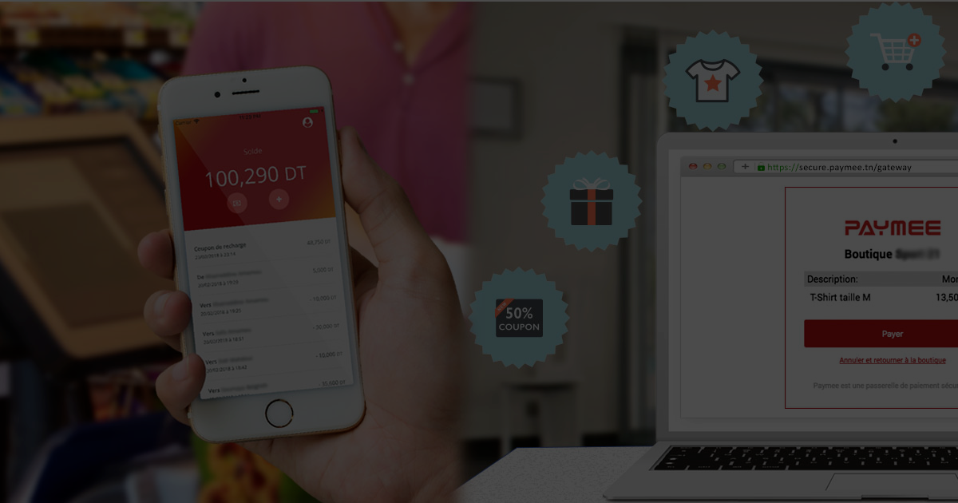
Problem
E-commerce payments methods are limited to credit cards and cash on delivery
Credit card fees are high
Cash on delivery requires extra security to transport funds
No easy way exists to do instant payment
Credit card terminals are seldom used in stores

Slide 3



Solution
An e-wallet mobile application to pay in store with mobile phone and an online payment gateway to pay on the Internet
Secure your money
by avoiding cash
Acquire new customers
by offering new payment methods
Instant Payment
Using digital transactions

Slide 4
Market Size
7
Million +
50
thousand +
2
thousand +
Connected users
With mobile phones
Stores
In all fields
E-commerce websites
In all categories

Slide 5
Product

Slide 6
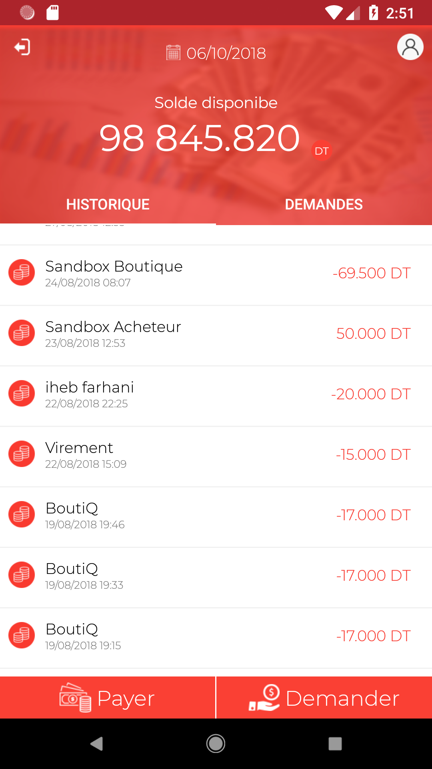
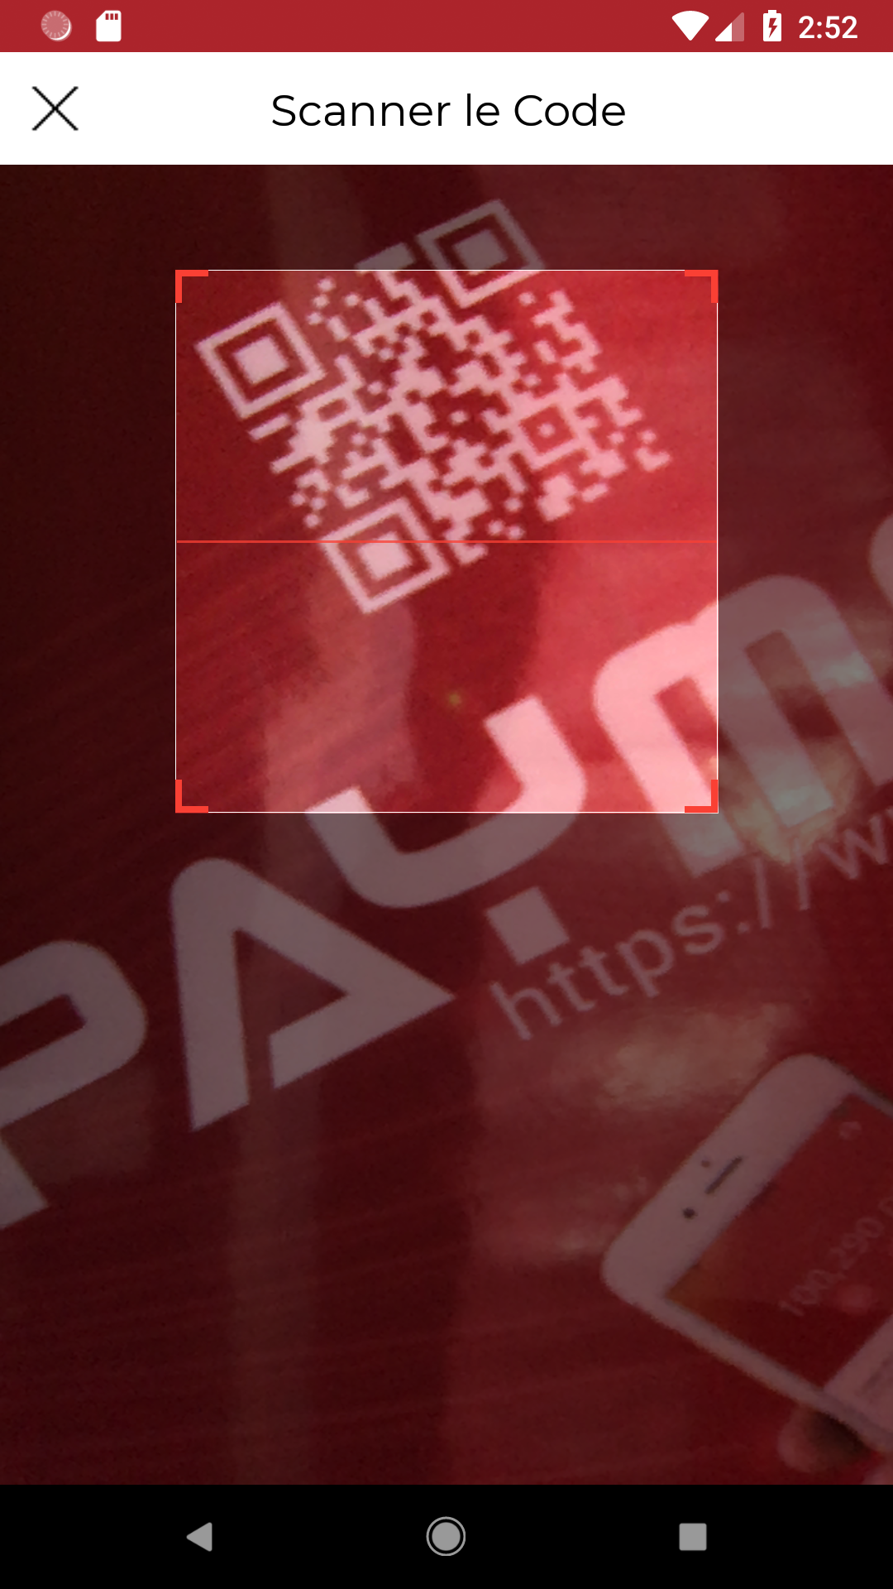
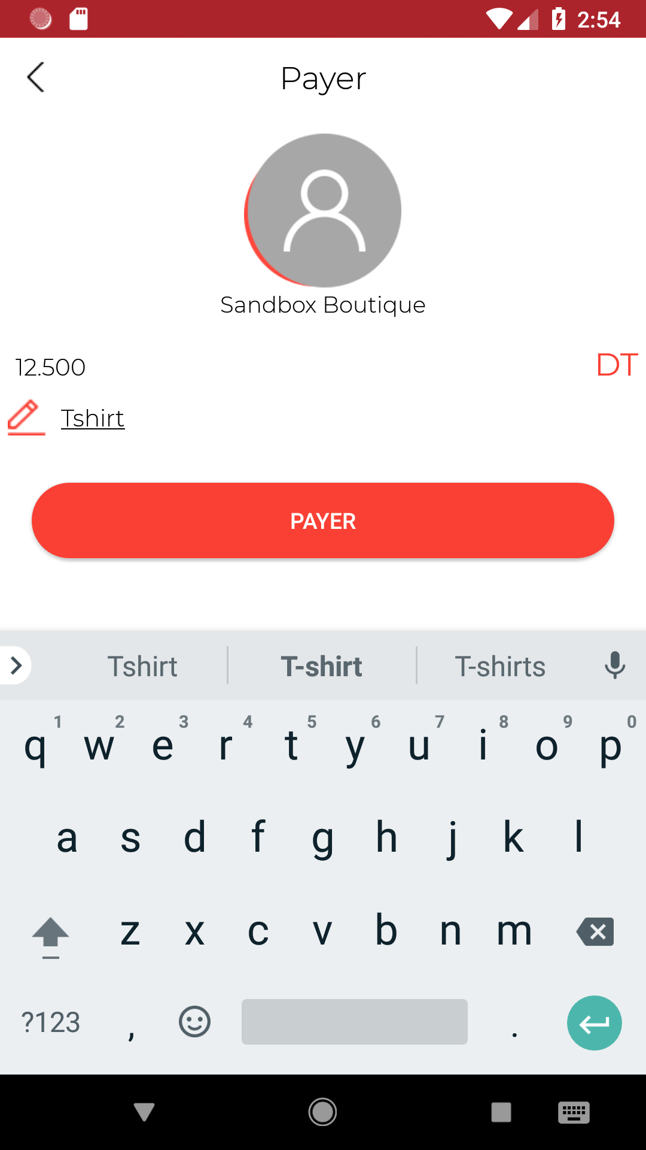
Pay in a Store, Send and Receive Money
Click Pay
Select receiver
Confirm

Slide 7
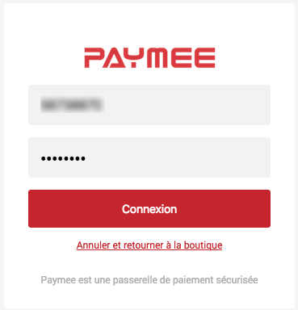
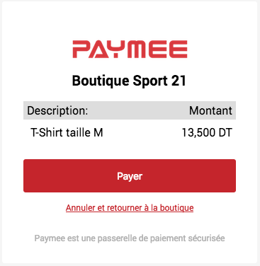
Pay Online
Order confirmation
Confirm
Checkout
Connect
Pay with Paymee

Slide 8



Particular use cases
Insurance
Refund customers
Money Pot
Collect money pots for special occasions
Companies
Top-Up employees’ accounts with bonus and allowances

Slide 9




Future optimizations
Go International
Start the service in other countries
Add USSD Payment
Partnership with telecommunications companies
Add debit card
Link a Paymee account to a debit card
Interoperability
Partnership with other payment service providers

Slide 10
Business Model
We take on average 1.7% commission from the merchant on each transaction
85
Million +
45
Tunisian Dinars
65
Million Tunisian Dinar
Transactions
10% of Available market
Average shopping cart
Online and In store
Revenue
Projected by 2021

Slide 11
Adoption Strategy
Partnerships
Web agencies
Governmental organizations
Clothing stores
E-commerce websites
Media
Facebook ads
Instagram influencers
TV and radio ads
Events
Exhibitions
Technology conferences

Slide 12
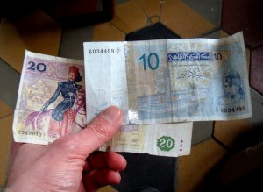


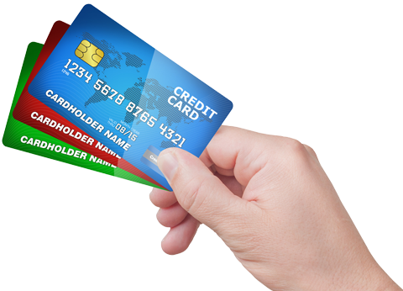

Competition
Affordable
Offline Payment
Online Payment Gateway
Expensive

Slide 13






Competitive Advantages
First to market
For online payment gateway based on an e-wallet
More Secure
Latest security technologies used, requires login on launch
Faster
Pay, Send and receive money instantly
Ease of use
Simple User Interface. 60 seconds to create an account
100% digital
All is done using the mobile phone
Free for individuals
Only merchants pay a commission

Slide 14



Team
Marwen Amamou, Business Developer and Backend Programmer,
Entrepreneur and programmer. A graduate of the engineering school of Versailles. Worked with ENGIE, Orange and Dassault Systems. Sold his first program at the age of 17. Started as a web developer and went his way up to be a business developer with technical background.
Nesrine Hileli, Business Developer and Marketing Director,
Treasurer at the Junior Chamber International. A graduate of Carthage School in Business and Marketing Intelligence.
Iheb Farhani, Mobile Application Programmer,
Founder of Coders Geeks+ and Android coach at the university’s Google Club. A graduate of the technology school of Sousse. Already ten mobile applications in his portfolio.

Slide 15

Press
The startup that will revolutionize payment methods in Tunisia.
The application that will change payment habits of tunisian consumers.
Paymee makes it simple to send and receive money.
L’instant M
L’économiste maghrébin
Media Press TN

Slide 16
Finance
We’re looking for 12 month financing to get an authorization as a payment service provider and to reach 20 million transactions on Paymee
20
Million
45
Tunisian Dinars
15
Million Tunisian Dinar
Transactions
average 1.7% commission
Average shopping cart
Online and In store
Revenue
Over 12 months

