Slide 1


Slide 2
OUR BIG IDEA
Polietik is the world’s first web/mobile enabled data-driven social media platform for civic engagement and politics.
POLIETIK’s mission is to provide a virtual platform for citizens of any constituency, district, or state to communicate, interact with, and engage their political representatives and vice-versa through an unique and innovative geo hierarchical approach. We wish to bring many major political activities under one umbrella platform that would bridge the gap between politics and technology.
Website- https://polietik.com/
Video Description- https://www.youtube.com/watch?v=b1dlGuL_ouE&feature=youtu.be

Slide 3
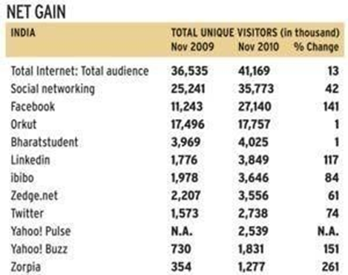
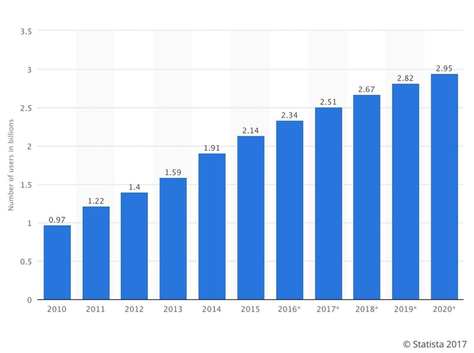
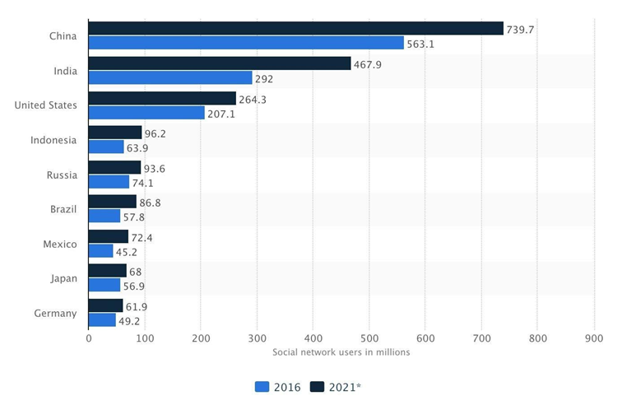
INDUSTRY OUTLOOK
The Social Media industry is an ever-growing one with total numbers of active users well exceed the 2 billion mark monthly. By the end of the decade, this number will be around the region of 3 billion as estimated by various studies. The following infographics depicts this:

Slide 4
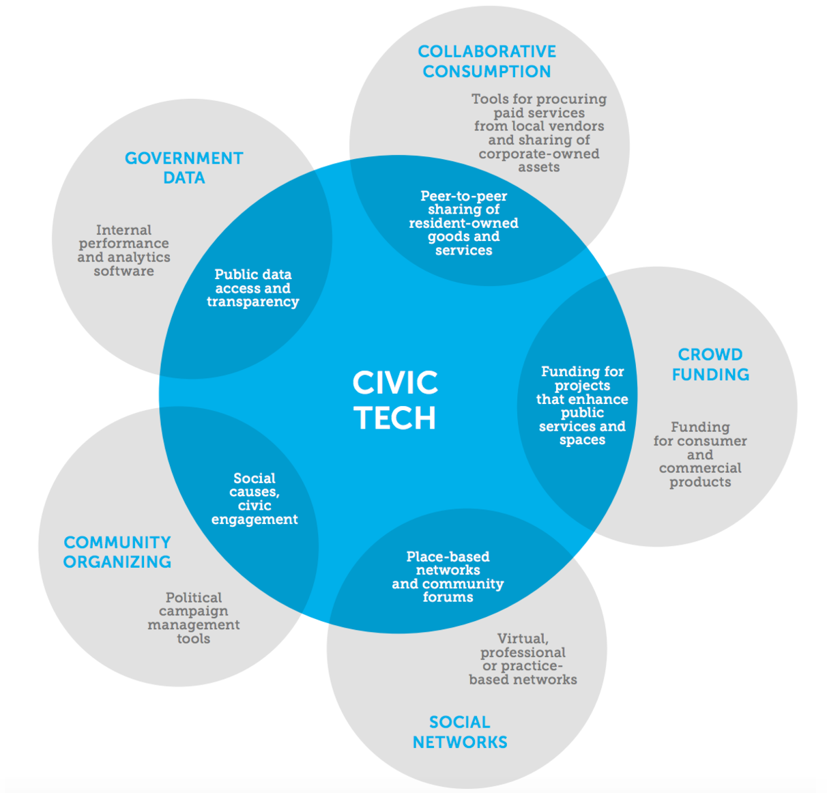
CIVIC TECHNOLOGY/GOVTECH
As an emerging sector, Civic Tech is defined as incorporating any technology that is used to empower citizens or help make government more accessible, efficient, and effective. Civic tech isn’t just talk, Omidyar notes, it is a community of people coming together to create tangible projects and take action. The civic tech and open data movements have grown with the ubiquity of personal technology.
A $400 billion market.

Slide 5
TARGET MARKET
FOR CITIZENS:
Age: 18-40 (initially millennial)
Gender: M/F/O
Location: Worldwide, India (Delhi initially) ​
Occupation: Student/ Any active job
Education level: Any level of Education, Knowledgeable about basic mobile/web technologies
FOR INFLUENCERS
Industry: Politics/ Bureaucracy/ Media
Location: Worldwide, India (Delhi initially)
Stage in Career: Upcoming/ Mature
Position: Currently holding official post or active political entity that does not hold public office.

Slide 6
KEY FEATURES OF THE PRODUCT
POLIETIK uses a unique geo-hierarchical architecture to make network relationships non-existent. That is, it allows people from within a geo-location (such as a constituency, district, or state) to engage in political discourse from that location’s particular feed including direct access to all other Citizens and Influencers within the same geolocation, thus not mandating any formal social networking relationship with other users. All activities that users engage in are location-specific.
Voices: Allow users to “Raise a Voice” on the platform by posting content in the form of header, description, and special tagging options - for e.g. users can talk about a specific issue affecting their community and then tag or link it to a specific Influencer. Also, users can agree or disagree to the Voices.
Data Analytics​: Use big-data and data analytics to study demographic data stored in our databases and then use the same to calculate various political trends and statistics based on predefined yet mutable parameters.
Allow users to see how similar they are in percentage to another politician or user by the number of supporters (based on geolocation).
Donation Service: Allow users to make quick and simple donations to their Influencer of choice by the click of a button (assuming that Influencer’s bank details have been verified). This would allow the general public to easily participate in the fundraising process and would immensely help political parties to raise large sums of money in a simple crowdfunding manner. Also, all donation will be catalogued so there is clear transparency concerning the movement of funds. A commission fee would be charged at predefined percentage for each donation.

Slide 7

REVENUE MODEL
Advertising: Allow Influencers to openly engage in digital/virtual campaigns on the platform based on a set of chosen parameters (eg. age group, gender, constituency, district, state, issue, time period, etc.) so as to get maximum political penetration within a target audience of their choice.
Big Data Access: As Polietik would like to incentivise usage by Influencers, it will provide them access to demographic statistical data from their regions based on the parameters requested. Apart from certain free data, even paid data would come at a fractional cost compared to the amount spent by political entities on acquiring such data from physical sources such as surveys.
Crowdfunding: Through Polietik, donating to one’s candidate or party of choice is as simple as a click of button as users can simply navigate to the profile of the entity they wish to donate to, and use our simple secure online donation gateway to donate money to them. Citizens can also donate to Influencers causes and issues they support and help raise influencers fund and create meaningful impact on society.

Slide 8
Progress
Sep. 2017
Incorporated Libereco Global Technologies Private Limited
Nov. 2017
Received Angel Investment from Ampcus Inc
Feb. 2018
Developed Web version of Polietik
Apr. 2018
Developed Android/IOS versions of Polietik

Slide 9
Funding History
Received $500,000 in Angel Funding from Ampcus Inc (https://www.ampcus.com/) led by Salil Sankaran (President) in October 2017. Used this money to develop the Polieitk platform on web, IOS and Android and to renumerate a team 10 dedicated developers and IT/Software specialists.
We are looking to raise a sum of $ 2 million for 20% equity in return which shall be used to enhance our marketing, business development and operational capacity and drive the growth of the company.
Current Equity Breakdown: Sarvashreshth Kalash (COO/Cofounder) – 37.5%, Siddhant Kalash (CEO/Cofounder) – 37.5 %, Salil Sankaran (Angel Investor) - 25%

Slide 10
Team
Siddhant Kalash - CEO/Cofounder :
Bachelors in Computer Science from Florida Institute of Technology 2013 - 2017
Project management
Worked with Northrop Grumman & Harris Corp. on Actuated Winglet Project
Created first functional POLIETIK prototype
Over 4+ Years in Software Development
Sarvashreshth Kalash - COO/Cofounder :
BSc International Relations and Politics from University of Bath
MSc Management (Strategic Management and Digital Business and Innovation)
Developed Marketing and Brand Management practices at Magent.me Imperial College London division. Held position of Brand Ambassador
Worked at KPMG (India/UK) in the Digital Consulting Division. Experience in financial management, digital architecture and data analytics implementation
Worked at Ampcus and SoCash as Business Development Manager. Oversaw client acquisition, revenue generation, key account management. Developed client relations and in charge of brand growth.
Consultant-Government Advisory-KPMG, India

