Slide 1

LEOSYSTEM

Slide 2
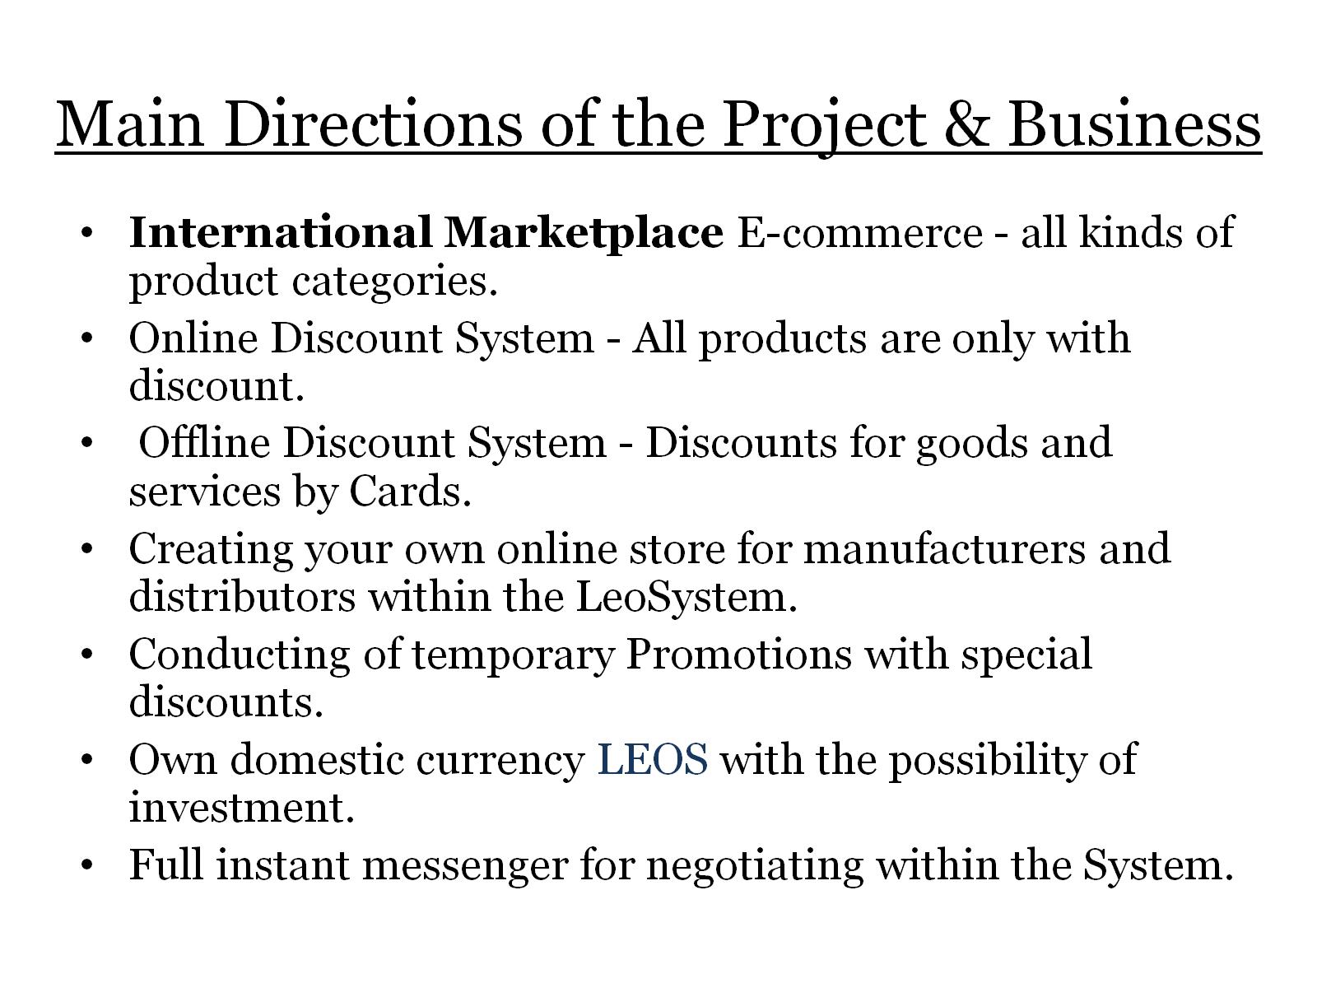
Main Directions of the Project & Business

Slide 3
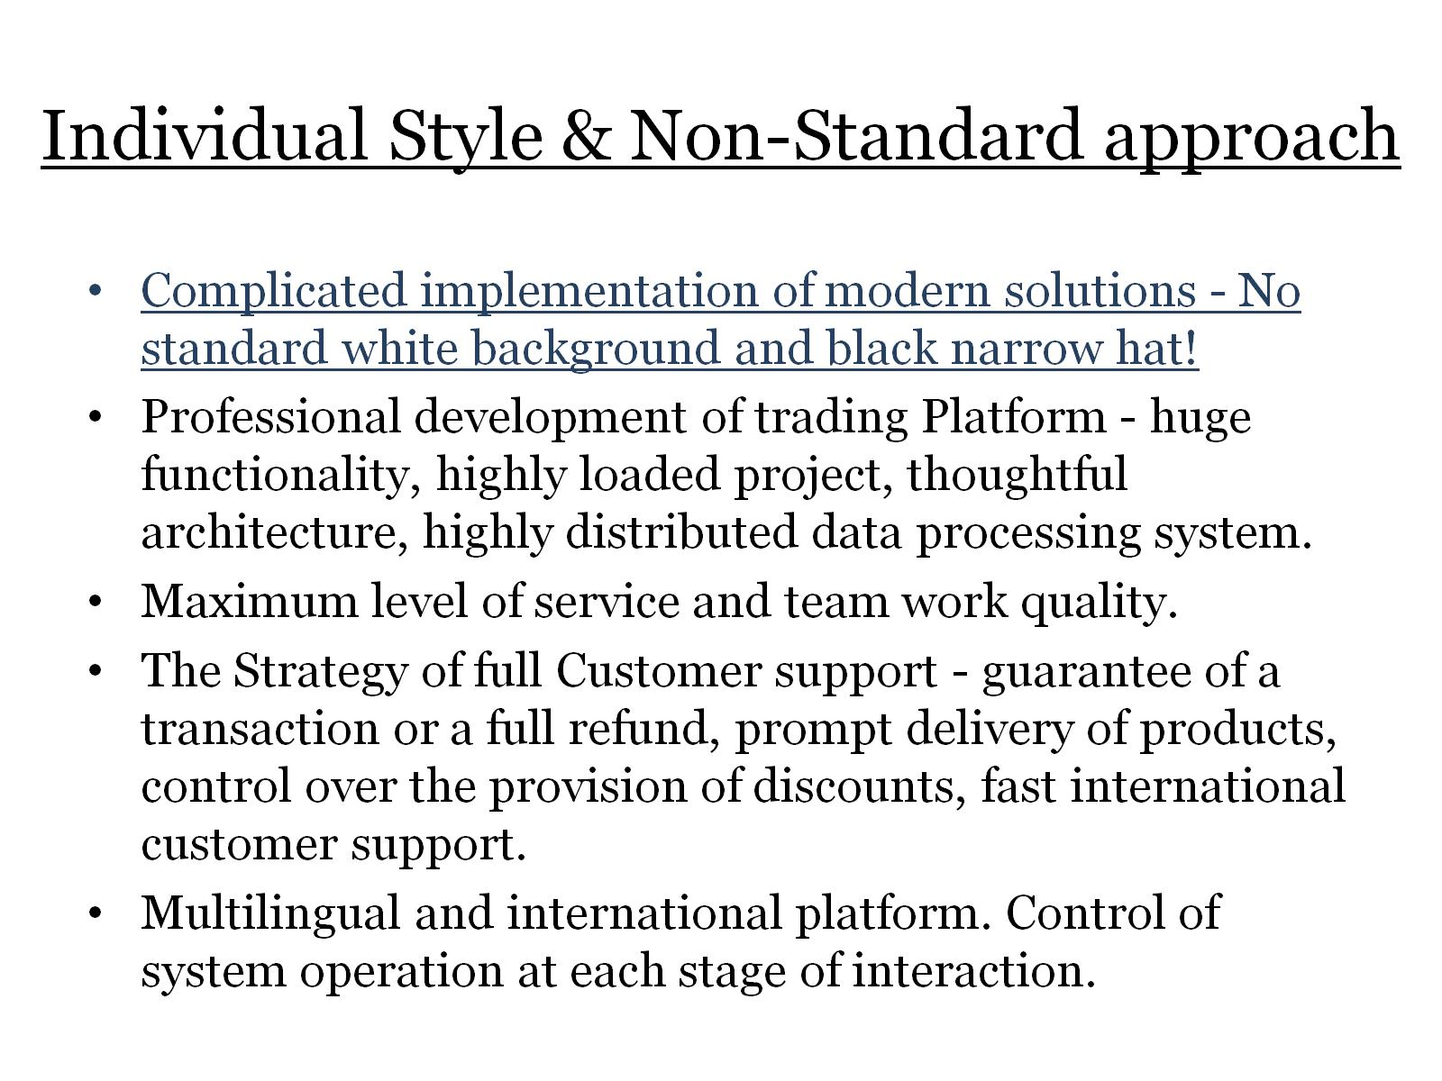
Individual Style & Non-Standard approach

Slide 4
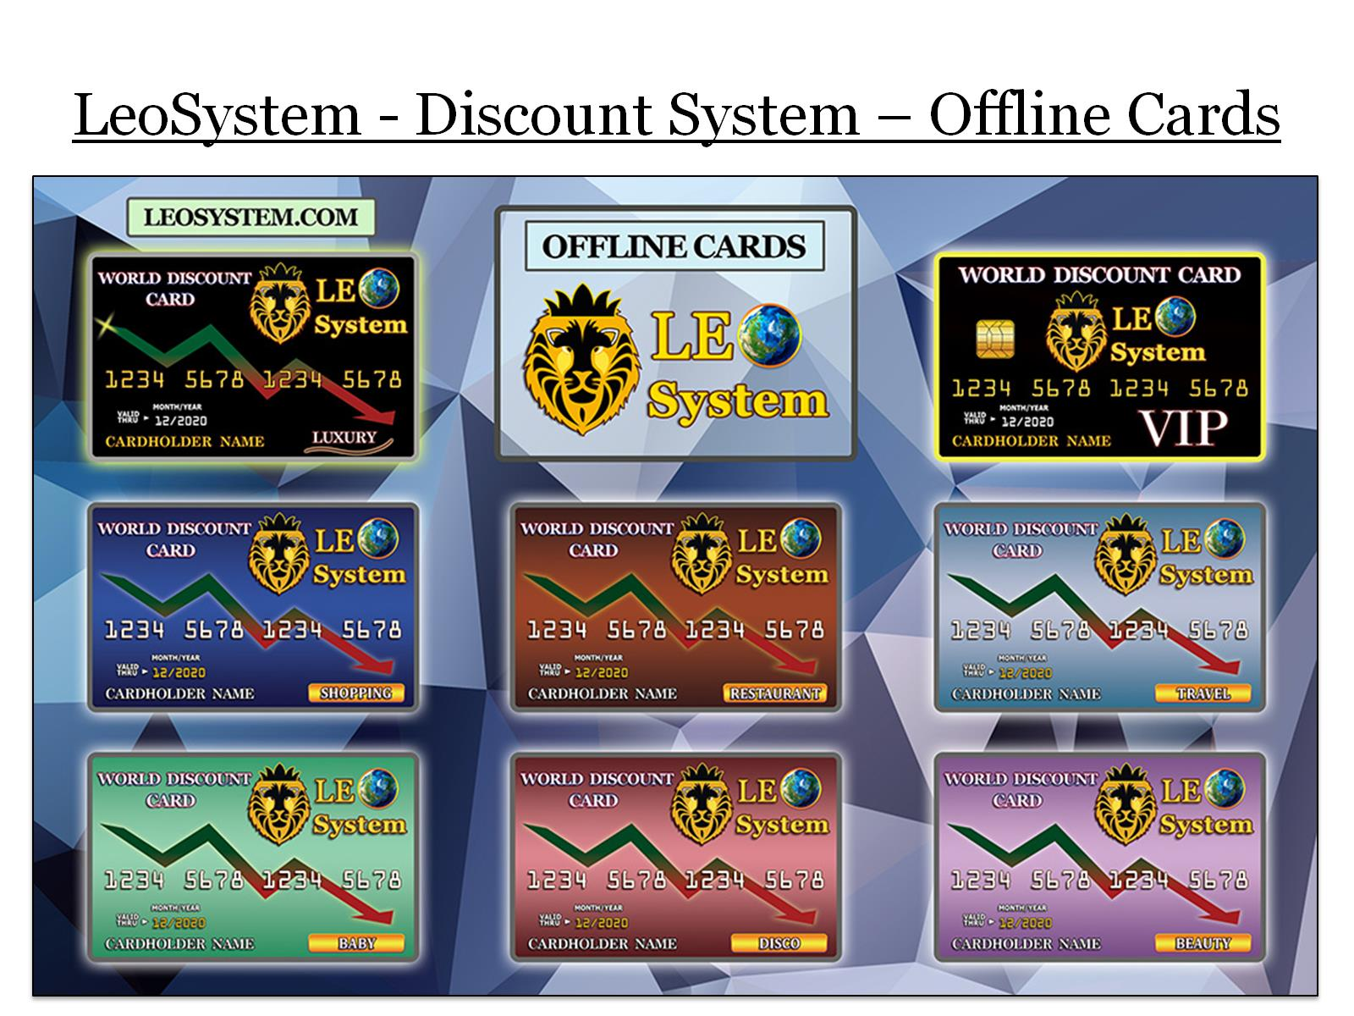
LeoSystem - Discount System – Offline Cards

Slide 5

LeoSystem - Discount System – Online Cards

Slide 6

Business Priorities

Slide 7
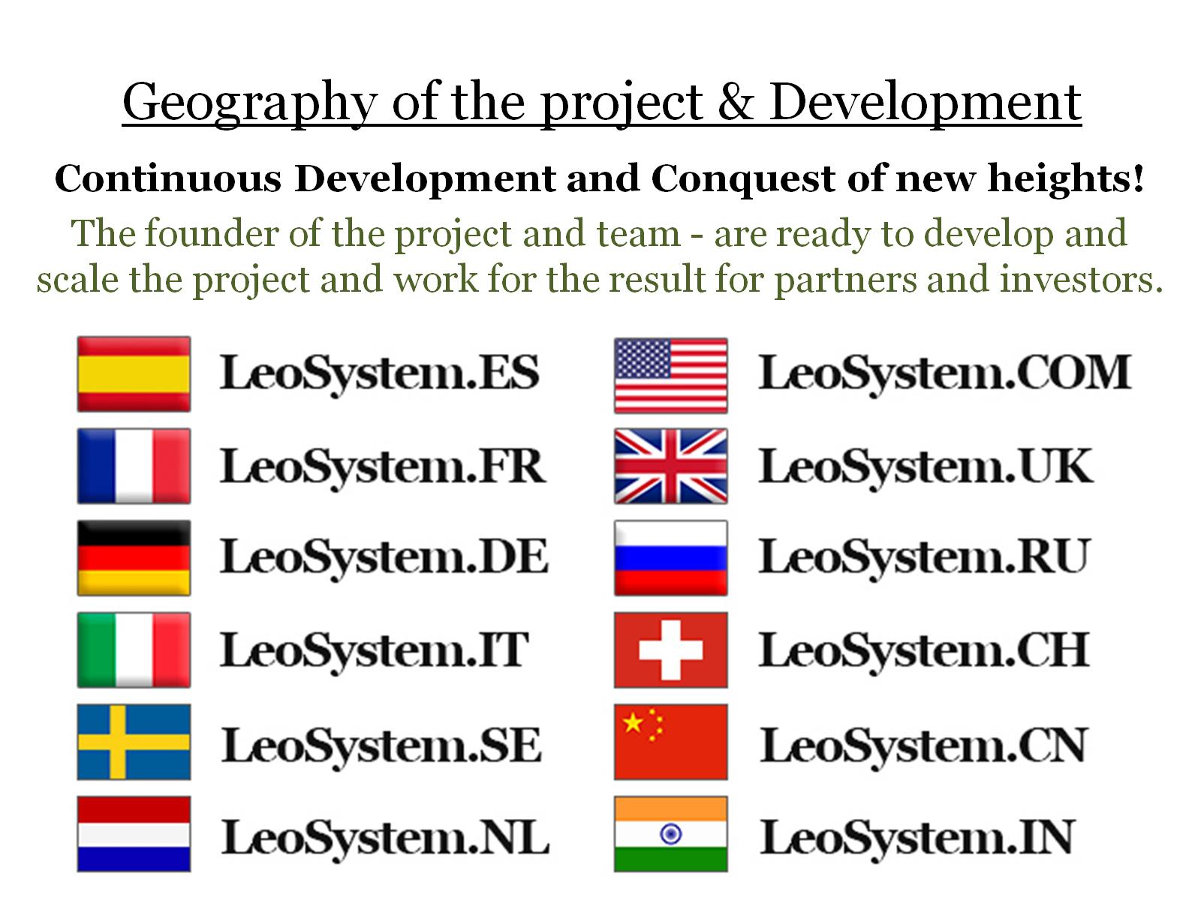
Geography of the project & Development

Slide 8
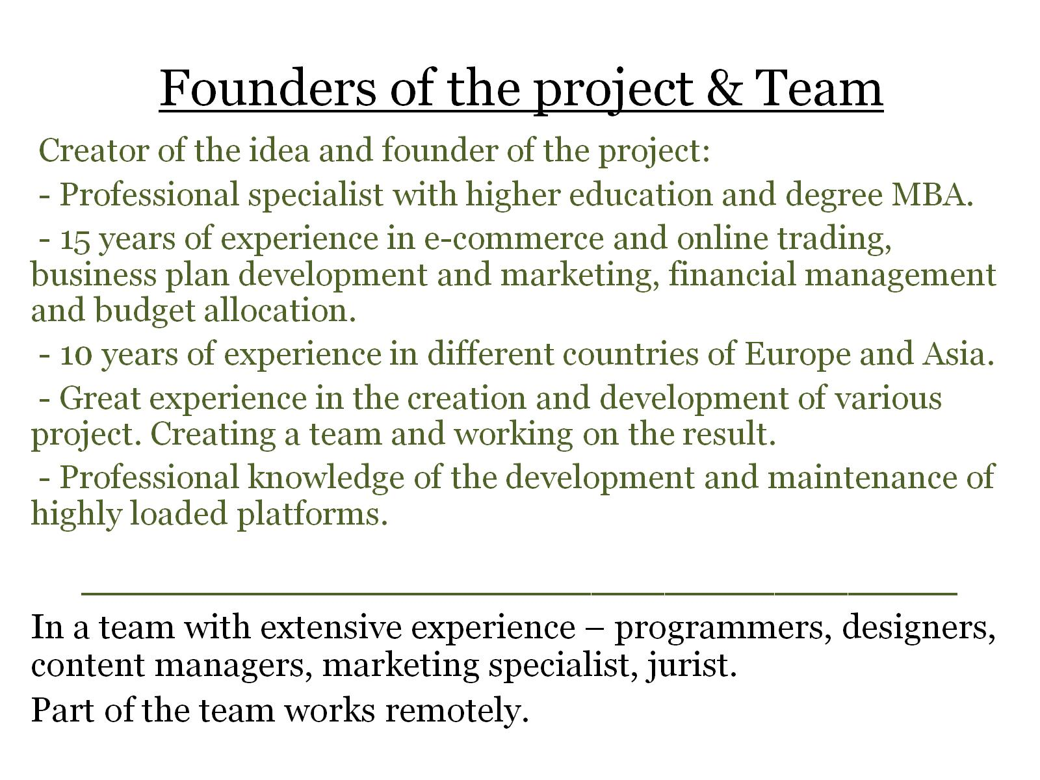
Founders of the project & Team

Slide 9
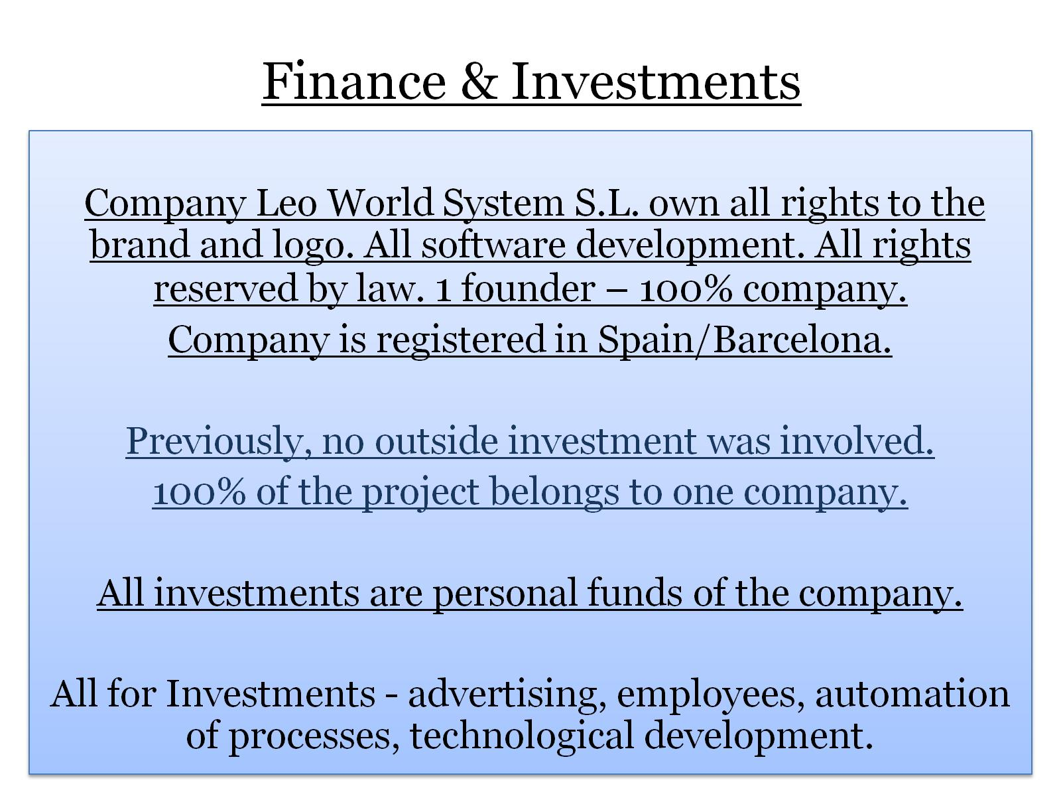
Finance & Investments

Slide 10
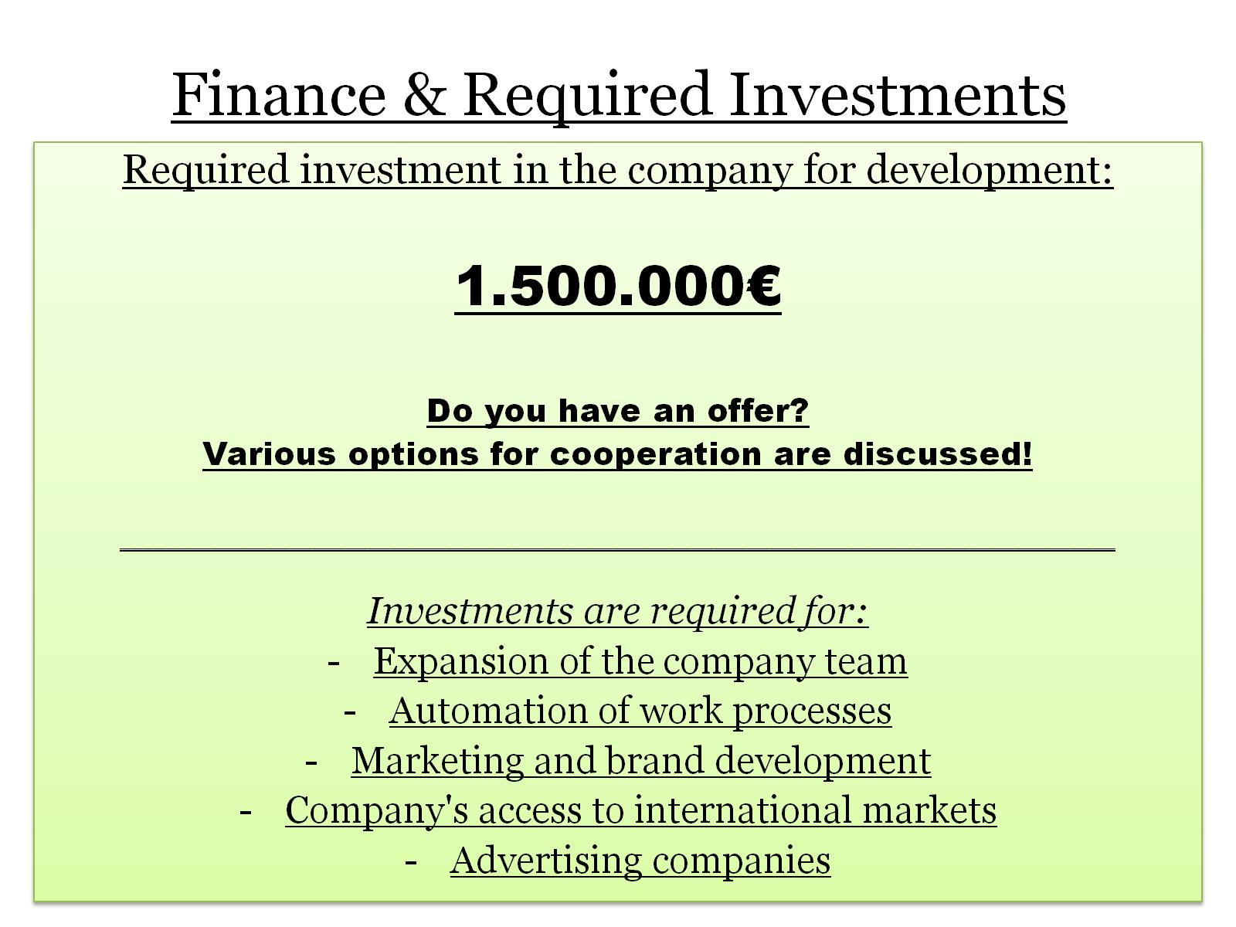
Finance & Required Investments

Slide 11
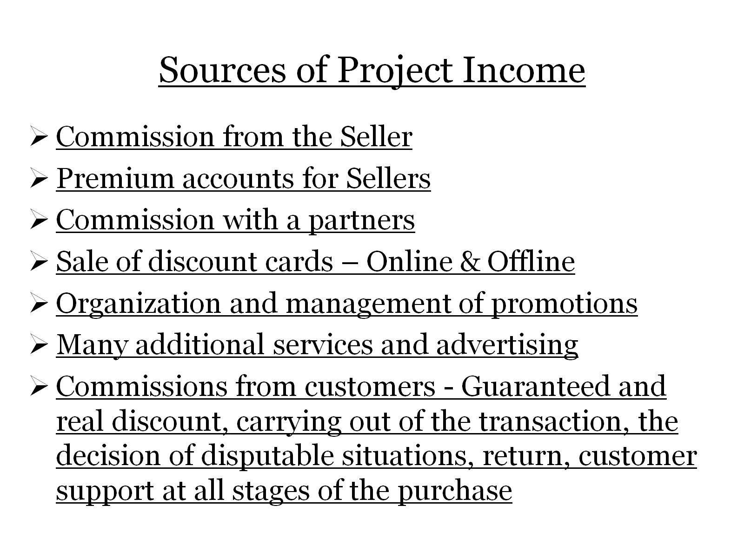
Sources of Project Income

Slide 12

Internal Currency LEOS & Modern Innovations

Slide 13
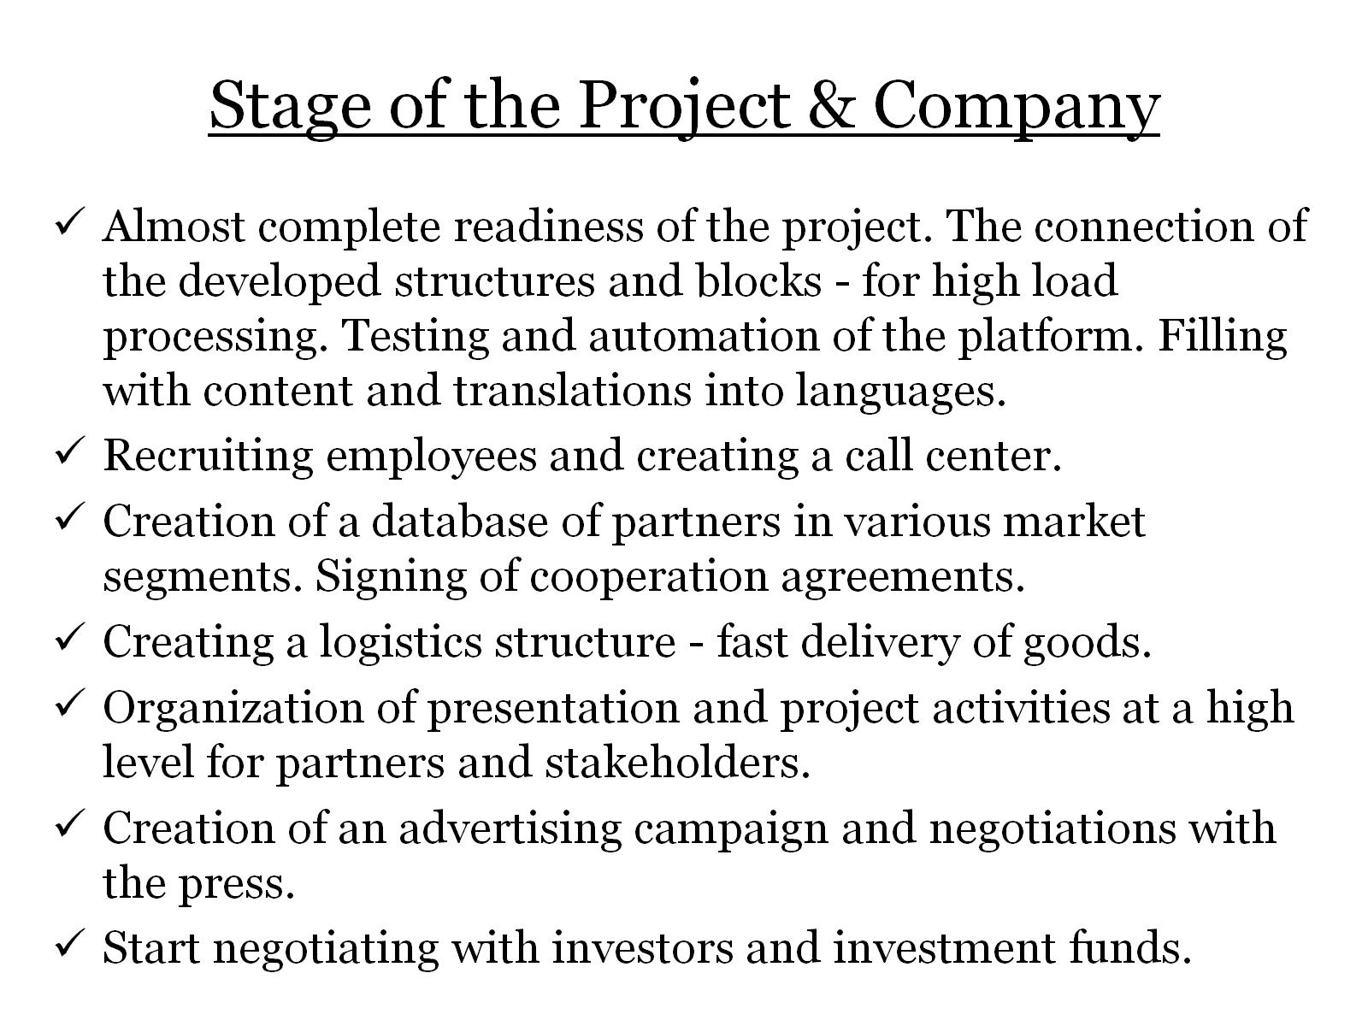
Stage of the Project & Company

Slide 14


Slide 15

Honest discounts are eternal! About the project, we can write and talk for a long time! A project done with a soul is more than money! https://LeoSystem.com Make a decision and we will go together to the heights!

Slide 16
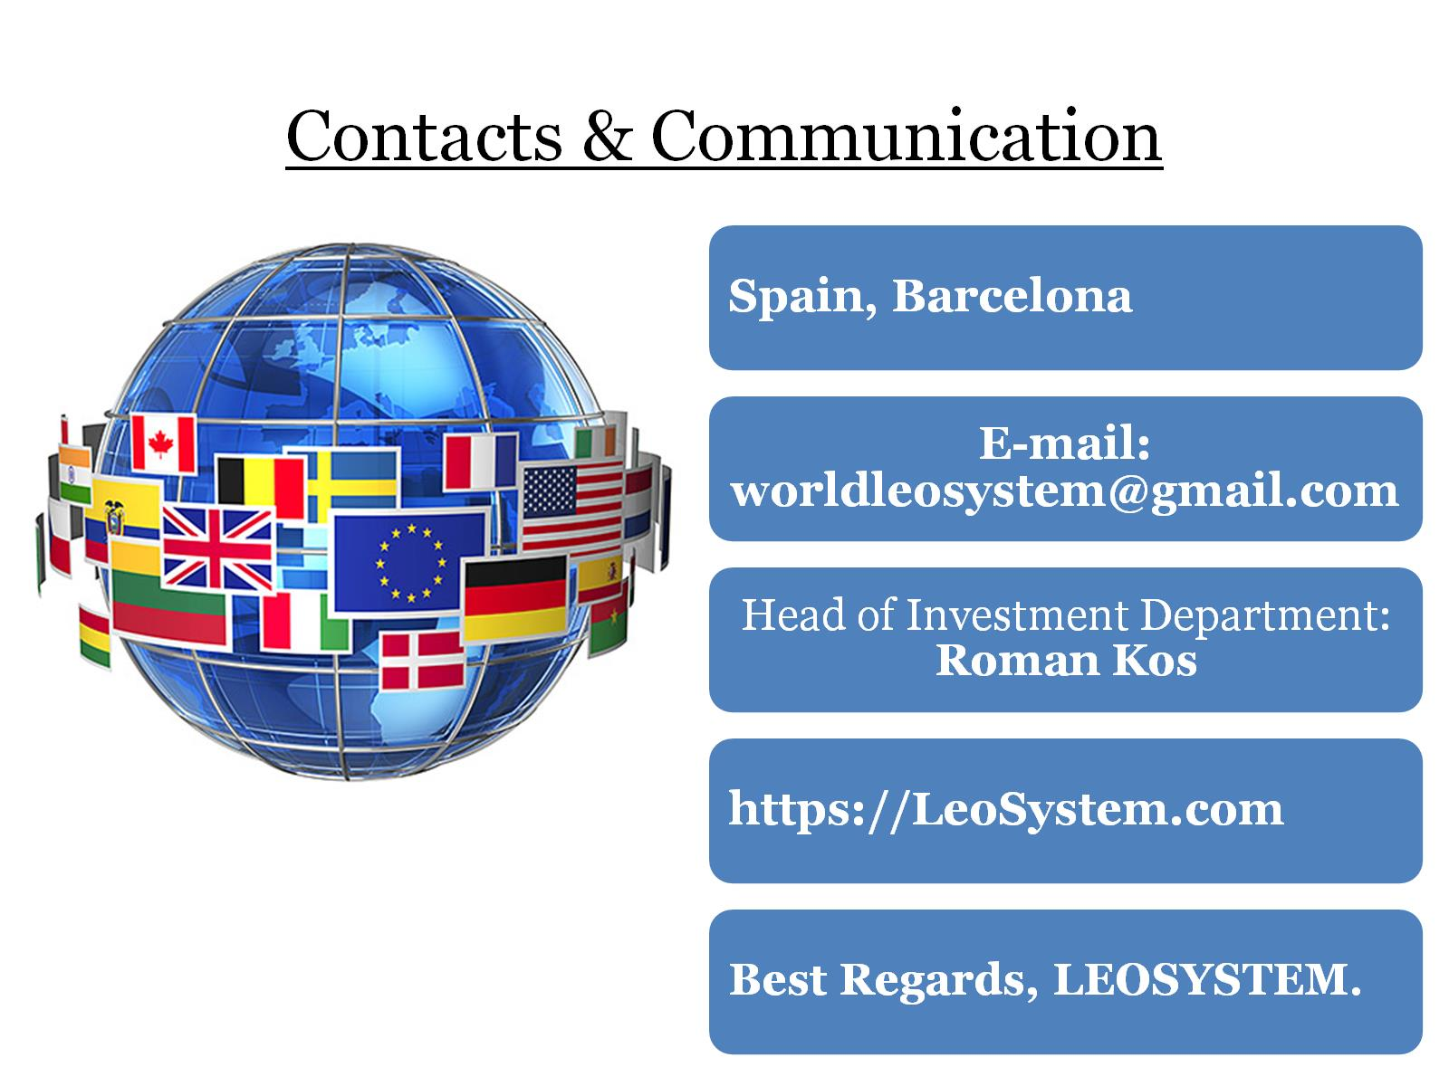
Contacts & Communication

