Slide 1
Kryptowatt Exchange
A platform that enables energy market access to individual traders using cryptocurrencies

Slide 2



Energy trade is difficult and expensive
Commodity and Energy trades are high commission trades
Trading Energy is almost impossible for end customers due to regulations
Commodity and Energy Trade instruments are extremely difficult for beginners
Notes:
Commodity and Energy trades are high commission trades
Trading Energy is almost impossible for end customers due to regulations
Commodity and Energy Trade instruments are extremely difficult for beginners
Cryptocurrency -> Fiat Currency -> Commodities or reverse is a very inefficient value cycle

Slide 3
kWi platform transforms Energy Trade
It’s fast and easy to trade with kWi Tools
EASY TRADE
Super fast with kWi tools
REAL
TIME
Every trade is hedged in energy exchanges
LOW
FEE
Even free trade with many product pairs
MULTIPLE
PAIRS
Crypto, commodity and energy pairs to trade
Notes:
It’s fast and easy to trade with kWi Tools Every trade is real time hedged in World’s best energy exchanges It’s low or even commission free on many product pairs kWi platform allows multiple crypto and multiple commodity and energy pairs to trade for different investor needs

Slide 4
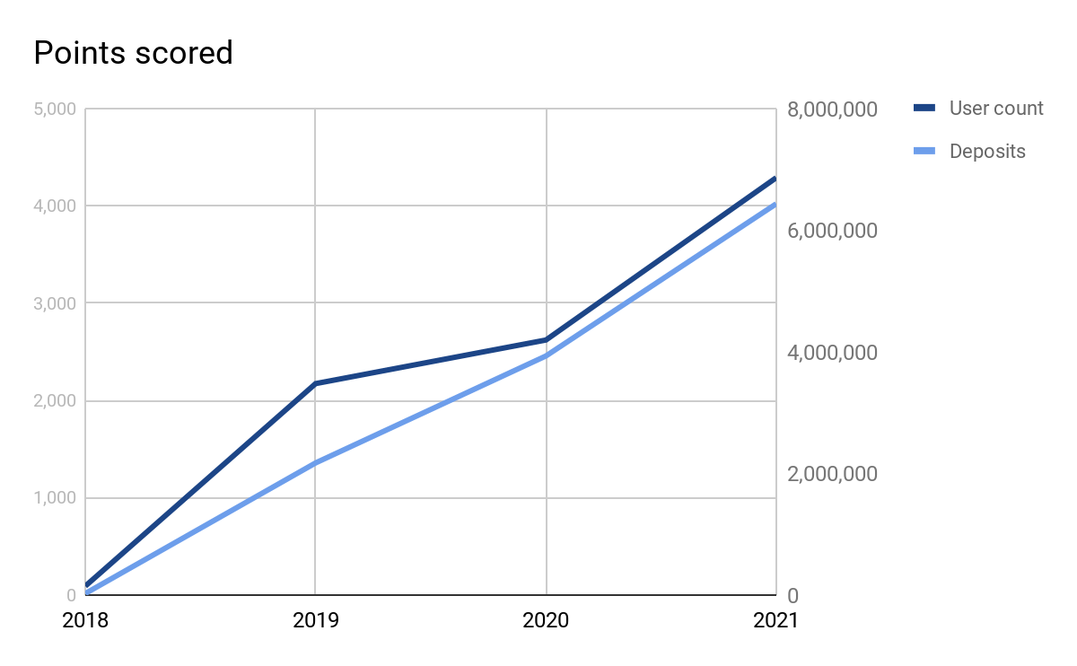
Expected User Growth
2018 is concept validation year with up to 100 users
User and deposit count is highly dependent on market cycles
We expect biggest growths on bear market of cryptocurrencies

Slide 5
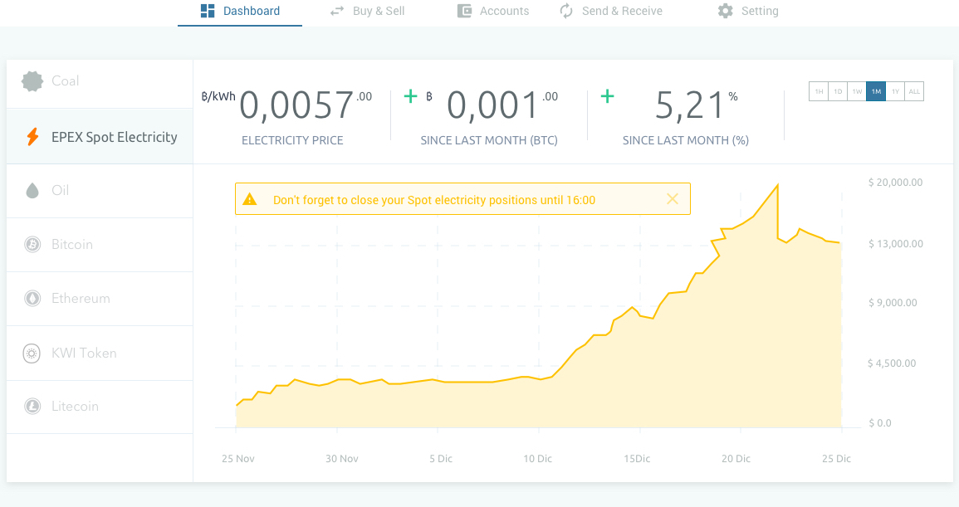
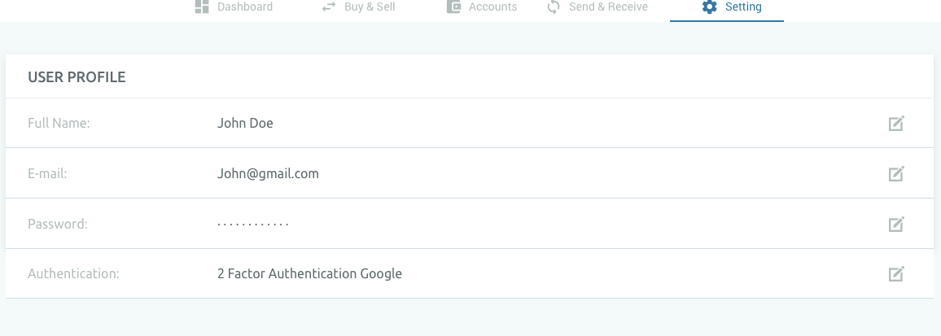
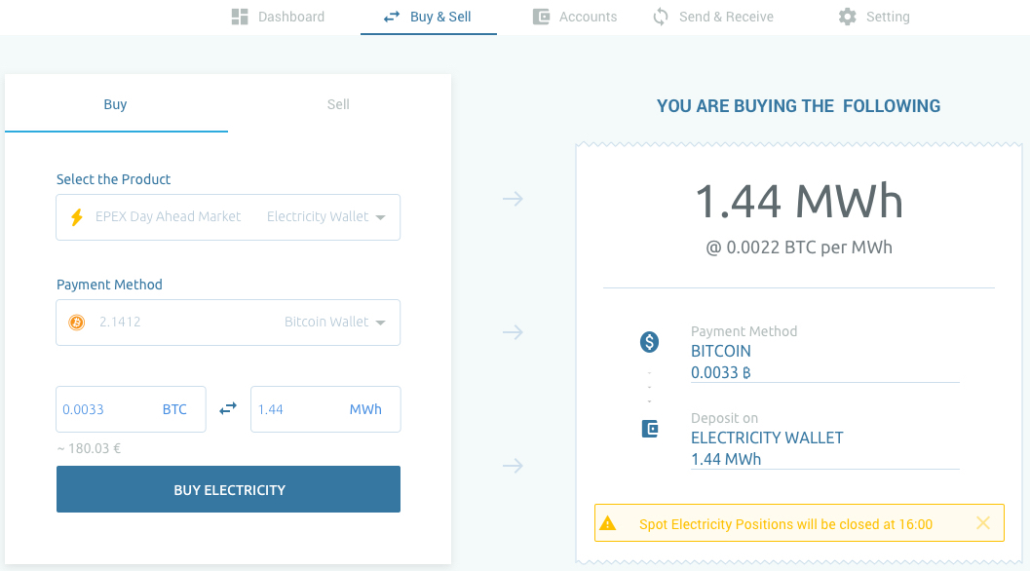
How does kWi Platform work?
Register
(KYC)
Deposit Fund
(BTC, ETH, LTC)
Trade Easily!
(kWh, Oil, Coal)
Notes:
Customers can deposit and start trading under 5 minutes
Know Your Customer and AML Regulations are followed for verification
kWi Platform accepts cryptocurrencies, SEPA and SWIFT transfers
Tickers and prices are generated through kWi algorithm from best trading platforms around the world
We integrate APIs of our partners to real time realize all user trades
This way we can offer low or zero commission trades possible

Slide 6
Market Size
€13.32
Billion+
€314 Million+
CRYPTO MARKET (WORLDWIDE)
ENERGY MARKET
(EUROPE)
€8 Million+
TRADE W/ KRYPTOWATT
MARKET SHARE
*Daily
Notes:
TOTAL MARKET Vol: $16.463.883.356 per 24H
kWi aims to reach a daily volume of $6.500.000 in 2021 which equals to %0,04 of total market available
Coin to Coin Market Size
Binance: $1.818.744.741 per 24H
Upbit: $1.311.149.987 per 24H
Huobi: $1.210.446.301 per 24H
Coin to Fiat Market Size
GDAX : $200.241.862 per 24H
Kraken: $193.353.710 per 24H

Slide 7
What is kWi Revenue Model?
We take %1,5 commissions on every trade pair
€8 Million
€15
€120.000
ENERGY TRADE W/ KWI
Share of Market
AVERAGE FEE
€1000/user daily transaction
REVENUE
Daily
*Daily
Notes:
%1,5 commissions on every trade pair
To be lowered 0,25 pips every year
%0 Withdrawal and Deposit fee
Spread profit according to market conditions
%0 commission for KWIT trade pairs (starting from December 2018)
KWIT ICO is expected to provide 20m€ liquidity
KWIT ICO will be %100 transparent and in cooperation with AFM Netherlands

Slide 8
Market Adoption
Community
Partnerships
Organic Growth
Twitter Influencers
Reddit and Subreddit
Telegram Channel
Company Channel
Trader Channels
European Emergy Exchange and Commissioners
New York Mercantile Exchange and Commissioners
KTR Kanzlei Law Office
Referral Campaign
Energy Efficiency Events
Trade Awareness Events
Notes:
Ready and working platform before ICO
A complete new asset class for crypto traders - 1st in the World!
Excellent parking place during bear markets
Marketing Platforms
Twitter Influencers
Reddit and Subreddit
Telegram Channel
Company Channel
Trader Channels

Slide 9
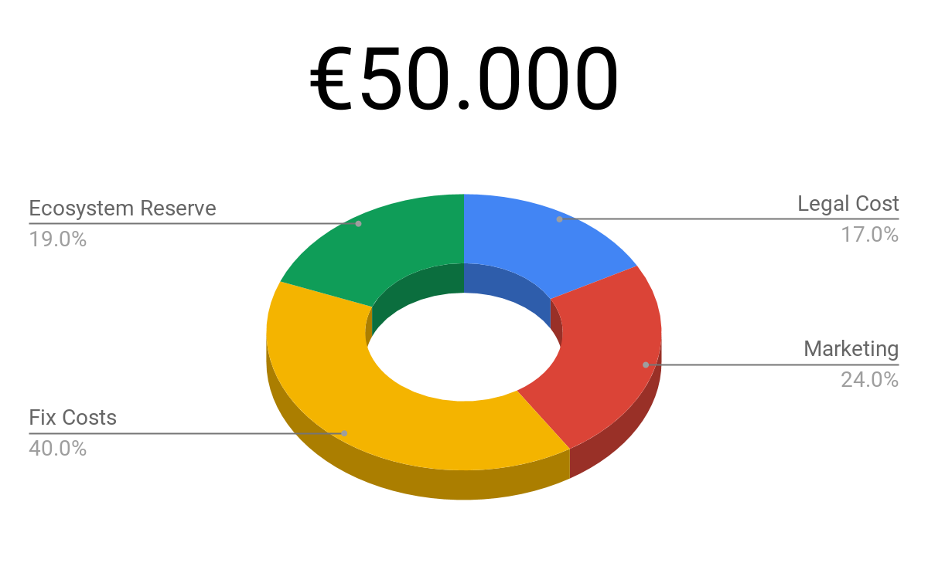
What we need
We expect to achieve by the end of December 2018;
100 trading users
120t€ net commission revenue
Positive cash flow generating company
Notes:
€ 50.000
%17 for Legal Costs
%24 for Marketing
%40 Fix Costs for 8 months
%19 Ecosystem Reserve
With this seed, we expect to achieve by the end of December 2018:
120t€ net commission revenue
100 users
Positive Cash Flow generating company

Slide 10

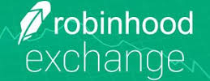





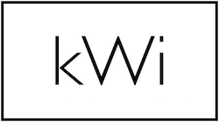
Competition
Fiat
Commodity
Crypto
Crypto

Slide 11
Roadmap
Beta Platform Launch
100 Users Reached Positive Cash Flow Reached
Applied to MIFID 2 2.000 Active Users Reached Tokens Regulated by AFM Netherlands
July 2018
December 2018
December 2019
September 2018
January 2019
December 2020
Platform Launch
Introduction of KWITs - ICO Introduction of commissionless trade through KWIT pairs
MIFID 2 Acquired Less than %1 commission on all Crypto and Fiat Pairs
Notes:
By the end of 2019:
Applied to MIFID 2 Licence
2.000 Active Users
Tokens regulated by AFM Netherlands
Initial Contacts with World’s best VCs to mass scale
By the end of 2020:
MIFID 2 Acquired
Less than %1 commission trades on all Crypto and Fiat pairs

Slide 12
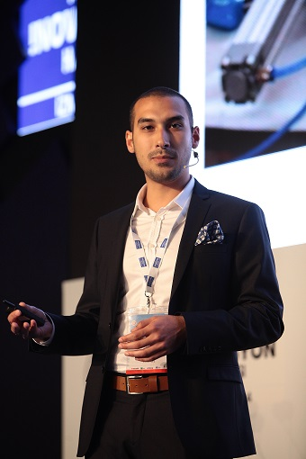
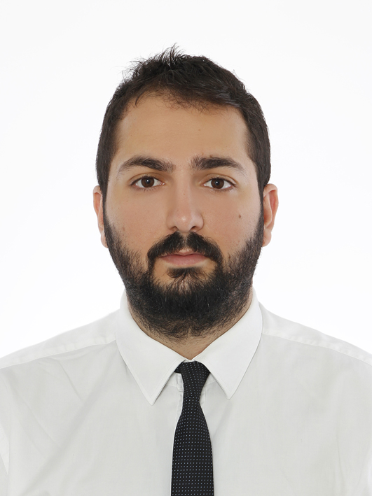

Founders
CTO
Ceyhun Derinboğaz
CEO
Fırat Aytaş
Business Dev.
Serkan Haşlak

Slide 13
THANK YOU
Fırat AYTAŞ
CEO
aytas@kryptowatt.de
+49 (0) 151 580 41 812

