Slide 1

Toaction.today
You can do it !!!

Slide 2
The problem we solve:
For regular sport (fitness) activities, you need a lot of information and some tools:
to keep personal statistics for analysis and making workout plan;
difficulties and loss of time with information search concerning kind of sports you want to go in for;
workout technique;
safety rules – we do not want to hurt ourselves;
required sport outfit and where one can buy it;
diet;
places to work out;
coach search.

Slide 3
Our solution:
Creation of sports information Internet community:
- kind of social network;
- encyclopaedia;
- interactive guide;
- Internet store.

Slide 4
Market potential
According to statistics in 2016, 162 million people are engaged in sports in 200,000 clubs worldwide. The revenue received in this business area reaches US$84 billion (Racquet and Sportsclub Association (IHRSA) report, May 2017).
(http://www.healthclubmanagement.co.uk/digital/index1.cfm?mag=Health%20Club%20Management&codeid=31950&linktype=story&ref=n&issue=2017%20issue%209)

Slide 5
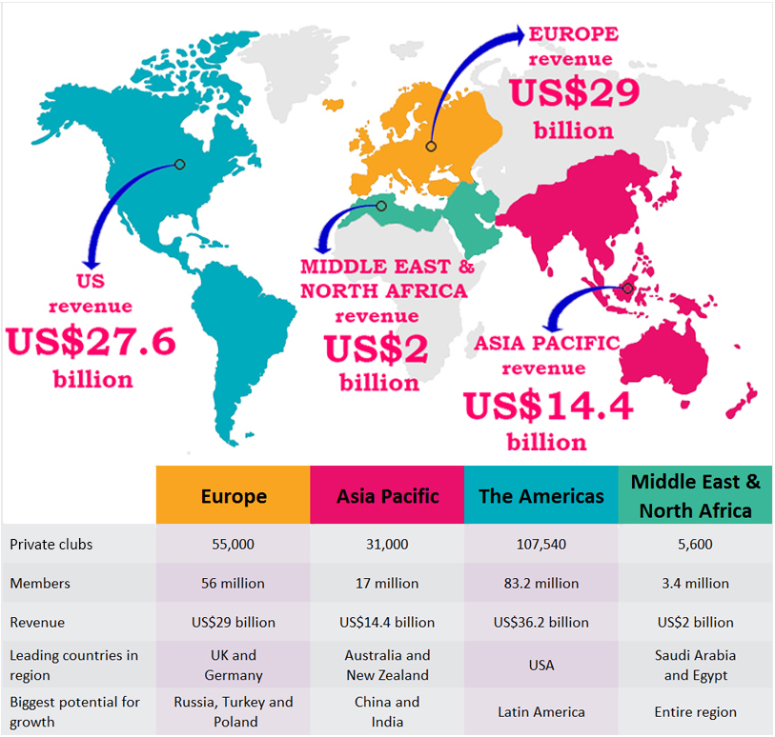
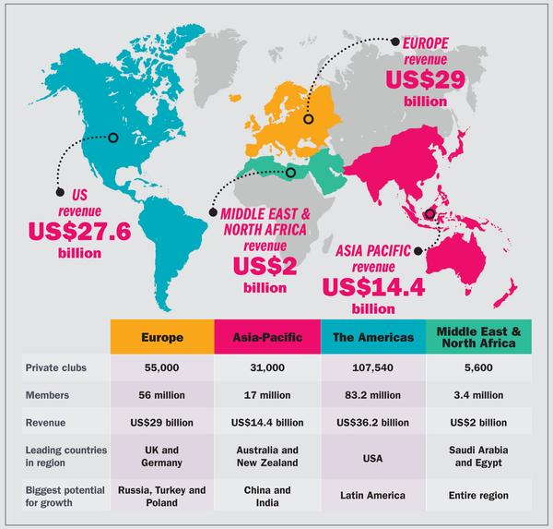
The 2017 IHRSA Global Report

Slide 6
Who are our customers?
people going in for sports or willing to go in for sports;
coaches, nutritionists, psychologists;
sport grounds, sport clubs …
manufacturers of sport goods and sport nutrition;
in the future, as we develop, we’ll consider other options
…

Slide 7
How will this startup earn?
sale of coach services;
sale of advertisement;
sale of sport goods and nutrition;
These are the ways to earn from this startup we see at this point.

Slide 8
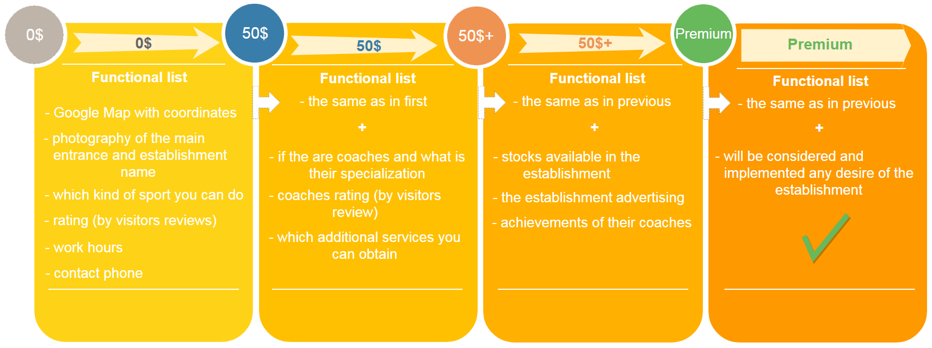
Calculation of price offer (sale of advertisement)

Slide 9
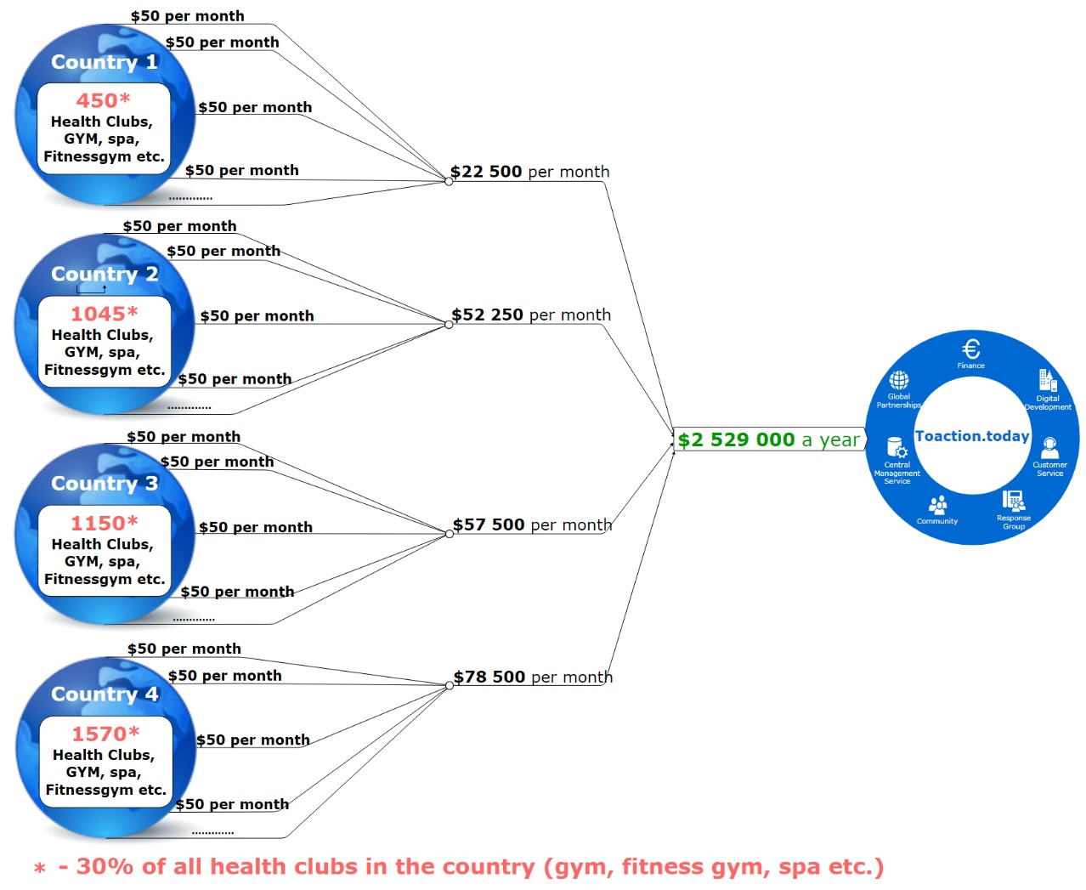

Slide 10
* the total number of clubs registered in the system
The second year of work.
Income calculation (advertising sales)
category | cost ( $ ) | month 1 | month 2 | month 3 | month 4 | month 5 | month 6 | month 7 | month 8 | month 9 | month 10 | month 11 | month 12 | Total
Clubs amount * |  | 200 | 450 | 950 | 1 950 | 2 950 | 3 950 | 4 950 | 5 950 | 6 950 | 7 950 | 8 950 | 9 950 | 9 950
Tariff “0” | 0 | 0 | 0 | 0 | 0 | 0 | 0 | 2 803 | 3 369 | 3 935 | 4 501 | 5 067 | 5 633 | 5 633
Tariff “50” | 50 | 0 | 0 | 0 | 0 | 0 | 0 | 1 650 | 1 983 | 2 317 | 2 650 | 2 983 | 3 317 | 3 317
Tariff “50+” | 100 | 0 | 0 | 0 | 0 | 0 | 0 | 495 | 595 | 695 | 795 | 895 | 995 | 995
Tariff “Premium” | 10 000 | 0 | 0 | 0 | 0 | 0 | 0 | 2 | 3 | 3 | 4 | 4 | 5 | 5
received per month |  |  |  |  |  |  |  | 156 750 | 188 417 | 220 083 | 251 750 | 283 417 | 315 083 | 1 415 500

Slide 11
Our competitors:
https://www.fitocracy.com/
https://www.gaia.com/yoga
http://www.mapmyfitness.com/
http://www.sparkpeople.com/
http://www.traineo.com/Fitness/Personal-Trainer-Courseware-Traineo
http://www.dailymile.com/#ref=logo
http://www.trainingpeaks.com/
https://virtuagym.com
…

Slide 12
Their disadvantages:
only one-language interface available;
information concerning only one kind of sports;
paid services for the users (not all of them, but mostly);
lack of information about trainers whose services are offered;
each website implements only one function, meaning that to get full information one has to use a few websites or programs;
synchronization is implemented with one or two gadgets.

Slide 13
Our advantages.
six language interface (Ukrainian, Russian, English, German, Spanish, French), and we also plan to add other languages (under certain conditions);
a few kinds of sports to start with – jogging, yoga, bodybuilding (techniques, coaches)…
guide with ALL available places for workouts worldwide, providing maximum information on them;
mobile applications for IOS and Android;
totally free for the users.

Slide 14
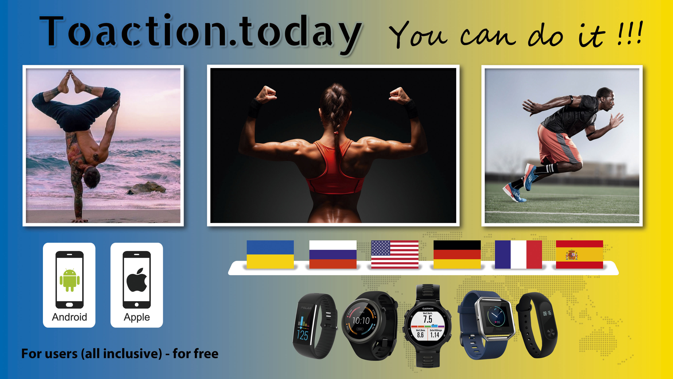

Slide 15
Time line for startup development.
from 0 to 2 months - Creating a project technical specification. Split the project into parts of the implementation. Implementation of thumbnail (Mockup) of the project project for client part, mobile part, administrative part.
from 2 to 4 month - Creating a user-friendly interface, design of client part interface, administrative part, mobile part.
from 4 to 6 month – Development of the project’s software architecture.
from 6 to 8 month – Development of protocols for the exchange of information between the client, the server and the Database. Connecting SMM managers, work with the media, promoting the project on media areas, specialized forums in the countries languages of which ​​we use.
from 8 to 11 month – writing functional code of the project for the client, mobile and administrative parts.
Release of project’s beta-version with all the necessary functionality.
from 11 to 13 month – Test of written functionality.
from 13 to 14 month – Creating continuous integration infrastructure and support.

Slide 16
Our team.
Vitaliy Maliborskiy – inspirer. Author of idea, striving to make in real. Entrepreneur experience, as well as a managerial experience. Being engaged in sports, I see the need for this startup as a product also for myself as a user.
Mykhailo Mendela - has experience in people managment and softwafe development (development of the web-sites, software for banks and of-course development of social network). These skills will help you quickly and to professionally implement the project.

Slide 17
Budget.
3 000 000 (three million) US dollars.
This amount is calculated for two years.
Startup financing is phased (step-by-step), according to timeline of the project and completed work.

Slide 18
Contacts.
Vitaliу Maliborskiy
address: Nezalezhnosti bulvar 6/317, Kalush, Ukraine, 77300
tel.: +(380) 68 1439895 (Ukrainian, learning English and not speaking it so far)
e-mail: toaction.today@gmail.com
website: http://toaction.today/ - українська, русский, English, Deutsch, Español, Français

