Slide 1
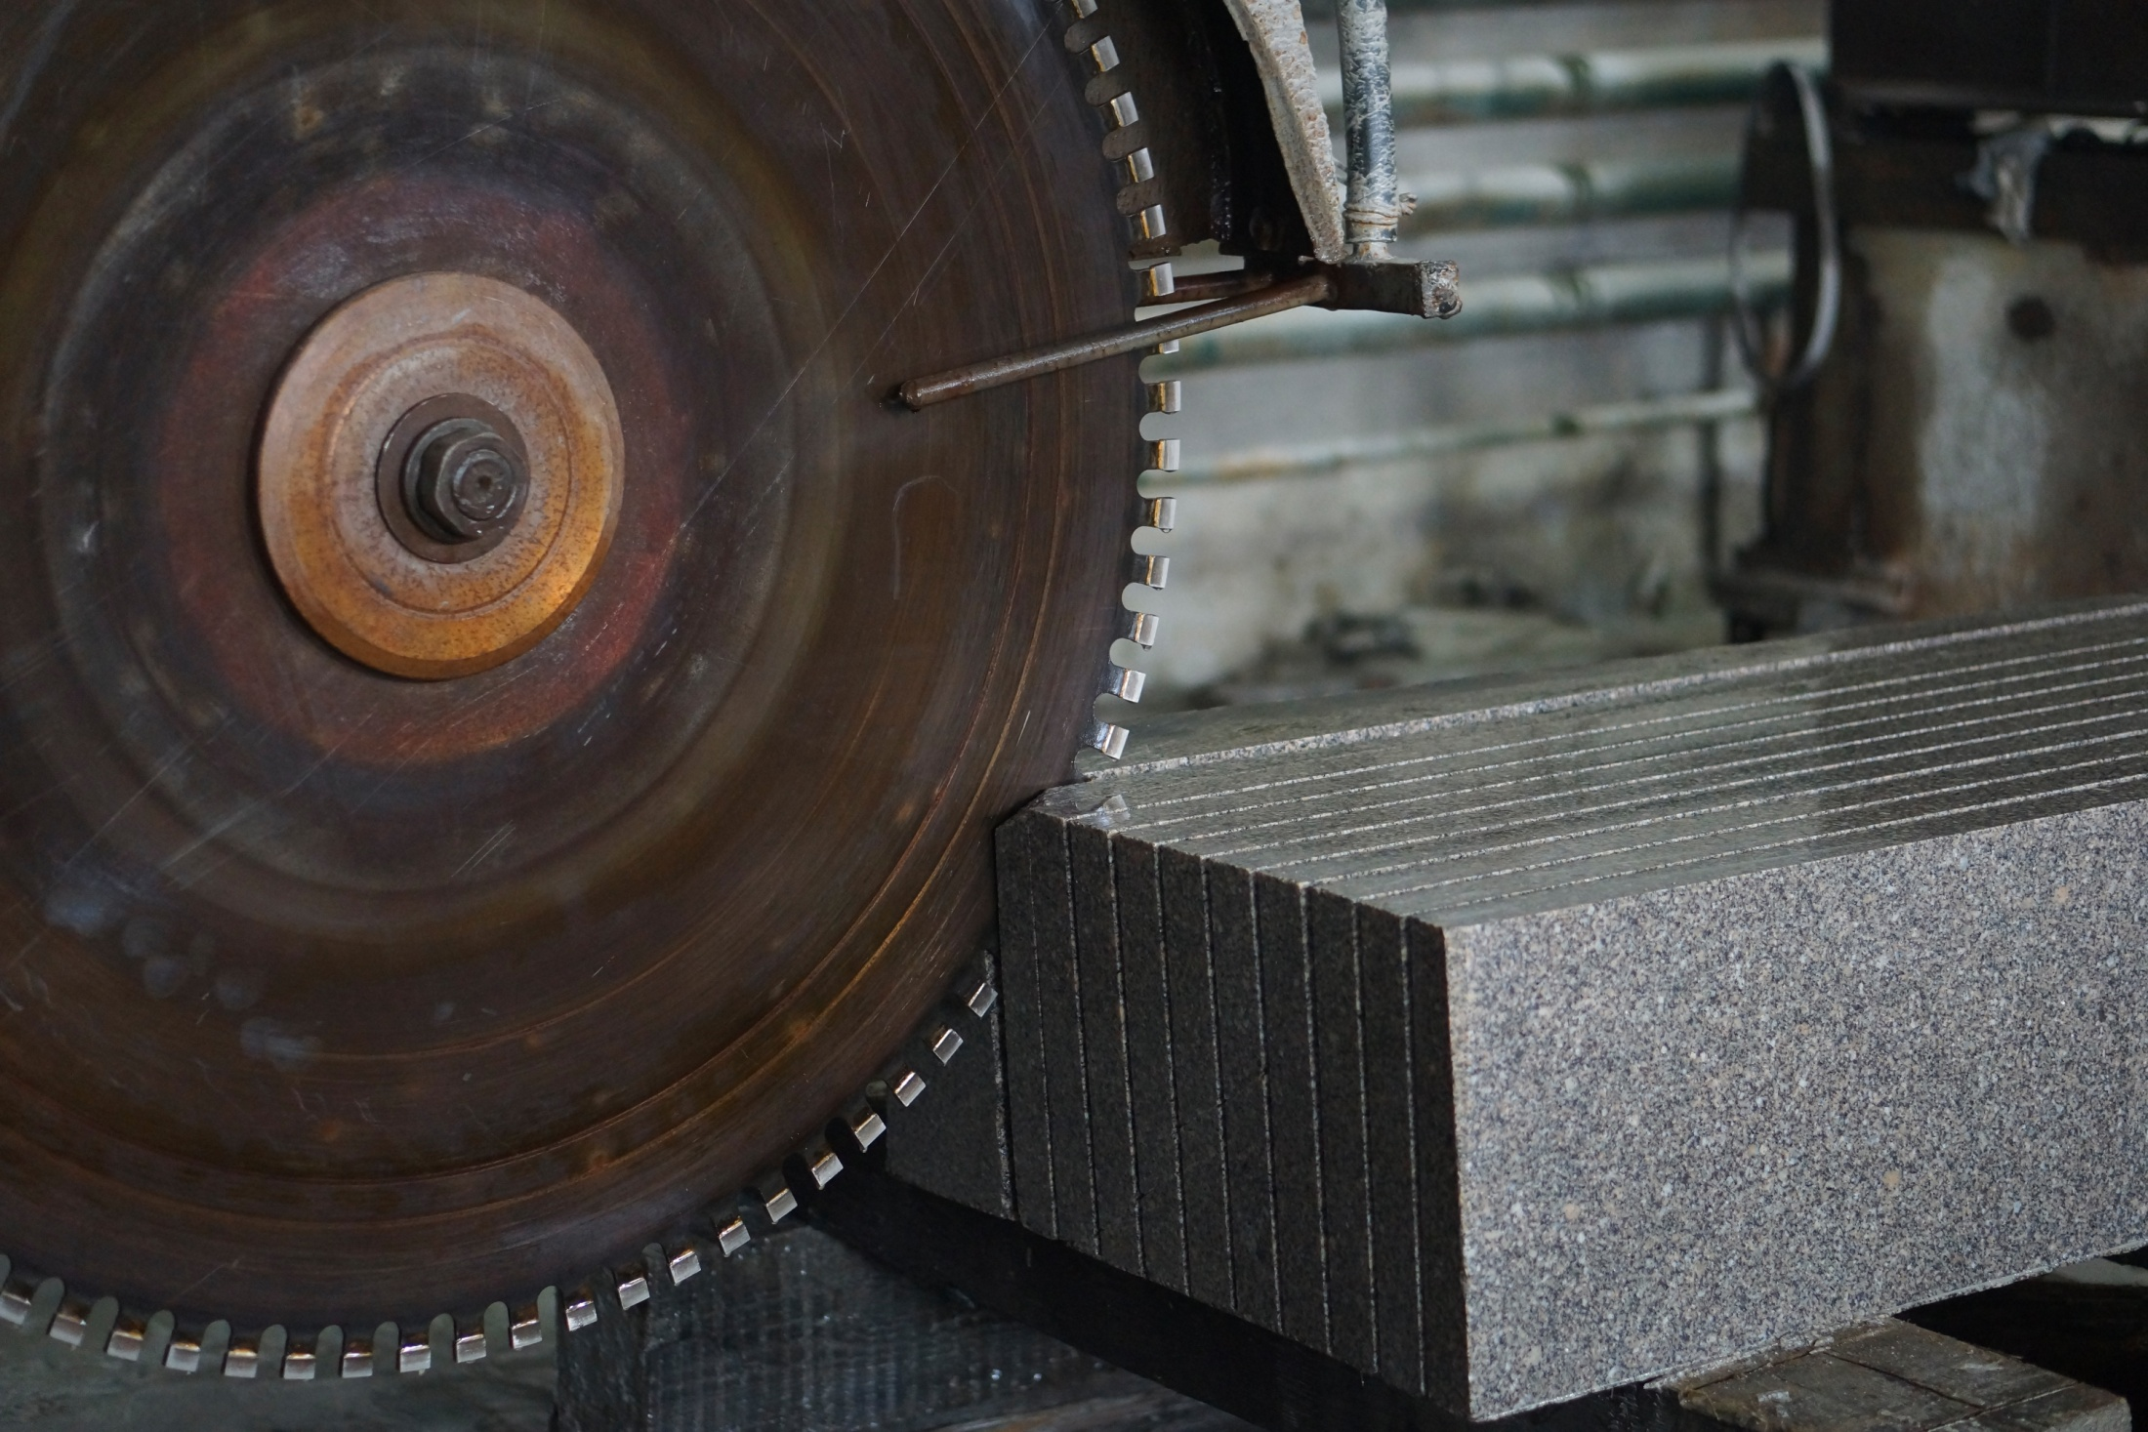
PRESENTATION OF THE I STAGE INVESTMENT PROJECT ON FOUNDING AN ENTERPRISE FOR GRANITE EXTRACTION and CUTTING, PRODUCTION of curbs, paving stones, slabs and custom products based on this material. «STONEX GROUP». RUSSIA, MOSCOW, 2016

Slide 2
INVESTMENT OFFER
Dear Sirs and Madams!
Stonex group of companies is happy to invite you to act as the sole investor or join the consolidation of investors in order to implement a truly ambitious project aimed at organizing an exemplary enterprise, which could become one of the five largest players in the Russian market.
The project has solid grounds and has more than just realistic prospects for its rapid development, as evidenced by the particular situation in the market, in-depth analysis the construction segment development prospects, the business plan and the feasibility study calculated on the basis of a realistic scenario.

Slide 3
PROJECT SUMMARY
The point of the project: to create a fully equipped modern enterprise for granite extraction and cutting with further production of curbs, paving stones, slabs and custom products in the territory of the Russian Federation.
Project goals and objectives:
- Creation of a modern own exemplary European-style production with 100% private capital;
- Meeting the Russian construction segment needs for high-quality and low-cost building materials;
- Creation of a healthy competitive environment in the construction materials middle price segment in the Ural Federal District and the Russian market.
- Becoming one of the five largest industrial and mining enterprises of the Russian Federation.
Features of the project:
Sources of funding: investor funds. The total investments amount: 327,300,000 rubles.
Project performance indicators:
The average annual discount rate in the forecast period: 10%;
Payback period (non-discounted), PP: 4.00 years; Discounted payback period, DPP: 4.75 years;
Index of profitability, IP: 0.92; Net Present Value, NPV: 254,655,000.00 rub.;
Internal return rate, IRR: 14%.

Slide 4
MARKET RESEARCH
Statistics for the volume of construction work in the Russian Federation, bln rub.
Statistics for the number of construction organizations in the Russian Federation.

Slide 5
Distribution of the the volume of construction works according to separate forms of ownership and in percentage.
Ratio of finished granite products production and sale vs. the demand in the domestic market, in ths. tons.

Slide 6
The existing acute lack of granite products in the Russian Federation domestic market, the rapid growth and development of the construction business segment, the increase in demand, together with a number of government programs aimed at the infrastructure development with a view to their implementation in the next 10 years, are more than positive factors for this project successful implementation.
This project challenge, the market capacity and the number of potential buyers are grounds for setting the minimum goal regarding the business idea, which is to cover at least 10% of the domestic market in the respective segment, which is an absolutely real and doable program!

Slide 7
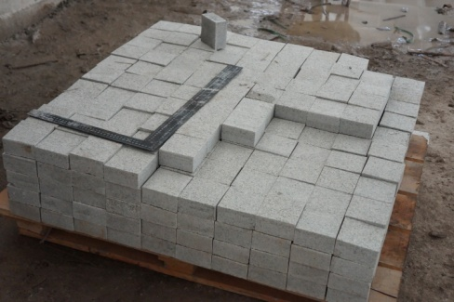
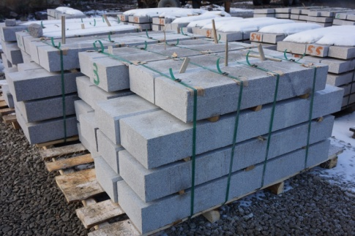
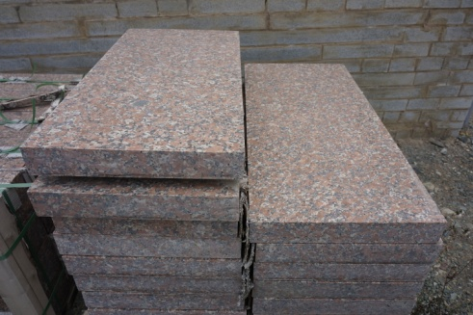
PLANNED PRODUCT RANGE:
- Chopped granite cobbles : 100x100x50 mm, 100x100x100 mm;
- Granite set, sawn and chopped: 100x100x30 mm, 100x100x40 mm, 100x100x50 mm;
- Granite set, sawn, flamed: 200x100x30 mm, 200x100x40 mm, 200x100x50 mm, 100x100x30 mm, 100x100x40 mm, 100x100x50 mm, 200x100x80 mm, 200x200x80 mm, 400x200x80 mm, 400x400x80 mm, 600x400x80 mm, 300x150x80 mm, 300x300x80 mm, 600x300x80 mm;
- Polished granite tiles: 600x300x20 mm, 600x300x30 mm;
- Flamed granite tiles: 600x300x30 mm;
- Granite curbs: GP-1 pp chamfer, L (600-2500) x300x150 mm;
- Granite curbs: SE-5 pp chamfer, L (600-2500) x200x80 mm;
- Granite steps: pp with to, 2000x350x30 mm, 1500x350x30 mm, 1200x350x30 mm.

Slide 8
BRIEF INFORMATION ABOUT PROJECT INITIATOR.
Initiator’s name: Stonex group of companies.
Address: 117218, Moscow, Nakhimovsky prospekt, 24, bld. 1.
Phone: +7 (495) 229-31-76, +7 (495) 779-67-22, +7 (903) 784-63-28.
E-mail: 7846328@mail.ru, url: www.stonex.ru skype: stonex.group.llc
Person responsible for the project: Andrey Yaroslavtsev, Sergey Sataev.
Date and place of company registration: 08.11.2006, Moscow.
Stonex group of companies is an international, vertically integrated holding company for the extraction, production, sale, delivery and installation of granite and marble products.
- The holding has an existing and functioning granite quarry, production, storage facilities and manufactories, which do not belong to the initiator;
- The natural stones import supplies directions is well developed;
- The holding includes a transport company with its own fleet of specialized equipment, a construction company;
- The company has its own office in the center of Moscow at Russia's largest specialized exhibition of modern building materials TCE "EXPOSTROY", a show-room, an additional finished goods warehouse of 2000 m2, handling equipment, trailers, cabins, a variety of equipment;
- The estimated value of the initiating company is at least 50,000,000.00 rubles;
- Management system for the supply of granite in the organization meets the requirements of GOST ISO 9001-2015, GOST R ISO 14001-2007, GOST 54934-2912.
- The company was awarded the title of "Reliable Russian Company", as evidenced by an entry in the register of reliable Russian companies at the link http://www.ruscentr.com/laureats/federal8/federal8_3366.html;
- The company was awarded the title of "Best Stone-working Company 2015", the company is a member of the Association of Russian Stone-working Enterprises ”Tsentr Kamnya", Moscow Chamber of Commerce, Chamber of Commerce of Russia.

Slide 9
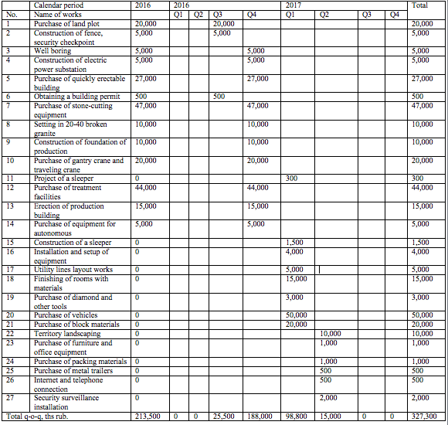
CAPITAL EXPENDITURE SCHEDULE,

Slide 10
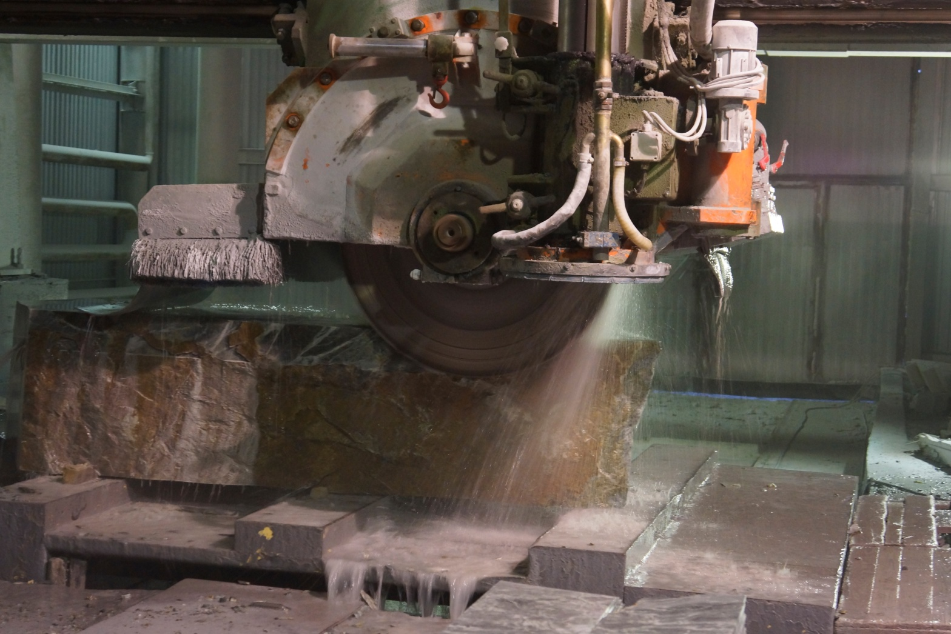
CONCLUSIONS
The investment project on founding an enterprise for granite extraction and cutting and production of curbs, paving stones, slabs and custom products on the basis of this raw material is profitable and cost-effective as proved by all investment analysis indicators and can be recommended for implementation.

