Slide 1

FAMEE
Mobile dating service for swingers

Slide 2





We are connecting markets FOR SWINGERS
Dating
Travel
Mobile
Worldwide

Slide 3

Market Capacity
USERS
CLUBS
Worldwide – 50 million active users (couple)
EU – 15 millions
USA – 10 millions
RU – 0,2 millions
Worldwide – 4 000 swinger clubs
EU – 500 clubs
USA – 2000 clubs (all states)
RU – 50 clubs

Slide 4

Market Capacity
AMOUNT
Expenses/year – $1000-$2500 per couple
Worldwide gross – $50–125 Billions
EU – $ 15–40 Billons
USA – $ 10–25 Billions
RU – $ 10-20 Millons

Slide 5
We are different dating. Why?

Slide 6


Business model
(why we are different)
Dating
Socialize
Trips
Parties
Ratings
Swinger Clubs
Swinger hotels and events
Swinger parties and travel
Profiles, advertise activity
Ratings

Slide 7

Monetization
PRO accounts
Up in search
Gifts
Extra parties and albums
Stickers
Advertiser’s profile
Club’s profiles fees
Event’s promotion
Adult brands advert
Local shops advert

Slide 8
Players/Competitors
SWINGER WEBS: SDC.COM
SWINGER APPS: Safari Swinger, Swinger People, MWL
OFFLINE: Local swinger clubs
GLOBAL DATING: Tinder, Badoo
GLOBAL TRAVEL: Tripadviser

Slide 9
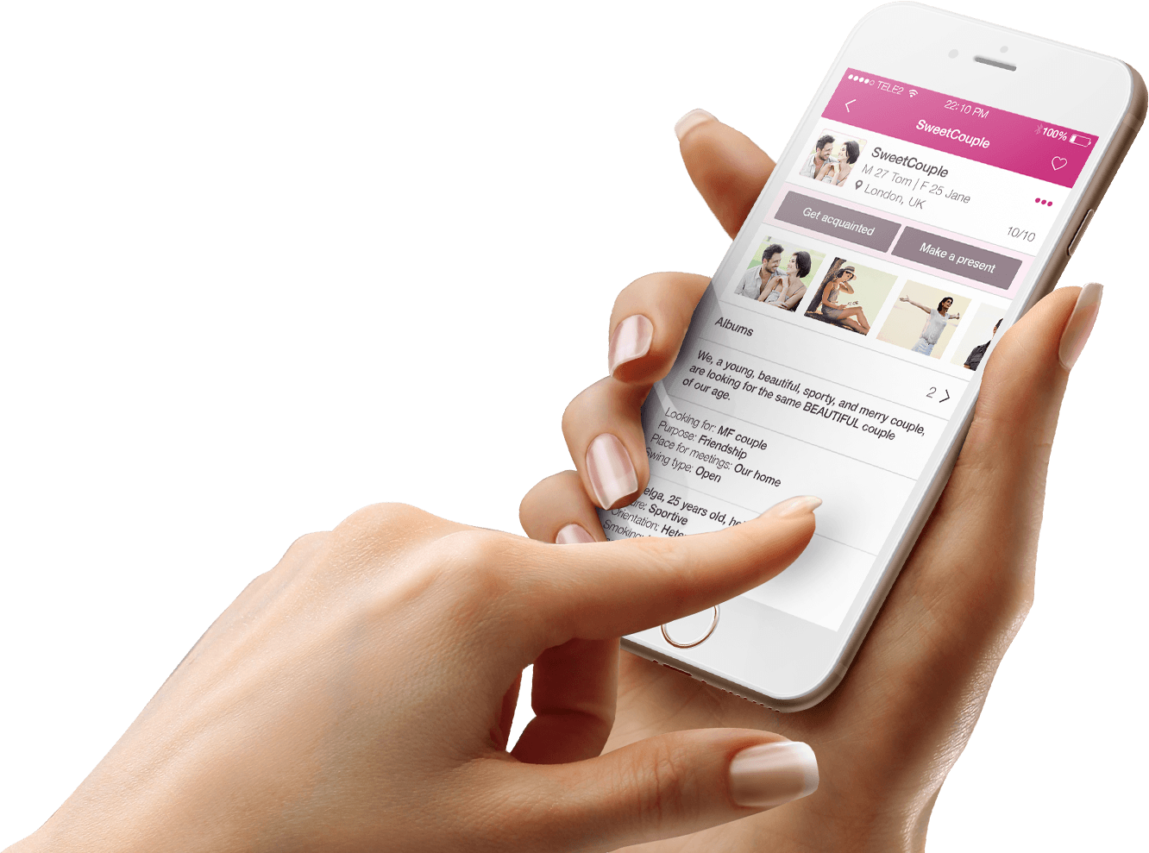
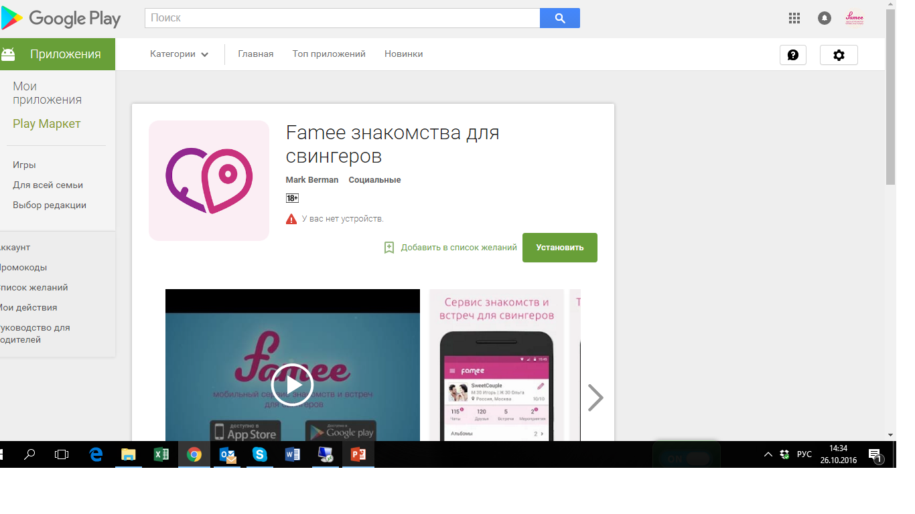

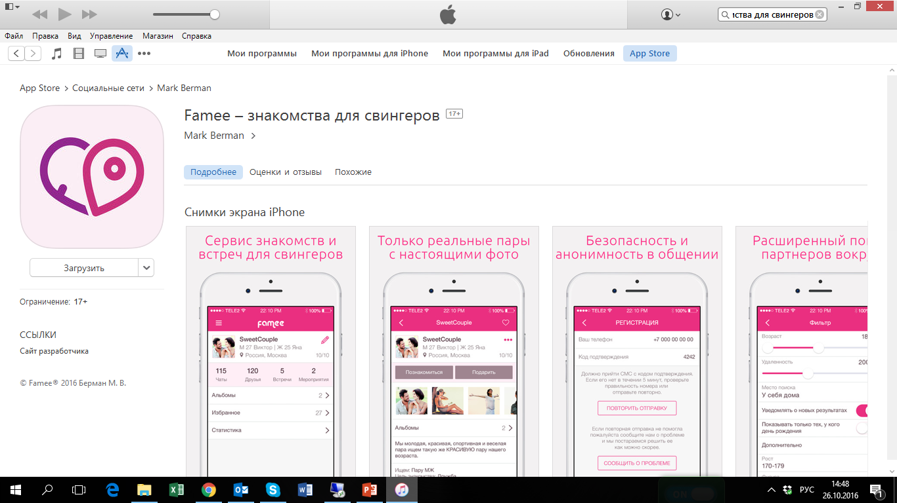

Second releases in Stores
Landing Page

Slide 10


Team all
Mark Berman
Konstantin Krasov
Seed invest, product, strategy
UI/UX, strategy
9 years as an entrepreneur and CEO
More than 100 projects in design
Vadim Gershman
Evgeny Stig
Android dev
IOS dev
Projects: соц. сеть Life, Chateam, Eyepay, iBank
Projects: Clericus, Megapolis, Trendy Shop, Kaztube
Aleksey Pavlov
Aleksandr Kulagin
Back-end dev
Web, mobile marketing
Projects: Love System, RabotaMastera, Fizzy Chat
www.linkedin.com/in/александр-кулагин-94ba7b64

Slide 11
PROJECT ECONOMICS
Landing Page

Slide 12
Necessary investments
Seed $50K
3 months
KPI – breakeven in RU
KPI - platform for advertisers
Round A1 $250K 6 months
KPI – breakeven in DE, AT and UK
KPI – 5 representatives, advertisers
Round A1 $300K 6 months
KPI – breakeven in ES, FR, IT
KPI – turnover > $250K

Slide 13

We are ready, and you?
Mark Berman
Famee’s Driver
berman@rambler.ru
+79153437000
Appfamee.com
Thank you for your attention

