Slide 1

CLOUTTERIES.COM
Gambling of the future

Slide 2
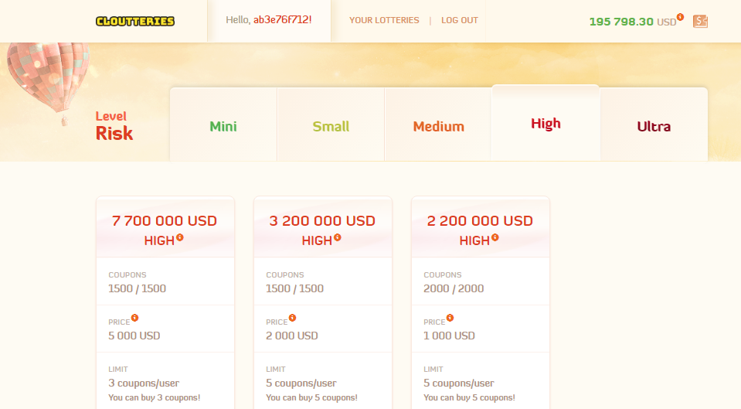

Online Lottery Project
provides the latest gambling solutions focused on blockchain and cryptocurrency technologies. Our goal is to optimize the chance of winning by introducing a new standard of services!

Slide 3
Traditional Lottery Weakness
A very small chance of winning (e.g. 1 : 160 000 000).
Guaranteeing standard payment options (e.g. neteller.com) significantly increases costs due to large losses caused by the necessity of currency conversions.
The need to maintain a large and complex banking structure.
Additional infrastructure requiring financial outlays and jobs.
By very large government restrictions to prevent money laundering, most lotteries are forced to physically print coupons because of using traditional payment methods (e.g. bank transfer).

Slide 4
Why Online Gambling?
Big and stable level of growth.
2.5 times increase in overall value over the last 9 years!
Online gambling market in $billions
source: statista.com
*estimated

Slide 5
Cryptocurrency Market Peak Value
At some points cryptocurrency market value was higher than overall global gambling market value!
Peaks value over the years in $billions
source: coinmarketcap.com

Slide 6
Actual Cryptocurrency Market Size
$212.54b
Total Global Market
Source : coinmarketcap.com
Date: 2018.08.23

Slide 7

CLOUTTERIES.COM
is a project that will base all its activity on the cryptocurrency market and on the Internet, reducing the costs of doing business. Our goal is to significantly increase the chances of winning each user in relation to the competition, maintaining the optimal conditions necessary to generate revenues, and the offer is directed to:
current online players in casino games and lottery games.
working people aged 18-65.
people using cryptocoins on a daily basis.
Users using the internet every day.

Slide 8
Lottery use case
1
2
3
4
5
The user top-ups his account with any cryptocurrency.
The system automatically exchanges funds for Bitcoin.
User can buy a coupon knowing the exact values in $ dollars.
After winning the lottery, the winner receives a win in bitcoins.
The system automatically calculates the tax on winnings and allows immediate withdrawal of funds!

Slide 9
Offer Content
Complete lottery platform with crew and vision
A payment system compatible
A stable and rational plan for the future
The entire undertaking was carried out without the participation of third parties.
Thanks to the use of coinpayments.com, the system supports almost all available cryptocurrencies.
The project is planned for years to come, guaranteeing stable development and interest among users.

Slide 10
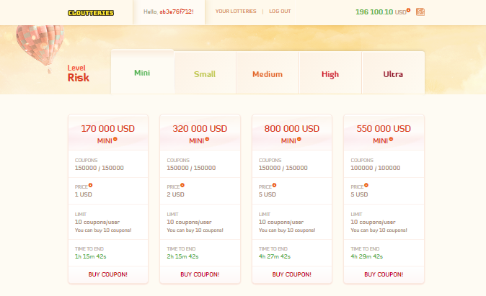
Ready Solution!
Test at: www.cloutteries.com

Slide 11

Business Model
How to make money with cryptocurrency?
Main income: 35% from cryptocurrency exchange rate dynamic changes
30% - from lotteries without winner
20% - from winning tax
15% - from advertising

Slide 12








Competitors

Slide 13
Our goal? 200 000€
New features
Servers
New cryptocurrency
Casino games and bets, for acquiring a wider group of users.
Efficient and safe, with load balancers.
Supported and released only by cloutteries.com.
Security
Tests
Gambling license
The exclusion of all possible mistakes that the offender could use.
Exclusion of any operational errors, logic errors and application errors.
With establishing a company in the Country of Curacao.

Slide 14
New Cryptocurrency under development!
The new coin is fully maintained by Cloutteries.com intended for our users. We focus on maintaining a stable course through an innovative approach to distribution.

Slide 15

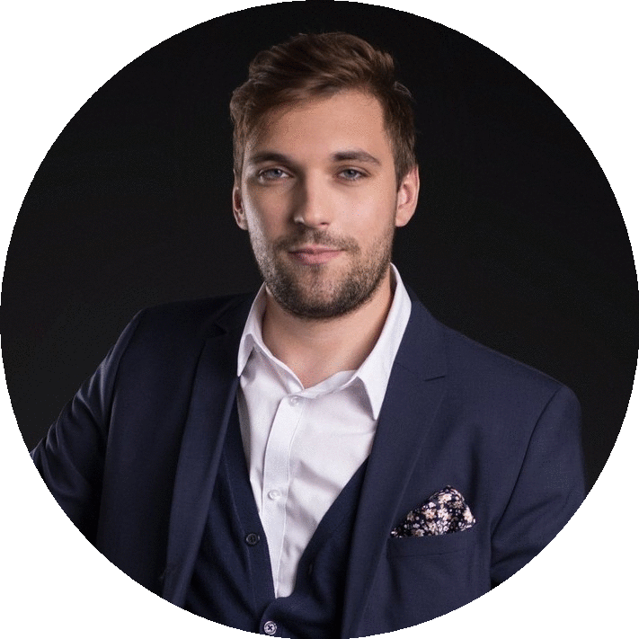
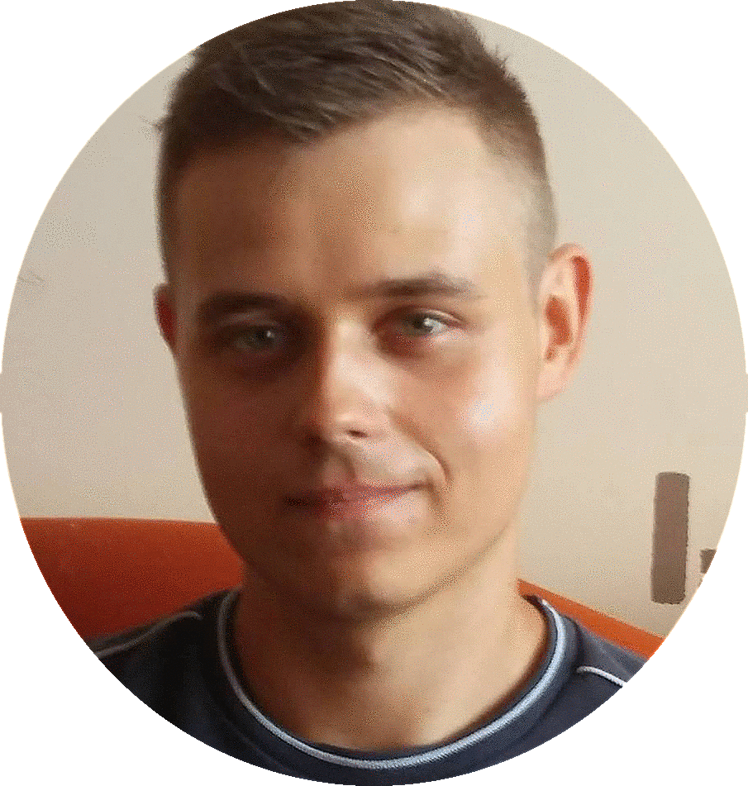
Management Team
Paweł Szarla IRS
Peter Wójcik CEO & Co-Founder
Radosław Szymczak
Co-Founder
Investor and Customer Relation Specialist
Originator and principal designer.
Financial support for the venture.

Slide 16
You want to raise the gamble to a new level? Contact us!
email: cloutteries.funds@yandex.com
gust: https://gust.com/companies/cloutteries-com linkedin: https://www.linkedin.com/in/piotr-w%C3%B3jcik-77798a16a/

