Slide 1
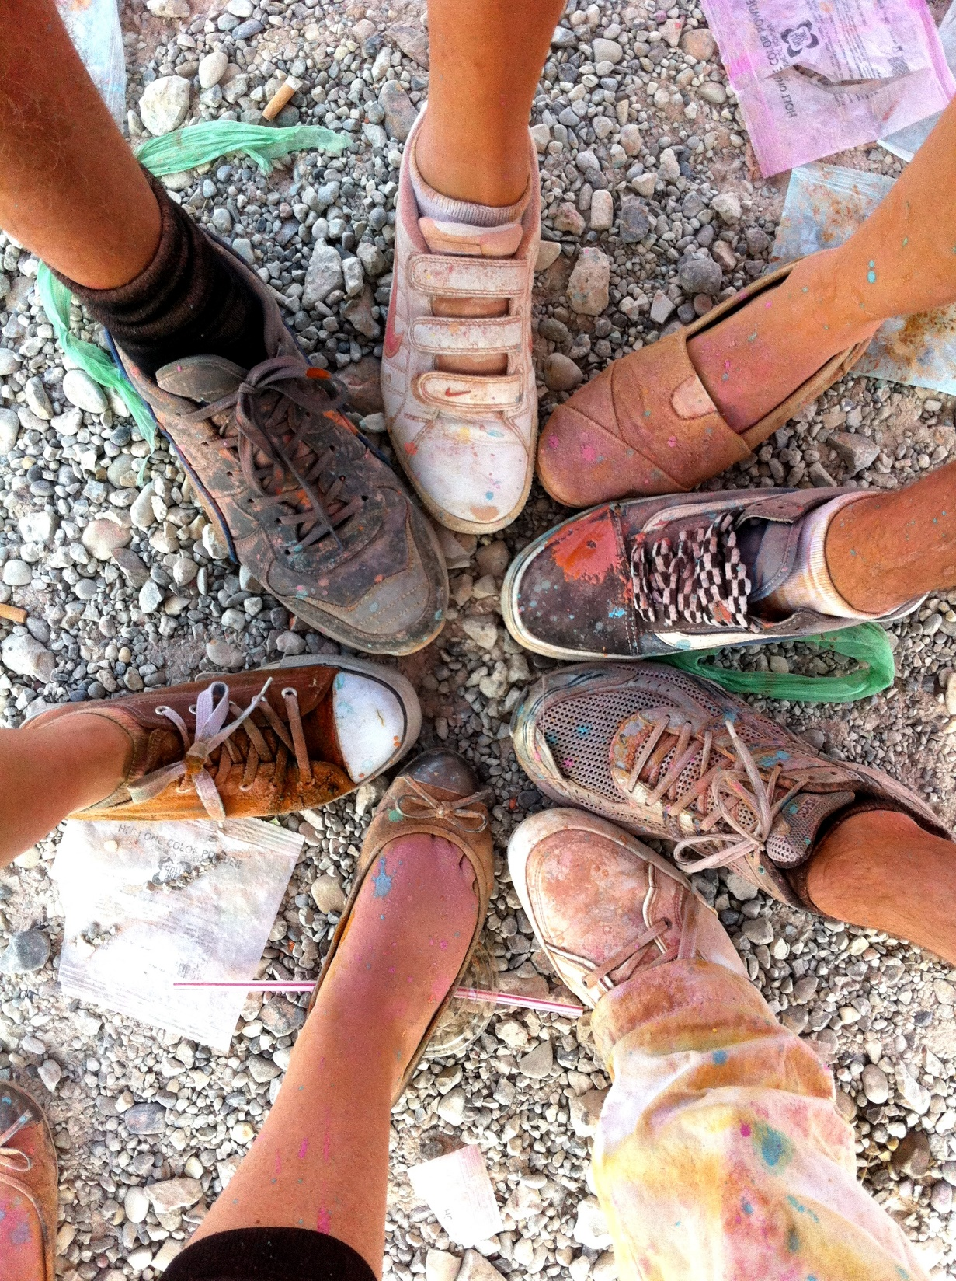

Feel Home Abroad

Slide 2

Problem that the platform solves
Finding a new circle of friends is not an easy thing for Internationals in a new city.
Currently available platforms cover only partly the needs of expatriates.
No easy way exists to find all information in one place for adapting to a new living place.

Slide 3







Product
A one-stop online marketplace for helping expatriates in adapting to a new city via
Meetups for Internationals
Activites & Events for Internationals
Trips to exlore the new country
Expat information
Courses for getting adapted to the new home country
Business directory of Expat Economy

Slide 4
Market success
4 cities in Europe and Asia are part of the community
Over 60k users with 56% retention rate
2300
2 cities
120k
120k
Monetized out of 4 cities with running Plattforms
Transactions in 1 year
Revenue
Visitors per month

Slide 5
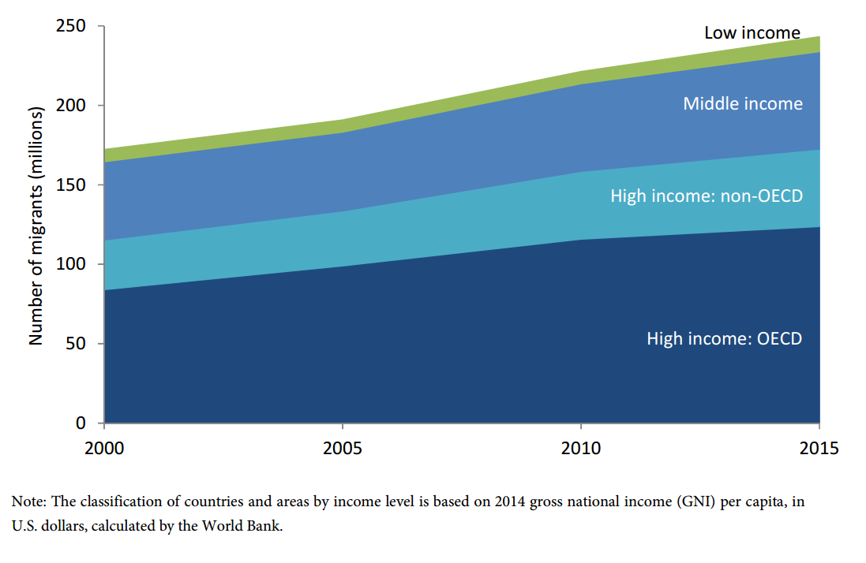
Market Size
224 M
Source: United Nations Migration Foundation
http://www.un.org/en/development/desa/population/migration/publications/migrationreport/docs/MigrationReport2015_Highlights.pdf
People lived outside of their country of origin in 2015
Source: United Nations Migration Foundation
http://www.un.org/en/development/desa/population/migration/publications/migrationreport/docs/MigrationReport2015_Highlights.pdf
High Income: More than 12.476 $ average income per capita
Middle Income: From 1026 to 12.476 $ average income per capita
Low Income: Below 1025$ average income per capita
Source: World Bank
https://datahelpdesk.worldbank.org/knowledgebase/articles/906519

Slide 6












Multiple Products
Competition
Website only
Multiple platforms
Expatriates.com
Single product

Slide 7
Direct Competition
2,2M users
(users are rather older. Av. Age: 40 Years)
220k users
(very exclusive and limited to 220k)
Both are based on payable subscription model for end user

Slide 8
Growth Strategy + Investment stages
PROVEN METHOD
Once weekly meet-up event made by a paid community member (~30 Euro) at the start of community. (Investment stage)
Introduction of different payable events (first trips, then courses, then activities). (Investment neutral stage)
Owners of Businesses are also part of the community of expatriates, therefore no advertising is required. They will come on their own. Resident Start-up community normally are the first users of the Business directory system (Profit stage)
NO ADVERTISING WILL BE USED!

Slide 9
Disruptive Business Model
_Competitors are using a payable memberships model („Internations“ and „A Small World“). For the end user, our platform is free therefore more attractive to users.
_No way for local smaller businesses (like most in the expat economy) to advertise their businesses. We have their clients thus present the perfect advertising plattform for expat businesses.
_Expat economy is only propagating via Word Of Mouth. No other way exists for them as it is not possible to target Expatriates precisely -> We bring the expat economy to the 21st century.

Slide 10
Financial Data
_Cost of running the service: 100 Euro per month for Server, Email, Bank account, CDN as well as other smaller stuff
_Over 160.000 Euro in revenue (we take a share of this) out of one single city, and only with Events revenue
_Profitable already (CEO pays himself a small salary)

Slide 11
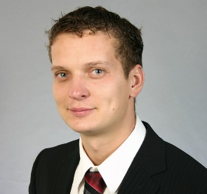
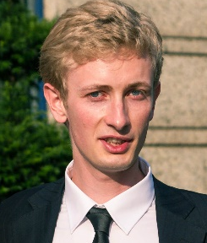
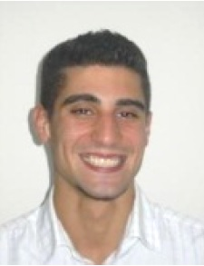
Team
Tim Stöhr
CEO
Andrey Karmeliuk
CTO
Toray Akcan
COO
Event management
Business development
Applications and website
Server+Performance management
Previous: Clinical trial Project coordinator, Regulatory submission, Contract analyst
Previous: Java Back-end Programmer
Previous: Bioinformatics Fellowship at Technische Universität München

Slide 12
Where we are going to take it!
_Searching for an investment of 200.000 Euro for 1 year assuming no revenue:
_4 Full time employees (150.000 Euro)
_1 Intern (12.000 Euro)
_Office (10.000 Euro)
_Expansion in ten cities simultaneously (10.000 Euro, 200 Euro per week)
_Outside contracting (10.000 Euro)
_Servers, Email and IT-related services (5.000 Euro)
_Administrative services (taxes etc…) (3.000 Euro)
_Goal: to have an International Friends Community in every major city of the world and be the leading co-operation partner for the Expat community in terms of advertising and/or customers. A very good proportion of Expatriate ticket sales go through our plattform.

