Slide 1


LIBERECO GLOBAL
TECHNOLOGIES PRIVATE
LIMITED

Slide 2

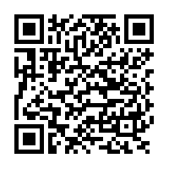
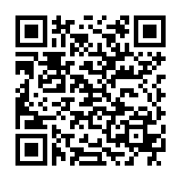
OUR BIG IDEA
iOS
Polietik is India’s first web/mobile enabled data-driven social media and crowdfunding/crowdsourcing platform for civic engagement, social causes, social entrepreneurship and politics.
Polietik’s mission is to provide a virtual platform for citizens of India to communicate, interact with, and engage influencers (bureaucrats, politicians, social activists, social entrepreneurs, NGOs, CSR driven corporates etc) and vice-versa through an unique and innovative geo hierarchical approach. We wish to bring many major civic activities under one umbrella platform that would bridge the gap between civic engagement and technology.
Android

Slide 3
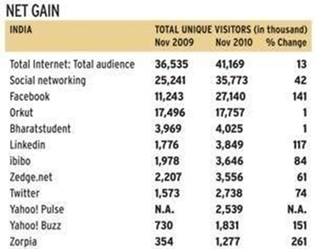
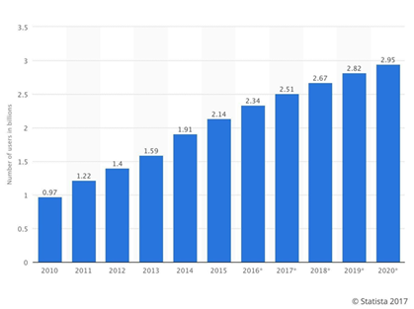
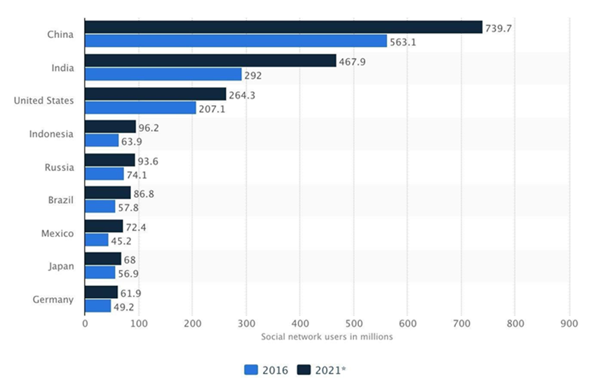
INDUSTRY OUTLOOK
The Social Media industry is an ever-growing one with total numbers of active users well exceed the 2 billion mark monthly.
In 2019, it is estimated that there will be around 258.27 million social network users in India, up from close to 168 million in 2016 and 350 million smartphone users.
Google and KPMG suggest vernacular/regional language internet users in India range up to 234 million. The report also projects local language users will grow to 536 million by 2021. It adds that more than 90 percent of the vernacular users access chat apps and digital entertainment content.

Slide 4

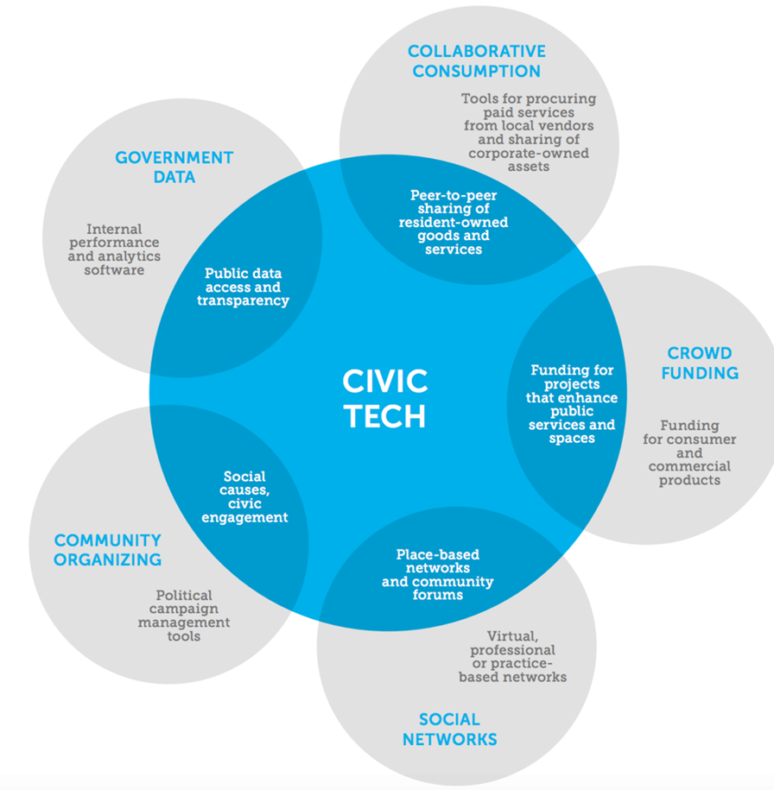
CIVIC TECHNOLOGY
As an emerging sector, Civic Tech is defined as incorporating any technology that is used to empower citizens or help make government more accessible, efficient, and effective. Civic tech isn’t just talk, Omidyar notes, it is a community of people coming together to create tangible projects and take action. The civic tech and open data movements have grown with the ubiquity of personal technology.
A $400 billion global market.

Slide 5


TARGET MARKET
FOR CITIZENS:
Age: 18-40 (initially millennial)
Gender: M/F/O
Location: Worldwide, India
Occupation: Student/ Any active job
Education level: Any level of Education, Knowledgeable about basic mobile/web technologies
FOR INFLUENCERS:
Industry: Politics/ Bureaucracy/ Media/ NGOs/ Corporates/Social Entrepreneurs and Activists
Location: Worldwide, India
Stage in Career: Upcoming/ Mature
Position: Currently holding position of civic authority

Slide 6
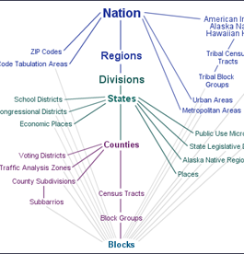
KEY FEATURES OF THE PRODUCT
POLIETIK uses a unique geo-hierarchical architecture to make network relationships non-existent. That is, it allows people from within a geo-location (such as a constituency, district, or state) to engage in political discourse from that location’s particular feed including direct access to all other Citizens and Influencers within the same geolocation, thus not mandating any formal social networking relationship with other users. All activities that users engage in are location-specific.
Voices: Allow users to “Raise a Voice” on the platform by posting content in the form of header, description, and special tagging options - for e.g. users can talk about a specific issue affecting their community and then tag or link it to a specific Influencer. Also, users can agree or disagree to the Voices.
Data Analytics​: Use big-data and data analytics to study demographic data stored in our databases and then use the same to calculate various political trends and statistics based on predefined yet mutable parameters.
Allow users to see how similar they are in percentage to another politician or user by the number of supporters (based on geolocation).
Crowdfunding and Crowdsourcing Service: Allow users to make quick and simple donations to their Influencer of choice by the click of a button (if Influencer’s bank details have been verified). This would allow the public to easily participate in the fundraising process and would immensely help influencers and social entrepreneurs to raise large sums of money and human resources in a simple crowdfunding and crowdsourcing manner. Also, all donation will be catalogued so there is clear transparency concerning the movement of funds

Slide 7


Adoption Strategy
Initial focus on Tier 1 and Tier 2 cities across India. Targeting centres of education and learning such as Universities, Institutes and Higher Secondary Schools. Adoption rate of social media is highest amongst millennials.
Social Media Marketing across various incumbent social media platforms (Facebook/twitter).
Target Events Monthly: DU College Fests, IIT/IIM Fests and various other startup focused fests across India etc.
Partnerships: Develop strategic partnerships with NGOs, social activists, Govt. Organisations, Bureaucrats etc

Slide 8

REVENUE MODEL
Advertising: Allow Influencers to openly engage in digital/virtual campaigns/promotions on the platform based on a set of chosen parameters (eg. age group, gender, constituency, district, state, issue, time period, etc.) so as to get maximum penetration within a target audience of their choice.
Big Data Access: As Polietik would like to incentivise usage by Influencers, it will provide them access to demographic statistical data from their regions based on the parameters requested. Apart from certain free data, even paid data would come at a fractional cost compared to the amount spent by political entities on acquiring such data from physical sources such as surveys.
Crowdfunding: Through Polietik, donating to causes that matter or social activists, NGOs, issues of choice is as simple as a click of button as users can simply navigate to the profile of the entity they wish to donate to, and use our simple secure online donation gateway to donate money to them.

Slide 9

Competition (In Terms of Revenue Model)
Advertising- Facebook/Twitter/Instagram: Mobile advertising is becoming popular among advertisers and is expected to grow 85% in 2021. Rise in mobile advertising will also help boost overall digital marketing spending to around $1.21 billion this year. Globally, mobile ad spending touched $36.6 billion in 2016, accounting for 51% of overall digital advertising spending, according to IAB’s Internet Advertising Revenue Report. Video ad spending grew 53% to $9.1 billion, social media spending grew by more than 50% to $16.3 billion
Big Data Analytics- NationBuilder/ Brigade/ Change.org: User data provides ultra-fine grain detail for instream delivery of promotions and native ads to segments that were too small to have been targeted in the past. In the past, advertisers had to choose from categories like 18-40 year olds in a specific region. Polietik can now segment custom audiences by precise ages, gender, connection types, mobile phone OS applicability, general interests, influencer followings and even specific behaviours. From there, lookalike audiences can be generated to reach fresh prospects in entirely new areas. INFONOMICS. Buyers: Polling Companies/ Corporates/ Think Tanks/ Research Organisations/Media etc.
Crowdfunding- Ketto/Milaap/RaangDe/Kickstarter etc. Transaction Value in the "Crowdfunding" segment amounts to US$8m in 2018. Transaction Value is expected to show an annual growth rate (CAGR 2018-2022) of 28.0% resulting in the total amount of US$21.7m in 2022. Milaap has raised more than 26 Million USD.

Slide 10
Progress
Incorporated Libereco Global Technologies Private Limited Sep 2017
Received Angel Investment from Ampcus Inc
Nov 2017
Developed Web version of Polietik
Feb 2018
Developed Android/IOS versions of Polietik
April 2018
Launch of Android App
July 2018
Launch of Android App
July 2018
Launch of iOS App
August 2018

Slide 11
Financial Overview
Polietik’s pre-revenue valuation as of 2017 (pre-angel investment) $5,261,679.17.
Angel Investment from Ampcus Inc led by President Salil Sankaran is $500,000. Used this money to develop the Polietik platform on web, IOS and Android and to remunerate a team 10 dedicated developers and IT/Software specialists.
We are looking to raise a sum of $500,000 for negotiable equity dilution which shall be used to enhance our marketing, business development and operational capacity and drive the growth of the company.
Current Equity Breakdown: Sarvashreshth Kalash (COO/Cofounder) – 37.5%, Siddhant Kalash (CEO/Cofounder) – 37.5 %, Salil Sankaran (Angel Investor) - 25%, Preeti Sinha (Investment Advisor – 0.35%)

Slide 12
Key Takeaways
POLIETIK’s goal is to create a penultimate platform for all civic and social activities such as campaigning, virtual advertising, donating, data collection, etc. among others features, that profoundly affects that way of engagement via technology and the internet.
Monetising is key but value can be enhanced as platform gains users/scale and becomes relevant. User acquisition and engagement are prime considerations. Further funding will strengthen this process.
User generated content platform are modus operandi for engagement and communication in society. Community building, sharing and interaction between people helps create user base at relatively low costs.
Content sharing and network building platforms can be monetised using micro transactions. Polietik’s revenue model builds on this notion. Indian market’s sheer scale gives this revenue model viability.
Polietik is highly scalable and can be implemented in other markets such as USA/UK/Europe etc.

Slide 13
Team
Siddhant Kalash - CEO/Cofounder :
Bachelors in Computer Science from Florida Institute of Technology 2013 - 2017
Project management
Worked with Northrop Grumman & Harris Corp. on Actuated Winglet Project
Created first functional POLIETIK prototype
Over 4+ Years in Software Development
Sarvashreshth Kalash - COO/Cofounder :
BSc International Relations and Politics from University of Bath
MSc Management (Strategic Management and Digital Business and Innovation)
Developed Marketing and Brand Management practices at Magent.me Imperial College London division. Held position of Brand Ambassador
Worked at KPMG (India/UK) in the Digital Consulting Division. Experience in financial management, digital architecture and data analytics implementation
Worked at Ampcus and SoCash as Business Development Manager. Oversaw client acquisition, revenue generation, key account management. Developed client relations and in charge of brand growth.
Consultant-Government Advisory-KPMG, India

Slide 14
Team Continued
Preeti Sinha (Advisor)
She built and served as the Global Convener of YES Global Institute (YGI), a practicing think tank at YES BANK in India to catalyze private capital into development. She ran several Resource Mobilization campaigns at the African Development Bank (AfDB). She built the US$ 8.8 billion African Financing Partnership (AFP) syndication platform amongst 8 development finance institutions (DFIs) for Africa. She was part of the team to raise US$ 7.1 billion for African Development Fund (ADF-13).
She was project director for the Financing for Development (FfD) Initiative at the World Economic Forum in Geneva and Davos, Switzerland. She has 15 years in investment banking for HSBC, Rabobank, Lehman Brothers and JP Morgan in London, Hong Kong, Mumbai and New York.
Preeti has an Executive Education degree from the Harvard Kennedy School of Government. She holds a Masters degree in Global Leadership from the World Economic Forum. She has an MBA from the Yale University School of Management (SOM) and an Honours degree from the Dartmouth College in Economics and Computer Science.
Salil Sankaran (Angel Investor)
Salil Sankaran serves as President at Ampcus Inc
He is responsible for establishing the strategic direction and future vision of Ampcus, and ensuring the portfolio of IT services offered is kept in sync with customer demands.
Salil is an MBA in Finance and a Master’s in Management Salil is an alumnus of the Delhi University in India. Salil is also an Advanced Post Graduate in systems and management.

Slide 15
Links
For Reference and Further Communication
Sarvashreshth Kalash – skalash1893@gmail.com/+91-9560488494
Polietik Website- https://polietik.com/
Polietik Android Link- https://play.google.com/store/apps/details?id=com.india.polietik
Polietik iOS Link- https://itunes.apple.com/in/app/Polietik/id1411394238?mt=8
Video Description- https://www.youtube.com/watch?v=b1dlGuL_ouE

Slide 16

Contact Details: Sarvashreshth Kalash (Yash), yash1893@gmail.com and +91-9560488494

