Slide 1
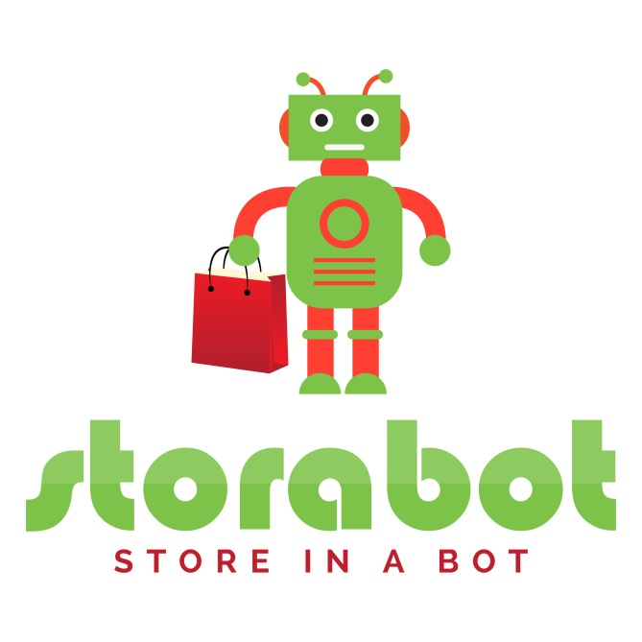
Messenger Store, First in Indonesia.
Storabot.com

Slide 2
Problems
The current era is Ecommerce era. Many offline sellers are closed because buyers now prefer to buy online because they save time, money and effort.
In selling online sellers can use their own website or sell in the market place although it will compete with the heavy competitors.
But buyers can also shop while interacting like in Social Media today. It is from a long day already predicted by Mark Zuckerberg: If I had to gues, SOCIAL COMMERCE is next to blow up.
So it requires an online store system that runs in Social Media, especially on Facebook which is the largest Social Media in the world.

Slide 3
Solution
Link demo: https://www.youtube.com/watch?v=qnBM8decoW8
STORABOT is a Web-based Software that helps create a full-featured and modern Online Store on Facebook Messenger.
STORABOT serve Online Shop visitors from start Selecting products, displaying Promotional Items, Cross Selling, Up Selling, recording buyer data, calculate postage, to follow up reminder of payment.
You just need to: Connect Fanpage, Organize Store, then Promote.
STORABOT has a unique concept, because buyers don't need to get out of Facebook to shop.

Slide 4
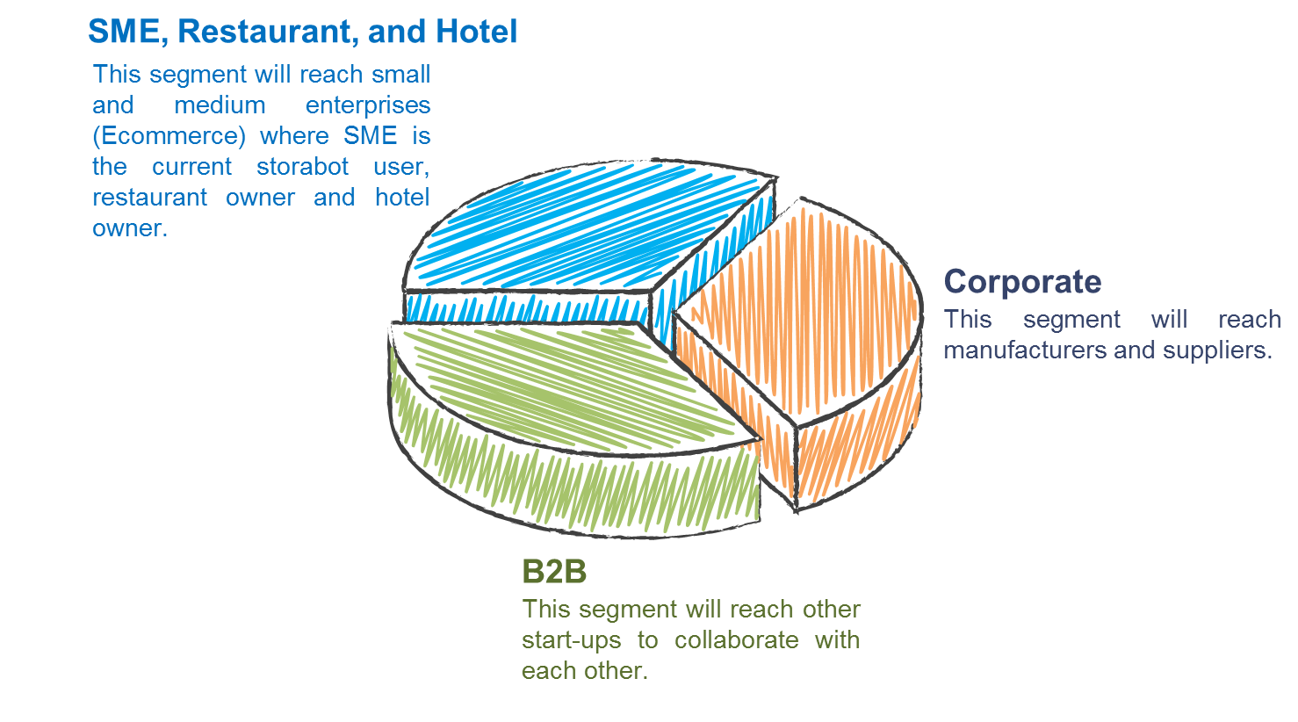
Target Customer

Slide 5
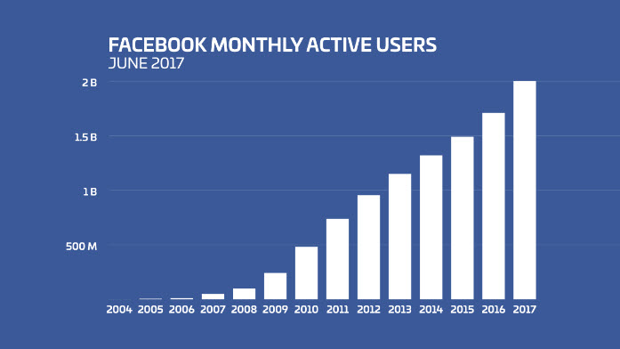
Market Sizing
The ever-increasing Facebook user is a plus for the Storabot market.

Slide 6

Competitor and Positioning
Our competitor is Chatzbro from Indonesia. In Indonesia, our position is very strong because we are the first in Indonesia and Storabot branding is better. Our store system features are much more complete.

Slide 7
Monetization/Business Model
Storabot has 3 package member types:
1. Silver Package: 5 Messenger Store, 50 Product, and 3 CS Users. 495000 IDR / year.
2. Gold Package: 15 Messenger Store, 150 Products, and 7 CS Users. 595000 IDR / year.
3. Gold Package: Unlimited Messenger Store, Unlimited Product, and 15 CS Users. 695000 IDR / year.

Slide 8
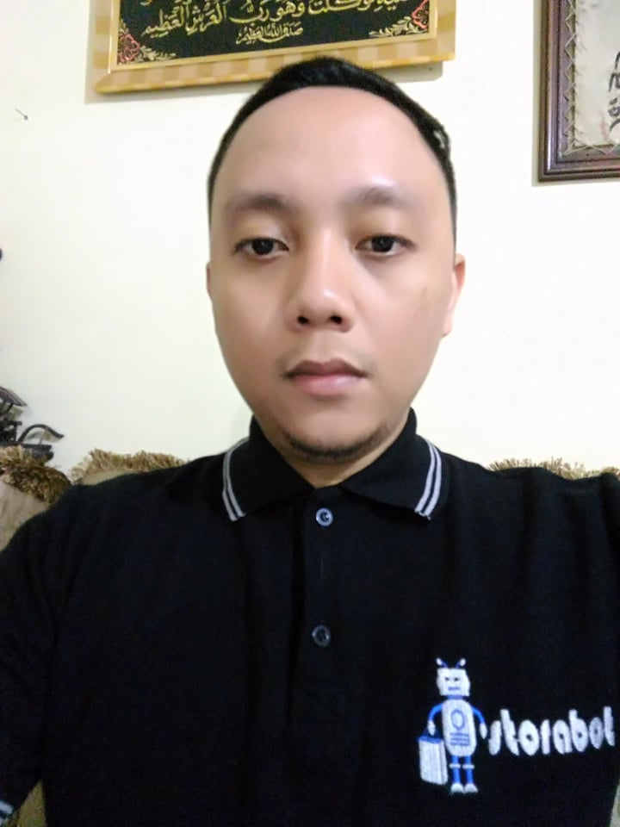
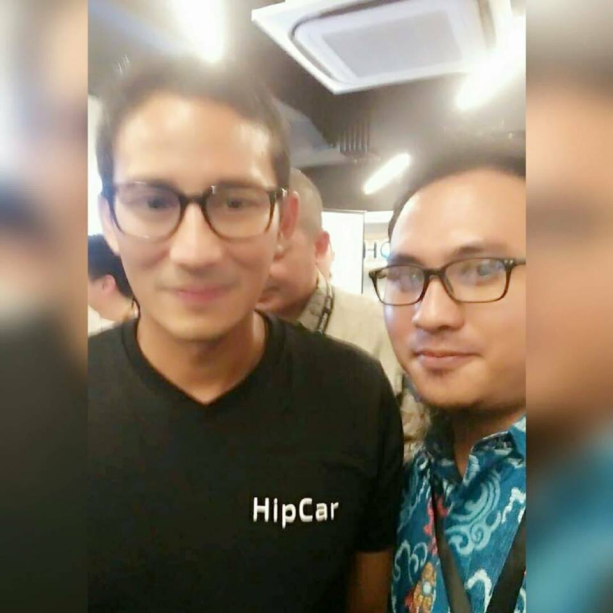
Team
Name: Dhany Sutriya
Citizenship: Indonesia
Position: CEO
Background/Achievement:
Education: Teknik Informatika, Universitas Gunadarma.
Role: Manage Storabot Team
Name: Budi Susilo
Citizenship: Indonesia
Position: CTO
Background/Achievement:
Education: Teknik Informatika, Universitas Budi Luhur.
Role: Manage Technical Team

Slide 9
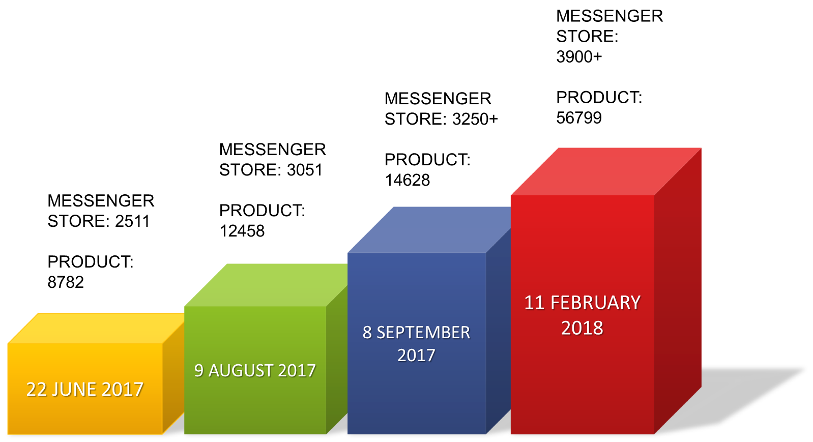
Tractions

Slide 10
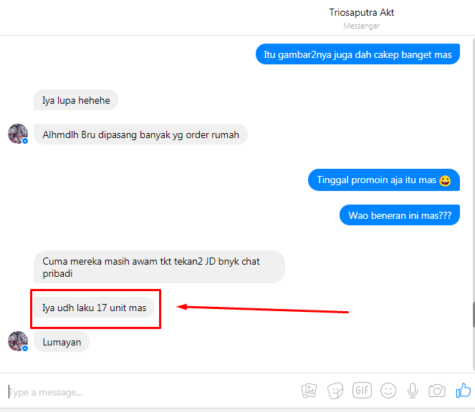
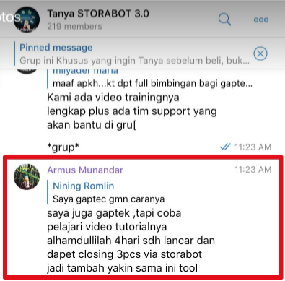
Testimony

Slide 11
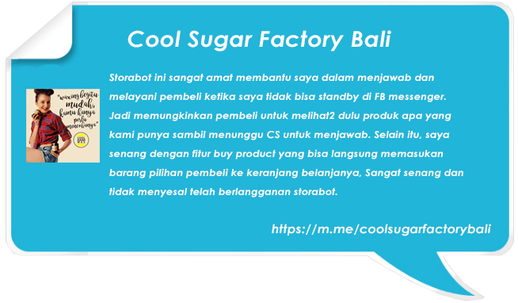
Testimony

Slide 12
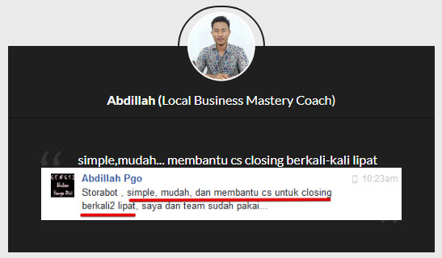
Testimony

Slide 13
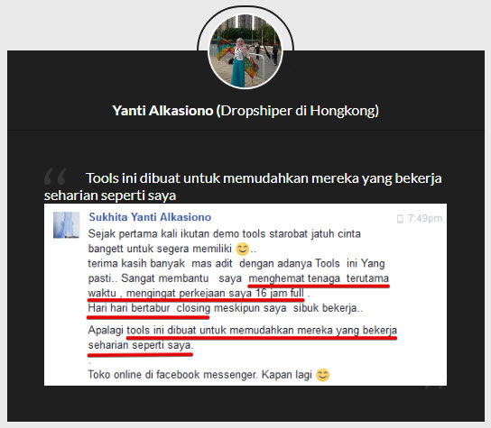
Testimony

Slide 14
Marketing and Customer Acquisition
Our marketing strategy is:
Conducting promo when releasing new features.
Collaborate with other start-ups. The offer for Storabot already has.
Collaborate with top digital marketers.
Create solutions other than retail, enlarge the Storabot market.
Entering the enterprise market.

Slide 15
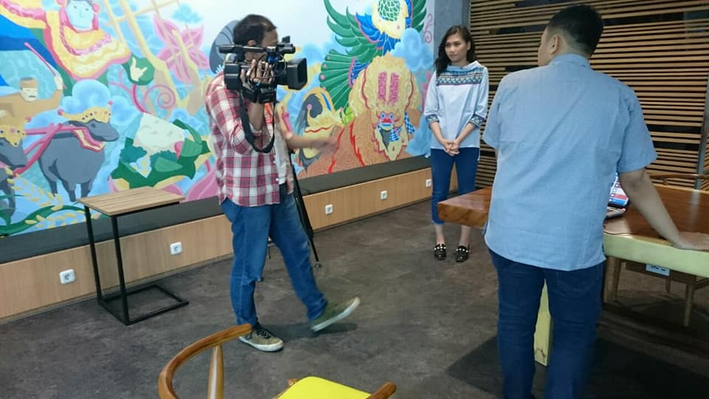
Publication
When covered CNN Indonesia

Slide 16

Contact Details
Address
South Tangerang, South Tangerang City, Banten, Indonesia.
Phone Number
+6282245177777
+6281380735857
Email Address
team@storabot.com
Website
storabot.com
Storabot Selling
storabot.net
Notes:
Provide contact info.

