Slide 1
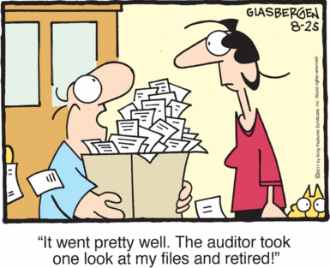
Before we start
An internal auditor is an employee of the company charged with providing independent and objective evaluations of the companies financial and operational business activities, including corporate governance
Assurance
Assurance that the organization is operating as management intends.
Internal Auditing
Insight
Objectivity
Insight for improving controls, processes, procedures, performance and risk management.
Objective assessment of operations.

Slide 2

Investors Presentation

Slide 3




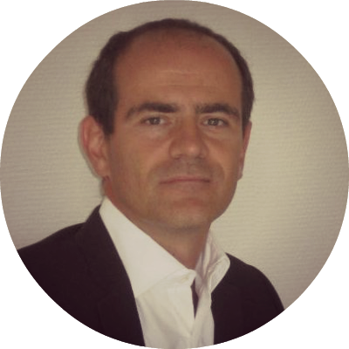
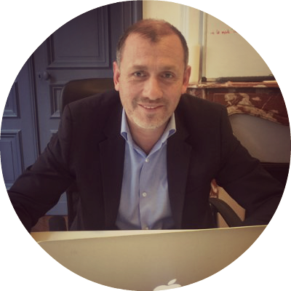

Eye2Scan Team
BI Advisor
Franck-Yves Inglebert
CEO
Masters in Corporate Finance (EDHEC)
15 years experience in Auditing and Internal Control (Nestlé, Faurecia, Gémalto)
Certified Fraud Examiner
8 years Industrial CEO Experience
Fredéric Pastore
Expert BI & Big Data
SAP Advisors
Mauro Molinari
CTO
Master degree : audit and accounting (HEC)- Master degree : Electrical Engineer – Bruxelles University- Master degree : Computer Engineer Mons University - Computer Engineering lectures, Politecnico di Milano
SAP Academy / Certified Fraud Examiner / Certified Information System Auditor
Ex EY Audit Manager
Xavier Ayral
Bachelors in Business Administration
17 years SAP experience
(Technical and Functional)
SAP Certified - MM, BW, ASAP
9 years IT CEO Experience
Antoine Rouchier
Masters in Corporate Finance (EDHEC)
20 years SAP FICO experience
(Project Management)
9 years IT CEO Experience

Slide 4


The internal auditing headache
Internal Audits are costly and time consuming
New industry standard : analyzing 100% of company’s transactions
Internal audit knowledge remains hidden and only periodically surfaces in audit reports
Only 30% of internal audit teams using analytics regularly
Conclusion
Companies lose time and money trying to manage and organize all the requested data and building quickly relevant dashboards with easy to use & implement solutions

Slide 5




Market validation
“Data analysis technologies are considered as N°1 priority where internal audit departments must improve” **
McKinsey forecasts a 50 to 60% gap between supply and demand of skilled people with deep analytic skills by 2018
“A more digitalized world is driving internal audit functions to desire to invest more in technology-enabled auditing approaches and tools” *
Business analytics and enterprise software is said to be one of the top 5 most profitable industries in the US
* Innovation & Practice of Continuous Auditing, Chan & M.A. Vasarhelyi ** Protiviti study 2015

Slide 6


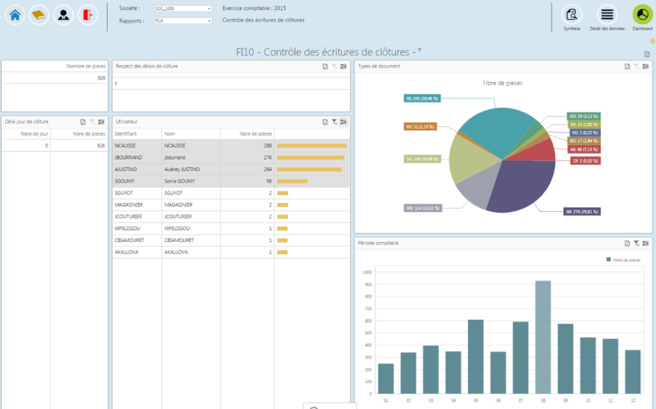


Our solution
Eye2Scan is an automated audit control software designed to help optimize your internal control, anticipate risk, and identify fraud at the touch of a button
To be updated
Plugging an auditor’s brain on your ERP system within 3 days
Embedding internal auditing library of professionally designed rules
Using intuitive dashboard interface, designed to work seamlessly

Slide 7
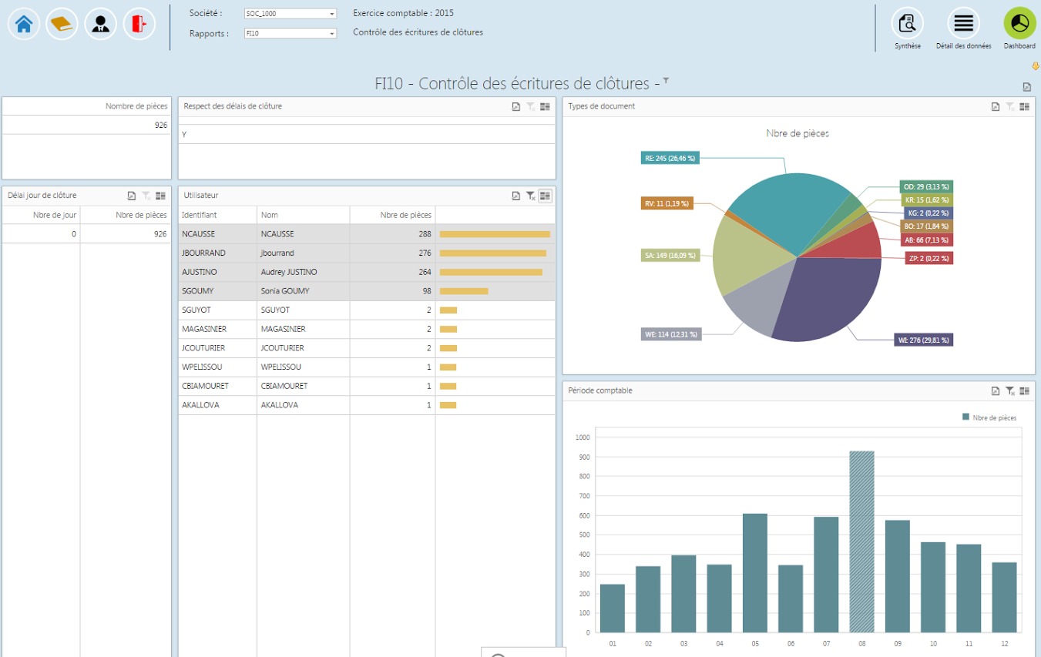

Product overview
French version
English version
https://www.youtube.com/watch?v=WIVuv1KBpQo
www.youtube.com/watch?v=eVC5SsI7HCg
Notes:
Gerard

Slide 8



Our advantages
Industry specific auditing rules with permanent updates
No ERP technical expertise required
At-Will analysis for 100% of all financial ERP data

Slide 9
Market size
100,000
ERP clients
in Europe
€ 3.5B
European market
Mid-Market Opportunities
180,000 companies in Europe top 13 countries
33% investing in process innovation
44% investing in organizational innovation
35,000
SAP R3
Customers

Slide 10
Competitors analysis
Low Threat Competitors
High Threat Competitors
Mid-Size providers in North America and Western Europe
Big 4 & BI software companies operating globally
ACL
SAP
Big 4
Remedyne
Sensage
SAS
Sage
Oracle

Slide 11
Value Curve – the CFO vision
ACL
Big 4
Eye2scan

Slide 12
Sales forecast
New
0.05% of European market in 5 years
Prospects/Sales ratio: 10%
Backlog
3 year subscription contracts

Slide 13
Sales Pipeline – 8 months market trial
70 qualified contacts resulted in 28% immediate sales leads
and 46% potential sales lead
Preci Dip (CH)
Omega
Sales leads meetings hold (16) resulted in 75%
proposals
Richemont
Anovo
Soufflet
Mylan
Manutan
Valeo
MGI Coutier
So far, 12 proposals resulted in
2 Go
3 No Go
7 Open
Fenwick
Allibert
Maïs Adour
Tigf
Mr Bricolage
Arc International
Novacap
Dillinger
Lotus bakeries
Seb
Couedic Madore
Bio Mérieux
Saint Gobain
Tag Heuer
SODIAAL
Berner
Etam
Customers :
Roquette
Faurecia
Maped
Bricorama.
Dassault Falcon Service
TISSOT
FINAREO
Proposals
Sales Leads
Qualifed SAP accounts
reached (ongoing)
Pierre Fabre
Picwic
Partnerships for next modules:

Slide 14
Business model
Marketing
Service
People
Technology
Applying the keen eye and expertise of an auditor has never been easier or more cost effective
3 years subscription
Service including updates, 5 days yearly on-site service, telephone technical assistance
Partnerships with ERP integrators
Empowering employees
High Benefits
In-house sales force
Share scheme
200 audit tests database
SAP partner
Enhancing product architecture
Co-development with major ERPs
Notes:
BRUNO
The business model of Eye2Scan relies on 4 pillars
From a marketing point of view, we propose a ready to plug and ready to use software, literally connecting the brain of an internal auditor to your ERP system. It is simple to install, simple to use and cost effective, only representing the costs of a few months of an internal Auditor. We offer to the customers a 3 years subscription contract. They will benefit from low annual budget, permanent improvements and this brings some security and value in our backlog.
We have also designed a complete service to support our customers. Thanks to the 3 years subsciption, we package for them:
Software and Rules maintenance and updates
A pack of on-site service (installation support, training, support to users). This allows us to keep a strong and tight relationship with our customer base and perfectly understand their needs in terms of tests and future improvements
a technical assistance through a telephone platform
In order to reinforce the technical support for installation and assistance we are developing partnership with ERP integrators. This brings some technical support for customers. For our partners it allows cross selling and a % of our sales. For us it allows a network of technical support, some potential network leads and references.
In order to bring high value to our customers, we pay a lot of attention to people. The cornerstone of our strategy being to digitalize internal Audit we need to have a unique combination of high skills in internal Audit and in IT skills. How to do so?
We want to attract key skills by proposing them above the market average compensations.
We are exciting their motivation by letting them work on a start-up project with clear entrepreneurial spirit and empowering them.
For instance we want to recruit In-house sales force for each European market : experienced Auditors (former managers who have the experience and taste for customer development) and with entrepreneurial spirit.
How do we retain them: Through training and high benefits including a share scheme.
At the heart of our business model, lies the technology. So our view is not “techno for the sake of techno”, but technology to serve a market and our customers needs.
The business model relies on permanent development library of tests which are fully automated and use standard files and tables of ERP. We currently have developed more than 50 audit tests. Our roadmap is to deliver 20 more tests every semester, reaching 200 tests in 5 years. This is bringing a unique and strong differentiation and a clear competitive advantage which will be very difficult to copy.
We are preparing a SAP partner certification program. This will allow to reinforce our brand and creditworthiness
Enhancing the product architecture in our roadmap by developing a full web-based version of E2S. This will allow a full SaaS mode, additional features and allowing to address cross selling and up selling. By allowing conversion tables with major ERP systems the new release will also allow to develop new versions of Eye2scan with the major ERP providers while keeping “in-house” the main differentiation (the brain of an auditor).

Slide 15
5 year plan
3 customers
Finalize legal structure
IP in E2S
Fund raising € 0.5m
1st recruitments (sales & mkg, CTO…)
10 customers
Development of big data
Start other ERPs
Prepare international
Fund raising € 1.5m
50 customers
International development
120 customers
200 tests
Other ERPs
160 tests
300 customers
International across Europe
Release web version for other ERPs
Sales € 10m
120 tests
Dashboard designer
Continue international
Co-development of other ERPs
Develop industries verticals
Break even
80 tests
Big Data
Workflow
Partnerships for other ERP
60 tests
2016
2017
2018
2019
2020

Slide 16
Business Plan
K€
Prospects
Customers in backlog
Net Sales
Development costs %
EBIT %
2016
20
3
50
N/S
(60) -124%
2017e
80
10
290
36%
(780) -270%
2018e
350
50
1 200
30%
(1 130) -90%
2019e
800
120
4 800
7%
270 6%
2020e
1 650
300
9 500
11%
3 100 33%
5 years to prospect 10% of potential market in Europe, secure 0.5% as customers and become profitable

Slide 17


Investing strategy (3 rounds)
39%
Working Capital
Operations
3 months daily sales outstanding
22%
€2.2M
Top team (IT and auditors) with above market average compensation
€1M fixed costs
15%
24%
Development
Sales & Marketing
40 - 50 tests developed / year
155 man/day for 50 tests
Sales force in each major country
12 months time to contract

Slide 18

Customer testimony
“Our external auditor has taken into account our usage of the Eye2Scan solution: We were able to demonstrate that we were pro-actively acting on the identified risks related to the financial statements generation and the company’s assets management.”
“As Eye2scan has successfully understood our company’s culture and our group environment with all its specificities, we decided to continue our collaboration with them.”
Notes:
TYLER

Slide 19


Thank you!
To contact us:
fy.inglebert@praxiam.fr
Phone : +33 6 80 65 58 02
Notes:
TYLER

Slide 20
Back up time

Slide 21
Product pricing
Features
Installation fee (by production environment)
Subscription free (1 Prod Environment, basic configuration)
Addition Production Environment
Full Subscription (Including all modules available)**
Small (Tier 1) €0-500M*
€5000
€20,400/year
€3,060/year
€34,900/year
Medium (Tier 2) €500-1000M
€5000
€40,800/year
€6,120/year
€55,300/year
Large (Tier 3) > €1000M
€5000
€61,200/year
€9,180/year
€75,700/year
(*)Sales Range
(**)Emailing/Dashboard designer/Workflow/IC Self Assessment/Additional 25 tests package…

Slide 22



Five Year Roadmap Vision – Eye2Scan
2016
2017
2018
2019
2020
Business enhancements
20 additional controls (1)
Done
Data import reengineering
Done
Functional enhancements
Eye2Scan Big Data & other ERPs
To be launched
V2 Client Server
20 additional controls (2)
On-going
Done
Technical enhancements
Mail & Workflow
On-going
Dashboard Designer
40 additional controls (3&4)
40 additional controls (5&6)
40 additional controls (7&8)
V3 Full Web
Next Modules

Slide 23
Market Milestones
FRANCE
2016
35,000 SAP R/3 ERP systems in Europe
SWITZERLAND
2017
100,000 ERP systems in Europe
Great Britain
2018
180,000
33% of mid-size companies invest in process innovation
Mid-size companies
GERMANY
2019
€ 3.5B
European Market
Other Europe
2020 +

