Slide 1

Unmanned aerial vehicles

Slide 2

Project goal:
To acquire investments for development of the project on sales and servicing of unmanned aircraft, developed by the company “Air Raptor".
«Air Raptor» company is:
A professional team of constructors and engineers;
More than 10 inventions;
5 projects for different market segments;
Possibility to acquire more than 6 patents;
Range of conceptually new functionality for UAV;
Development of specialized software.

Slide 3
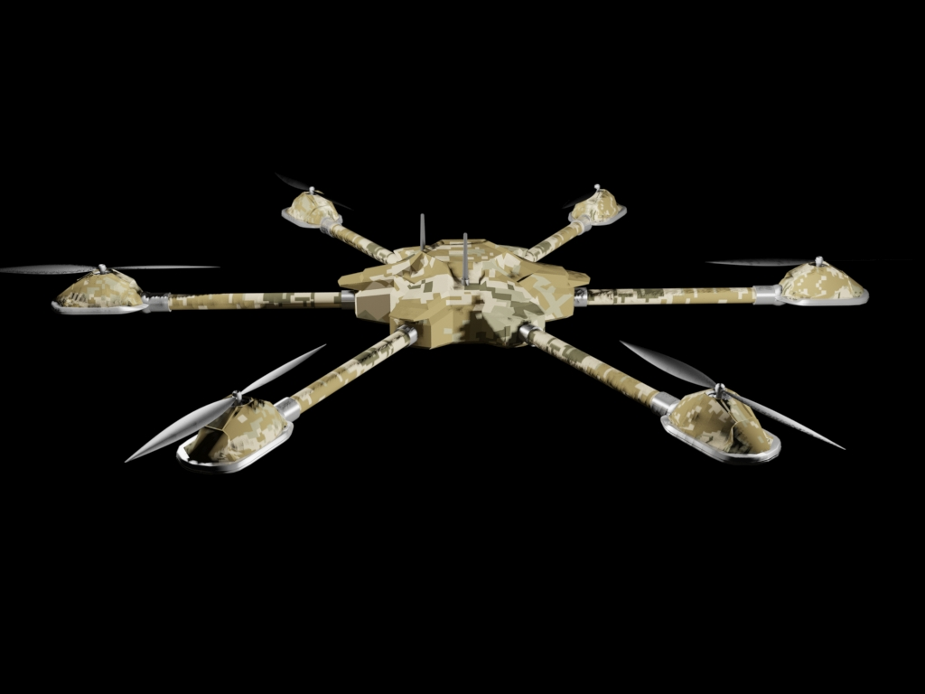
“Air Raptor” company offers:
Absolutely new security system, which has no analogues;
Mobile monitoring area
Unique software;
New directions for use of the UAV;
Multifunctional UAV;
Highly competitive product;

Slide 4
Security complex UAV
UAV-multicopter - which has a unique frame; equipped with different modules (depending on type), meant for the autonomous control over a given territory and remote intelligence over surrounding areas;
The lander for UAVs - stationary storage multicopter hemispherical station with automatic replacement of rechargeable batteries, equipped with means of communication and connected to the Internet for remote control of a multicopter;
The software package that allows you to transfer and record video by UAV cameras (thermal imagers), as well as to manage them in real time;
Specialized software for UAV to perform the required functions.

Slide 5
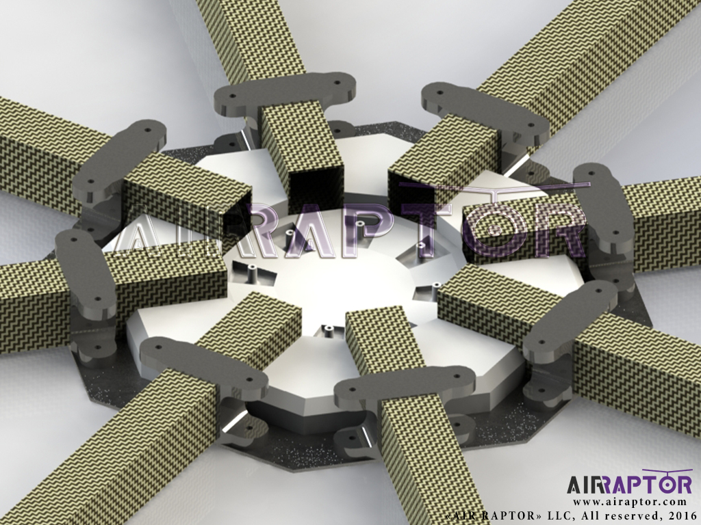
The advantages of development of a a reinforced frame
Description of the benefits
Reinforced central plate
Quick replacement of beams and brackets for motors
Titanium construction designed for special assignments

Slide 6
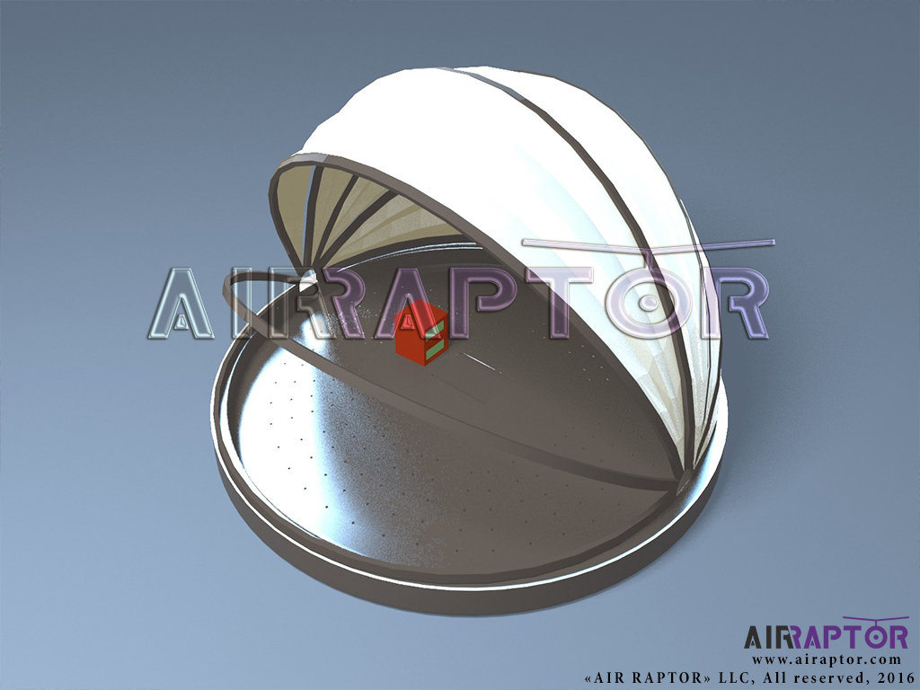
Advantages of development of a lander
Automatic replacement of an accumulator battery
Protection from weather factors
Data transmission to the operator
Opening and closing of the sphere by a signal from the drone
Possibility of flight of a drone from one module to another, for the longitudinal check of the territory (the border or the gas transmission system)

Slide 7
Comparative analysis of one of the products, developed by the «Air Raptor» company against other UAVs:
Criteria: | UAV, «Air Raptor» | UAV DJI S 1000
Flight time | Up to 45 minutes of flight time | Up to 25 minutes of flight time
Work load | Up to 12 kg | Up to 8 kg
Automatic replacement of an accumulator battery | yes | no
Replacement of components | Up to 5 minutes | Up to 3 hours
Multi-operated suspension | yes | no
Software for economy use of an accumulator battery | yes | no
Strengthened design | yes | no

Slide 8
The effectiveness of work by use of UAV
Criteria: | Security system | UAV, «Air Raptor»
The reduction in personnel costs | none | yes
Speed of response to emergency | standard | fast
The possibility of persecution | yes | yes, fast
Mobile video and photographic images | stationary | mobile
Camera functionality | stationary, 360 ° | mobile, 360 °
Personnel errors | human factor | none
The effect of surprise | standard | high
The use of non-lethal weapons | middle | high
The use of a thermal imager | stationary | mobile
Targeting and setting of the goal | stationary | mobile
Algorithm of change of monitoring | stationary | dynamic

Slide 9
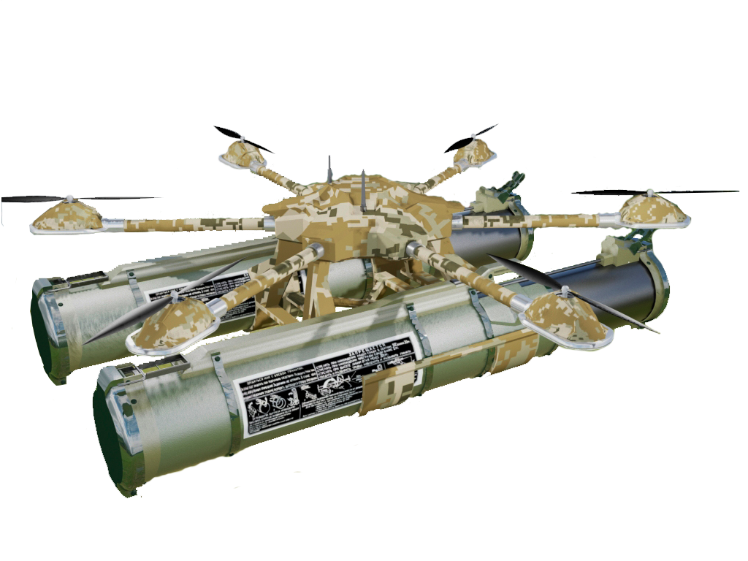
Benefits of development of specialized UAVs
Over 10 unique functionalities developed in five different fields of use of UAVs unparalleled anywhere in the world.

Slide 10
Air Raptor company offer
300 000 $
Development
Sale
Service
Pay-off period: 10 month
Profit

Slide 11
Thank you for attention!

