Slide 1


Slide 2
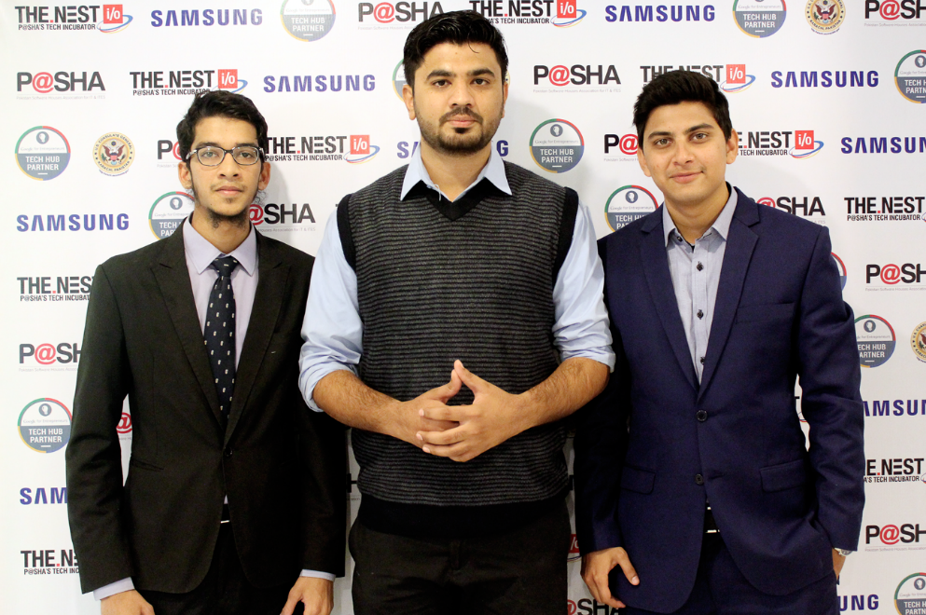
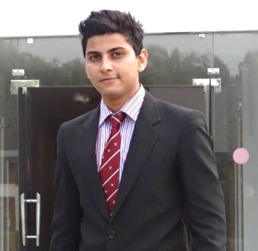
Team
Syed Ahmad Hussain
Osama Alam
CTO
CEO/ Business Manager

Slide 3
SUMMARY
Big Opportunity - First mover in $111.2m Market
Beta Product Launched with 170+ Campuses and 7000 programs information

Slide 4
PROBLEM
Students lack an easy way to find degree program and Universities
No centralized information Platform
Paper based admission application
Visiting universities and submit applications is time taking and costly
Institutions don’t have focused marketing platform for admissions campaigns
1. Costly advertising campaigns with less target audience

Slide 5
PROBLEM
Every 1 out of 2 student apply in 2 or more universities and spend extra 500pkr to 2000pkr for submission of application
An average University spends 5 Million pkr in advertising of Admission campaigns
Every 1 out of 3 student leaves their university in very first year because of wrong decision of choosing university or course

Slide 6
SOLUTION
Students
Centralized information portal
Online admission system
One stop solution for queries
Institutions
Focused audience
Market opportunity

Slide 7
Market Opportunity
There are around 4 million+ students applying in Universities only single year with 2 admission cycles
300+ Campuses in Pakistan where some Universities spends 20% of their budget in single admission life cycle

Slide 8
DAAKHLA.PK
Search Universities
Compare Universities
Apply Online
Career Counseling
Test your skills
Events/Forums

Slide 9
THANK YOU

